Slide 1
Photon statistics of a superradiant laser based on cold atoms of Strontium-88
Neven Gentil
supervised by
Stefan A.Schäffer
1

Slide 2
Summary:
What is superradiance? How do we achieve this state of lasing?
The superradiant experiment: atoms of strontium and the multilevel structure
The first order correlation function g¹: what does this physically mean?
Standard setup for g¹ and its limitations
The balanced heterodyne setup
Electronic noise reduction
Power to noise ratio and other verifications
g¹ for a standard laser
g¹ for the superradiant laser
Numerical simulation as a comparison: master equation & cumulants expansion method
Conclusion.
Introduction
Experiment
Results
2

Slide 3

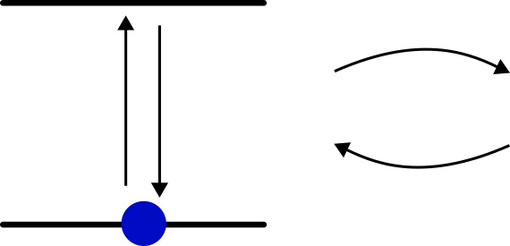
Cavity: two partially reflective mirrors. One mode of the cavity must fit the gain medium frequency: they must be in “resonance”
Composition of a laser: cavity + gain medium
𝜿: cavity loss rate
By constructive/destructive interference, the cavity field is restricted to well defined frequencies (called “modes”)
Gain medium: any “two-level” system
Excited state
g
Cavity modes
Two possibilities:
g ≫ 𝜿: strong coupling
g ≪ 𝜿: weak coupling
“Rest” state
g: coefficient describing the strength of interaction between the gain medium and the cavity field/modes
What is superradiance? How do we achieve this state of lasing? - 3

Slide 4
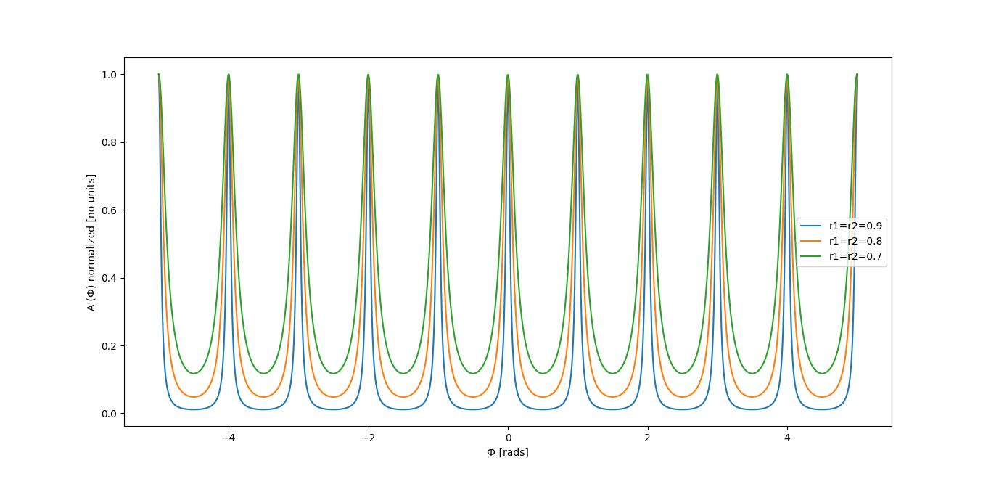
The cavity loss rate (𝜿) is linked to the reflectivity of the mirrors (coefficient “r”)
Transmission
High reflectivity: narrow linewidth for the cavity modes = narrow cavity linewidth
Low reflectivity: broad linewidth for the cavity modes = broad cavity linewidth
What is superradiance? How do we achieve this state of lasing? - 3

Slide 5
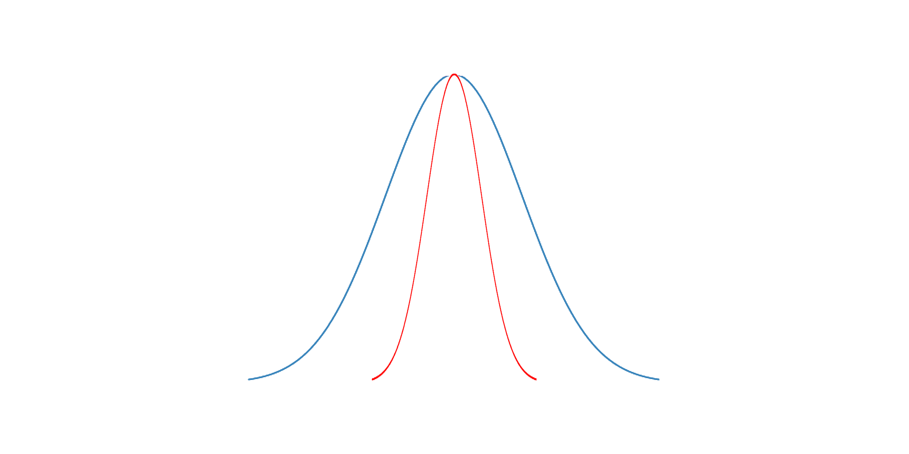
“Standard” laser = good cavity regime ⟹ the gain linewidth is broader than the cavity linewidth
This is achieved by high reflectivity of the mirrors: the photons inside the cavity need many round-trip before exiting.
gain linewidth
cavity linewidth
𝜔
The output frequency spectrum is restricted to the narrower linewidth: here the cavity linewidth.
The cavity linewidth is influenced by mechanical fluctuations ⟹ the spectrum linewidth is influenced by mechanical fluctuations
What is superradiance? How do we achieve this state of lasing? - 3

Slide 6
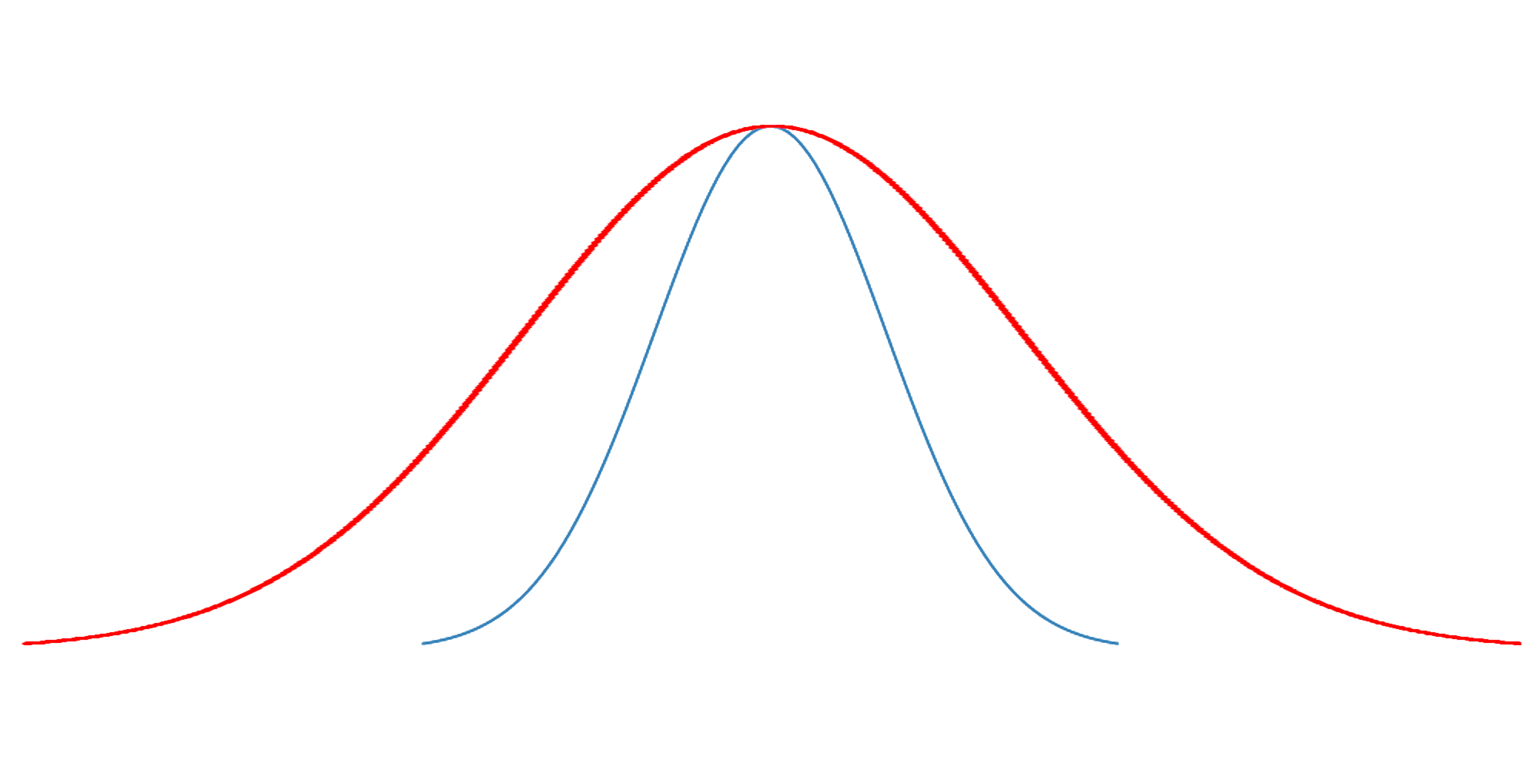
“Superradiant” laser = bad cavity regime ⟹ the gain linewidth is narrower than the cavity linewidth
This is achieved by low reflectivity of the mirrors: the photons quickly exit the cavity
gain linewidth
cavity linewidth
𝜔
The output frequency spectrum is restricted to the gain linewidth.
Thanks to the few round-trip, the gain linewidth is almost not influenced by mechanical fluctuations ⟹ the frequency spectrum is mainly determined by the two-level transition spectrum of the gain medium.
What is superradiance? How do we achieve this state of lasing? - 3

Slide 7
Superradiance:
Bad-cavity regime
Strong-collective coupling
Coherence time/length determined by the gain medium, here cold atoms of Strontium-88. In theory, the output linewidth may be as narrow as the transition linewidth used.
The cavity is weakly coupled to one single atom (g ≪ 𝜿) but the strongly coupled to the ensemble (Ng ≫ 𝜿 with N the number of atoms)
What is superradiance? How do we achieve this state of lasing? - 3

Slide 8
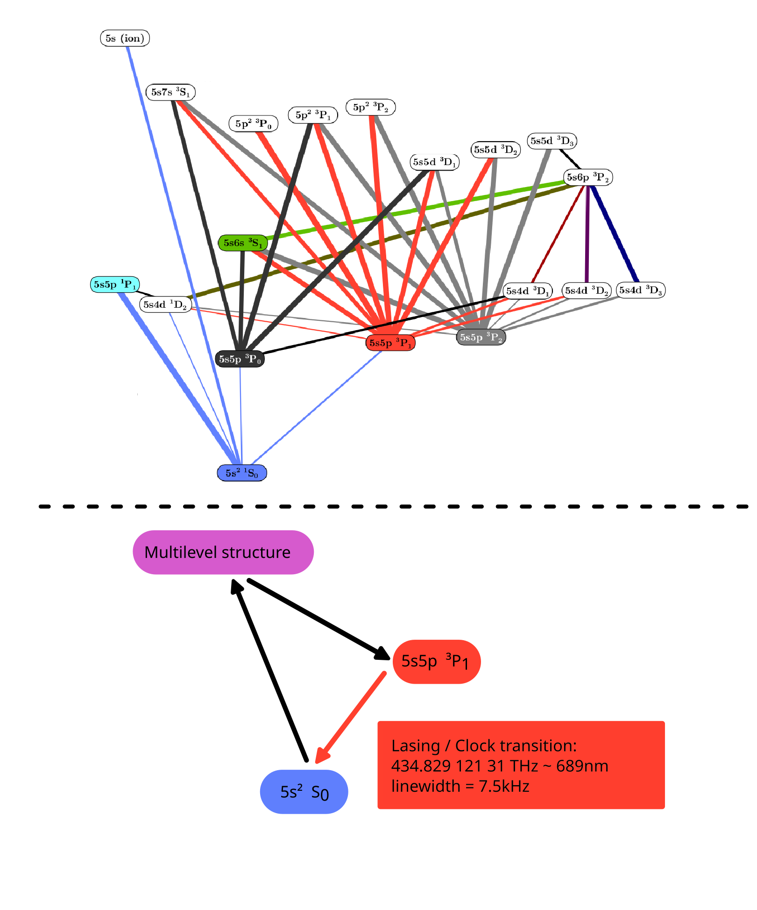
Why ⁸⁸Sr?
The most abundant isotope of strontium at ∼82% by mass.
No nuclear spin: simpler level structure compared to other isotopes and makes it easier to work with, especially for the many transitions involved in the repumping/cooling scheme.
Two electrons in their outermost shell: structure of electronic transitions that is particularly useful in quantum metrology.
The transition ¹S₀ -³P₁ has a linewidth of 7.5 kHz.
The superradiant experiment: atoms of strontium and the multilevel structure - 4

Slide 9
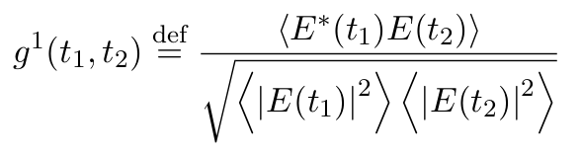
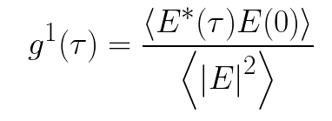

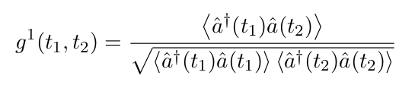
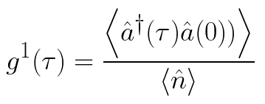
Non-stationary case
Stationary case
Frontier of the
quantum world
“You shall
not pass!”
Non-stationary case
Stationary case
The first order correlation function g¹: what does this physically mean? - 4

Slide 10
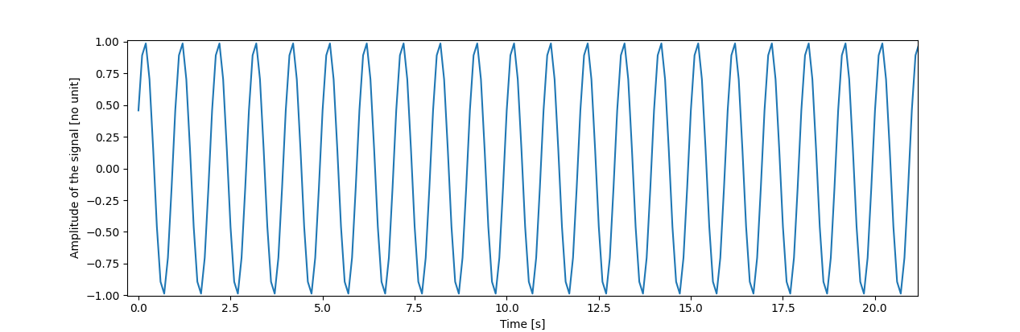
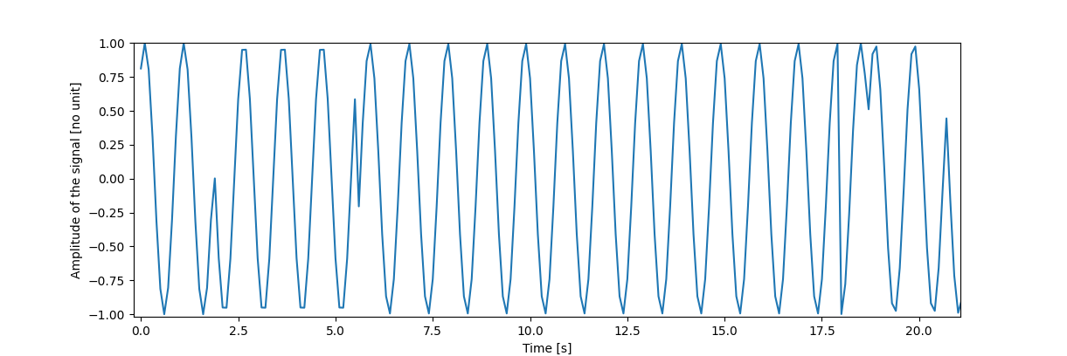
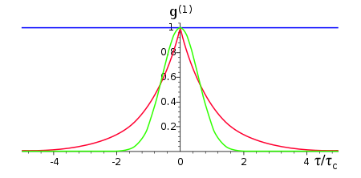
Perfectly coherent signal (perfectly well defined phase and frequency)
Chaotic signal generated by collision broadening (random phase jumps)
Perfectly coherent light
“Gaussian” light
“Lorentzian” light
The first order correlation function g¹: what does this physically mean? - 4

Slide 11
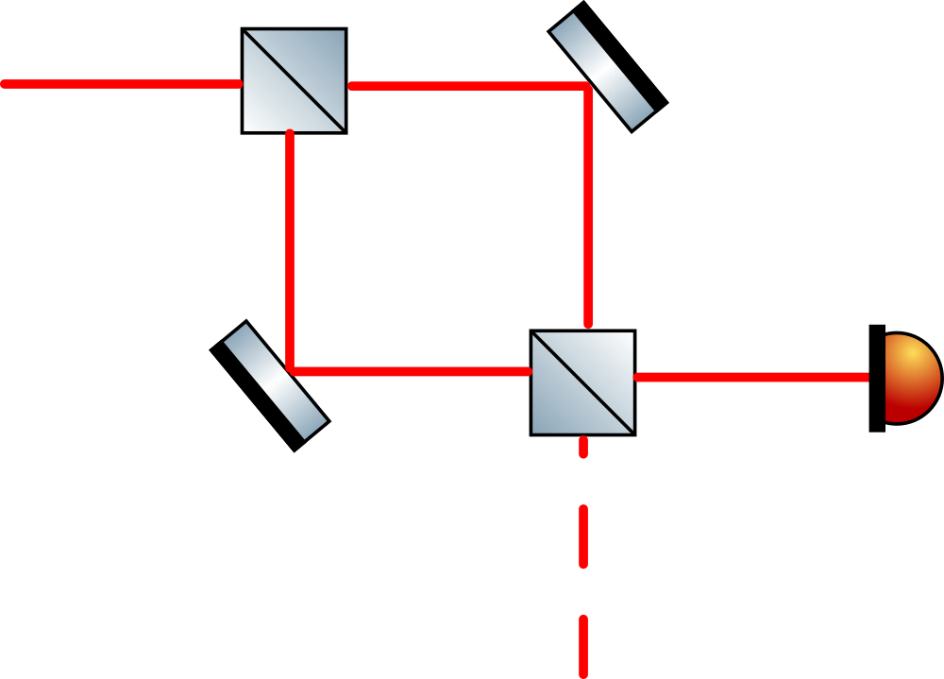

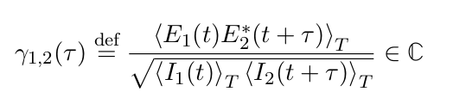
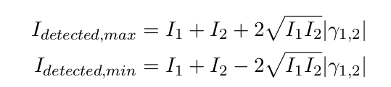
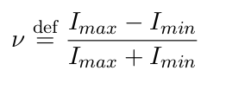
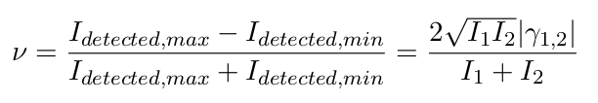
Standard setup for g¹ and its limitations - 4

Slide 12
Limitations?
Standard setup for g¹ and its limitations - 4

Slide 13
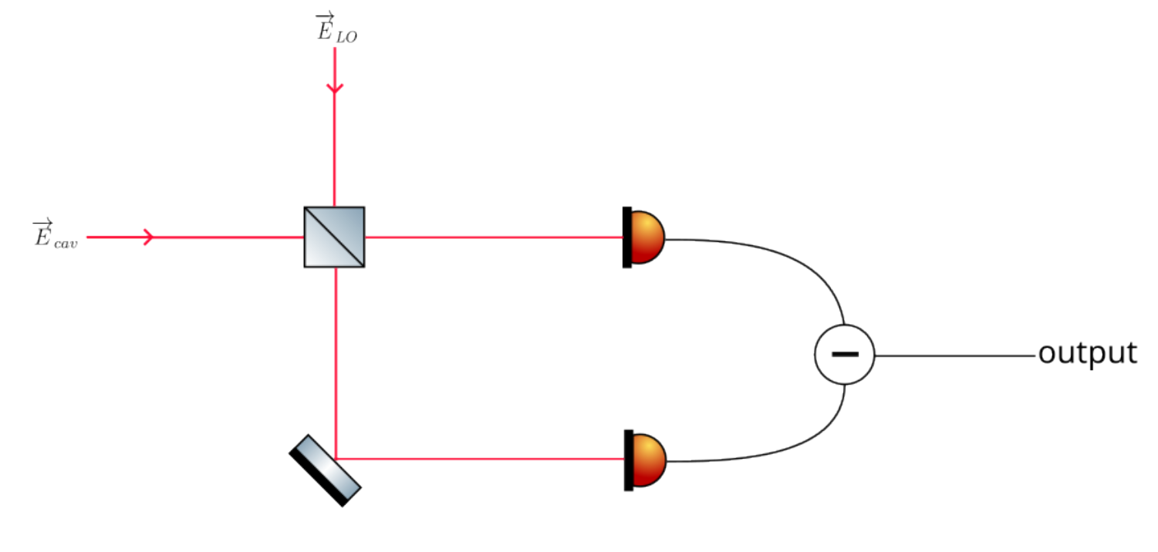
Remove correlated noise
Power tuned by local oscillator
Frequency difference
The balanced heterodyne setup - 4

Slide 14
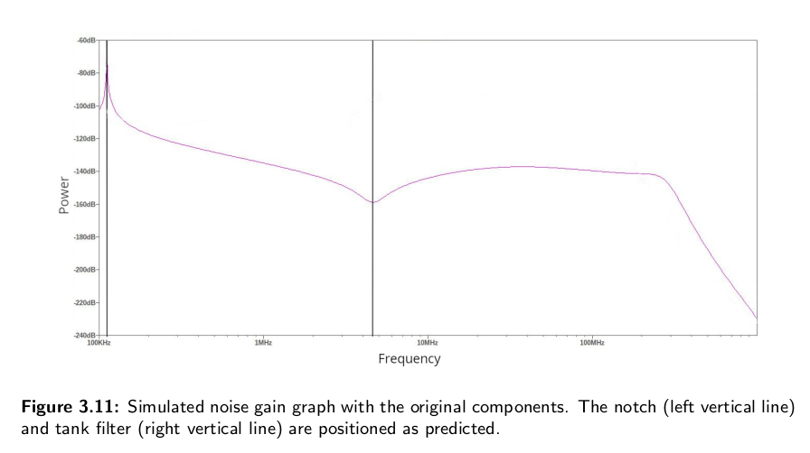
Electronic noise reduction - 4

Slide 15
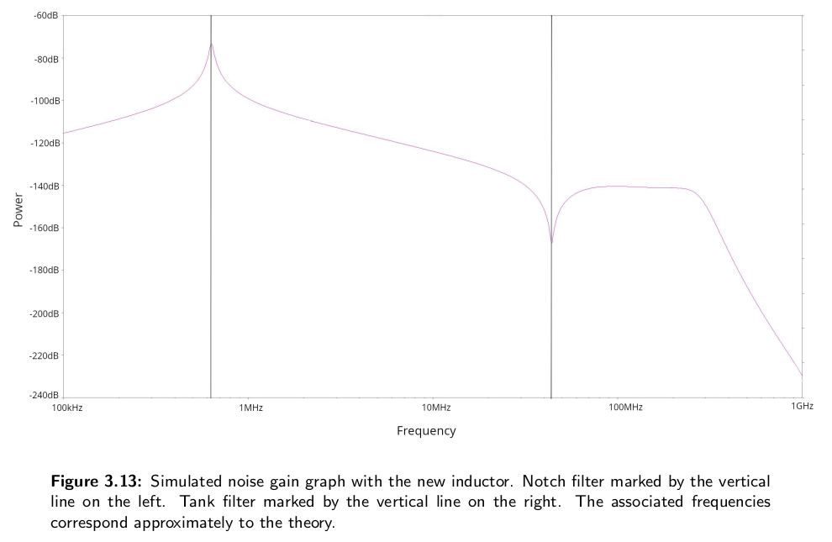
Electronic noise reduction - 4

Slide 16
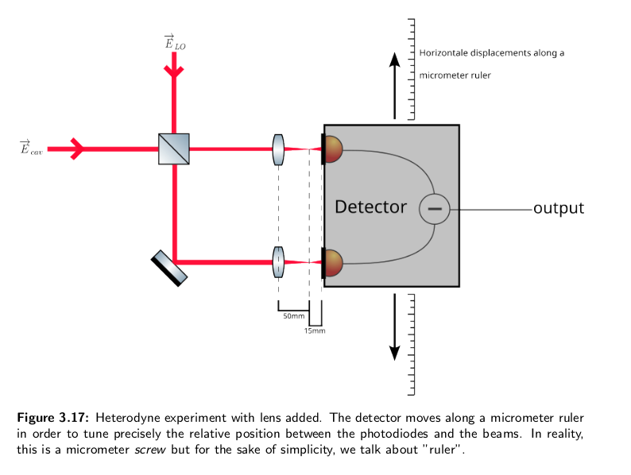
Power to noise ratio and other verifications - 4

Slide 17
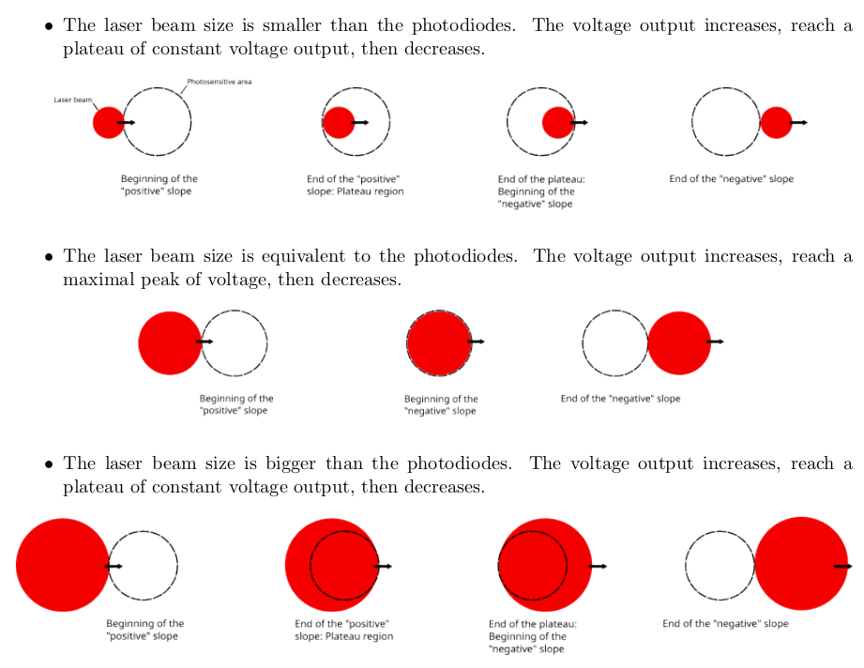
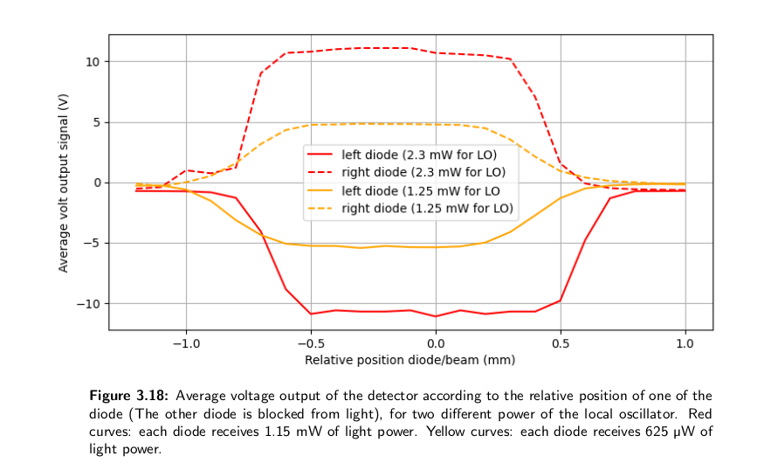
Power to noise ratio and other verifications - 4

Slide 18
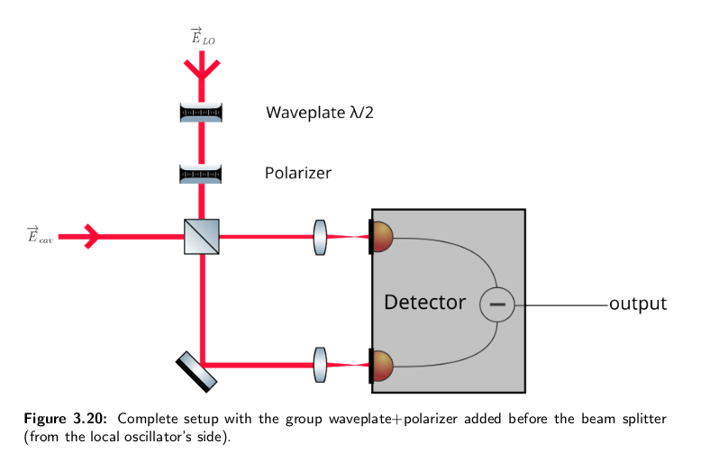
Power to noise ratio and other verifications - 4

Slide 19
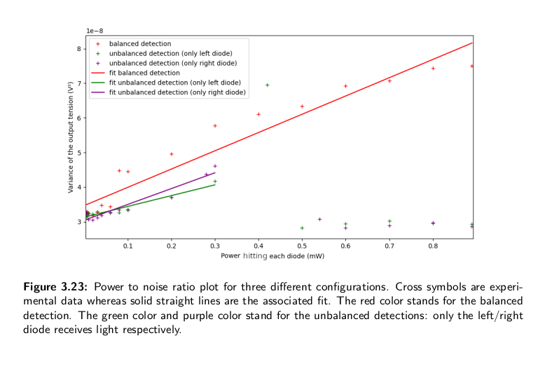
Power to noise ratio and other verifications - 4

Slide 20
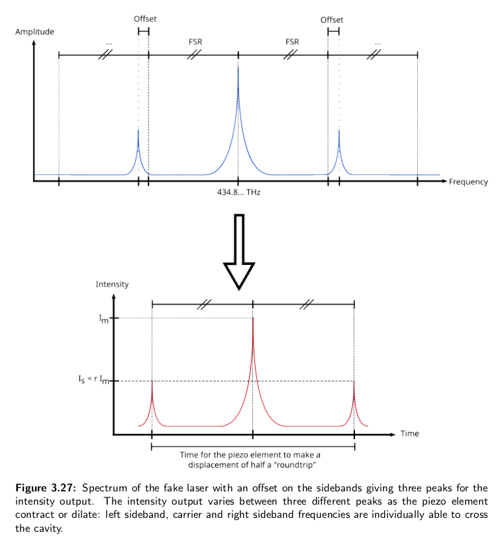
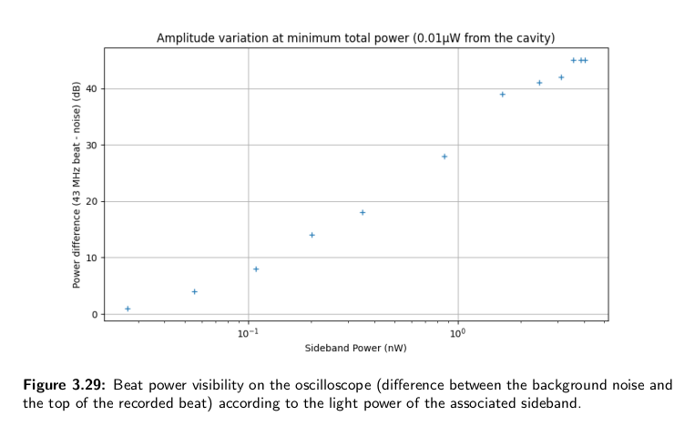
Power to noise ratio and other verifications - 4

Slide 21
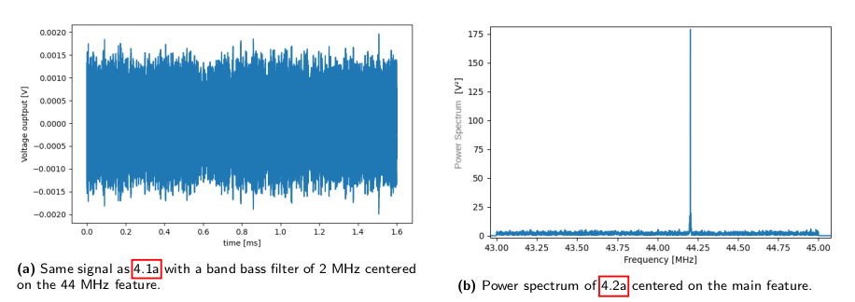
g¹ for a standard laser - 4

Slide 22
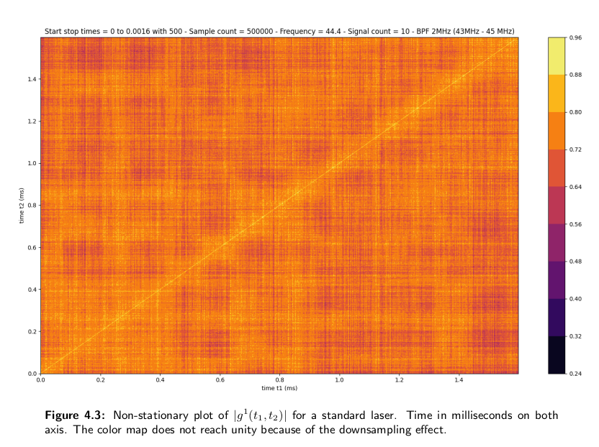
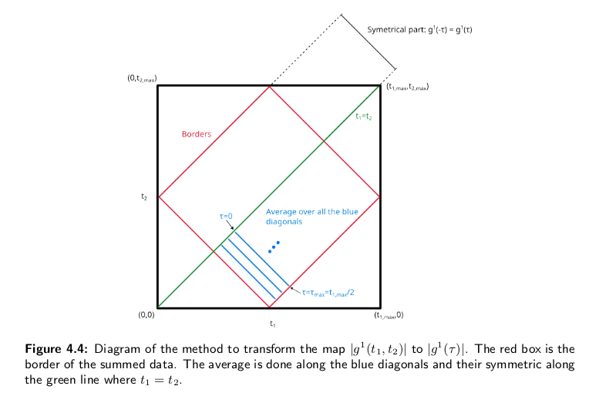
g¹ for a standard laser - 4

Slide 23
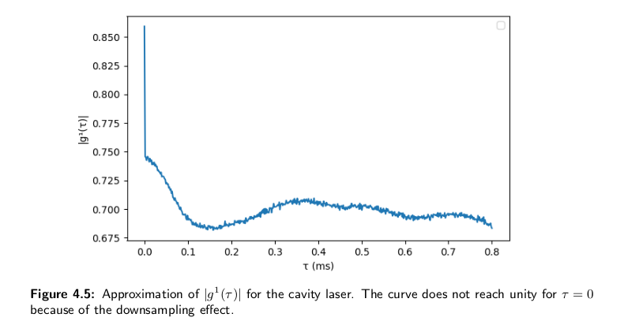
g¹ for a standard laser - 4

Slide 24
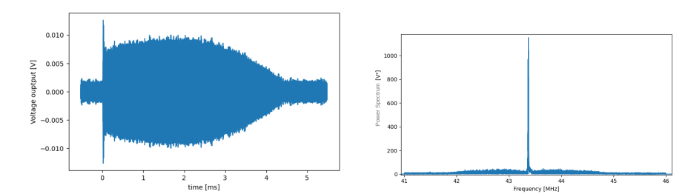
g¹ for the superradiant laser - 4

Slide 25

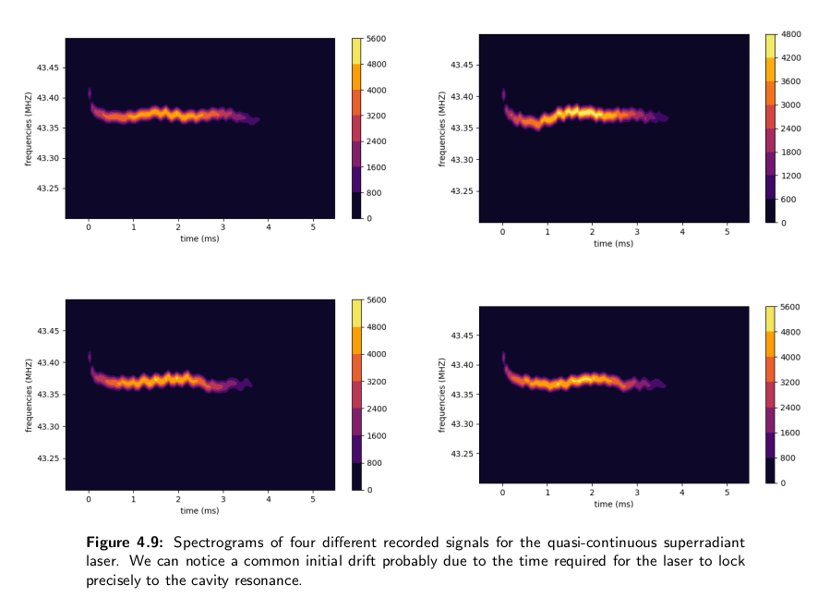
g¹ for the superradiant laser - 4

Slide 26
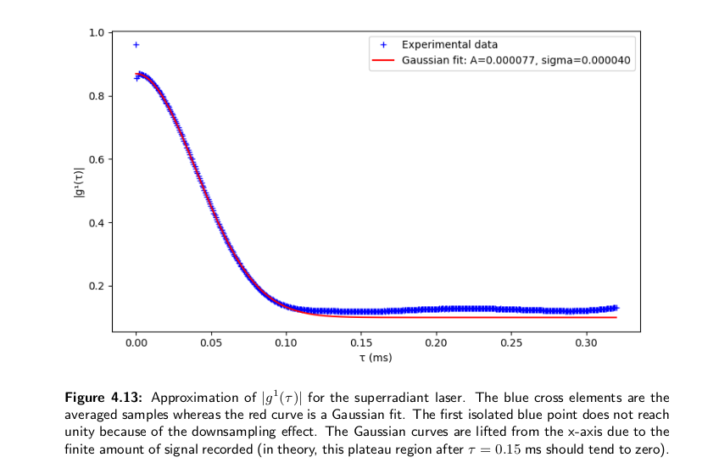
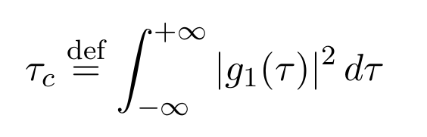




g¹ for the superradiant laser - 4

Slide 27
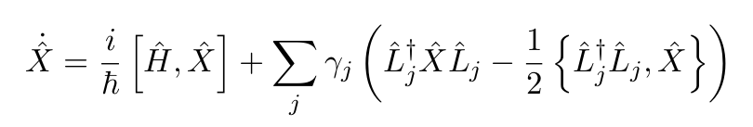




Numerical simulation as a comparison: master equation & cumulants expansion method - 4

Slide 28
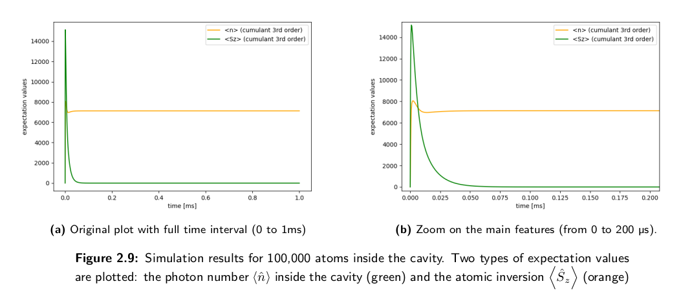
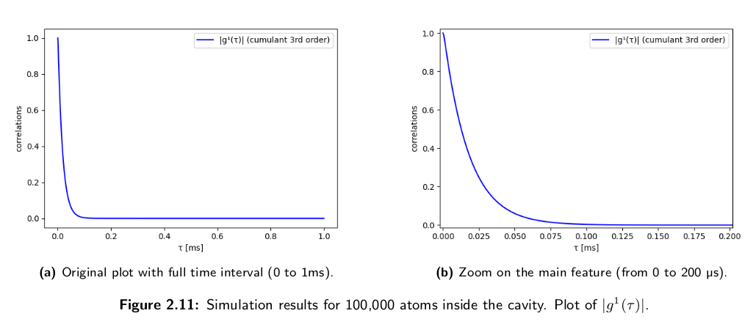

Numerical simulation as a comparison: master equation & cumulants expansion method - 4

Slide 29
Conclusion
4

