Slide 1

Spring事件通知之引申
——2018-08-16 祁琛琛

Slide 2

目 录
CONTENTS
观察者模式
Spring事件机制
JDK观察者模式

Slide 3
思考
问：
有一个购物商城的系统，出现了大量用户添加商品到购物车失败的情况、大量用户付款失败的情况等等。为了及时发现问题，通常会发送报警给相关技术负责人，你作为这块报警功能的开发者，会怎么设计？

Slide 4
思考
答：
提供发送报警的模块，在添加购物车模块里调用发送报警的API，在用户付款模块里调用发送报警的API【紧耦合】
利用观察者模式，业务模块(作为被观察者)发布报警消息，报警模块(观察者)监听对应的消息进行发送【松耦合】

Slide 5
实现
消息事件：
public class MessageEvent { private String message; public MessageEvent(String message) { this.message = message; } public String getMessage() { return message; } public void setMessage(String message) { this.message = message; } @Override public String toString() { return "MessageEvent{" + "message='" + message + '\'' + '}'; } }

Slide 6
实现
事件发布者：
public class MessageEventPublisher { private Set<MessageEventListener> messageEventListeners; public MessageEventPublisher(){ messageEventListeners = new LinkedHashSet<>(); } public void addMessageEventListener(MessageEventListener messageEventListener){ messageEventListeners.add(messageEventListener); } public void removeMessageEventListener(MessageEventListener messageEventListener){ messageEventListeners.remove(messageEventListener); } public void publishEvent(MessageEvent messageEvent){ for(MessageEventListener messageEventListener : messageEventListeners){ messageEventListener.onApplicationEvent(messageEvent); } } }

Slide 7
实现
事件监听器：
public interface MessageEventListener { void onApplicationEvent(MessageEvent messageEvent); }
public class MessageEventPrintListener implements MessageEventListener{ @Override public void onApplicationEvent(MessageEvent messageEvent){ System.out.println("处理" + messageEvent); } }

Slide 8
实现
运行：
public class MessageEventMain { public static void main(String[] args){ MessageEvent messageEvent = new MessageEvent(“用户添加商品到购物车失败"); MessageEventPublisher messageEventPublisher = new MessageEventPublisher(); MessageEventListener messageEventPrintListener = new MessageEventPrintListener(); messageEventPublisher.addMessageEventListener(messageEventPrintListener); messageEventPublisher.publishEvent(messageEvent); } }
结果：
处理MessageEvent{message='用户添加商品到购物车失败'}

Slide 9
观察者模式
概念：
定义了对象间一对多的关系，当被观察者状态发生变更时，所有的观察者都会收到通知，并进行相应的处理。
MessageEventPublisher
通知
MessageEventListener
被观察者
注册
观察者

Slide 10
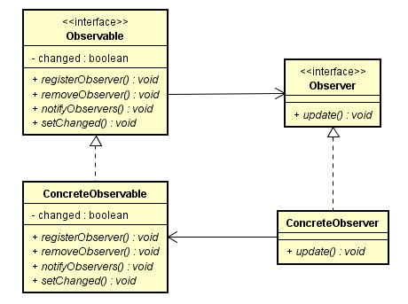
观察者模式

Slide 11
Spring实现
概念：
Spring里提供的事件机制，就是观察者模式的实际使用。
Spring事件机制提供两种方式：同步事件和异步事件。
可以采用编码方式，也可以采用注解方式(从4.2版本开始支持)
核心类：ApplicationEvent、ApplicationListener、ApplicationContext

Slide 12
Spring同步事件
public class DemoEvent extends ApplicationEvent {
private static final long serialVersionUID = 1L;
private String msg;
public void sysLog() { System.out.println(msg); }
public DemoEvent(Object source,String msg) { super(source); this.setMsg(msg); }
public String getMsg() { return msg; }
public void setMsg(String msg) { this.msg = msg; } }
@Component public class DemoPublisher { @Autowired ApplicationContext context; public void published() { DemoEvent event = new DemoEvent(this, "用户付款出现大量失败"); System.out.println("发部event："+event); context.publishEvent(event); System.out.println("发部event："+event + "完成"); } }
@Component public class DemoListener implements ApplicationListener<DemoEvent> { @Override public void onApplicationEvent(DemoEvent event) { String msg = event.getMsg(); System.out.println(“demoListener接收消息："+msg); } }

Slide 13
Spring同步事件
@Configuration @ComponentScan({"com.gentlemanqc.spring.event.sync"}) public class EventConfig { public static void main(String[] args) throws Exception { AnnotationConfigApplicationContext context =
new AnnotationConfigApplicationContext(EventConfig.class); DemoPublisher publisher = context.getBean(DemoPublisher.class); publisher.published(); context.close();
}
发布event：com.gentlemanqc.spring.event.sync.DemoEvent[source=com.gentlemanqc.spring.event.sync.DemoPublisher@5f0fd5a0]
demoListener接收消息：用户付款出现大量失败
发布event：com.gentlemanqc.spring.event.sync.DemoEvent[source=com.gentlemanqc.spring.event.sync.DemoPublisher@5f0fd5a0]完成

Slide 14
Spring同步事件
@Configuration @ComponentScan({"com.gentlemanqc.spring.event.sync"}) public class EventConfig { public static void main(String[] args) throws Exception { AnnotationConfigApplicationContext context =
new AnnotationConfigApplicationContext(EventConfig.class); DemoPublisher publisher = context.getBean(DemoPublisher.class); publisher.published(); context.close();
}
发布event：com.gentlemanqc.spring.event.sync.DemoEvent[source=com.gentlemanqc.spring.event.sync.DemoPublisher@5f0fd5a0]
demoListener接收消息：用户付款出现大量失败
发布event：com.gentlemanqc.spring.event.sync.DemoEvent[source=com.gentlemanqc.spring.event.sync.DemoPublisher@5f0fd5a0]完成

Slide 15
Spring异步事件
public class DemoEvent extends ApplicationEvent {
private static final long serialVersionUID = 1L;
private String msg;
public void sysLog() { System.out.println(msg); }
public DemoEvent(Object source,String msg) { super(source); this.setMsg(msg); }
public String getMsg() { return msg; }
public void setMsg(String msg) { this.msg = msg; } }
@Component public class DemoPublisher { @Autowired ApplicationContext context; public void published() { DemoEvent event = new DemoEvent(this, "用户付款出现大量失败"); System.out.println("发部event："+event); context.publishEvent(event); System.out.println("发部event："+event + "完成"); } }
@Component public class DemoListener3{
@EventListener @Async public void onApplicationEvent(DemoEvent event) throws Exception{ Thread.sleep(2000); String msg = event.getMsg(); System.out.println(“demoListener3接收消息："+msg); } }

Slide 16
Spring异步事件
@Configuration @ComponentScan({“com.gentlemanqc.spring.event.async”}) @EnableAsync //使用@Async必须提供taskExecutor，所以实现AsyncConfigurer接口 public class EventConfig implements AsyncConfigurer {
@Override public Executor getAsyncExecutor() { ThreadPoolTaskExecutor taskExecutor = new ThreadPoolTaskExecutor(); taskExecutor.setCorePoolSize(10); taskExecutor.setMaxPoolSize(80); taskExecutor.setQueueCapacity(100); taskExecutor.initialize(); return taskExecutor; } public static void main(String[] args) throws Exception { AnnotationConfigApplicationContext context = new AnnotationConfigApplicationContext(EventConfig.class); DemoPublisher publisher = context.getBean(DemoPublisher.class); publisher.published(); context.close(); } }
发布event：com.gentlemanqc.spring.event.async.DemoEvent[source=com.gentlemanqc.spring.event.async.DemoPublisher@4ae9cfc1] 发布event：com.gentlemanqc.spring.event.async.DemoEvent[source=com.gentlemanqc.spring.event.async.DemoPublisher@4ae9cfc1]完成 demoListener3接收消息：用户付款出现大量失败

Slide 17
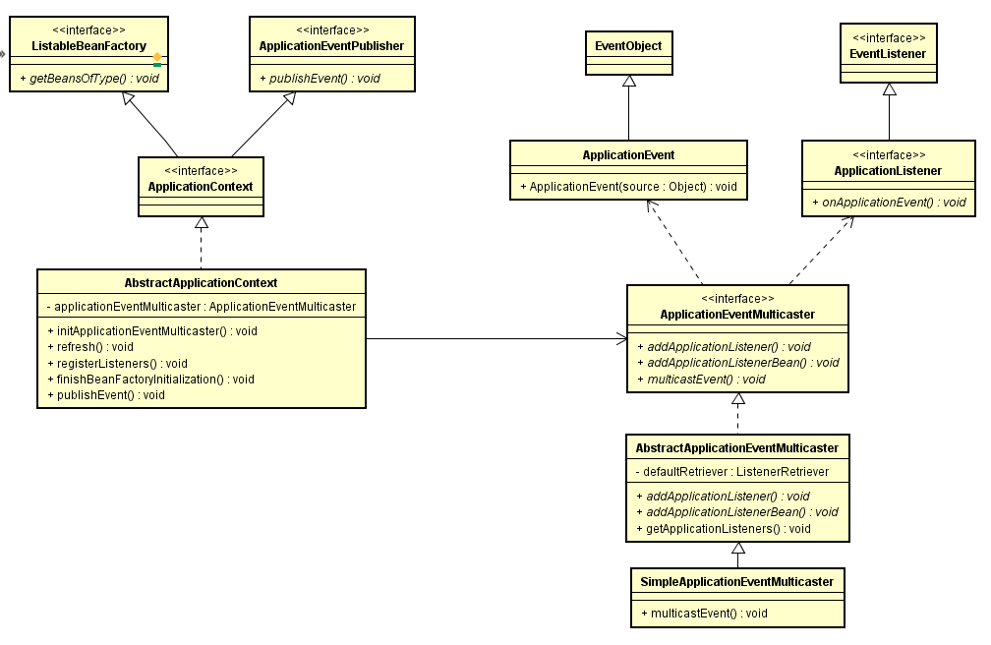
类图

Slide 18
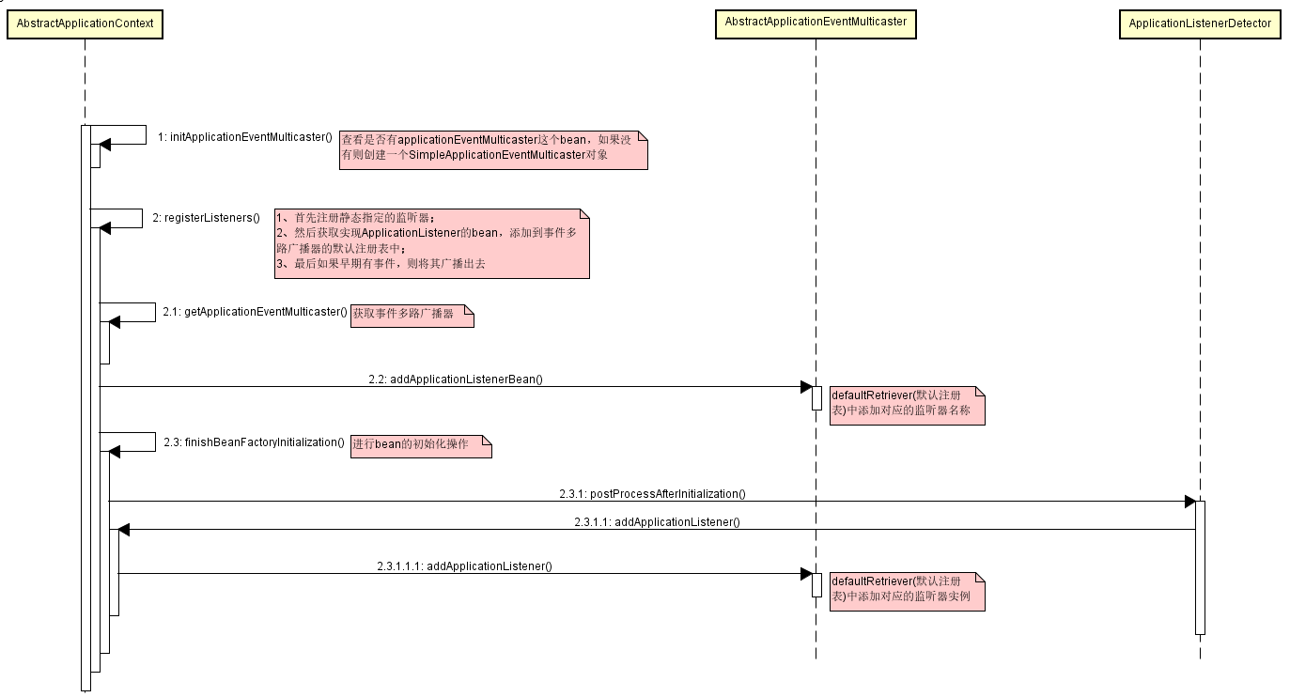
初始化时类图

Slide 19
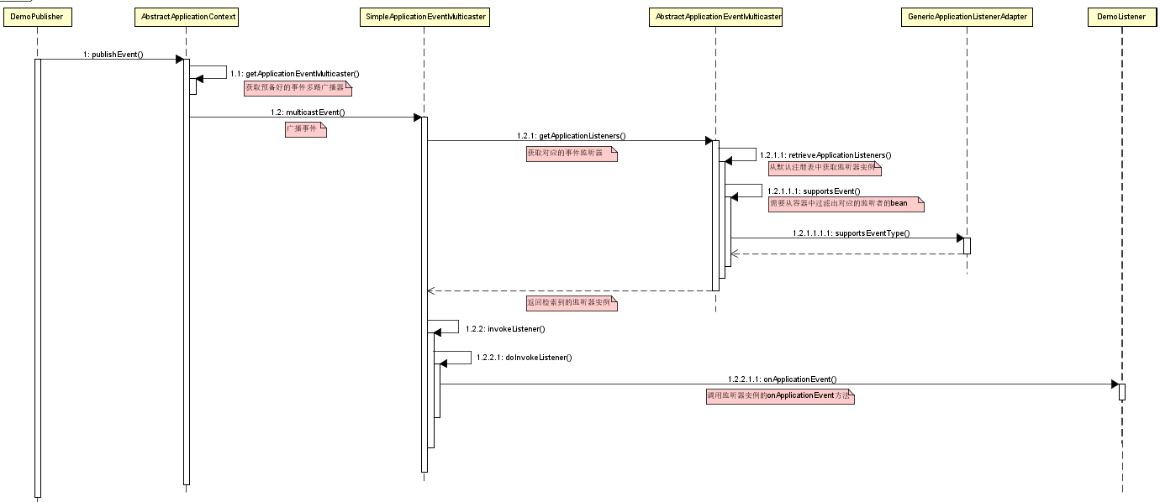
通知时类图

Slide 20
核心类AbstractApplicationEventMulticaster
public abstract class AbstractApplicationEventMulticaster implements ApplicationEventMulticaster, BeanClassLoaderAware, BeanFactoryAware { private final ListenerRetriever defaultRetriever = new ListenerRetriever(false); final Map<ListenerCacheKey, ListenerRetriever> retrieverCache = new ConcurrentHashMap<>(64); @Nullable private ClassLoader beanClassLoader; @Nullable private BeanFactory beanFactory; private Object retrievalMutex = this.defaultRetriever;
@Override public void addApplicationListener(ApplicationListener<?> listener) { synchronized (this.retrievalMutex) { // Explicitly remove target for a proxy, if registered already, // in order to avoid double invocations of the same listener. Object singletonTarget = AopProxyUtils.getSingletonTarget(listener); if (singletonTarget instanceof ApplicationListener) { this.defaultRetriever.applicationListeners.remove(singletonTarget); } this.defaultRetriever.applicationListeners.add(listener); this.retrieverCache.clear(); } } @Override public void addApplicationListenerBean(String listenerBeanName) { synchronized (this.retrievalMutex) { this.defaultRetriever.applicationListenerBeans.add(listenerBeanName); this.retrieverCache.clear(); } }

Slide 21
核心类ListenerRetriever
保存监听器的注册
private class ListenerRetriever { public final Set<ApplicationListener<?>> applicationListeners; public final Set<String> applicationListenerBeans; private final boolean preFiltered; public ListenerRetriever(boolean preFiltered) { this.applicationListeners = new LinkedHashSet<>(); this.applicationListenerBeans = new LinkedHashSet<>(); this.preFiltered = preFiltered; } public Collection<ApplicationListener<?>> getApplicationListeners() { List<ApplicationListener<?>> allListeners = new ArrayList<>( this.applicationListeners.size() + this.applicationListenerBeans.size()); allListeners.addAll(this.applicationListeners); if (!this.applicationListenerBeans.isEmpty()) { BeanFactory beanFactory = getBeanFactory(); for (String listenerBeanName : this.applicationListenerBeans) { try { ApplicationListener<?> listener = beanFactory.getBean(listenerBeanName, ApplicationListener.class); if (this.preFiltered || !allListeners.contains(listener)) { allListeners.add(listener); } } catch (NoSuchBeanDefinitionException ex) { // Singleton listener instance (without backing bean definition) disappeared - // probably in the middle of the destruction phase } } } AnnotationAwareOrderComparator.sort(allListeners); return allListeners; }}

Slide 22
核心类SimpleApplicationEventMulticaster
private void doInvokeListener(ApplicationListener listener, ApplicationEvent event) { try { listener.onApplicationEvent(event); } catch (ClassCastException ex) { String msg = ex.getMessage(); if (msg == null || matchesClassCastMessage(msg, event.getClass().getName())) { // Possibly a lambda-defined listener which we could not resolve the generic event type for // -> let's suppress the exception and just log a debug message. Log logger = LogFactory.getLog(getClass()); if (logger.isDebugEnabled()) { logger.debug("Non-matching event type for listener: " + listener, ex); } } else { throw ex; } } }

Slide 23
JDK实现
public class JdkDemoPublisher extends Observable{ private Date publishTime; public Date getPublishTime() { return publishTime; } public void setPublishTime(Date publishTime) { this.publishTime = publishTime; } public void publishEvent(JdkDemoEvent jdkDemoEvent){ setChanged();//因为不同包中protected方法无法被子类继承，所以无法通过创建子类对象的方式来调用父类protected方法 notifyObservers(jdkDemoEvent); } }
public class JdkDemoEvent{ private String msg; public void sysLog() { System.out.println(msg); } public JdkDemoEvent(String msg) { this.setMsg(msg); } public String getMsg() { return msg; } public void setMsg(String msg) { this.msg = msg; } }
public class JdkDemoListener implements Observer { @Override public void update(Observable o, Object arg) { JdkDemoEvent jdkDemoEvent = (JdkDemoEvent)arg; JdkDemoPublisher jdkDemoPublisher = (JdkDemoPublisher)o; System.out.println("观察者获取到消息：" + jdkDemoEvent.getMsg()
+ "，发布时间为" + jdkDemoPublisher.getPublishTime()); } }

Slide 24
JDK实现
public class JdkEventConfig { public static void main(String[] args) throws Exception { JdkDemoPublisher jdkDemoPublisher = new JdkDemoPublisher(); jdkDemoPublisher.setPublishTime(new Date()); Observer jdkDemoListener = new JdkDemoListener(); jdkDemoPublisher.addObserver(jdkDemoListener); JdkDemoEvent jdkDemoEvent = new JdkDemoEvent("这是一条测试消息"); jdkDemoPublisher.publishEvent(jdkDemoEvent); } }
观察者获取到消息：这是一条测试消息，发布时间为Thu Aug 16 19:45:17 CST 2018

Slide 25
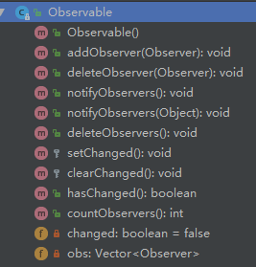
JDK实现
public void notifyObservers(Object arg) { /* * a temporary array buffer, used as a snapshot of the state of * current Observers. */ Object[] arrLocal; synchronized (this) { /* We don't want the Observer doing callbacks into * arbitrary code while holding its own Monitor. * The code where we extract each Observable from * the Vector and store the state of the Observer * needs synchronization, but notifying observers * does not (should not). The worst result of any * potential race-condition here is that: * 1) a newly-added Observer will miss a * notification in progress * 2) a recently unregistered Observer will be * wrongly notified when it doesn't care */ if (!changed) return; arrLocal = obs.toArray(); clearChanged(); } for (int i = arrLocal.length-1; i>=0; i--) ((Observer)arrLocal[i]).update(this, arg); }

Slide 26
JDK实现
问：
为什么setChanged采用protected修饰？
Observer定义为类，有什么缺陷？这样设计合理吗？

Slide 27
学习资料
官网地址： https://docs.spring.io/spring-framework/docs/current/spring-framework-reference/core.html#context-functionality-events

Slide 28

THANKS！
www.cardinfo.com.cn

