Slide 1
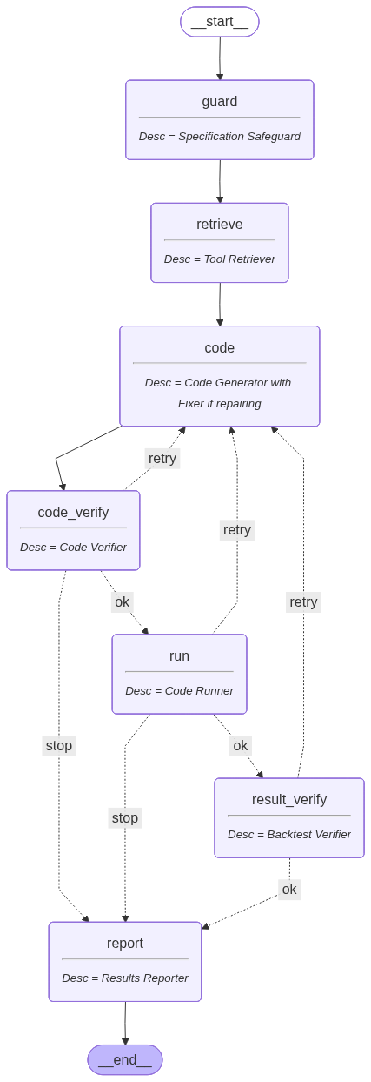
Langchain Workflow
Data
Local data
Data Loader
Yahoo finance
Alpha vantage

