Slide 1

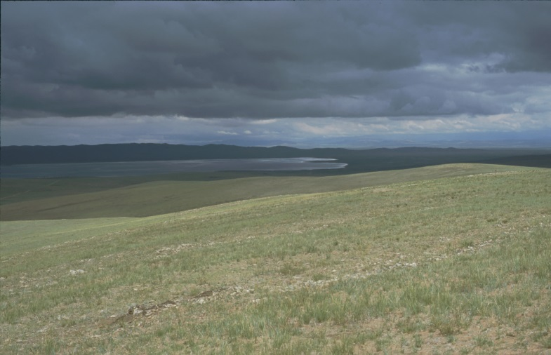
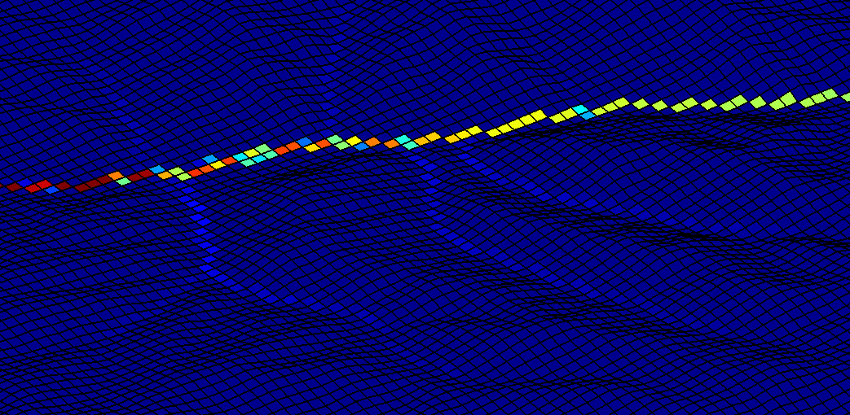
Geo.X Hackathon: The challenge of +4 data – Visualizing and comparing outputs from landscape evolution models Network analysis of LEMs
Jan, Malte, Simon, Wolfgang

