Slide 1

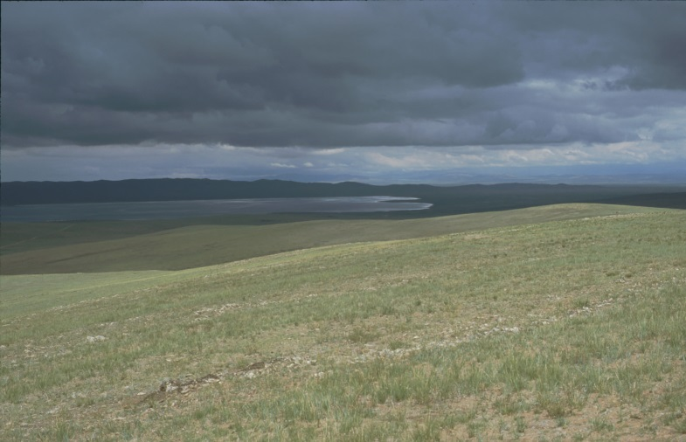
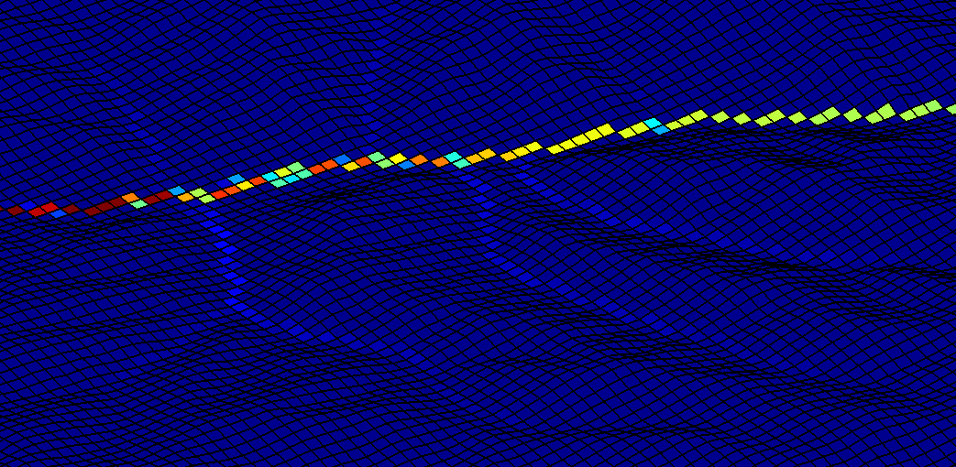
Geo.X Hackathon: The challenge of +4 data – Visualizing and comparing outputs from landscape evolution models Network analysis of LEMs
Jan, Malte, Simon, Wolfgang

Slide 2
Problem statement
Can 4D data be reduced to a simpler topology to
(a) visualize data, show data in a condensed form (b) analyse the data, derive parameters (c) identify or quantify processes?

Slide 3
Idea
Generalisation of DEM (here: landform classification)
Create network based on generalized DEM
Analyse and visualize network topology instead of 4D dataset
Network construction is based on spatial characteristics of the generalized DEM

Slide 4
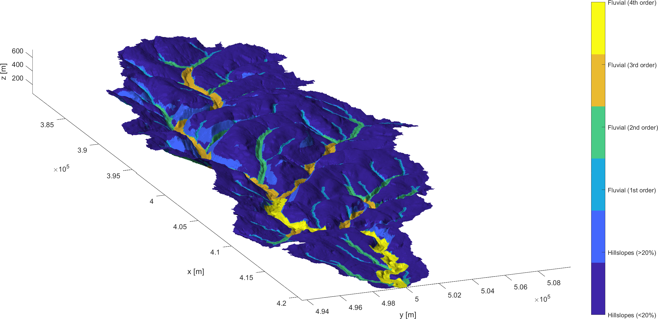
Generalisation of DEM
Simple landform classification at t=0

Slide 5
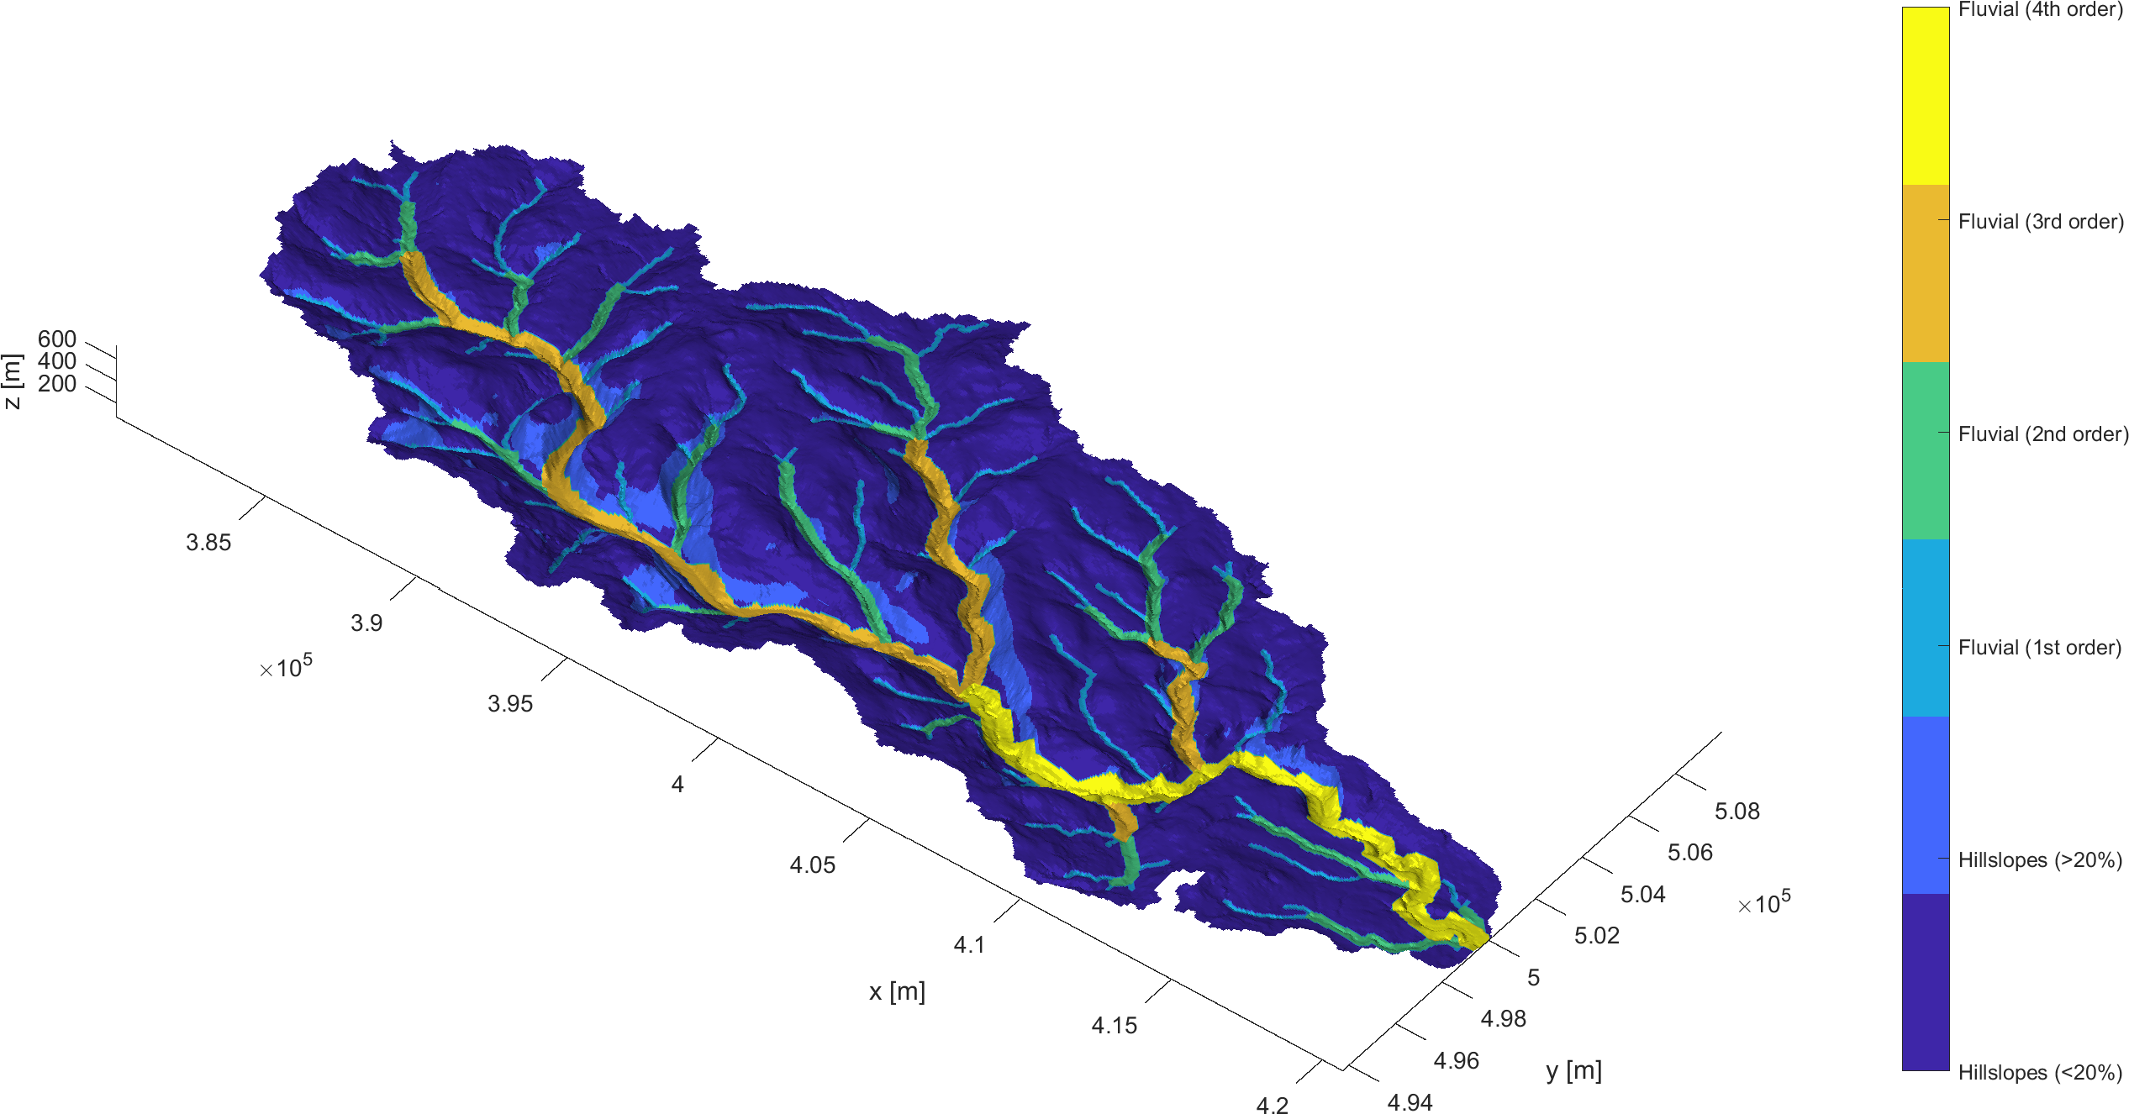
Generalisation of DEM
Simple landform classification at t=0

Slide 6
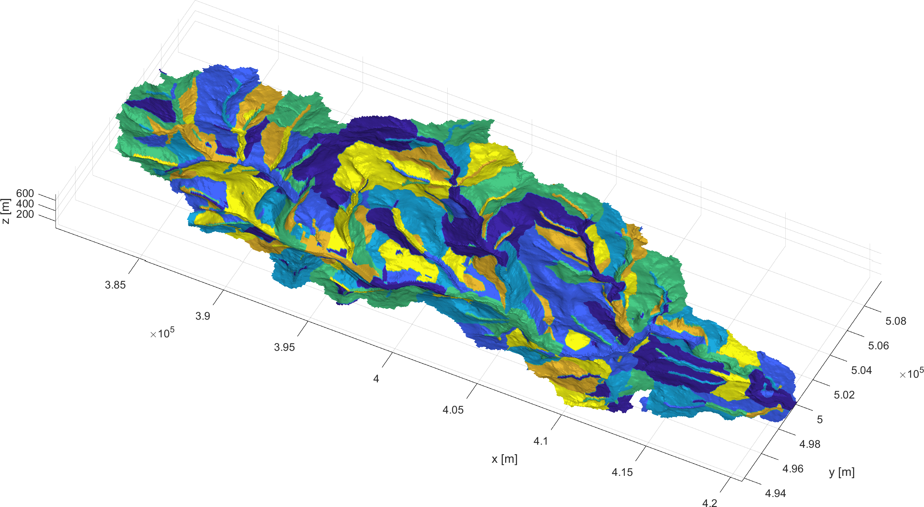
Generalisation of DEM at t=0
Subdivide classes into smaller regions (max 2km extent)

Slide 7
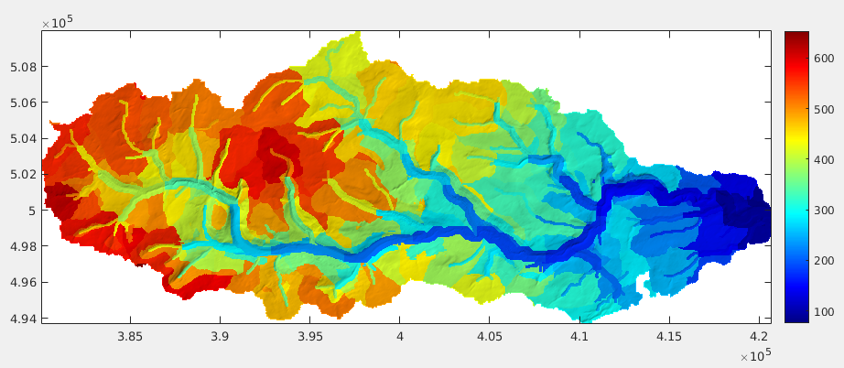
Perform zonal statistics on regions
Example: mean elevation of each region

Slide 8
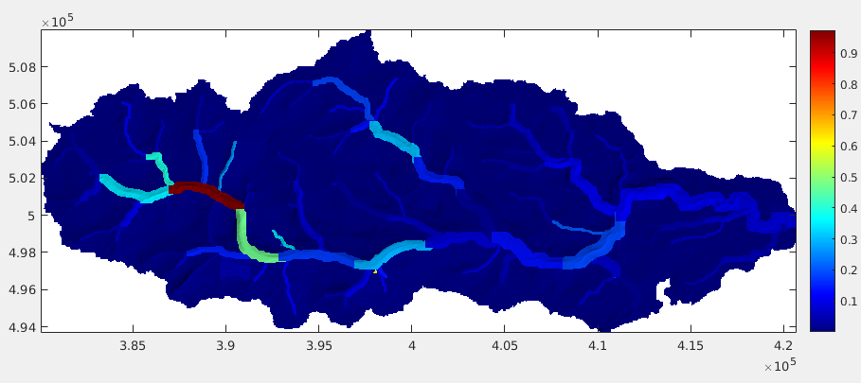
Aggregate zonal statistics over time
Change of statistical value over time
Example: change of mean elevation over time

Slide 9
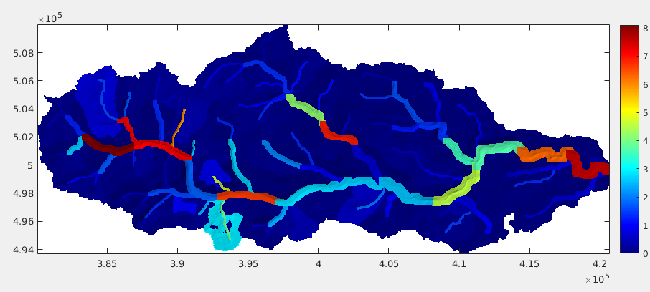
Aggregate zonal statistics over time
Change of statistical value over time
Example: DEM of difference, time stdev of roughness

Slide 10
Define network nodes & edges
Centroid of each defined region = network node
Set node connections for neighboring regions
Add parameters to network: e.g. zonal statistics

Slide 11
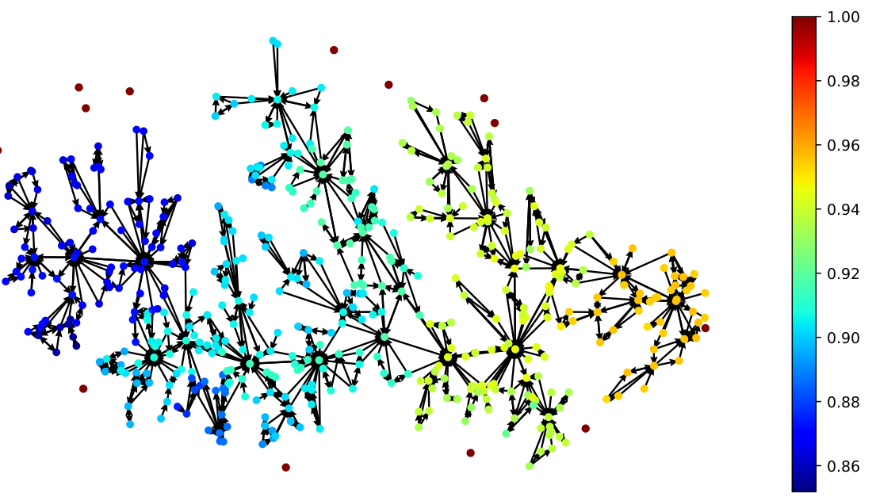
Directed Network topology

Slide 12
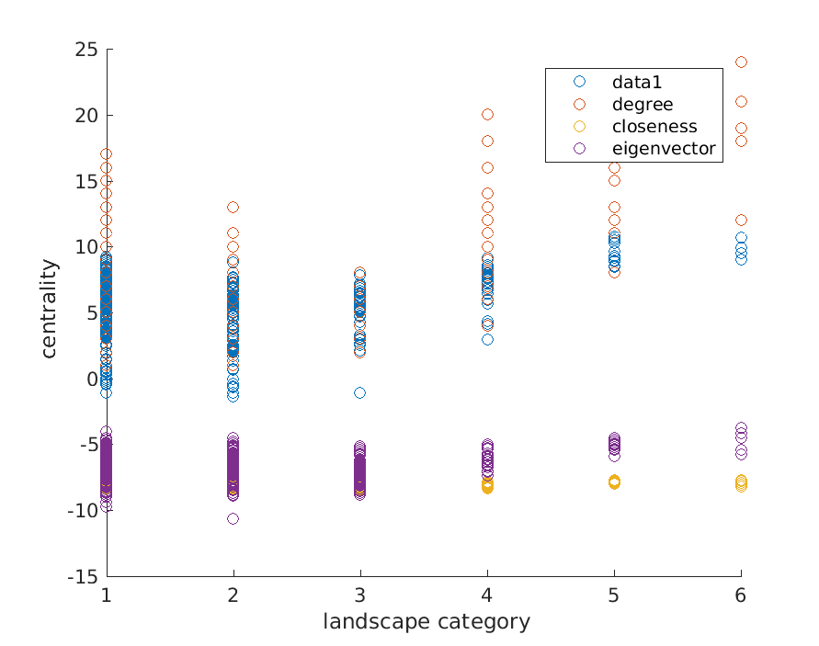
Node centrality versus lanscape type
betweenness

