Slide 1
Calibration

Slide 2
NCAR/CUNY Spatial Population Downscaling Model
We hypothesize that estimates of α can be correlated to observed demographic, socio-economic, and geographic variables, while β can be linked to and/or estimated from observed distance-density gradients. For purposes of estimating and projecting α we include additional ancillary data:
Demographic
Age specific fertility and mortality
Median age
% elderly (65+)
Geographic
Physical amenities index
Ecozone
Socio-Economic
Sectoral employment
Unemployment rate
Poverty rate
Educational attainment
Social amenities index

Slide 3
Fitting the Population Potential Model
Assume that β is a universal parameter for region s and estimate from historic data by minimizing the error term in:
We then use the estimate of β and α = 1 to generate a projected population distribution from the historic data using:

Slide 4
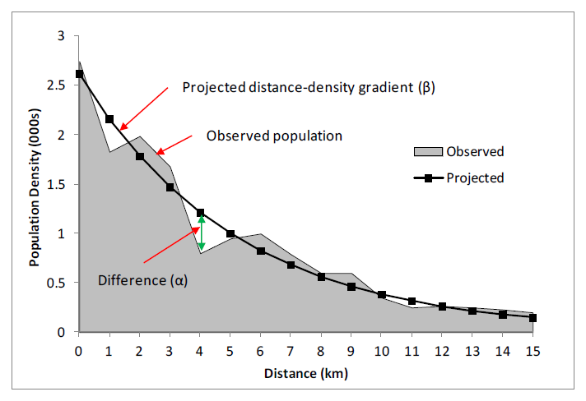
Cell-specific Population Potential
For each cell i there will be an error in projected population:
We hypothesize that these errors can be explained by local demographic/geographic characteristics, which are used to estimate the α parameter.

Slide 5
Cell-specific Population Potential
For each cell i we calculate the value of α necessary to eliminate ε. We call this value the observed α.

Slide 6
Cell-specific Population Potential
We then estimate the relationship between observed α and cell-specific demographic/geographic characteristics by fitting a spatially autoregressive model:
where X is the set of explanatory variables, u the random effect component, ρ is the spatial autocorrelation coefficient and W is a spatial weight matrix. From this procedure we estimate a set of cell specific α values.

