Slide 1

Partner Business Review
September 2025 – August 2026
Sub-Business Unit: PHARMACY_OTC
V9 Beta 1.1
Notes:
[Sources]
User-supplied partner_data.xlsx and subbusiness_unit_data.xlsx; periods and input hashes in accompanying audit export. Brand assets supplied with Dev5.
[/Sources]
Official reported CVR; partner/SBU aggregate weighted by sessions

Slide 2
PHARMACY_OTC Business Development
Latest SBU performance — August 2026
SBU GMV
SBU Orders
SBU AOV
SBU CVR
€615,937
37,972
€16.22
20.5%
▲ 2.2% vs prev. month
▼ 0.5% vs prev. month
▲ 2.7% vs prev. month
▼ 2.1 pp vs prev. month
Comparison unavailable
Comparison unavailable
Comparison unavailable
Growth Composition
Key Takeaways
GMV
+2.2%
• GMV increased 2.2% vs previous month.
Orders
-0.5%
• Higher basket size partly offset lower order volume.
AOV
+2.7%
• CVR declined by 2.1 pp to 20.5%.
Notes:
[Sources]
User-supplied partner_data.xlsx and subbusiness_unit_data.xlsx; periods and input hashes in accompanying audit export. Brand assets supplied with Dev5.
[/Sources]
Official reported CVR; partner/SBU aggregate weighted by sessions

Slide 3

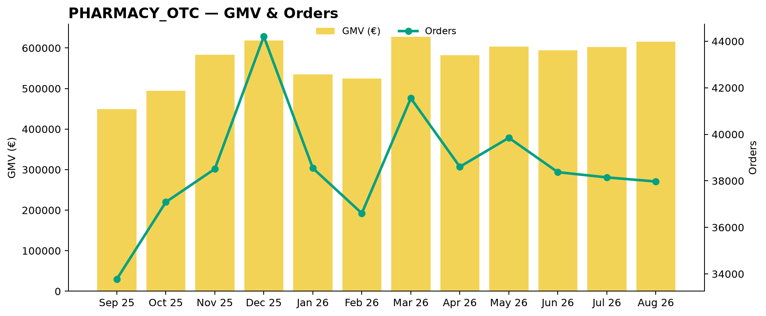
PHARMACY_OTC Performance Trend
Last 12 available months
Across the displayed period, PHARMACY_OTC GMV changed +37.3%, while orders changed +12.4%.
Notes:
[Sources]
User-supplied partner_data.xlsx and subbusiness_unit_data.xlsx; periods and input hashes in accompanying audit export. Brand assets supplied with Dev5.
[/Sources]
Official reported CVR; partner/SBU aggregate weighted by sessions

Slide 4
Partner vs PHARMACY_OTC
Comparable period: August 2026
KPI
Partner
PHARMACY_OTC
Gap
AOV
€30.88
€16.22
90.4% better than PHARMACY_OTC
CVR
9.7%
20.5%
10.8 pp worse than PHARMACY_OTC
Uptime
98.6%
91.5%
7.1 pp better than PHARMACY_OTC
PNA
4.5%
8.0%
3.5 pp better than PHARMACY_OTC
Cancels
1.9%
2.5%
0.6 pp better than PHARMACY_OTC
Benchmark comparison uses the latest common period available in both datasets: August 2026.
Notes:
[Sources]
User-supplied partner_data.xlsx and subbusiness_unit_data.xlsx; periods and input hashes in accompanying audit export. Brand assets supplied with Dev5.
[/Sources]
Official reported CVR; partner/SBU aggregate weighted by sessions

Slide 5
Growth vs PHARMACY_OTC
MoM growth comparison — August 2026
KPI
Partner
PHARMACY_OTC
Growth Gap
GMV Growth
+33.8%
+2.2%
+31.5 pp
Orders Growth
+19.8%
-0.5%
+20.3 pp
AOV Growth
+11.7%
+2.7%
+8.9 pp
Notes:
[Sources]
User-supplied partner_data.xlsx and subbusiness_unit_data.xlsx; periods and input hashes in accompanying audit export. Brand assets supplied with Dev5.
[/Sources]
Official reported CVR; partner/SBU aggregate weighted by sessions

Slide 6
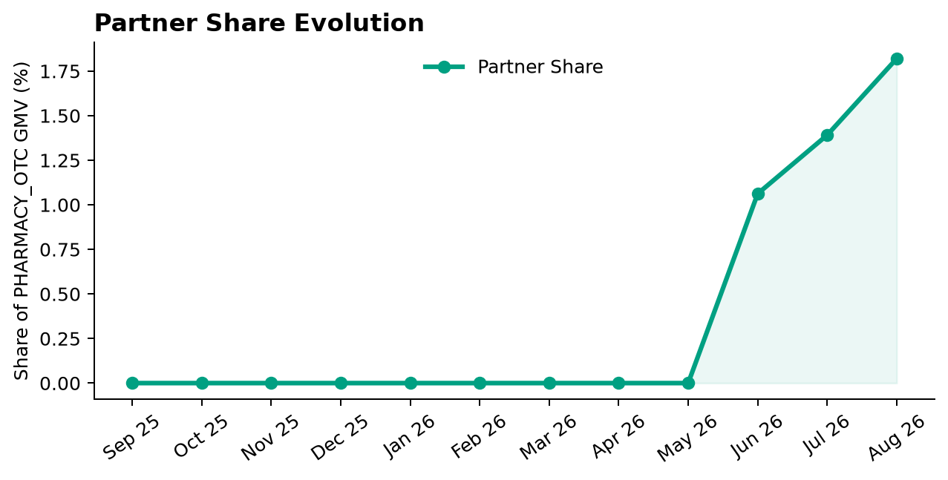
Partner Share of PHARMACY_OTC
Partner GMV as a share of PHARMACY_OTC GMV — August 2026
Share of PHARMACY_OTC GMV
1.8%
▲ 0.4 pp vs prev. month
Comparison unavailable
Partner gained 0.43 pp of PHARMACY_OTC GMV share vs previous month.
Notes:
[Sources]
User-supplied partner_data.xlsx and subbusiness_unit_data.xlsx; periods and input hashes in accompanying audit export. Brand assets supplied with Dev5.
[/Sources]
Official reported CVR; partner/SBU aggregate weighted by sessions

Slide 7
Executive Summary
Latest partner performance — August 2026
GMV
Orders
AOV
Partner CVR
€11,211
363
€30.88
9.7%
▲ 33.8% vs prev. month
▲ 19.8% vs prev. month
▲ 11.7% vs prev. month
▲ 2.5 pp vs prev. month
90.4% better than PHARMACY_OTC
10.8 pp worse than PHARMACY_OTC
• GMV changed +33.8% vs previous month.
• Order volume moved more sharply than basket size during the month.
• Partner CVR is 10.8 pp worse than the selected PHARMACY_OTC benchmark (August 2026).
Notes:
[Sources]
User-supplied partner_data.xlsx and subbusiness_unit_data.xlsx; periods and input hashes in accompanying audit export. Brand assets supplied with Dev5.
[/Sources]
Official reported CVR; partner/SBU aggregate weighted by sessions

Slide 8
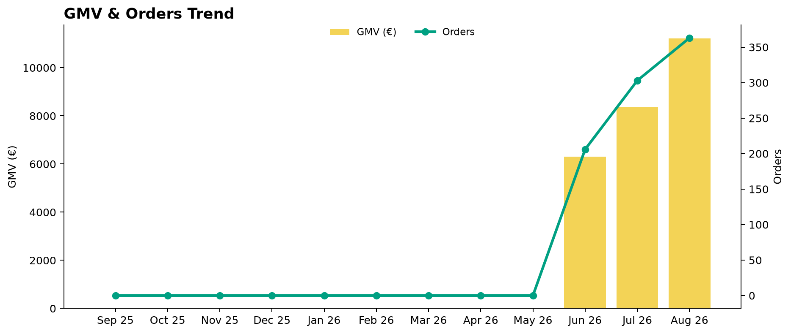
Partner Performance Evolution
Monthly GMV and delivered orders
Notes:
[Sources]
User-supplied partner_data.xlsx and subbusiness_unit_data.xlsx; periods and input hashes in accompanying audit export. Brand assets supplied with Dev5.
[/Sources]
Official reported CVR; partner/SBU aggregate weighted by sessions

Slide 9
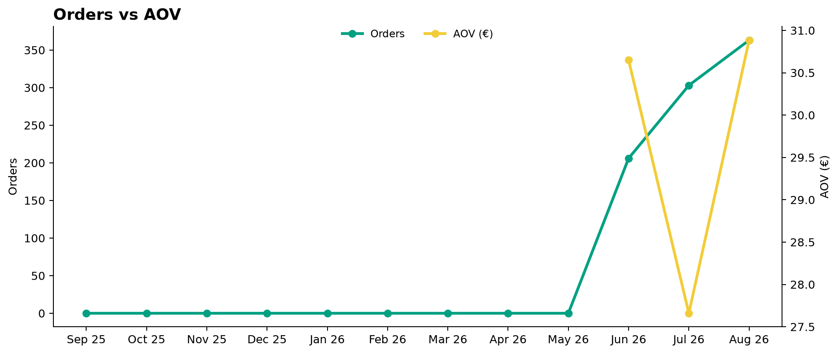
Growth Drivers
Order volume and average basket evolution
Notes:
[Sources]
User-supplied partner_data.xlsx and subbusiness_unit_data.xlsx; periods and input hashes in accompanying audit export. Brand assets supplied with Dev5.
[/Sources]
Official reported CVR; partner/SBU aggregate weighted by sessions

Slide 10
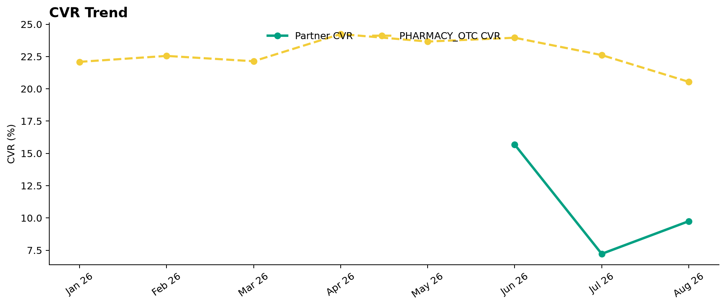
Conversion Performance
Partner CVR vs PHARMACY_OTC
Notes:
[Sources]
User-supplied partner_data.xlsx and subbusiness_unit_data.xlsx; periods and input hashes in accompanying audit export. Brand assets supplied with Dev5.
[/Sources]
Official reported CVR; partner/SBU aggregate weighted by sessions

Slide 11
Operational Health
Latest partner performance — Uptime vs 95% target; PNA/Cancels vs PHARMACY_OTC (August 2026)
Operating Store Uptime
Partner PNA
Partner Cancels
98.6%
4.5%
1.9%
▲ 0.8 pp vs prev. month
▼ 0.9 pp vs prev. month
▼ 0.7 pp vs prev. month
3.6 pp better than 95% target
3.5 pp better than PHARMACY_OTC
0.6 pp better than PHARMACY_OTC
Interpretation
Uptime is evaluated against a 95% operating target. Lower is better for PNA and Cancels. Green indicates improvement; red indicates deterioration. Uptime coverage: 1/1 operating store. Missing current store records: 0.
Notes:
[Sources]
User-supplied partner_data.xlsx and subbusiness_unit_data.xlsx; periods and input hashes in accompanying audit export. Brand assets supplied with Dev5.
[/Sources]
Official reported CVR; partner/SBU aggregate weighted by sessions

Slide 12
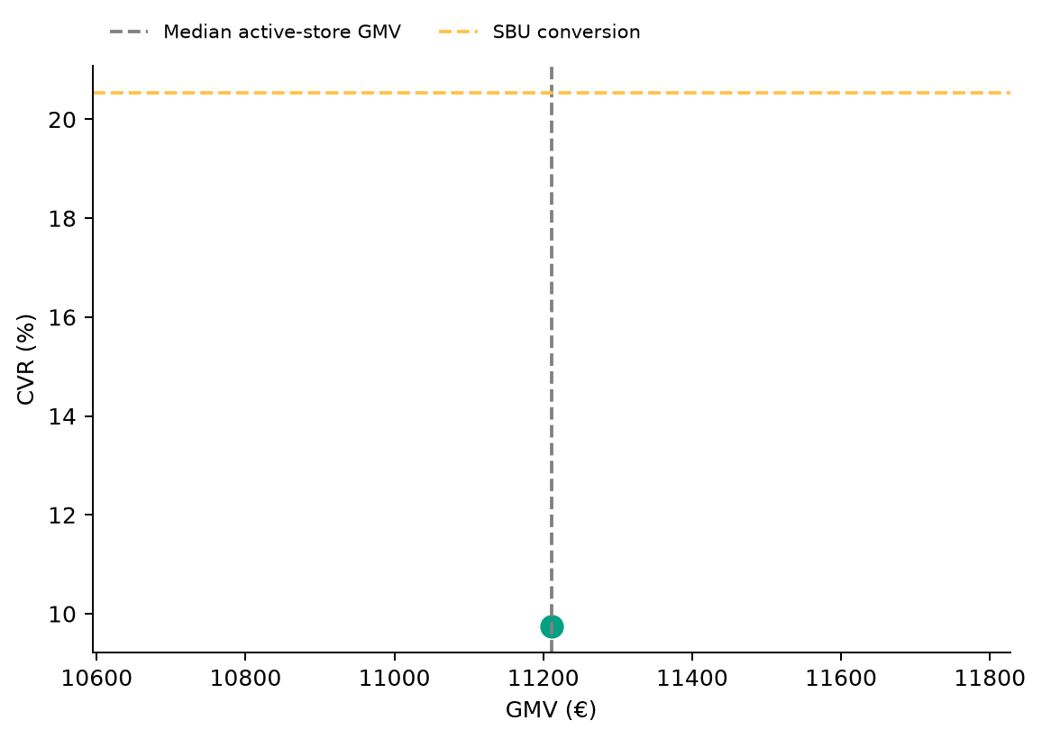
Store Performance Matrix
2026-08 · Commercial position is separate from operational status
Store legend
Chabua Amirejibi Highway 1 0179 Tbilisi T'bilisi Georgia
1 store plotted · 1 No Activity store reviewed separately.
Positioning uses GMV and conversion; opportunity ranking uses the assessed KPI gaps and exposure.
Notes:
[Sources]
User-supplied partner_data.xlsx and subbusiness_unit_data.xlsx; periods and input hashes in accompanying audit export. Brand assets supplied with Dev5.
[/Sources]
Official reported CVR; partner/SBU aggregate weighted by sessions

Slide 13

Top GMV Stores
2026-08
Store
GMV
Commercial status
Operational status
Top Stores
1
Chabua Amirejibi Highway 1 0179 Tbilisi T'bilisi Georgia
€11,211
Conversion Opportunity
Healthy
2
Varketili-3 II micro-district 3 0011 Tbilisi Tbilisi Georgia
€0
No Activity
Not applicable
100.0%
Top 2 stores generated 100.0% of total partner GMV in August 2026.
Reported partner GMV: €11,211
Notes:
[Sources]
User-supplied partner_data.xlsx and subbusiness_unit_data.xlsx; periods and input hashes in accompanying audit export. Brand assets supplied with Dev5.
[/Sources]
Official reported CVR; partner/SBU aggregate weighted by sessions

Slide 14


How We Prioritize Opportunities
2026-08 · Higher Priority = stronger case for action
SEVERITY — 0–100
IMPACT — 0–100
PRIORITY — 0–100
How large is the KPI problem?
How much business exposure
sits behind the problem?
Where should we act first?
Compared with the relevant SBU benchmark or operating target.
Evidence volume and confidence are considered. Larger reliable negative gaps create higher Severity.
Dominant-KPI protection keeps a major problem from being hidden by healthy KPIs.
Order-related exposure behind the KPI gap. Higher-volume problems generally create higher Impact.
Not euros. Not guaranteed recovered orders. Not a financial forecast.
Metric Priority =
KPI Severity × KPI Impact / 100
Store Priority combines eligible KPI-level priorities, with dominant-KPI protection so one major issue cannot be diluted.
MAIN ACTION KPI
BASE ACTION RULE · Priority ≥ 5.0
The KPI with the strongest paired business case for action at that store.
The 5.0 threshold remains provisional. V2.1 overrides can classify lower-score stores ACTION.
Priority ranks stores. Separate V2.1 triage assigns ACTION / MONITOR / HEALTHY / UNCLASSIFIED (six ACTION stores shown by default).
Missing evidence → incomplete assessment, not zero. Critical observations are reviewed separately from business Priority.
Uptime: 95% target; restoration exposure uses healthy history where available.
Exposure components may overlap; headline exposure uses the largest. An opportunity signal, not a recovery promise.
Benchmark: 2026-08. SBU peer composition is not available.

Slide 15
Priority Opportunities & Actions
2026-08 · V2.1 business triage · Priority ranking remains unchanged
#1 · Chabua Amirejibi Highway 1 0179 Tbilisi T'bilisi Georgia
OVERALL ACTION FOCUS
1 selected of 1 ACTION store
Priority 34.09 · Primary Action KPI: CVR
Primary Action KPI
CVR
ACTION · Base Priority
Stores Requiring Action
CVR 9.7% vs SBU 20.5%
1 store
Priority Range
Likely operational driver: Assortment / pricing / content / discoverability / funnel quality: investigate
Highest 34.09 · Lowest 34.09
Critical / Review Items
Review assortment, pricing, content and discoverability, then investigate the conversion journey
0 items
Review items are separate from Priority.
Next review
Intended effect: Improve conversion against the SBU benchmark
1
Confirm priority stores
2
Assign owner / deadline
3
Track progress next review

Slide 16
Action Plan
Agree owners and dates for the selected V2.1 ACTION stores
Store / Primary KPI
Recommended action
Owner / deadline
Chabua Amirejibi Highway 1 0179 Tbilisi T'bilisi Georgia / CVR
Review assortment, pricing, content and discoverability, then investigate the conversion journey
To agree

Slide 17
Operational & Data Review
Critical observations and hygiene remain visible independently of business Priority
Store / type
Evidence
Review action
Varketili-3 II micro-district 3 0011 Tbilisi Tbilisi Georgia / Activity review
No sessions, order attempts or deliveries in reporting month; no observed operating history—verify activation
Confirm listing status and investigate absent demand or order activity
Notes:
[Sources]
User-supplied partner_data.xlsx and subbusiness_unit_data.xlsx; periods and input hashes in accompanying audit export. Brand assets supplied with Dev5.
[/Sources]
Official reported CVR; partner/SBU aggregate weighted by sessions

Slide 18
Discussion
Confirm actions, responsibilities and the next review date
Which interventions should we start first?
Notes:
[Sources]
User-supplied partner_data.xlsx and subbusiness_unit_data.xlsx; periods and input hashes in accompanying audit export. Brand assets supplied with Dev5.
[/Sources]
Official reported CVR; partner/SBU aggregate weighted by sessions

Slide 19
Thank You
Partner Business Review · V9 Beta 1.1
Let’s turn the agreed actions into measurable progress.
Notes:
[Sources]
User-supplied partner_data.xlsx and subbusiness_unit_data.xlsx; periods and input hashes in accompanying audit export. Brand assets supplied with Dev5.
[/Sources]
Official reported CVR; partner/SBU aggregate weighted by sessions

Slide 20
APPENDIX — Store Diagnostics
2026-08 · 2 stores · Reference section
Store-level context
Lifecycle, KPI evidence and recommendations for each store.
Notes:
[Sources]
User-supplied partner_data.xlsx and subbusiness_unit_data.xlsx; periods and input hashes in accompanying audit export. Brand assets supplied with Dev5.
[/Sources]
Official reported CVR; partner/SBU aggregate weighted by sessions

Slide 21
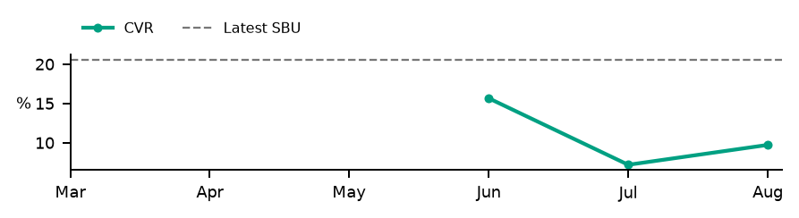
Store Diagnostics
Chabua Amirejibi Highway 1 0179 Tbilisi T'bilisi Georgia
August 2026
GMV
DELIVERED
SESSIONS
ATTEMPTS
ACTIVE
DATA OK
COMPLETE
€11,211
363
3,796
374
Business: ACTION · Base Priority
CVR
PNA
Cancels
Uptime
9.7%
4.5%
1.9%
98.6%
SBU 20.5%
SBU 8.0%
SBU 2.5%
Target 95.0%
Below SBU · -10.8 pp
Below SBU · -3.5 pp
Below SBU · -0.6 pp
Above Target · +3.6 pp
Severity
Impact
Priority
Primary Action KPI
CVR
34.23
99.56
34.09
Worst KPI / Severity Driver
CVR
PRIORITY ≥ 5.0
Largest Exposure KPI
CVR
Confidence / evidence
Main KPI trend
CVR 96% · n=3,796
PNA 93% · n=374
Cancels 97% · n=374
Assessment evidence
Current sessions or order activity · Critical observations: None
Likely operational driver: Assortment / pricing / content / discoverability / funnel quality: investigate
Review assortment, pricing, content and discoverability, then investigate the conversion journey
Intended effect: Improve conversion against the SBU benchmark
Notes:
[Sources]
User-supplied partner_data.xlsx and subbusiness_unit_data.xlsx; periods and input hashes in accompanying audit export. Brand assets supplied with Dev5.
[/Sources]
Official reported CVR; partner/SBU aggregate weighted by sessions
V2.1 business triage:
{"Business Classification": "ACTION", "Action Reason": "BASE_PRIORITY", "Supporting Rule Matches": [], "Primary Action KPI": "CVR", "Likely Operational Driver": "Assortment / pricing / content / discoverability / funnel quality: investigate", "Operational/Data State": ["COMPLETE"]}

Slide 22
Store Diagnostics
Varketili-3 II micro-district 3 0011 Tbilisi Tbilisi Georgia
August 2026
GMV
DELIVERED
SESSIONS
ATTEMPTS
NO ACTIVITY
DATA OK
NOT APPLICABLE
€0
0
0
0
Business: UNCLASSIFIED
CVR
PNA
Cancels
Uptime
Not assessed
Not assessed
Not assessed
Not assessed
SBU 20.5%
SBU 8.0%
SBU 2.5%
Target 95.0%
Lifecycle state · reference only
Lifecycle state · reference only
Lifecycle state · reference only
Lifecycle state · reference only
Severity
Impact
Priority
Lifecycle state
No Activity
0.00
0.00
0.00
Worst KPI / Severity Driver
None
NO ROUTINE RECOVERY
Largest Exposure KPI
No assessed exposure
Confidence / evidence
Main KPI trend
CVR · Rate unavailable / not assessed · n=0
Trend unavailable
PNA · Rate unavailable / not assessed · n=0
Cancels · Rate unavailable / not assessed · n=0
Lifecycle / activity evidence
No sessions, order attempts or deliveries in reporting month; no observed operating history—verify activation
Lifecycle / activity action
Review store activity
Notes:
[Sources]
User-supplied partner_data.xlsx and subbusiness_unit_data.xlsx; periods and input hashes in accompanying audit export. Brand assets supplied with Dev5.
[/Sources]
Official reported CVR; partner/SBU aggregate weighted by sessions
V2.1 business triage:
{"Business Classification": "UNCLASSIFIED", "Action Reason": "", "Supporting Rule Matches": [], "Primary Action KPI": "None", "Likely Operational Driver": "Not assessed; review lifecycle / data evidence", "Operational/Data State": ["NO_ACTIVITY"]}

