Slide 1

Partner Business Review
August 2026 – August 2026
Sub-Business Unit: FLOWERS
V9_Beta2
Notes:
[Sources]
User-supplied partner_data.xlsx and subbusiness_unit_data.xlsx; periods and input hashes in accompanying audit export. Brand assets supplied with Dev5.
[/Sources]
Official reported CVR; partner/SBU aggregate weighted by sessions

Slide 2
FLOWERS Business Development
Latest SBU performance — August 2026
SBU GMV
SBU Orders
SBU AOV
SBU CVR
€34,127
844
€40.44
3.9%
▼ 14.7% vs prev. month
▼ 9.9% vs prev. month
▼ 5.3% vs prev. month
▼ 0.2 pp vs prev. month
Comparison unavailable
Comparison unavailable
Comparison unavailable
Growth Composition
Key Takeaways
GMV
-14.7%
• GMV decreased 14.7% vs previous month.
Orders
-9.9%
• Both order volume and basket size declined vs previous month.
AOV
-5.3%
• CVR declined by 0.2 pp to 3.9%.
Notes:
[Sources]
User-supplied partner_data.xlsx and subbusiness_unit_data.xlsx; periods and input hashes in accompanying audit export. Brand assets supplied with Dev5.
[/Sources]
Official reported CVR; partner/SBU aggregate weighted by sessions

Slide 3

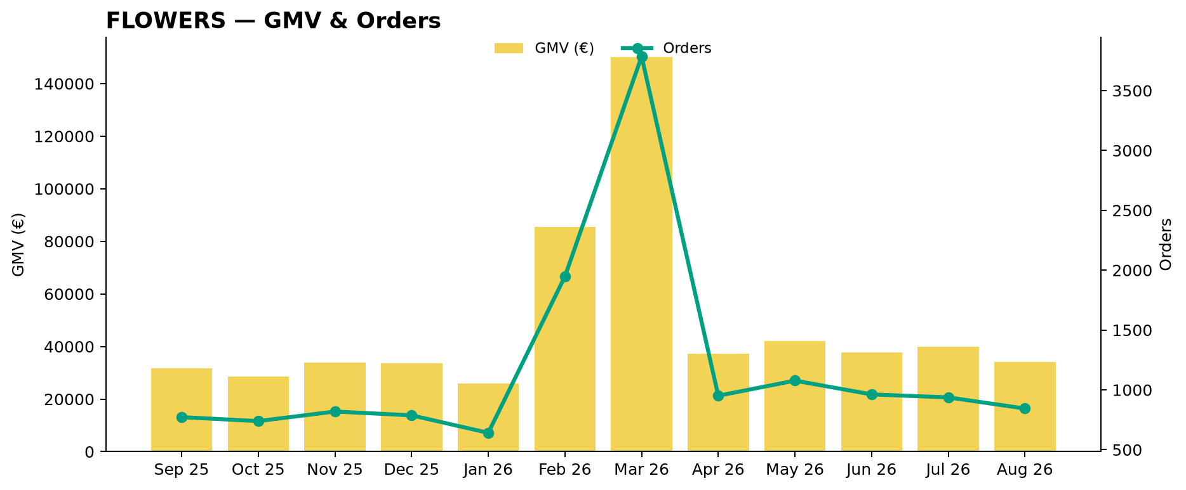
FLOWERS Performance Trend
Last 12 available months
Across the displayed period, FLOWERS GMV changed +7.5%, while orders changed +9.3%.
Notes:
[Sources]
User-supplied partner_data.xlsx and subbusiness_unit_data.xlsx; periods and input hashes in accompanying audit export. Brand assets supplied with Dev5.
[/Sources]
Official reported CVR; partner/SBU aggregate weighted by sessions

Slide 4
Partner vs FLOWERS
Comparable period: August 2026
KPI
Partner
FLOWERS
Gap
AOV
€10.00
€40.44
75.3% worse than FLOWERS
CVR
20.0%
3.9%
16.1 pp better than FLOWERS
Uptime
10.0%
62.0%
52.0 pp worse than FLOWERS
PNA
8.0%
7.8%
0.2 pp worse than FLOWERS
Cancels
2.5%
8.4%
5.9 pp better than FLOWERS
Benchmark comparison uses the latest common period available in both datasets: August 2026.
Notes:
[Sources]
User-supplied partner_data.xlsx and subbusiness_unit_data.xlsx; periods and input hashes in accompanying audit export. Brand assets supplied with Dev5.
[/Sources]
Official reported CVR; partner/SBU aggregate weighted by sessions

Slide 5
Growth vs FLOWERS
MoM growth comparison — August 2026
KPI
Partner
FLOWERS
Growth Gap
GMV Growth
-14.7%
Orders Growth
-9.9%
AOV Growth
-5.3%
Partner MoM: Not comparable — incomplete store coverage
Notes:
[Sources]
User-supplied partner_data.xlsx and subbusiness_unit_data.xlsx; periods and input hashes in accompanying audit export. Brand assets supplied with Dev5.
[/Sources]
Official reported CVR; partner/SBU aggregate weighted by sessions

Slide 6
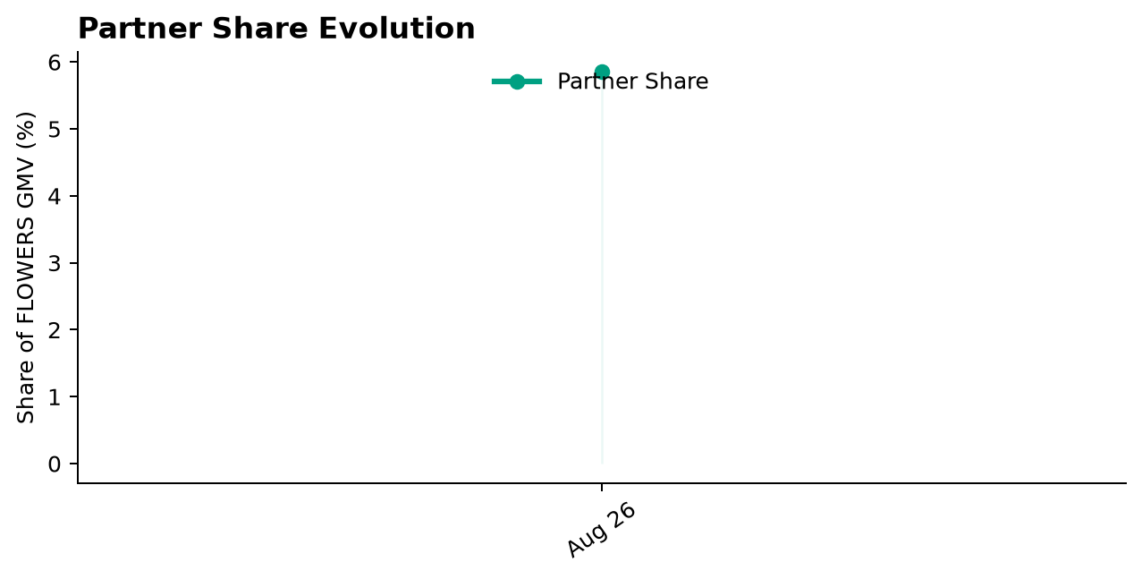
Partner Share of FLOWERS
Partner GMV as a share of FLOWERS GMV — August 2026
Share of FLOWERS GMV
5.9%
Comparison unavailable
Comparison unavailable
Notes:
[Sources]
User-supplied partner_data.xlsx and subbusiness_unit_data.xlsx; periods and input hashes in accompanying audit export. Brand assets supplied with Dev5.
[/Sources]
Official reported CVR; partner/SBU aggregate weighted by sessions

Slide 7
Executive Summary
Latest partner performance — August 2026
GMV
Orders
AOV
Partner CVR
€2,000
200
€10.00
20.0%
Comparison unavailable
Comparison unavailable
Comparison unavailable
Comparison unavailable
75.3% worse than FLOWERS
16.1 pp better than FLOWERS
• Partner CVR is 16.1 pp better than the selected FLOWERS benchmark (August 2026).
Notes:
[Sources]
User-supplied partner_data.xlsx and subbusiness_unit_data.xlsx; periods and input hashes in accompanying audit export. Brand assets supplied with Dev5.
[/Sources]
Official reported CVR; partner/SBU aggregate weighted by sessions

Slide 8
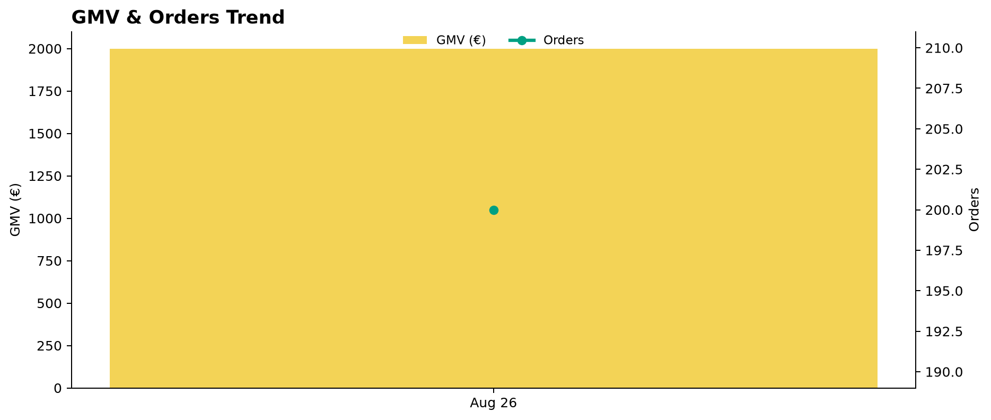
Partner Performance Evolution
Monthly GMV and delivered orders
Notes:
[Sources]
User-supplied partner_data.xlsx and subbusiness_unit_data.xlsx; periods and input hashes in accompanying audit export. Brand assets supplied with Dev5.
[/Sources]
Official reported CVR; partner/SBU aggregate weighted by sessions

Slide 9
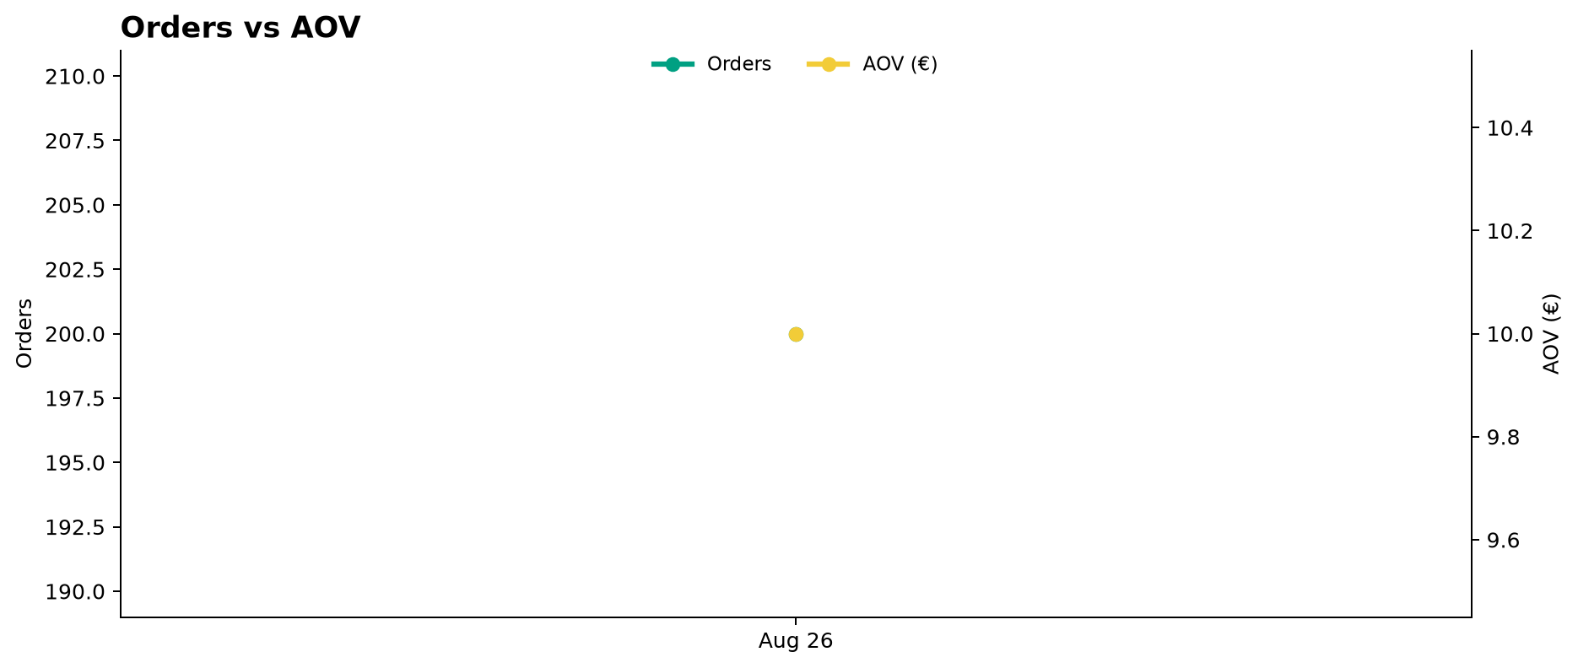
Growth Drivers
Order volume and average basket evolution
Notes:
[Sources]
User-supplied partner_data.xlsx and subbusiness_unit_data.xlsx; periods and input hashes in accompanying audit export. Brand assets supplied with Dev5.
[/Sources]
Official reported CVR; partner/SBU aggregate weighted by sessions

Slide 10
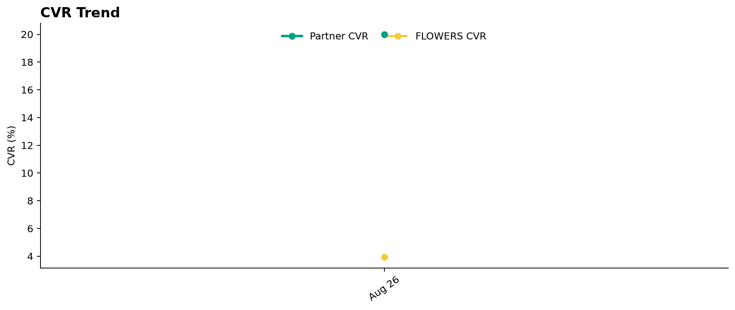
Conversion Performance
Partner CVR vs FLOWERS
Notes:
[Sources]
User-supplied partner_data.xlsx and subbusiness_unit_data.xlsx; periods and input hashes in accompanying audit export. Brand assets supplied with Dev5.
[/Sources]
Official reported CVR; partner/SBU aggregate weighted by sessions

Slide 11
Operational Health
Latest partner performance — Uptime vs 95% target; PNA/Cancels vs FLOWERS (August 2026)
Operating Store Uptime
Partner PNA
Partner Cancels
10.0%
8.0%
2.5%
Comparison unavailable
Comparison unavailable
Comparison unavailable
85.0 pp worse than 95% target
0.2 pp worse than FLOWERS
5.9 pp better than FLOWERS
Interpretation
Uptime is evaluated against a 95% operating target. Observed Uptime is treated as opening-hours configuration hygiene and does not increase business priority. Lower is better for PNA and Cancels. Uptime coverage: 1/1 operating store. Missing current store records: 0.
Notes:
[Sources]
User-supplied partner_data.xlsx and subbusiness_unit_data.xlsx; periods and input hashes in accompanying audit export. Brand assets supplied with Dev5.
[/Sources]
Official reported CVR; partner/SBU aggregate weighted by sessions

Slide 12
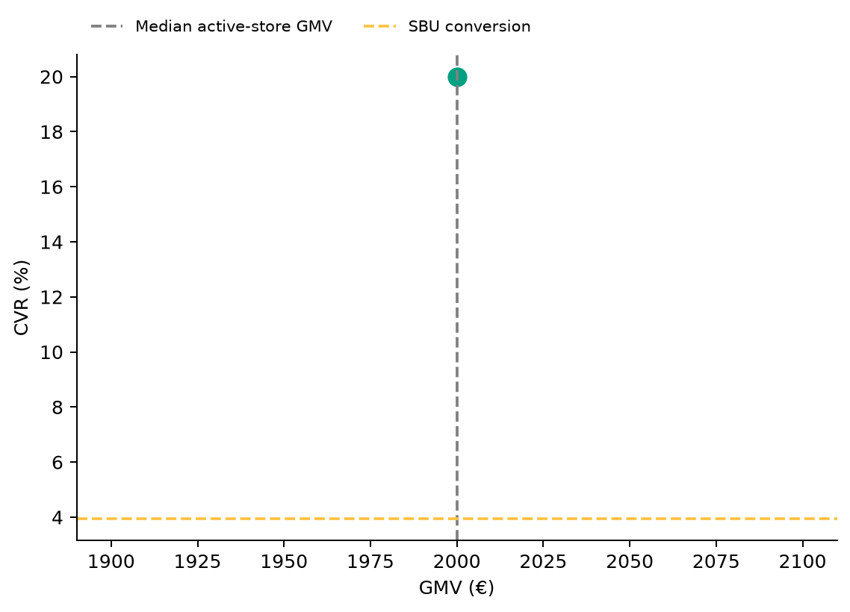
Store Performance Matrix
2026-08 · Commercial position is separate from operational status
Store legend
A
1 store plotted · 0 stores reviewed separately.
Positioning uses GMV and conversion; opportunity ranking uses the assessed KPI gaps and exposure.
Notes:
[Sources]
User-supplied partner_data.xlsx and subbusiness_unit_data.xlsx; periods and input hashes in accompanying audit export. Brand assets supplied with Dev5.
[/Sources]
Official reported CVR; partner/SBU aggregate weighted by sessions

Slide 13

Top GMV Stores
2026-08
Store
GMV
Commercial status
Operational status
Top Stores
1
A
€2,000
Top Performer
Watch
100.0%
Top 1 store generated 100.0% of total partner GMV in August 2026.
Reported partner GMV: €2,000
Notes:
[Sources]
User-supplied partner_data.xlsx and subbusiness_unit_data.xlsx; periods and input hashes in accompanying audit export. Brand assets supplied with Dev5.
[/Sources]
Official reported CVR; partner/SBU aggregate weighted by sessions

Slide 14



How We Prioritize Opportunities
2026-08 · Higher Priority = stronger case for action
SEVERITY — 0–100
IMPACT — 0–100
PRIORITY — 0–100
How large is the KPI problem?
How much business exposure
sits behind the problem?
Where should we act first?
Compared with the relevant SBU benchmark or operating target.
Evidence volume and confidence are considered. Larger reliable negative gaps create higher Severity.
Dominant-KPI protection keeps a major problem from being hidden by healthy KPIs.
Order-related exposure behind the KPI gap. Higher-volume problems generally create higher Impact.
Not euros. Not guaranteed recovered orders. Not a financial forecast.
Metric Priority =
KPI Severity × KPI Impact / 100
Store Priority combines eligible KPI-level priorities, with dominant-KPI protection so one major issue cannot be diluted.
PRIMARY ACTION KPI
BASE ACTION RULE · Priority ≥ 5.0
The KPI with the strongest paired business case for action at that store.
The 5.0 threshold remains provisional. V2.1 overrides can classify lower-score stores ACTION.
Priority ranks stores. Separate V2.1 triage assigns ACTION / MONITOR / HEALTHY / UNCLASSIFIED (six ACTION stores shown by default).
Missing evidence → incomplete assessment, not zero. Critical observations are reviewed separately from business Priority.
Uptime: 95% target; restoration exposure uses healthy history where available. FLOWERS: hygiene only; excluded from business Priority.
Exposure components may overlap; headline exposure uses the largest. An opportunity signal, not a recovery promise.
Benchmark: 2026-08. SBU peer composition is not available.

Slide 15
Priority Opportunities & Actions
2026-08 · V2.1 business triage · Priority ranking remains unchanged
Next review
No stores classified ACTION
under the current V2.1 rules.
1
Confirm priority stores
2
Assign owner / deadline
3
Track progress next review
MONITOR, HEALTHY and UNCLASSIFIED remain separate.
Review operational/data observations and Appendix context.

Slide 16
Action Plan
Agree owners and dates for the selected V2.1 ACTION stores
Store / Primary KPI
Recommended action
Owner / deadline
No items in this list. See the separate review and diagnostic sections.

Slide 17
Operational & Data Review
Critical observations and hygiene remain visible independently of business Priority
Store / type
Evidence
Review action
A / Opening-hours hygiene
Observed uptime 10.0%; verify configured opening hours
Verify and correct configured store opening hours
Notes:
[Sources]
User-supplied partner_data.xlsx and subbusiness_unit_data.xlsx; periods and input hashes in accompanying audit export. Brand assets supplied with Dev5.
[/Sources]
Official reported CVR; partner/SBU aggregate weighted by sessions

Slide 18
Discussion
Confirm actions, responsibilities and the next review date
Which interventions should we start first?
Notes:
[Sources]
User-supplied partner_data.xlsx and subbusiness_unit_data.xlsx; periods and input hashes in accompanying audit export. Brand assets supplied with Dev5.
[/Sources]
Official reported CVR; partner/SBU aggregate weighted by sessions

Slide 19
Thank You
Partner Business Review · V9_Beta2
Let’s turn the agreed actions into measurable progress.
Notes:
[Sources]
User-supplied partner_data.xlsx and subbusiness_unit_data.xlsx; periods and input hashes in accompanying audit export. Brand assets supplied with Dev5.
[/Sources]
Official reported CVR; partner/SBU aggregate weighted by sessions

Slide 20
APPENDIX — Store Diagnostics
2026-08 · 1 store · Reference section
Store-level context
Lifecycle, KPI evidence and recommendations for each store.
Notes:
[Sources]
User-supplied partner_data.xlsx and subbusiness_unit_data.xlsx; periods and input hashes in accompanying audit export. Brand assets supplied with Dev5.
[/Sources]
Official reported CVR; partner/SBU aggregate weighted by sessions

Slide 21
Store Diagnostics
A
August 2026
GMV
DELIVERED
SESSIONS
ATTEMPTS
ACTIVE
DATA OK
COMPLETE
€2,000
200
1,000
400
Business: HEALTHY
CVR
PNA
Cancels
Uptime
20.0%
8.0%
2.5%
10.0%
SBU 3.9%
SBU 7.8%
SBU 8.4%
Target 95.0%
Above SBU · +16.1 pp
Above SBU · +0.2 pp
Below SBU · -5.9 pp
Below Target · -85.0 pp
Hygiene only — excluded from business Priority
Severity
Impact
Priority
Primary Action KPI
PNA
0.68
2.54
0.02
Worst KPI / Severity Driver
PNA
PRIORITY < 5.0
Largest Exposure KPI
PNA
Confidence / evidence
Main KPI trend
CVR 87% · n=1,000
Trend unavailable
PNA 93% · n=400
Cancels 98% · n=400
Critical Review — raw observations; separate from business materiality
Uptime 10.0% · uptime observation (hygiene only)
Likely operational driver: Product availability; verify the sample before causal attribution
Review affected products, stock accuracy and availability synchronization; validate the cause of PNA
Intended effect: Reduce PNA-affected demand
Notes:
[Sources]
User-supplied partner_data.xlsx and subbusiness_unit_data.xlsx; periods and input hashes in accompanying audit export. Brand assets supplied with Dev5.
[/Sources]
Official reported CVR; partner/SBU aggregate weighted by sessions
V2.1 business triage:
{"Business Classification": "HEALTHY", "Action Reason": "", "Supporting Rule Matches": [], "Primary Action KPI": "PNA", "Likely Operational Driver": "Product availability; verify the sample before causal attribution", "Operational/Data State": ["COMPLETE", "HYGIENE_REVIEW"]}

