Slide 1

Partner Business Review
September 2025 – August 2026
Sub-Business Unit: JEWELRY
V9_Beta2
Notes:
[Sources]
User-supplied partner_data.xlsx and subbusiness_unit_data.xlsx; periods and input hashes in accompanying audit export. Brand assets supplied with Dev5.
[/Sources]
Official reported CVR; partner/SBU aggregate weighted by sessions

Slide 2
JEWELRY Business Development
Latest SBU performance — August 2026
SBU GMV
SBU Orders
SBU AOV
SBU CVR
€3,816
79
€48.31
2.2%
▼ 19.7% vs prev. month
▼ 26.9% vs prev. month
▲ 9.8% vs prev. month
▼ 0.6 pp vs prev. month
Comparison unavailable
Comparison unavailable
Comparison unavailable
Growth Composition
Key Takeaways
GMV
-19.7%
• GMV decreased 19.7% vs previous month.
Orders
-26.9%
• Higher basket size partly offset lower order volume.
AOV
+9.8%
• CVR declined by 0.6 pp to 2.2%.
Notes:
[Sources]
User-supplied partner_data.xlsx and subbusiness_unit_data.xlsx; periods and input hashes in accompanying audit export. Brand assets supplied with Dev5.
[/Sources]
Official reported CVR; partner/SBU aggregate weighted by sessions

Slide 3

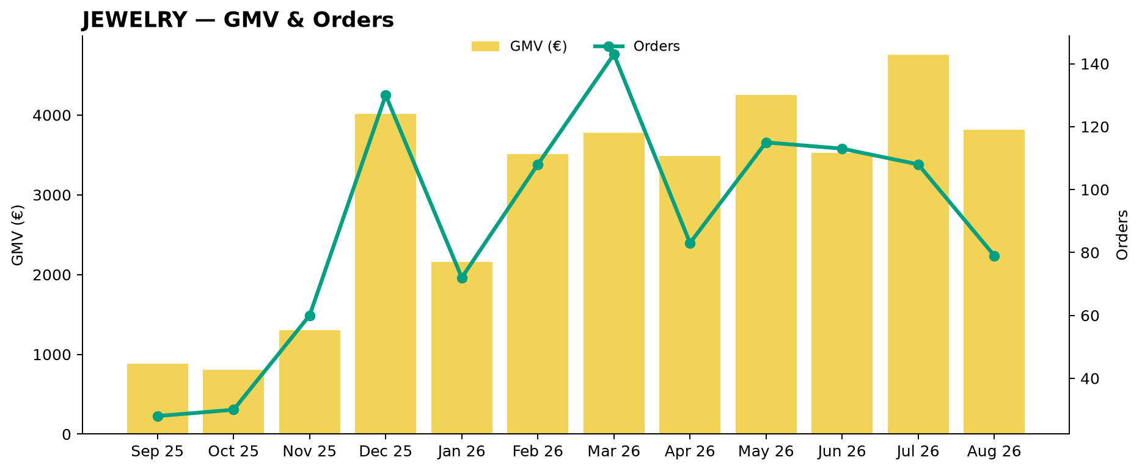
JEWELRY Performance Trend
Last 12 available months
Across the displayed period, JEWELRY GMV changed +332.0%, while orders changed +182.1%.
Notes:
[Sources]
User-supplied partner_data.xlsx and subbusiness_unit_data.xlsx; periods and input hashes in accompanying audit export. Brand assets supplied with Dev5.
[/Sources]
Official reported CVR; partner/SBU aggregate weighted by sessions

Slide 4
Partner vs JEWELRY
Comparable period: August 2026
KPI
Partner
JEWELRY
Gap
AOV
€44.10
€48.31
8.7% worse than JEWELRY
CVR
4.2%
2.2%
2.0 pp better than JEWELRY
Uptime
98.9%
59.8%
39.1 pp better than JEWELRY
PNA
0.0%
12.1%
12.1 pp better than JEWELRY
Cancels
0.0%
11.0%
11.0 pp better than JEWELRY
Benchmark comparison uses the latest common period available in both datasets: August 2026.
Notes:
[Sources]
User-supplied partner_data.xlsx and subbusiness_unit_data.xlsx; periods and input hashes in accompanying audit export. Brand assets supplied with Dev5.
[/Sources]
Official reported CVR; partner/SBU aggregate weighted by sessions

Slide 5
Growth vs JEWELRY
MoM growth comparison — August 2026
KPI
Partner
JEWELRY
Growth Gap
GMV Growth
+759.7%
-19.7%
+779.4 pp
Orders Growth
+400.0%
-26.9%
+426.9 pp
AOV Growth
+71.9%
+9.8%
+62.1 pp
Notes:
[Sources]
User-supplied partner_data.xlsx and subbusiness_unit_data.xlsx; periods and input hashes in accompanying audit export. Brand assets supplied with Dev5.
[/Sources]
Official reported CVR; partner/SBU aggregate weighted by sessions

Slide 6

Partner Share of JEWELRY
Partner GMV as a share of JEWELRY GMV — August 2026
Share of JEWELRY GMV
5.8%
▲ 5.2 pp vs prev. month
Comparison unavailable
Partner gained 5.24 pp of JEWELRY GMV share vs previous month.
Notes:
[Sources]
User-supplied partner_data.xlsx and subbusiness_unit_data.xlsx; periods and input hashes in accompanying audit export. Brand assets supplied with Dev5.
[/Sources]
Official reported CVR; partner/SBU aggregate weighted by sessions

Slide 7
Executive Summary
Latest partner performance — August 2026
GMV
Orders
AOV
Partner CVR
€220
5
€44.10
4.2%
▲ 759.7% vs prev. month
▲ 400.0% vs prev. month
▲ 71.9% vs prev. month
▲ 3.4 pp vs prev. month
8.7% worse than JEWELRY
2.0 pp better than JEWELRY
• GMV changed +759.7% vs previous month.
• Order volume moved more sharply than basket size during the month.
• Partner CVR is 2.0 pp better than the selected JEWELRY benchmark (August 2026).
Notes:
[Sources]
User-supplied partner_data.xlsx and subbusiness_unit_data.xlsx; periods and input hashes in accompanying audit export. Brand assets supplied with Dev5.
[/Sources]
Official reported CVR; partner/SBU aggregate weighted by sessions

Slide 8
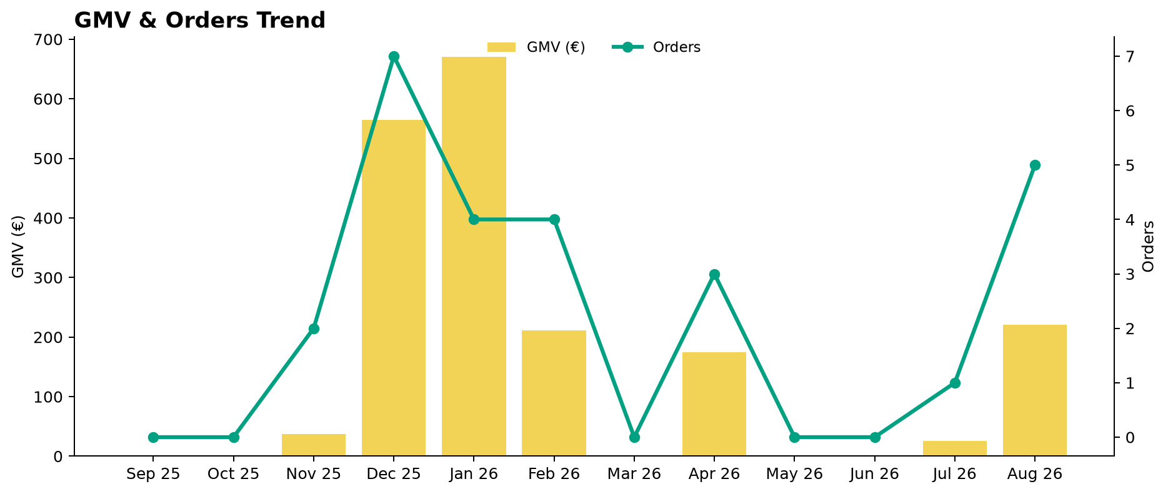
Partner Performance Evolution
Monthly GMV and delivered orders
Notes:
[Sources]
User-supplied partner_data.xlsx and subbusiness_unit_data.xlsx; periods and input hashes in accompanying audit export. Brand assets supplied with Dev5.
[/Sources]
Official reported CVR; partner/SBU aggregate weighted by sessions

Slide 9
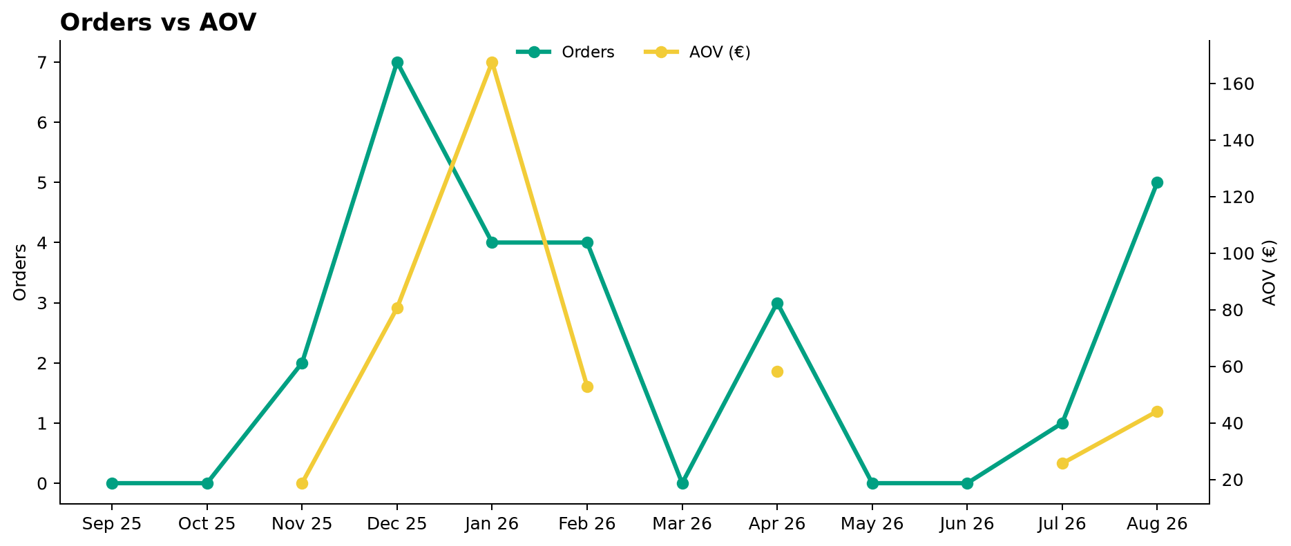
Growth Drivers
Order volume and average basket evolution
Notes:
[Sources]
User-supplied partner_data.xlsx and subbusiness_unit_data.xlsx; periods and input hashes in accompanying audit export. Brand assets supplied with Dev5.
[/Sources]
Official reported CVR; partner/SBU aggregate weighted by sessions

Slide 10
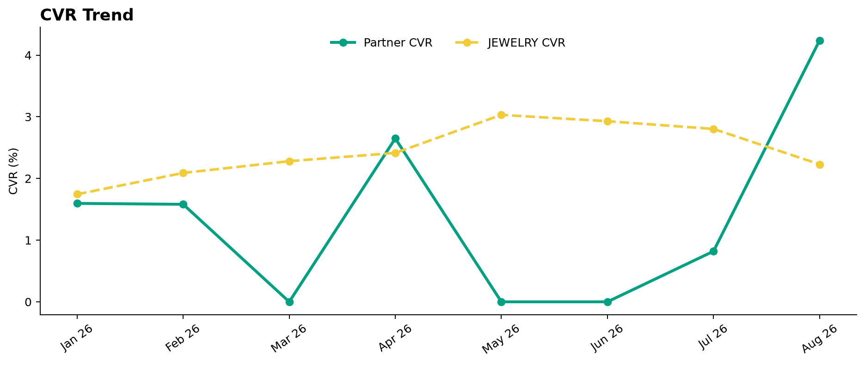
Conversion Performance
Partner CVR vs JEWELRY
Notes:
[Sources]
User-supplied partner_data.xlsx and subbusiness_unit_data.xlsx; periods and input hashes in accompanying audit export. Brand assets supplied with Dev5.
[/Sources]
Official reported CVR; partner/SBU aggregate weighted by sessions

Slide 11
Operational Health
Latest partner performance — Uptime vs 95% target; PNA/Cancels vs JEWELRY (August 2026)
Operating Store Uptime
Partner PNA
Partner Cancels
98.9%
0.0%
0.0%
▲ 1.0 pp vs prev. month
No change vs prev. month
No change vs prev. month
3.9 pp better than 95% target
12.1 pp better than JEWELRY
11.0 pp better than JEWELRY
Interpretation
Uptime is evaluated against a 95% operating target. Lower is better for PNA and Cancels. Green indicates improvement; red indicates deterioration. Uptime coverage: 1/1 operating store. Missing current store records: 0.
Notes:
[Sources]
User-supplied partner_data.xlsx and subbusiness_unit_data.xlsx; periods and input hashes in accompanying audit export. Brand assets supplied with Dev5.
[/Sources]
Official reported CVR; partner/SBU aggregate weighted by sessions

Slide 12
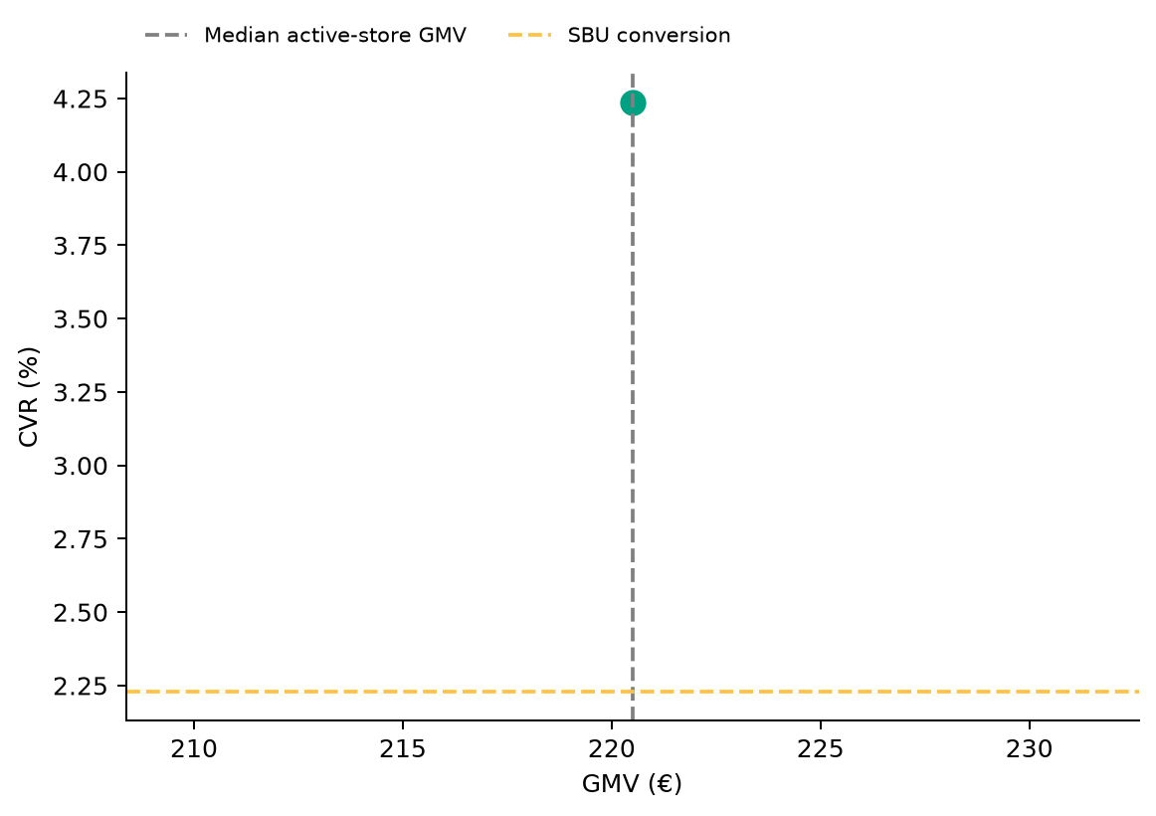
Store Performance Matrix
2026-08 · Commercial position is separate from operational status
Store legend
70 Vazha Pshavela Ave, Tbilisi 0186 0101 Tbilisi T'bilisi Georgia
1 store plotted · 0 stores reviewed separately.
Positioning uses GMV and conversion; opportunity ranking uses the assessed KPI gaps and exposure.
Notes:
[Sources]
User-supplied partner_data.xlsx and subbusiness_unit_data.xlsx; periods and input hashes in accompanying audit export. Brand assets supplied with Dev5.
[/Sources]
Official reported CVR; partner/SBU aggregate weighted by sessions

Slide 13

Top GMV Stores
2026-08
Store
GMV
Commercial status
Operational status
Top Stores
1
70 Vazha Pshavela Ave, Tbilisi 0186 0101 Tbilisi T'bilisi Georgia
€220
Top Performer
Healthy
100.0%
Top 1 store generated 100.0% of total partner GMV in August 2026.
Reported partner GMV: €220
Notes:
[Sources]
User-supplied partner_data.xlsx and subbusiness_unit_data.xlsx; periods and input hashes in accompanying audit export. Brand assets supplied with Dev5.
[/Sources]
Official reported CVR; partner/SBU aggregate weighted by sessions

Slide 14



How We Prioritize Opportunities
2026-08 · Higher Priority = stronger case for action
SEVERITY — 0–100
IMPACT — 0–100
PRIORITY — 0–100
How large is the KPI problem?
How much business exposure
sits behind the problem?
Where should we act first?
Compared with the relevant SBU benchmark or operating target.
Evidence volume and confidence are considered. Larger reliable negative gaps create higher Severity.
Dominant-KPI protection keeps a major problem from being hidden by healthy KPIs.
Order-related exposure behind the KPI gap. Higher-volume problems generally create higher Impact.
Not euros. Not guaranteed recovered orders. Not a financial forecast.
Metric Priority =
KPI Severity × KPI Impact / 100
Store Priority combines eligible KPI-level priorities, with dominant-KPI protection so one major issue cannot be diluted.
PRIMARY ACTION KPI
BASE ACTION RULE · Priority ≥ 5.0
The KPI with the strongest paired business case for action at that store.
The 5.0 threshold remains provisional. V2.1 overrides can classify lower-score stores ACTION.
Priority ranks stores. Separate V2.1 triage assigns ACTION / MONITOR / HEALTHY / UNCLASSIFIED (six ACTION stores shown by default).
Missing evidence → incomplete assessment, not zero. Critical observations are reviewed separately from business Priority.
Uptime: 95% target; restoration exposure uses healthy history where available.
Exposure components may overlap; headline exposure uses the largest. An opportunity signal, not a recovery promise.
Benchmark: 2026-08. SBU peer composition is not available.

Slide 15
Priority Opportunities & Actions
2026-08 · V2.1 business triage · Priority ranking remains unchanged
Next review
No stores classified ACTION
under the current V2.1 rules.
1
Confirm priority stores
2
Assign owner / deadline
3
Track progress next review
MONITOR, HEALTHY and UNCLASSIFIED remain separate.
Review operational/data observations and Appendix context.

Slide 16
Action Plan
Agree owners and dates for the selected V2.1 ACTION stores
Store / Primary KPI
Recommended action
Owner / deadline
No items in this list. See the separate review and diagnostic sections.

Slide 17
Operational & Data Review
Critical observations and hygiene remain visible independently of business Priority
Store / type
Evidence
Review action
No items in this list. See the separate review and diagnostic sections.
Notes:
[Sources]
User-supplied partner_data.xlsx and subbusiness_unit_data.xlsx; periods and input hashes in accompanying audit export. Brand assets supplied with Dev5.
[/Sources]
Official reported CVR; partner/SBU aggregate weighted by sessions

Slide 18
Discussion
Confirm actions, responsibilities and the next review date
Which interventions should we start first?
Notes:
[Sources]
User-supplied partner_data.xlsx and subbusiness_unit_data.xlsx; periods and input hashes in accompanying audit export. Brand assets supplied with Dev5.
[/Sources]
Official reported CVR; partner/SBU aggregate weighted by sessions

Slide 19
Thank You
Partner Business Review · V9_Beta2
Let’s turn the agreed actions into measurable progress.
Notes:
[Sources]
User-supplied partner_data.xlsx and subbusiness_unit_data.xlsx; periods and input hashes in accompanying audit export. Brand assets supplied with Dev5.
[/Sources]
Official reported CVR; partner/SBU aggregate weighted by sessions

Slide 20
APPENDIX — Store Diagnostics
2026-08 · 1 store · Reference section
Store-level context
Lifecycle, KPI evidence and recommendations for each store.
Notes:
[Sources]
User-supplied partner_data.xlsx and subbusiness_unit_data.xlsx; periods and input hashes in accompanying audit export. Brand assets supplied with Dev5.
[/Sources]
Official reported CVR; partner/SBU aggregate weighted by sessions

Slide 21
Store Diagnostics
70 Vazha Pshavela Ave, Tbilisi 0186 0101 Tbilisi T'bilisi Georgia
August 2026
GMV
DELIVERED
SESSIONS
ATTEMPTS
ACTIVE
DATA OK
COMPLETE
€220
5
118
5
Business: HEALTHY
CVR
PNA
Cancels
Uptime
4.2%
0.0%
0.0%
98.9%
SBU 2.2%
SBU 12.1%
SBU 11.0%
Target 95.0%
Above SBU · +2.0 pp
Below SBU · -12.1 pp
Below SBU · -11.0 pp
Above Target · +3.9 pp
Severity
Impact
Priority
Primary Action KPI
None
0.00
0.00
0.00
Worst KPI / Severity Driver
None
PRIORITY < 5.0
Largest Exposure KPI
No assessed exposure
Confidence / evidence
Main KPI trend
CVR 44% · n=118
Trend unavailable
PNA 14% · n=5
Cancels 33% · n=5
Assessment evidence
Current sessions or order activity · Critical observations: None
Likely operational driver: No supported primary issue
Continue routine monitoring of performance and evidence
Notes:
[Sources]
User-supplied partner_data.xlsx and subbusiness_unit_data.xlsx; periods and input hashes in accompanying audit export. Brand assets supplied with Dev5.
[/Sources]
Official reported CVR; partner/SBU aggregate weighted by sessions
V2.1 business triage:
{"Business Classification": "HEALTHY", "Action Reason": "", "Supporting Rule Matches": [], "Primary Action KPI": "None", "Likely Operational Driver": "No supported primary issue", "Operational/Data State": ["COMPLETE"]}

