Slide 1

Partner Business Review
August 2026 – August 2026
Sub-Business Unit: SUPERMARKET
V9_Beta2
Notes:
[Sources]
User-supplied partner_data.xlsx and subbusiness_unit_data.xlsx; periods and input hashes in accompanying audit export. Brand assets supplied with Dev5.
[/Sources]
Official reported CVR; partner/SBU aggregate weighted by sessions

Slide 2
SUPERMARKET Business Development
Latest SBU performance — August 2026
SBU GMV
SBU Orders
SBU AOV
SBU CVR
€2,890,695
127,067
€22.75
23.9%
▼ 4.3% vs prev. month
▼ 3.3% vs prev. month
▼ 1.1% vs prev. month
▼ 1.2 pp vs prev. month
Comparison unavailable
Comparison unavailable
Comparison unavailable
Growth Composition
Key Takeaways
GMV
-4.3%
• GMV decreased 4.3% vs previous month.
Orders
-3.3%
• Both order volume and basket size declined vs previous month.
AOV
-1.1%
• CVR declined by 1.2 pp to 23.9%.
Notes:
[Sources]
User-supplied partner_data.xlsx and subbusiness_unit_data.xlsx; periods and input hashes in accompanying audit export. Brand assets supplied with Dev5.
[/Sources]
Official reported CVR; partner/SBU aggregate weighted by sessions

Slide 3
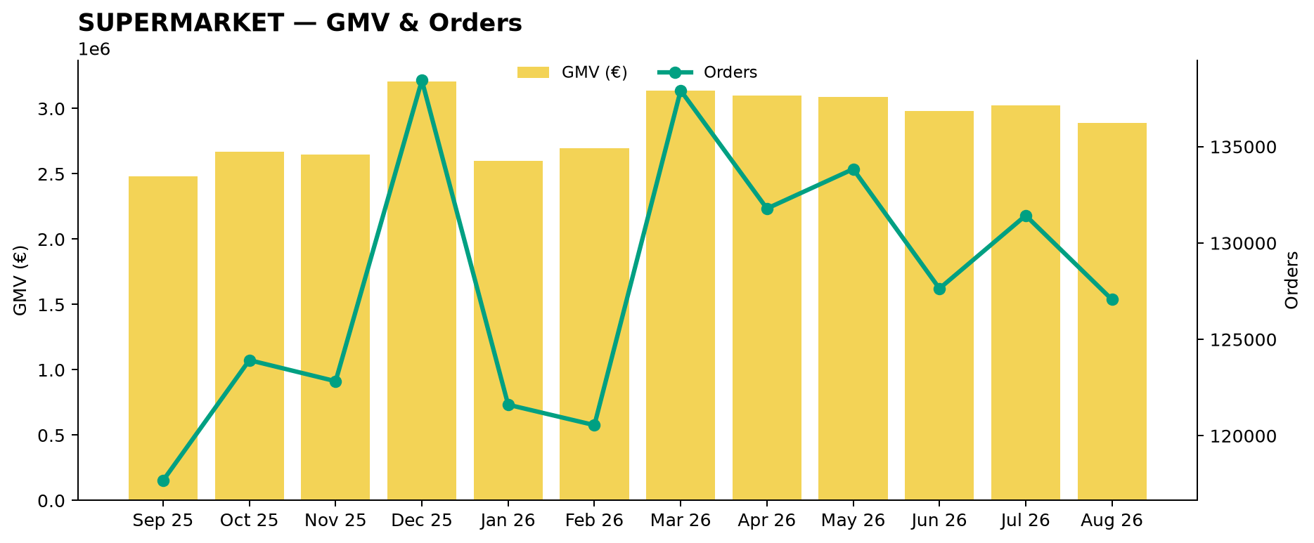
SUPERMARKET Performance Trend
Last 12 available months
Across the displayed period, SUPERMARKET GMV changed +16.5%, while orders changed +8.0%.
Notes:
[Sources]
User-supplied partner_data.xlsx and subbusiness_unit_data.xlsx; periods and input hashes in accompanying audit export. Brand assets supplied with Dev5.
[/Sources]
Official reported CVR; partner/SBU aggregate weighted by sessions

Slide 4
Partner vs SUPERMARKET
Comparable period: August 2026
KPI
Partner
SUPERMARKET
Gap
AOV
€10.00
€22.75
56.0% worse than SUPERMARKET
CVR
20.0%
23.9%
3.9 pp worse than SUPERMARKET
Uptime
95.0%
83.3%
11.7 pp better than SUPERMARKET
PNA
8.0%
25.9%
17.9 pp better than SUPERMARKET
Cancels
2.5%
2.4%
0.1 pp worse than SUPERMARKET
Benchmark comparison uses the latest common period available in both datasets: August 2026.
Notes:
[Sources]
User-supplied partner_data.xlsx and subbusiness_unit_data.xlsx; periods and input hashes in accompanying audit export. Brand assets supplied with Dev5.
[/Sources]
Official reported CVR; partner/SBU aggregate weighted by sessions

Slide 5
Growth vs SUPERMARKET
MoM growth comparison — August 2026
KPI
Partner
SUPERMARKET
Growth Gap
GMV Growth
-4.3%
Orders Growth
-3.3%
AOV Growth
-1.1%
Partner MoM: Not comparable — incomplete store coverage
Notes:
[Sources]
User-supplied partner_data.xlsx and subbusiness_unit_data.xlsx; periods and input hashes in accompanying audit export. Brand assets supplied with Dev5.
[/Sources]
Official reported CVR; partner/SBU aggregate weighted by sessions

Slide 6
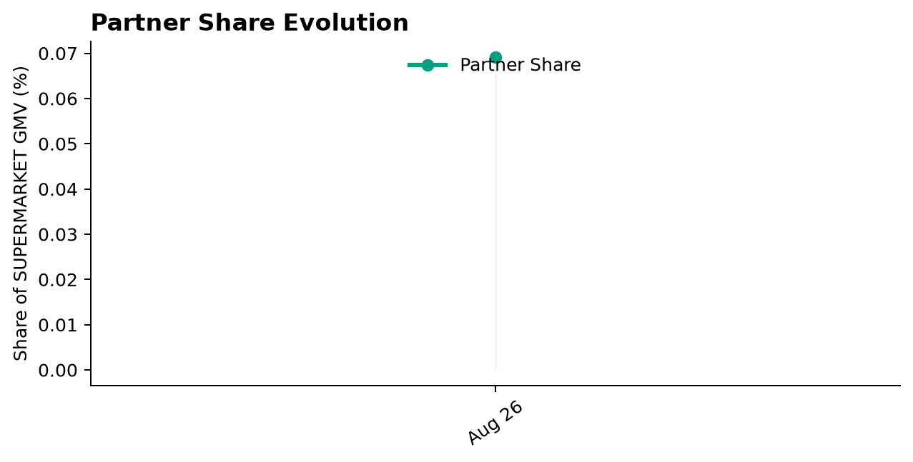
Partner Share of SUPERMARKET
Partner GMV as a share of SUPERMARKET GMV — August 2026
Share of SUPERMARKET GMV
0.1%
Comparison unavailable
Comparison unavailable
Notes:
[Sources]
User-supplied partner_data.xlsx and subbusiness_unit_data.xlsx; periods and input hashes in accompanying audit export. Brand assets supplied with Dev5.
[/Sources]
Official reported CVR; partner/SBU aggregate weighted by sessions

Slide 7
Executive Summary
Latest partner performance — August 2026
GMV
Orders
AOV
Partner CVR
€2,000
200
€10.00
20.0%
Comparison unavailable
Comparison unavailable
Comparison unavailable
Comparison unavailable
56.0% worse than SUPERMARKET
3.9 pp worse than SUPERMARKET
• Partner CVR is 3.9 pp worse than the selected SUPERMARKET benchmark (August 2026).
Notes:
[Sources]
User-supplied partner_data.xlsx and subbusiness_unit_data.xlsx; periods and input hashes in accompanying audit export. Brand assets supplied with Dev5.
[/Sources]
Official reported CVR; partner/SBU aggregate weighted by sessions

Slide 8
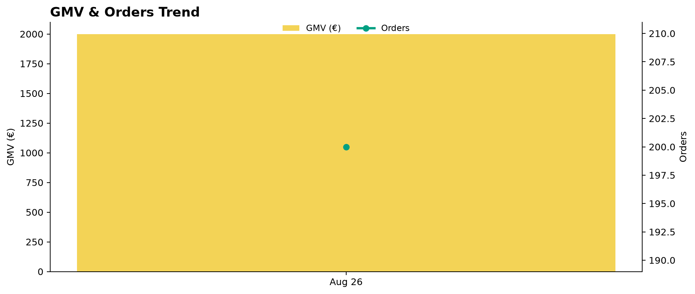
Partner Performance Evolution
Monthly GMV and delivered orders
Notes:
[Sources]
User-supplied partner_data.xlsx and subbusiness_unit_data.xlsx; periods and input hashes in accompanying audit export. Brand assets supplied with Dev5.
[/Sources]
Official reported CVR; partner/SBU aggregate weighted by sessions

Slide 9
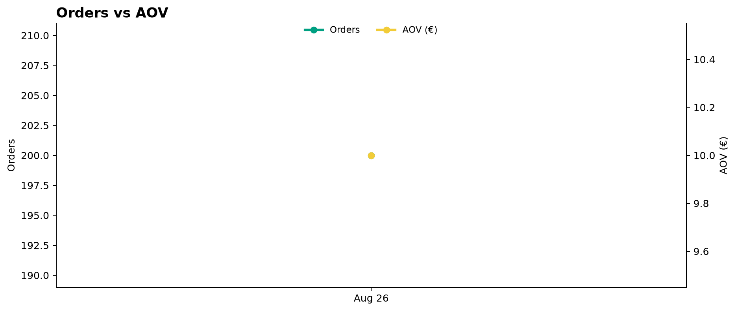
Growth Drivers
Order volume and average basket evolution
Notes:
[Sources]
User-supplied partner_data.xlsx and subbusiness_unit_data.xlsx; periods and input hashes in accompanying audit export. Brand assets supplied with Dev5.
[/Sources]
Official reported CVR; partner/SBU aggregate weighted by sessions

Slide 10
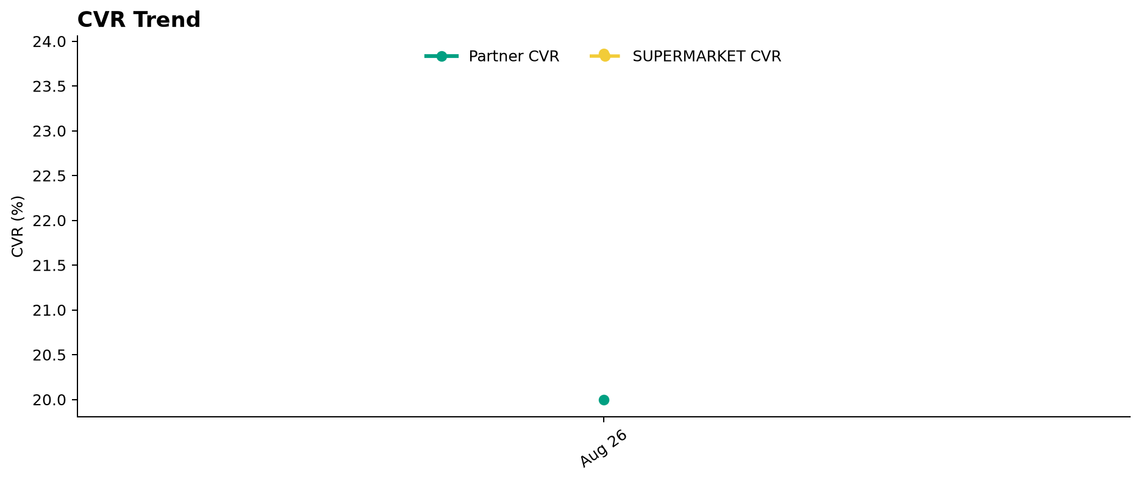
Conversion Performance
Partner CVR vs SUPERMARKET
Notes:
[Sources]
User-supplied partner_data.xlsx and subbusiness_unit_data.xlsx; periods and input hashes in accompanying audit export. Brand assets supplied with Dev5.
[/Sources]
Official reported CVR; partner/SBU aggregate weighted by sessions

Slide 11
Operational Health
Latest partner performance — Uptime vs 95% target; PNA/Cancels vs SUPERMARKET (August 2026)
Operating Store Uptime
Partner PNA
Partner Cancels
95.0%
8.0%
2.5%
Comparison unavailable
Comparison unavailable
Comparison unavailable
In line with 95% target
17.9 pp better than SUPERMARKET
0.1 pp worse than SUPERMARKET
Interpretation
Uptime is evaluated against a 95% operating target. Lower is better for PNA and Cancels. Green indicates improvement; red indicates deterioration. Uptime coverage: 1/1 operating store. Missing current store records: 0.
Notes:
[Sources]
User-supplied partner_data.xlsx and subbusiness_unit_data.xlsx; periods and input hashes in accompanying audit export. Brand assets supplied with Dev5.
[/Sources]
Official reported CVR; partner/SBU aggregate weighted by sessions

Slide 12
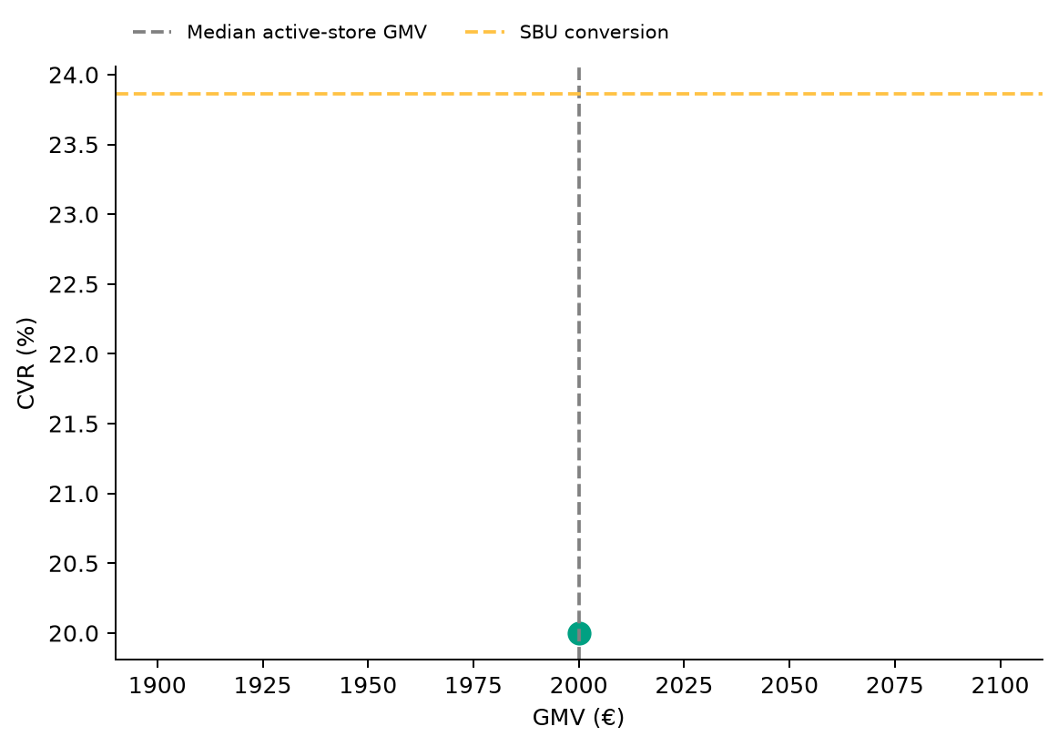
Store Performance Matrix
2026-08 · Commercial position is separate from operational status
Store legend
A
1 store plotted · 0 stores reviewed separately.
Positioning uses GMV and conversion; opportunity ranking uses the assessed KPI gaps and exposure.
Notes:
[Sources]
User-supplied partner_data.xlsx and subbusiness_unit_data.xlsx; periods and input hashes in accompanying audit export. Brand assets supplied with Dev5.
[/Sources]
Official reported CVR; partner/SBU aggregate weighted by sessions

Slide 13

Top GMV Stores
2026-08
Store
GMV
Commercial status
Operational status
Top Stores
1
A
€2,000
Conversion Opportunity
Watch
100.0%
Top 1 store generated 100.0% of total partner GMV in August 2026.
Reported partner GMV: €2,000
Notes:
[Sources]
User-supplied partner_data.xlsx and subbusiness_unit_data.xlsx; periods and input hashes in accompanying audit export. Brand assets supplied with Dev5.
[/Sources]
Official reported CVR; partner/SBU aggregate weighted by sessions

Slide 14



How We Prioritize Opportunities
2026-08 · Higher Priority = stronger case for action
SEVERITY — 0–100
IMPACT — 0–100
PRIORITY — 0–100
How large is the KPI problem?
How much business exposure
sits behind the problem?
Where should we act first?
Compared with the relevant SBU benchmark or operating target.
Evidence volume and confidence are considered. Larger reliable negative gaps create higher Severity.
Dominant-KPI protection keeps a major problem from being hidden by healthy KPIs.
Order-related exposure behind the KPI gap. Higher-volume problems generally create higher Impact.
Not euros. Not guaranteed recovered orders. Not a financial forecast.
Metric Priority =
KPI Severity × KPI Impact / 100
Store Priority combines eligible KPI-level priorities, with dominant-KPI protection so one major issue cannot be diluted.
PRIMARY ACTION KPI
BASE ACTION RULE · Priority ≥ 5.0
The KPI with the strongest paired business case for action at that store.
The 5.0 threshold remains provisional. V2.1 overrides can classify lower-score stores ACTION.
Priority ranks stores. Separate V2.1 triage assigns ACTION / MONITOR / HEALTHY / UNCLASSIFIED (six ACTION stores shown by default).
Missing evidence → incomplete assessment, not zero. Critical observations are reviewed separately from business Priority.
Uptime: 95% target; restoration exposure uses healthy history where available.
Exposure components may overlap; headline exposure uses the largest. An opportunity signal, not a recovery promise.
Benchmark: 2026-08. SBU peer composition is not available.

Slide 15
Priority Opportunities & Actions
2026-08 · V2.1 business triage · Priority ranking remains unchanged
Next review
No stores classified ACTION
under the current V2.1 rules.
1
Confirm priority stores
2
Assign owner / deadline
3
Track progress next review
MONITOR, HEALTHY and UNCLASSIFIED remain separate.
Review operational/data observations and Appendix context.

Slide 16
Action Plan
Agree owners and dates for the selected V2.1 ACTION stores
Store / Primary KPI
Recommended action
Owner / deadline
No items in this list. See the separate review and diagnostic sections.

Slide 17
Operational & Data Review
Critical observations and hygiene remain visible independently of business Priority
Store / type
Evidence
Review action
No items in this list. See the separate review and diagnostic sections.
Notes:
[Sources]
User-supplied partner_data.xlsx and subbusiness_unit_data.xlsx; periods and input hashes in accompanying audit export. Brand assets supplied with Dev5.
[/Sources]
Official reported CVR; partner/SBU aggregate weighted by sessions

Slide 18
Discussion
Confirm actions, responsibilities and the next review date
Which interventions should we start first?
Notes:
[Sources]
User-supplied partner_data.xlsx and subbusiness_unit_data.xlsx; periods and input hashes in accompanying audit export. Brand assets supplied with Dev5.
[/Sources]
Official reported CVR; partner/SBU aggregate weighted by sessions

Slide 19
Thank You
Partner Business Review · V9_Beta2
Let’s turn the agreed actions into measurable progress.
Notes:
[Sources]
User-supplied partner_data.xlsx and subbusiness_unit_data.xlsx; periods and input hashes in accompanying audit export. Brand assets supplied with Dev5.
[/Sources]
Official reported CVR; partner/SBU aggregate weighted by sessions

Slide 20
APPENDIX — Store Diagnostics
2026-08 · 1 store · Reference section
Store-level context
Lifecycle, KPI evidence and recommendations for each store.
Notes:
[Sources]
User-supplied partner_data.xlsx and subbusiness_unit_data.xlsx; periods and input hashes in accompanying audit export. Brand assets supplied with Dev5.
[/Sources]
Official reported CVR; partner/SBU aggregate weighted by sessions

Slide 21
Store Diagnostics
A
August 2026
GMV
DELIVERED
SESSIONS
ATTEMPTS
ACTIVE
DATA OK
COMPLETE
€2,000
200
1,000
400
Business: MONITOR
CVR
PNA
Cancels
Uptime
20.0%
8.0%
2.5%
95.0%
SBU 23.9%
SBU 25.9%
SBU 2.4%
Target 95.0%
Below SBU · -3.9 pp
Below SBU · -17.9 pp
Above SBU · +0.1 pp
At Target · +0.0 pp
Severity
Impact
Priority
Primary Action KPI
CVR
8.67
45.16
3.92
Worst KPI / Severity Driver
CVR
PRIORITY < 5.0
Largest Exposure KPI
CVR
Confidence / evidence
Main KPI trend
CVR 87% · n=1,000
Trend unavailable
PNA 93% · n=400
Cancels 98% · n=400
Assessment evidence
Current sessions or order activity · Critical observations: None
Likely operational driver: Assortment / pricing / content / discoverability / funnel quality: investigate
Review assortment, pricing, content and discoverability, then investigate the conversion journey
Intended effect: Improve conversion against the SBU benchmark
Notes:
[Sources]
User-supplied partner_data.xlsx and subbusiness_unit_data.xlsx; periods and input hashes in accompanying audit export. Brand assets supplied with Dev5.
[/Sources]
Official reported CVR; partner/SBU aggregate weighted by sessions
V2.1 business triage:
{"Business Classification": "MONITOR", "Action Reason": "", "Supporting Rule Matches": [], "Primary Action KPI": "CVR", "Likely Operational Driver": "Assortment / pricing / content / discoverability / funnel quality: investigate", "Operational/Data State": ["COMPLETE"]}

