Slide 1

PetFood Business Review
August 2026
Sub-Business Unit: PETS
Notes:
[Sources]
User-supplied partner_data.xlsx and subbusiness_unit_data.xlsx; periods and input hashes in accompanying audit export. Brand assets supplied with Dev5.
[/Sources]
Official reported CVR; partner/SBU aggregate weighted by sessions

Slide 2
PETS Business Development
Latest SBU performance — August 2026
SBU GMV
SBU Orders
SBU AOV
SBU CVR
€152,169
9,106
€16.71
26.4%
▲ 5.3% vs prev. month
▲ 3.5% vs prev. month
▲ 1.8% vs prev. month
▲ 0.3 pp vs prev. month
Comparison unavailable
Comparison unavailable
Comparison unavailable
Growth Composition
Key Takeaways
GMV
+5.3%
• GMV increased 5.3% vs previous month.
Orders
+3.5%
• Both order volume and average basket supported growth.
AOV
+1.8%
• CVR improved by 0.3 pp to 26.4%.
Notes:
[Sources]
User-supplied partner_data.xlsx and subbusiness_unit_data.xlsx; periods and input hashes in accompanying audit export. Brand assets supplied with Dev5.
[/Sources]
Official reported CVR; partner/SBU aggregate weighted by sessions

Slide 3


PETS Performance Trend
Last 12 available months
Across the displayed period, PETS GMV changed +100.4%, while orders changed +73.2%.
Notes:
[Sources]
User-supplied partner_data.xlsx and subbusiness_unit_data.xlsx; periods and input hashes in accompanying audit export. Brand assets supplied with Dev5.
[/Sources]
Official reported CVR; partner/SBU aggregate weighted by sessions

Slide 4
PetFood vs PETS
Comparable period: August 2026
KPI
Partner
PETS
Gap
AOV
Not assessed
€16.71
Benchmark unavailable
CVR
2.5%
26.4%
23.9 pp worse than PETS
Uptime
0.0%
91.3%
91.3 pp worse than PETS
PNA
45.0%
6.1%
38.9 pp worse than PETS
Cancels
22.0%
2.5%
19.5 pp worse than PETS
Benchmark comparison uses the latest common period available in both datasets: August 2026.
Notes:
[Sources]
User-supplied partner_data.xlsx and subbusiness_unit_data.xlsx; periods and input hashes in accompanying audit export. Brand assets supplied with Dev5.
[/Sources]
Official reported CVR; partner/SBU aggregate weighted by sessions

Slide 5
PetFood vs PETS · Visual
August 2026 · Comparable performance metrics · Each metric uses its own scale
AOV (€)
Not assessed
Benchmark unavailable
€16.71
CVR (%)
2.5%
23.9 pp worse than PETS
26.4%
Uptime (%)
0.0%
91.3 pp worse than PETS
91.3%
PNA (%)
45.0%
38.9 pp worse than PETS
6.1%
Cancels (%)
22.0%
19.5 pp worse than PETS
2.5%
Benchmark comparison uses the latest common period available in both datasets: August 2026.
Notes:
[Sources]
Existing Beta2 analysis output and presentation.context; input hashes in the unchanged audit export.
[/Sources]
Official reported CVR; partner/SBU aggregate weighted by sessions

Slide 6
PetFood Growth vs PETS
MoM growth comparison — August 2026
KPI
Partner
PETS
Growth Gap
GMV Growth
-100.0%
+5.3%
-105.3 pp
Orders Growth
-100.0%
+3.5%
-103.5 pp
AOV Growth
+1.8%
Notes:
[Sources]
User-supplied partner_data.xlsx and subbusiness_unit_data.xlsx; periods and input hashes in accompanying audit export. Brand assets supplied with Dev5.
[/Sources]
Official reported CVR; partner/SBU aggregate weighted by sessions

Slide 7
PetFood Growth vs PETS · Visual
MoM growth comparison — August 2026 · Shared percentage scale
-100.0%
Growth Gap
-105.3 pp
GMV Growth
+5.3%
-100.0%
Growth Gap
-103.5 pp
Orders Growth
+3.5%
Not assessed
Growth Gap
Comparison unavailable
AOV Growth
+1.8%
Notes:
[Sources]
Existing Beta2 analysis output and presentation.context; input hashes in the unchanged audit export.
[/Sources]
Official reported CVR; partner/SBU aggregate weighted by sessions

Slide 8
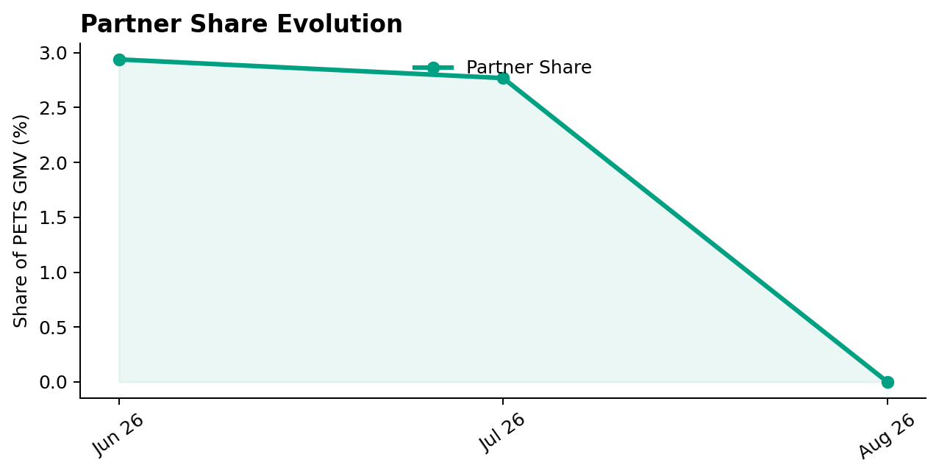
PetFood Share of PETS
Partner GMV as a share of PETS GMV — August 2026
Share of PETS GMV
0.0%
▼ 2.8 pp vs prev. month
Comparison unavailable
Partner lost 2.77 pp of PETS GMV share vs previous month.
Notes:
[Sources]
User-supplied partner_data.xlsx and subbusiness_unit_data.xlsx; periods and input hashes in accompanying audit export. Brand assets supplied with Dev5.
[/Sources]
Official reported CVR; partner/SBU aggregate weighted by sessions

Slide 9
PetFood Performance & Conversion Evolution
Monthly GMV and delivered orders · Partner sessions and conversion
GMV & Orders
GMV
Orders
€0
0
▼ 100.0% vs prev. month
▼ 100.0% vs prev. month
• GMV changed -100.0% vs previous month.
Partner Sessions × Partner CVR
Partner Sessions
Partner CVR
4,000
2.5%
No change vs prev. month
No change vs prev. month
23.9 pp below PETS benchmark
• Partner CVR is 23.9 pp below PETS benchmark.
Notes:
[Sources]
Existing Beta2 analysis output and presentation.context; input hashes in the unchanged audit export.
[/Sources]
Official reported CVR; partner/SBU aggregate weighted by sessions

Slide 10
Operational Health
Latest partner performance — Uptime vs 95% target; PNA/Cancels vs PETS (August 2026)
Operating Store Uptime
Partner PNA
Partner Cancels
0.0%
45.0%
22.0%
▼ 72.0 pp vs prev. month
No change vs prev. month
No change vs prev. month
95.0 pp worse than 95% target
38.9 pp worse than PETS
19.5 pp worse than PETS
0.0%
45.0%
22.0%
95.0%
6.1%
2.5%
Interpretation
Uptime is evaluated against a 95% operating target. Lower is better for PNA and Cancels. Green indicates improvement; red indicates deterioration. Uptime coverage: 1/1 operating store. Missing current store records: 0.
Notes:
[Sources]
User-supplied partner_data.xlsx and subbusiness_unit_data.xlsx; periods and input hashes in accompanying audit export. Brand assets supplied with Dev5.
[/Sources]
Official reported CVR; partner/SBU aggregate weighted by sessions

Slide 11

Top GMV Stores
2026-08
Store
GMV
Commercial status
Operational status
Top Stores
No positive-GMV stores available for the current period.
0 stores displayed
No positive-GMV stores available for the current period.
Reported partner GMV: €0
Notes:
[Sources]
User-supplied partner_data.xlsx and subbusiness_unit_data.xlsx; periods and input hashes in accompanying audit export. Brand assets supplied with Dev5.
[/Sources]
Official reported CVR; partner/SBU aggregate weighted by sessions

Slide 12



How We Prioritize Opportunities
2026-08 · Higher Priority = stronger case for action
SEVERITY — 0–100
IMPACT — 0–100
PRIORITY — 0–100
How large is the KPI problem?
How much business exposure
sits behind the problem?
Where should we act first?
Compared with the relevant SBU benchmark or operating target.
Evidence volume and confidence are considered. Larger reliable negative gaps create higher Severity.
Dominant-KPI protection keeps a major problem from being hidden by healthy KPIs.
Order-related exposure behind the KPI gap. Higher-volume problems generally create higher Impact.
Not euros. Not guaranteed recovered orders. Not a financial forecast.
Metric Priority =
KPI Severity × KPI Impact / 100
Store Priority combines eligible KPI-level priorities, with dominant-KPI protection so one major issue cannot be diluted.
PRIMARY ACTION KPI
BASE ACTION RULE · Priority ≥ 5.0
The KPI with the strongest paired business case for action at that store.
The 5.0 threshold remains provisional. V2.1 overrides can classify lower-score stores ACTION.
Priority ranks stores. Separate V2.1 triage assigns ACTION / MONITOR / HEALTHY / UNCLASSIFIED (six ACTION stores shown by default).
Missing evidence → incomplete assessment, not zero. Critical observations are reviewed separately from business Priority.
Uptime: 95% target; restoration exposure uses healthy history where available.
Exposure components may overlap; headline exposure uses the largest. An opportunity signal, not a recovery promise.
Benchmark: 2026-08. SBU peer composition is not available.

Slide 13
Priority Opportunities & Actions
2026-08 · V2.1 business triage · Priority ranking remains unchanged
#1 · პეტფუდი — შინაური ცხოველების კვებისა და ვეტერინარული მომსახურების ცენტრი, ჭავჭავაძის გამზირი 123
OVERALL ACTION FOCUS
1 selected of 1 ACTION store
Priority 93.55 · Primary Action KPI: Uptime
Primary Action KPI
Uptime
ACTION · Base Priority
Stores Requiring Action
Uptime 0.0% vs target 95.0%
1 store
Priority Range
Likely operational driver: Store availability; investigate scheduling / execution
Highest 93.55 · Lowest 93.55
Critical / Review Items
Restore availability during scheduled opening hours and verify persistent downtime
4 items
Review items are separate from Priority.
Next review
Intended effect: Improve uptime toward the 95% target
1
Confirm priority stores
Ultra-low current scale; human review required. Validate persistence / operational recovery.
2
Assign owner / deadline
3
Track progress next review
Notes:
Presentation-only layout. Recommended actions, priority and review evidence come unchanged from V9_Beta2. Meeting fields are editable text, initially unagreed.
Official reported CVR; partner/SBU aggregate weighted by sessions

Slide 14
Operational & Data Review
Critical observations and hygiene remain visible independently of business Priority
4
items to review
1
stores affected
4
critical observations
STORE / LOCATION
TYPE
EVIDENCE
REVIEW ACTION
პეტფუდი — შინაური ცხოველების კვებისა და ვეტერინარული მომსახურების ცენტრი, ჭავჭავაძის გამზირი 123
Critical observation
CVR 2.5% vs SBU 26.4%; denominator 4,000
Review assortment, pricing and the conversion journey; verify the sample before escalation
პეტფუდი — შინაური ცხოველების კვებისა და ვეტერინარული მომსახურების ცენტრი, ჭავჭავაძის გამზირი 123
Critical observation
Cancels 22.0% vs SBU 2.5%; denominator 1,000
Review partner-cancelled orders and resolve the main failure reasons; verify the sample before escalation
პეტფუდი — შინაური ცხოველების კვებისა და ვეტერინარული მომსახურების ცენტრი, ჭავჭავაძის გამზირი 123
Critical observation
PNA 45.0% vs SBU 6.1%; denominator 1,000
Review stock accuracy and availability of affected products; verify the sample before escalation
პეტფუდი — შინაური ცხოველების კვებისა და ვეტერინარული მომსახურების ცენტრი, ჭავჭავაძის გამზირი 123
Critical observation
Uptime 0.0% vs target 95.0%
Restore availability during scheduled opening hours; verify the sample before escalation
Notes:
Presentation-only layout. Recommended actions, priority and review evidence come unchanged from V9_Beta2. Meeting fields are editable text, initially unagreed.
Official reported CVR; partner/SBU aggregate weighted by sessions

Slide 15
Discussion
Confirm actions, responsibilities and the next review date
Which interventions should we start first?
Notes:
[Sources]
User-supplied partner_data.xlsx and subbusiness_unit_data.xlsx; periods and input hashes in accompanying audit export. Brand assets supplied with Dev5.
[/Sources]
Official reported CVR; partner/SBU aggregate weighted by sessions

Slide 16
Action Plan
Agree actions, owners and dates during the business review
PRIORITY ACTION 1
Priority 93.55
პეტფუდი — შინაური ცხოველების კვებისა და ვეტერინარული მომსახურების ცენტრი, ჭავჭავაძის გამზირი 123
Primary Action KPI
Uptime
Recommended Action (System)
Restore availability during scheduled opening hours and verify persistent downtime
Agreed Action (Meeting)
[To agree]
Owner
[To agree]
Contact
[To agree]
ETA
[To agree]
Follow-up KPI
Uptime
Next check-in:
[To agree]
Notes:
Presentation-only layout. Recommended actions, priority and review evidence come unchanged from V9_Beta2. Meeting fields are editable text, initially unagreed.
Official reported CVR; partner/SBU aggregate weighted by sessions

Slide 17
Action Plan
Additional agreed actions
ACTION 1
ACTION 2
Action / Topic
Action / Topic
[To agree]
[To agree]
Agreed Action
Agreed Action
[To agree]
[To agree]
Owner
Contact
Owner
Contact
[To agree]
[To agree]
[To agree]
[To agree]
ETA
Follow-up KPI
ETA
Follow-up KPI
[To agree]
[To agree]
[To agree]
[To agree]
Next check-in:
[To agree]
Notes:
Presentation-only layout. Recommended actions, priority and review evidence come unchanged from V9_Beta2. Meeting fields are editable text, initially unagreed.
Official reported CVR; partner/SBU aggregate weighted by sessions

Slide 18
Thank You
Partner Business Review · V9_Beta2
Let’s turn the agreed actions into measurable progress.
Notes:
[Sources]
User-supplied partner_data.xlsx and subbusiness_unit_data.xlsx; periods and input hashes in accompanying audit export. Brand assets supplied with Dev5.
[/Sources]
Official reported CVR; partner/SBU aggregate weighted by sessions

Slide 19
APPENDIX — Store Diagnostics
2026-08 · 1 store · Reference section
Store-level context
Lifecycle, KPI evidence and recommendations for each store.
Notes:
[Sources]
User-supplied partner_data.xlsx and subbusiness_unit_data.xlsx; periods and input hashes in accompanying audit export. Brand assets supplied with Dev5.
[/Sources]
Official reported CVR; partner/SBU aggregate weighted by sessions

Slide 20
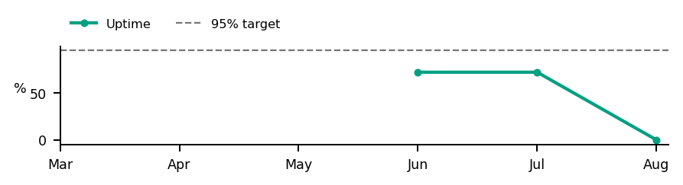
Store Diagnostics
პეტფუდი — შინაური ცხოველების კვებისა და ვეტერინარული მომსახურების ცენტრი, ჭავჭავაძის გამზირი 123
თბილისი · August 2026
GMV
DELIVERED
SESSIONS
ATTEMPTS
ACTIVE
DATA OK
COMPLETE
€0
0
4,000
1,000
Business: ACTION · Base Priority · Ultra-low current scale; human review required. Validate persistence / operational recovery.
CVR
PNA
Cancels
Uptime
2.5%
45.0%
22.0%
0.0%
SBU 26.4%
SBU 6.1%
SBU 2.5%
Target 95.0%
Below SBU · -23.9 pp
Above SBU · +38.9 pp
Above SBU · +19.5 pp
Below Target · -95.0 pp
Severity
Impact
Priority
Primary Action KPI
Uptime
98.09
100.00
93.55
Worst KPI / Severity Driver
Uptime
PRIORITY ≥ 5.0
Largest Exposure KPI
Uptime
Confidence / evidence
Main KPI trend
CVR 96% · n=4,000
PNA 97% · n=1,000
Cancels 99% · n=1,000
Critical Review — raw observations; separate from business materiality
CVR 2.5% · n=4,000 | PNA 45.0% · n=1,000 | Cancels 22.0% · n=1,000 | Uptime 0.0% · uptime observation
Likely operational driver: Store availability; investigate scheduling / execution
Restore availability during scheduled opening hours and verify persistent downtime
Intended effect: Improve uptime toward the 95% target
Notes:
[Sources]
User-supplied partner_data.xlsx and subbusiness_unit_data.xlsx; periods and input hashes in accompanying audit export. Brand assets supplied with Dev5.
[/Sources]
Official reported CVR; partner/SBU aggregate weighted by sessions
V2.1 business triage:
{"Business Classification": "ACTION", "Action Reason": "BASE_PRIORITY", "Supporting Rule Matches": [], "Primary Action KPI": "Uptime", "Likely Operational Driver": "Store availability; investigate scheduling / execution", "Operational/Data State": ["COMPLETE"]}

