Slide 1

პეტფუდი — შინაური ცხოველების კვებისა და ვეტერინარული მომსახურების ცენტრი Business Review
September 2025 – August 2026
Sub-Business Unit: BEAUTY_PERSONAL_CARE
V9_Beta2
Notes:
[Sources]
User-supplied partner_data.xlsx and subbusiness_unit_data.xlsx; periods and input hashes in accompanying audit export. Brand assets supplied with Dev5.
[/Sources]
Official reported CVR; partner/SBU aggregate weighted by sessions

Slide 2
BEAUTY_PERSONAL_CARE Business Development
Latest SBU performance — August 2026
SBU GMV
SBU Orders
SBU AOV
SBU CVR
€111,423
4,269
€26.10
9.3%
▲ 9.5% vs prev. month
▲ 5.6% vs prev. month
▲ 3.7% vs prev. month
▲ 0.2 pp vs prev. month
Comparison unavailable
Comparison unavailable
Comparison unavailable
Growth Composition
Key Takeaways
GMV
+9.5%
• GMV increased 9.5% vs previous month.
Orders
+5.6%
• Both order volume and average basket supported growth.
AOV
+3.7%
• CVR improved by 0.2 pp to 9.3%.
Notes:
[Sources]
User-supplied partner_data.xlsx and subbusiness_unit_data.xlsx; periods and input hashes in accompanying audit export. Brand assets supplied with Dev5.
[/Sources]
Official reported CVR; partner/SBU aggregate weighted by sessions

Slide 3

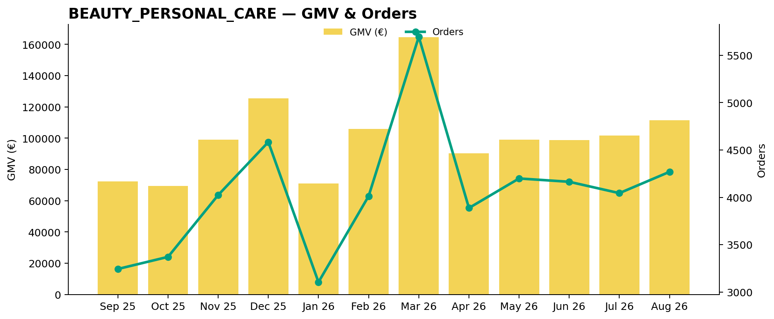
BEAUTY_PERSONAL_CARE Performance Trend
Last 12 available months
Across the displayed period, BEAUTY_PERSONAL_CARE GMV changed +54.0%, while orders changed +31.6%.
Notes:
[Sources]
User-supplied partner_data.xlsx and subbusiness_unit_data.xlsx; periods and input hashes in accompanying audit export. Brand assets supplied with Dev5.
[/Sources]
Official reported CVR; partner/SBU aggregate weighted by sessions

Slide 4
პეტფუდი — შინაური ცხოველების კვებისა და ვეტერინარული მომსახურების ცენტრი vs BEAUTY_PERSONAL_CARE
Comparable period: August 2026
KPI
Partner
BEAUTY_PERSONAL_CARE
Gap
AOV
€44.10
€26.10
69.0% better than BEAUTY_PERSONAL_CARE
CVR
4.2%
9.3%
5.1 pp worse than BEAUTY_PERSONAL_CARE
Uptime
98.9%
76.8%
22.1 pp better than BEAUTY_PERSONAL_CARE
PNA
0.0%
12.4%
12.4 pp better than BEAUTY_PERSONAL_CARE
Cancels
0.0%
5.2%
5.2 pp better than BEAUTY_PERSONAL_CARE
Benchmark comparison uses the latest common period available in both datasets: August 2026.
Notes:
[Sources]
User-supplied partner_data.xlsx and subbusiness_unit_data.xlsx; periods and input hashes in accompanying audit export. Brand assets supplied with Dev5.
[/Sources]
Official reported CVR; partner/SBU aggregate weighted by sessions

Slide 5
პეტფუდი — შინაური ცხოველების კვებისა და ვეტერინარული მომსახურების ცენტრი vs BEAUTY_PERSONAL_CARE · Visual
August 2026 · Comparable performance metrics · Each metric uses its own scale
AOV (€)
€44.10
69.0% better than BEAUTY_PERSONAL_CARE
€26.10
CVR (%)
4.2%
5.1 pp worse than BEAUTY_PERSONAL_CARE
9.3%
Uptime (%)
98.9%
22.1 pp better than BEAUTY_PERSONAL_CARE
76.8%
PNA (%)
0.0%
12.4 pp better than BEAUTY_PERSONAL_CARE
12.4%
Cancels (%)
0.0%
5.2 pp better than BEAUTY_PERSONAL_CARE
5.2%
Benchmark comparison uses the latest common period available in both datasets: August 2026.
Notes:
[Sources]
Existing Beta2 analysis output and presentation.context; input hashes in the unchanged audit export.
[/Sources]
Official reported CVR; partner/SBU aggregate weighted by sessions

Slide 6
პეტფუდი — შინაური ცხოველების კვებისა და ვეტერინარული მომსახურების ცენტრი Growth vs BEAUTY_PERSONAL_CARE
MoM growth comparison — August 2026
KPI
Partner
BEAUTY_PERSONAL_CARE
Growth Gap
GMV Growth
+759.7%
+9.5%
+750.2 pp
Orders Growth
+400.0%
+5.6%
+394.4 pp
AOV Growth
+71.9%
+3.7%
+68.2 pp
Notes:
[Sources]
User-supplied partner_data.xlsx and subbusiness_unit_data.xlsx; periods and input hashes in accompanying audit export. Brand assets supplied with Dev5.
[/Sources]
Official reported CVR; partner/SBU aggregate weighted by sessions

Slide 7
პეტფუდი — შინაური ცხოველების კვებისა და ვეტერინარული მომსახურების ცენტრი Growth vs BEAUTY_PERSONAL_CARE · Visual
MoM growth comparison — August 2026 · Shared percentage scale
+759.7%
Growth Gap
+750.2 pp
GMV Growth
+9.5%
+400.0%
Growth Gap
+394.4 pp
Orders Growth
+5.6%
+71.9%
Growth Gap
+68.2 pp
AOV Growth
+3.7%
Notes:
[Sources]
Existing Beta2 analysis output and presentation.context; input hashes in the unchanged audit export.
[/Sources]
Official reported CVR; partner/SBU aggregate weighted by sessions

Slide 8
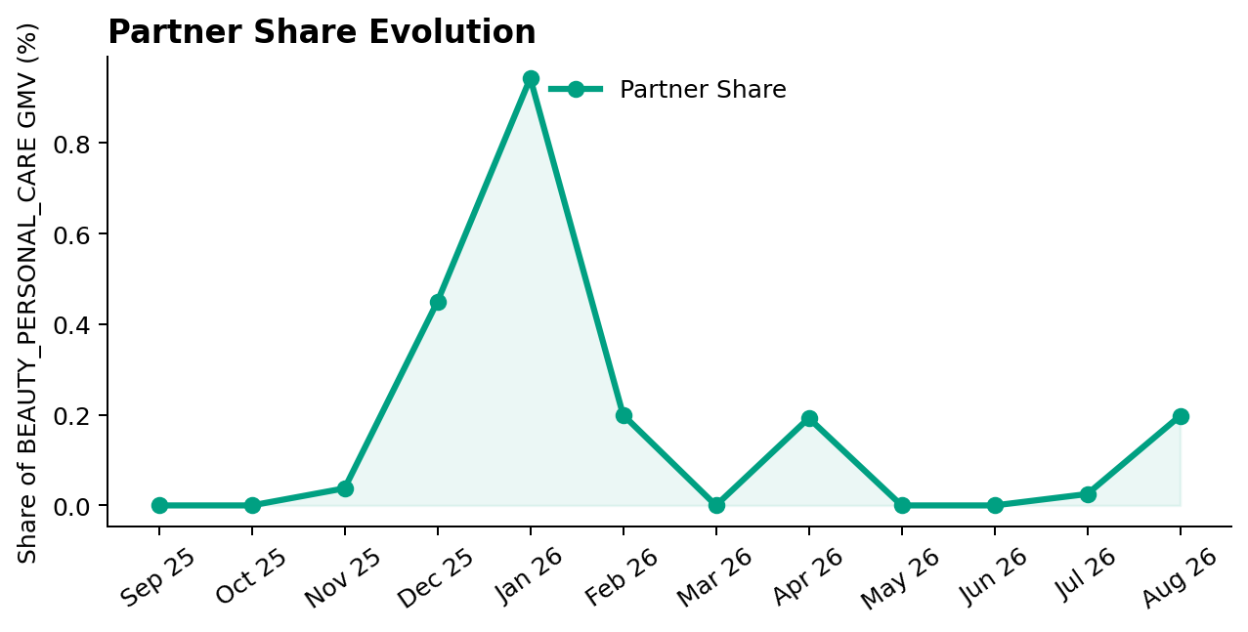
პეტფუდი — შინაური ცხოველების კვებისა და ვეტერინარული მომსახურების ცენტრი Share of BEAUTY_PERSONAL_CARE
Partner GMV as a share of BEAUTY_PERSONAL_CARE GMV — August 2026
Share of BEAUTY_PERSONAL_CARE GMV
0.2%
▲ 0.2 pp vs prev. month
Comparison unavailable
Partner gained 0.17 pp of BEAUTY_PERSONAL_CARE GMV share vs previous month.
Notes:
[Sources]
User-supplied partner_data.xlsx and subbusiness_unit_data.xlsx; periods and input hashes in accompanying audit export. Brand assets supplied with Dev5.
[/Sources]
Official reported CVR; partner/SBU aggregate weighted by sessions

Slide 9
პეტფუდი — შინაური ცხოველების კვებისა და ვეტერინარული მომსახურების ცენტრი Performance & Conversion Evolution
Monthly GMV and delivered orders · Partner sessions and conversion
GMV & Orders
GMV
Orders
€220
5
▲ 759.7% vs prev. month
▲ 400.0% vs prev. month
• GMV changed +759.7% vs previous month.
• Order volume moved more sharply than basket size.
Partner Sessions × Partner CVR
Partner Sessions
Partner CVR
118
4.2%
▼ 3.3% vs prev. month
▲ 3.4 pp vs prev. month
5.1 pp below BEAUTY_PERSONAL_CARE benchmark
• Partner CVR is 5.1 pp below BEAUTY_PERSONAL_CARE benchmark.
Missing months / measurements are blank. Lines break at missing values.
Notes:
[Sources]
Existing Beta2 analysis output and presentation.context; input hashes in the unchanged audit export.
[/Sources]
Official reported CVR; partner/SBU aggregate weighted by sessions

Slide 10
Operational Health
Latest partner performance — Uptime vs 95% target; PNA/Cancels vs BEAUTY_PERSONAL_CARE (August 2026)
Operating Store Uptime
Partner PNA
Partner Cancels
98.9%
0.0%
0.0%
▲ 1.0 pp vs prev. month
No change vs prev. month
No change vs prev. month
3.9 pp better than 95% target
12.4 pp better than BEAUTY_PERSONAL_CARE
5.2 pp better than BEAUTY_PERSONAL_CARE
98.9%
0.0%
0.0%
95.0%
12.4%
5.2%
Interpretation
Uptime is evaluated against a 95% operating target. Lower is better for PNA and Cancels. Green indicates improvement; red indicates deterioration. Uptime coverage: 1/1 operating store. Missing current store records: 0.
Notes:
[Sources]
User-supplied partner_data.xlsx and subbusiness_unit_data.xlsx; periods and input hashes in accompanying audit export. Brand assets supplied with Dev5.
[/Sources]
Official reported CVR; partner/SBU aggregate weighted by sessions

Slide 11

Top GMV Stores
2026-08
Store
GMV
Commercial status
Operational status
Top Stores
1
70 Vazha Pshavela Ave, Tbilisi 0186 0101 Tbilisi T'bilisi Georgia
€220
Conversion Opportunity
Healthy
100.0%
Top 1 store generated 100.0% of total partner GMV in August 2026.
Reported partner GMV: €220
Notes:
[Sources]
User-supplied partner_data.xlsx and subbusiness_unit_data.xlsx; periods and input hashes in accompanying audit export. Brand assets supplied with Dev5.
[/Sources]
Official reported CVR; partner/SBU aggregate weighted by sessions

Slide 12



How We Prioritize Opportunities
2026-08 · Higher Priority = stronger case for action
SEVERITY — 0–100
IMPACT — 0–100
PRIORITY — 0–100
How large is the KPI problem?
How much business exposure
sits behind the problem?
Where should we act first?
Compared with the relevant SBU benchmark or operating target.
Evidence volume and confidence are considered. Larger reliable negative gaps create higher Severity.
Dominant-KPI protection keeps a major problem from being hidden by healthy KPIs.
Order-related exposure behind the KPI gap. Higher-volume problems generally create higher Impact.
Not euros. Not guaranteed recovered orders. Not a financial forecast.
Metric Priority =
KPI Severity × KPI Impact / 100
Store Priority combines eligible KPI-level priorities, with dominant-KPI protection so one major issue cannot be diluted.
PRIMARY ACTION KPI
BASE ACTION RULE · Priority ≥ 5.0
The KPI with the strongest paired business case for action at that store.
The 5.0 threshold remains provisional. V2.1 overrides can classify lower-score stores ACTION.
Priority ranks stores. Separate V2.1 triage assigns ACTION / MONITOR / HEALTHY / UNCLASSIFIED (six ACTION stores shown by default).
Missing evidence → incomplete assessment, not zero. Critical observations are reviewed separately from business Priority.
Uptime: 95% target; restoration exposure uses healthy history where available.
Exposure components may overlap; headline exposure uses the largest. An opportunity signal, not a recovery promise.
Benchmark: 2026-08. SBU peer composition is not available.

Slide 13
Priority Opportunities & Actions
2026-08 · V2.1 business triage · Priority ranking remains unchanged
Next review
No stores classified ACTION
under the current V2.1 rules.
1
Confirm priority stores
2
Assign owner / deadline
3
Track progress next review
MONITOR, HEALTHY and UNCLASSIFIED remain separate.
Review operational/data observations and Appendix context.

Slide 14
Action Plan
Agree owners and dates for the selected V2.1 ACTION stores
Store / Primary KPI
Recommended action
Owner / deadline
No items in this list. See the separate review and diagnostic sections.

Slide 15
Operational & Data Review
Critical observations and hygiene remain visible independently of business Priority
Store / type
Evidence
Review action
No items in this list. See the separate review and diagnostic sections.
Notes:
[Sources]
User-supplied partner_data.xlsx and subbusiness_unit_data.xlsx; periods and input hashes in accompanying audit export. Brand assets supplied with Dev5.
[/Sources]
Official reported CVR; partner/SBU aggregate weighted by sessions

Slide 16
Discussion
Confirm actions, responsibilities and the next review date
Which interventions should we start first?
Notes:
[Sources]
User-supplied partner_data.xlsx and subbusiness_unit_data.xlsx; periods and input hashes in accompanying audit export. Brand assets supplied with Dev5.
[/Sources]
Official reported CVR; partner/SBU aggregate weighted by sessions

Slide 17
Thank You
Partner Business Review · V9_Beta2
Let’s turn the agreed actions into measurable progress.
Notes:
[Sources]
User-supplied partner_data.xlsx and subbusiness_unit_data.xlsx; periods and input hashes in accompanying audit export. Brand assets supplied with Dev5.
[/Sources]
Official reported CVR; partner/SBU aggregate weighted by sessions

Slide 18
APPENDIX — Store Diagnostics
2026-08 · 1 store · Reference section
Store-level context
Lifecycle, KPI evidence and recommendations for each store.
Notes:
[Sources]
User-supplied partner_data.xlsx and subbusiness_unit_data.xlsx; periods and input hashes in accompanying audit export. Brand assets supplied with Dev5.
[/Sources]
Official reported CVR; partner/SBU aggregate weighted by sessions

Slide 19
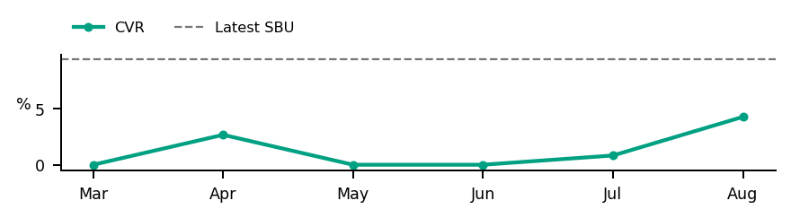
Store Diagnostics
70 Vazha Pshavela Ave, Tbilisi 0186 0101 Tbilisi T'bilisi Georgia
August 2026
GMV
DELIVERED
SESSIONS
ATTEMPTS
ACTIVE
DATA OK
COMPLETE
€220
5
118
5
Business: MONITOR
CVR
PNA
Cancels
Uptime
4.2%
0.0%
0.0%
98.9%
SBU 9.3%
SBU 12.4%
SBU 5.2%
Target 95.0%
Below SBU · -5.1 pp
Below SBU · -12.4 pp
Below SBU · -5.2 pp
Above Target · +3.9 pp
Severity
Impact
Priority
Primary Action KPI
CVR
17.39
7.90
1.37
Worst KPI / Severity Driver
CVR
PRIORITY < 5.0
Largest Exposure KPI
CVR
Confidence / evidence
Main KPI trend
CVR 44% · n=118
PNA 14% · n=5
Cancels 33% · n=5
Assessment evidence
Current sessions or order activity · Critical observations: None
Likely operational driver: Assortment / pricing / content / discoverability / funnel quality: investigate
Review assortment, pricing, content and discoverability, then investigate the conversion journey
Intended effect: Improve conversion against the SBU benchmark
Notes:
[Sources]
User-supplied partner_data.xlsx and subbusiness_unit_data.xlsx; periods and input hashes in accompanying audit export. Brand assets supplied with Dev5.
[/Sources]
Official reported CVR; partner/SBU aggregate weighted by sessions
V2.1 business triage:
{"Business Classification": "MONITOR", "Action Reason": "", "Supporting Rule Matches": [], "Primary Action KPI": "CVR", "Likely Operational Driver": "Assortment / pricing / content / discoverability / funnel quality: investigate", "Operational/Data State": ["COMPLETE"]}

