Slide 1

Partner Business Review
September 2025 – August 2026
Sub-Business Unit: PETS
V9_Beta2
Notes:
[Sources]
User-supplied partner_data.xlsx and subbusiness_unit_data.xlsx; periods and input hashes in accompanying audit export. Brand assets supplied with Dev5.
[/Sources]
Official reported CVR; partner/SBU aggregate weighted by sessions

Slide 2
PETS Business Development
Latest SBU performance — August 2026
SBU GMV
SBU Orders
SBU AOV
SBU CVR
€152,169
9,106
€16.71
26.4%
▲ 5.3% vs prev. month
▲ 3.5% vs prev. month
▲ 1.8% vs prev. month
▲ 0.3 pp vs prev. month
Comparison unavailable
Comparison unavailable
Comparison unavailable
Growth Composition
Key Takeaways
GMV
+5.3%
• GMV increased 5.3% vs previous month.
Orders
+3.5%
• Both order volume and average basket supported growth.
AOV
+1.8%
• CVR improved by 0.3 pp to 26.4%.
Notes:
[Sources]
User-supplied partner_data.xlsx and subbusiness_unit_data.xlsx; periods and input hashes in accompanying audit export. Brand assets supplied with Dev5.
[/Sources]
Official reported CVR; partner/SBU aggregate weighted by sessions

Slide 3


PETS Performance Trend
Last 12 available months
Across the displayed period, PETS GMV changed +100.4%, while orders changed +73.2%.
Notes:
[Sources]
User-supplied partner_data.xlsx and subbusiness_unit_data.xlsx; periods and input hashes in accompanying audit export. Brand assets supplied with Dev5.
[/Sources]
Official reported CVR; partner/SBU aggregate weighted by sessions

Slide 4
Partner vs PETS
Comparable period: August 2026
KPI
Partner
PETS
Gap
AOV
€14.63
€16.71
12.5% worse than PETS
CVR
18.6%
26.4%
7.8 pp worse than PETS
Uptime
94.4%
91.3%
3.1 pp better than PETS
PNA
3.7%
6.1%
2.4 pp better than PETS
Cancels
2.3%
2.5%
0.3 pp better than PETS
Benchmark comparison uses the latest common period available in both datasets: August 2026.
Notes:
[Sources]
User-supplied partner_data.xlsx and subbusiness_unit_data.xlsx; periods and input hashes in accompanying audit export. Brand assets supplied with Dev5.
[/Sources]
Official reported CVR; partner/SBU aggregate weighted by sessions

Slide 5
Partner vs PETS · Visual
August 2026 · Comparable performance metrics · Each metric uses its own scale
AOV (€)
€14.63
12.5% worse than PETS
€16.71
CVR (%)
18.6%
7.8 pp worse than PETS
26.4%
Uptime (%)
94.4%
3.1 pp better than PETS
91.3%
PNA (%)
3.7%
2.4 pp better than PETS
6.1%
Cancels (%)
2.3%
0.3 pp better than PETS
2.5%
Benchmark comparison uses the latest common period available in both datasets: August 2026.
Notes:
[Sources]
Existing Beta2 analysis output and presentation.context; input hashes in the unchanged audit export.
[/Sources]
Official reported CVR; partner/SBU aggregate weighted by sessions

Slide 6
Growth vs PETS
MoM growth comparison — August 2026
KPI
Partner
PETS
Growth Gap
GMV Growth
+3.9%
+5.3%
-1.5 pp
Orders Growth
+5.5%
+3.5%
+1.9 pp
AOV Growth
-1.5%
+1.8%
-3.3 pp
Notes:
[Sources]
User-supplied partner_data.xlsx and subbusiness_unit_data.xlsx; periods and input hashes in accompanying audit export. Brand assets supplied with Dev5.
[/Sources]
Official reported CVR; partner/SBU aggregate weighted by sessions

Slide 7
Growth vs PETS · Visual
MoM growth comparison — August 2026 · Shared percentage scale
+3.9%
Growth Gap
-1.5 pp
GMV Growth
+5.3%
+5.5%
Growth Gap
+1.9 pp
Orders Growth
+3.5%
-1.5%
Growth Gap
-3.3 pp
AOV Growth
+1.8%
Notes:
[Sources]
Existing Beta2 analysis output and presentation.context; input hashes in the unchanged audit export.
[/Sources]
Official reported CVR; partner/SBU aggregate weighted by sessions

Slide 8
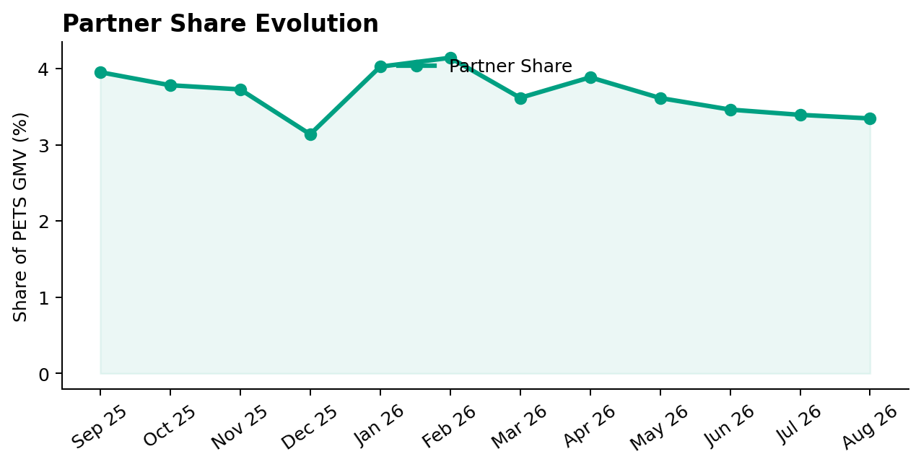
Partner Share of PETS
Partner GMV as a share of PETS GMV — August 2026
Share of PETS GMV
3.3%
▼ 0.0 pp vs prev. month
Comparison unavailable
Partner lost 0.05 pp of PETS GMV share vs previous month.
Notes:
[Sources]
User-supplied partner_data.xlsx and subbusiness_unit_data.xlsx; periods and input hashes in accompanying audit export. Brand assets supplied with Dev5.
[/Sources]
Official reported CVR; partner/SBU aggregate weighted by sessions

Slide 9
Executive Summary
Latest partner performance — August 2026
GMV
Orders
AOV
Partner CVR
€5,090
348
€14.63
18.6%
▲ 3.9% vs prev. month
▲ 5.5% vs prev. month
▼ 1.5% vs prev. month
▲ 0.6 pp vs prev. month
12.5% worse than PETS
7.8 pp worse than PETS
• GMV changed +3.9% vs previous month.
• Order volume moved more sharply than basket size during the month.
• Partner CVR is 7.8 pp worse than the selected PETS benchmark (August 2026).
Notes:
[Sources]
User-supplied partner_data.xlsx and subbusiness_unit_data.xlsx; periods and input hashes in accompanying audit export. Brand assets supplied with Dev5.
[/Sources]
Official reported CVR; partner/SBU aggregate weighted by sessions

Slide 10
Partner Performance & Conversion Evolution
Monthly GMV and delivered orders · Partner sessions and conversion
GMV & Orders
Partner Sessions × Partner CVR
Notes:
[Sources]
Existing Beta2 analysis output and presentation.context; input hashes in the unchanged audit export.
[/Sources]
Official reported CVR; partner/SBU aggregate weighted by sessions

Slide 11
Operational Health
Latest partner performance — Uptime vs 95% target; PNA/Cancels vs PETS (August 2026)
Operating Store Uptime
Partner PNA
Partner Cancels
94.4%
3.7%
2.3%
▲ 0.4 pp vs prev. month
▲ 0.0 pp vs prev. month
▲ 0.1 pp vs prev. month
0.6 pp worse than 95% target
2.4 pp better than PETS
0.3 pp better than PETS
94.4%
3.7%
2.3%
95.0%
6.1%
2.5%
Interpretation
Uptime is evaluated against a 95% operating target. Lower is better for PNA and Cancels. Green indicates improvement; red indicates deterioration. Uptime coverage: 1/1 operating store. Missing current store records: 0.
Notes:
[Sources]
User-supplied partner_data.xlsx and subbusiness_unit_data.xlsx; periods and input hashes in accompanying audit export. Brand assets supplied with Dev5.
[/Sources]
Official reported CVR; partner/SBU aggregate weighted by sessions

Slide 12

Top GMV Stores
2026-08
Store
GMV
Commercial status
Operational status
Top Stores
1
Pet Supplies Central, 123 Long Avenue, Tbilisi, Georgia
€5,090
Conversion Opportunity
Watch
100.0%
Top 1 store generated 100.0% of total partner GMV in August 2026.
Reported partner GMV: €5,090
Notes:
[Sources]
User-supplied partner_data.xlsx and subbusiness_unit_data.xlsx; periods and input hashes in accompanying audit export. Brand assets supplied with Dev5.
[/Sources]
Official reported CVR; partner/SBU aggregate weighted by sessions

Slide 13



How We Prioritize Opportunities
2026-08 · Higher Priority = stronger case for action
SEVERITY — 0–100
IMPACT — 0–100
PRIORITY — 0–100
How large is the KPI problem?
How much business exposure
sits behind the problem?
Where should we act first?
Compared with the relevant SBU benchmark or operating target.
Evidence volume and confidence are considered. Larger reliable negative gaps create higher Severity.
Dominant-KPI protection keeps a major problem from being hidden by healthy KPIs.
Order-related exposure behind the KPI gap. Higher-volume problems generally create higher Impact.
Not euros. Not guaranteed recovered orders. Not a financial forecast.
Metric Priority =
KPI Severity × KPI Impact / 100
Store Priority combines eligible KPI-level priorities, with dominant-KPI protection so one major issue cannot be diluted.
PRIMARY ACTION KPI
BASE ACTION RULE · Priority ≥ 5.0
The KPI with the strongest paired business case for action at that store.
The 5.0 threshold remains provisional. V2.1 overrides can classify lower-score stores ACTION.
Priority ranks stores. Separate V2.1 triage assigns ACTION / MONITOR / HEALTHY / UNCLASSIFIED (six ACTION stores shown by default).
Missing evidence → incomplete assessment, not zero. Critical observations are reviewed separately from business Priority.
Uptime: 95% target; restoration exposure uses healthy history where available.
Exposure components may overlap; headline exposure uses the largest. An opportunity signal, not a recovery promise.
Benchmark: 2026-08. SBU peer composition is not available.

Slide 14
Priority Opportunities & Actions
2026-08 · V2.1 business triage · Priority ranking remains unchanged
#1 · Pet Supplies Central, 123 Long Avenue, Tbilisi, Georgia
OVERALL ACTION FOCUS
1 selected of 1 ACTION store
Priority 14.94 · Primary Action KPI: CVR
Primary Action KPI
CVR
ACTION · Base Priority
Stores Requiring Action
CVR 18.6% vs SBU 26.4%
1 store
Priority Range
Likely operational driver: Assortment / pricing / content / discoverability / funnel quality: investigate
Highest 14.94 · Lowest 14.94
Critical / Review Items
Review assortment, pricing, content and discoverability, then investigate the conversion journey
0 items
Review items are separate from Priority.
Next review
Intended effect: Improve conversion against the SBU benchmark
1
Confirm priority stores
2
Assign owner / deadline
3
Track progress next review

Slide 15
Action Plan
Agree owners and dates for the selected V2.1 ACTION stores
Store / Primary KPI
Recommended action
Owner / deadline
Pet Supplies Central, 123 Long Avenue, Tbilisi, Georgia / CVR
Review assortment, pricing, content and discoverability, then investigate the conversion journey
To agree

Slide 16
Operational & Data Review
Critical observations and hygiene remain visible independently of business Priority
Store / type
Evidence
Review action
No items in this list. See the separate review and diagnostic sections.
Notes:
[Sources]
User-supplied partner_data.xlsx and subbusiness_unit_data.xlsx; periods and input hashes in accompanying audit export. Brand assets supplied with Dev5.
[/Sources]
Official reported CVR; partner/SBU aggregate weighted by sessions

Slide 17
Discussion
Confirm actions, responsibilities and the next review date
Which interventions should we start first?
Notes:
[Sources]
User-supplied partner_data.xlsx and subbusiness_unit_data.xlsx; periods and input hashes in accompanying audit export. Brand assets supplied with Dev5.
[/Sources]
Official reported CVR; partner/SBU aggregate weighted by sessions

Slide 18
Thank You
Partner Business Review · V9_Beta2
Let’s turn the agreed actions into measurable progress.
Notes:
[Sources]
User-supplied partner_data.xlsx and subbusiness_unit_data.xlsx; periods and input hashes in accompanying audit export. Brand assets supplied with Dev5.
[/Sources]
Official reported CVR; partner/SBU aggregate weighted by sessions

Slide 19
APPENDIX — Store Diagnostics
2026-08 · 1 store · Reference section
Store-level context
Lifecycle, KPI evidence and recommendations for each store.
Notes:
[Sources]
User-supplied partner_data.xlsx and subbusiness_unit_data.xlsx; periods and input hashes in accompanying audit export. Brand assets supplied with Dev5.
[/Sources]
Official reported CVR; partner/SBU aggregate weighted by sessions

Slide 20
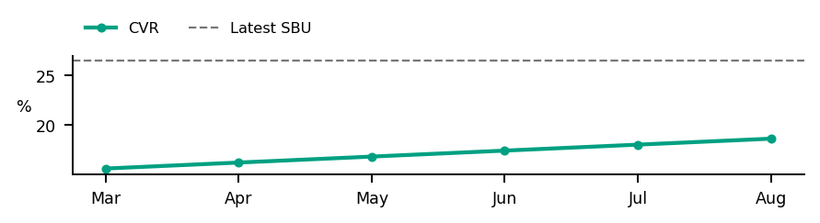
Store Diagnostics
PETS regression partner
August 2026
GMV
DELIVERED
SESSIONS
ATTEMPTS
ACTIVE
DATA OK
COMPLETE
€5,090
348
1,770
620
Business: ACTION · Base Priority
CVR
PNA
Cancels
Uptime
18.6%
3.7%
2.3%
94.4%
SBU 26.4%
SBU 6.1%
SBU 2.5%
Target 95.0%
Below SBU · -7.8 pp
Below SBU · -2.4 pp
Below SBU · -0.3 pp
Below Target · -0.6 pp
Severity
Impact
Priority
Primary Action KPI
CVR
20.16
74.10
14.94
Worst KPI / Severity Driver
CVR
PRIORITY ≥ 5.0
Largest Exposure KPI
CVR
Confidence / evidence
Main KPI trend
CVR 92% · n=1,770
PNA 95% · n=620
Cancels 98% · n=620
Assessment evidence
Current sessions or order activity · Critical observations: None
Likely operational driver: Assortment / pricing / content / discoverability / funnel quality: investigate
Review assortment, pricing, content and discoverability, then investigate the conversion journey
Intended effect: Improve conversion against the SBU benchmark
Notes:
[Sources]
User-supplied partner_data.xlsx and subbusiness_unit_data.xlsx; periods and input hashes in accompanying audit export. Brand assets supplied with Dev5.
[/Sources]
Official reported CVR; partner/SBU aggregate weighted by sessions
V2.1 business triage:
{"Business Classification": "ACTION", "Action Reason": "BASE_PRIORITY", "Supporting Rule Matches": [], "Primary Action KPI": "CVR", "Likely Operational Driver": "Assortment / pricing / content / discoverability / funnel quality: investigate", "Operational/Data State": ["COMPLETE"]}

