Slide 1

Partner Business Review
July 2026 – August 2026
Sub-Business Unit: PETS
V9_Beta2
Notes:
[Sources]
User-supplied partner_data.xlsx and subbusiness_unit_data.xlsx; periods and input hashes in accompanying audit export. Brand assets supplied with Dev5.
[/Sources]
Official reported CVR; partner/SBU aggregate weighted by sessions

Slide 2
PETS Business Development
Latest SBU performance — August 2026
SBU GMV
SBU Orders
SBU AOV
SBU CVR
€152,169
9,106
€16.71
26.4%
▲ 5.3% vs prev. month
▲ 3.5% vs prev. month
▲ 1.8% vs prev. month
▲ 0.3 pp vs prev. month
Comparison unavailable
Comparison unavailable
Comparison unavailable
Growth Composition
Key Takeaways
GMV
+5.3%
• GMV increased 5.3% vs previous month.
Orders
+3.5%
• Both order volume and average basket supported growth.
AOV
+1.8%
• CVR improved by 0.3 pp to 26.4%.
Notes:
[Sources]
User-supplied partner_data.xlsx and subbusiness_unit_data.xlsx; periods and input hashes in accompanying audit export. Brand assets supplied with Dev5.
[/Sources]
Official reported CVR; partner/SBU aggregate weighted by sessions

Slide 3


PETS Performance Trend
Last 12 available months
Across the displayed period, PETS GMV changed +100.4%, while orders changed +73.2%.
Notes:
[Sources]
User-supplied partner_data.xlsx and subbusiness_unit_data.xlsx; periods and input hashes in accompanying audit export. Brand assets supplied with Dev5.
[/Sources]
Official reported CVR; partner/SBU aggregate weighted by sessions

Slide 4
Partner vs PETS
Comparable period: August 2026
KPI
Partner
PETS
Gap
AOV
Not assessed
€16.71
Benchmark unavailable
CVR
Not assessed
26.4%
Benchmark unavailable
Uptime
Not assessed
91.3%
Benchmark unavailable
PNA
Not assessed
6.1%
Benchmark unavailable
Cancels
Not assessed
2.5%
Benchmark unavailable
Benchmark comparison uses the latest common period available in both datasets: August 2026.
Notes:
[Sources]
User-supplied partner_data.xlsx and subbusiness_unit_data.xlsx; periods and input hashes in accompanying audit export. Brand assets supplied with Dev5.
[/Sources]
Official reported CVR; partner/SBU aggregate weighted by sessions

Slide 5
Partner vs PETS · Visual
August 2026 · Comparable performance metrics · Each metric uses its own scale
AOV (€)
Not assessed
Benchmark unavailable
€16.71
CVR (%)
Not assessed
Benchmark unavailable
26.4%
Uptime (%)
Not assessed
Benchmark unavailable
91.3%
PNA (%)
Not assessed
Benchmark unavailable
6.1%
Cancels (%)
Not assessed
Benchmark unavailable
2.5%
Benchmark comparison uses the latest common period available in both datasets: August 2026.
Notes:
[Sources]
Existing Beta2 analysis output and presentation.context; input hashes in the unchanged audit export.
[/Sources]
Official reported CVR; partner/SBU aggregate weighted by sessions

Slide 6
Growth vs PETS
MoM growth comparison — August 2026
KPI
Partner
PETS
Growth Gap
GMV Growth
+5.3%
Orders Growth
+3.5%
AOV Growth
+1.8%
Notes:
[Sources]
User-supplied partner_data.xlsx and subbusiness_unit_data.xlsx; periods and input hashes in accompanying audit export. Brand assets supplied with Dev5.
[/Sources]
Official reported CVR; partner/SBU aggregate weighted by sessions

Slide 7
Growth vs PETS · Visual
MoM growth comparison — August 2026 · Shared percentage scale
Not assessed
Growth Gap
Comparison unavailable
GMV Growth
+5.3%
Not assessed
Growth Gap
Comparison unavailable
Orders Growth
+3.5%
Not assessed
Growth Gap
Comparison unavailable
AOV Growth
+1.8%
Notes:
[Sources]
Existing Beta2 analysis output and presentation.context; input hashes in the unchanged audit export.
[/Sources]
Official reported CVR; partner/SBU aggregate weighted by sessions

Slide 8
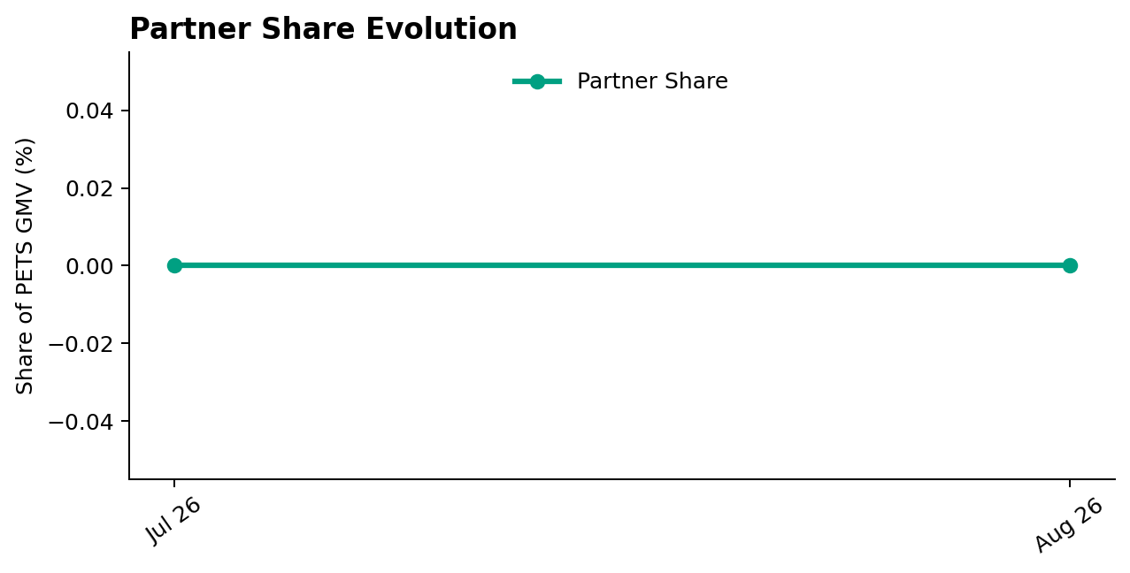
Partner Share of PETS
Partner GMV as a share of PETS GMV — August 2026
Share of PETS GMV
0.0%
No change vs prev. month
Comparison unavailable
Partner share of PETS GMV was unchanged vs previous month.
Notes:
[Sources]
User-supplied partner_data.xlsx and subbusiness_unit_data.xlsx; periods and input hashes in accompanying audit export. Brand assets supplied with Dev5.
[/Sources]
Official reported CVR; partner/SBU aggregate weighted by sessions

Slide 9
Executive Summary
Latest partner performance — August 2026
GMV
Orders
AOV
Partner CVR
€0
0
Not assessed
Not assessed
Comparison unavailable
Comparison unavailable
Comparison unavailable
Comparison unavailable
Benchmark unavailable
Benchmark unavailable
Notes:
[Sources]
User-supplied partner_data.xlsx and subbusiness_unit_data.xlsx; periods and input hashes in accompanying audit export. Brand assets supplied with Dev5.
[/Sources]
Official reported CVR; partner/SBU aggregate weighted by sessions

Slide 10
Partner Performance & Conversion Evolution
Monthly GMV and delivered orders · Partner sessions and conversion
GMV & Orders
Partner Sessions × Partner CVR
Partner CVR: Not assessed. Missing months / measurements are blank. Lines break at missing values.
Notes:
[Sources]
Existing Beta2 analysis output and presentation.context; input hashes in the unchanged audit export.
[/Sources]
Official reported CVR; partner/SBU aggregate weighted by sessions

Slide 11
Operational Health
Latest partner performance — Uptime vs 95% target; PNA/Cancels vs PETS (August 2026)
Operating Store Uptime
Partner PNA
Partner Cancels
Not assessed
Not assessed
Not assessed
Comparison unavailable
Comparison unavailable
Comparison unavailable
Benchmark unavailable
Benchmark unavailable
Benchmark unavailable
Not assessed
Not assessed
Not assessed
95.0%
6.1%
2.5%
Interpretation
Uptime is evaluated against a 95% operating target. Lower is better for PNA and Cancels. Green indicates improvement; red indicates deterioration. Uptime coverage: 0/0 operating stores. Missing current store records: 0.
Notes:
[Sources]
User-supplied partner_data.xlsx and subbusiness_unit_data.xlsx; periods and input hashes in accompanying audit export. Brand assets supplied with Dev5.
[/Sources]
Official reported CVR; partner/SBU aggregate weighted by sessions

Slide 12

Top GMV Stores
2026-08
Store
GMV
Commercial status
Operational status
Top Stores
No positive-GMV stores available for the current period.
0 stores displayed
No positive-GMV stores available for the current period.
Reported partner GMV: €0
Notes:
[Sources]
User-supplied partner_data.xlsx and subbusiness_unit_data.xlsx; periods and input hashes in accompanying audit export. Brand assets supplied with Dev5.
[/Sources]
Official reported CVR; partner/SBU aggregate weighted by sessions

Slide 13



How We Prioritize Opportunities
2026-08 · Higher Priority = stronger case for action
SEVERITY — 0–100
IMPACT — 0–100
PRIORITY — 0–100
How large is the KPI problem?
How much business exposure
sits behind the problem?
Where should we act first?
Compared with the relevant SBU benchmark or operating target.
Evidence volume and confidence are considered. Larger reliable negative gaps create higher Severity.
Dominant-KPI protection keeps a major problem from being hidden by healthy KPIs.
Order-related exposure behind the KPI gap. Higher-volume problems generally create higher Impact.
Not euros. Not guaranteed recovered orders. Not a financial forecast.
Metric Priority =
KPI Severity × KPI Impact / 100
Store Priority combines eligible KPI-level priorities, with dominant-KPI protection so one major issue cannot be diluted.
PRIMARY ACTION KPI
BASE ACTION RULE · Priority ≥ 5.0
The KPI with the strongest paired business case for action at that store.
The 5.0 threshold remains provisional. V2.1 overrides can classify lower-score stores ACTION.
Priority ranks stores. Separate V2.1 triage assigns ACTION / MONITOR / HEALTHY / UNCLASSIFIED (six ACTION stores shown by default).
Missing evidence → incomplete assessment, not zero. Critical observations are reviewed separately from business Priority.
Uptime: 95% target; restoration exposure uses healthy history where available.
Exposure components may overlap; headline exposure uses the largest. An opportunity signal, not a recovery promise.
Benchmark: 2026-08. SBU peer composition is not available.

Slide 14
Priority Opportunities & Actions
2026-08 · V2.1 business triage · Priority ranking remains unchanged
Next review
No stores classified ACTION
under the current V2.1 rules.
1
Confirm priority stores
2
Assign owner / deadline
3
Track progress next review
MONITOR, HEALTHY and UNCLASSIFIED remain separate.
Review operational/data observations and Appendix context.

Slide 15
Action Plan
Agree owners and dates for the selected V2.1 ACTION stores
Store / Primary KPI
Recommended action
Owner / deadline
No items in this list. See the separate review and diagnostic sections.

Slide 16
Operational & Data Review
Critical observations and hygiene remain visible independently of business Priority
Store / type
Evidence
Review action
ZERO / Activity review
No sessions, order attempts or deliveries in reporting month; no observed operating history—verify activation
Confirm listing status and investigate absent demand or order activity
Notes:
[Sources]
User-supplied partner_data.xlsx and subbusiness_unit_data.xlsx; periods and input hashes in accompanying audit export. Brand assets supplied with Dev5.
[/Sources]
Official reported CVR; partner/SBU aggregate weighted by sessions

Slide 17
Discussion
Confirm actions, responsibilities and the next review date
Which interventions should we start first?
Notes:
[Sources]
User-supplied partner_data.xlsx and subbusiness_unit_data.xlsx; periods and input hashes in accompanying audit export. Brand assets supplied with Dev5.
[/Sources]
Official reported CVR; partner/SBU aggregate weighted by sessions

Slide 18
Thank You
Partner Business Review · V9_Beta2
Let’s turn the agreed actions into measurable progress.
Notes:
[Sources]
User-supplied partner_data.xlsx and subbusiness_unit_data.xlsx; periods and input hashes in accompanying audit export. Brand assets supplied with Dev5.
[/Sources]
Official reported CVR; partner/SBU aggregate weighted by sessions

Slide 19
APPENDIX — Store Diagnostics
2026-08 · 1 store · Reference section
Store-level context
Lifecycle, KPI evidence and recommendations for each store.
Notes:
[Sources]
User-supplied partner_data.xlsx and subbusiness_unit_data.xlsx; periods and input hashes in accompanying audit export. Brand assets supplied with Dev5.
[/Sources]
Official reported CVR; partner/SBU aggregate weighted by sessions

Slide 20
Store Diagnostics
ZERO
August 2026
GMV
DELIVERED
SESSIONS
ATTEMPTS
NO ACTIVITY
DATA OK
NOT APPLICABLE
€0
0
0
0
Business: UNCLASSIFIED
CVR
PNA
Cancels
Uptime
0.0%
Not assessed
Not assessed
0.0%
SBU 26.4%
SBU 6.1%
SBU 2.5%
Target 95.0%
Lifecycle state · reference only
Lifecycle state · reference only
Lifecycle state · reference only
Lifecycle state · reference only
Severity
Impact
Priority
Lifecycle state
No Activity
0.00
0.00
0.00
Worst KPI / Severity Driver
None
NO ROUTINE RECOVERY
Largest Exposure KPI
No assessed exposure
Confidence / evidence
Main KPI trend
CVR · Rate unavailable / not assessed · n=0
Trend unavailable
PNA · Rate unavailable / not assessed · n=0
Cancels · Rate unavailable / not assessed · n=0
Lifecycle / activity evidence
No sessions, order attempts or deliveries in reporting month; no observed operating history—verify activation
Lifecycle / activity action
Review store activity
Notes:
[Sources]
User-supplied partner_data.xlsx and subbusiness_unit_data.xlsx; periods and input hashes in accompanying audit export. Brand assets supplied with Dev5.
[/Sources]
Official reported CVR; partner/SBU aggregate weighted by sessions
V2.1 business triage:
{"Business Classification": "UNCLASSIFIED", "Action Reason": "", "Supporting Rule Matches": [], "Primary Action KPI": "None", "Likely Operational Driver": "Not assessed; review lifecycle / data evidence", "Operational/Data State": ["NO_ACTIVITY"]}

