Slide 1
WP4 – Whole Rock, Mineral Systems models, new tools
Dan Smith, Nicky Taylor, Renzhi Zhu, Chetan Nathwani, Jamie Wilkinson & more.

Slide 2
Original Philosophy
Wanted a global view of arc magmatism and porphyry fertility
Vital to be able to explore terrains with no porphyry fertility, and to identify exotic suites that could generate false positives.
Geodynamic setting is obviously important – but also non-unique given the diversity of fertile locations / event windows.
What are the gross characteristics that contribute to fertility?

Slide 3
Whole Rock data – pros and cons
Whole rock data is
excellent at tracking the silicate history of a system;
weak for the sulphur & metal history;
weak for volatiles.
Each analysis is a combination of groundmass, crystals and any inclusions / exotics; WR data an integrated product of various processes.
Quick to analyse (esp. with pXRF), high quality data for many elements, large databases already in place.

Slide 4
pXRF trial work
Eva Marquis, FAMOS @ Leicester 2019
Pellet
Coarse Crush
Intact Rock
CL17: Chilean Basaltic Andesite
CL27: Chilean Dacite
CL30: Chilean Dacite
(Bars denote range of values analysed in sample)

Slide 5
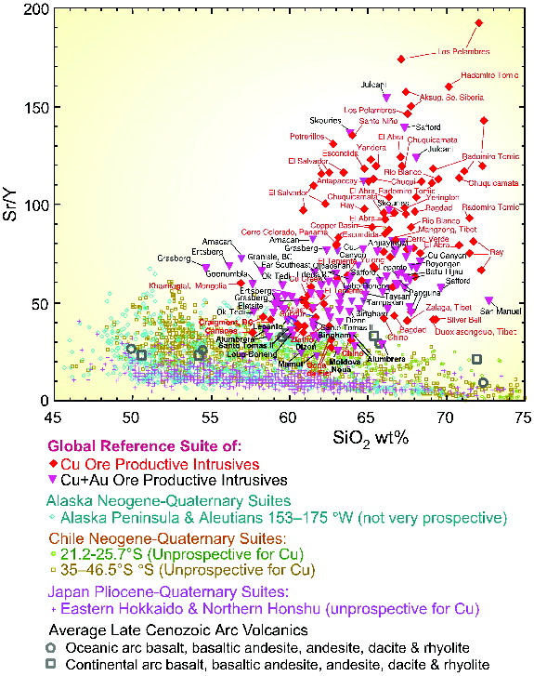
The applications of WR data
Already established as fertility indicator, following Loucks et al. 2014.

Slide 6
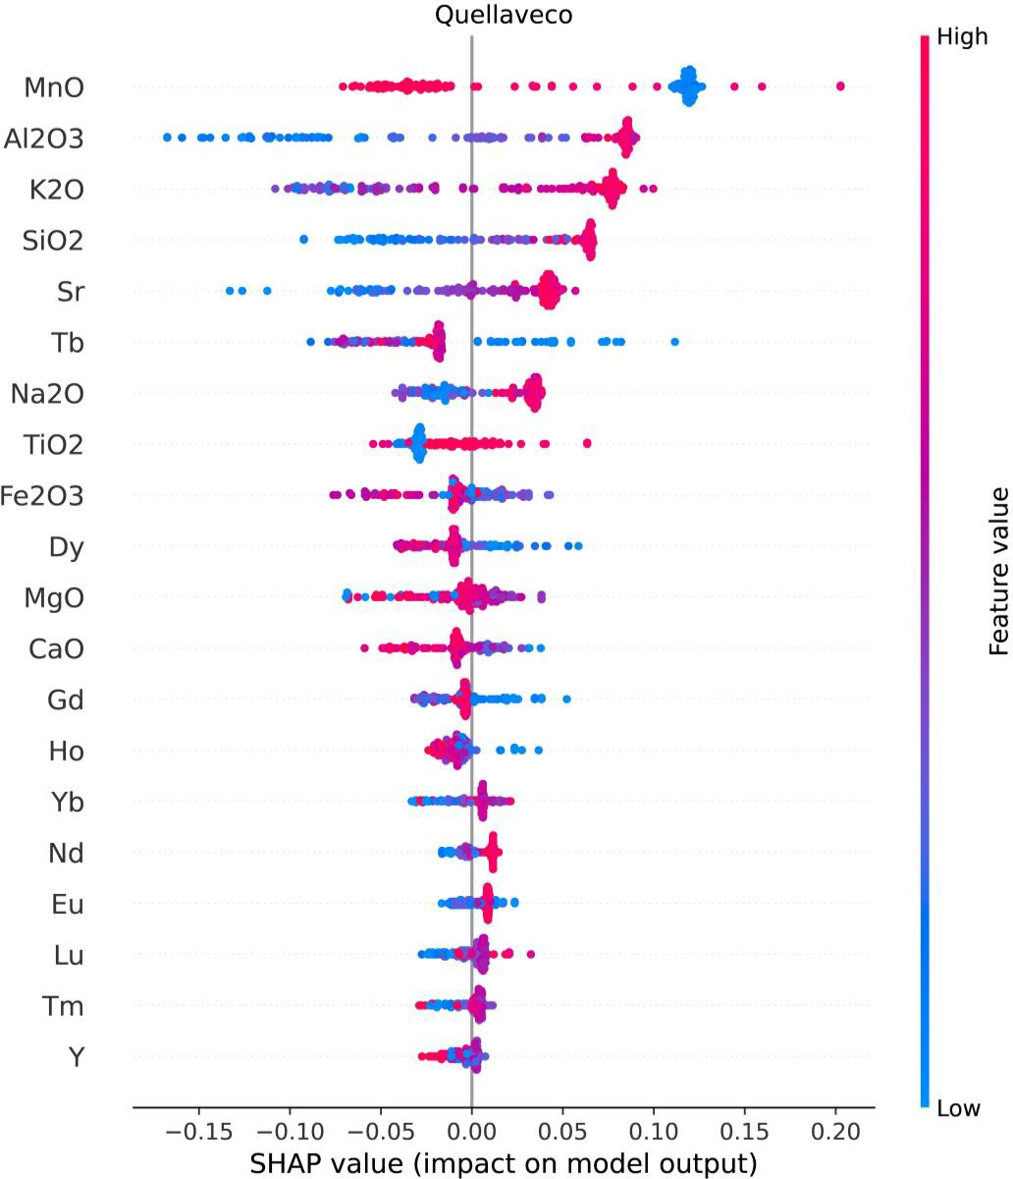
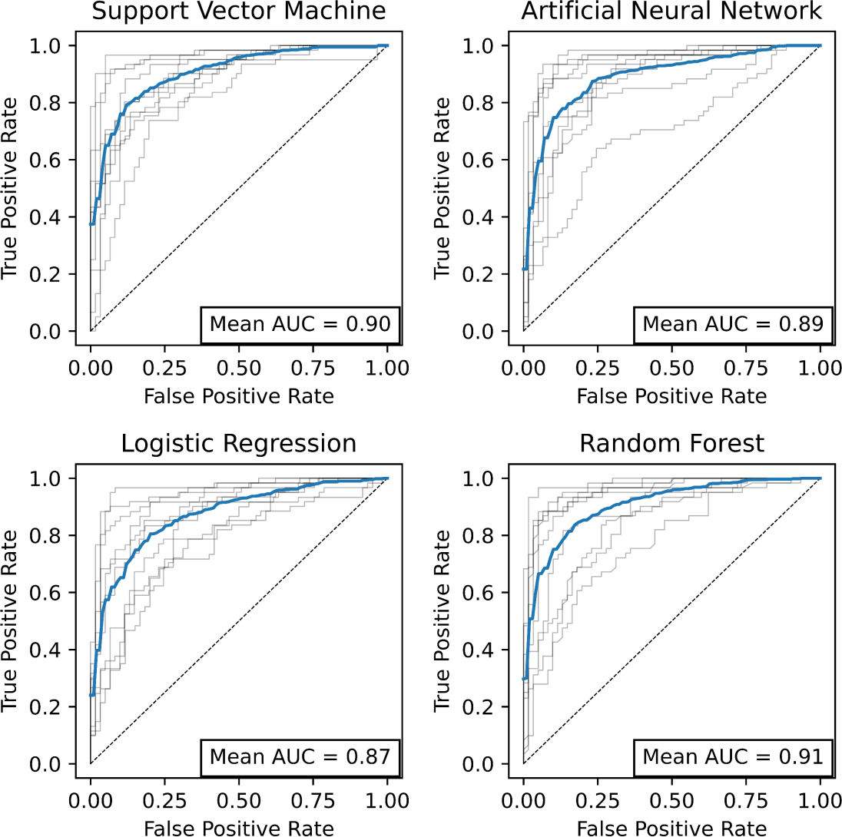
Recognition of fertile WR using machine learning
Four machine learning algorithms were trained using a filtered Georoc dataset, plus in-house whole rock data
Effective for discrimination of “fertile” from “unfertile” rocks in the database (tested using 10-fold cross-validation)
Feature importance SHAP values can be extracted to allow interpretability and escape from the ‘black box’
Nathwani et al. (2021
Mineralium Deposita)

Slide 7
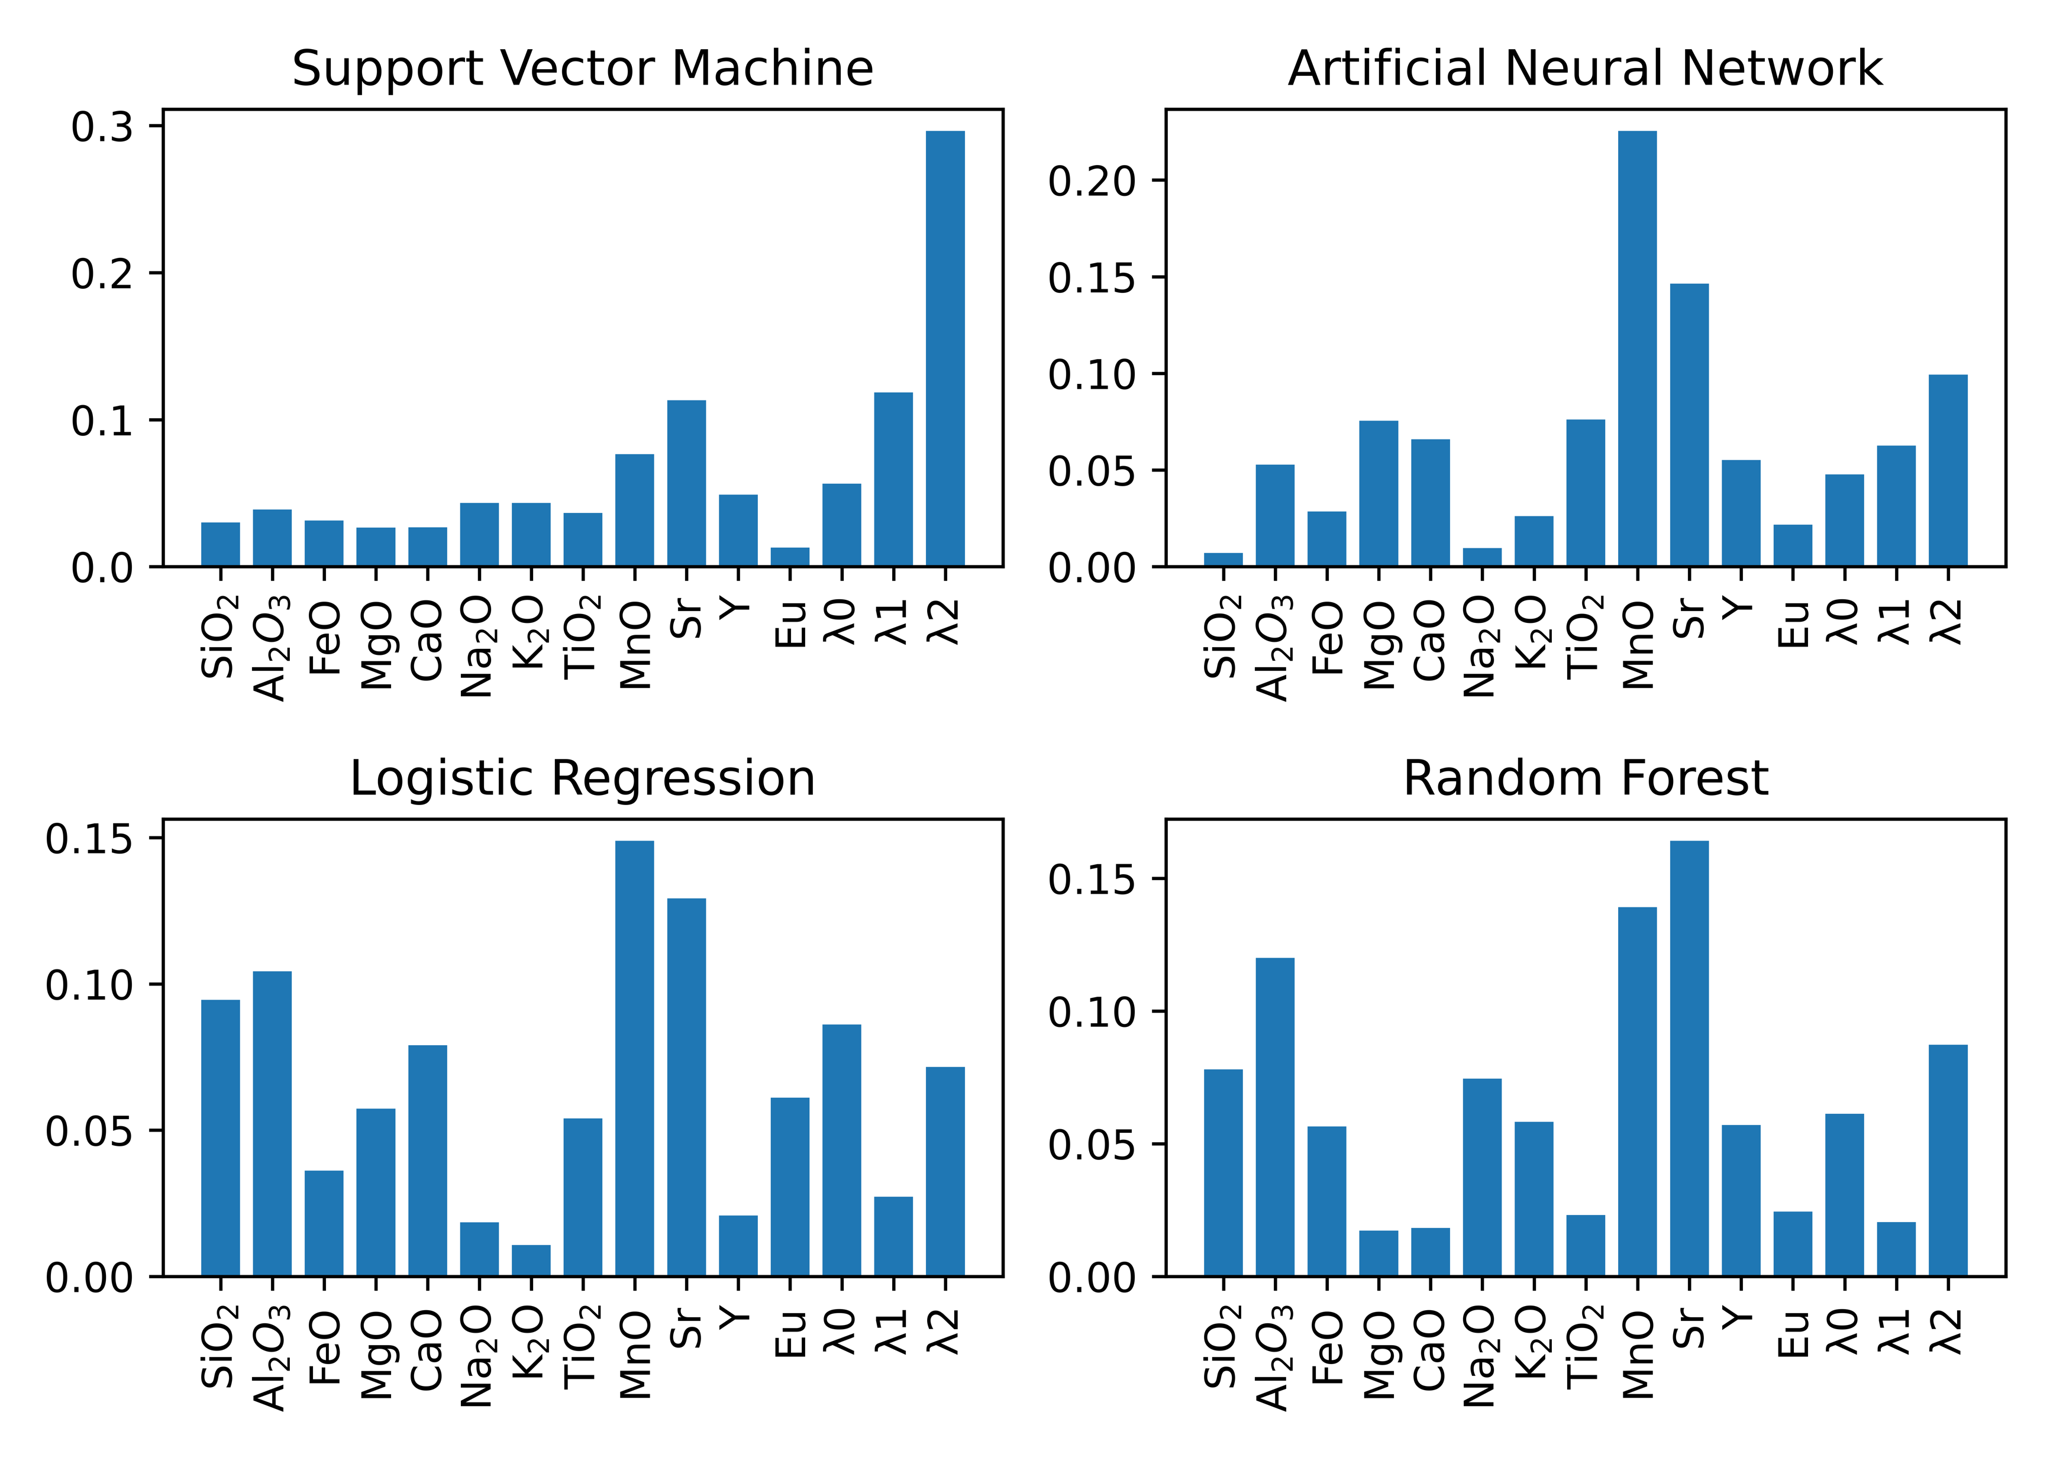
Extracting processes from ML
Feature importance information helps to identify potential petrogenetic processes
Perhaps multivariate/ machine learning models will help us distinguish economic from merely porphyry-prone? (MnO?)
High Sr
(plagioclase suppression)
Concave REE profile
(amphibole, cpx ± garnet)
Low MnO
(amphibole fractionation..??)
High Al₂O₃
(plagioclase suppression..?)
Nathwani et al. (2021, Min. Dep.)
REE λ parameters from O’Neill (2016)

Slide 8
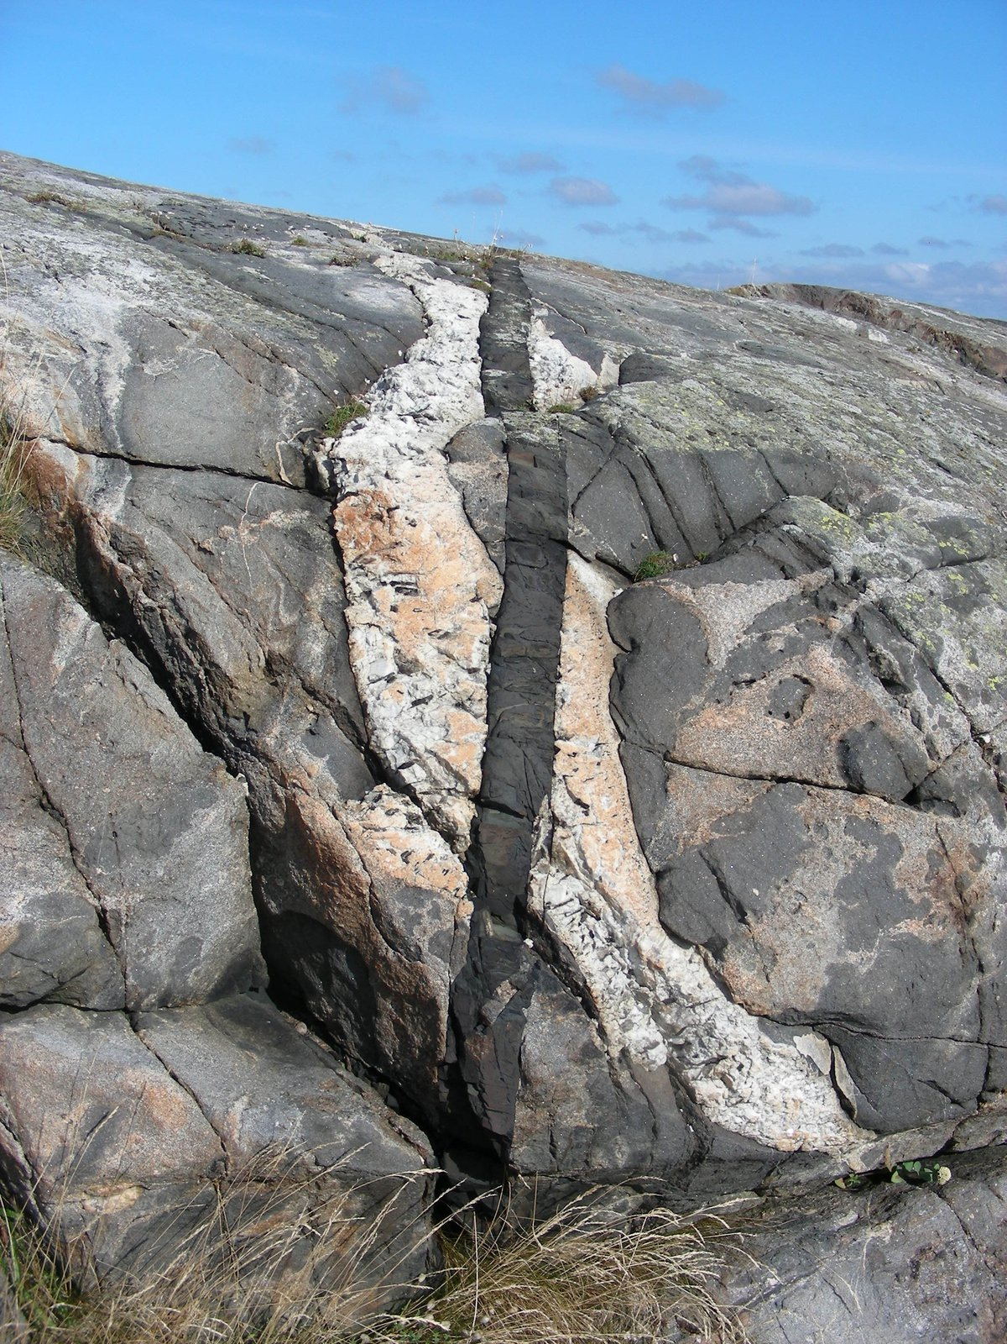
Whole Rock data – collection and purpose
Academic studies typically collect and analyse WR to classify and distinguish rocks.
Collection – and hence resulting data – are rarely intended to produce statistically representative (volumetric) datasets.
X₂O
X₂O
SiO₂
SiO₂

Slide 9
Samples vs Suites
In any determination of overall classification (including fertility) how do we weight samples for a location?
This is compounded by sampling strategies; the number of samples falling into a category has no real statistical meaning.
X₂O
X₂O
SiO₂
SiO₂

Slide 10
Trends, not samples
Academic samples more often collected to define trends, and these data can be reviewed for statistical quality with no prior knowledge needed of volumetric abundance at outcrop.
Can then review whether trends project into fertility fields.
This is a means of reviewing the processes, rather than the sample chemistry.
X₂O
X₂O
SiO₂
SiO₂

Slide 11
Linear regression as data reduction
y = mx+c
X₂O
Trend lines can be calculated statistically.
May need to use max range on a linear mixed effects regression model – where data are “clumpy” there can be unwanted linear regressions.
Some normalisation needed, depending on elements being interrogated –
total sum effect on majors
Big differences between ∆x and ∆y lead to poor regressions
Inflections are problematic statistically, but expected based on mineral-in events.
SiO₂
X₂O
SiO₂
X₂O
SiO₂

Slide 12
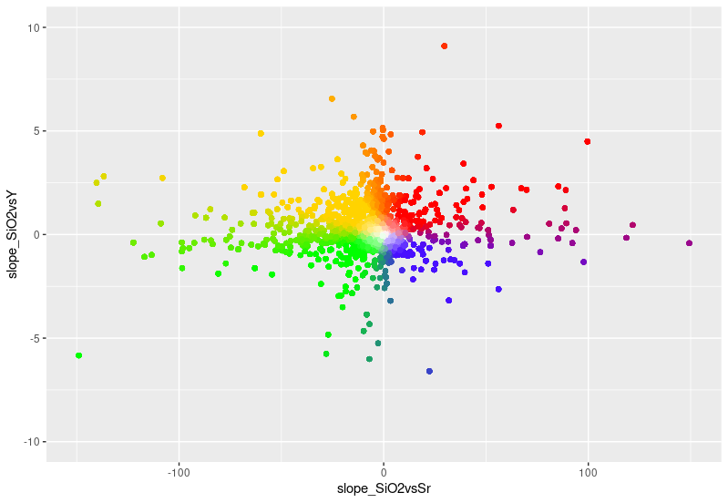
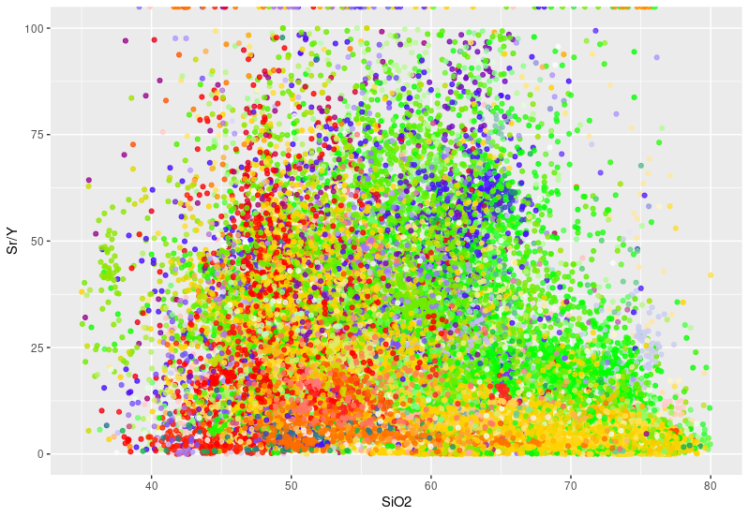
Regression-reduced data: Sr & Y (GEOROC, all arcs)

Slide 13
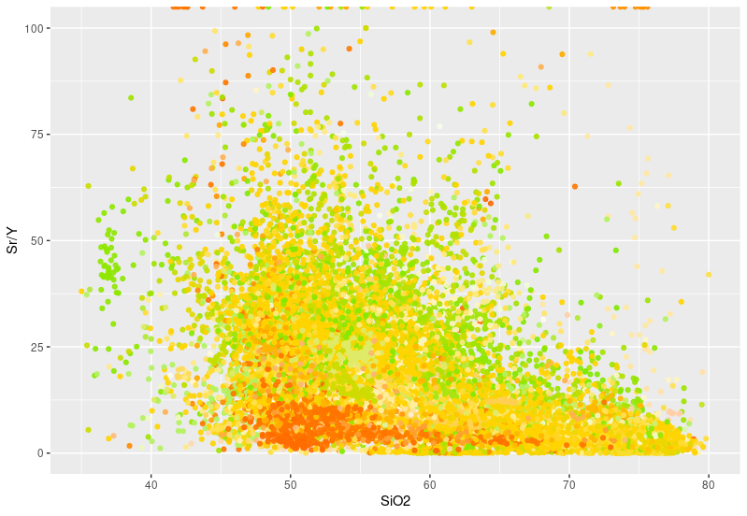
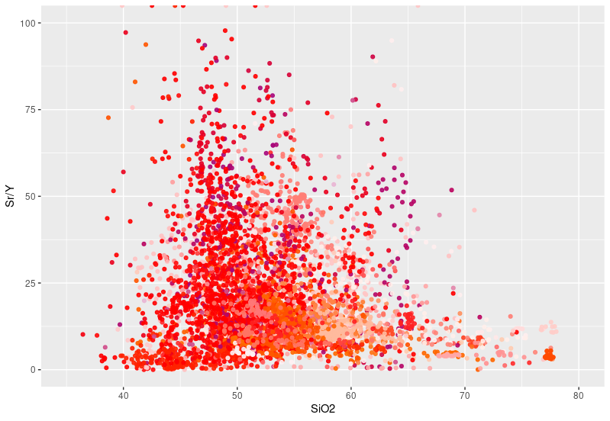
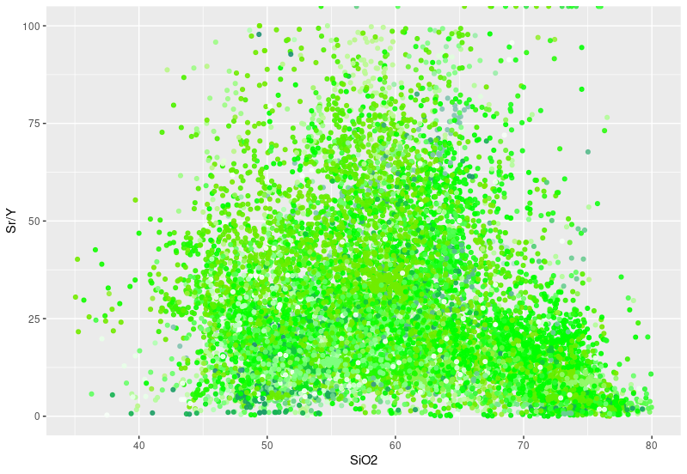
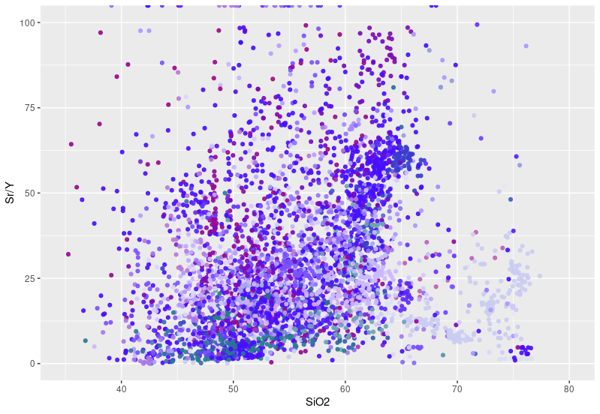
Sr/Y vs SiO₂, colour separated by Sr, Y slopes
Majority of data sit at relatively low (barren) Sr/Y)
High Sr/Y for flat to negative Y. Sr less important.
Positive Y slope
Negative Y slope
Negative Sr slope
Positive Sr slope

Slide 14
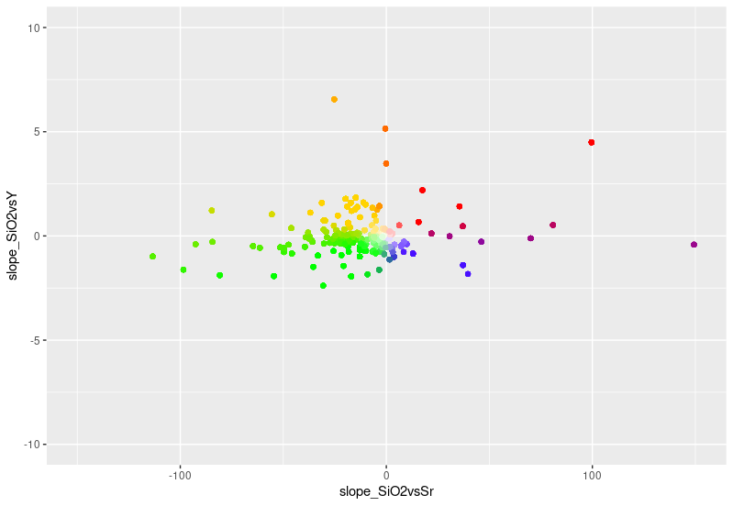
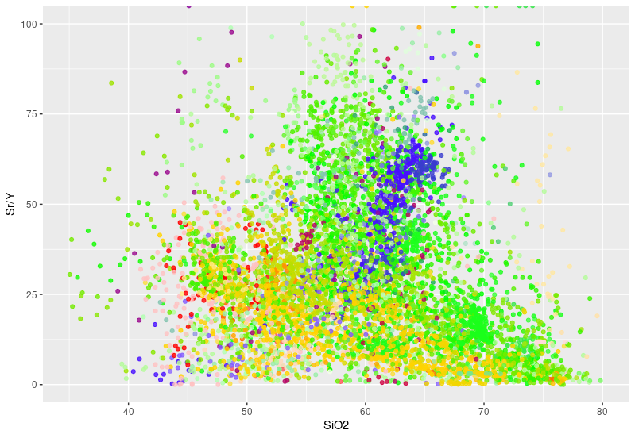
Regression-reduced data: Sr & Y (GEOROC, Andes)

Slide 15
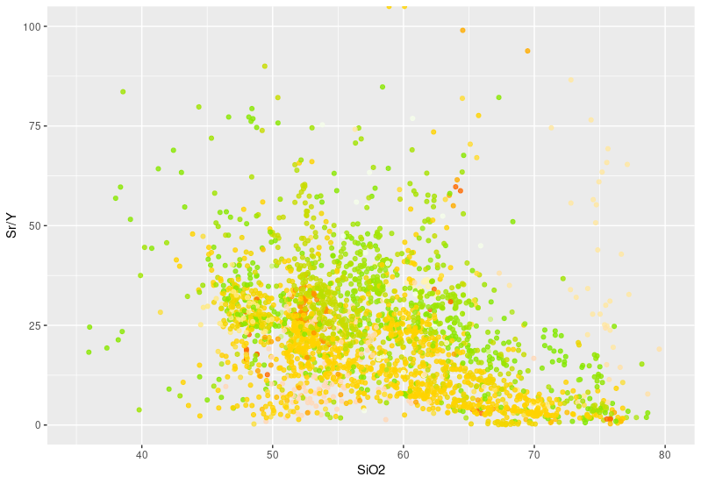
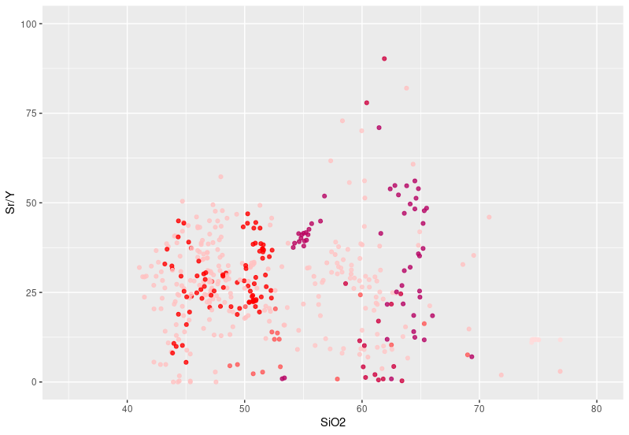
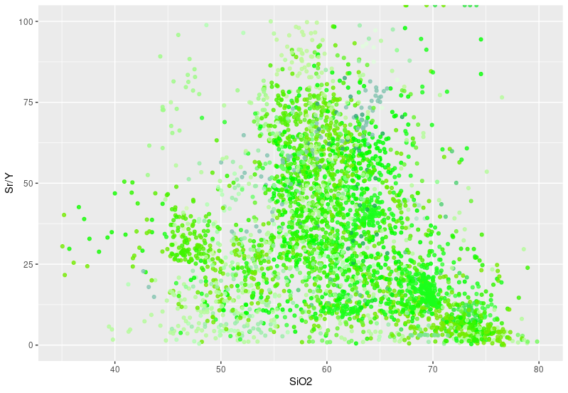
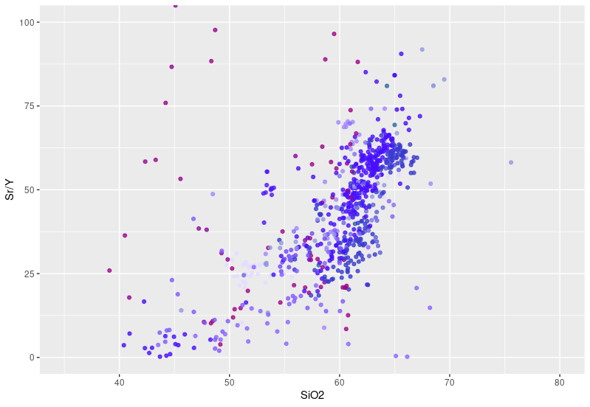
Regression-reduced data: Sr & Y (GEOROC, Andes)
Positive Y slope
Negative Y slope
Negative Sr slope
Positive Sr slope

Slide 16
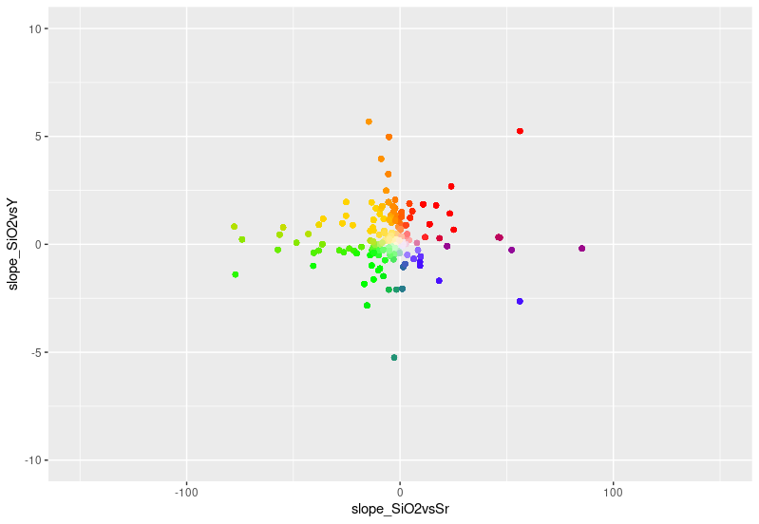
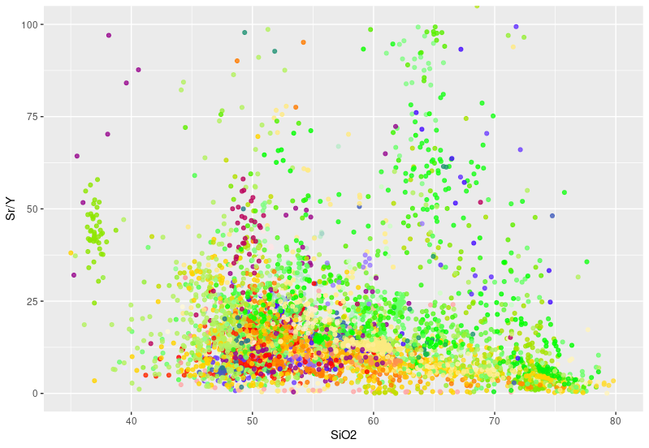
Regression-reduced data: Sr & Y (GEOROC, Honshu)

Slide 17
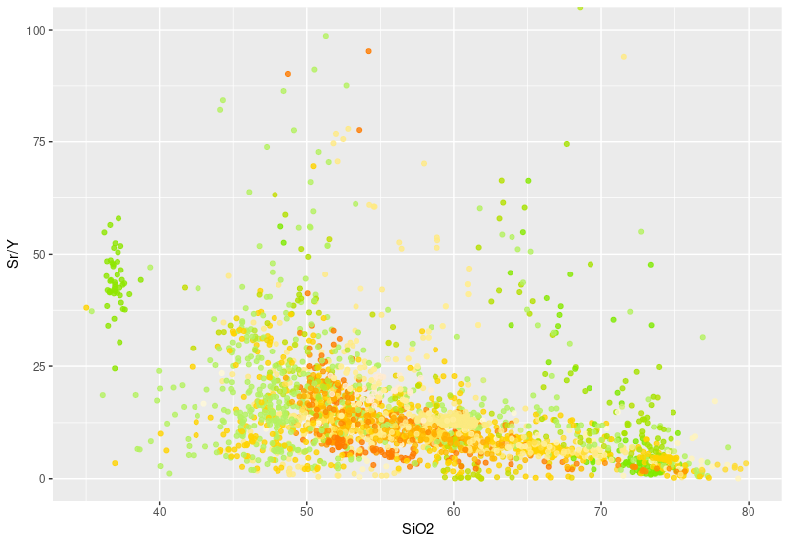
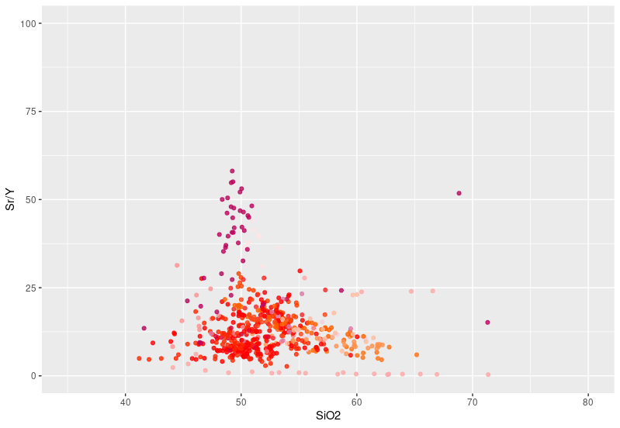
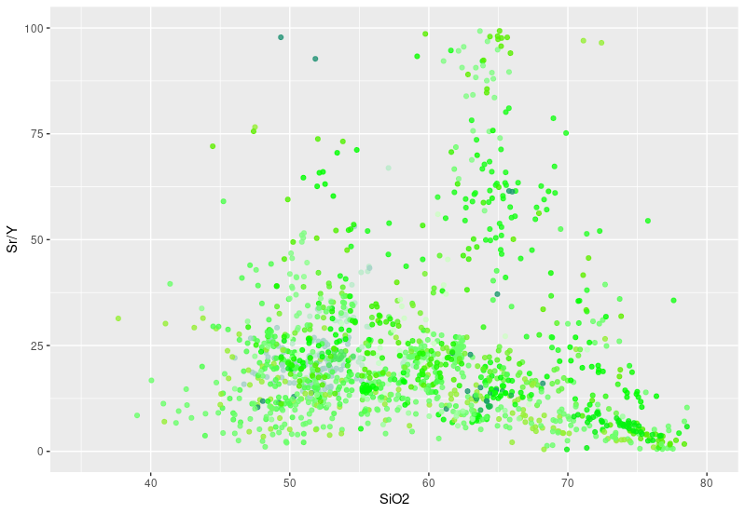
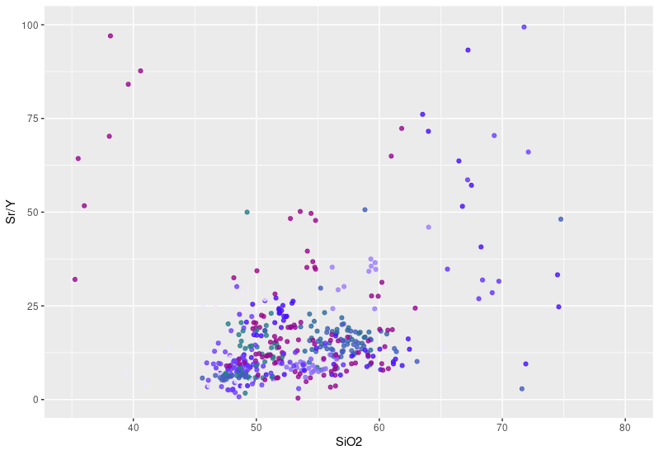
Regression-reduced data: Sr & Y (GEOROC, Honshu)
Positive Y slope
Negative Y slope
Negative Sr slope
Positive Sr slope

Slide 18
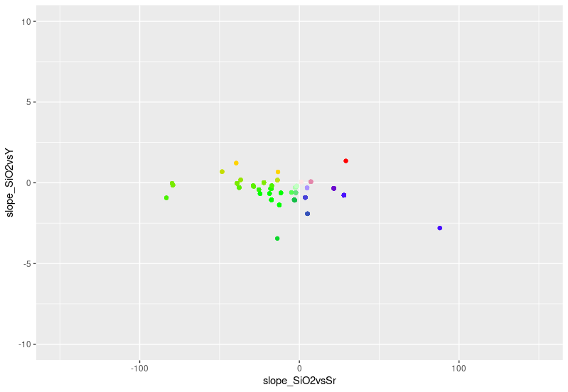
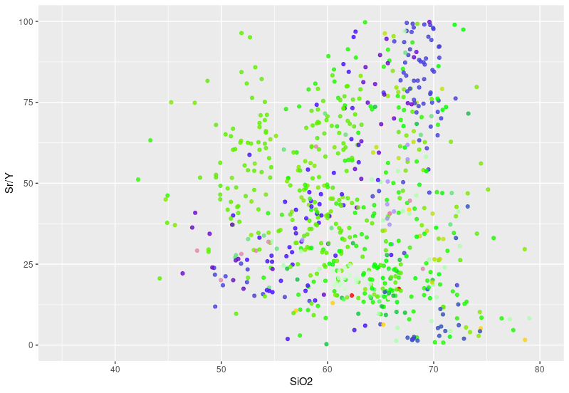
Regression-reduced data: Sr & Y (PCD-associated)

Slide 19
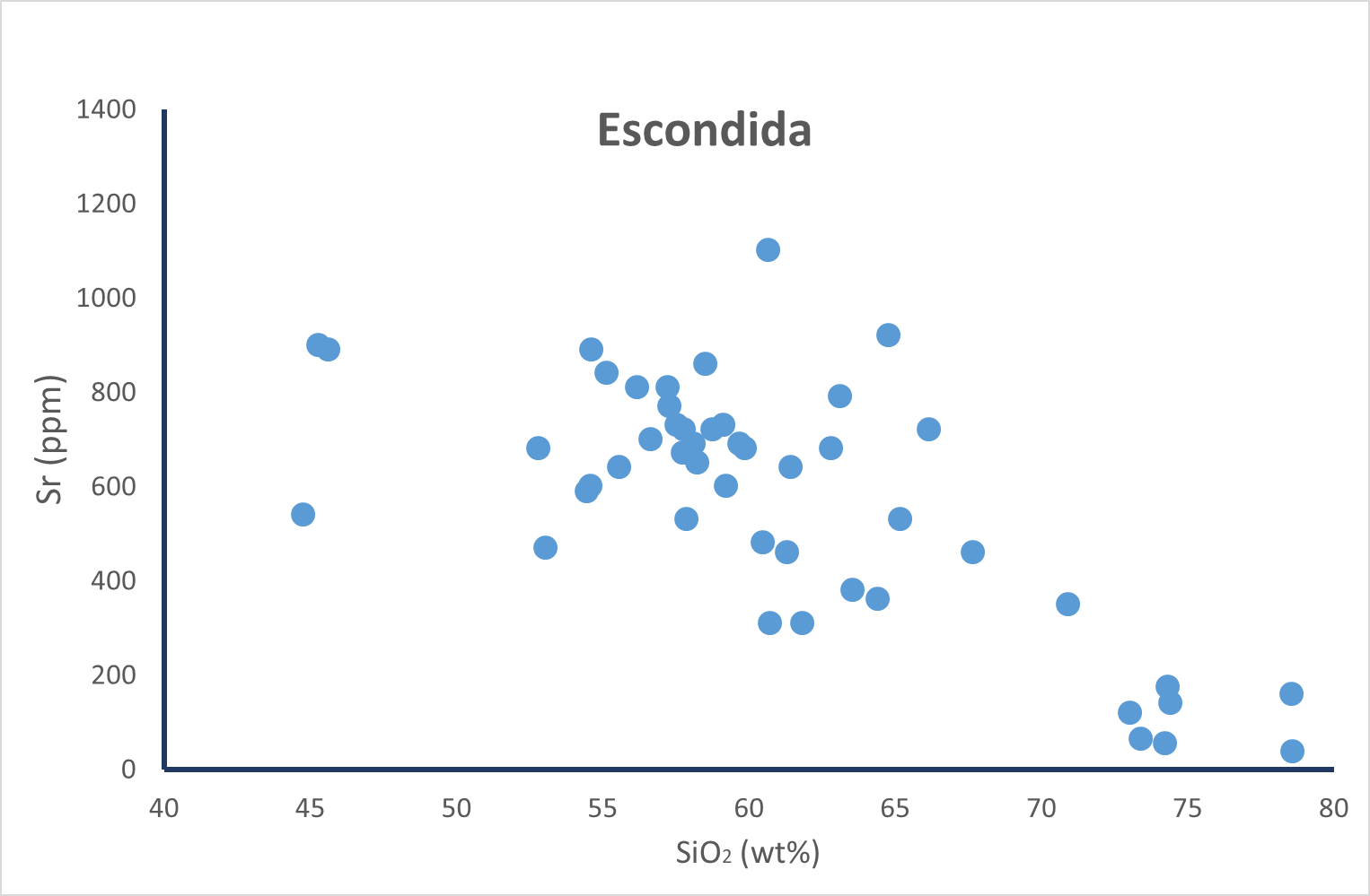
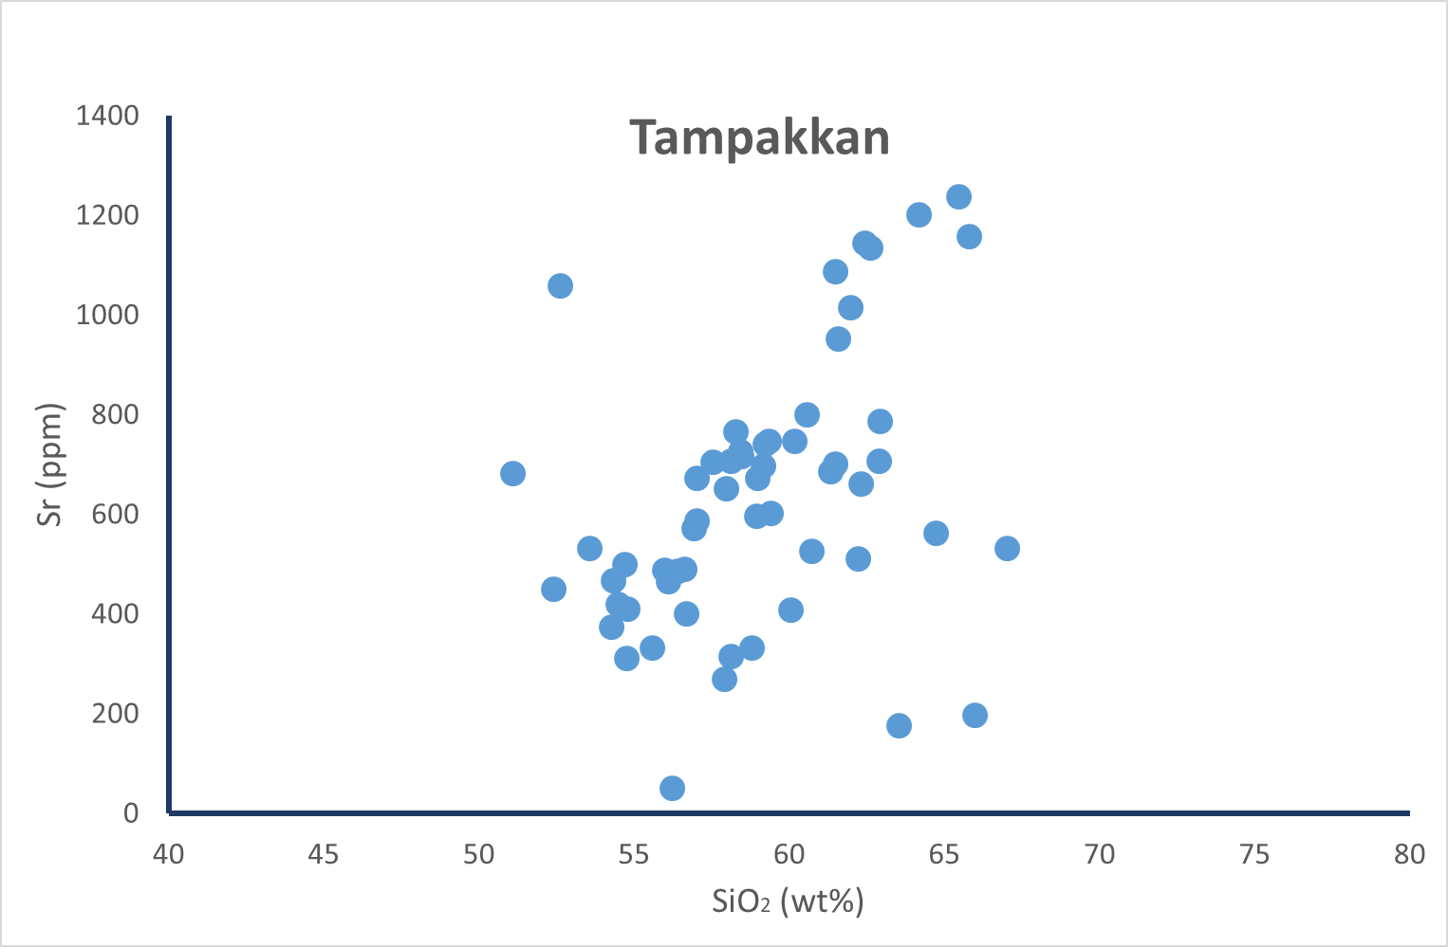
Regression-reduced data: Sr & Y
Samples plotting in the “Loucks Wedge” arrive there by two pathways:
Sr increasing, Y decreasing with SiO₂
Sr decreasing but initially high, Y decreasing with SiO₂
Sr/Y is effective, and sample-based ML approaches work because over the values of interest (nominally 65% SiO₂) Sr is high and Y is low.
However, this obfuscates two pathways
Water rich, plag supressed
LILE-enriched, plag stable
Not necessarily exclusive – Sr somewhat vulnerable to accumulation, non-LLOD effects in WR data.

Slide 20
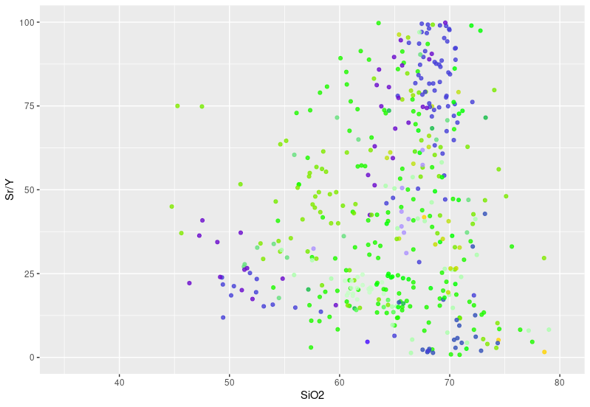
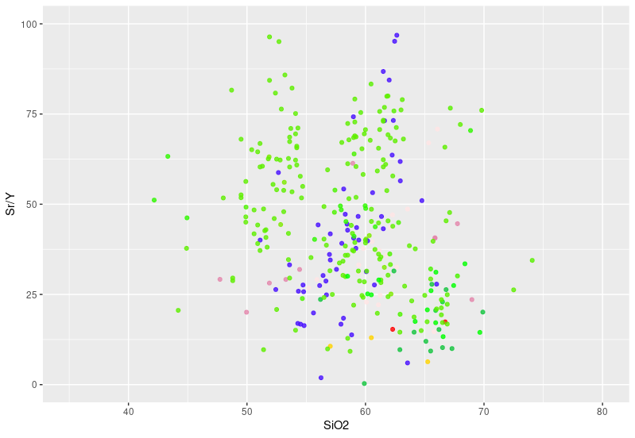
Regression-reduced data: Sr & Y (Cu-Mo, Cu-Au)
Cu-Mo
Not really seeing a strong distinction between metal associations and Sr/Y typology
However, metal associations are not WR geochemical analyses, but economic & metallurgical properties. Better data may refine here.
Not assessed for size of deposit.
Cu-Au

Slide 21
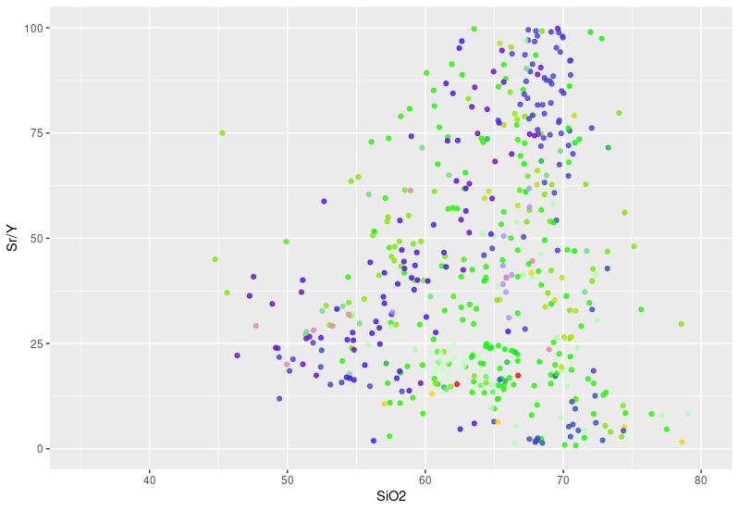
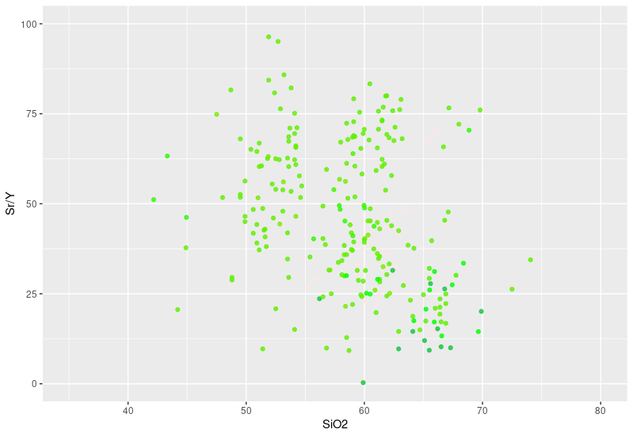
Regression-reduced data: Sr & Y (K vs CA)
Calc-alkaline
Potassic suites almost exclusively the high initial Sr pathway
Reflects LILE enriched source (metasomatised SCLM, lower crustal sequence?)
Calc-alkaline suites contain both mechanisms.
Potassic

Slide 22
Regression-reduced data: potential and next steps
Any pair of elements can be reduced to a small number of data points (slope, intercept, quality statistics), irrespective of # samples
Don’t need to subsample large datasets for ML approaches.
Can feed in ratios or other modified data (e.g. λREE).
Intending to trial ML on reduced dataset (selected elements vs SiO₂)
Likely need to subdivide datasets. Including two mechanisms may cause it to fail.
Including intercept values may be useful in tracking enrichments at source.

Slide 23
Takeaway messages
Elevated Sr/Y isn’t particularly reliant on plagioclase suppression during differentiation.
Decreasing Y is necessary.
Suggests two endmember mechanisms - LILE enrichment at source (metasomatism? Post-subduction type magmatism?), or very hydrous differentiation (amph>>plag).
Why do both work, and apparently as a continuum?

Slide 24
Mush buffering

Slide 25
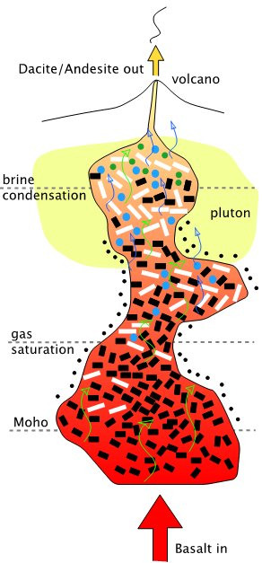
Mush Buffering
Classic fractional crystallisation is challenging in a mush environment, particularly if crystallising phases are reactive with the evolving melt.
Reaction-replacement (or peritectic) mineral-melt reactions would instead govern the chemistry.
Extracted melts are a product of multiply-saturated equilibria (in arcs – CHOMPI)
Exact position within the CHOMPI space will depend on temperature, flux rate, pathways, etc. AND the presence of all phases.
However, some of the phases form at the expense of others in reaction-replacement processes
CHOMPI is buffered, and the mineral buffers are capacious, but finite.
T R A N S - C R U S T A L M U S H
Cashman et al. (2017, Science)

Slide 26
Cpx sponge is a buffer
Amphibole-in phase relations are typically at the expense of an earlier-formed silicate – often cpx
Magmas released from hot zone likely to show a continuum from cpx to hbl fractionation – supported by CHOMPI and Davidson’s follow ups to amph sponge model.
Cpx is near ubiquitous and likely abundant; buffer is capacious and hence the norm.

Slide 27
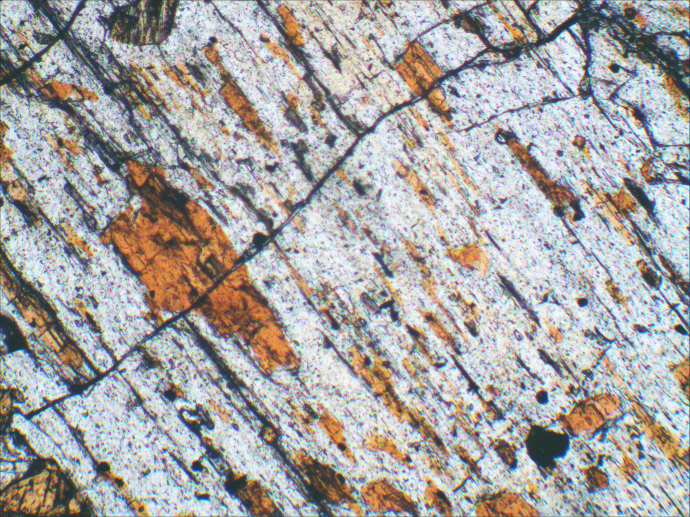
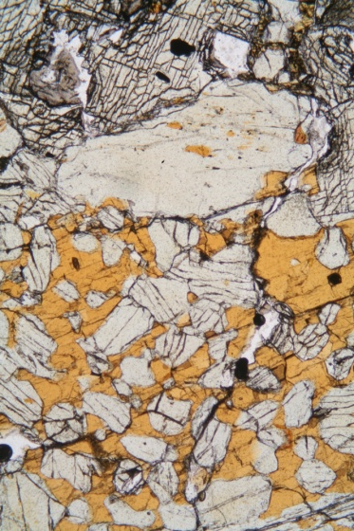
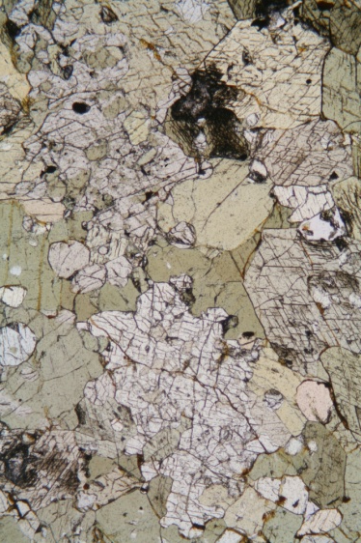
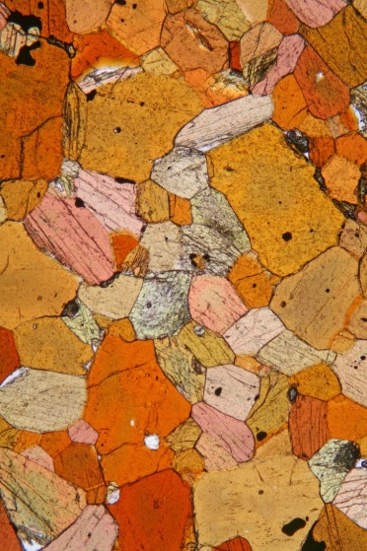
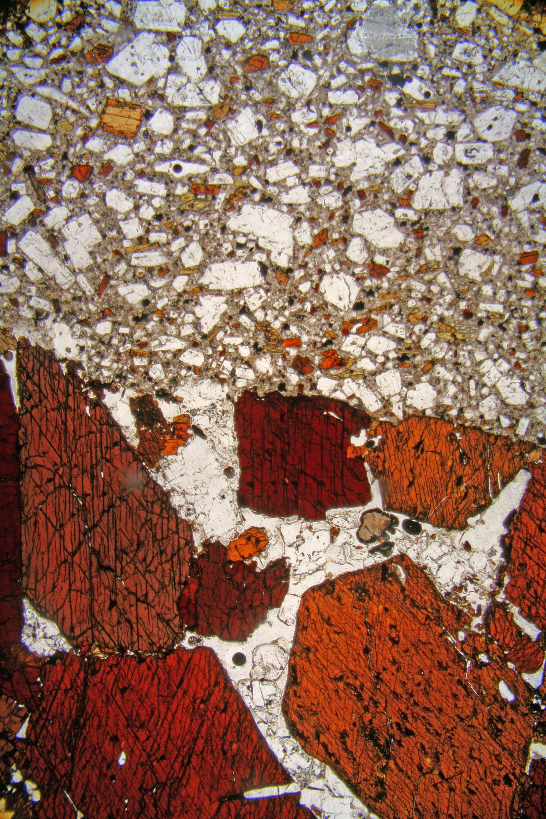
Amphibole styles
Peritectic
Cpx > Hbl
Peritectic
Cpx = Hbl
Peritectic
Cpx < Hbl
Peritectic
Hbl
Idiomorphic
Hbl

Slide 28
Amphibole compositions
Peritectic amphiboles
Peritectic amphiboles have cpx-like Mg numbers.
The idiomorphic (liquidus) amphiboles are iron rich.
Late crystallisation of plag in this case produces high Mg#, low Al amphiboles, with marked negative Eu anomalies.
Liquidus amphibole favoured by high water in melt.
Idiomorphic amphiboles
Late rims

Slide 29
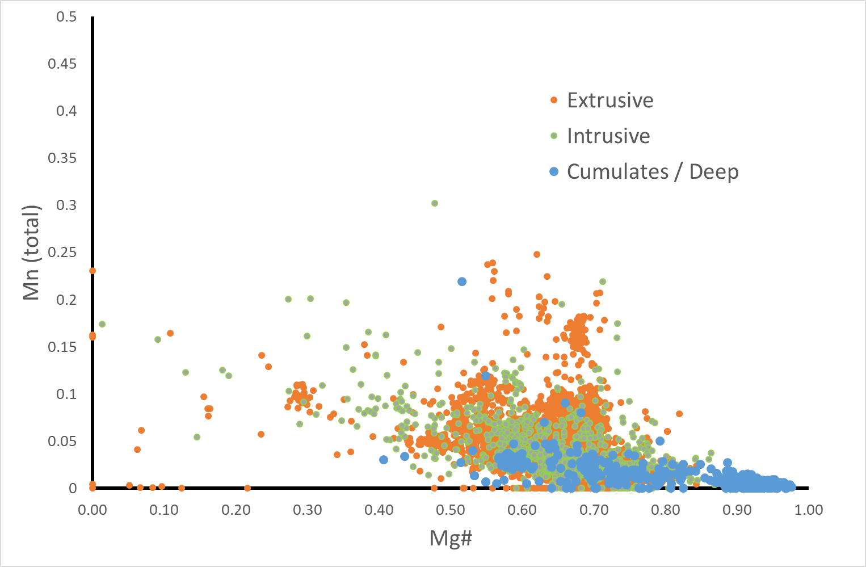
Convergent Margin amphiboles

Slide 30
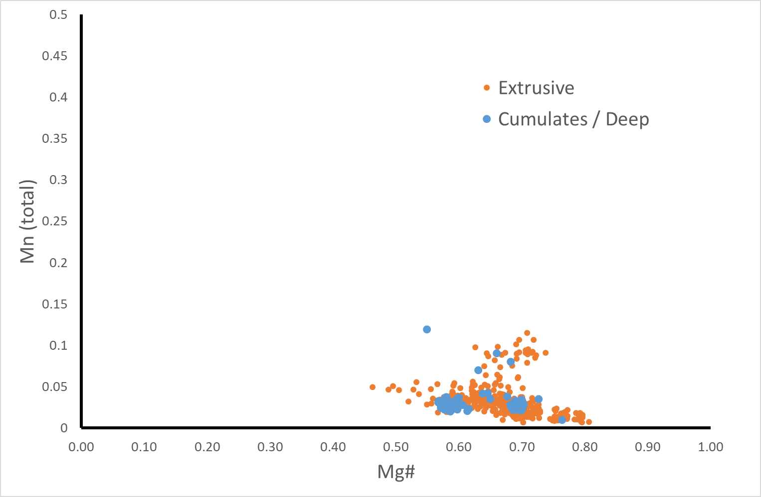
Savo amphiboles

Slide 31
Amphibole Compositions contd.
Compositional Controls
Mg²⁺ ↔ Fe^{2+ VI}Al ↔ Fe³⁺
Normal (peritectic) conditions
Mg# set by cpx. Minimal effect on Fe²⁺
Reducing; Fe³⁺ “fractionated” in octahedral site
Melt H₂O buffered unless cpx exhausted?
Unbuffered (phenocryst) conditions
Mg# no longer controlled by cpx. Greater fractionation of Fe²⁺
Oxidising; fractionation Fe²⁺ > Fe³⁺
Melt H₂O controlled by basic lever rule?
Unbuffered (cumulate) conditions
Mg# no longer controlled by cpx. Greater fractionation of Fe²⁺
Oxidising; fractionation Fe²⁺ > Fe³⁺
Plag supressed at high P; higher ^{VI}Al
Melt H₂O controlled by basic lever rule?

Slide 32
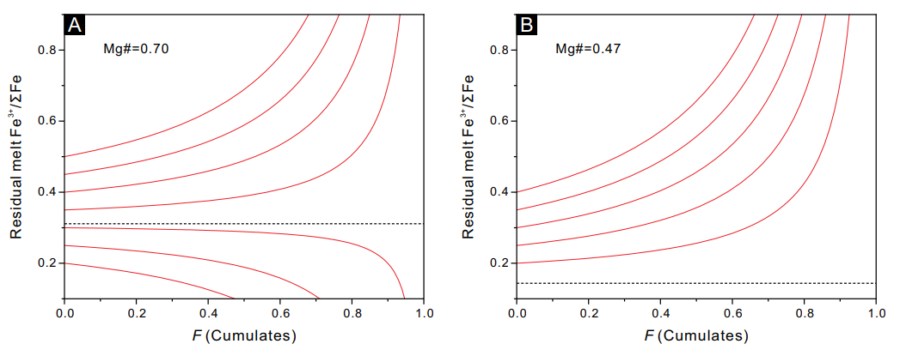
Amphibole and redox
High Mg# (cpx-like) amph can reduce melts
Low Mg# amph can oxidise melts
Zhang, Jingbo, Wang, Rui and Hong, Jun. "Amphibole fractionation and its potential redox effect on arc crust: Evidence from the Kohistan arc cumulates" American Mineralogist, vol. 107, no. 9, 2022, pp. 1779-1788. https://doi.org/10.2138/am-2022-8141

Slide 33
Amphibole Compositions contd.
Compositional Controls
Mg²⁺ ↔ Fe^{2+ VI}Al ↔ Fe³⁺
Normal (peritectic) conditions
Sulphide saturated in lower crust
Limited H₂O in derived melts
Unbuffered (phenocryst) conditions
Late stage oxidation, post-sulphide saturation
Unspectacular H₂O
Unbuffered (cumulate) conditions
Oxidation in lower crust – remobilisation of sulphides (S & Cu?)?
High H₂O
Characteristic Mn signature? Mg²⁺ ↔ Mn²⁺?

Slide 34
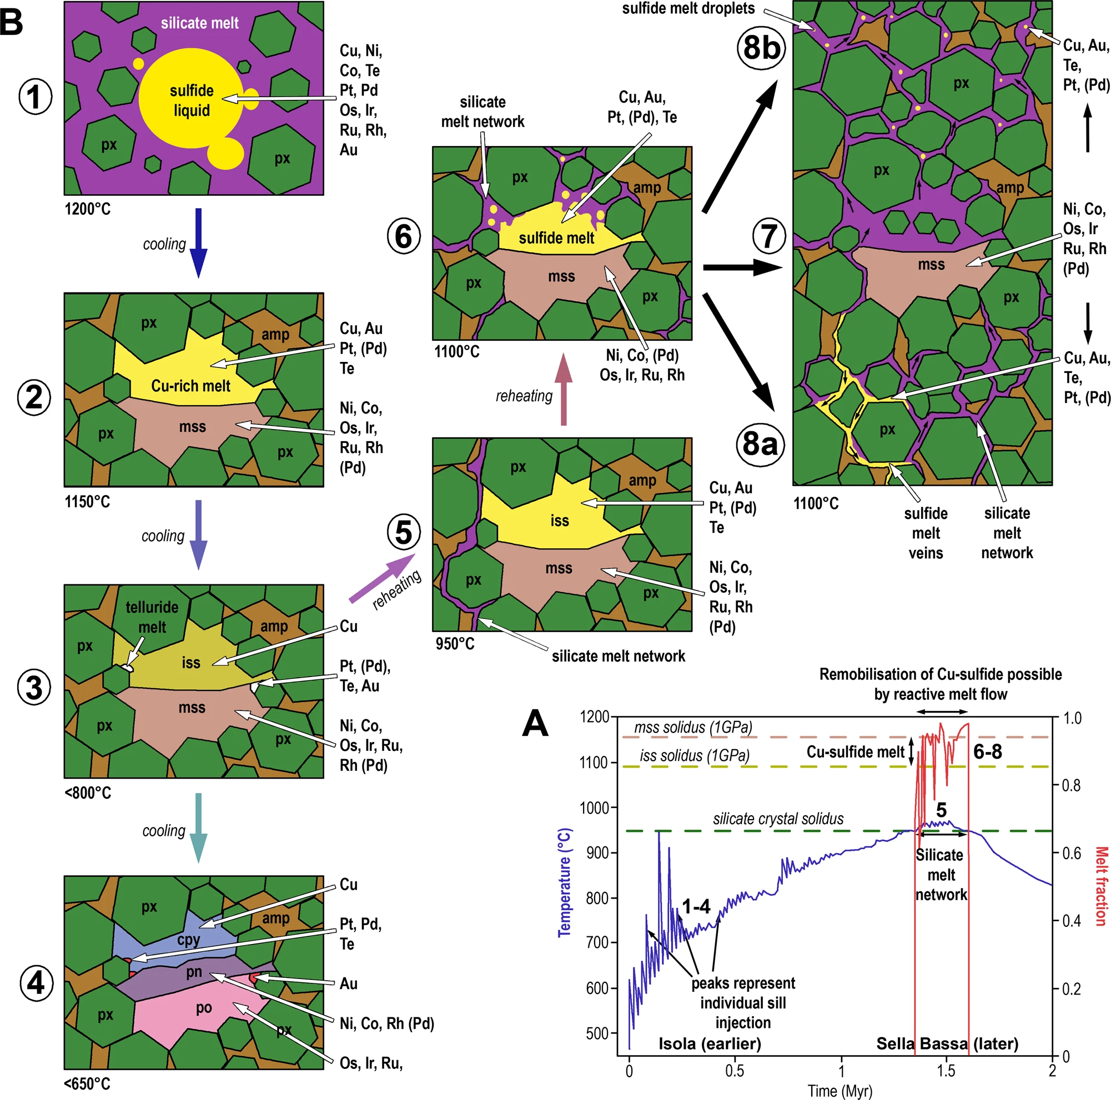
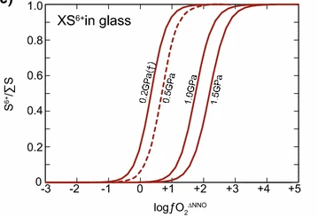
Matjuschkin et al 2016

Slide 35
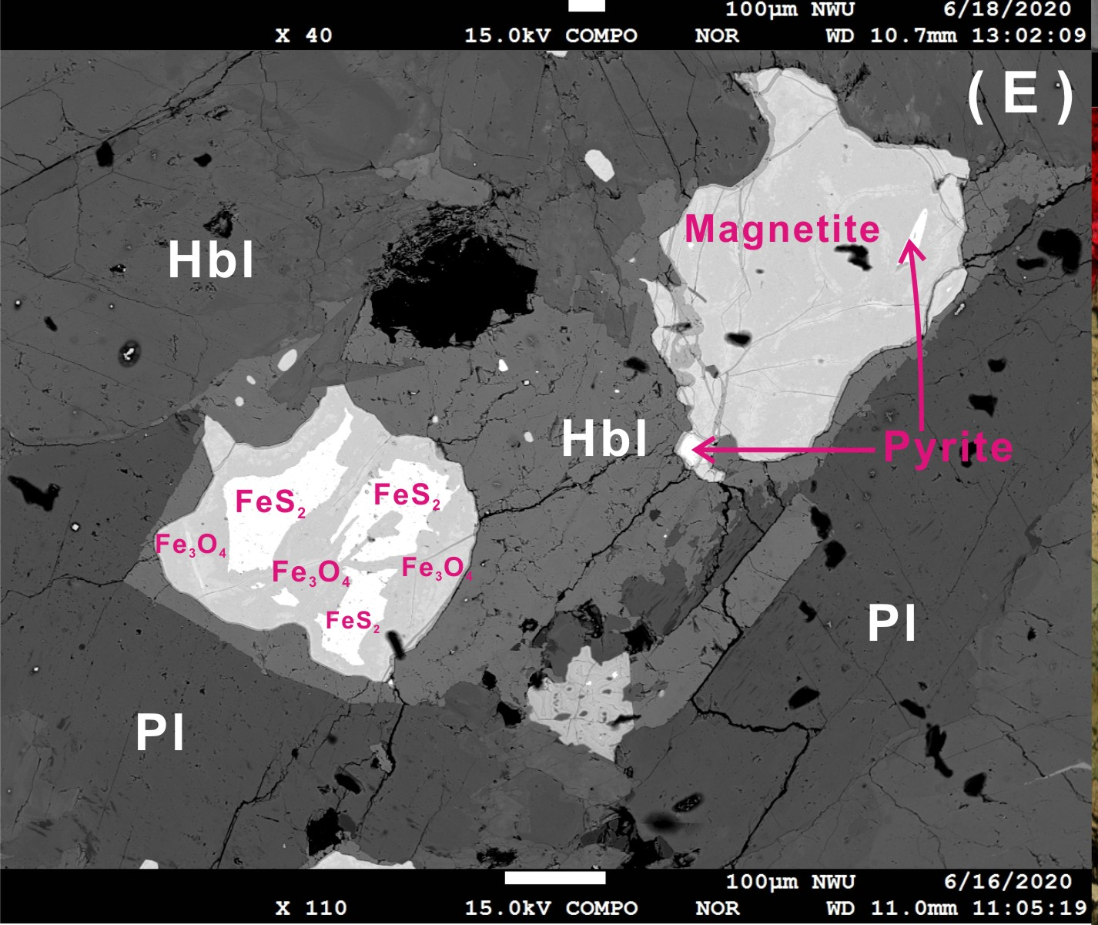
Hydrous style - Oxidation of lower crust?
Key issue is timing of amphibole being unconstrained by precursor cpx.
Easily done in phenocrysts, but wouldn’t have any influence on S (or Cu).
Surpassing the peritectic buffer in the lower crust means more water, possible release of S and Cu, and positive feedbacks with plag suppression.
Emptying buffer of CPX is a key driver.
Alternative mechanisms are that metasomatising fluids /melts during the reaction replacement can break down earliest sulphides.
Ren-Zhi Zhu Shao-Cong Lai, Fangyue Wang, Jiang-Feng Qin, Chao Zhang, Shaowei Zhao – in prep

Slide 36
Mush Buffering and two Sr/Y pathways
Fractionation with reaction replacement
Percolative flow / MASH
Partial melting / disruption
Syn-subduction
Needs mature crust (hbl>>cpx & plag)
Remobilises some trapped sulphides; potentially avoids some loss
High water; plag supression
Syn- and post-subduction
Needs mature crust (hbl>>cpx & plag)
Needs disruption (extension)
Remobilising trapped sulphides.
LILE-rich (potassic, high Sr) – not particularly wet.

Slide 37
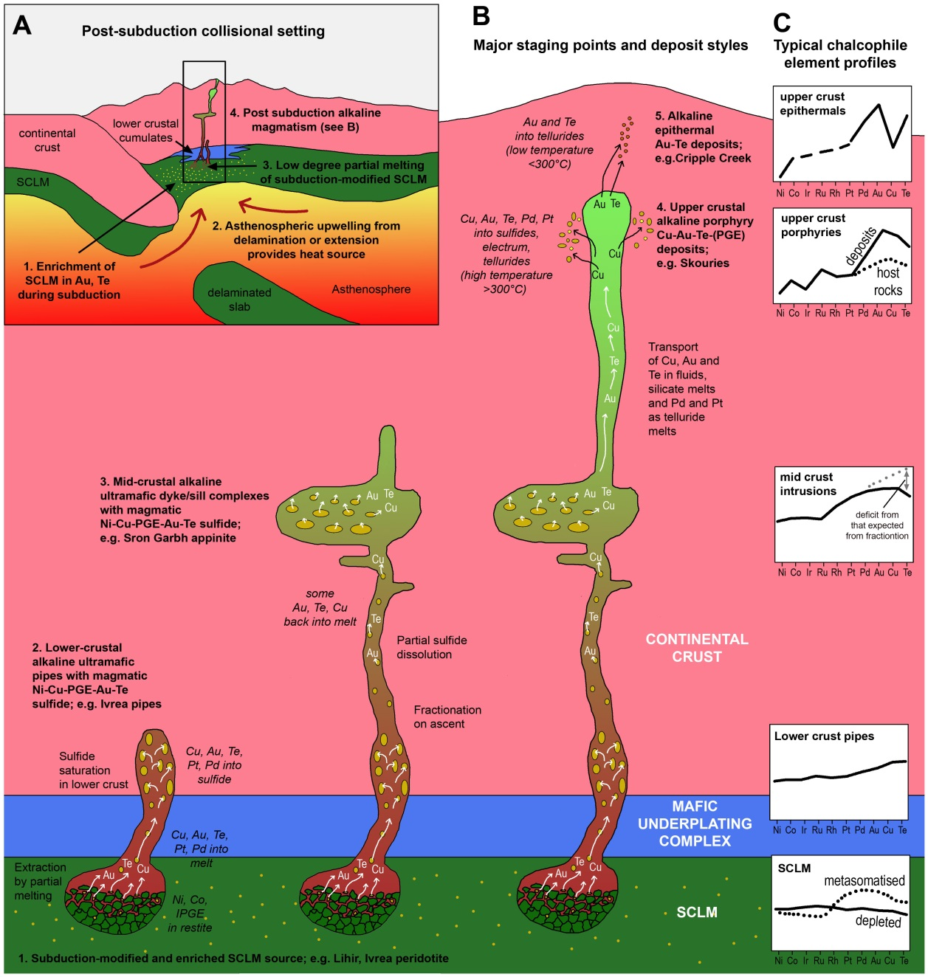
Remelting style
Would expect this family of deposits to be Au, Te rich – but these data are lacking
Au often in terms of recovered metal, not the original geochemical signature.
Holwell, David A., et al. "A metasomatized lithospheric mantle control on the metallogenic signature of post-subduction magmatism." Nature communications 10.1 (2019): 1-10.

Slide 38
From model to tools
Early ambition of FAMOS was to challenge established porphyry model and adapt a mineral systems approach.
Perhaps both paradigms (really wet vs a bit wet) are correct.
No single mineral system pathway from source to sink – consistent with geodynamic variety of porphyry deposits.
WP4 tools and ML approaches are working because of common role for amphibole; is success of Sr serendipity?
Splitting data into different pathways, or looking more specifically at amphibole-driven geochemistry may yield better results.

