Slide 1

Advanced Methods for Information Representation
Effect of thresholding,amplification & shifting of Detail Wavelet Coefficients

Slide 2
Background
FIR filters used in the orthogonal DWT cannot have
linear phase.We need linear phase FIR filters to avoid distortion at edges and discontinuities. This is why biorthogonal filters are used for image compression , denoising,etc.
In order to implement a two-channel perfect reconstruction biorthogonal DWT, the FIR filters used in the filter bank should possess the following properties:
1. The filter length L is even.
2. The filters have linear phase response.
3. g0 [n] and h0 [n] are not time-reversed versions of each other.
4. Similarly, g1 [n] and h1 [n] are not time-reversed versions of each other.

Slide 3
Biorthogonal filter bank:

Slide 4
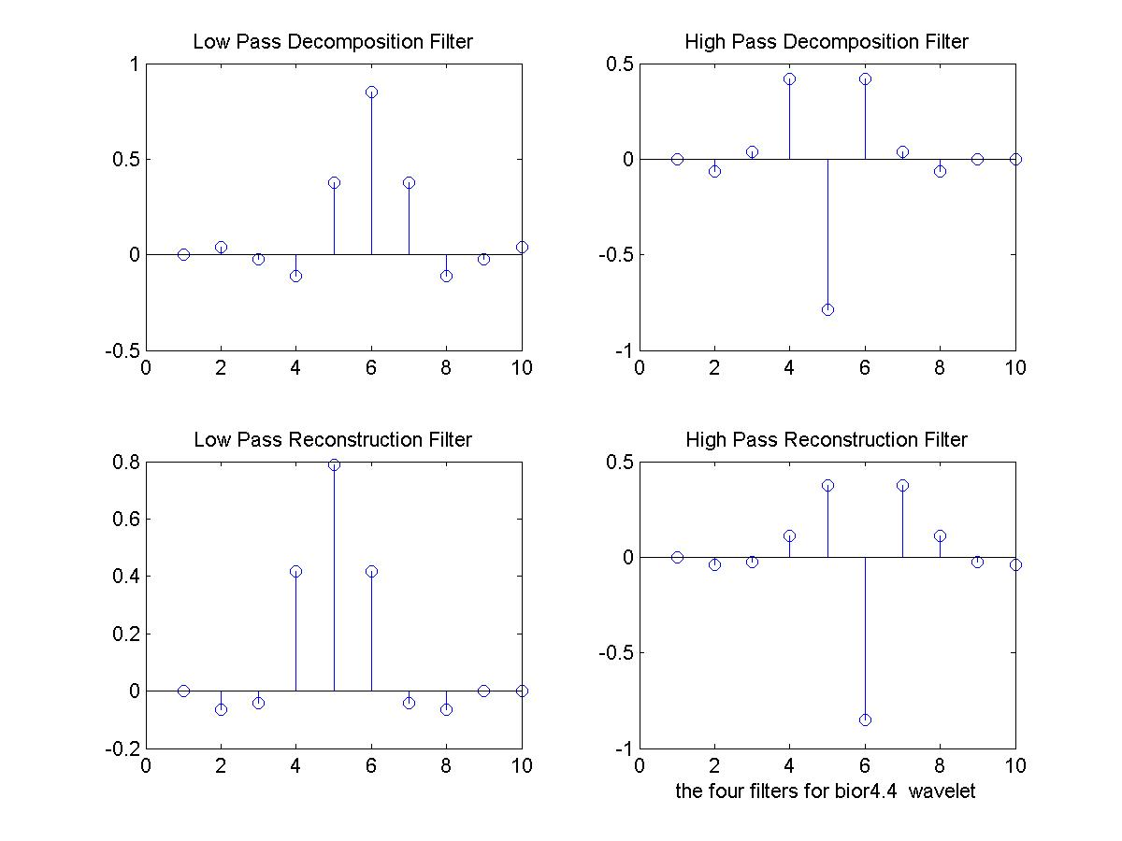

Slide 5
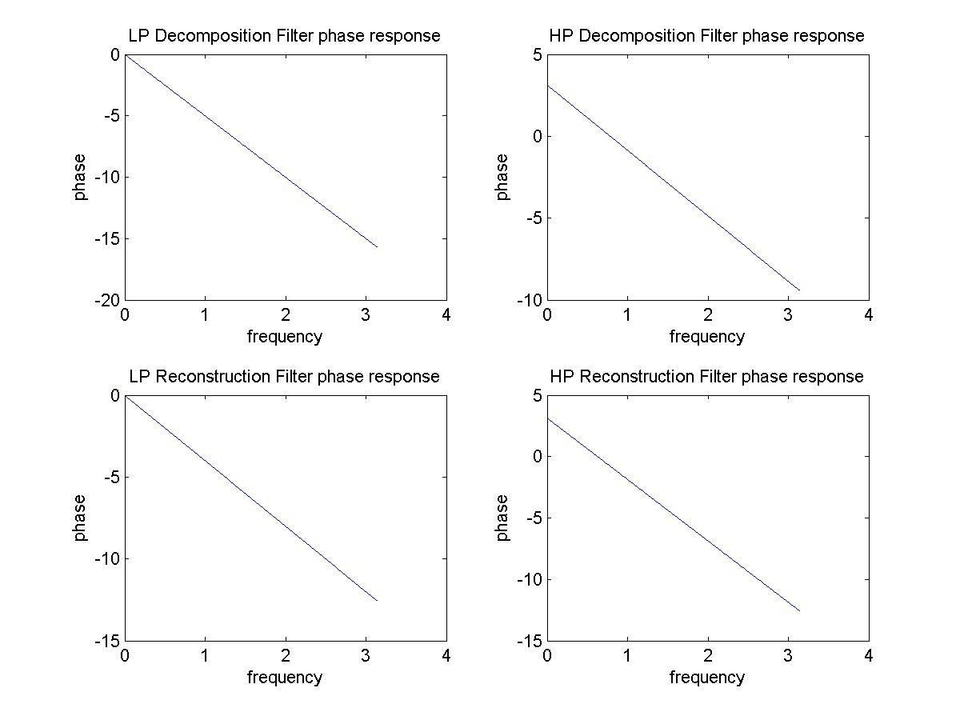

Slide 6
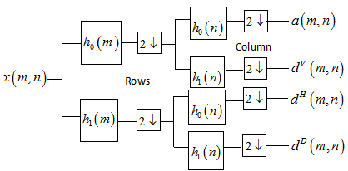

Slide 7
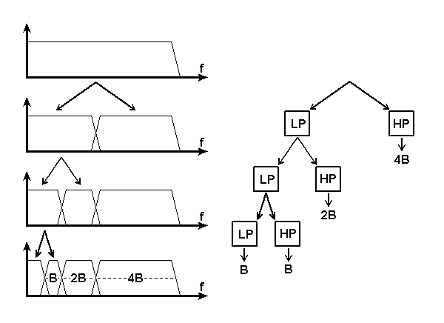

Slide 8
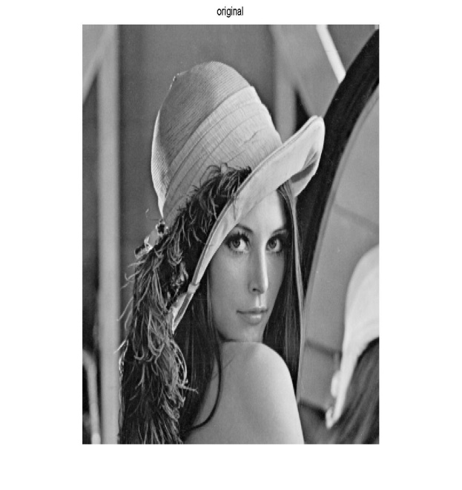
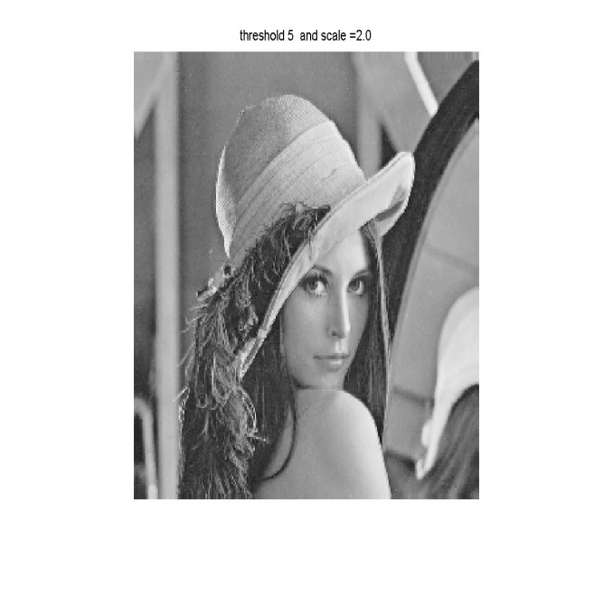
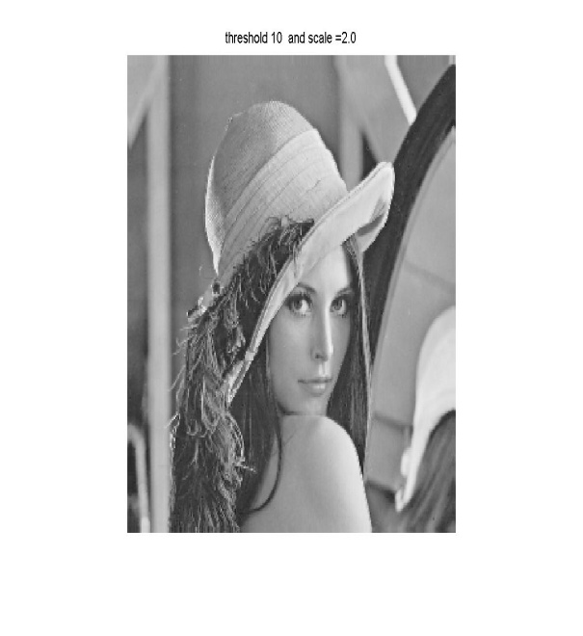

Thresholding &amplification
Coefficients in the detail subbands are less informative and their values are less compared to approximate coefficients.So removing some coefficients in the detail subband does not have siginificant effect.

Slide 9
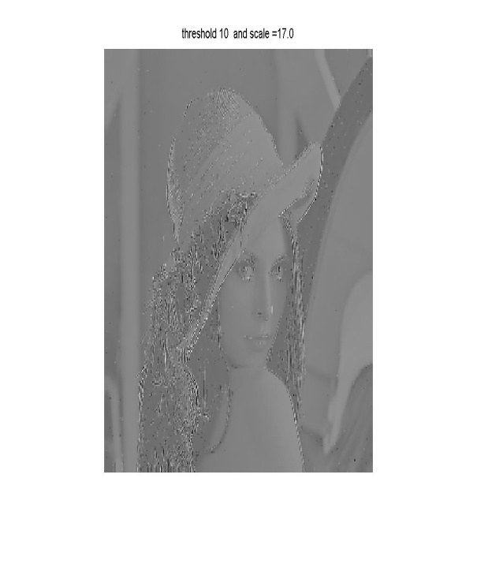

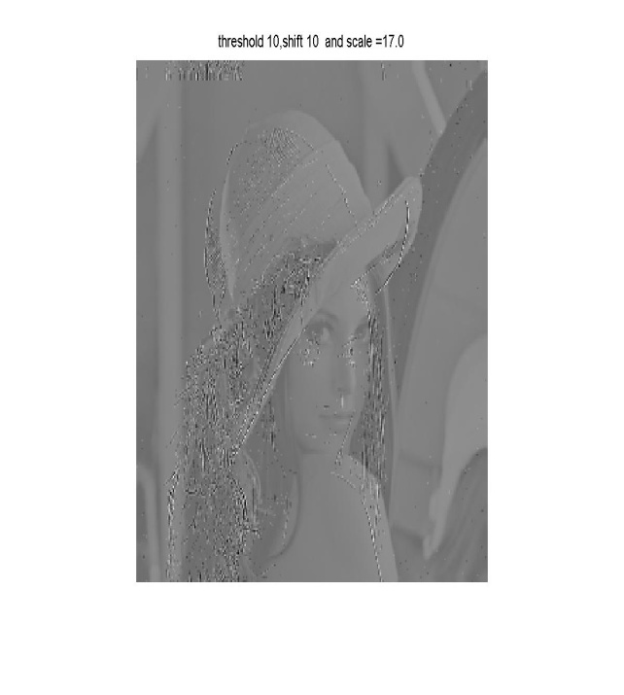

Shifting detail coefficients
The detail coefficients exist at the edges and high frequency positions can be evidenced visually by applying shifting to detail coefficients

Slide 10
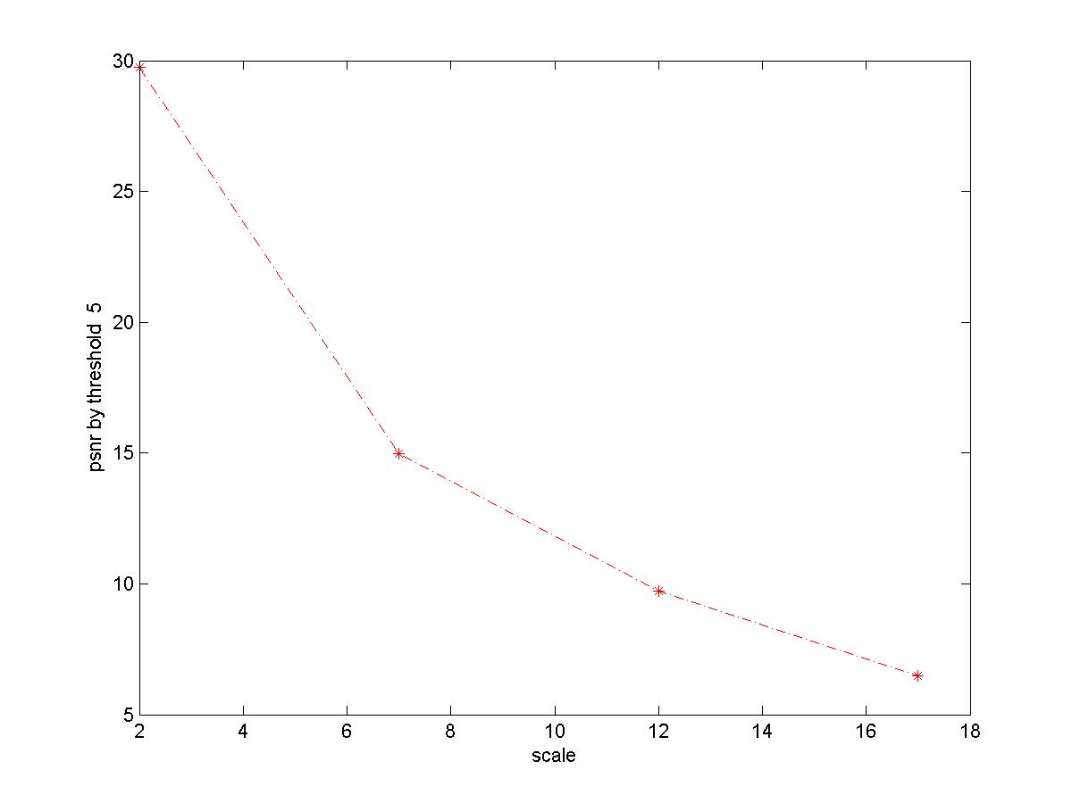
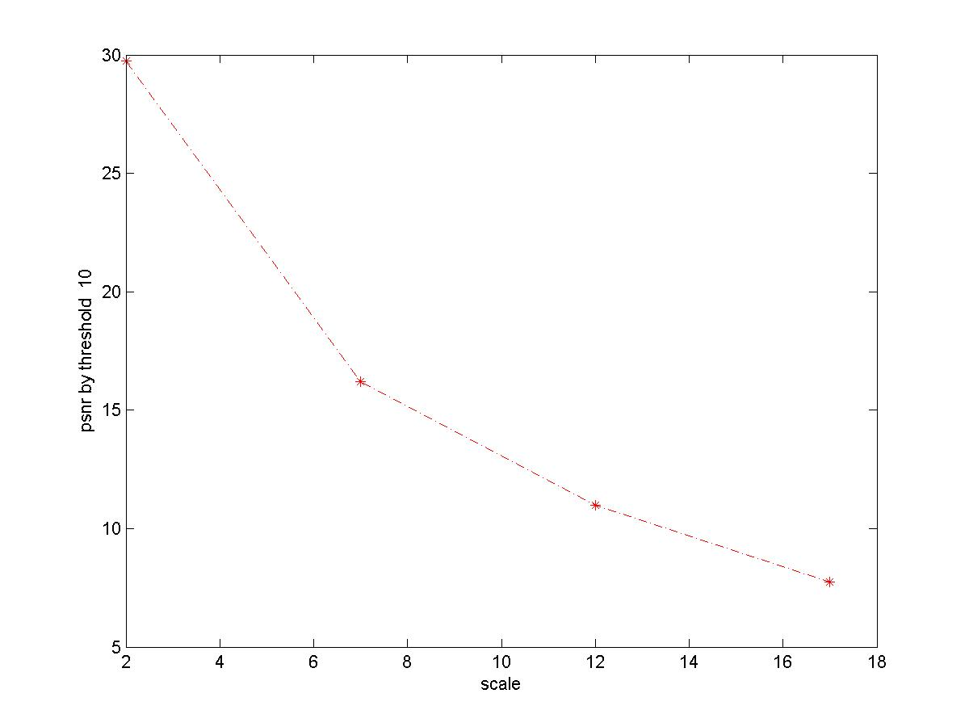
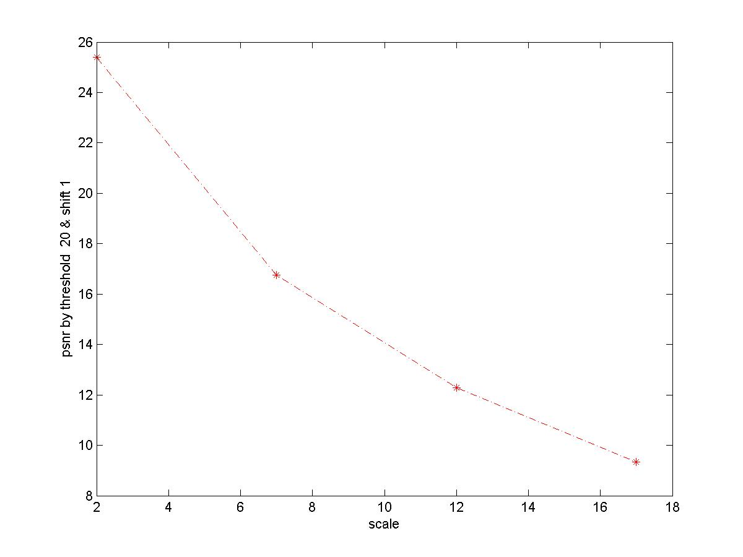
PSNR VS Thresholding
The more threshold is the less PSNR value.But not much difference , reveals insignificance of detail coefficients and energy compaction ability of wavelet transform

Slide 11
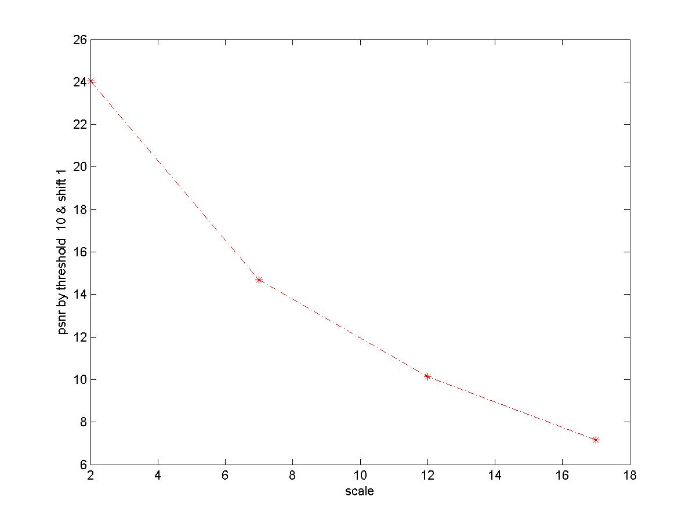


PSNR VS Shifting
Shifting has no much impact as thresholding in PSNR value. This is intuitive as the coefficients are not removed ,but moved.Its dependence depends also on the nature of image

Slide 12
Amplification of thresholded detail coeff.
The higher is the amplification of detail coefficient, the dimmer is the reconstructed image. This is because the background(low pass or approximate coefficients) are seen relative to the amplified details since it uses interpolation b/n max and min to represent in [0 255]
Obviously the PSNR is inversely proportion to amplification.

Slide 13
Thank you

