Slide 1
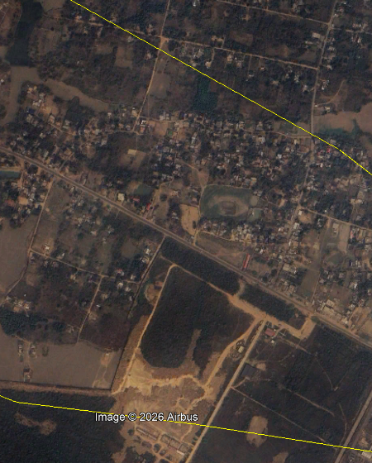
Village Economic Growth Intelligence
Reading village-level growth from lights, land cover and population, 2020 to 2025. Pilot district: Goalpara, Assam.
Image: Dakidal village, Google Earth (Airbus/CNES), 28 Mar 2025
Notes:
Open with the problem: village-level economic data barely exists, but satellites see lights, roofs and roads. This deck covers how we defined growth, what data we used, what we found in Goalpara, and what comes next.

Slide 2
We call it growth when a village builds more and lights up more
Economic growth here means the same village showing, between 2020 and 2025:
45%
Built-up change
Dynamic World 'built' probability, 10 m
Physical expansion
more built-up land, so houses, shops and roads
Energy and activity
more light at night
A stable or growing population
so growth is not just people leaving
Direct trace of capital investment
45%
Nightlight change
VIIRS monthly radiance, ~463 m
Electrification and commercial activity
10%
Population change
Entry rule A village is ranked only if built-up area and nightlight both rose and population did not fall. One signal alone is not enough.
WorldPop 100 m grid
Supporting signal only, since it is modelled
Notes:
The weights are a judgement call: built-up and lights are directly observed economic traces, population is modelled so it gets a small weight. The entry rule stops a village with only one noisy signal from ranking.

Slide 3
Three open datasets, one pipeline anyone can re-run
Source (via Google Earth Engine) | Resolution | Why we chose it
NOAA VIIRS Day/Night Band, monthly (VCMCFG) | ~463 m | Global, consistent proxy for electrification; annual median removes noise
Google Dynamic World v1 (Sentinel-2) | 10 m | Fine enough for village footprints; class probabilities avoid hard-label flicker
WorldPop population, 100 m grid | 100 m | Gives a population count per village boundary
1
Extract
2
Clean
3
Process
4
Score
Zonal statistics per village for 2020 and 2025 through GEE batch tasks
Drop villages under 50 ha (VIIRS pixel mixing) and IQR outliers such as glare
Absolute and % change per signal, then RobustScaler (median and IQR)
45/45/10 weighted sum on villages that pass the entry rule; take the top 100
Notes:
Everything is open data pulled through Earth Engine. Parameters (district, years, weights, paths) live in one config file, so another district means changing config, not code.

Slide 4
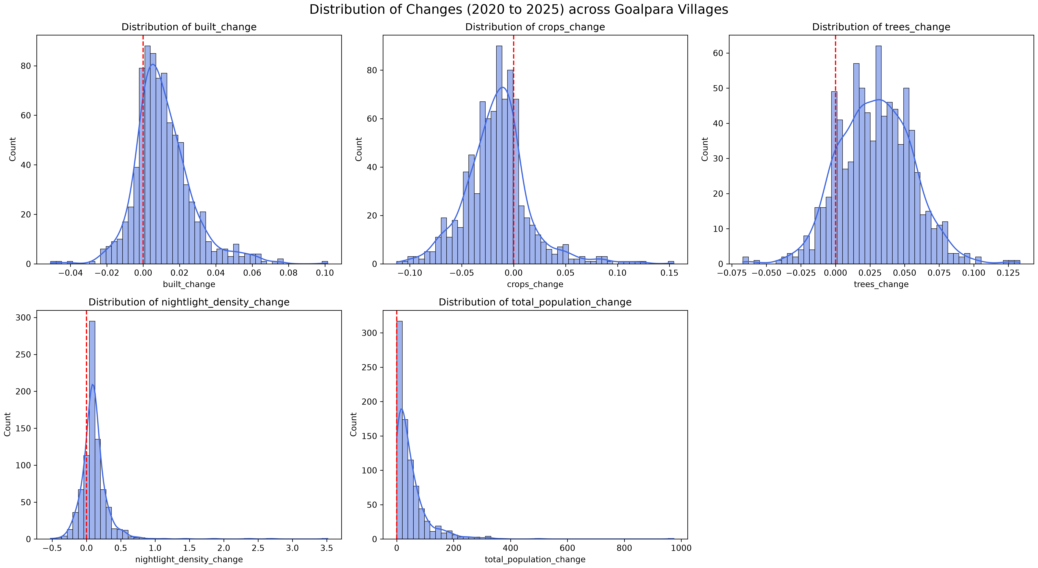
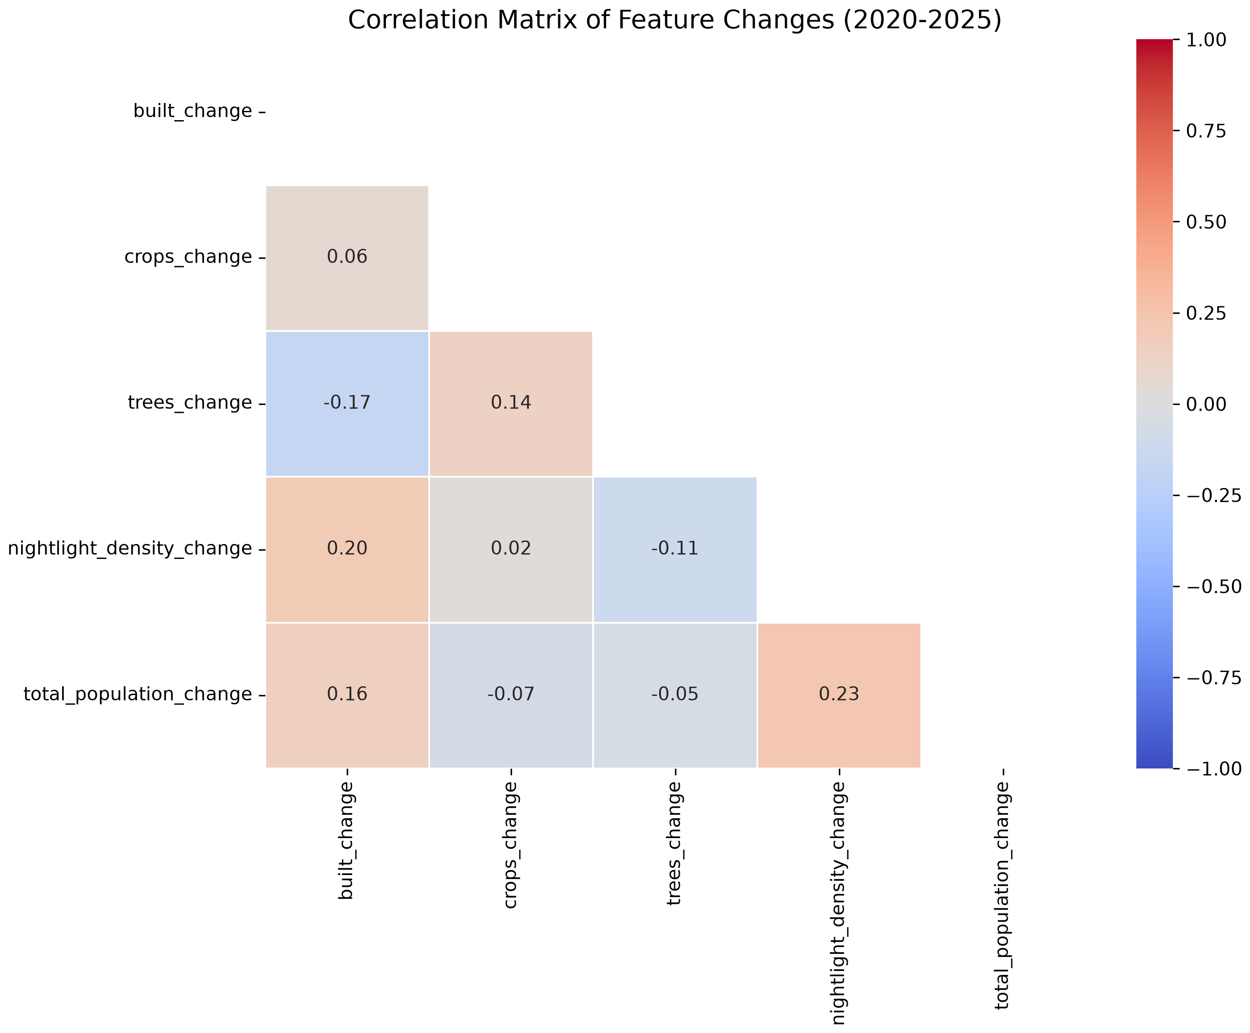
Changes are heavily skewed, so we score on robust scales
Fig. 2 Correlation between the changes
Fig. 1 Change 2020 to 2025 per village (red line = no change)
Long right tails. Nightlight and population changes have a few extreme villages, so we use median/IQR scaling and IQR filtering instead of a fixed cutoff.
Signals are complementary. Built, light and population changes correlate only 0.16 to 0.23. Crops and trees move against built-up (trees: -0.17), so they stay context, not score inputs.
Notes:
Distributions show why a plain min-max or mean-based scaler would let a handful of outliers dominate. The weak correlations mean no two signals duplicate each other, which supports combining them.

Slide 5
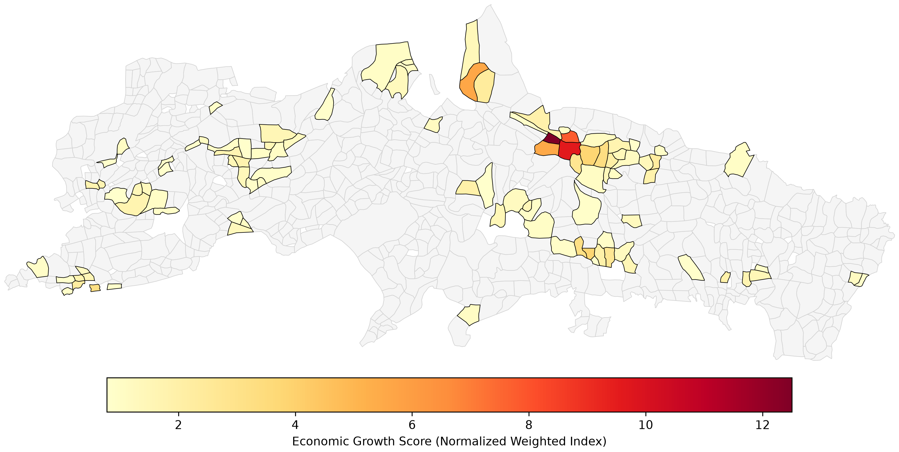
Top-scoring villages concentrate in one east-central cluster
~12
highest score on the map scale, in the dark-red village
< 4
where most of the top 100 sit; scores fall off steeply after the first few
100
Fig. 3 Top 100 villages in Goalpara, shaded by growth score. Grey = all other villages.
villages ranked and exported with scores and 2020/2025 attributes
Scores are relative (robust-scaled changes), so they rank villages against each other; they are not rupee values.
Notes:
Read the map from the colour bar: a few dark red villages in the east-central cluster, then a long tail of pale ones scattered west and south. The interactive HTML map in the repo lets you hover for each village's numbers.

Slide 6
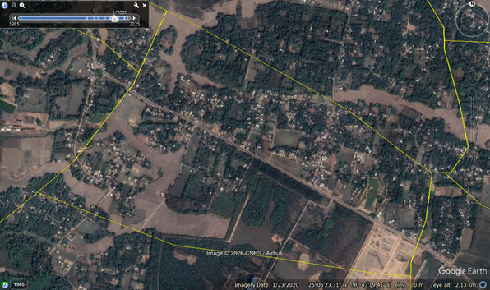
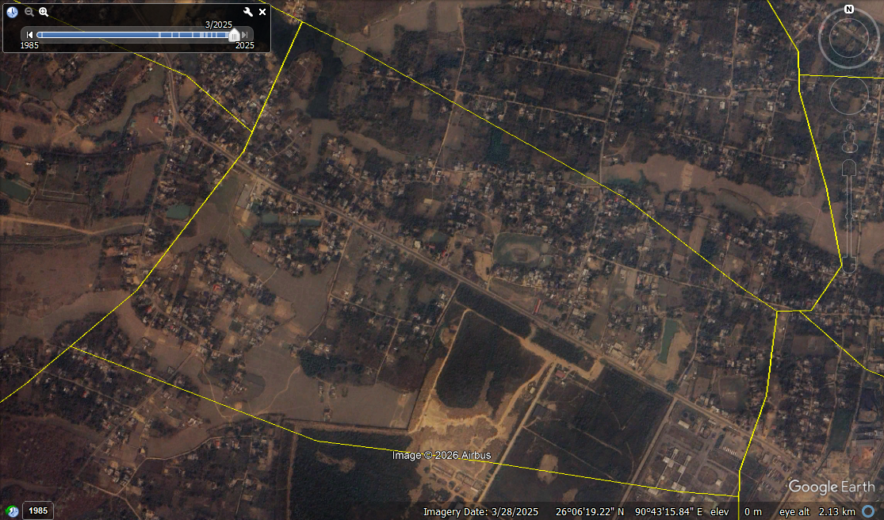
Sanity check on the ground: Dakidal village, 2020 vs 2025
Jan 2020
Mar 2025
2
2
1
1
Google Earth very-high-resolution imagery, Airbus/CNES. Yellow lines are village boundaries.
1 Bare plot to built site. The sandy cleared plot near the lower right has become a laid-out site with structures.
2 Denser settlement along the road. More roofs and lanes appear in the village core, which is what the built-up and light signals pick up.
Notes:
One village eyeballed against very high resolution imagery: a sanity check, not a validation. A proper validation would compare many villages against census or electricity-connection data.

Slide 7
What this cannot tell us yet, and what we would do next
Limitations
With more time or data
VIIRS is ~463 m, coarser than many villages; neighbours share pixels
'Built' probability can confuse bare soil with roofs; one year is sensitive to season and cloud
WorldPop 2025 is modelled, so population change is weak evidence
No ground truth yet: weights are a judgement call
Pilot covers one district, not all of India
Validate against census, electricity-connection or welfare data
Use building footprints and Sentinel-1 radar to firm up construction
Fit a multi-year trend instead of two end years
Test weights and report how stable the top 100 is
Run every district for a national top 100
Goalpara (done)
All Assam districts
India
same code; new config and boundaries
Notes:
The pipeline is config-driven, so scaling up is a data problem (village boundaries for all of India) rather than a code problem. The biggest gap is validation, which is where more data would help most.

