Slide 1

National Football League Analysis and Marketing
Geovanni Flores

Slide 2

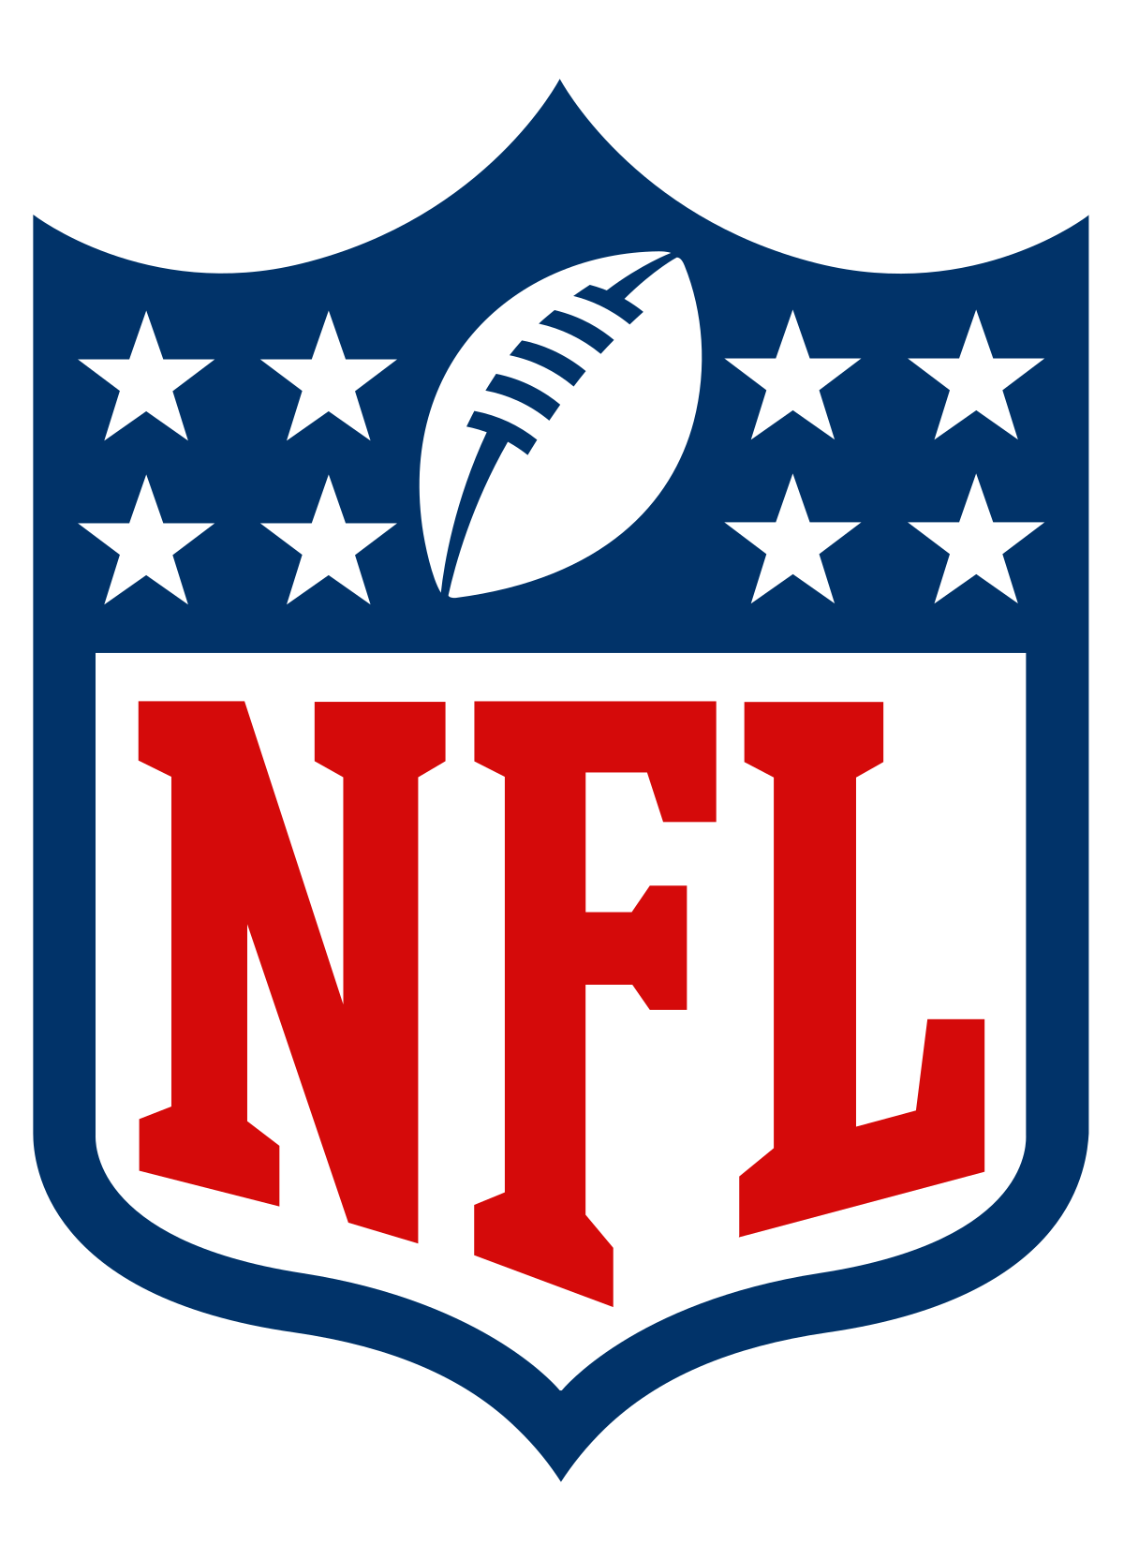

History of the NFL
Formed in Canton, Ohio in September 1920.
Originally named the Akron Professional Football Association (APFA)
William “Pudge” Heffelfinger – First professional football player.
In 1922, APFA rebranded itself as the National Football League.
Originally consisted of 11 professional football clubs.
Currently, there are 32 NFL teams with two conferences, the American League and the National League.

Slide 3



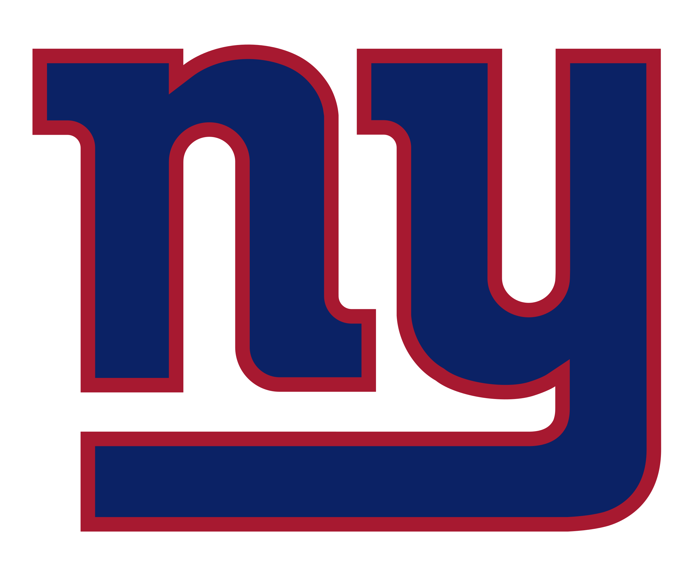



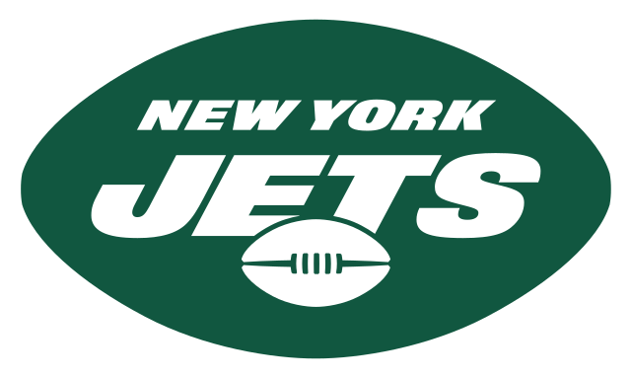


Franchise’s Net Value – Top 10
1. Dallas Cowboys – $6.5 billion
2. New England Patriots – $5 billion
3. New York Giants – $4.85 billion
4. Los Angeles Rams – $4.8 billion
5. Washington Commanders – $4.2 billion
6. San Francisco 49ers – $4.175 billion
7. Chicago Bears – $4.075 billion
8. New York Jets – $4.05 billion
9. Philadelphia Eagles – $3.8 billion
10. Denver Broncos – $3.75 billion

Slide 4



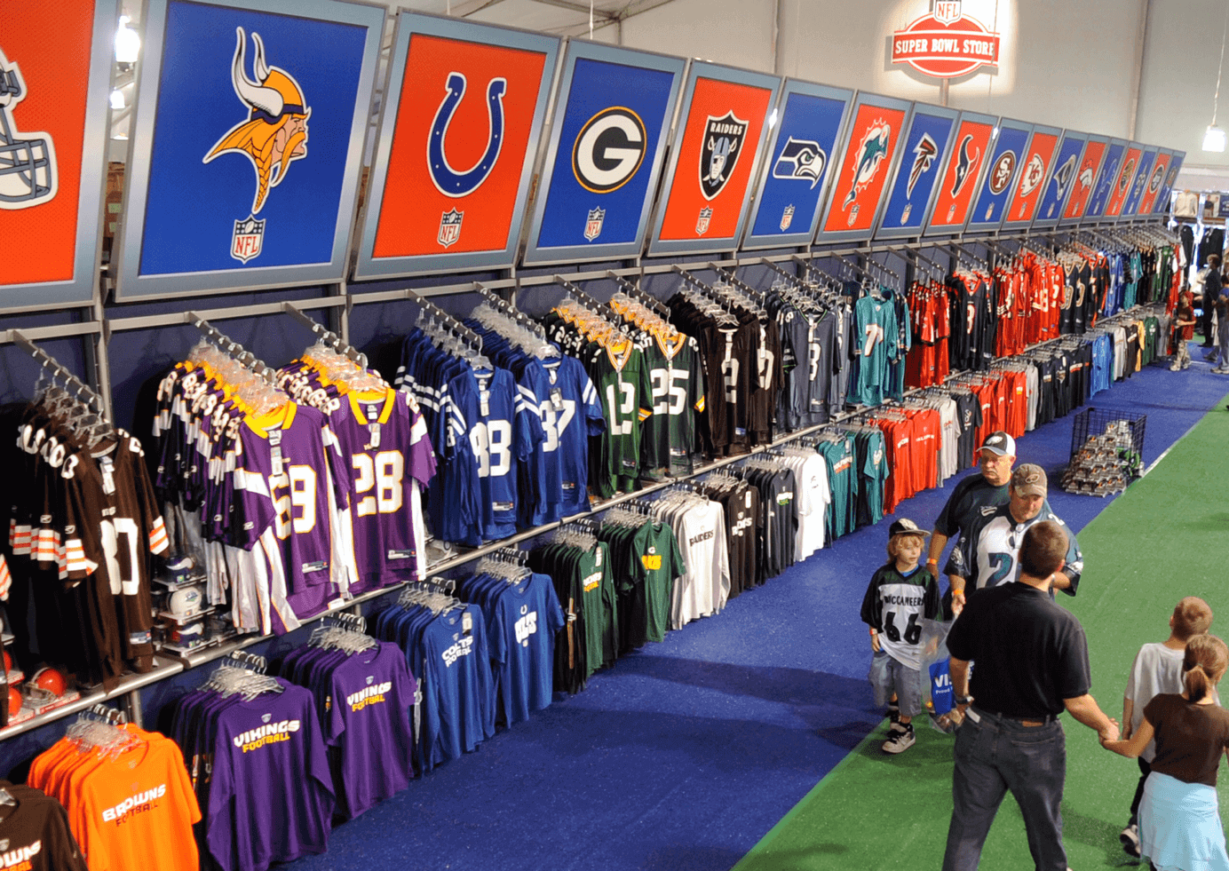
Sources of Revenue
Estimated at $91 Billion – the NFL ranks as the world’s most valuable sport.
Rights fees are estimated at $950 million.
Walt Disney is paying $2.7 Billion a year to hold ESPN’s “Monday Night Football”
Local revenue come from:
Merchandising
Ticket sales
Advertising partnerships (Visa & Gatorade)
Venues/Stadiums

Slide 5
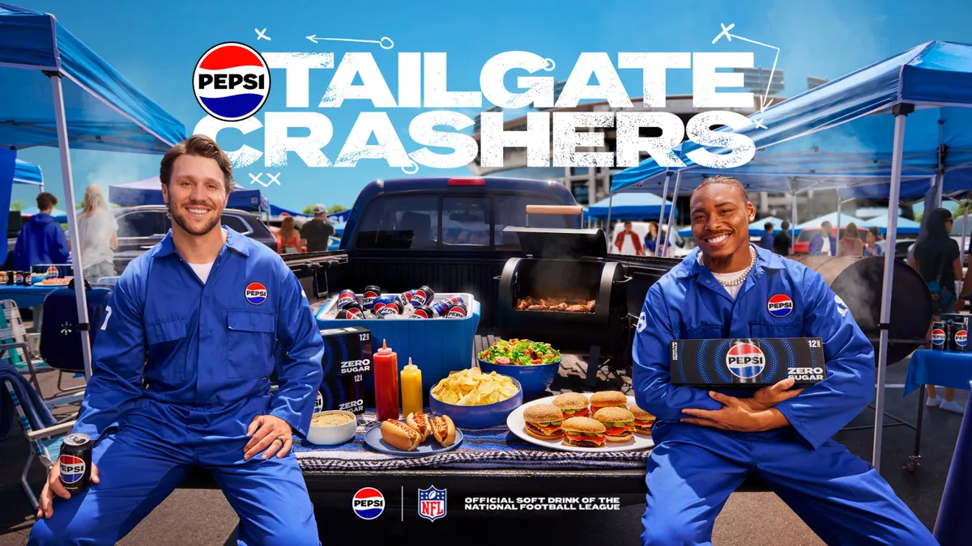
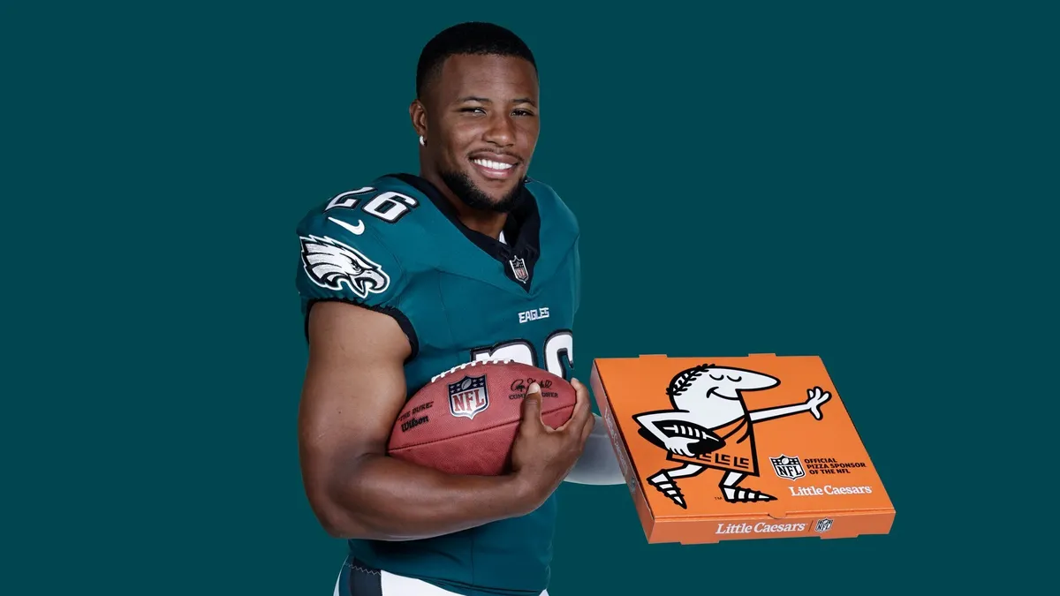
Marketing and Fan Engagement
Global Expansion Strategy: Increasing brand reach through the International Series with regular-season games in London, Germany, and Mexico.
Digital Transformation: Leveraging NFL+ and social media partnerships to capture younger demographics and "second-screen" viewers.
Sponsorship Synergy: Maximizing revenue through high-value integrations with official partners in technology, betting, and apparel.
Localized Fan Experiences: Using data analytics to tailor stadium experiences and regional marketing campaigns for diverse fan bases.
Strategic Media Rights: Securing long-term stability through record-breaking broadcast and streaming deals with major networks and Amazon.

Slide 6
Super Bowl
Economists estimated $447 million in revenue for the city.
Significant economic impact were in four key sectors; lodging, transportation, and restaurants.
NBC sold 70 add slots at $7 million each.
The live event reached approximately 100 million viewers.
Halftime show performers don’t get paid by NFL.
Ultimately, their exposure usually generates sales of their music.

Slide 7
Sources
https://www.forbes.com/sites/mikeozanian/2021/08/05/the-nfls-most-valuable-teams-2021-average-team-value-soars-to-35-billion-as-league-shrugs-off-pandemic-year/?sh=3b24bbd2654e
https://www.latimes.com/entertainment-arts/business/story/2021-03-18/nfl-doubles-fees-for-tv-rights-streams-more-games-on-amazon#:~:text=The%20fee%20will%20increase%20from,games%20for%20its%20Peacock%20service.
https://www.bloomberglinea.com/2022/02/12/super-bowl-2022-whats-the-score-with-the-games-economic-impact/

