Slide 1

Digital Circuits
数字电路（数字电子技术）
Subject: Digital Circuits
Lecturer: 陈新

Slide 2

Digital Circuits
● Lecturer: Associate. Prof. 陈新
● Office: Micro-Electronics
Building 微电子楼309
email: xin.chen@sjtu.edu.cn
● Assist Tutor:
杨启明
杨启明
15939727804
yangqimingxpz@sjtu
.edu.cn
13596086951
dushande2000@163
.com

Slide 3

Digital Circuits

Slide 4

EST2501 Course Information
● Name: Digital Electronics
● Hours/Credits: 32/2.0
● Terms offered: Spring 2024
● Textbook: Digital Fundamentals by Floyd,
11th edition
● Grading
○ Homework Assignments, 30% (英文答题、抄题)
○ Final Exam, 70% (要求：英文试卷、不许带电子词典 )

Slide 5
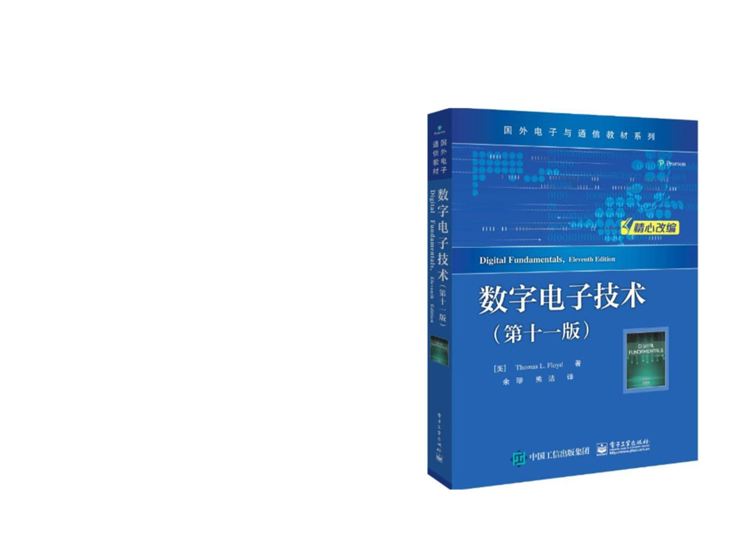
数字电子技术
● Required:
Digital Fundamentals
11/E by Thomas L
Floyd, Science Press
& Pearson Education,

Slide 6
CHAPTER 1
INTRODUCTORY DIGITAL CONCEPTS

Slide 7
1-1 DIGITAL AND ANALOG QUANTITIES
数字量和模拟量

Slide 8
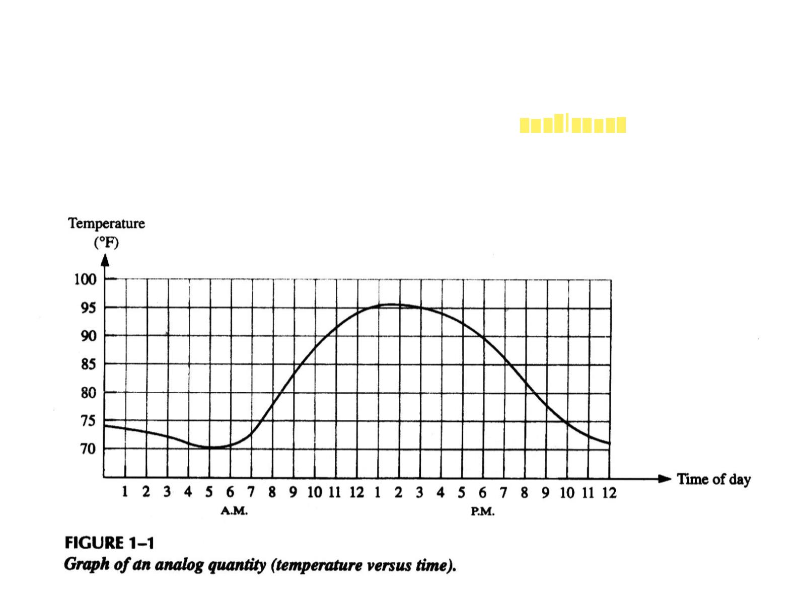
What’s Analog Quantity?
● An analog quantity(模拟量), having continuous values,
takes on all the infinite values in between, say, [a, b].

Slide 9
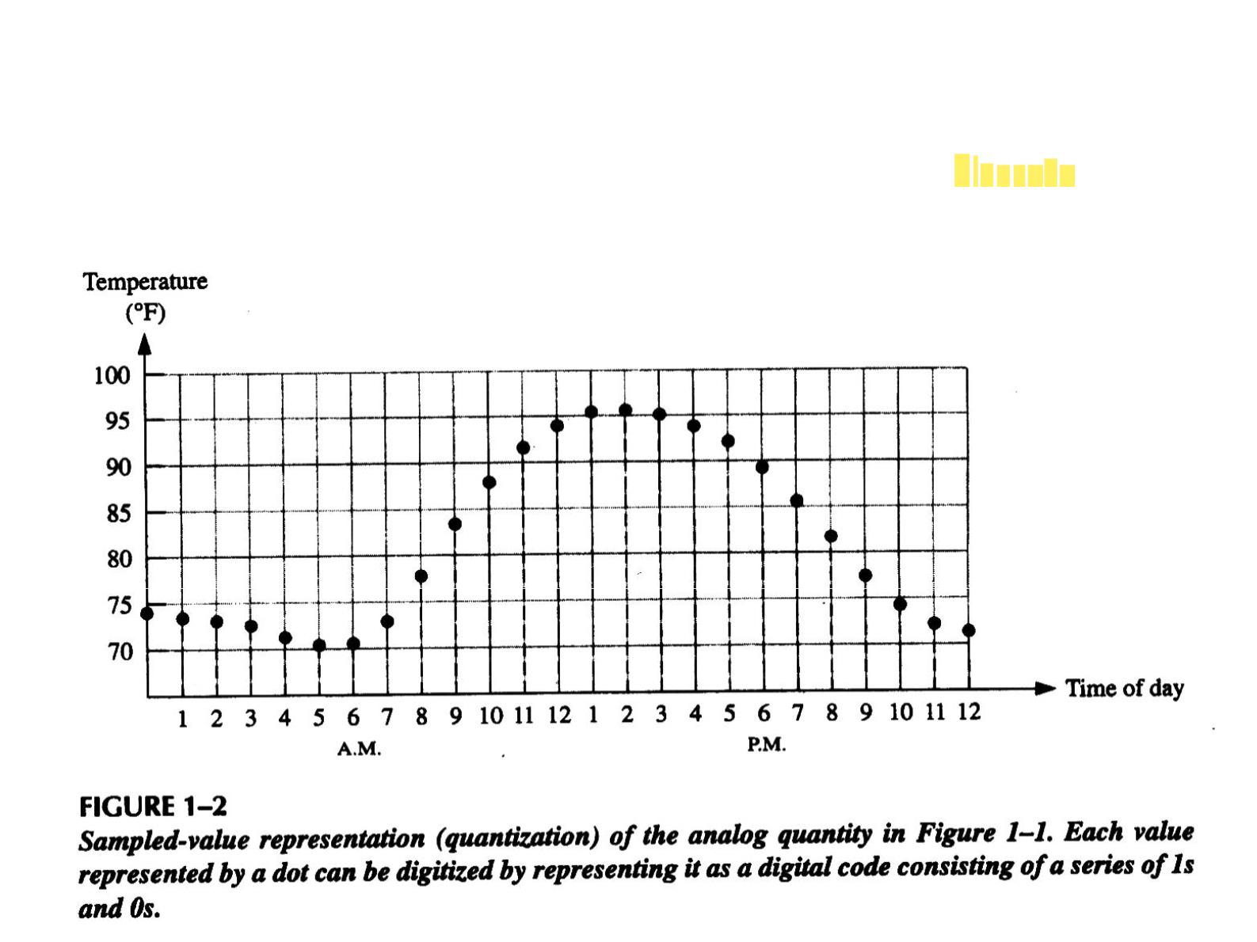
What’ s Digital Quantity?
● A digital quantity（数字量） has a set of discrete
values.

Slide 10

Analog-to-Digital Conversion
● A signal （信号） is a quantity that carries
information.
● Mathematically, a signal is a function of some
independent variables.
● To process analog signals by digital means, it is first
necessary to convert them into digital form, that is, to
convert them to a sequence of numbers having finite
precision. This procedure is called analog-to-digital
(A/D) conversion, and the corresponding devices are
called A/D converters (ADCs).

Slide 11
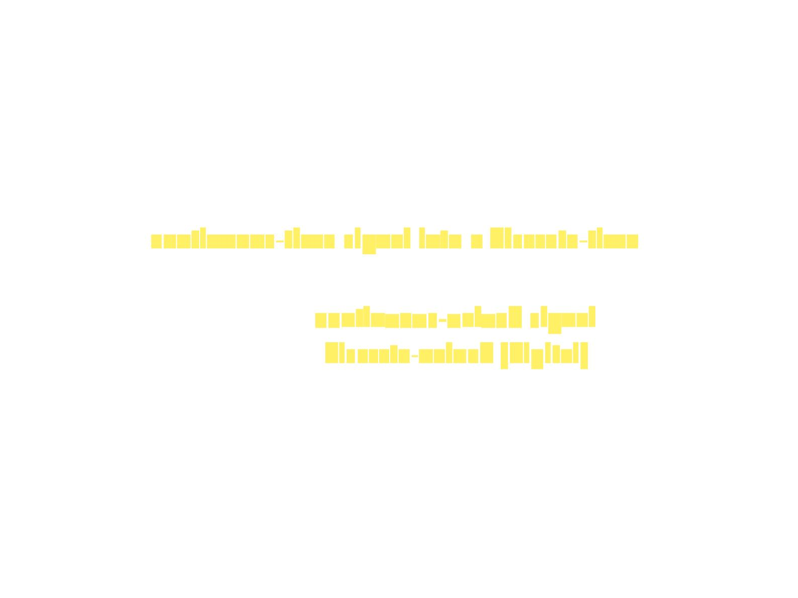
● Conceptually, we view A/D conversion as a
three-step process:
○ Sampling（采样）. The conversion of a
continuous-time signal into a discrete-time signal.
○ Quantization（量化）. The conversion of a
discrete-time continuous-valued signal into a
discrete-time, discrete-valued (digital) signal.
○ Coding（编码）. In this process, each quantized
sample is represented by a finite number of binary
digits (bits).

Slide 12
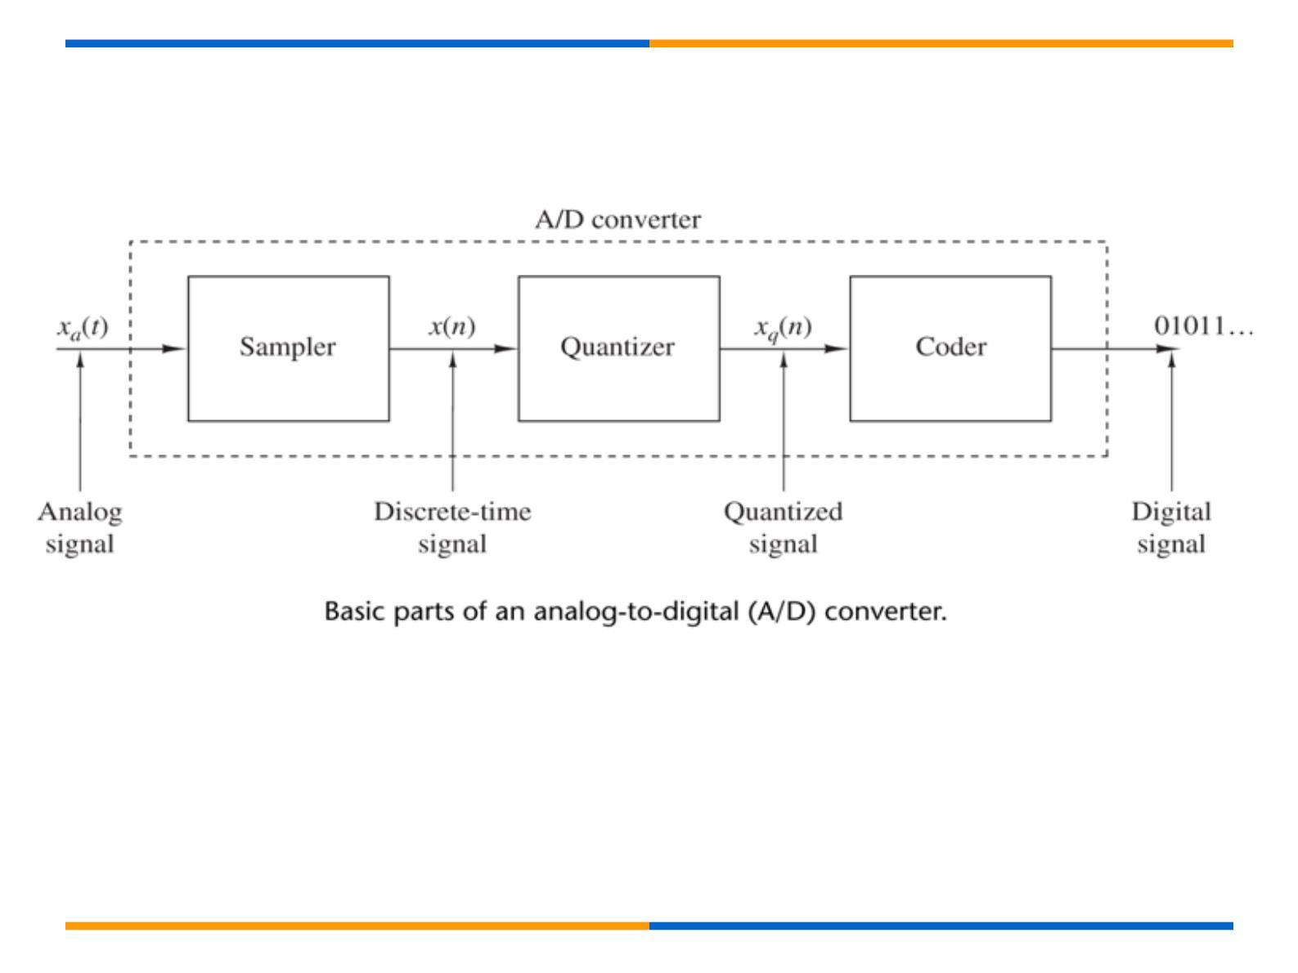

Slide 13
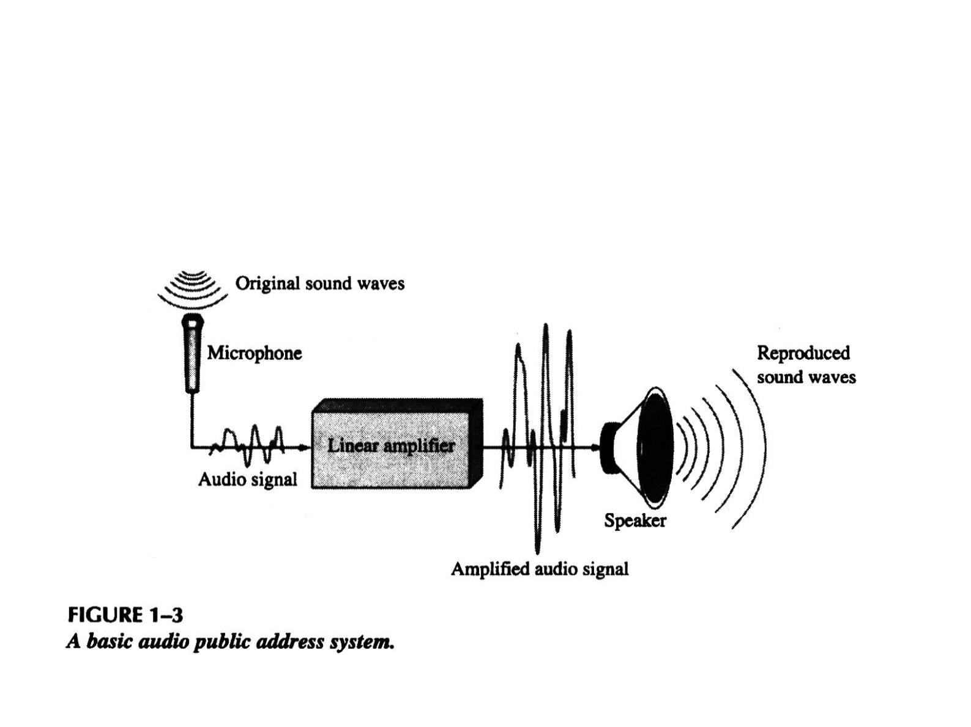
Analog Example
● A public address system, used to amplify sound so
that it can be heard by large audience, is one
example of an application of analog electronics.

Slide 14
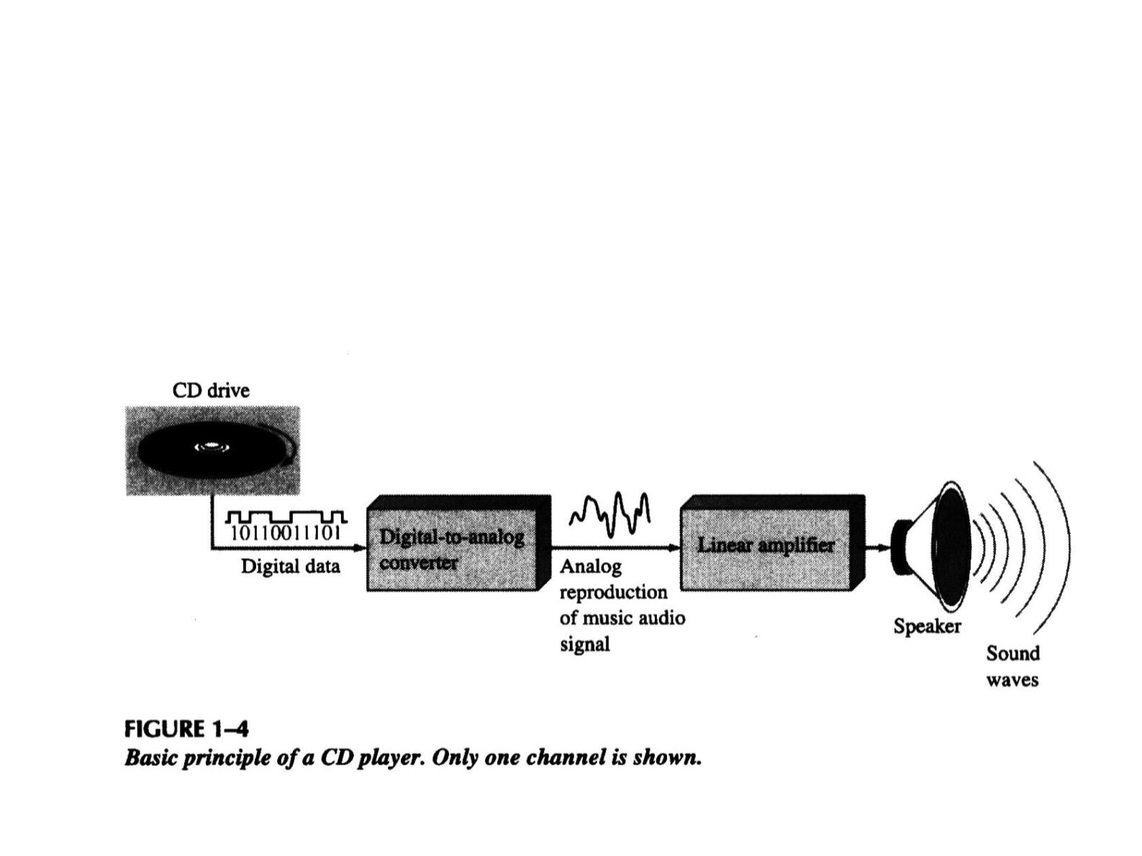
A Mixed System
● The compact disk (CD) player is an example of a
system in which both digital and analog circuits are
used.
Analog-to-Digital Converter (ADC)
&
Digital-to-Analog Converter (DAC)

Slide 15
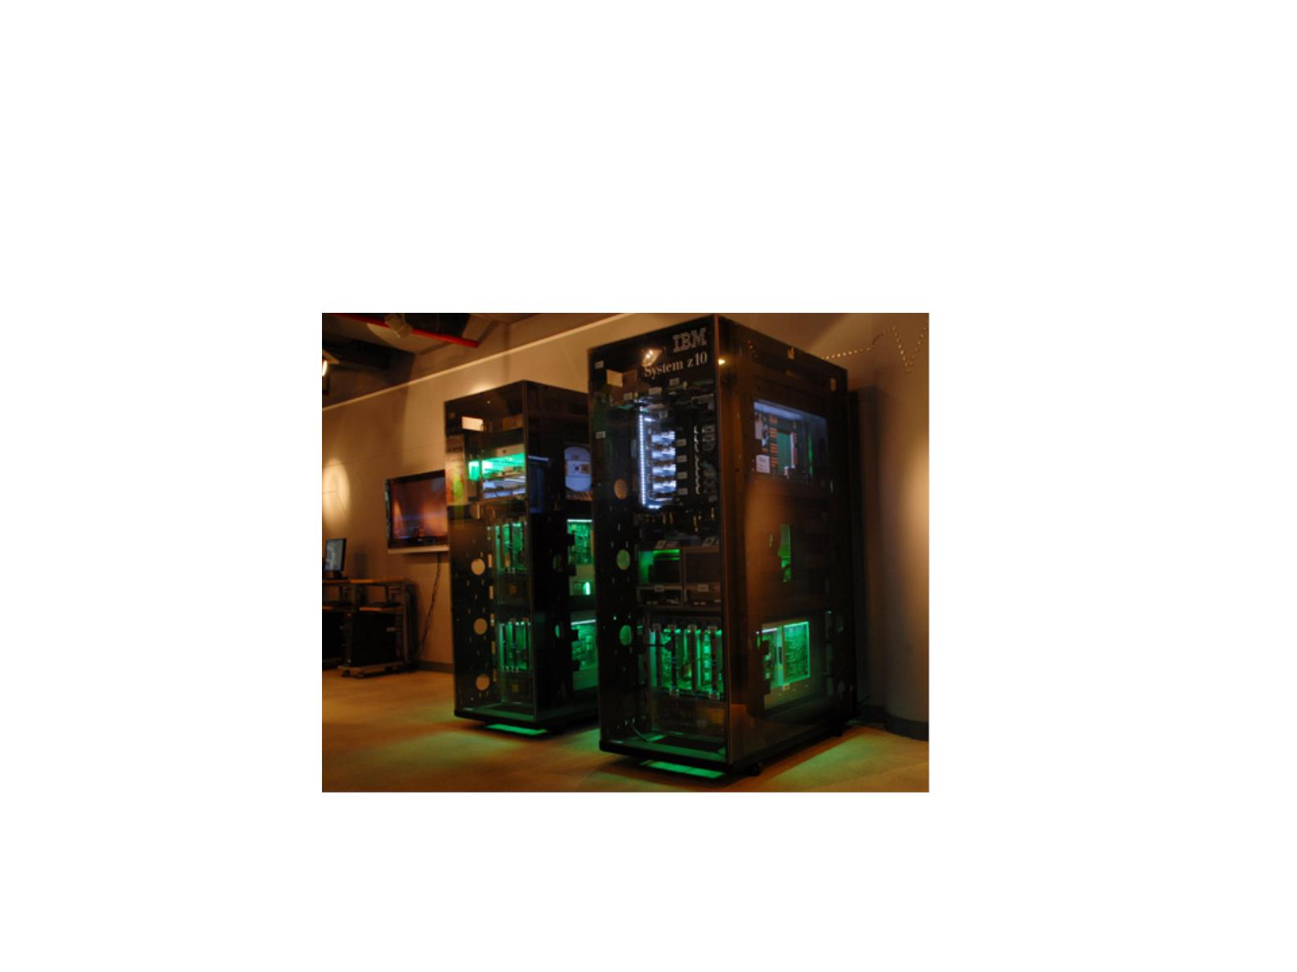
Digital Example
● A computer system is one example of an application
of digital electronics.

Slide 16
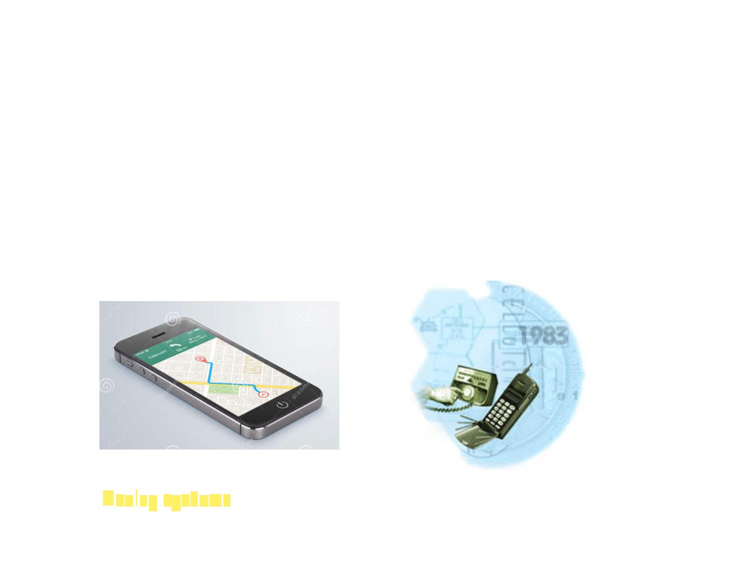
The Digital Advantage
● 数字电路与模拟电路比较的优势？
○ Digital has certain advantages over analog, e.g., digital data
can be stored, processed, and transmitted more efficiently
and reliably than analog data.
○ Digital circuits are less vulnerable to noise than analog
circuits.
○ Digital circuits are more compact, less power consuming.
❐ Analog systems can generally handle higher power than digital
systems （另外：远距离传输依然依赖模拟信号）

Slide 17
1-2 BINARY DIGITS, LOGIC LEVELS, and
DIGITAL WAVEFORMS
二进制数、逻辑电平和数字波形

Slide 18
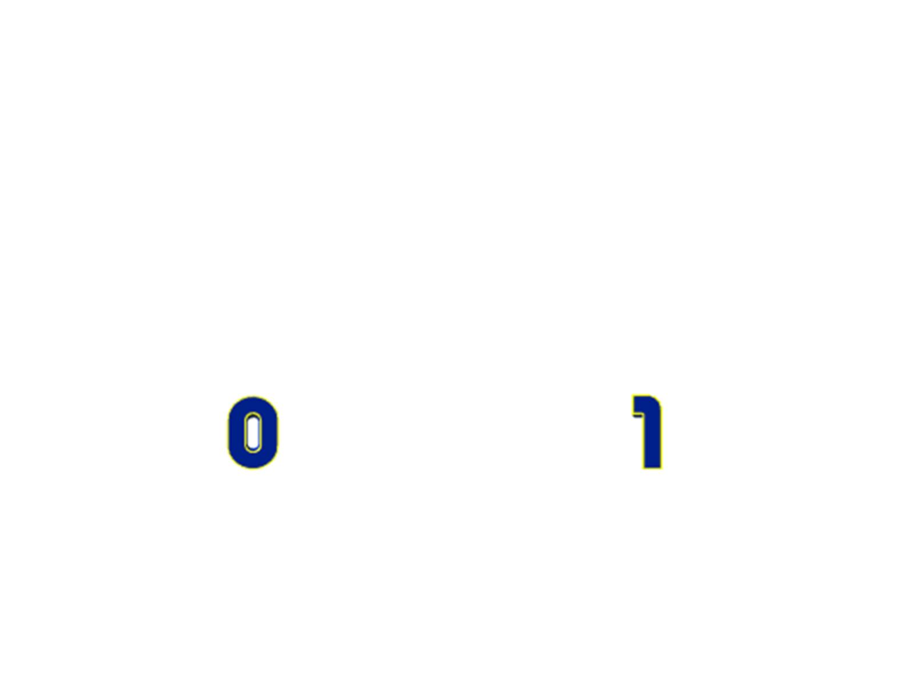
Binary Digits（二进制数字）
● The two digits in the binary system, 1 and 0, are
called bits, which is a contraction of the words
binary digit.

Slide 19

How to represent 0 and 1?
● In digital circuits, two different voltage levels are
used to represent the two bits. The higher/lower
voltage level is referred to as a HIGH/LOW, or H/L.

Slide 20
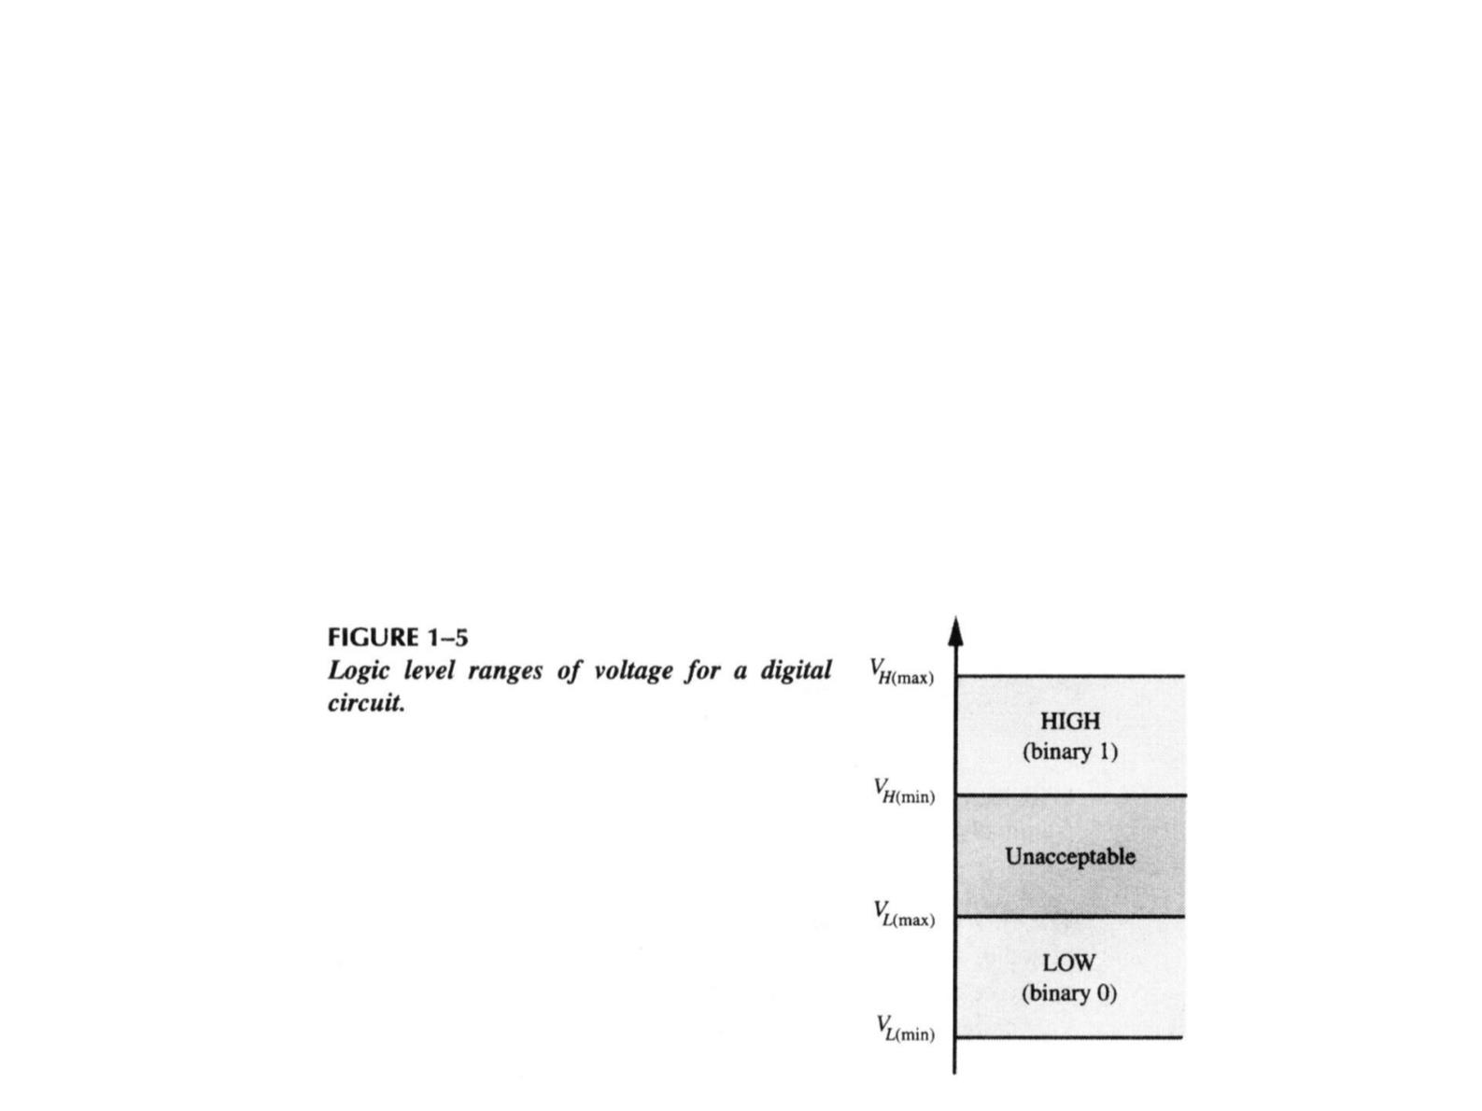
Logic Levels（逻辑电平）
● In a practical digital circuit, a HIGH can be
any voltage between a specified minimum
value and a specified maximum value.
Likewise, a LOW can be any voltage between
a specified minimum and a specified
maximum.

Slide 21
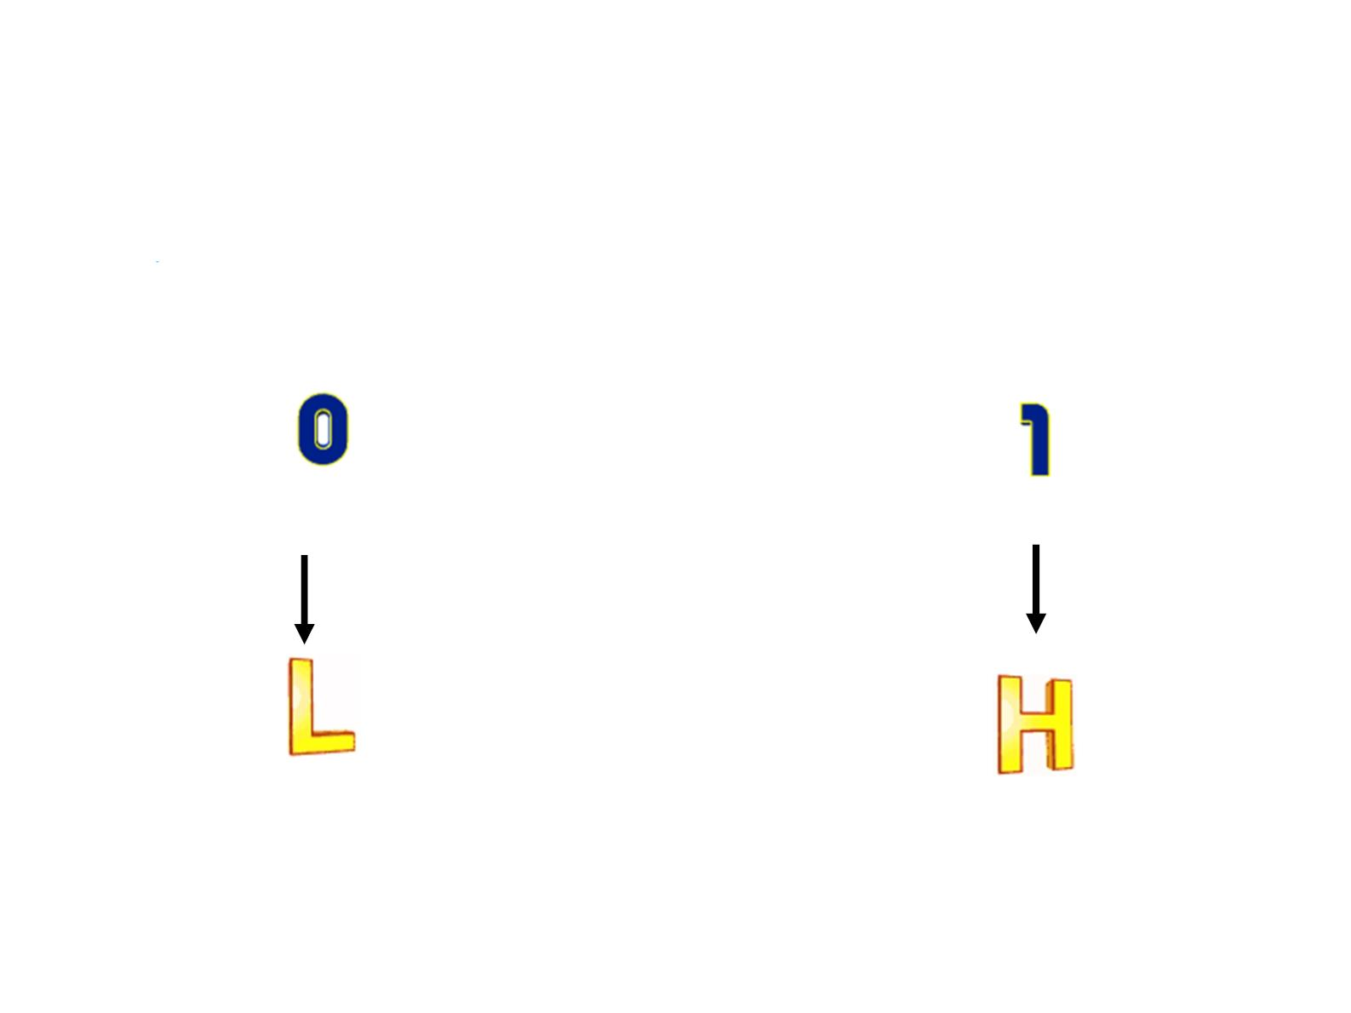
Positive Logic System（正逻辑）
● A 1 is represented by HIGH and a 0 is represented
by LOW.

Slide 22
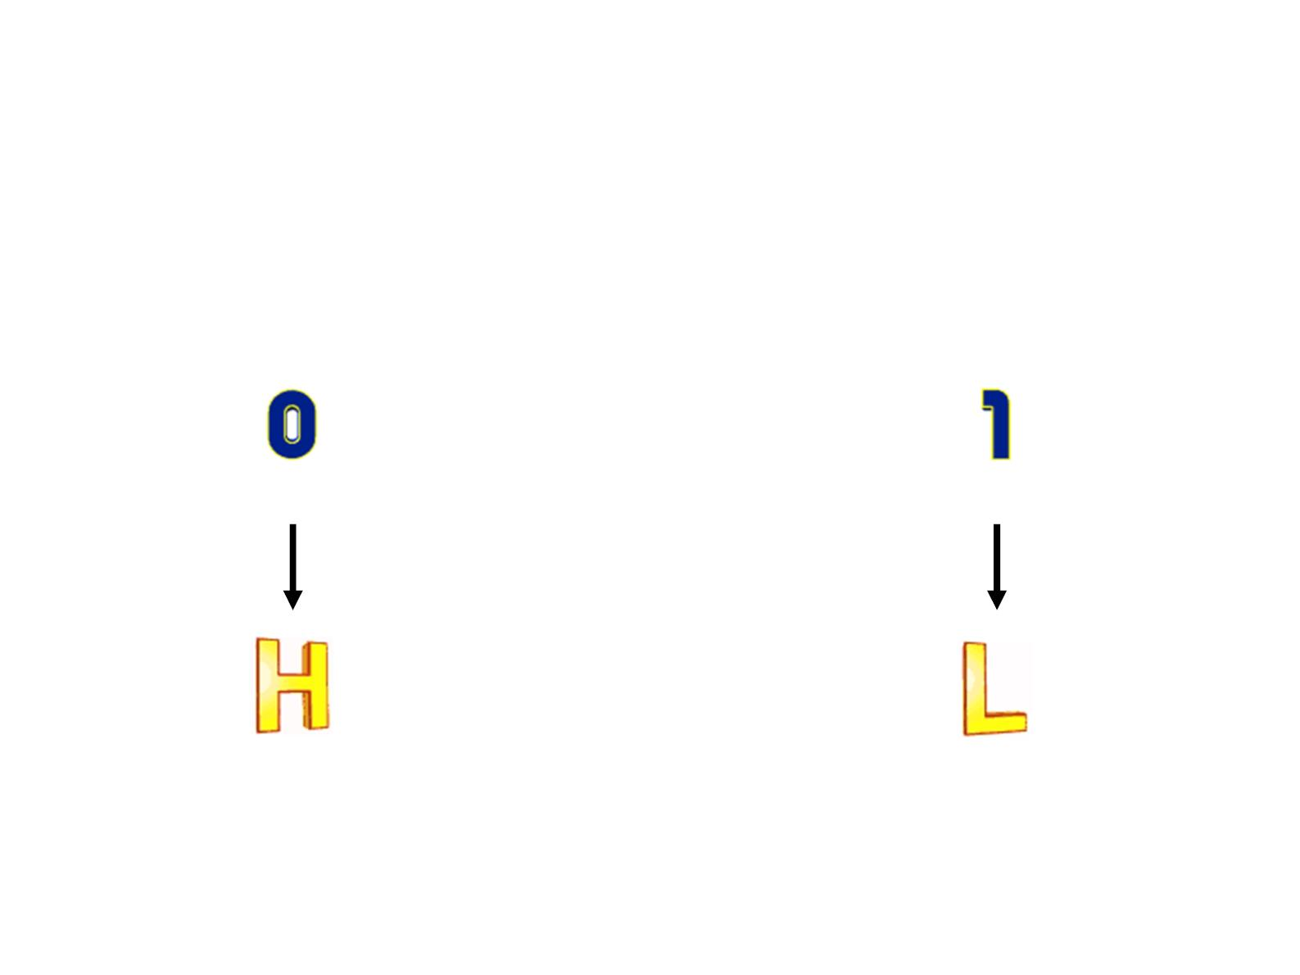
Negative Logic System（负逻辑）
● A 0 is represented by HIGH and a 1 is represented
by LOW.

Slide 23
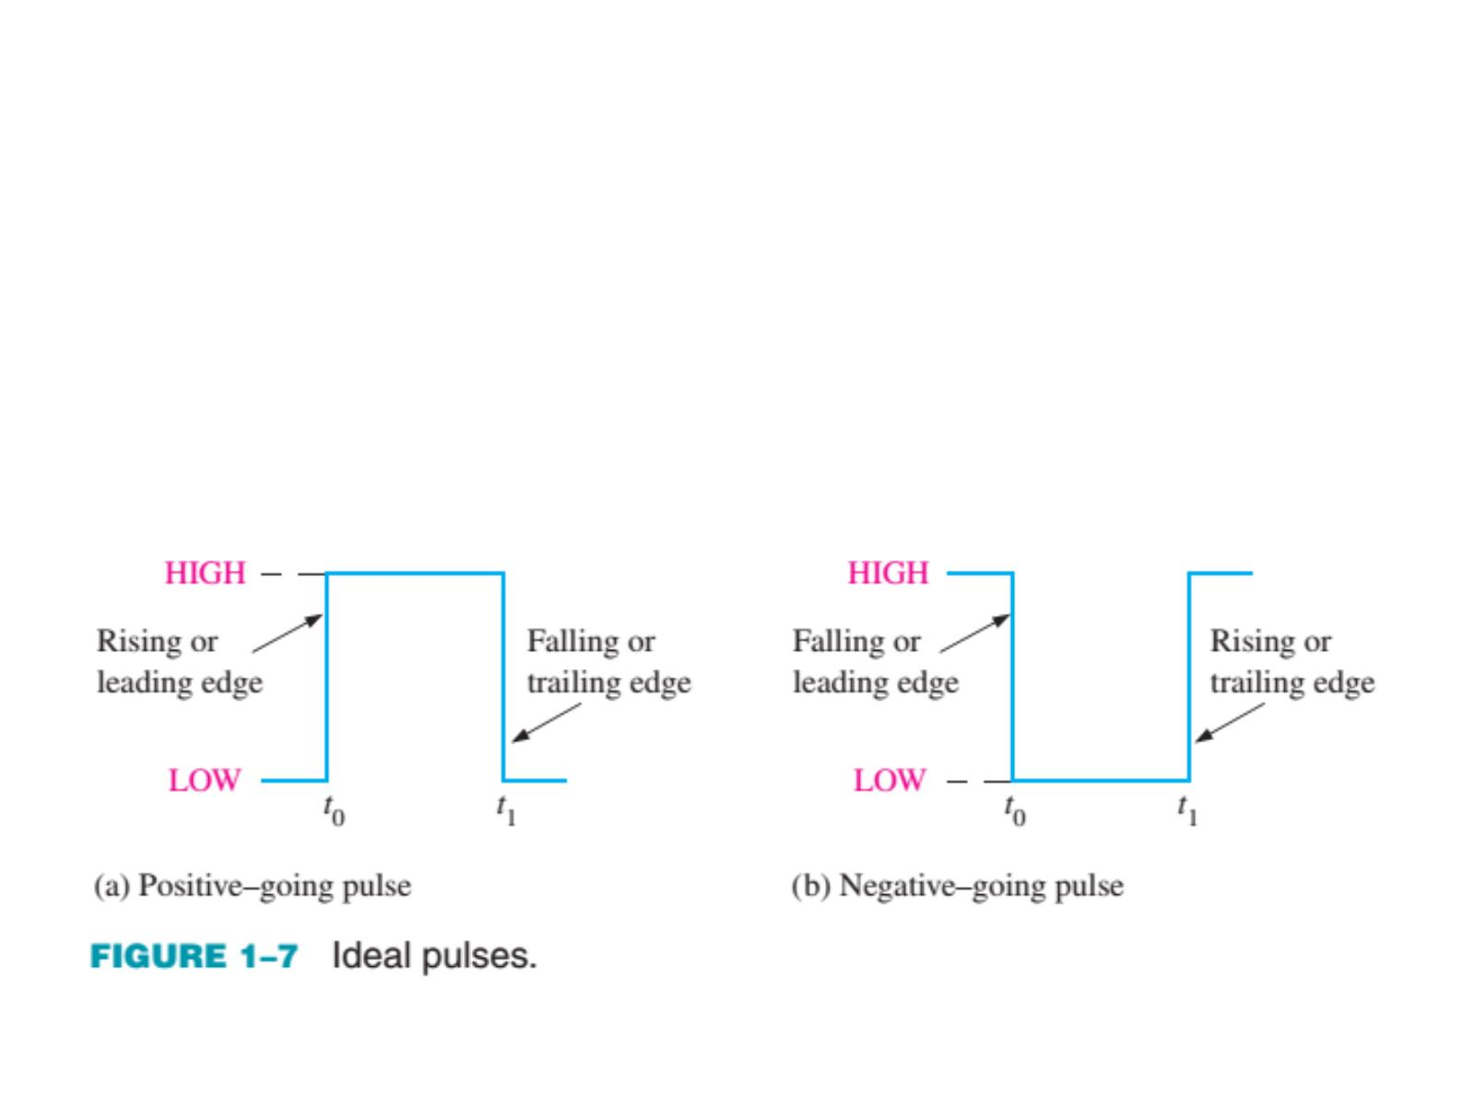
Ideal Pulses（理想脉冲）
● Digital waveform consists of voltage levels that are changing
back and forth between the HIGH and LOW levels or states.

Slide 24
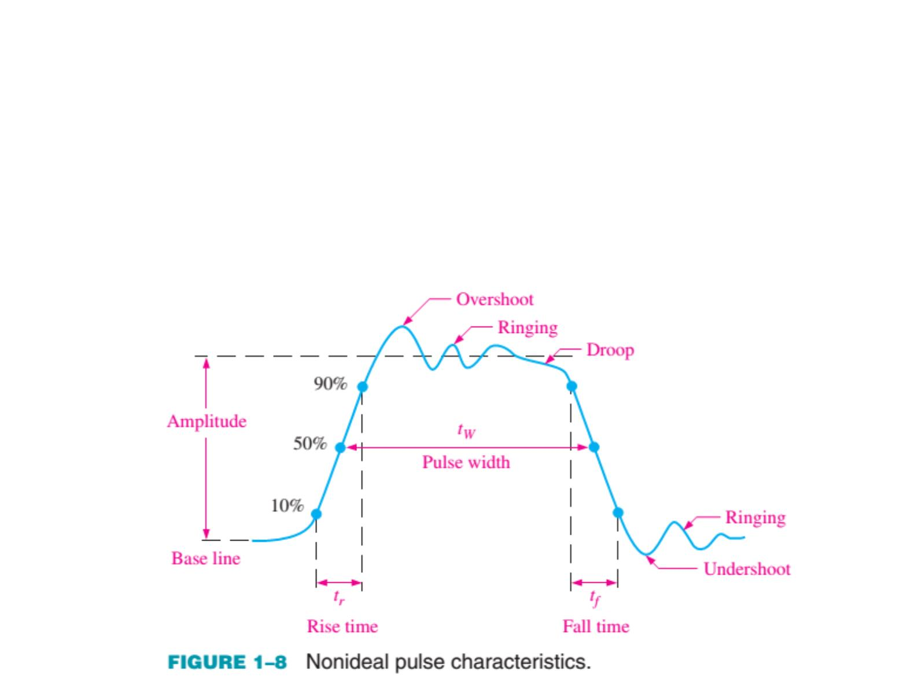
Nonideal Pulse （非理想脉冲）
● The time required for the pulse to go from its LOW
(HIGH) level to its HIGH (LOW) level is called the rise
(fall) time. In practice, it is common to measure rise (fall)
time from 10%(90%) of the pulse amplitude to 90%(10%)
of the pulse amplitude.

Slide 25
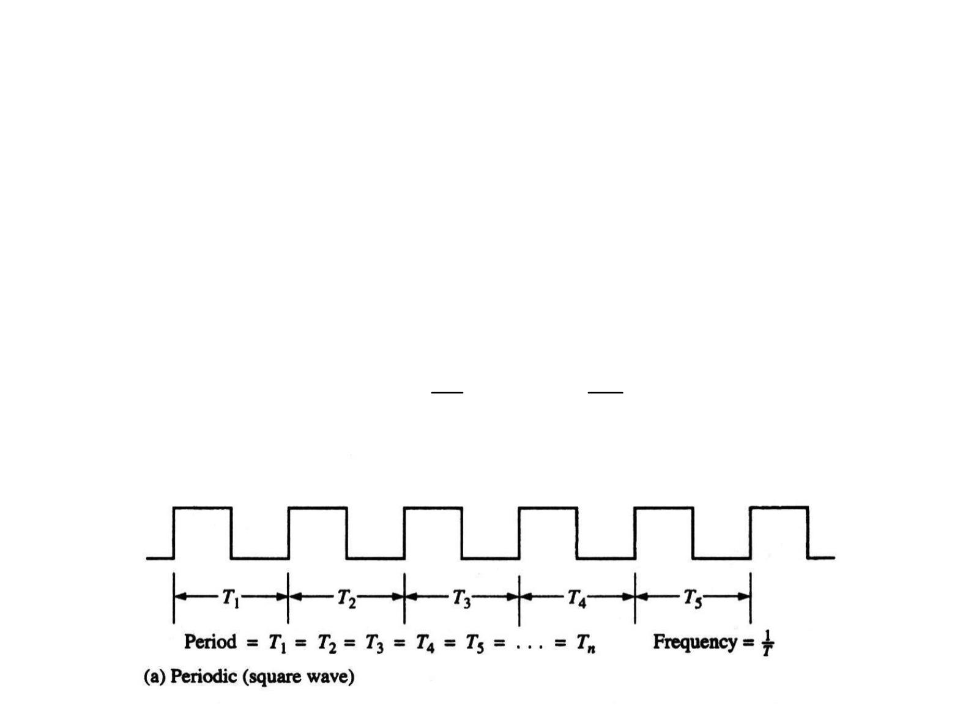
Period Pulse （周期脉冲）
● A periodic waveform is one that repeats itself at a
fixed interval, called a period (T ). The frequency (f )
is the rate at which it repeats itself and is measured
in hertz (Hz). The relationship between f and T is
expressed as follows:
1
1
f = , T =
T
f

Slide 26
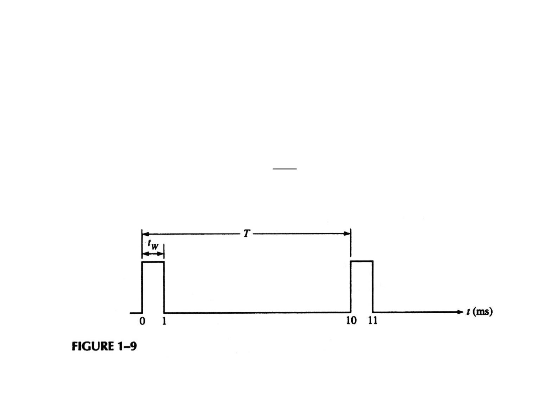
Period Pulse
● The duty cycle (D ) is defined as the ratio of the
pulse width (t ) to the period (T ) and can be
w
expressed as a percentage.
 
t
D = 
W

100%
 
T
 

Slide 27
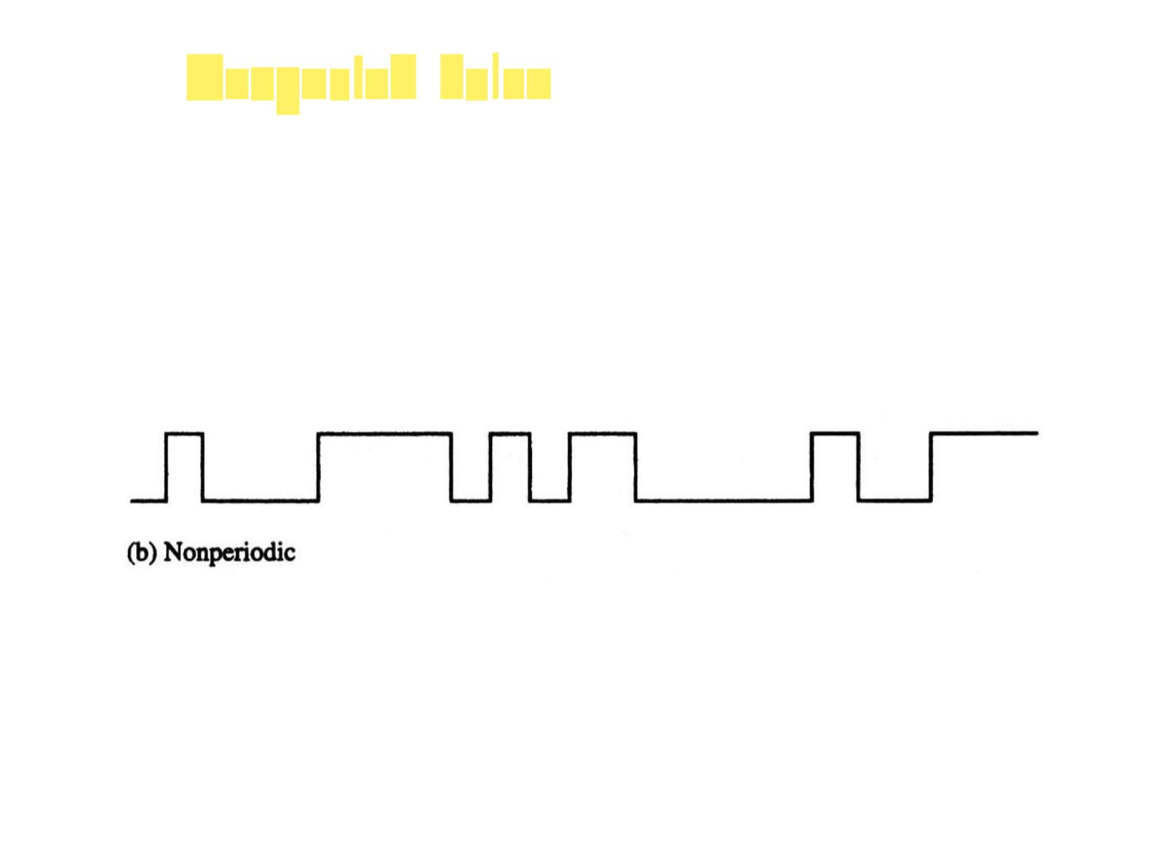
Nonperiod Pulse （非周期脉冲）
● A nonperiodic waveform, of course, does not
repeat itself at fixed intervals and may be
composed of pulses of randomly differing
pulses widths and/or randomly differing time
intervals between the pulses.

Slide 28
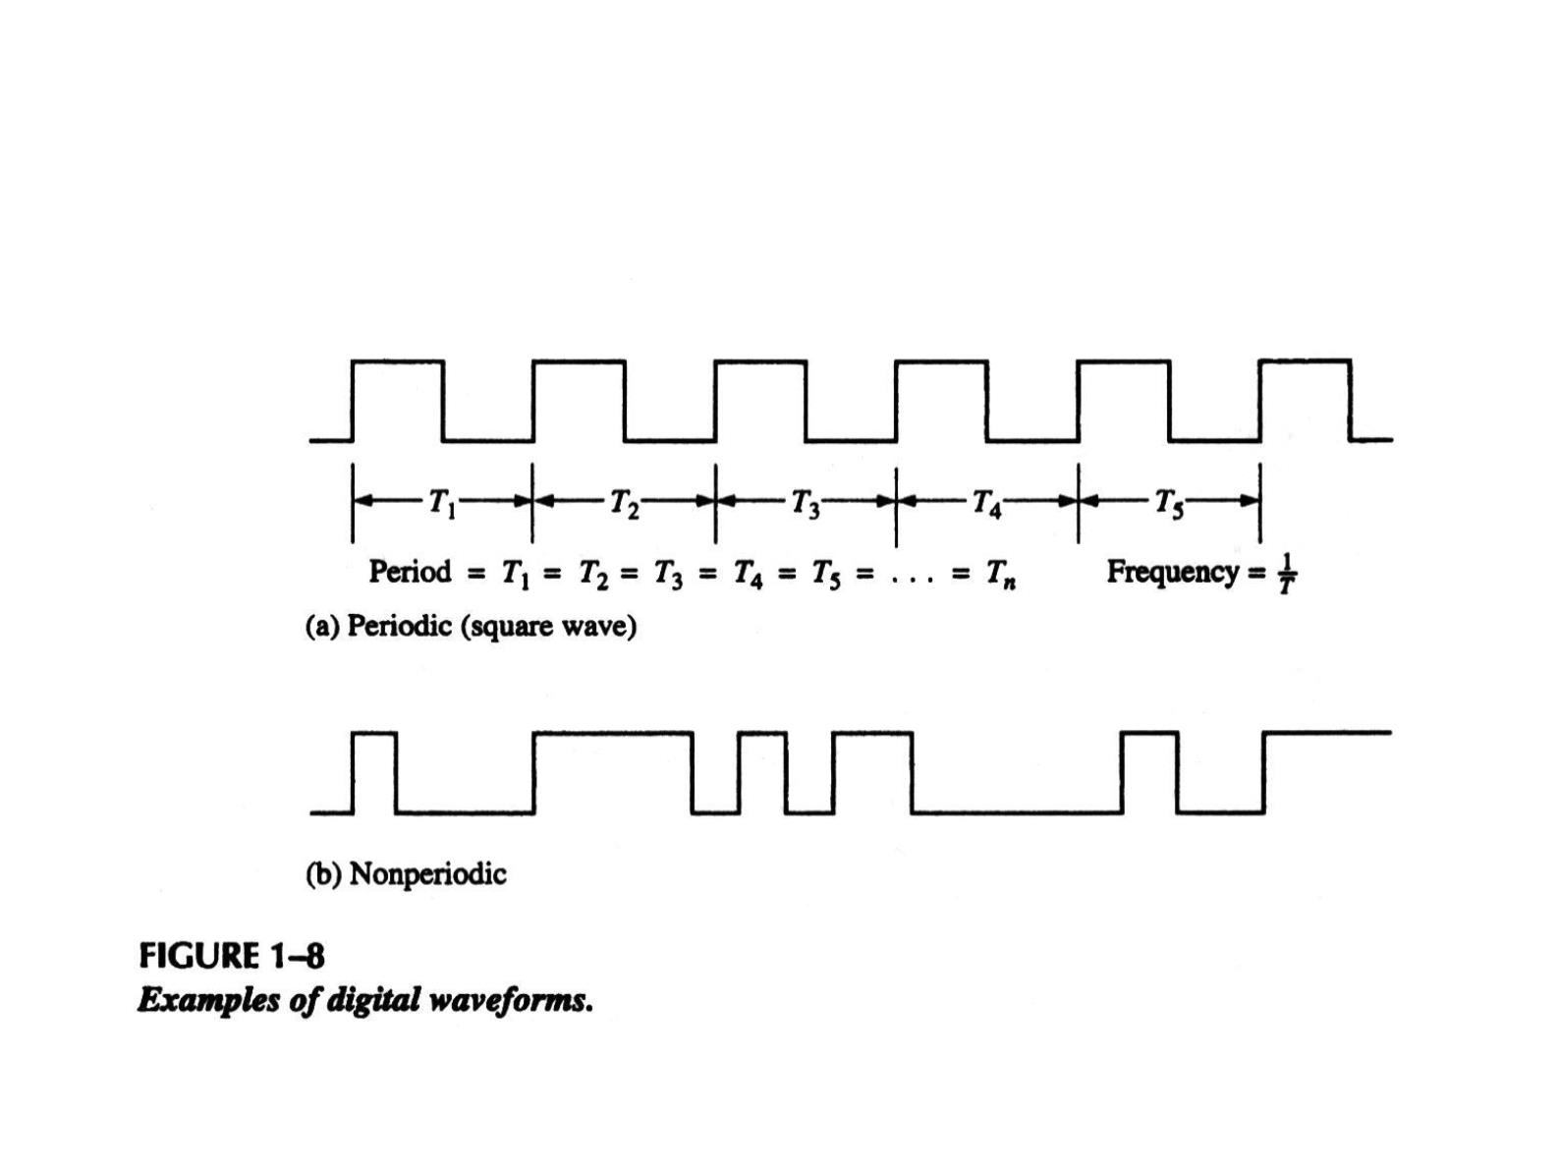
Digital Waveforms（数字波形）
● Digital waveforms consists of a series of pulses,
(voltage levels that are changing back and forth
between the HIGH and LOW levels).

Slide 29
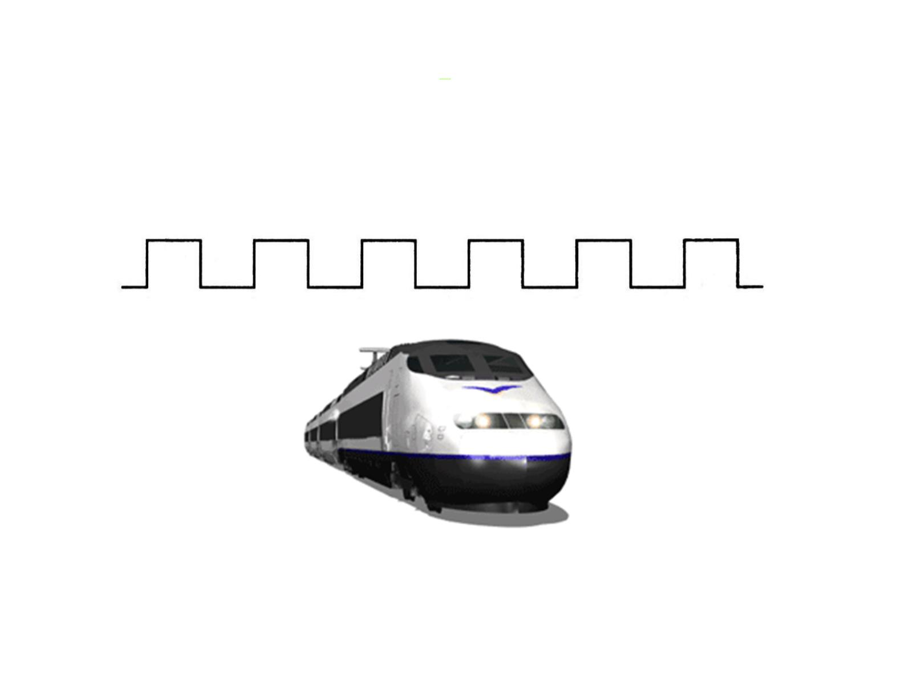
Pulse Train
● Digital waveforms are sometimes called pulse trains.

Slide 30
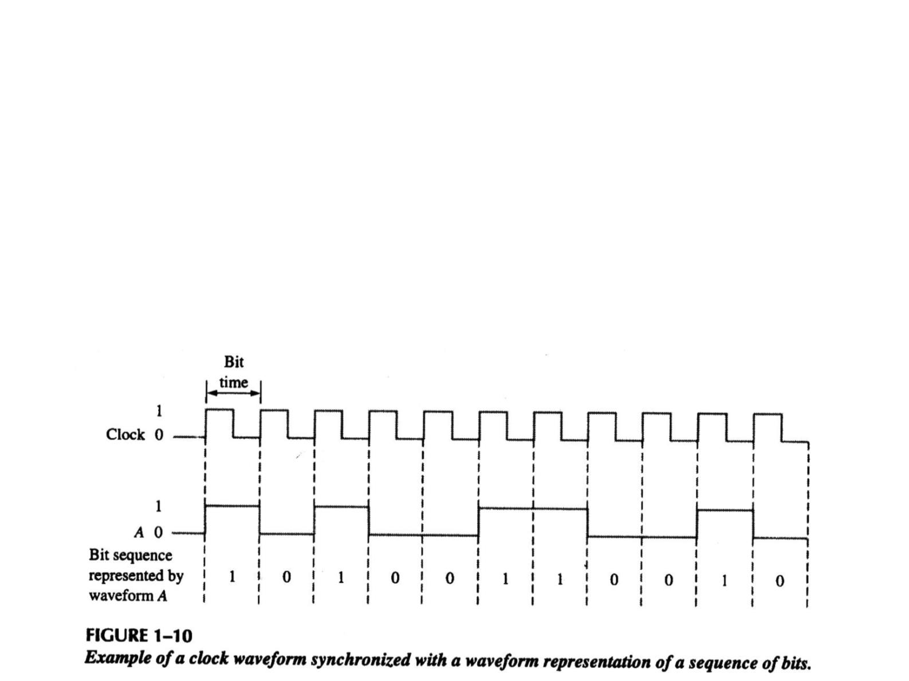
A Digital Waveform Carries Binary Information
（带二进制信息的数字波形）
● Binary information that is handled by digital systems
appears as waveforms that represent sequences of
bits. When the waveform is HIGH, a binary 1 is
present; when the waveform is LOW, a binary 0 is
present. Each bit in a sequence occupies a defined
time interval called a bit time, or bit interval.

Slide 31
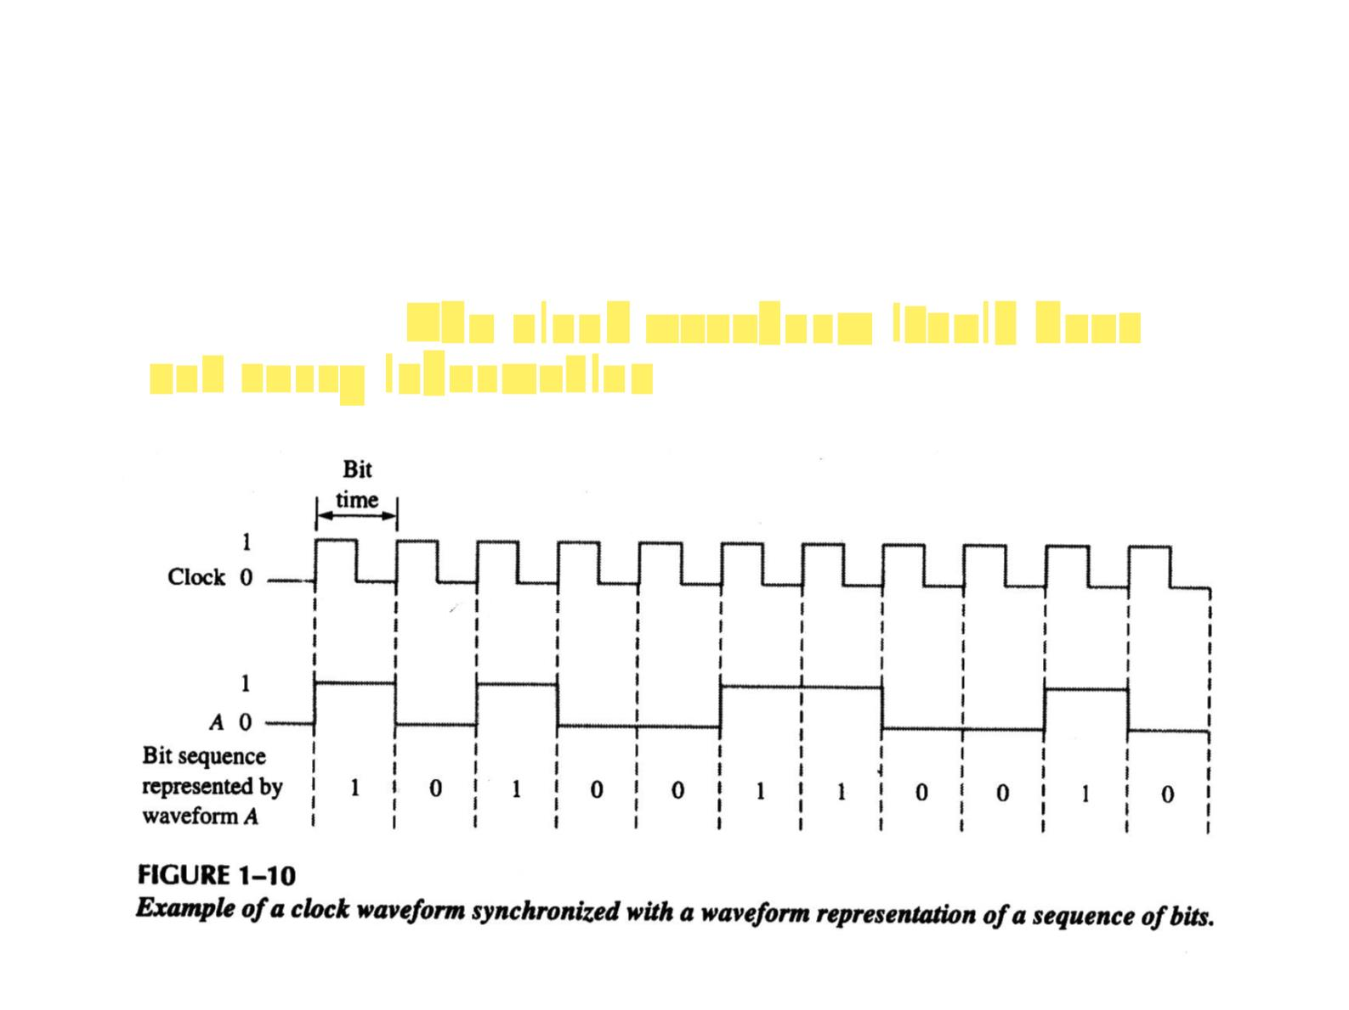
The Clock（时钟）
● In digital systems, all digital waveforms are
synchronized with a basic timing waveform,
called the clock. The clock is a periodic
waveform. The clock waveform itself does
not carry information.

Slide 32
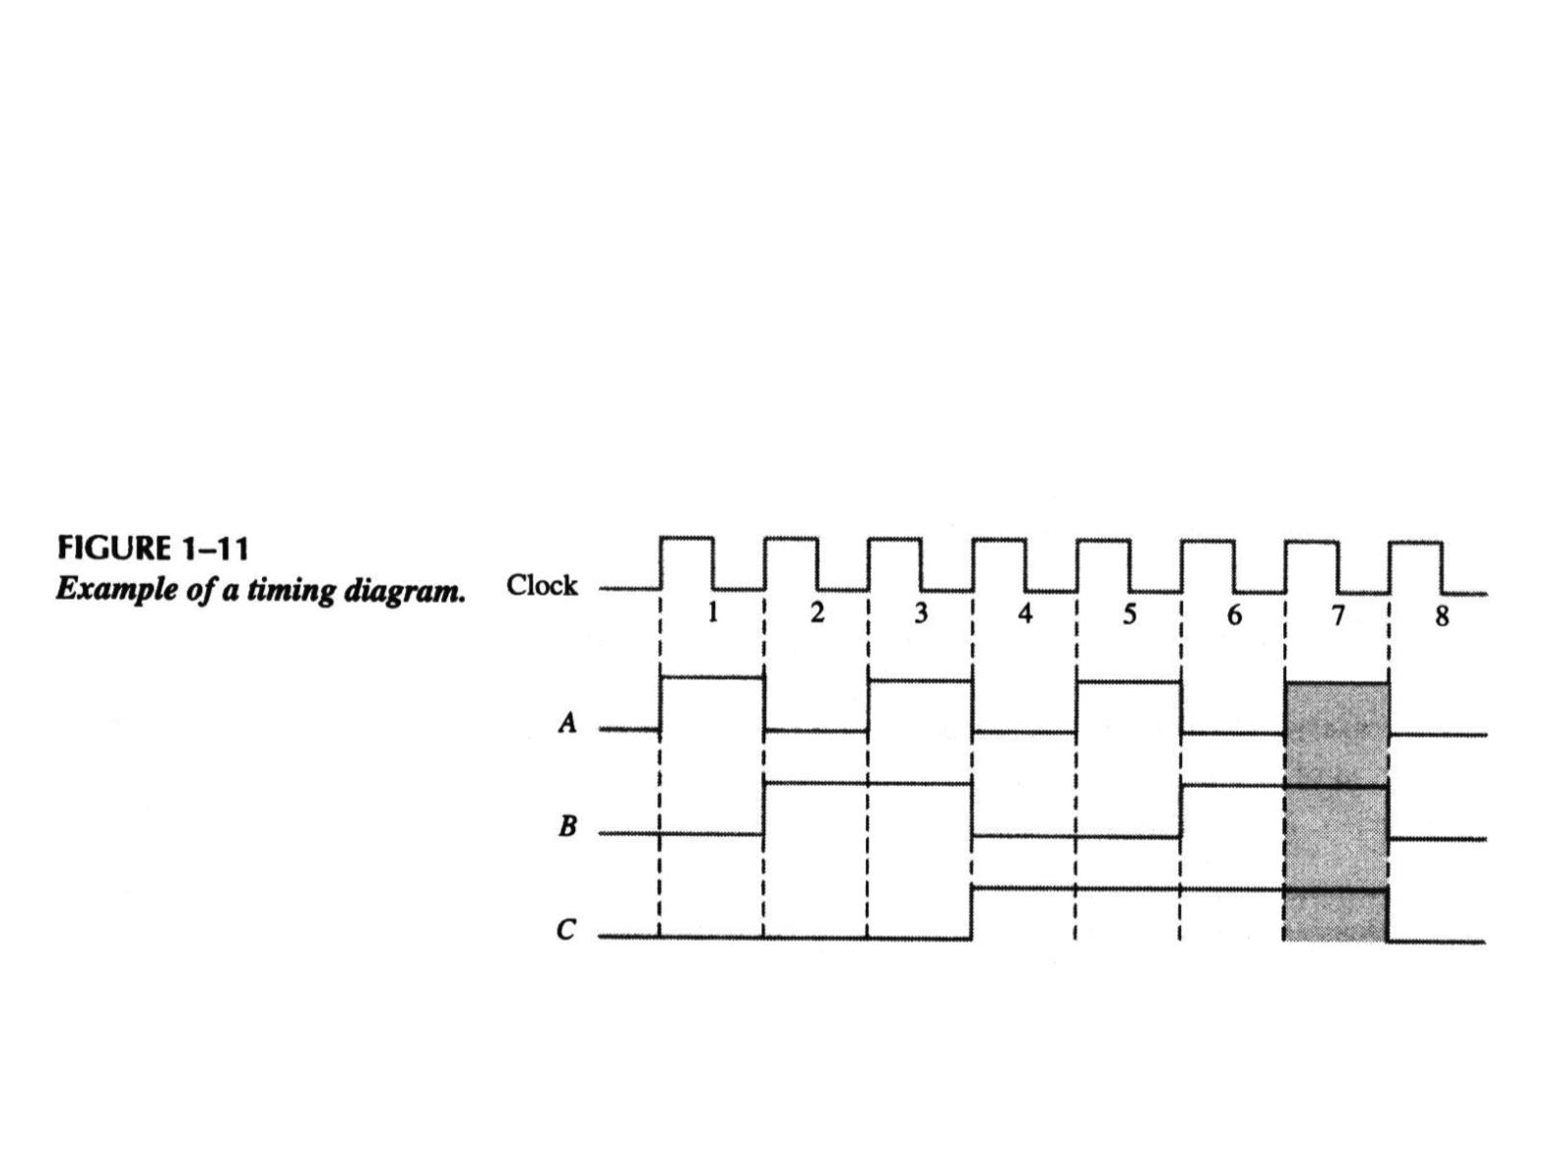
Timing Diagrams（时序图）
● A timing diagram is a graph of digital
waveforms showing the actual time
relationship of two or more waveforms and
how each changes in relation to the others.

Slide 33
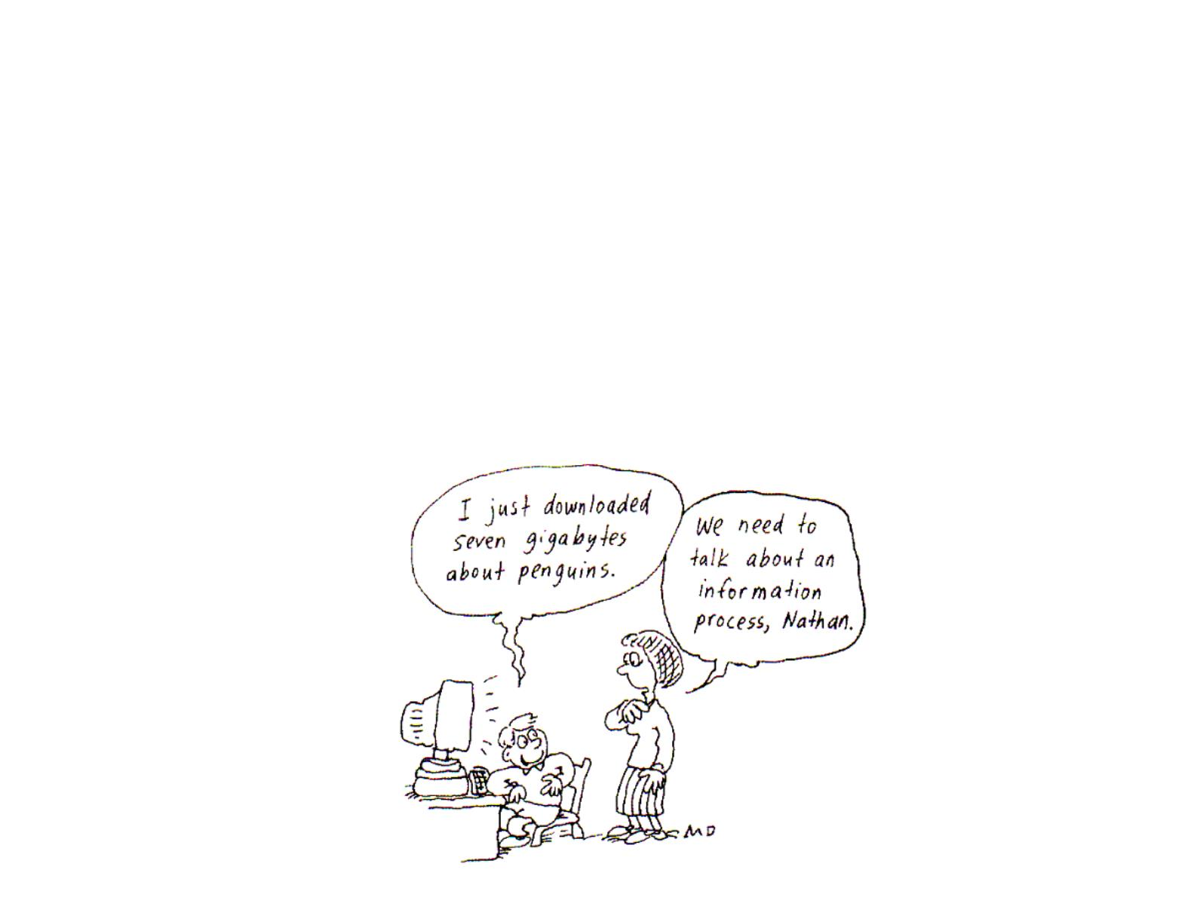
Data Transfer（数据传输）
● Data refers to groups of bits that convey some type
of information. Binary data, which are represented
by digital waveforms, must be transferred from one
circuit to another within a digital system or from one
system to another in order to accomplish a given
purpose.数据是指一组可以用来传达某种信息的位。

Slide 34
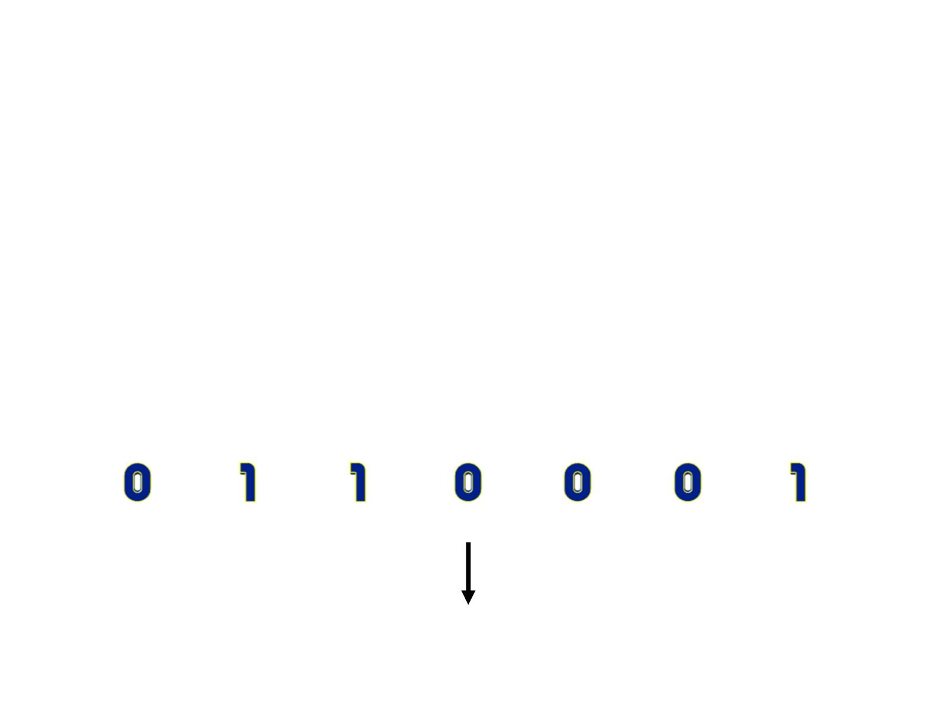
Codes（编码）
● Groups of bits (combination of 1s and 0s), called
codes, are used to represent numbers, letters,
symbols, instructions, and anything else required in a
given application.
● The American Standard Code for Information
Interchange (ASCII) – pronounced “askee” – is a
universally accepted alphanumeric code used in most
computers and other electronic equipment.
1

Slide 35
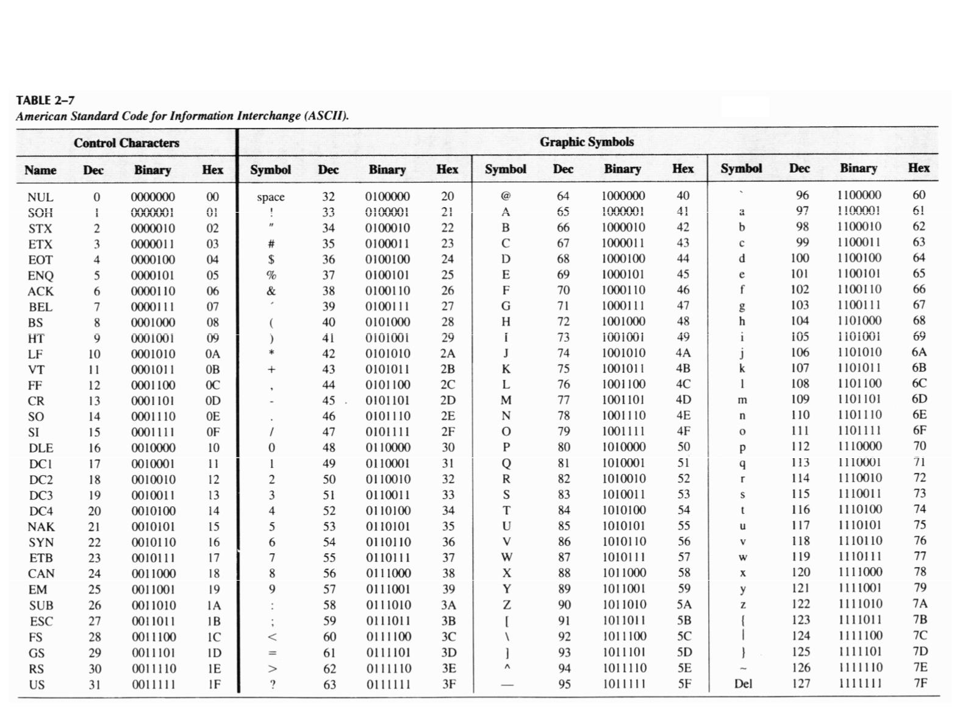
ASCII

Slide 36
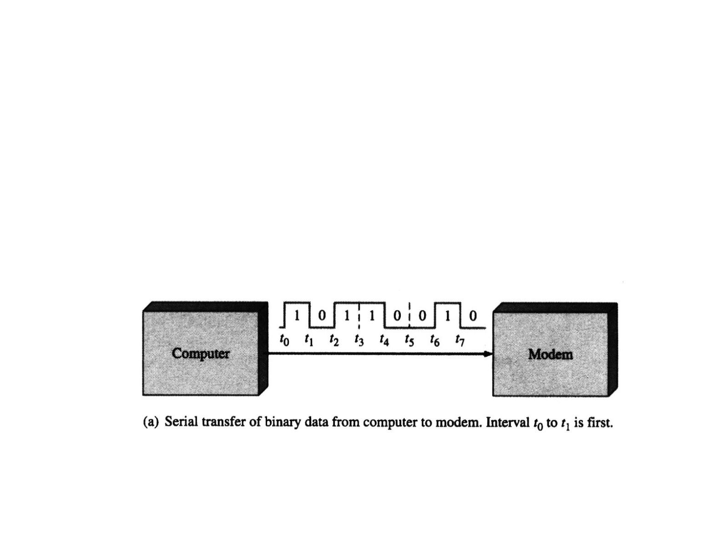
Serial Data Transfer(串行传输)
● When bits are transferred in serial form from one
point to another, they are sent one bit at a time
along a single conductor. To transfer n bits in series,
it takes n time intervals.

Slide 37
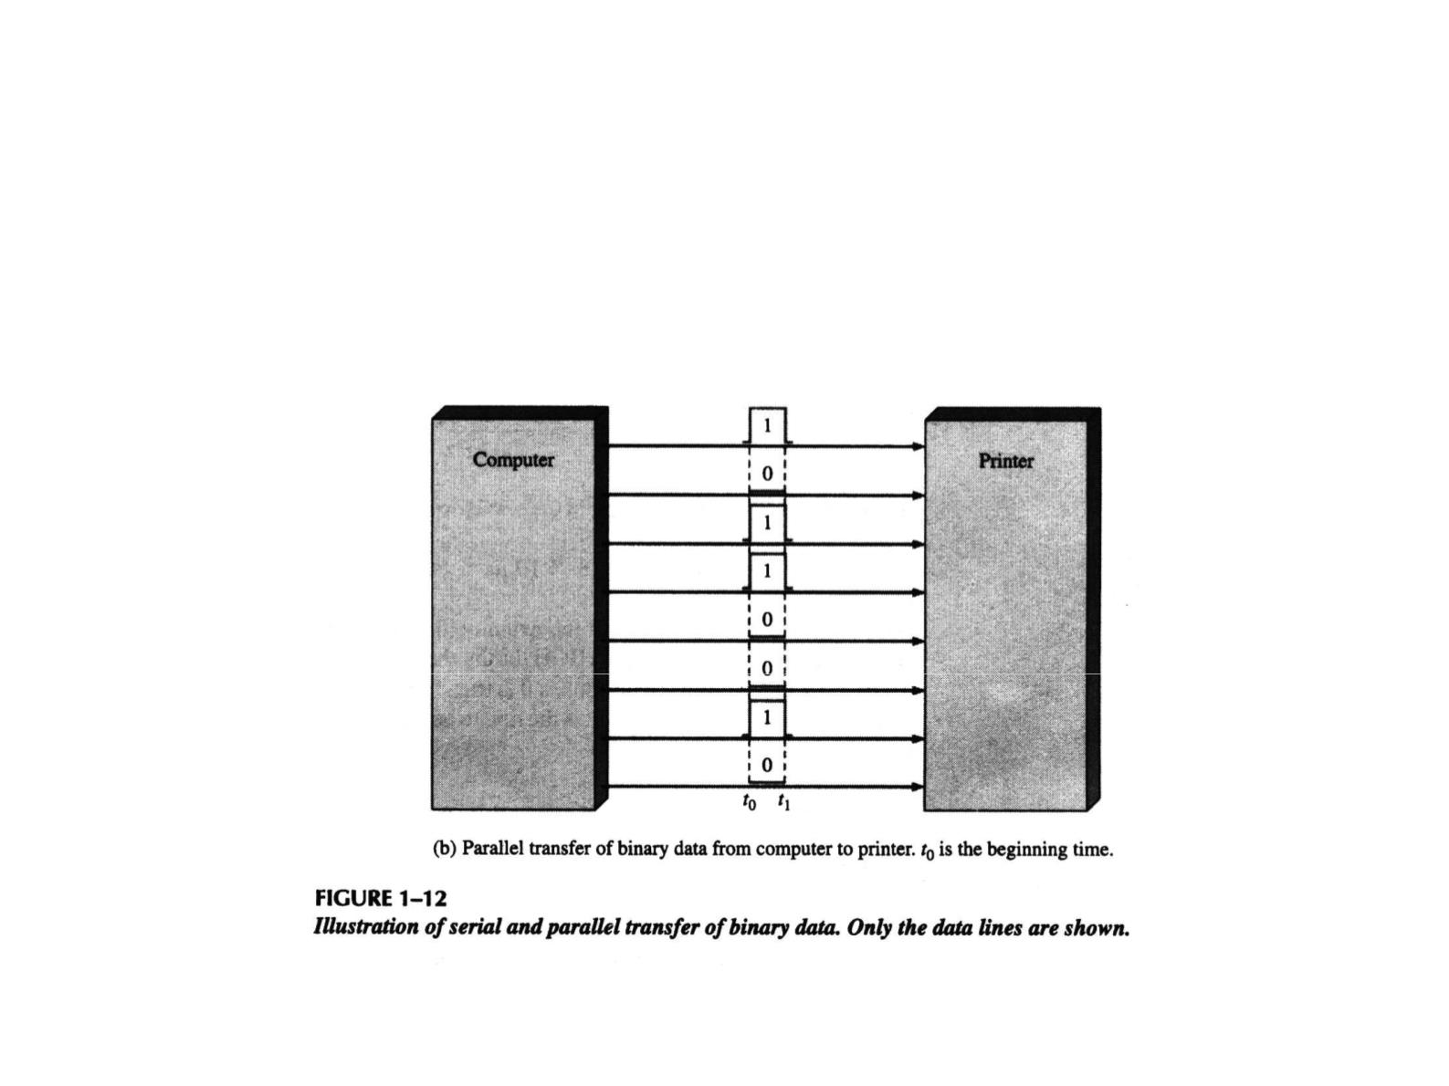
Parallel Data Transfer(并行传输)
● When bits are transferred in parallel form, all the
bits in a group are sent out on separate lines at the
same time. There is one line for each bit. To transfer
n bits in parallel, it takes one time interval.

Slide 38
1-3 BASIC LOGIC OPERATIONS
基本逻辑运算

Slide 39
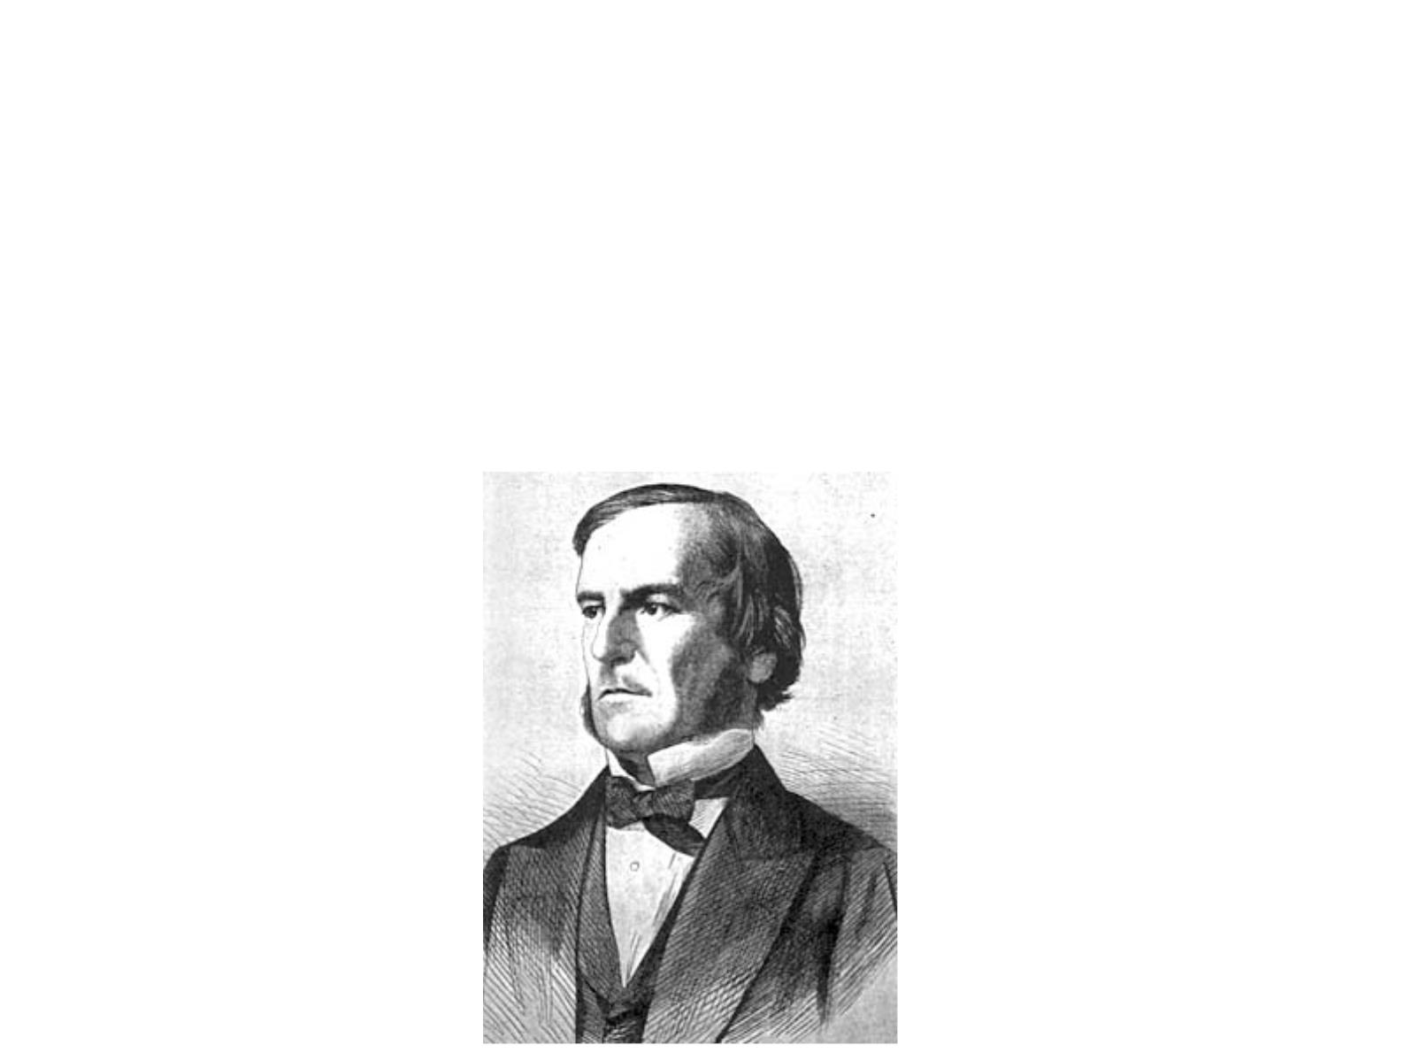
Boolean Algebra（布尔代数）
● In 1850s, the Irish logician and mathematician
George Bool developed a mathematical system for
formulating logic statements with symbols so that
problems can be written and solved in a manner
similar to ordinary algebra.

Slide 40
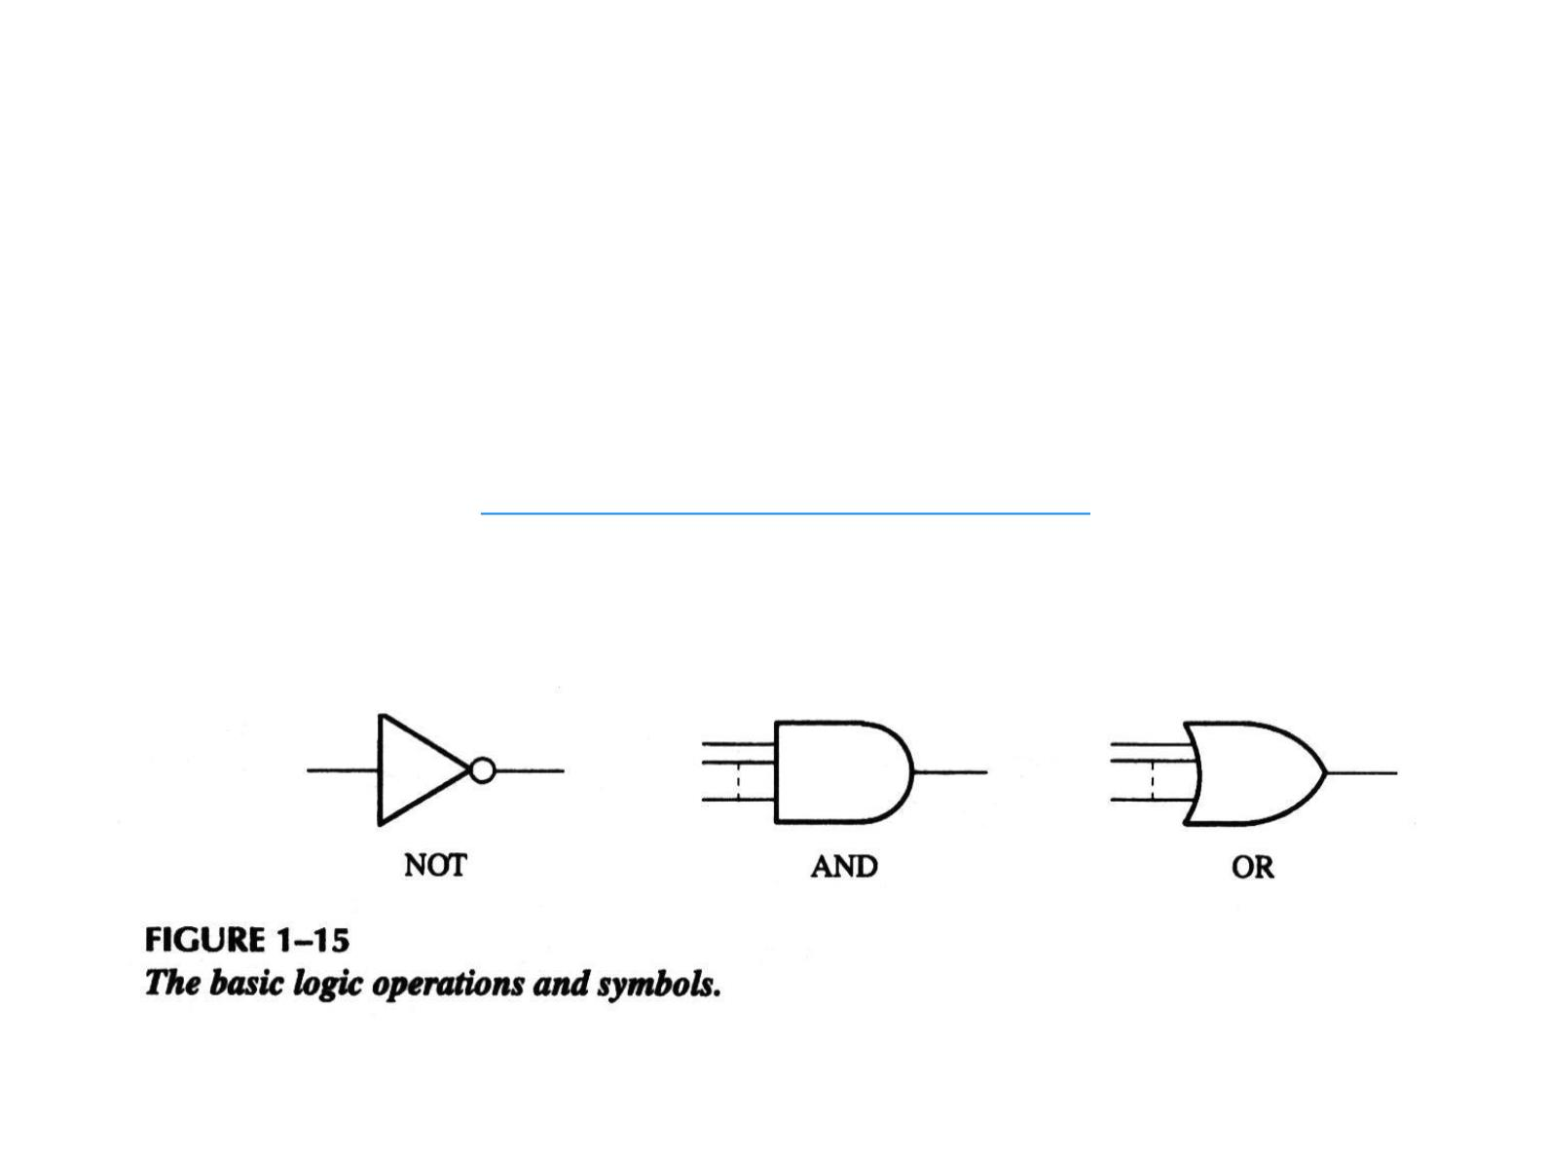
Basic Logic Operations（基本逻辑运算）
● In Boolean algebra, there are three basic logic
operations: NOT, AND, and OR.
● Each of the three basic logic operations produces a
unique response (output) to a given set of conditions
(inputs).
● The standard distinctive shape symbols for the three
basic logic operations are shown below.

Slide 41
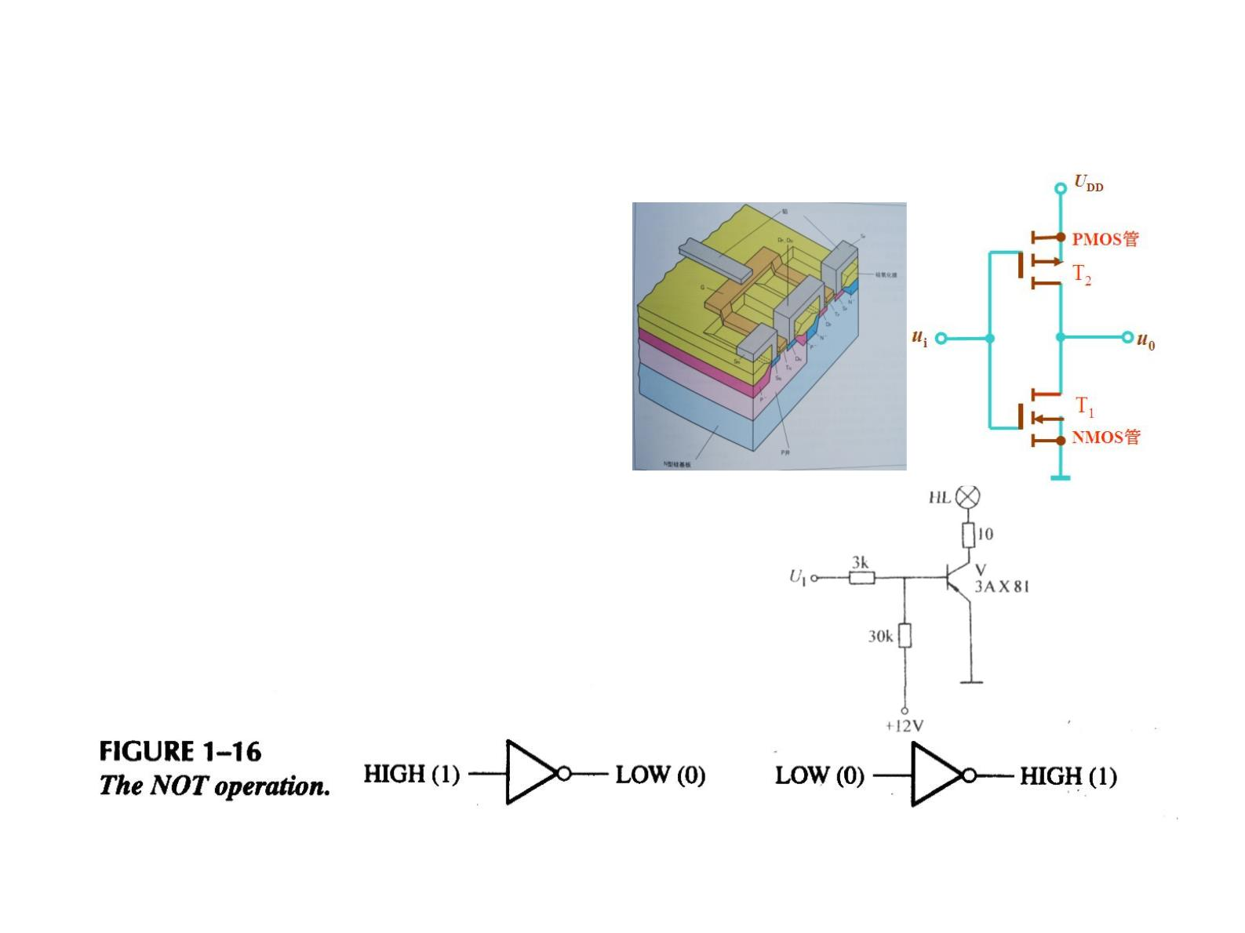
The NOT Operation（非运算）
● The NOT operation
changes one logic level to
the opposite logic level.
● The NOT operation is
implemented by a logic
circuit known as an inverter
(NOT gate).

Slide 42
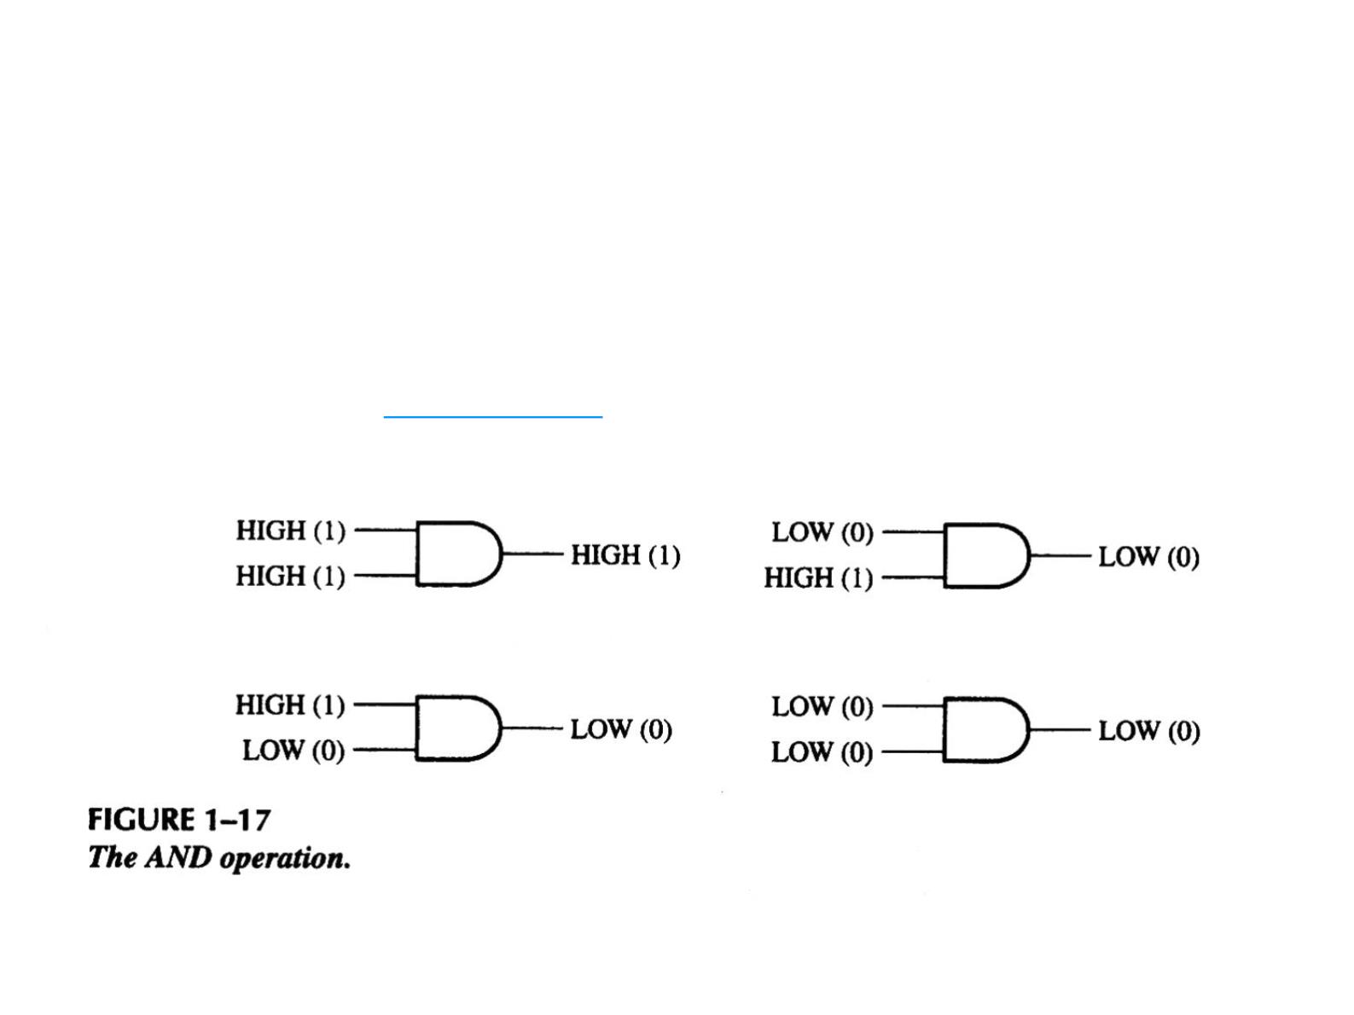
The AND Operation（与运算）
● The AND operation produces a HIGH output only if all
the inputs are HIGH. When any or all inputs are LOW,
the output is LOW.
● The AND operation is implemented by a logic circuit
known as an AND gate.

Slide 43
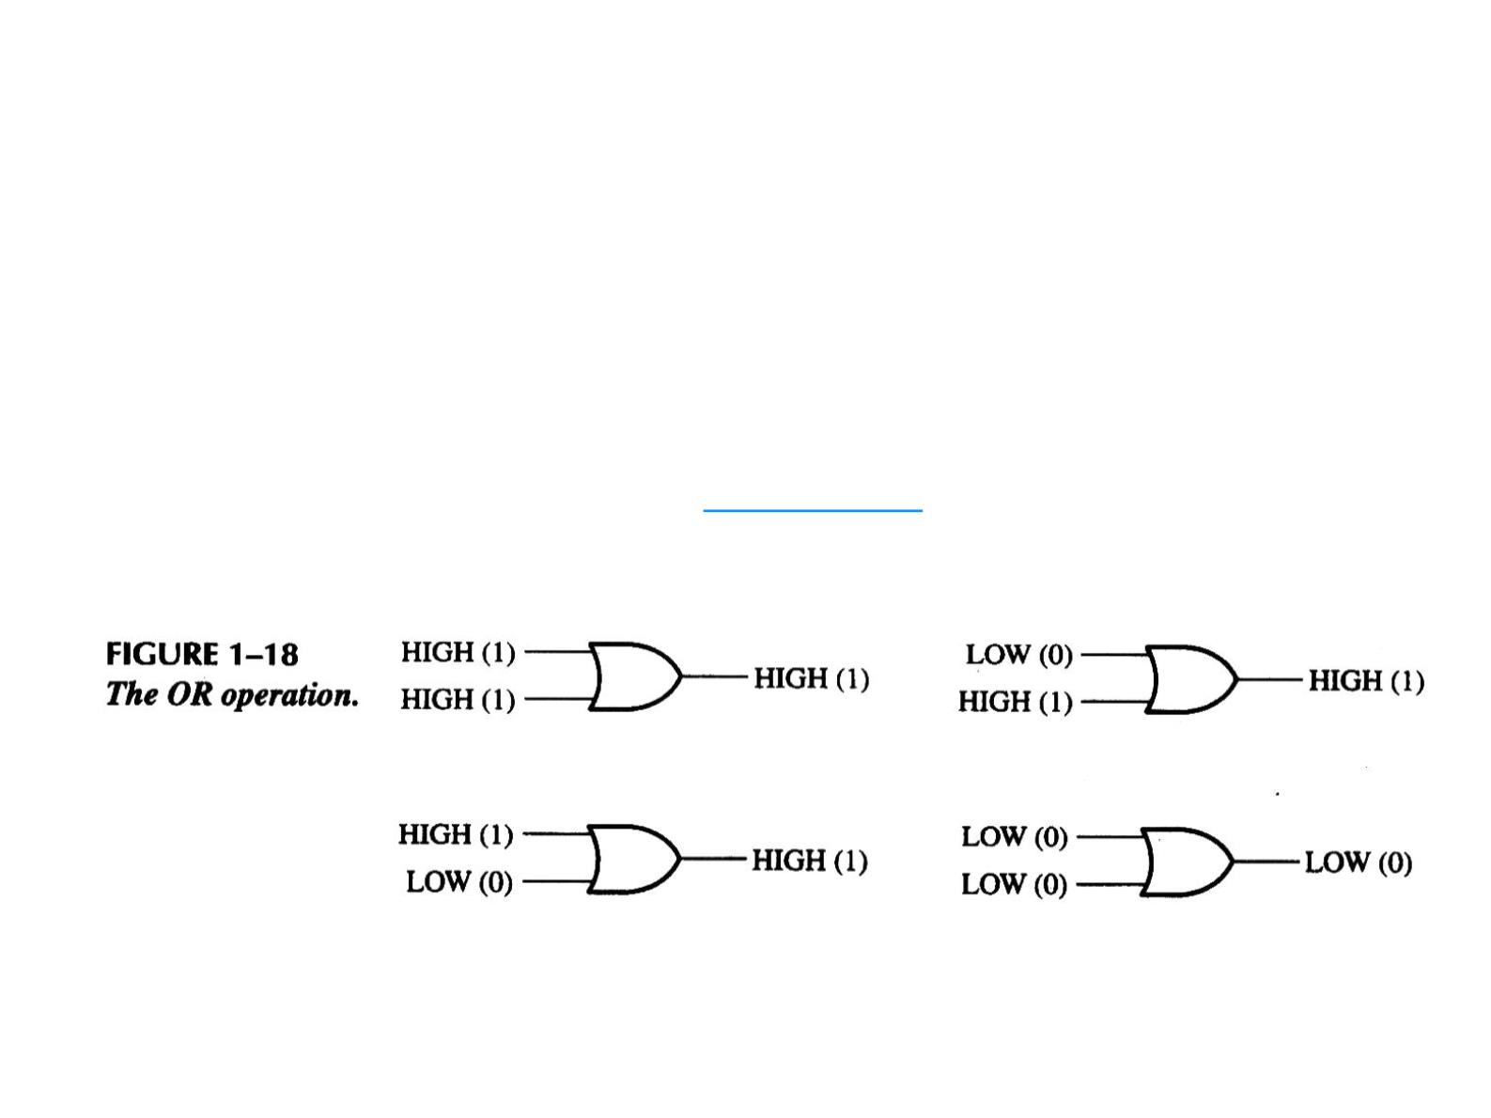
The OR Operation（或运算）
● The OR operation produces a LOW output only
if all the inputs are LOW. When any or all
inputs are HIGH, the output is HIGH.
● The OR operation is implemented by a logic
circuit known as an OR gate.

Slide 44
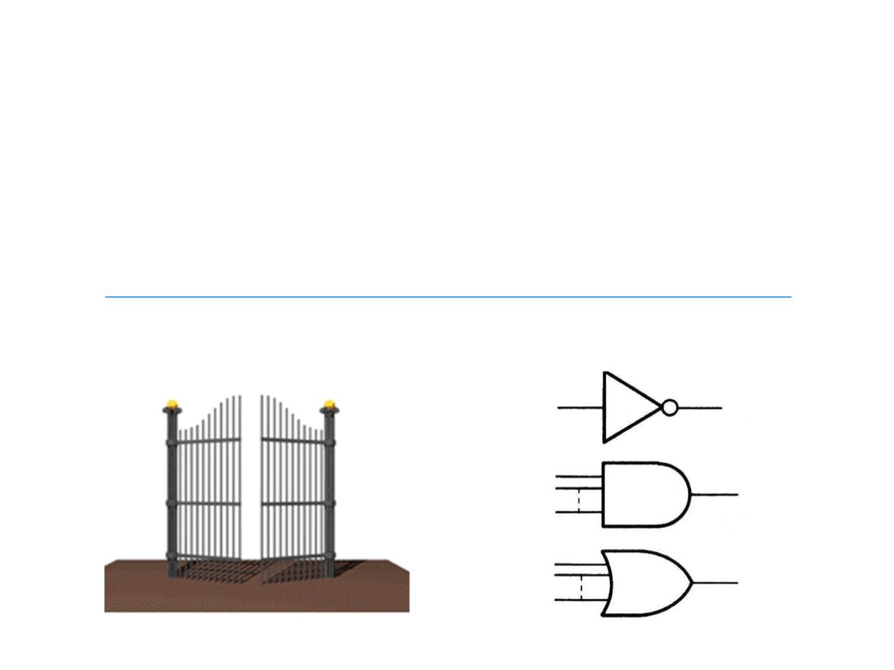
Logic Gates（逻辑门）
● A circuit that performs a specified basic logic
operation is called a logic gate. Logic gates form the
building blocks for digital systems.
● The true/false statements mentioned earlier are
represented by a HIGH (true) and a LOW (false).
● AND and OR gates can have any number of inputs.

Slide 45
1-5 DIGITAL INTEGRATED CIRCUITS
数字集成电路

Slide 46
Introductory Paragraph
● All the logic elements and functions that have been
discussed – and many more – are available in integrated
circuit (IC) form. Modern digital systems use ICs almost
exclusively in their designs because of their small size,
high reliability, low cost, and low power consumption. It
is important to be able to recognize the IC packages and
to know how the pin connections are numbered, as well as
to be familiar with the way in which circuit complexities
and circuit technologies determine the various IC
classifications.
● 集成电路（ integrated circuit ）是目前用的最广泛的一类
器件。它具有尺寸小、功耗低、价格便宜、可靠性高等优点。
因此学会认识不同芯片的管脚封装类型、使用方法、生产工
艺等基本知识十分必要。
现代数字系统几乎使用IC由于体积小，因此仅在其设计中，高可靠性、低成本、低功耗。它能够识别 IC 封装和了解引脚连接的编号方式，以及熟悉电路复杂性的方式

Slide 47
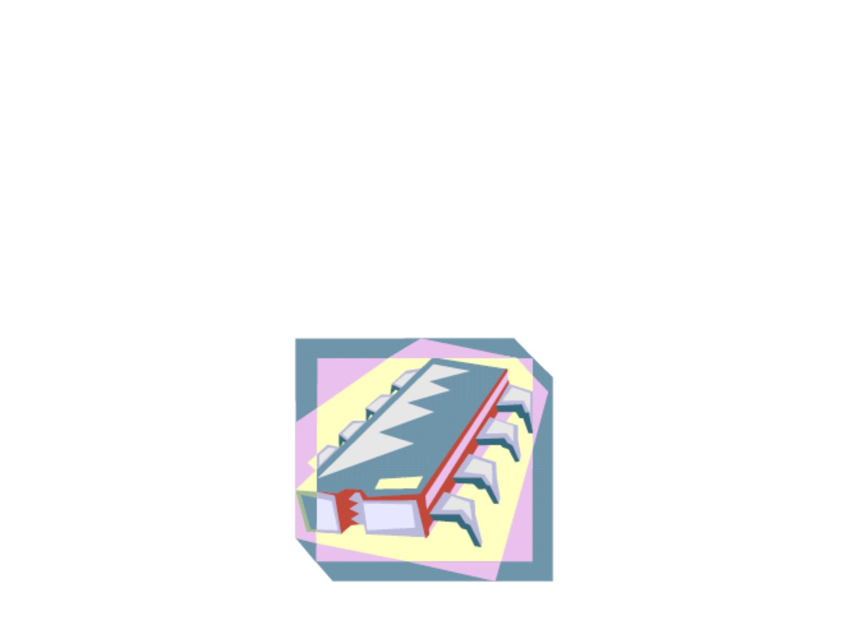
IC
● A monolithic (整体) IC is an electronic
circuit that is fabricated on a single chip of
semiconductor material (usually silicon)
called substrate（基片）. All the
components that make up the circuit –
transistors, diodes, resistors, and
capacitors – are an integral part of that
single chip.
半导体材料（通常为硅）
称为基片（基片）。所有
构成电路的组件 –
晶体管、二极管、电阻器和
电容器 – 是其中不可或缺的一部分
单芯片。

Slide 48
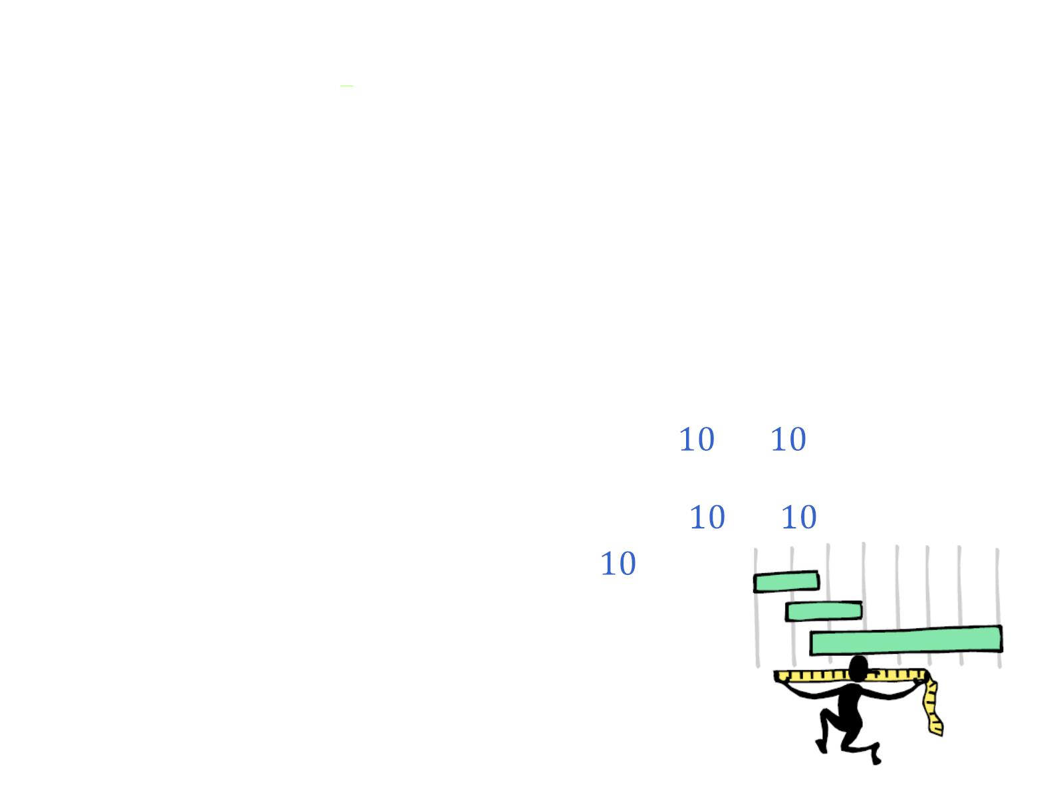
Integrated Circuit Complexity Classification
● ICs are classified according to their complexity
depending on the number of equivalent gate circuits
on a single chip:
○ Small-scale integration (SSI): < 10, gates, flip-flops.
○ Medium-scale integration (MSI): 10 – 100 gates or flip-
flops, encoders, decoders, registers, multiplexers (data
selectors), adders.
○ Large-scale integration (LSI): 100 – 10000, memories.
○ Very large-scale integration (VLSI):
^{ହ} – ଻
,
microprocessors, single-chip computers.
○ Ultra large-scale integration (ULSI):
଻ – ଽ
○ Giga-scale integration (GSI): >
ଽ

Slide 49
Integrated Circuit Technologies
● The types of transistors with which all ICs are
implemented are either BJTs (bipolar junction
transistors) or MOSFETs (metal-oxide
semiconductor field-effect transistors).
● Two types of digital circuit technology that use
BJTs are TTL (transistor-transistor logic) and ECL
(emitter-coupled logic).
● The major circuit technologies that use MOSFETs
are CMOS (complementary MOS) and NMOS (n-
channel MOS).
● SSI and MSI circuits are generally available in both
TTL and CMOS.
● LSI, VLSI, ULSI, and GSI are generally
implemented with CMOS or NMOS because it
requires less area on a chip and consumes less power.

Slide 50
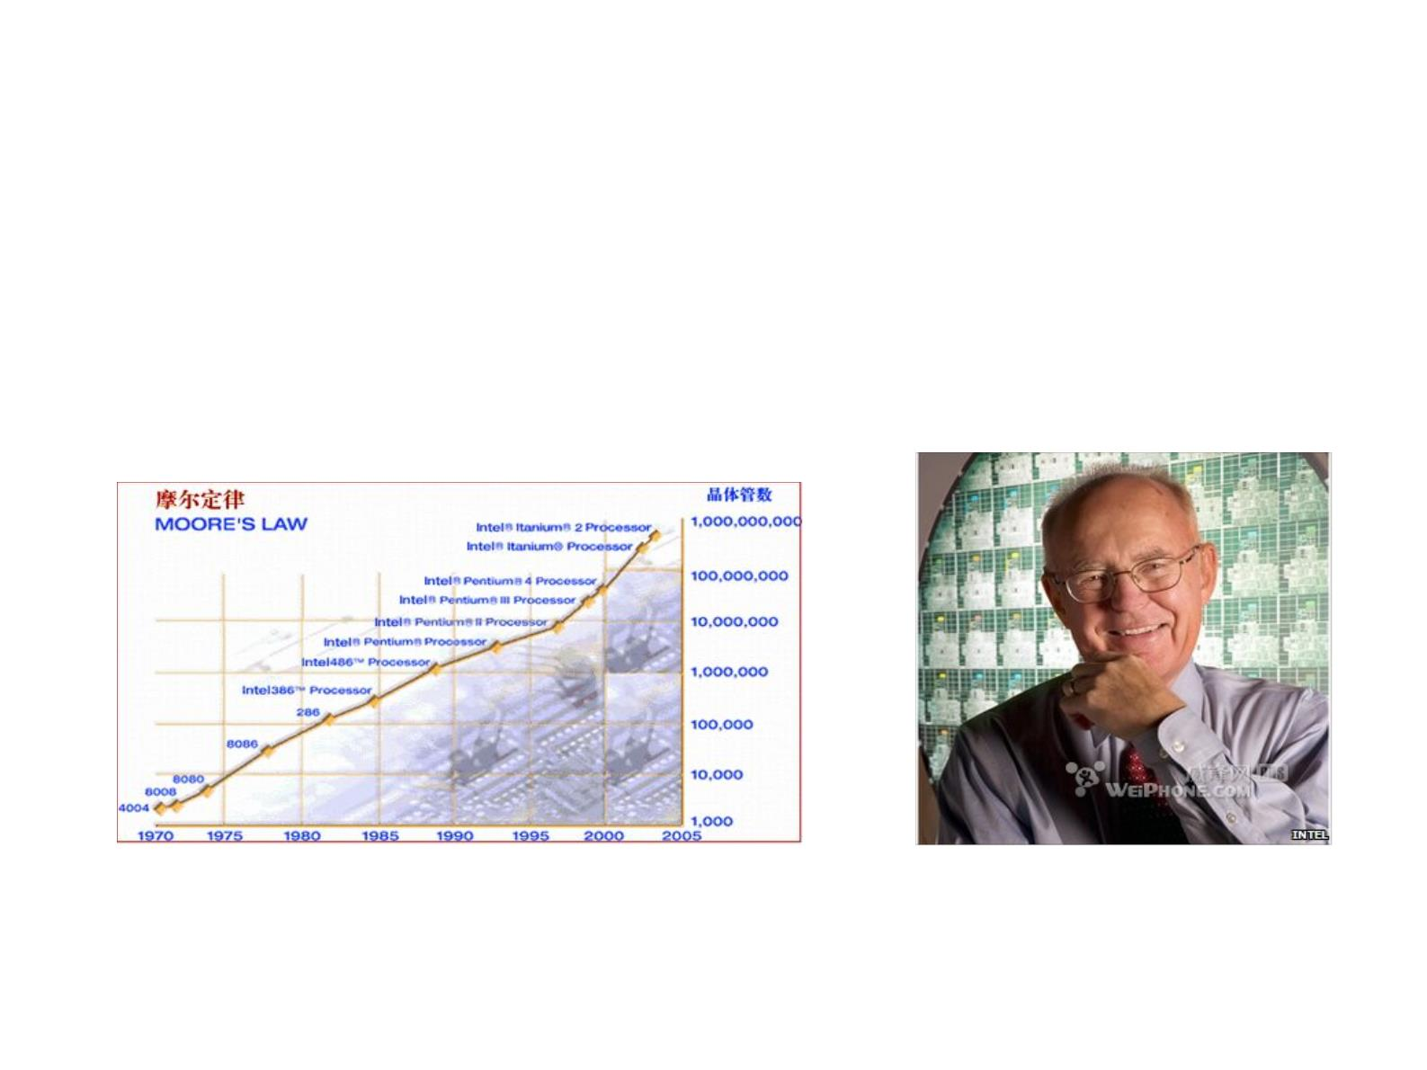
摩尔定律
● 当价格不变时，集成电路上可容纳的元器件
的数目，约每隔18-24个月便会增加一倍，性
能也将提升一倍。
《我国集成电路领域重要技术发展趋势和技术预见浅析》余文科，李 芳，程 媛，赵 琦

Slide 51
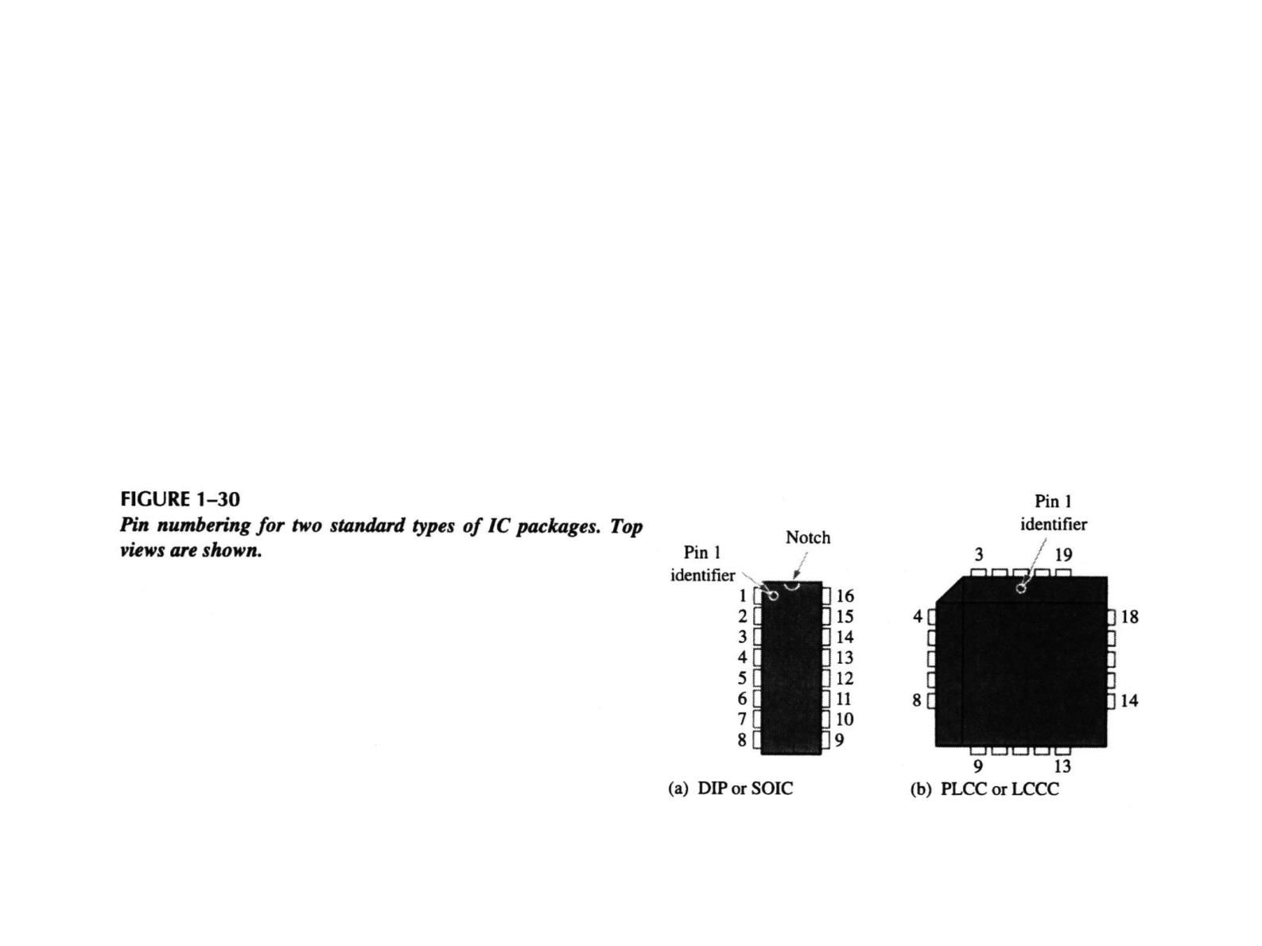
Pin Numbering（引脚编号）
● All IC packages have a standard format for
numbering the pins. Looking at the top of
the package, pin 1 is indicated by an
identifier that can be either a small dot, a
notch, or a beveled edge. Starting with pin 1,
the pin numbers increase as you go
counterclockwise.

Slide 52

Quiz
1. Compared to analog systems, digital systems
a. are less prone to noise
b. can represent an infinite number of values
c. can handle much higher power
d. all of the above

Slide 53
Quiz
2. The number of values that can be assigned to a bit are
a. one
b. two
c. three
d. ten

Slide 54
Quiz
3. The time measurement between the 50% point on the
leading edge of a pulse to the 50% point on the trailing edge
of the pulse is called the
a. rise time
b. fall time
c. period
d. pulse width

Slide 55
Quiz
4. The time measurement between the 90% point on the
trailing edge of a pulse to the 10% point on the trailing edge
of the pulse is called the
a. rise time
b. fall time
c. period
d. pulse width

Slide 56
Quiz
5. The reciprocal of the frequency of a clock signal is the
a. rise time
b. fall time
c. period
d. pulse width

Slide 57
Quiz
6. If the period of a clock signal is 500 ps, the frequency is
a. 20 MHz
b. 200 MHz
c. 2 GHz
d. 20 GHz

Slide 58
Quiz
7. AND, OR, and NOT gates can be used to form
a. storage devices
b. comparators（比较器）
c. data selectors
d. all of the above

Slide 59
Quiz
9. A device that is used to switch one of several input lines to a
single output line is called a
a. comparator
b. decoder
c. counter
d. multiplexer

Slide 60
Quiz
10. For most digital work, an oscilloscope should be coupled
to the signal using
a. ac coupling（交流耦合）
对于大多数数字工作，应耦合示波器
对信号使用
b. dc coupling（直流耦合）
c. GND coupling（GND）耦合
d. none of the above

Slide 61

Homework
● Problems: 1, 2, 6(b), 7, 8, 12, 13, 17

