Slide 1
Day 1, Session 2: Python and Vector Data
BC Gov Intermediate Remote Sensing Workshop 2023
Darren Wiens
Sparkgeo

Slide 2
Session Agenda
Talk about Python and Vector Data
Google Colab

Slide 3
What is Vector Data?
Points
Lines
Polygons

Slide 4
Point
xy[z] coordinate location
zero area, zero length

Slide 5
Line
connected xy[z] coordinate locations
non-zero length, zero area

Slide 6
Polygons
connected xy[z] coordinate locations, closed
non-zero area

Slide 7
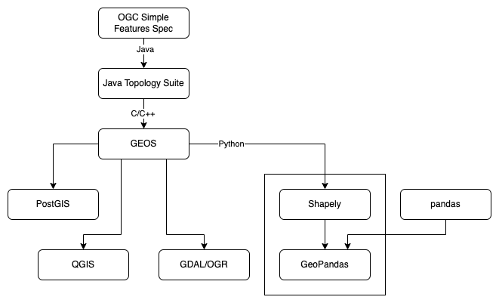
Geospatial Vector Data Landscape

Slide 8
Shapely
Built on GEOS
Provides a data model and set theoretic operations for planar vector data
Does not consider coordinate reference system
shapely.readthedocs.io

Slide 9
Shapely Data Model
Points (Point)
Curves (LineString and LinearRing)
Surfaces (Polygon)
Collections (MultiPoint, MultiLineString, and MultiPolygon)

Slide 10

Shapely Point
from shapely.geometry import Point
Point(0, 0)

Slide 11

Shapely Curves
from shapely.geometry import LineString
LineString([[0, 0], [1, 0], [1, 1], [0, 1]])

Slide 12

Shapely Curves
from shapely.geometry import LinearRing
LinearRing([[0, 0], [1, 0], [1, 1], [0, 1]])

Slide 13

Shapely Surfaces
from shapely.geometry import Polygon
Polygon([[0, 0], [1, 0], [1, 1], [0, 1]])

Slide 14

Shapely Collections
from shapely.geometry import MultiPoint
MultiPoint([Point(0, 0), Point(1, 1)])

Slide 15
Shapely Coordinate Reference Systems
Shapely does not recognize coordinate reference systems
Assumes all geometries share the same plane
In other words, it is up to the user to manage coordinates

Slide 16
pandas
pandas is one of the more foundational modules in data science, providing a robust data frame (table) framework
Data structures:
DataFrame: table-like object
Series: column-like object
https://pandas.pydata.org/

Slide 17
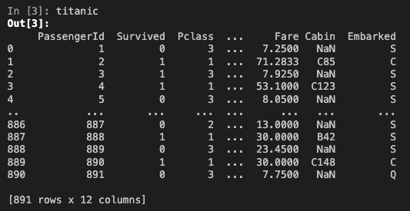
pandas
titanic = pd.read_csv("titanic.csv")
source: https://pandas.pydata.org/docs/getting_started/intro_tutorials/02_read_write.html

Slide 18
GeoPandas
pandas has no concept of location
GeoPandas adds support for geographic data
Data structures:
GeoSeries: a Series containing Shapely geometries
GeoDataFrame: a DataFrame containing a GeoSeries

Slide 19
GeoPandas: GeoDataFrame
we can load many data sources (e.g. shapefile, GeoJSON, etc.) into a GeoDataFrame using read_file()
GeoDataFrames have many properties and methods available
import geopandas as gpd
gdf = gpd.read_file(“my_data.geojson”)
print(gdf.crs)
# projects, buffers and opens map of geometries
gdf.to_crs(9822).buffer(10000).explore()

