Slide 1
Day 2, Session 1: Raster Data
BC Gov Intermediate Remote Sensing Workshop 2023
Darren Wiens
Sparkgeo

Slide 2
Session Agenda
Talk about Raster Data
Google Colab

Slide 3
What is Raster Data?
Rectangular grids of cells (a “band”)
Cells each have a single numeric value
Bands may be combined (i.e. layered) for visualization

Slide 4
Band Interpretation
Bands | Interpretation
1 | Band 1: greyscale (each cell value is assigned a color from black to white) or a defined colormap
2 | Band 1: greyscale or a defined colormap Band 2: opacity (each cell value controls the opacity of the corresponding output pixel)
3 | Band 1: red (each cell determines the redness of the output) Band 2: green (each cell determines the greenness of the output) Band 3: blue (each cell determines the blueness of the output)
4 | Band 1: red Band 2: green Band 3: blue Band 4: opacity

Slide 5
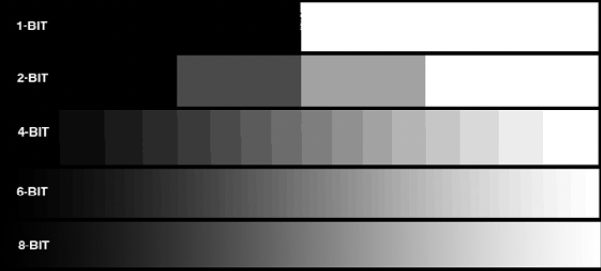
Bit Depth
All cells must have the same bit depth
The number of bits indicates how many gradations are supported
More bits = more values and more storage required
Imagery can be provided in several bit depths (e.g. 64, 32, or 16)
Many Python and web imagery tools require data to be rescaled to unsigned 8-bit integer
integer values: 0 - 255
source: https://www.projectorcentral.com/All-About-Bit-Depth.htm

Slide 6
numpy
https://numpy.org/
numpy arrays have emerged as the standard Python data structure for numerical arrays
as numpy contains a large number of commonly and repeatedly used methods, you will often see numpy imported as: import numpy as np

Slide 7
numpy Arrays
my_python_array = [[1, 2, 3], [4, 5, 6]]
my_numpy_array = np.array(my_python_array)
numpy arrays have properties, including:
shape: (rows, columns)
my_numpy_array.shape -> (2, 3)
ndim: number of dimensions
my_numpy_array.ndim -> 2 (height and width)
size: total number of elements
my_numpy_array.size -> 6
dtype: data type (bit depth)
my_numpy_array.dtype -> dtype('int64')

Slide 8
numpy Arrays
images are often represented by 2- or 3-dimension numpy arrays
2-dimension:
np.shape -> [rows, columns]
e.g. [1000, 2000] -> 1000 cells tall, 2000 cells wide
represented as greyscale or a defined colormap
3-dimension:
np.shape -> [bands, rows, columns] OR [rows, columns, bands]
e.g. [3, 1000, 2000] -> 1000 tall, 2000 wide, 3 bands deep
e.g. [1000, 2000, 3] -> 1000 tall, 2000 wide, 3 bands deep
certain Python modules expect imagery in one order or the other

Slide 9
numpy Arrays: Reordering Axes
np.moveaxis(a, source, destination)
a = array
source = original axes positions
destination = final axes positions
e.g. reorder an array (a) with shape [3, 1000, 2000] to [1000, 2000, 3]
np.moveaxis(a, 0, 2)
move 1st axis to 3rd position
np.moveaxis(a, 0, -1)
move 1st axis to last position
np.moveaxis(a, [0, 1, 2], [2, 0, 1])
explicitly set all axis positions
^ all same result

Slide 10
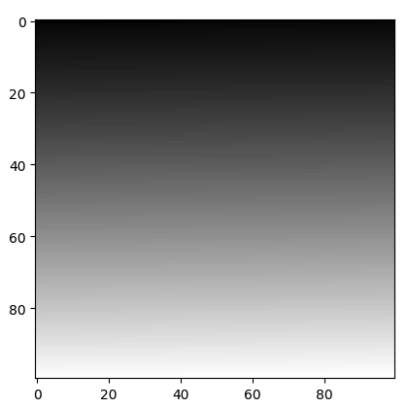
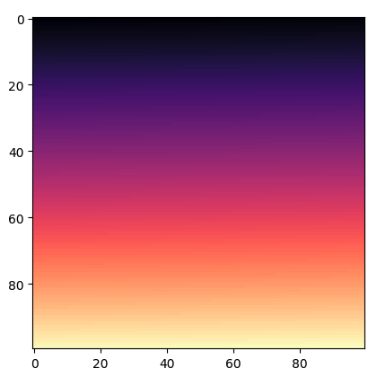
numpy Arrays: Display Image
import matplotlib.pyplot as plt
a = np.arange(10000).reshape([100,100])
plt.imshow(a, cmap="gray") | plt.imshow(a, cmap="magma")

Slide 11
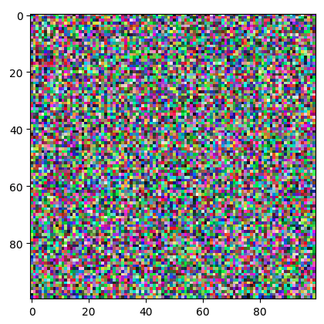
numpy Arrays: Display Image
import matplotlib.pyplot as plt
a = np.random.randint(low=0, high=255, size=[100,100,3])
plt.imshow(a)

Slide 12
PIL and pillow
PIL
Python Imaging Library
Python 2 only
pillow
PIL -> Python 3
^ both commonly referred to as “PIL”

Slide 13
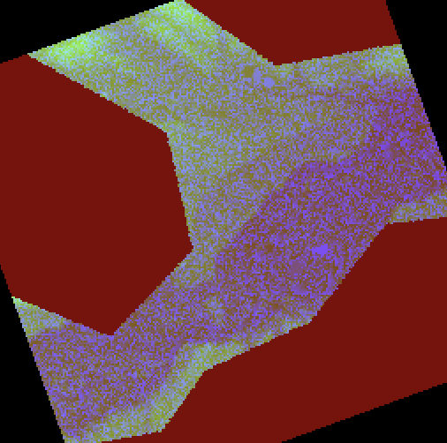
PIL and pillow: Image
almost always need to load data into a PIL Image object
can load from a file (many file types supported)
PIL Image has its own show() method
from PIL import Image
with Image.open("elevation.tif") as im:
im.rotate(20).show()

Slide 14
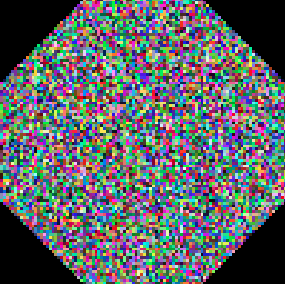
PIL and pillow: Image
can load from a numpy array
notice that PIL Image requires either:
integer: 0 - 255 (uint8, below array is created by default as int64)
float: 0 - 1
a = np.random.randint(low=0, high=255, size=[100,100,3]).astype("uint8")
im = Image.fromarray(a)
im.rotate(45).show()

Slide 15
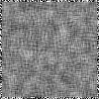

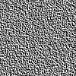
PIL and pillow: ImageFilter
from PIL import Image, ImageFilter
a = np.random.randint(low=0, high=255, size=[100,100]).astype("uint8")
im = Image.fromarray(a)
im.filter(ImageFilter.BLUR)
im.filter(ImageFilter.EMBOSS)

Slide 16
PIL and pillow: save
save PIL images using the save() method
im = Image.fromarray(a)
im.save(“output.png")

Slide 17
Rasterio
numpy and PIL have no concept of location
among other things, rasterio provides a common framework for locating images geographically
https://rasterio.readthedocs.io/

Slide 18
Rasterio: Profile
{
'driver': 'GTiff',
'dtype': 'uint8',
'nodata': None,
'width': 5100,
'height': 4050,
'count': 3,
'crs': CRS.from_epsg(3005),
'transform':
Affine(
42.332881168718224, 0.0, 955862.7791796497,
0.0,
-42.33297832254004,
1253643.6376030308
),
'blockxsize': 256,
'blockysize': 256,
'tiled': True,
'interleave': 'pixel'
}
open spatial rasters with rasterio.open()
rasterio organizes metadata into a profile object
import rasterio
dataset = rasterio.open(tif_path)
dataset.profile

Slide 19
Rasterio: read()
opening a dataset and reading the profile does not load any pixels data
we can read pixel data from an open dataset into a numpy array with read(x)
the previous profile had 3 bands (count=3)
band indexing starts at 1!
band1 = dataset.read(1)

Slide 20
Rasterio: read()
read() works on a single band at a time
to read multiband imagery, we must read individual bands and combine using np.dstack()
r = dataset.read(1)
g = dataset.read(2)
b = dataset.read(3)
band_stack = np.dstack([r, g, b]) -> array shape [rows, columns, 3]

Slide 21
Rasterio: write()
to save data using rasterio, open a file location in write (‘w’) mode, providing a profile (either from another file or created yourself)
then, pass a numpy array (arr) and specify the band index
with rasterio.open('output.tif', 'w', **profile) as dst:
dst.write(arr, 1)

