Slide 1
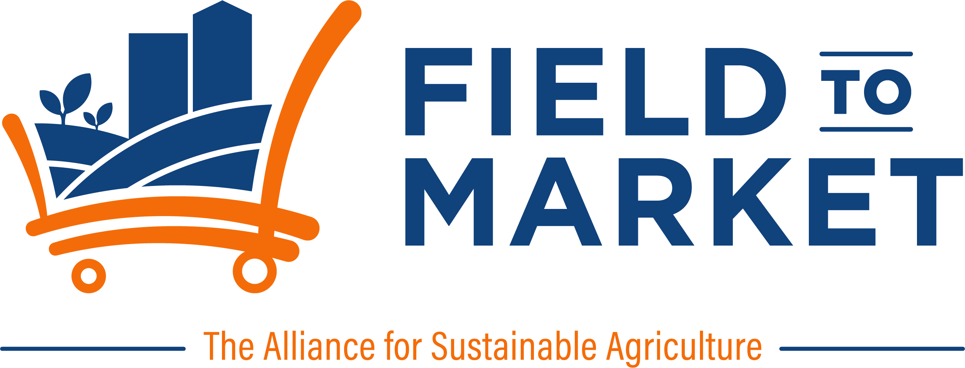
Counting alfalfa cuttings
from orbit
One 62-acre field in northwestern New Mexico, read from free satellite imagery. The pipeline was built to find one planting and one harvest a year. This field is cut three to four times every summer — and the imagery shows every one.
Field to Market remote sensing demonstration · 713 clear observations, January 2020 to September 2026 · analysis run 19 October 2026
Notes:
One alfalfa field in San Juan County, New Mexico. Everything here comes from free satellite imagery; nobody visited the field and no grower was asked.

Slide 2

One field, seven years
A single management unit: on average 100% of the boundary is one crop, so the curves below belong to the whole field and not to an average of two.
62
713
3 days
Wheat → Alfalfa
acres (25.2 ha)
San Juan County, New Mexico
cloud-free observations
Jan 2020 – Sep 2026
typical gap between
clear images
winter wheat 2020–21,
alfalfa 2022 onward
The crop changed in 2022. USDA's Cropland Data Layer records winter wheat in 2020 and 2021, then alfalfa from 2022 onward, at 99.6–100% purity every year. That rotation is what makes this field useful: it contains its own control.
Density is the whole story. An image every three days is what makes a cutting visible at all. A crop that is mown and regrows inside five weeks is invisible to a sensor that passes monthly — the field would simply look green all summer.
Crop type from the USDA Cropland Data Layer (30 m). Greenness from Sentinel-2 surface reflectance (10 m), cloud-masked. Boundary supplied with the report pack; no field visit and no grower input.

Slide 3
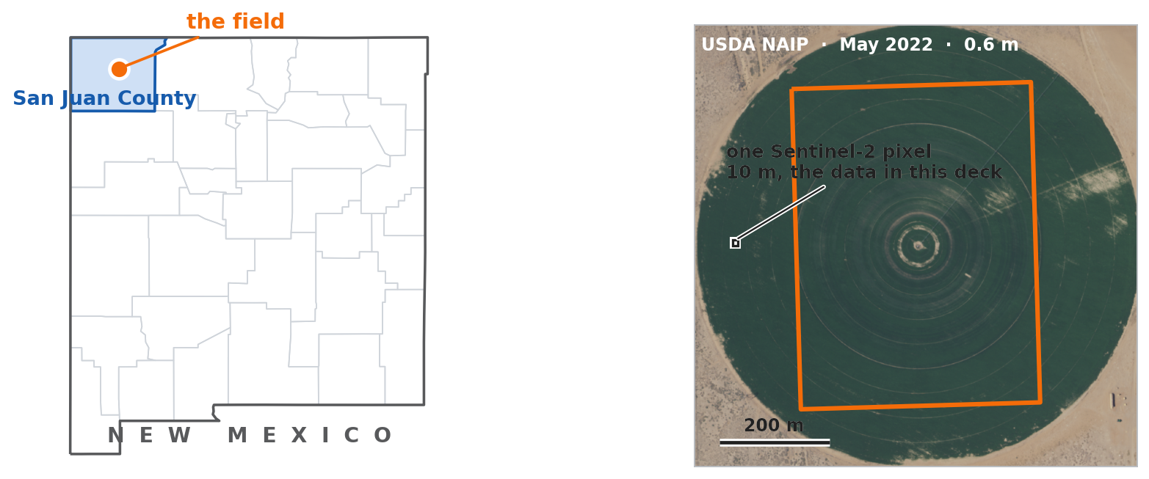
Where the field is
San Juan County, New Mexico — the irrigated valley northwest of Farmington, at about 1,600 m.
It is a center pivot — a 122-acre irrigated circle, wheel tracks and center point visible. That is why the water goes on so regularly, and why the cutting schedule is so steady.
The orange box is drawn, not surveyed: a hand-drawn rectangle covering 51% of the pivot, well inside the circle. It never touches the dry corners, which is why the crop layer reads 100% one crop — and it means every number here describes half a pivot.
Notes:
The boundary came with the report pack as an axis-aligned rectangle with field_id 'drawn'. The aerial imagery shows it sits inside a center pivot and covers about half of it.

Slide 4
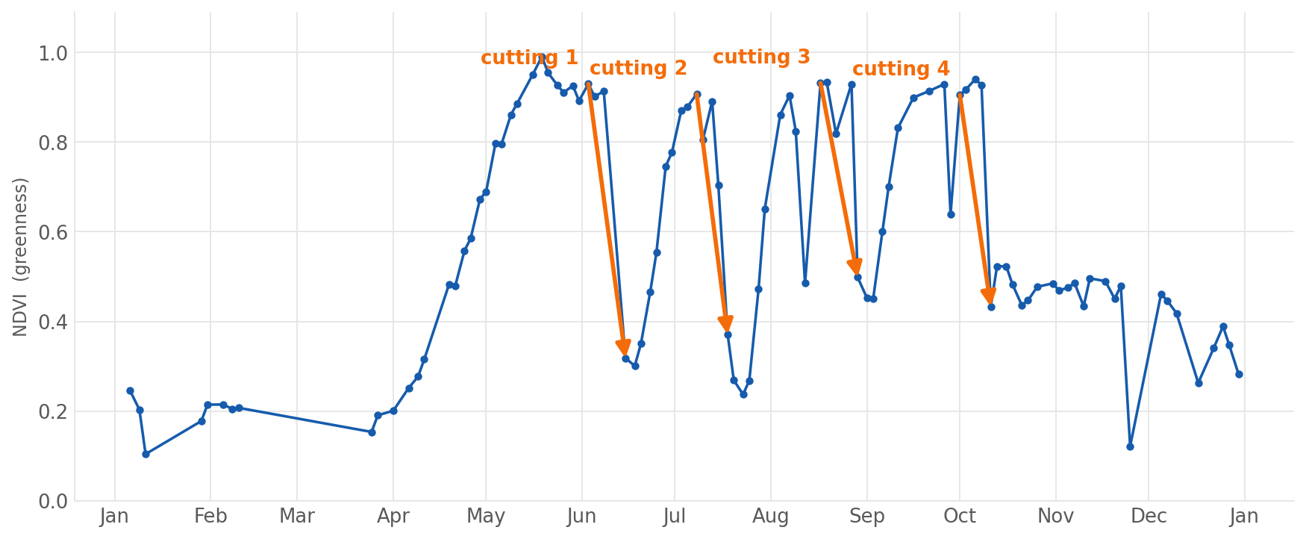
What a cutting looks like from space
A full alfalfa canopy reads about 0.93 on the greenness index. Within days of mowing, the same field reads 0.32 — bare stubble and windrows. Then it regrows and the pattern repeats. The two narrow spikes in August and late September are cloud shadow, not cuttings, and are rejected: see slide 9.
Notes:
The hero chart. Four cuttings in 2023, each one a fall from full canopy to stubble inside a single revisit gap.

Slide 5
Three to four cuttings a year, every year
Fifteen cuttings detected across five alfalfa seasons. The two wheat years, read by the identical method, give one biomass removal each — the grain harvest.
3–4
43 days
4–15 Jun
0.93 → 0.48
cuttings per complete
alfalfa season
median between cuttings
(range 33 – 62)
first cutting, all five years
an 11-day spread
typical greenness
across a cutting
Year | Crop (USDA) | Cuttings | First to last | Mean gap (days)
2020 | Winter Wheat | 1 | — | —
2021 | Winter Wheat | 1 | — | —
2022 | Alfalfa | 4 (1 flagged) | 13 Jun – 18 Oct | 42
2023 | Alfalfa | 4 (1 flagged) | 15 Jun – 11 Oct | 39
2024 | Alfalfa | 3 | 04 Jun – 12 Sep | 50
2025 | Alfalfa | 4 (1 flagged) | 12 Jun – 01 Nov | 47
2026 | not yet published | 3 | 02 Jun – 08 Aug | 34
"Flagged" marks a cutting detected after 1 October, when a hard freeze would produce the same signature. It is counted and labeled, not hidden.

Slide 6
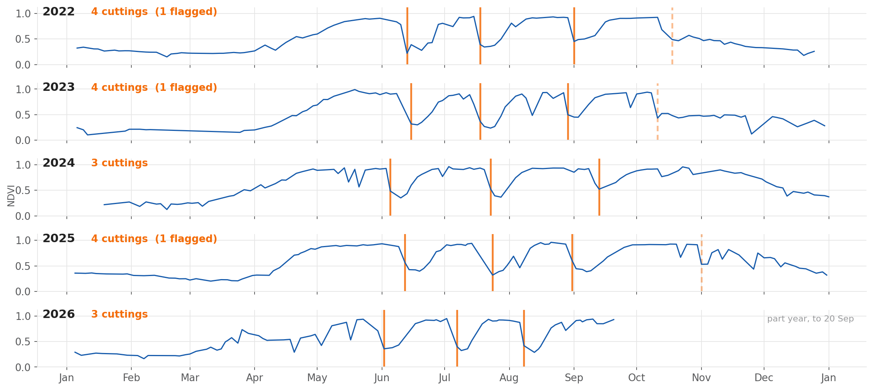
The same rhythm, year after year
2026 is a part year, running to 20 September. Dashed lines are the flagged late-season cuttings.

Slide 7
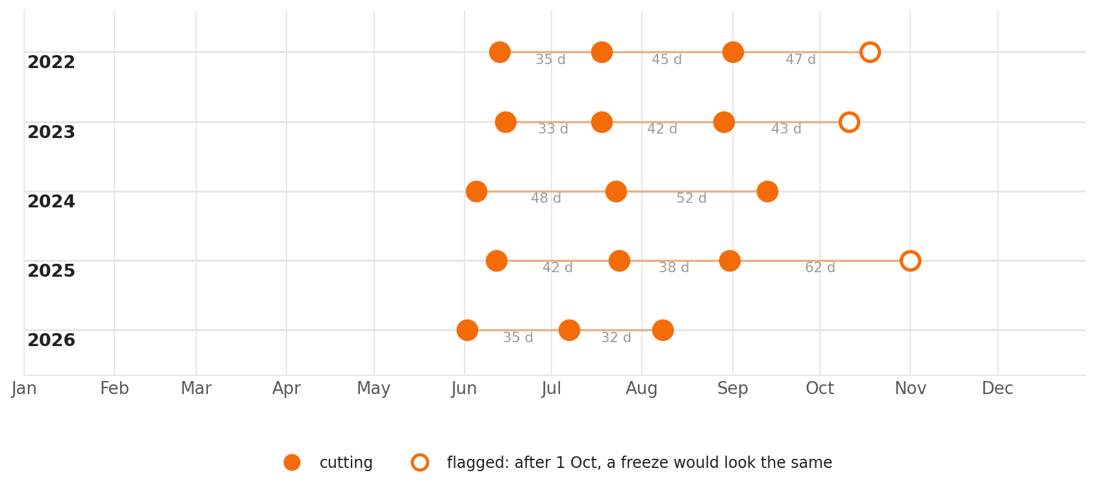
A cutting calendar, built without visiting the farm
The schedule is remarkably stable. First cutting between 4 and 15 June in all five years, then roughly every six weeks until the stand goes dormant.
2024 is the exception — three cuttings, with 48- and 52-day gaps where other years run 33 to 45. Something stretched the cycle that summer. The imagery shows that it happened; it cannot say why.

Slide 8
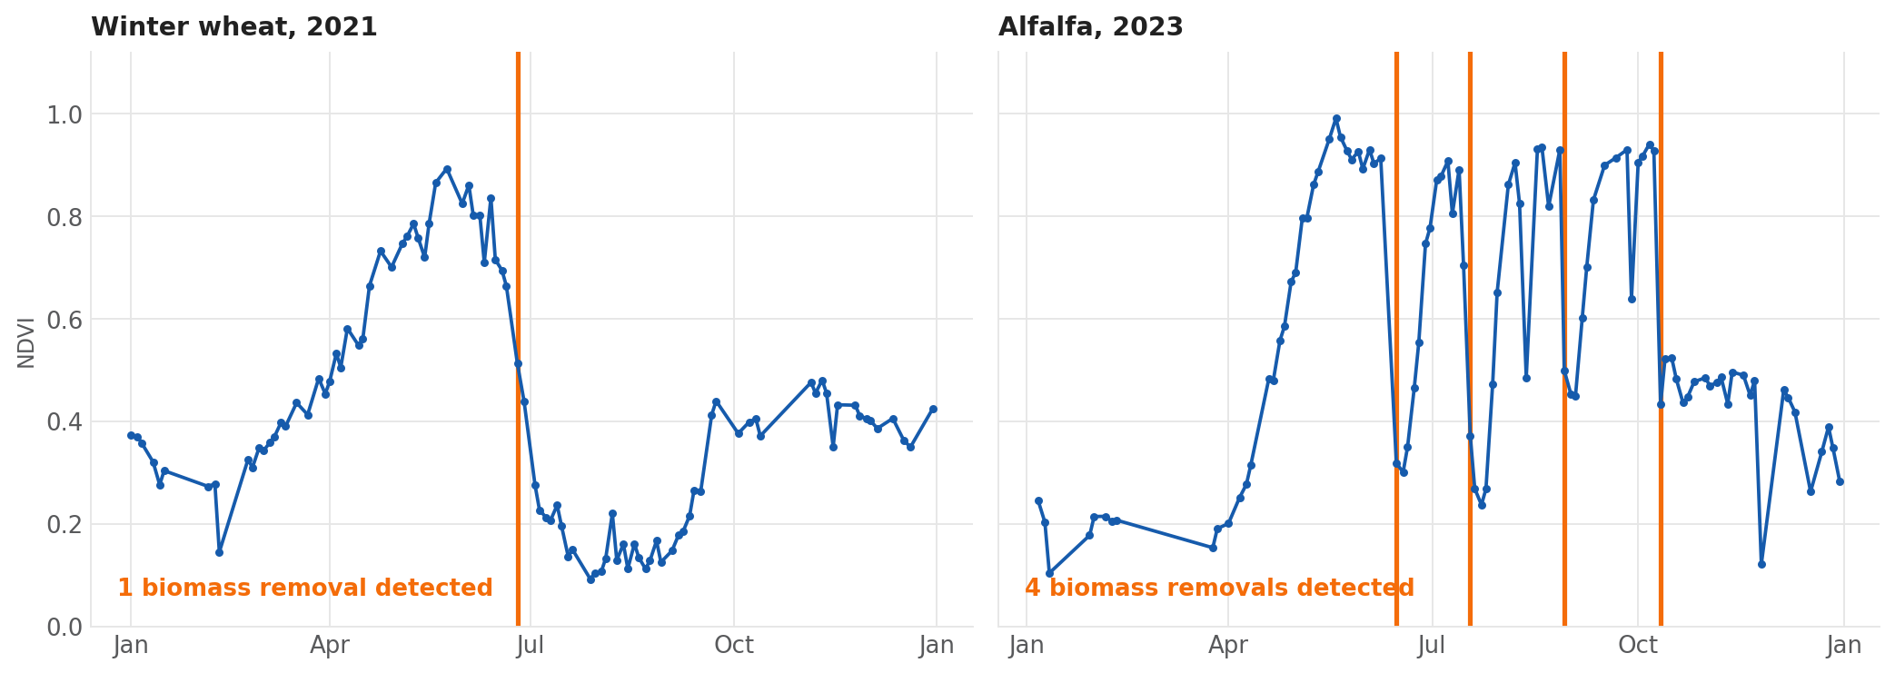
The method did not know which crop it was looking at
Same field, same algorithm, same constants. Only the crop changed.
This is the closest thing to a control available without a grower record: a field that grew an annual grain and then a perennial forage, read by one unchanged method. One removal in the wheat years, four in the alfalfa year.

Slide 9
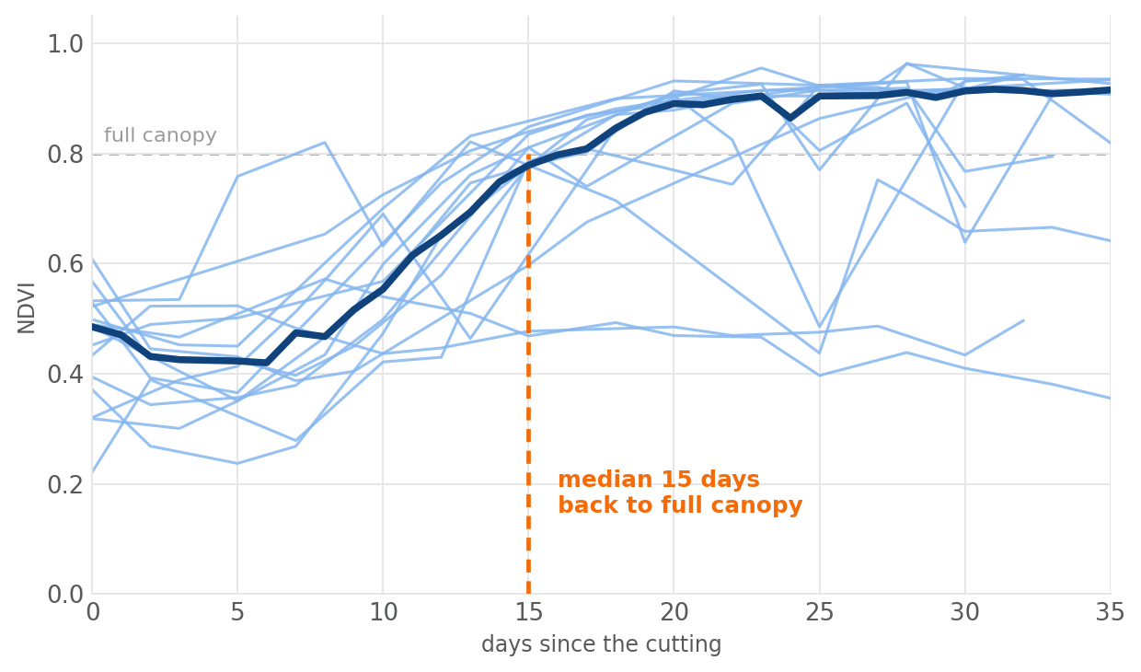
The biology is visible too
WHAT THE CURVE SAYS
Fifteen days from stubble back to full canopy, as a median across all fifteen cuttings. The regrowth curves sit almost on top of one another — this stand behaves the same way every time it is cut.
Then it waits. The median gap between cuttings is 43 days, but the canopy is full again by day 15. The remaining four weeks are the grower letting the stand build yield before mowing again.
The one flat track near 0.47 is a late-October cutting that never regrows, because the stand is going dormant.
"Full canopy" is a greenness of 0.80, the level this stand plateaus at through the summer. Each track stops at the next cutting.

Slide 10
Telling a cutting from a cloud
A fall in greenness is not enough on its own. Four tests, each one added because a real case in this field's own record defeated the rule before it.
Test | What it requires | The case that put it there
Standing | Greenness above 0.60 before the fall | Dormant winter regrowth oscillates around 0.45 and is not a crop anyone cuts.
Step | A drop of 0.30 or more, measured from the last standing observation, completed within 12 days | A mature stand sits near its peak for weeks before it is cut. Measuring from the seasonal peak instead turned the 7-day first cutting of 2023 into a "27-day senescence" and missed it entirely.
Persistent | The low holds across at least two clear observations | On 12 August 2023 the field reads 0.49 between a 0.90 and a 0.93 five days later. Alfalfa cannot regrow a canopy in five days — that is cloud shadow. Without this test 2023 reads six cuttings instead of four.
Spaced | At least 18 days since the previous cutting | A stand needs about a month to regrow; two cuttings a fortnight apart would be one event counted twice.
Cloud is judged on the share of FIELD pixels that survived masking, not the scene cloud percentage: five of the twenty detected falls sit under scenes 14–34% clouded, and the field itself is clear in every one.

Slide 11
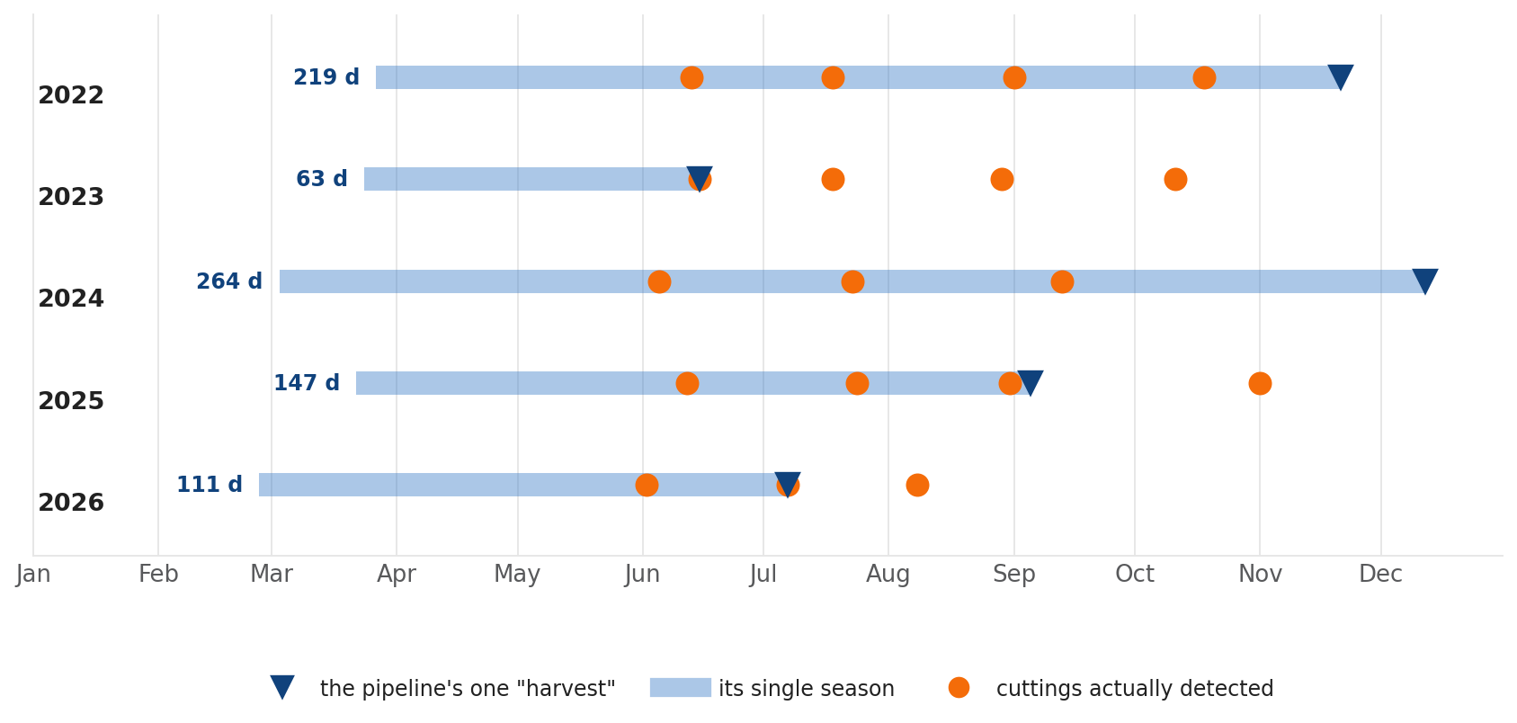
What an annual-crop model makes of a perennial
This is the finding that matters for the people building the production pipeline.
The pipeline reports one planting and one harvest per year. On this field its "harvest" lands on the first cutting in 2023, the second in 2026, the third in 2025, and on nothing at all in 2022 and 2024 — and the season it reports swings from 63 to 264 days on an unchanging crop.

Slide 12
A perennial has no off-season, so two of our metrics stop meaning anything
COVER CROP
SOIL ARMOR BEFORE PLANTING
Of the five winters from 2021–22 onward, the pipeline calls four a likely cover crop and the fifth a possible one. There is no cover crop. There is alfalfa, which was there in August and is still there in December.
The clearest case is winter 2023–24, scored on an "off-season" greenness peak of 0.94 on 6 October. That is not a cover crop establishing. It is the standing hay crop, five days before the fourth cutting.
The pre-planting window runs from last year's harvest to this year's planting. On a perennial there is no planting, so in 2024 and 2026 the window collapses to nothing and no figure is produced at all.
Where a figure does appear it is not wrong so much as beside the point: March 2025 reads 0.97 covered, 96% of it classed as residue. That is a dormant alfalfa stand, not last year's crop residue.
Neither metric is broken. Both were defined for a crop that is planted and harvested once a year, and this field is not one.

Slide 13
What this is not
• No cutting record has ever been checked against this. Not for this field, not for any field. Every count in this deck is read from the shape of a curve. The pattern is strong and the biology is consistent, but no accuracy figure exists and none is quoted here.
• Autumn is genuinely ambiguous. Three of the fifteen cuttings fall after 1 October, when a hard freeze would take a canopy down the same way. They are flagged throughout rather than quietly counted or quietly dropped.
• Dates carry a window, not a day. A cutting is placed between the last clear image showing a standing crop and the first showing stubble — a median of 10 days apart. That window is set by cloud and revisit, not by the method.
• The thresholds were tuned on this one field. Four tests and seven constants, read against this field's own 2023 season and then left alone across the other six years. That is a demonstration, not a validated model.
• One field is one field — and only half a pivot of it. Everything here is a drawn rectangle covering 51% of one center pivot in one irrigated valley. A boundary taken out to the pivot edge would include the wetted margin and the dry corners, and would not behave the same way.

Slide 14
Why it is worth doing properly
WHAT THIS WOULD UNLOCK
WHAT IT WOULD TAKE TO TRUST IT
Forage is a blind spot. Hay and alfalfa are poorly served by metrics built around a single annual harvest, and they are a large share of irrigated acreage in the West.
Cutting count and timing are the management signal. How many times a stand is cut, and how long it is allowed to recover, is most of what distinguishes one alfalfa operation from another.
It needs no new data. Every number here came from imagery the pipeline already downloads for every field it touches.
One season of real cutting dates. A grower's log for ten alfalfa fields over one summer would be enough to measure, for the first time, whether the count is right and how close the dates land.
A perennial path through the pipeline. Detect the crop as perennial from the Cropland Data Layer, then skip planting, harvest, cover crop and pre-planting armor, and report a cutting series instead.
Fields outside this valley. Rain-fed and shorter-season stands, to see whether constants fitted here travel at all.
The pipeline found something it was never designed to look for. That is worth a validation season.

