Slide 1

AFT FLASH project:
what remote sensing detected
98 fields enrolled in Farmer-Led Advances in Soil Health, read from satellite imagery and compared against what was entered in the Fieldprint Calculator.
Fieldprint project 370 · winters 2022-23 to 2025-26 · analysis run 11 October 2026

Slide 2

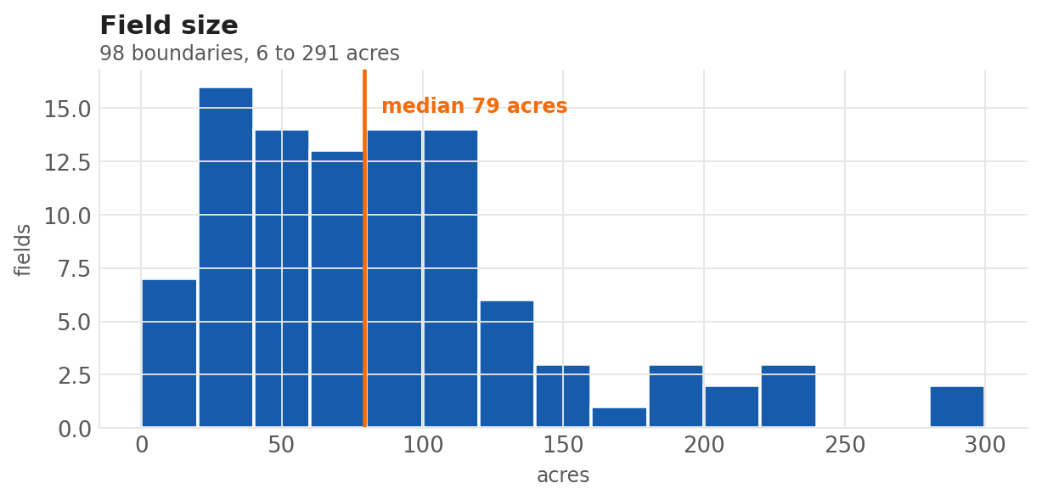
The cohort
195 Fieldprint payloads (field-years or crop intervals) from 98 field boundaries.
98
8,668
6
15,323
distinct field boundaries
acres, median field size 79 acres
counties, all Illinois
cloud-free observations read
County | fields
Jo Daviess | 39
Montgomery | 25
Champaign | 12
Livingston | 9
Coles | 7
Ford | 5
The same physical field appears once per crop year under a different Fieldprint id, so boundaries were deduplicated on geometry.

Slide 3
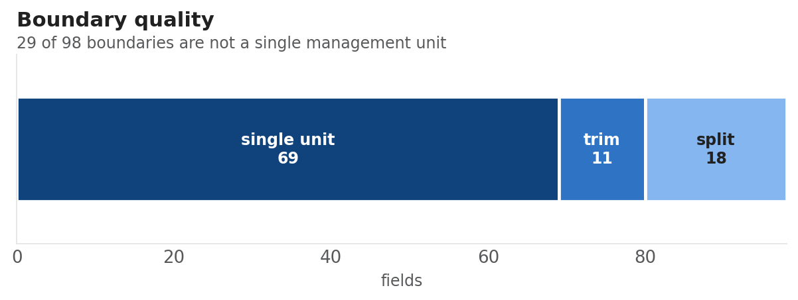
What we run
For each boundary, we get crop history, season dates, soil cover, and an off-season verdict.
• Sentinel-2 L2A surface reflectance, 10 m, cloud-masked with the scene classification layer.
• 2022 to present — four complete off-seasons: 2022-23, 2023-24, 2024-25, 2025-26.
• USDA Cropland Data Layer for crop type and for the check on whether a boundary holds one field or several.
• 88 minutes for all 98 fields, no failures. Median 126 clear observations per field.
Boundary quality is checked before anything else, because every number downstream averages over whatever the outline contains.
Ideally, the 29 fields with mixed crop history would be redrawn and reanalyzed.
Crops present (CDL): corn on 97 fields, soybeans on 91, winter wheat on 4, with small areas of grass, pasture and alfalfa.

Slide 4
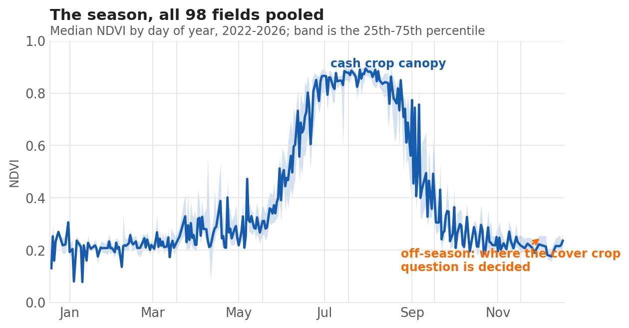
The growing season
What a corn and soybean rotation looks like from orbit.
The cash crop signal is strong: bare ground through April, canopy closing in June, senescence from late August.
The cover crop verdict gets made in the flat stretch between November and April, where the signal is small, the sky is cloudy, and the difference between a planted cover and bare residue is a few hundredths of NDVI.
The slides that follow are focused on the off-season window.

Slide 5
What AFT project staff entered
The Fieldprint payloads carry a cover crop record in exactly one winter.
Winter | fields with a cover crop recorded | What the payload contains
2020-21 | 0 | tillage, planting, fertilizer, harvest
2021-22 | 0 | tillage, planting, fertilizer, harvest
2022-23 | 0 | tillage, planting, fertilizer, harvest
2023-24 | 0 | tillage, planting, fertilizer, harvest
2024-25 | 0 | tillage, planting, fertilizer, harvest
2025-26 | 98 of 98 | + planting_cover, with planting and termination dates
A planting_cover activity appears 98 times in the entire archive: once per field, all in the 2026 harvest-year interval. Every year from 2008 to 2025 carries the other four activity types and no cover crop record.
The historical intervals are rotation pre-fills, the crop history Fieldprint needs for its calculations, while only the latest submission year carries more practice detail.

Slide 6
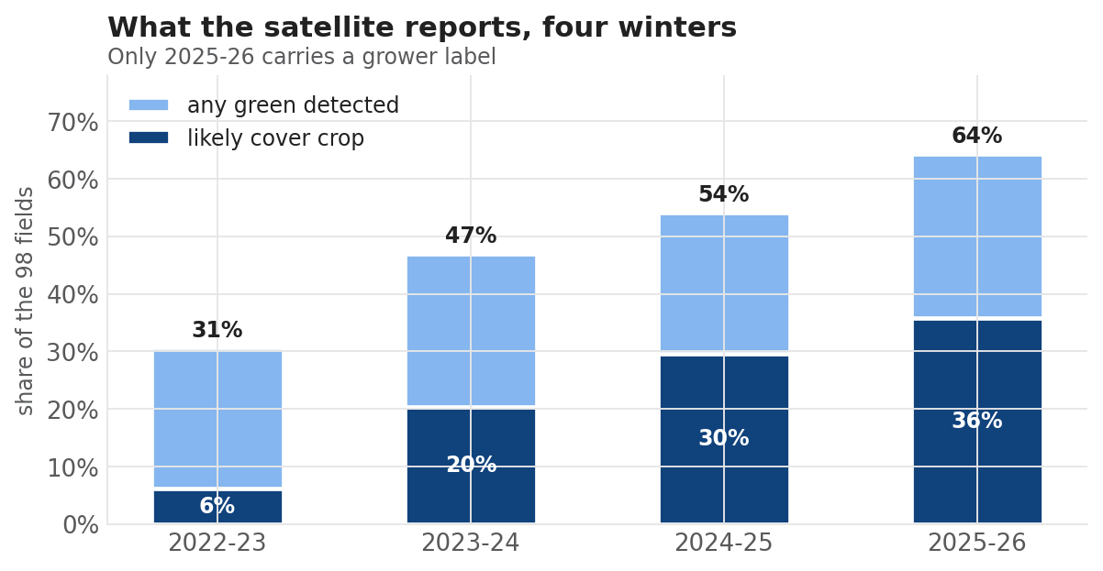
Cover prevalence the satellite reports
Four winters, same 98 fields, same thresholds.
The trend is monotonic and the rise is substantial: from under a third of fields showing off-season green in 2022-23 to roughly two thirds in 2025-26.
That is the shape a cohort progressively adopting cover crops would produce, which is what a soil health project is designed to create.

Slide 7
THE COMPARISON
Of 98 fields planted to a cover crop,
the satellite finds 63.
35.7%
64.3%
35
strict reading
"likely cover crop" only — 35 of 98
loose reading
any off-season green — 63 of 98
missed entirely
"no cover crop detected"
Verdict, winter 2025-26 | fields
likely cover crop | 35
possible cover crop | 26
green cover — cover crop or small grain | 2
no cover crop detected | 35

Slide 8
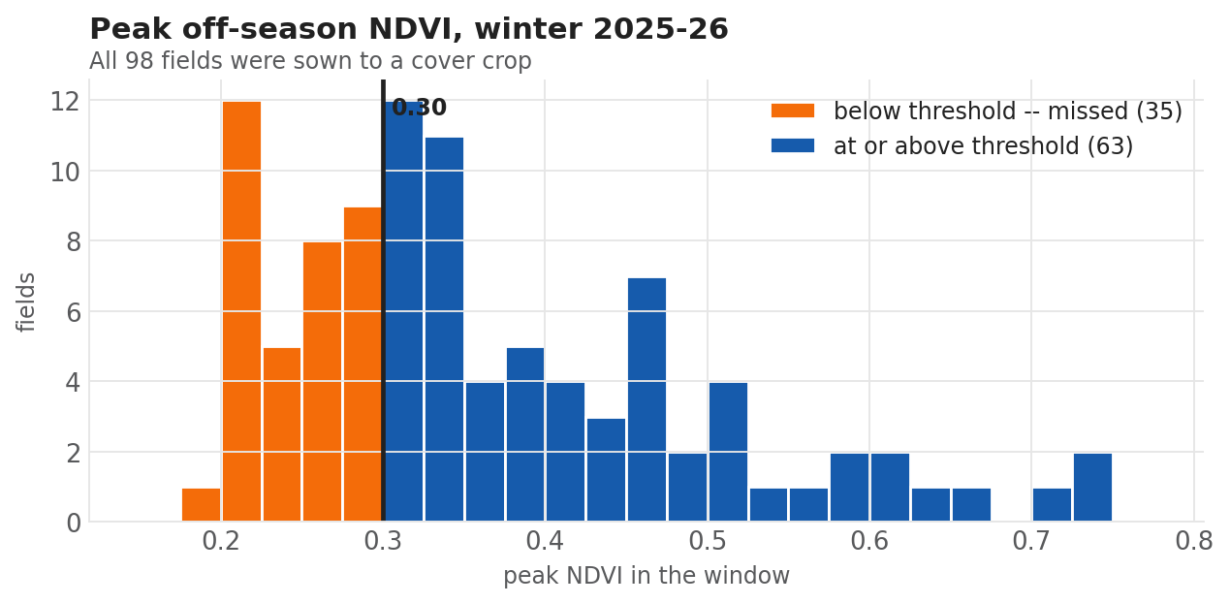
The misses are not bare fields
Every missed field showed green, but none reached the NDVI threshold to make a verdict on green cover.
All 35 misses fall between NDVI 0.193 and 0.292.
Not one is below 0.15, which is what bare ground typically reads (from the scientific literature). 34 of the 35 sit in the band 0.20 to 0.30, immediately under the NDVI threshold line.
The detector is not confusing a cover crop with bare soil. It is seeing a modest amount of green cover but declining to call it.

Slide 9
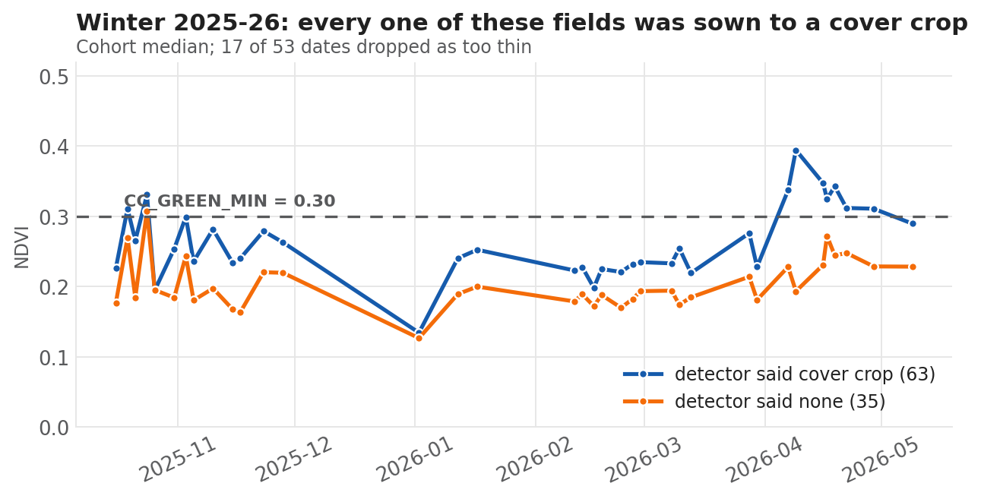
The off-season, detected against missed
Both groups were planted with cover crops. The separation is real but small.
Both groups sit near NDVI of 0.20 from November to March. The split opens in April, when the detected group climbs toward 0.39 and the missed group reaches about 0.27.
At 42° north a cover crop planted in late October accumulates very little biomass before dormancy. Almost the entire usable signal is compressed into four to six weeks in spring, the time window where Illinois cloud cover is typically heavy.

Slide 10
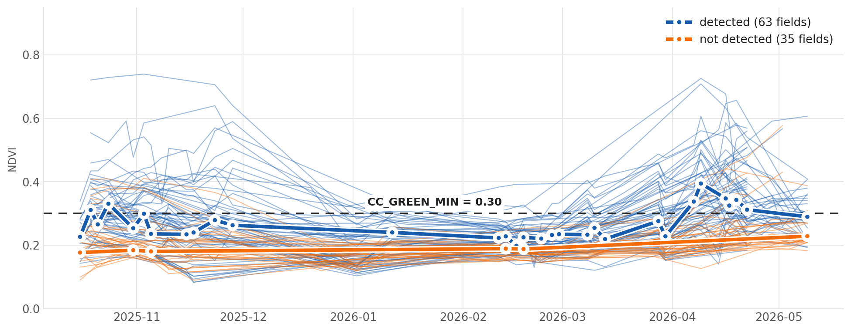
Every field, every clear date
Off-season 2025-26. One thin line per field, both group medians on top.
The two groups overlap through most of the winter and separate only in April. Markers show dates carrying at least twenty clear fields; between early December and early February almost none did, so the medians bridge that stretch.

Slide 11
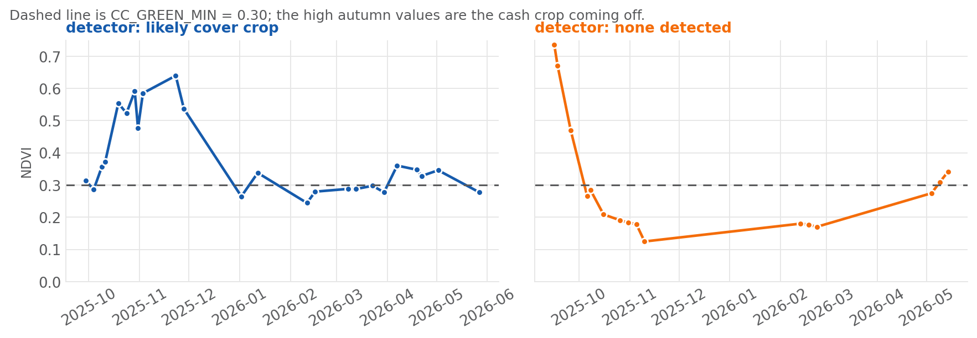
Two fields side by side
Both seemed to have been planted with cover crops in October 2025, but only one cleared the line.
Left: a clear spring rise that stays near or above 0.30 from March. Right: a collapse to 0.12 by November, a flat winter near 0.18, and a rise that only begins in May, reaching 0.34 at the very edge of the window, after the grower's 20 May termination date. NDVI sees green, not intent: neither panel can distinguish a sown cover crop from volunteer regrowth or weeds.

Slide 12
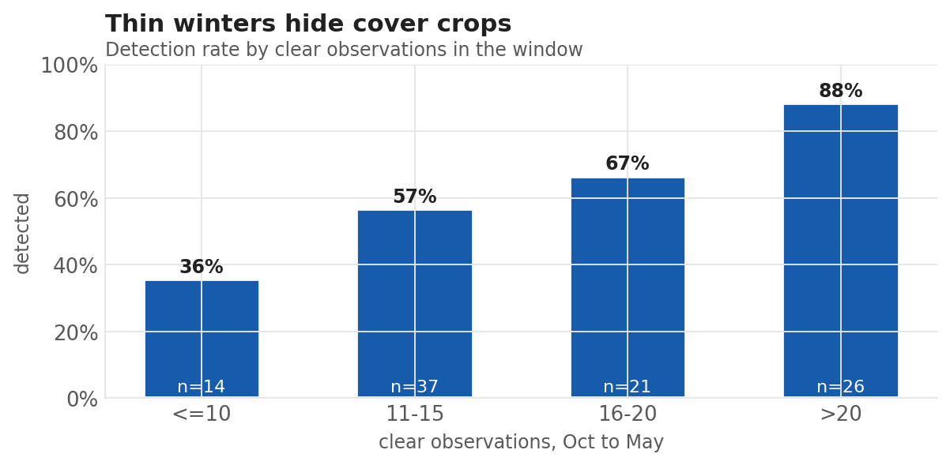
Thin winters hide cover crops
Detection tracks how many clear days the window contains.
Fields with ten or fewer clear observations are detected 35.7% of the time. Fields with more than twenty are detected 88.5% of the time: two and a half times the rate on the same practice.
The median winter here carries 15 clear observations and the thinnest carries 7. Seventeen of the 53 dates in the window had fewer than twenty of the 98 fields clear at once.
Some of the 35 misses are due to heavy cloud cover.

Slide 13
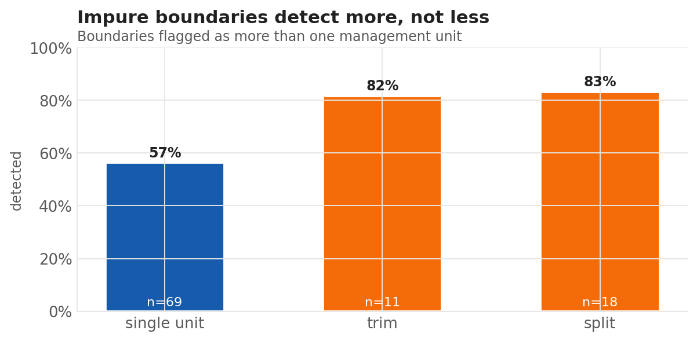
Mixed boundaries detect more, not less
Boundary quality has a significant impact.
Boundaries the CDL check flags as holding more than one management unit are detected at 83%. Clean single-unit boundaries are detected at 56%.
A boundary spilling into a grassed waterway, a field margin, another management unit, or a neighbor's ground collects winter green that does not belong to the field, and the average rises above the threshold.
29 of these 98 boundaries are likely not a single management unit. On this cohort, that inflates apparent adoption rather than degrading it.

Slide 14
Soil armor: a second, independent measurement
Different bands, different physics, same imagery.
The slides up to this point came from NDVI: greenness in the visible and near-infrared.
Soil armor comes from the shortwave infrared, where cellulose and lignin absorb, and decomposes every pixel into three fractions that sum to one:
It is not a tillage metric
Soil armor represents ground cover from living and dead plant tissue. A field under a living cover crop and a field under heavy stubble are both protected, and armor counts both.
• living cover: green canopy
• crop residue: stubble from the previous crop or a terminated cover crop
• bare soil
Method: NDVI–DFI ternary unmixing, after Guerschman et al. (2009) and Wang et al. (2019). Results are exploratory.
Soil armor is one minus the bare fraction, the share of the surface protected by anything at all.

Slide 15
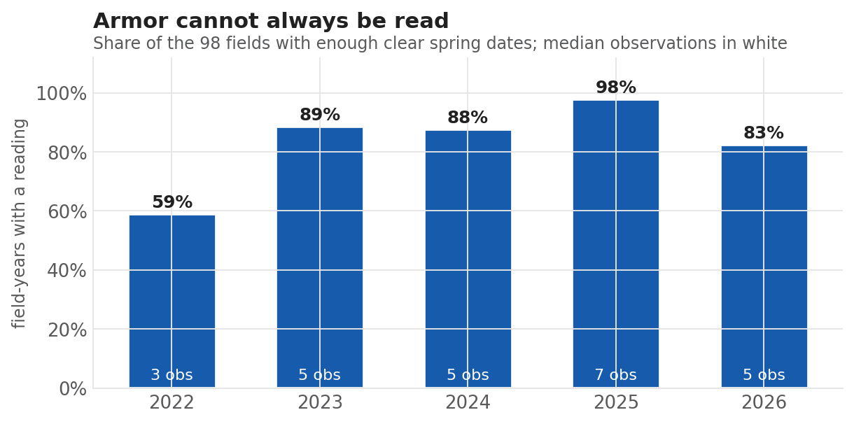
Armor cannot always be read here
It needs clear days in a narrow pre-planting window, and northern Illinois does not always supply them.
408 of 490 field-years produced a reading: 83%.
The failures are almost entirely too few clear dates: 72 of the 82 gaps are windows with one or two usable observations, below the minimum of three.
2022 is the worst year at 59% readable, with a median of three observations per window. 2025 is the best at 98%.
This is the same cloud problem that suppresses cover crop detection, now hitting a second metric, and the armor window is narrower, so it hits harder.

Slide 16
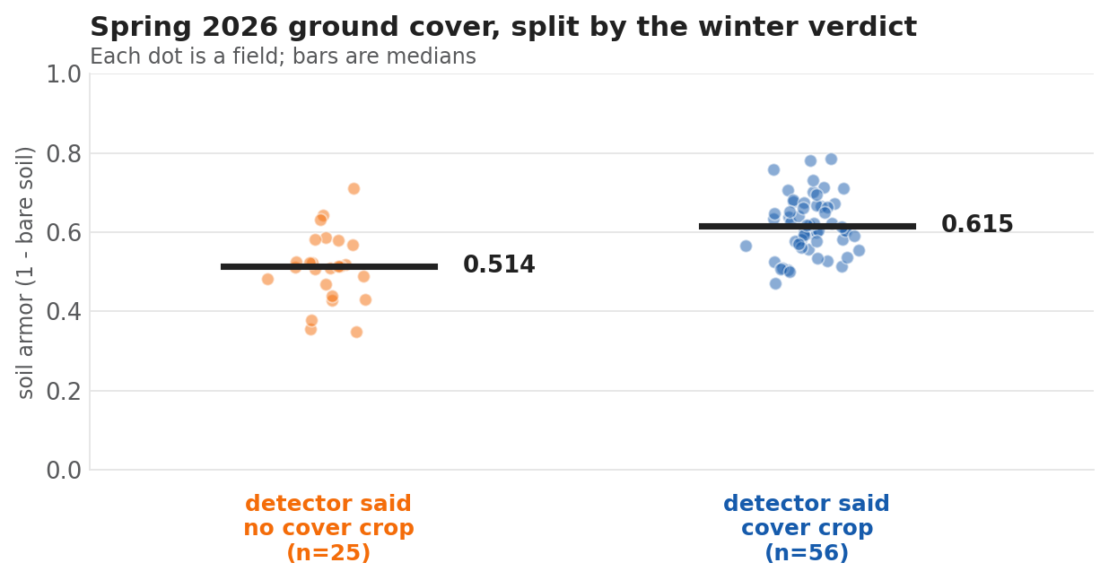
The two measurements agree with each other
Spring 2026 ground cover against what NDVI concluded about the winter before it.
Spring 2026 | armor | n
detector said cover crop | 0.615 | 56
detector said none | 0.514 | 25
A gap of 0.101, with AUC 0.83 (p < 0.001). Fields NDVI called cover-cropped carry measurably more ground cover into spring.
This is consistency but not accuracy. Both numbers come from the same satellite over the same field, and a weedy field looks green to one and covered to the other.

Slide 17
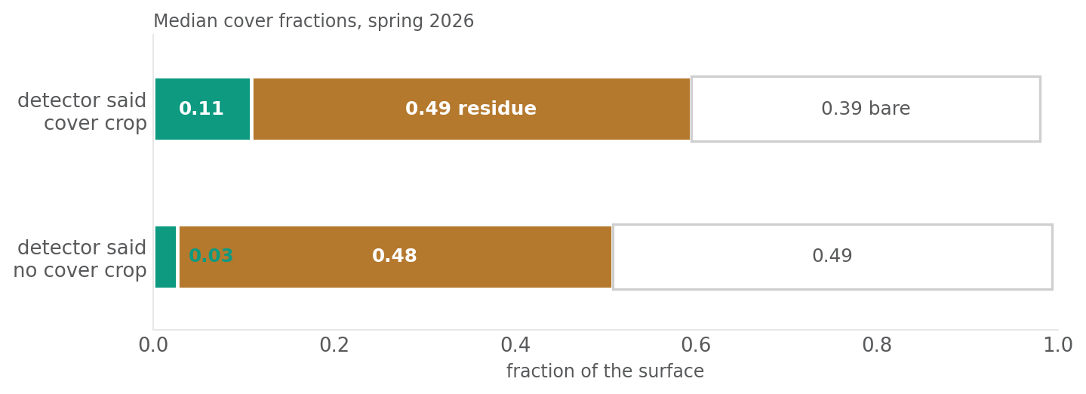
Detection agreement
The separation sits in living cover and not in residue.
Residue is identical between the two groups: 0.49 against 0.48. Living cover is four times higher on the fields NDVI called: 0.11 against 0.03. Living cover is low in both groups because the window closes three days before planting and terminations ran to 20 May; by then much of a terminated cover crop has already become residue, where armor still counts it.

Slide 18
ASSESSMENT
Does the data entry in the Fieldprint Calculator match what the satellite sees?
This question has three separate answers.
Question | Answer | Basis
Does the entered practice match the imagery? | Partly — 64% | 63 of 98 fields show off-season green consistent with the recorded cover crop; 35 do not.
Can the data entry be trusted where it exists? | Yes | Planting and termination dates are present on all 98 and are agronomically plausible for Illinois.
Is the entry complete? | No | Eighteen crop years carry no cover crop field at all.
The disagreement is not evidence that growers misreported. However, this analysis suggests that there is opportunity to improve data entry to better represent of what happened on the ground.

Slide 19
What would improve data quality for this project
Redraw the field boundaries for the 29 fields with mixed CDL histories
Enter cover crops for prior years, if any
Monitor cover crop growth for 25% or more fields to run the remote sensing analysis against ground truth detection in late fall and early spring, before and after the coldest part of winter.
Replace pre-filled crop histories with more farmer data to better represent what happened on the ground.

Slide 20
IN ONE PAGE
98 Illinois fields, all planted with a cover crop in Fall 2025. The satellite makes a positive verdict on 63 fields.
The 35 it misses are not bare. Every field shows green between NDVI 0.19 and 0.29, right under the threshold detection borrowed from the literature.
Winter cloud explains part of it. Fields with more than twenty clear days are detected two and a half times more often than fields with ten or fewer.

