Slide 1
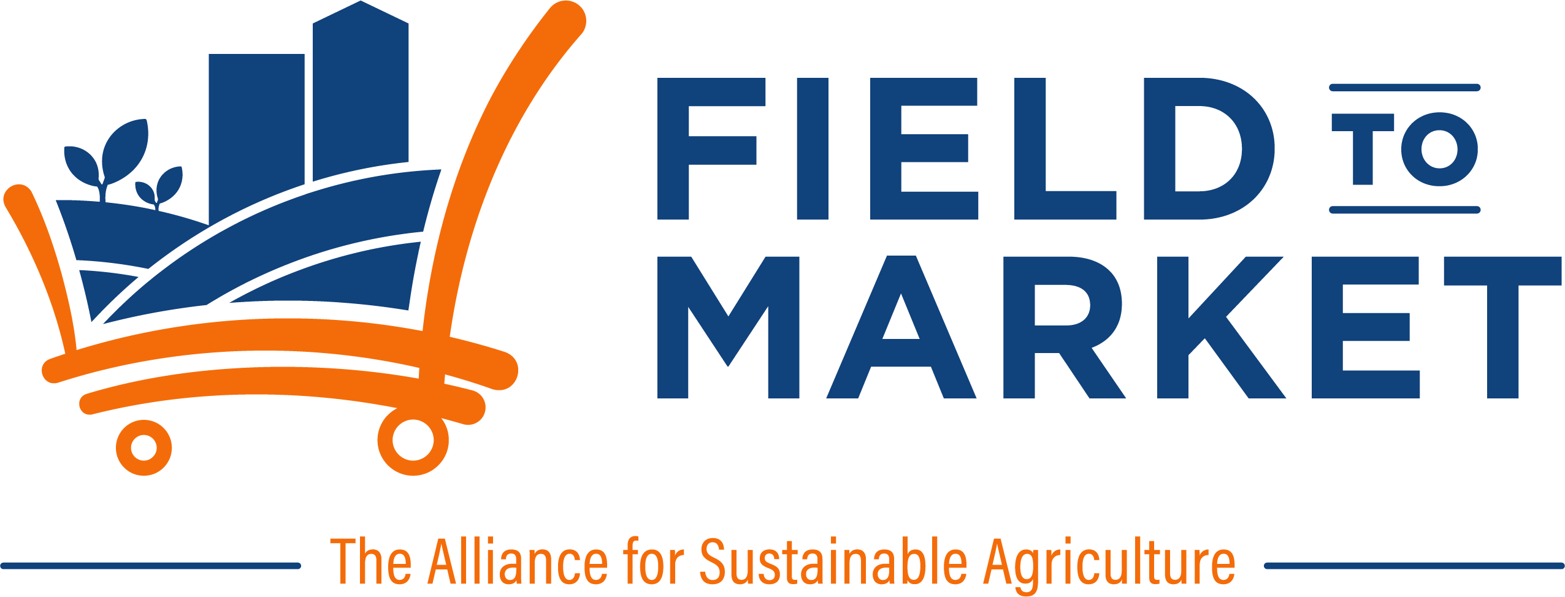
Cotton ground,
measured from orbit
A working pipeline that reads tillage, residue and cover crops off free satellite imagery — and an honest account of what it can and cannot do yet.
Validated against 183 cotton field-years
Georgia, 2018–2021
September 2026
Notes:
Open by saying this is not a concept deck. The pipeline runs today, and we have finished testing it against real farmer-reported data. Some of what we found is good and some of it is not, and both are in this deck.

Slide 2

What we are asking cotton for
The ask comes first, because the technical work only matters if it gets finished. Two things are needed, and one of them is not money.
ONE
TWO
Implementation funding
Ground truth from cotton ground
To move this out of demonstration and into the Fieldprint Platform, where growers and brands actually use it.
Residue transects and practice records. Without them the numbers stay provisional, and we will keep saying so.
The second cannot be bought from a vendor. Only growers and their agronomists have it, which is why this conversation is with you and not with a software company.
Field to Market · Cotton remote sensing
Notes:
Lead with the ask so nobody spends the next twelve slides wondering where this is going. Put weight on the closing line: the data is the part only this room can supply.

Slide 3
Nearly every sustainability claim made about cotton rests on what someone remembered and wrote down.
Self-reported practice data is costly to collect, impossible to audit at scale, and slow to arrive. Brands are being asked to verify what nobody can see.
Meanwhile satellites photograph every cotton field in the country every five days, free of charge, and have done since 2017. The question is whether that imagery can carry the claim.
We spent this year finding out. This deck is what we learned, including where it fell short.
Notes:
Framing slide. Do not rush it. The audience knows the self-reporting problem intimately, because they pay for it. Land the last line so the honesty later reads as credibility rather than retreat.

Slide 4
What we built
A field boundary goes in. All of this comes out, for every season back to 2017, with no field visit and no cost per acre.
Crop grown
Planting and harvest
Cover crops
Soil armor
Each year of the rotation, from the USDA Cropland Data Layer.
Inferred from the green-up and senescence curve.
Off-season green cover between cash crops.
How much of the surface is protected, by residue or by anything living.
Sentinel-2
Two implementations
No new sensors
10 m pixels, every 5 days, free
R and Python, checked against each other
Nothing to install on a farm
Field to Market · Cotton remote sensing
Notes:
The bottom band is the cost story: no hardware, no per-acre imagery fee. The imagery is a public good already paid for.

Slide 5
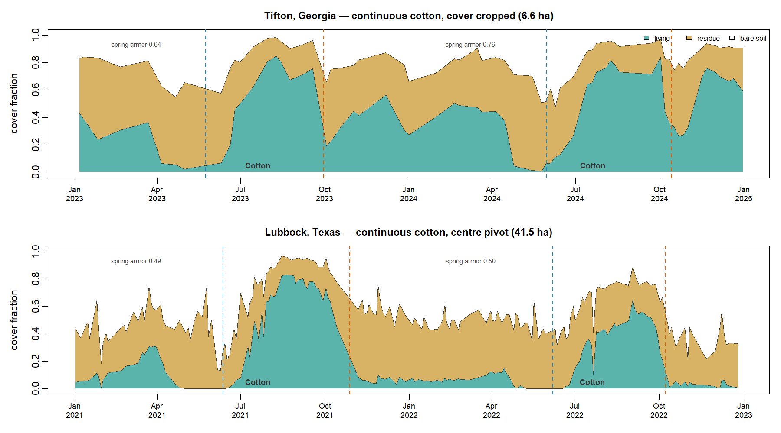
Two cotton fields, two years, every clear day
Green is living cover. Tan is residue. White is bare soil. Both fields grow continuous cotton, so the crop is not what separates them.
The Georgia field is cover cropped and never opens up. The Texas pivot returns to bare ground after every harvest and stays there until June.
Sentinel-2, all cloud-free dates. Dashed lines mark inferred planting and harvest.
Notes:
Linger here. Everything is computed, not drawn by hand. The winter gap in the Texas panel is exactly the erosion-exposure window a Fieldprint score should care about, and nobody visited either field.

Slide 6
Soil armor: cover from any source
Every pixel is split into three fractions that add to one. A field protected by stubble and a field protected by a living cover crop both score high, because both resist erosion.
Living
Residue
Bare soil
Green canopy or cover crop
Stubble, litter, dead stalks
Exposed, erodible ground
Soil armor = 1 − bare soil
Separating residue from bare soil needs shortwave infrared, not just a greenness index — to visible light, dry stubble and dry dirt look nearly the same.
Ternary unmixing in NDVI–DFI space. Endmembers fitted on 65,555 cloud-free pixels — provisional.
Notes:
The important idea is that armor counts residue and living cover together. That is deliberate, and it is also why armor turns out not to be a tillage detector.

Slide 7
On cotton, armor tracks reported tillage
Median spring soil armor for 183 cotton field-years, grouped by the residue class the grower reported. The order is right and the spread is wide.
Conventional
0.408
n = 48
under 15% residue
Reduced
0.508
n = 9
15 to 30% residue
Conservation
0.594
n = 126
over 30% residue
A conservation-tilled cotton field carries roughly half again as much cover through the spring as a conventionally tilled one. Slide 12 explains what is really driving that gap.
Time-weighted mean, 1 March to 15 May. Bars scaled to 0.70.
Notes:
Flag the n of 9 on the reduced class honestly if asked: too small to lean on, and excluded from every accuracy figure later.

Slide 8
Then we checked it against farmers
A University of Georgia grower survey gave us boundaries, crop, tillage class, cover crop and irrigation, field by field and year by year. It is the first time any of this was tested against something a farmer said.
183
144
34
21,129
cotton field-years
distinct cotton fields
Georgia counties
acres of cotton
Every field-year was scored blind: the pipeline never saw the survey answers. Accuracy figures below are cross-validated by field, so repeat years of one farm cannot flatter the result.
Survey years 2018–2021. Median field 82 acres. 78% irrigated.
Notes:
Stress the blind scoring and the by-field cross-validation. Technical audiences will ask; getting in front of it buys trust for the next slide.

Slide 9
The cotton scorecard
What we measure | Field-years | Correct | Catches | False alarms
Crop is cotton | 183 | 85.2% | 156 of 183 | 25
Cover crop grown | 182 | 75.3% | 111 of 114 | 42
Conservation tillage | 174 | 76.4% | 105 of 126 | 20
Cotton is the strong crop. It misses almost nothing: 97% of cover crops and 83% of conservation-tilled fields are caught.
False alarms are the weak point. The system over-calls conservation practice, which is exactly what calibration data fixes.
Cover crop and tillage thresholds fitted in-sample; cross-validated they fall to 75.2% and 73.8%.
Notes:
Do not hide the footnote. The in-sample figures are the optimistic view; the cross-validated ones are what to plan against. Both are in the written report.

Slide 10
Bad field boundaries break everything downstream
A boundary drawn around two management units blends two crops into one curve. We can detect that before reporting anything — and it predicts almost perfectly whether we get the crop right.
Under 60% one crop
12.9%
31 fields
60–75% one crop
72.0%
25 fields
75–90% one crop
90.0%
90 fields
Over 90% one crop
88.1%
201 fields
This is free quality control. Refusing to score the worst 16% of boundaries lifts crop accuracy from 80.7% to 88.7% and costs nothing but an honest “we cannot read this field”.
Agreement with grower-reported crop, by share of the boundary CDL assigns to a single class. All 347 field-years.
Notes:
This shows operational maturity rather than a science result. Knowing when to refuse to answer is what a platform needs.

Slide 11
What an uncalibrated threshold costs
Our cover crop threshold was set from Corn Belt literature, where winter residue sits at NDVI 0.10–0.25. In Georgia the median field with no cover crop at all peaks at 0.53 — 0.50 on cotton. Winter weeds, volunteer and a mild climate put green on ground nobody planted.
CORN BELT THRESHOLD
REFITTED ON COTTON GROUND
60
42
false alarms out of 68 cotton fields that grew no cover crop. It called almost every field a cover crop, so the answer carried no information.
false alarms, while still catching 111 of 114 real cover crops. Accuracy 67% to 75% from a single recalibrated number.
One constant, refitted on 182 fields, removed 18 of every 60 false alarms. That is what your data buys, and it is the cheapest improvement available to us.
Cotton field-years only. Threshold moved from NDVI 0.35 to 0.449.
Notes:
This is the money slide for the funding ask. The defect was invisible for the entire life of the project and took real ground truth to surface. Say that plainly: we could not have found it any other way.

Slide 12
The finding we did not want
Split the same cotton fields by tillage and cover crop, then read — down the columns rather than across the rows.
Median spring armor | No cover crop | With cover crop
Conventional tillage | 0.344 n = 35 | 0.604 n = 13
Conservation tillage | 0.507 n = 31 | 0.625 n = 95
A conventionally tilled field with a cover crop reads 0.604 — indistinguishable from a conservation-tilled one at 0.625, and far above a conventionally tilled field without one at 0.344. Armor is not reading the tillage pass — it is reading the cover crop, and 75% of conservation-tilled cotton here also has one.
All four combinations are loaded in the demo app
Georgia cotton, grower-confirmed practice. With a cover crop: Mitchell Co., no-till 0.624 · Jefferson Co., tilled 0.553. Without one: Mitchell Co., tilled 0.488 · Screven Co., no-till 0.480. Cover crop column 0.589, column without 0.484.
So we report it as cover, not tillage. That is the honest claim, it is the one that resists erosion, and it is the one we will defend.
Time-weighted spring soil armor, 174 cotton field-years with a reported tillage class. The four named fields illustrate the pattern; the 174 establish it.
Notes:
Include this slide deliberately. An audience that has been sold remote sensing before is waiting for the catch, and showing it ourselves is worth more than any accuracy figure.
The table is the evidence; the four named fields are the demonstration. If anyone doubts it, open the app and filter the field library on "grower-confirmed". Read the four down the columns, not across: the two with a cover crop average 0.589, the two without average 0.484. Tillage moves these four by 0.03, the cover crop by 0.11 -- the same split the 174 field-years show.
Do not offer a ratio for how much more armor reads cover than tillage. The slide used to say 0.26 against 0.02, which took the largest cover cell and the smallest tillage cell from opposite corners of the table. Read fairly it is 0.19 against 0.09, and on marginal medians 0.200 against 0.186. The direction holds under every reading; no single multiple does, so make the point with the three cells instead.
Do not lean on the 0.480 against 0.488 pair even though it points the right way. Eight thousandths on an index this deck calls provisional is not a number to defend in a room, and offering it invites the one objection that would cost us the rest.
Jefferson Co. is the soft one if pressed: its 2021 phenology confidence is low, and the armor window closes three days before an estimated planting date. It still lands above both fields with no cover crop, which is the point being made.
Be straight that four fields illustrate rather than prove. They also differ in size, county and irrigation. The 174 field-years carry the claim.

Slide 13
What your ground truth would buy
What we need | What it fixes | Why it cannot wait
Residue line transects | Turns soil armor from a rank into a real percentage of ground covered | The one measurement that separates residue from a cover crop
Practice records outside Georgia | Regional thresholds instead of one national constant | A Corn Belt number cost us 60 false alarms on 68 fields
Planting and harvest dates | The only component still untested against anything | Every seasonal window in the pipeline depends on these
Reduced-till fields, 15–30% | A three-class answer instead of a two-class one | We have 9 such cotton fields. Nine is not enough to fit anything
None of this requires new instruments or a research station. It is a clipboard, a tape, and the records growers already keep — matched to fields we can already see.
Field to Market · Cotton remote sensing
Notes:
We are asking for measurements that are cheap on the ground but impossible to synthesise from orbit. Make clear we are not asking anyone to fund a satellite.

Slide 14
The commitment we are seeking
PHASE 1
PHASE 2
PHASE 3
Platform integration
Cotton calibration campaign
Cotton Belt rollout
Move the pipeline into the Fieldprint Platform so growers see it in their own reports.
Residue transects and practice records on [___] cotton fields across [___] regions.
Regional thresholds from Georgia to the High Plains, reported with stated confidence.
[$____]
[$____]
[$____]
[__ months]
[__ growing seasons]
[__ months]
What you get is not a score with a number after it. It is a measurement with a stated accuracy, an audit trail back to public imagery, and a published account of where it fails.
Field to Market · Cotton remote sensing
Notes:
Figures in brackets need filling before this is presented. Do not improvise them in the room. If pressed, offer to follow up in writing the same week.

Slide 15
The imagery is already free. The fields are already photographed. What is missing is the ground.
Cotton is the crop this works best on today. Of everything we tested, cotton gave the cleanest separation and the highest catch rate — 97% of cover crops, 83% of conservation-tilled fields.
It is also where the gaps are clearest. We can name every one of them, which is how you know the rest of the numbers are worth something.
Fund the integration, supply the ground truth, and cotton gets a soil cover measurement its supply chain can actually audit.
Eric Coronel
Field to Market
ecoronel@fieldtomarket.org
Full validation report and
source code available on request
Notes:
Close on the ask, not the technology. Offer the written validation report in the room: it contains every number in this deck plus the ones that did not flatter us, and handing it over is the strongest trust signal available.

Slide 16
Appendix — Phase 1 engineering breakdown
Workstream | Hours
Read and understand the existing pipeline | 16–24
Dependency packaging, GDAL in containers | 16–24
Job orchestration: queue, workers, retries | 40–60
Caching layer on S3 | 24–32
CDL bulk store on S3 — pattern already built | 8–16
API service and boundary validation | 32–40
Hardening external dependencies | 16–24
Test suite — none exists today | 40–56
Observability and cost controls | 16–24
Infrastructure as code, CI/CD | 24–32
Sum, one senior developer | 232–332
Integration with Fieldprint internals | not estimable
Lean MVP: 150–190 h
Batch only, one region, no public API. Results written to a table the platform reads.
Risk already retired
USDA CropScape could not take platform traffic — a 40-hour contingency. Now built and measured: 52 minutes to 5.6 seconds, agreeing with the API on 346 of 347 fields.
Measured, not guessed
1.3 min per field for 7 seasons · 2,415 lines of Python · zero tests today
Productionisation, not research: the algorithms are finished and cross-checked between two implementations. Refitting constants per region is science work, costed under Phase 2.
Assumes AWS, containerised workers, an existing API gateway. The integration line needs sight of the platform.
Notes:
Only show this if a technical evaluator is in the room. Per-field runtime of over a minute rules out a synchronous API, which is why orchestration is the largest line. The retired-risk card is the one to dwell on: the biggest contingency in the September estimate was closed by building it. Be candid that the integration row cannot be estimated from outside.

