Slide 1
Practical GeoPose
Steve Smyth, GeoPose Editor
119th OGC Member Meeting
Virtual | 16th June 2021

Slide 2
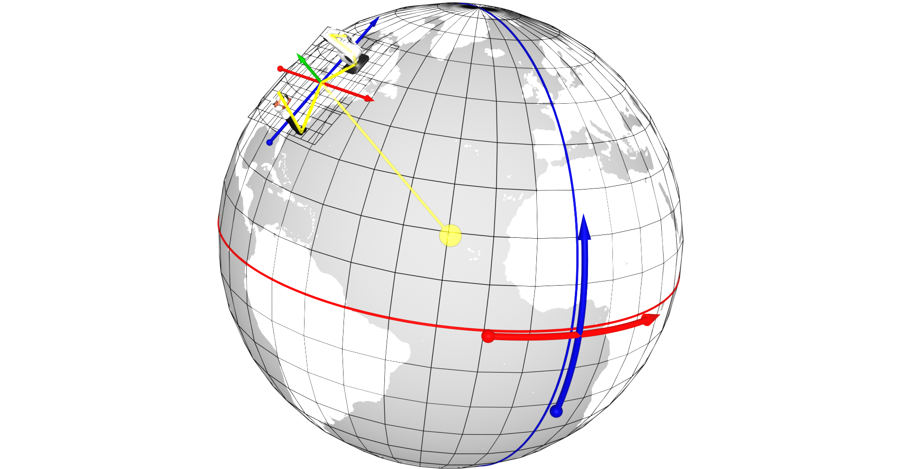
GeoPose
A Pose captures location and orientation of a real or digital object.
A Pose has an associated FrameTransform Chain. The Pose’s FrameTransform Chain encapsulates sufficient information to transform pose geometry in any component Frame to any other Frame in its associated FrameTransform Chain.
A Fixed Pose is a Pose whose associated Outermost Frame is related to an Ephemeris Object - a spatial object whose location and orientation are externally defined.
A GeoPose is a Fixed Pose related to a geospatial Ephemeris Object (the Earth) via a Topocentric Reference Frame.
Short Version:
A GeoPose ties the location and orientation of a spatial object to the Earth’s surface.
Notes:
From this we derive the idea of poses, and the chained reference systems to relate between the geographical, Earth-based system and individual objects and their histories of locations and orientations

Slide 3
GeoPose Standardisation Targets
The Basic GeoPose targets are simple and concise – no options. It satisfies most use case requirements.
The Advanced GeoPose target supports more complex use cases where the outer geographic reference frame is not LTP-ENU and/or a valid time is needed.
Composite:
The Chain GeoPose target provides additional flexibility with multiple intermediate frames or specific coordinate reference systems as needed.
The Frame Graph target supports the full structure need to represent networks of reference frames that arise with the use of multiple and linked location technologies.
The (Time) Sequence targets support the packaging of fixed-length time series of GeoPoses and the payload data objects for open-ended GeoPose streams from an external source.
SolarPose provides samples for any or all of the targets – see https://service.geopose.io/solar/swagger/index.html for details.
The SolarPose demo uses the Basic-YPR target.

Slide 4
GeoPose
GeoPose is
GeoPose is not
an encapsulation of location and orientation as a concrete data object
based on a logical data model
with a JSON encoding to express, capture, save and share the position and orientation of any real or digital object and observer in the real world.
a method to obtain a person, place or thing’s earth-anchored position or pose,
a substitute for the camera sensor model,
an API or library

Slide 5
SolarPose
A GeoPose gives the location and orientation of a real or virtual object referenced to an externally defined reference frame.
There are eight types of GeoPose data objects in the 1.0 draft standard.
SolarPose is a Web service that provides samples of all eight targets. The served GeoPoses give the orientation of the sun from a geographic location relative to a local tangent plane, east-north-up coordinate system at one or more times.
SolarPose is a source of simple but varying samples of GeoPose JSON-encoded data objects that conform to the current GeoPose 1.0 draft standard. It is maintained in synchronization with the GeoPose 1.0 draft.
Notes:
Jeremy: say in the vision that this has to do with geographical locations

Slide 6
Plan
We will take a quick look at:
The OpenAPI/Swagger documentation for SolarPose.
The GeoPose 1.0 draft validator and some GeoPose 1.0 data objects.
A simple web application that illustrates
SolarPose as a GeoPose sample data source and
the basics of creating and using Basic-YPR GeoPose 1.0 data objects.
You will leave with pointers to
The GeoPose 1.0 draft. https://github.com/opengeospatial/GeoPose/blob/main/standard/pdf/geopose_standard.pdf
The SolarPose demo and code in GeoPose repo: https://github.com/opengeospatial/GeoPose/tree/main/Implementations/SolarPose%20Service or hosted at https://geopose.io/geopose/1.0/demo/index.html
The GeoPose validator. https://service.geopose.io/solar/swagger/index.html
Notes:
Jeremy: say in the vision that this has to do with geographical locations

Slide 7
SolarPose API
SolarPose is a service that supplies simple but varying sample GeoPose JSON-encoded data objects that conform to the current GeoPose 1.0 draft standard. All of the GeoPose 1.0 standardization targets are covered. It is maintained in synchronization with the 1.0 draft.
https://service.geopose.io/solar/swagger/index.html
Notes:
Jeremy: say in the vision that this has to do with geographical locations

Slide 8
TLDR: There AreTwo Basic Requests
{"location":{"lat":35.66,"lon":139.74,"h":10},"angles":{"yaw":257.14921747186986,"pitch":57.50097065431083,"roll":0}}
https://service.geopose.io/solar/solarpose/ypr?longitude=139.74&latitude=35.66&height=10&unixTimeMs=1623646822123 =>
https://service.geopose.io/solar/solarpose/quaternion?longitude=139.74&latitude=35.66&height=10&unixTimeMs=1623646822123 =>
{
"location": { "lat": 35.66, "lon": 139.74, "h": 10 },
"angles": { "yaw": 257.14921747186988, "pitch": 57.50097065431083, "roll": 0 }
}
{
"location": { "lat":35.66, "lon":139.74, "h":10},
"quaternion": { "x":-0.37604132228466663, "y":-0.2999170948690563, "z":0.6854190524748135, "w":-0.5466656955070747}
}
Not surprisingly, parameters go in the query part of the URL. The demo uses the first – YPR – style.
Notes:
Jeremy: say in the vision that this has to do with geographical locations

Slide 9
DemoSolarPose demo
{"location":{"lat":35.66,"lon":139.74,"h":10},"angles":{"yaw":257.14921747186986,"pitch":57.50097065431083,"roll":0}}
See real GeoPose objects.
See how you might use a service to deliver them.
See how a client might consume them.
https://geopose.io/geopose/1.0/demo/index.html
Notes:
Jeremy: say in the vision that this has to do with geographical locations

Slide 10
Summary
GeoPose 1.0 Links
GeoPose 1.0 draft standard: https://github.com/opengeospatial/GeoPose/blob/main/standard/pdf/geopose_standard.pdf
GeoPose 1.0 samples and validator: https://service.geopose.io/solar/swagger/index.html
SolarPose demo: https://geopose.io/geopose/1.0/demo/index.html
Questions? Comments? Suggestions?

