Slide 1
OGC API DGGS - Background
Robert Gibb
119th OGC Member Meeting
Virtual | 16 June 2021

Slide 2
DGGS APIs – Tested Constructs
DGGS-Powered COLLECTIONS
(OGC API - Common)
{datasetAPI}/collections/{collectionId}
(OGC API - Features)
{datasetAPI}/collections/{collectionId}/items
(Features API benefitting from DGGS power)
(OGC API - Coverages)
{datasetAPI}/collections/{collectionId}/coverage
(Coverages API benefitting from DGGS power)

Slide 3
DGGS APIs – Tested Constructs
[DGGS API - Core]
Conformance Class "Core"
COLLECTION DGGS DATA ACCESS
{datasetAPI}/collections/{collectionId}/dggs
{datasetAPI}/collections/{collectionId}/dggs/{dggsId}
{datasetAPI}/collections/{collectionId}/dggs/{dggsId}/zones

Slide 4
DGGS APIs – Tested Constructs
[DGGS API - Core]
Conformance Class "DGGS Zone Data" - (What is here?)
{datasetAPI}/collections/{collectionId}/dggs/{dggsId}/zones/{zoneId}
[returns actual data, e.g. Zarr / Xarray, GeoJSON]
Conformance Class "List Data Zones" - (Where is it?)
(virtual (processing results) or data collection)
{datasetAPI}/collections/{collectionId}/dggs/{dggsId}/zones/listZonesWithData/{hierarchyLevel}[?bbox=]
(which zones have data at this level?)

Slide 5
DGGS APIs – Tested Constructs
[DGGS API - Core]
Conformance Class “DGGS Structure"
{datasetAPI}/dggs
{datasetAPI}/dggs/{dggsId}
information about the DGGS (hierarchy levels, zones etc.)
{datasetAPI}/dggs/{dggsId}/zones
{datasetAPI}/dggs/{dggsId}/zones/{zoneId}
[links for child, parent, sibling zones]

Slide 6
DGGS APIs – Tested Constructs
[DGGS API - Core]
Conformance Class "Topological Zone relationships"
{datasetAPI}/dggs/{dggsId}/zones/{zoneId}/children?zone={id} => child?another={zoneId}…
{datasetAPI}/dggs/{dggsId}/zones/{zoneId}/parents?zone={id} => parent?another={zoneId}…
{datasetAPI}/dggs/{dggsId}/zones/{zoneId}/neighbours?zone={id} ≅> sibling?another={zoneId}…
Conformance Class "Zones as Features"
{datasetAPI}/dggs/{dggsId}/features/ (landing page)
{datasetAPI}/dggs/{dggsId}/features/collections/
{datasetAPI}/dggs/{dggsId}/features/collections/{zoneId}
{datasetAPI}/dggs/{dggsId}/features/collections/{zoneId}/items (zone polygons)

Slide 7
OGC API DGGS
OGC Abstract Specification 21 v 2.0 DGGS: https://github.com/opengeospatial/ogcapi-discrete-global-grid-systems/blob/master/20-040r3-OGC-AS21-DGGSv2.0-draft-19170-1-proof.pdf c.f. section 8.3.3. Core Topological Query Functions module
Defines ZoneQuery operations which are redefined from Query2D and Query 3D ISO 19107:2019 Spatial Schema – these are DE9IM operations: within, crosses, union etc – and augmented by temporal and hierarchical topological operators.
Three critical differences are introduced in ZoneQuery:
Geometries in ZoneQuery are represented by Zonal Identifiers, rather than by sets of coordinates in Query2D and Query3D,
A single set of operations now cover 1D, 2D, 3D & 4D topological queries, this is achieved through a projectTo parameter, which constrains the dimensionality of the operation.
The operations are all defined as topological comparisons between two individual zones, rather than two features. With DGGS all features are represented by lists of Zonal Identifiers. Features can be compared topologically by applying the zone level comparisons to members in the list.

Slide 8
DGGS – RS Navigator: topological functions on ZoneID
distance (another:ZonalIdentifier, projectTo:DirectPosition[4])
<<query>> contains (another:ZonalIdentifier, projectTo:DirectPosition[4])
crosses (another:ZonalIdentifier, projectTo:DirectPosition[4])
disjoint (another:ZonalIdentifier, projectTo:DirectPosition[4])
equals (another:ZonalIdentifier, projectTo:DirectPosition[4])
intersects (another:ZonalIdentifier,projectTo:DirectPosition[4])
overlaps (another:ZonalIdentifier, projectTo:DirectPosition[4])
touches (another:ZonalIdentifier, projectTo:DirectPosition[4])
within (another:ZonalIdentifier, projectTo:DirectPosition[4])
withinDistance(another:ZonalIdentifier, dist:Distance, projectTo:DirectPosition[4])
parentOf (another:ZonalIdentifier, inheritID:Boolean, projectTo:DirectPosition[4])
childOf (another:ZonalIdentifier, inheritID:Boolean, projectTo:DirectPosition[4])
siblingOf (another:ZonalIdentifier, inheritID:Boolean, projectTo:DirectPosition[4])
<<query>> (1D) relativePosition(another:ZonalIdentifier, projectTo:DirectPosition[4])
<<reference>> relate (another:ZonalIdentifier, matrix:CharacterString, projectTo:DirectPosition[4])
<<reference>> (1D) relatePosition(another:ZonalIdentifier, relate:RelativePosition, projectTo:DirectPosition[4])
<<set>> buffer (dist:Distance, projectTo:DirectPosition[4])
difference (another:ZonalIdentifier, rangeRefine:refinementLevelRange, projectTo:DirectPosition[4])
intersection (another:ZonalIdentifier, rangeRefine:refinementLevelRange, projectTo:DirectPosition[4])
symDifference(another:ZonalIdentifier, rangeRefine:refinementLevelRange, projectTo:DirectPosition[4])
union (another:ZonalIdentifier, rangeRefine:refinementLevelRange, projectTo:DirectPosition[4])
parent (inheritID:Boolean, levels:Integer, projectTo:DirectPosition[4])
child (inheritID:Boolean, levels:Integer, projectTo:DirectPosition[4])
sibling (inheritID:Boolean, levels:Integer, projectTo:DirectPosition[4])

Slide 9
DGGS – RS Navigator: topological function parameters
another:ZonalIdentifier Specifies the target region for the query. In zonal query a zone's identifier provides (Mandatory) suﬀicient description of its topology. ZonalIdentifier takes the place of the geometry data used in Query2D and Query3D for both the source and the target.
projectTo:DirectPosition[4] projectTo specifies an optional reference direction, surface or volume for an operation.
(Optional, default:(1,1,1,1) ) Allowed values for each direction are {0,1,n}. projectTo takes one of three forms:
1D: In its one-dimensional form for specifying a reference direction,
only one direction has a value of 1. For example, (0,0,0,1) projects to the temporal axis, and (0,0,1,0) projects
to the vertical axis. Only the 1D form is supported by relativePosition and
relatePosition, default (0,0,0,1).
2D: In its two-dimensional form for specifying a reference surface, two directions have a
value of 1. For example, a surface at height n is specified by a projectTo value of (1,1,n,0)
representing the vector [(0,0,n,0),(1,1,n,0)].
3D: In its three-dimensional form for specifying a reference volume, three directions have
a value of 1. For example, (1,1,1,0) projects to a spatial volume without reference to time, and (1,1,n,1) projects to a surface spanning all time at height n.

Slide 10
DGGS – RS Navigator: topological functions parameters (cont)
rangeRefine:refinementLevelRange Specifies the range of refinement levels to include in a return <<set>>. (Optional, default: [min:max]) The integers representing the lower and upper bounds in the refinementLevelRange
datatype are both included in the range.
levels:Integer Levels indicates the relative number of levels in the hierarchy to be traversed in (Optional, default:1) assembling a result <<set>>
inheritID:Boolean When inheritID has a value of True the result <<set>> only contains cells for which the
(Optional, default:False) IDs have shared inheritance, and a value of False indicates that inheritance is ignored.
dist:Distance a distance measure with units.
(Mandatory)
matrix:CharacterString 3x3 intersection matrix of DE-9IM string codes with values {0,1,2,3,F,*}
(Mandatory)
relate:RelativePosition a RelativePosition enumeration as defined in W3C/OGC 16-071r3 as one of: (Mandatory) {Before, After, Meets, MetBy, Overlaps, OverlappedBy, Starts, StartedBy,
During, Contains, Finishes, FinishedBy, Equals, In, Disjoint}

Slide 11
OGC API DGGS - Background
Robert Gibb
119th OGC Member Meeting
Virtual | 16 June 2021

Slide 12
OGC API DGGS
The DGGS Abstract Specification 21 v2.0 contains definitions for a suite of 4D topological operations that we are going to represent in SwaggerHub as an OpenAPI description.
Practical work step 1: Describing OGC API – DGGS DE9IM <<query>> parameters in YAML
Practical work step 2: Describing OGC API – DGGS DE9IM <<query>> operations in YAML
Practical work step 3: Describing OGC API – DGGS DE9IM <<set>> operations in YAML
Practical work step 4: Describing OGC API – DGGS <<reference>> and other operations in YAML

Slide 13
OGC API DGGS: Dev Resources
Abstract Specification: https://github.com/opengeospatial/ogcapi-discrete-global-grid-systems/blob/master/20-040r3-OGC-AS21-DGGSv2.0-draft-19170-1-proof.pdf c.f. section 8.3.3. Core Topological Query Functions module
TB-16 OGC API – DGGS-Process: https://app.swaggerhub.com/apis/aaime-sh/dggs-process/0.0.3 this is going to be our starting point, it implements many contextual functions for DGGS, but only 2x of the 24x operations specified in section 8.3.3 are defined, and only in their 2D form.
GitHub: https://github.com/opengeospatial/ogcapi-discrete-global-grid-systems This is where the YAML file we will be working in is stored.
2021-06-16 Developer Track – OGC API DGGS: https://app.swaggerhub.com/apis/rggibb/dggs-zonequery/0.0.4 This is the test space for our YAML file.

Slide 14
Requirements
Familiarity with git (clone, etc.)
Familiarity with github
Familiarity with YAML, but we will introduce you to YAML
We have a starting YAML file: https://github.com/opengeospatial/ogcapi-discrete-global-grid-systems/blob/master/dggs-zonequery.yml
So if you would like to open it …

Slide 15
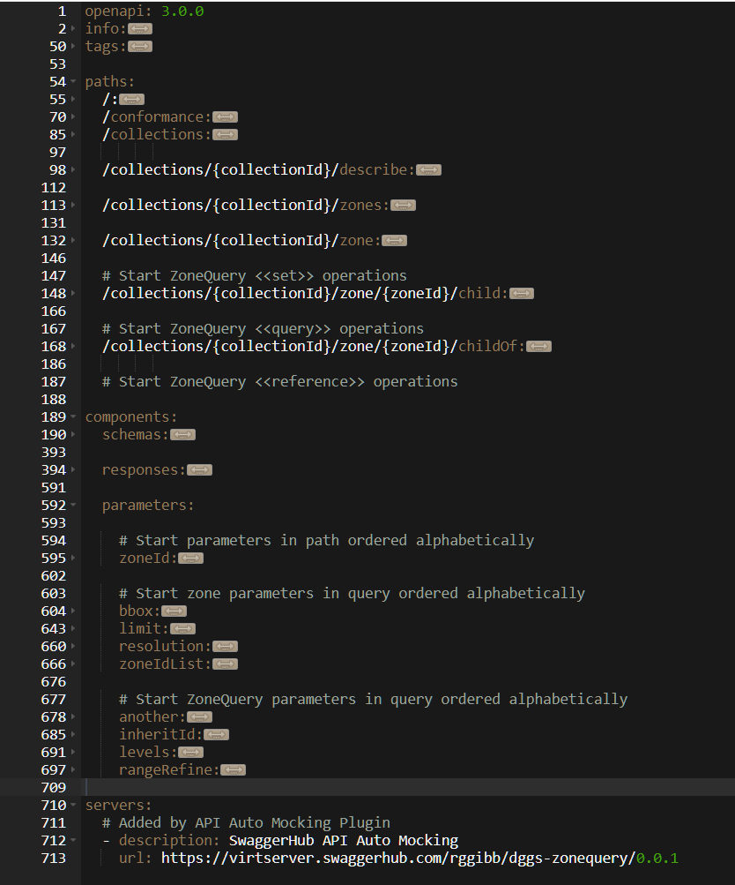
OGC API – DGGS DE9IM <<query>> operations in YAML
YAML file structure:
Step 3
Step 1
Step 2
Step 4

Slide 16
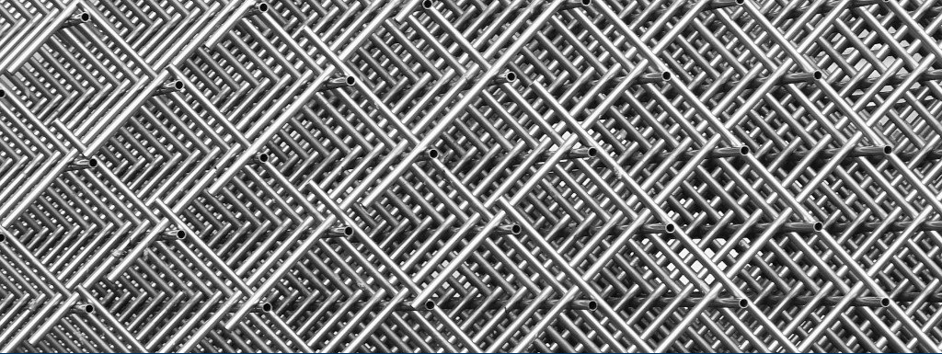
OGC API DGGS <<query>>
OGC API DGGS parameters
#OGCAPI

Slide 17
DGGS – RS Navigator: topological function parameters
another:ZonalIdentifier Specifies the target region for the query. In zonal query a zone's identifier provides (Mandatory) suﬀicient description of its topology. ZonalIdentifier takes the place of the geometry data used in Query2D and Query3D for both the source and the target.
projectTo:DirectPosition[4] projectTo specifies an optional reference direction, surface or volume for an operation.
(Optional, default:(1,1,1,1) ) Allowed values for each direction are {0,1,n}. projectTo takes one of three forms:
1D: A one-dimensional form for specifying a reference direction,
only one direction has a value of 1. For example, (0,0,0,1) projects to the temporal axis, and (0,0,1,0) projects
to the vertical axis. Only the 1D form is supported by relativePosition and
relatePosition, default (0,0,0,1).
2D: A two-dimensional form for specifying a reference surface,
two directions have a value of 1. For example, a surface at height n is specified by a projectTo value of (1,1,n,0)
representing the vector [(0,0,n,0),(1,1,n,0)].
3D: A three-dimensional form for specifying a reference volume,
three directions have a value of 1. For example, (1,1,1,0) projects to a spatial volume without reference to time, and (1,1,n,1) projects to a surface spanning all time at height n.
started

Slide 18
DGGS – RS Navigator: topological functions parameters (cont)
rangeRefine:refinementLevelRange Specifies the range of refinement levels to include in a return <<set>>. (Optional, default: [min:max]) The integers representing the lower and upper bounds in the refinementLevelRange
datatype are both included in the range.
levels:Integer Levels indicates the relative number of levels in the hierarchy to be traversed in (Optional, default:1) assembling a result <<set>>
inheritID:Boolean When inheritID has a value of True the result <<set>> only contains cells for which the
(Optional, default:False) IDs have shared inheritance, and a value of False indicates that inheritance is ignored.
dist:Distance a distance measure with units.
(Mandatory)
matrix:CharacterString 3x3 intersection matrix of DE-9IM string codes with values {0,1,2,3,F,*}
(Mandatory)
relate:RelativePosition a RelativePosition enumeration as defined in W3C/OGC 16-071r3 as one of: (Mandatory) {Before, After, Meets, MetBy, Overlaps, OverlappedBy, Starts, StartedBy,
During, Contains, Finishes, FinishedBy, Equals, In, Disjoint}
started
started
started

Slide 19
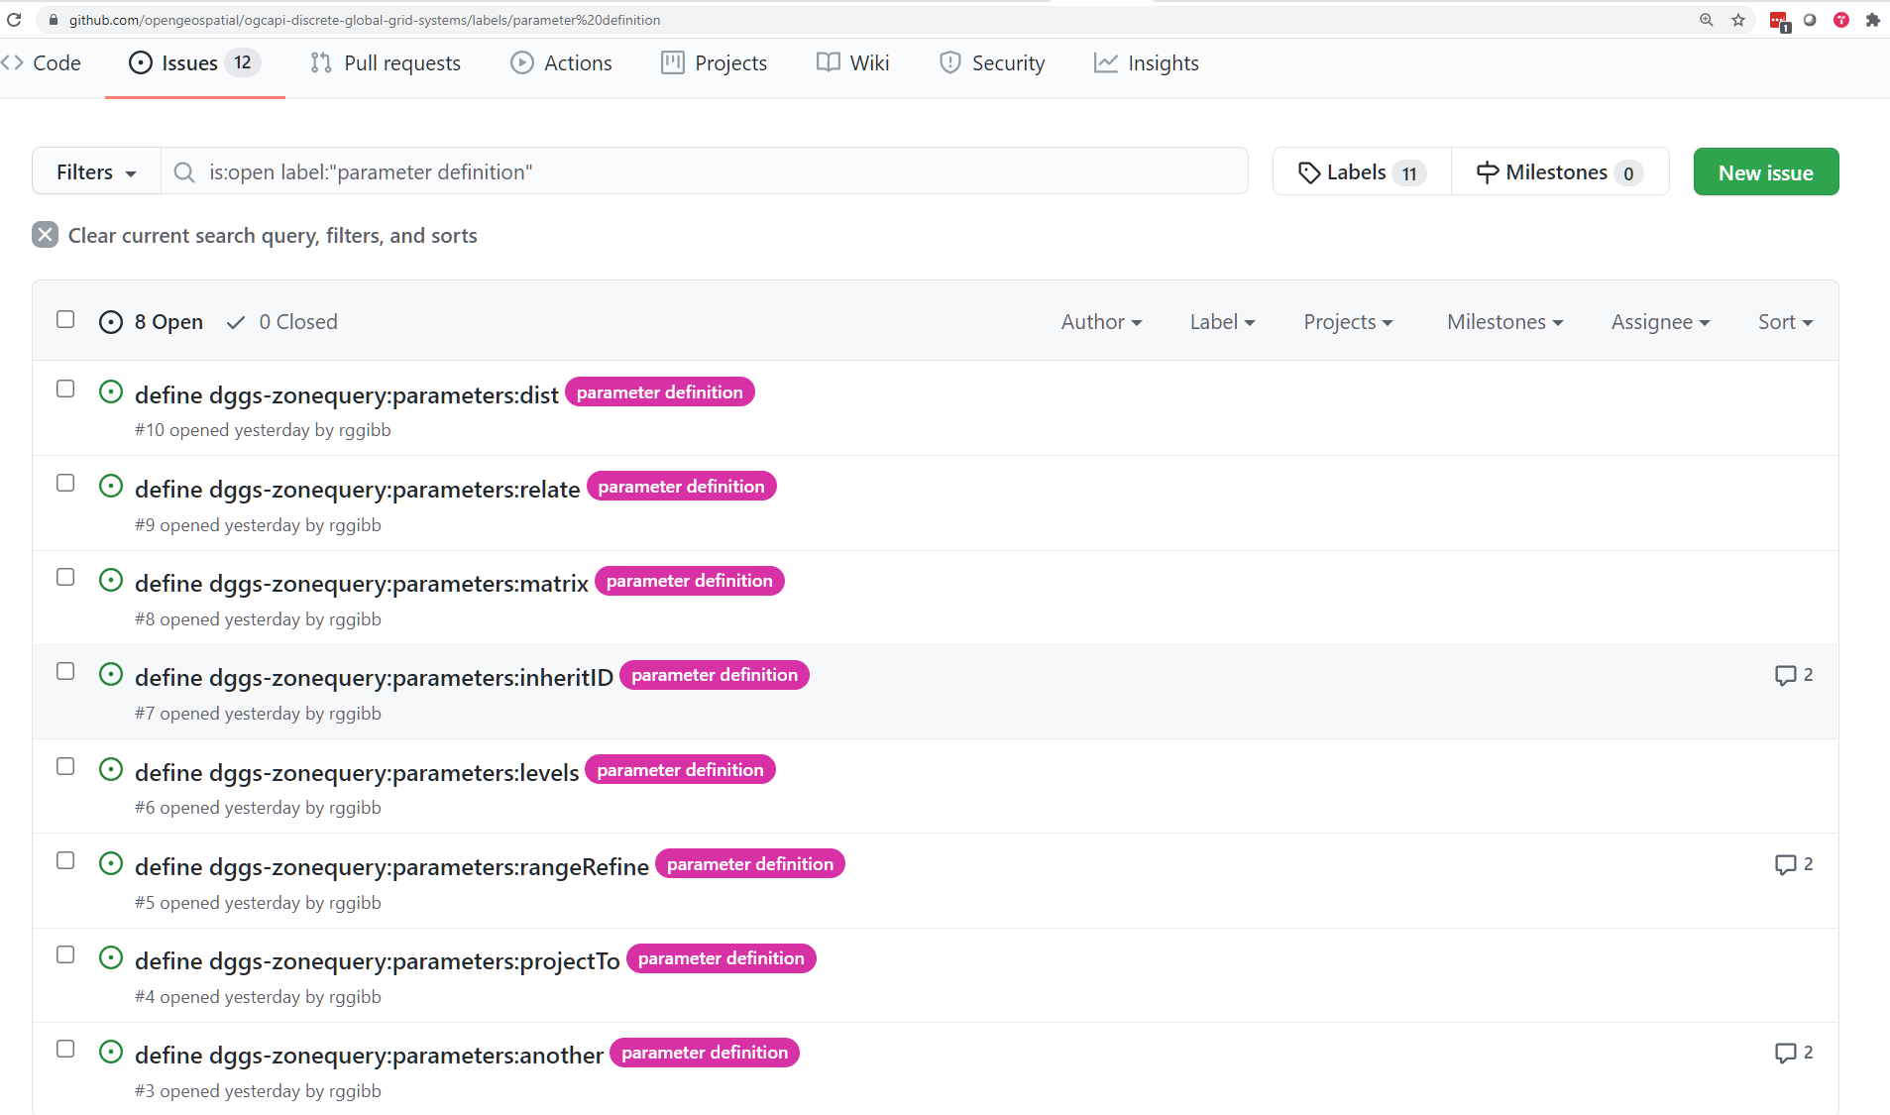
DGGS – RS Navigator: topological functions parameters (cont)

Slide 20
OGC API – DGGS DE9IM <<query>> operations in YAML
YAML file structure:
Step 1

Slide 21
OGC API DGGS <<query>>
OGC API DGGS <<query>>
#OGCAPI

Slide 22
OGC API – DGGS DE9IM <<query>> operations in YAML
Overview
DE9IM <<query>> are: contains, crosses, disjoint, equals, intersects, overlaps, touches, within, withinDistance, relativePosition parentOf, childOf, siblingOf
General pattern: /zone/{ZonalIdentifier}/{query}?another=ZonalIdentifier&projectTo=DirectPosition[4] return True|False
Variations: /zone/{ZonalIdentifier}/parentOf | childOf | siblingOf?another=ZonalIdentifier&inheritID:Boolean &projectTo:DirectPosition[4] return True|False /zone/{ZonalIdentifier}/withinDistance?another=ZonalIdentifier&dist:Distance&projectTo:DirectPosition[4] return True|False /zone/{ZonalIdentifier}/relativePosition?another=ZonalIdentifier&projectTo:DirectPosition[4] return RelativePosition where RelativePosition:{Before, After, Meets, MetBy, Overlaps, OverlappedBy, Starts, StartedBy, During, Contains, Finishes, FinishedBy, Equals, In, Disjoint}

Slide 23
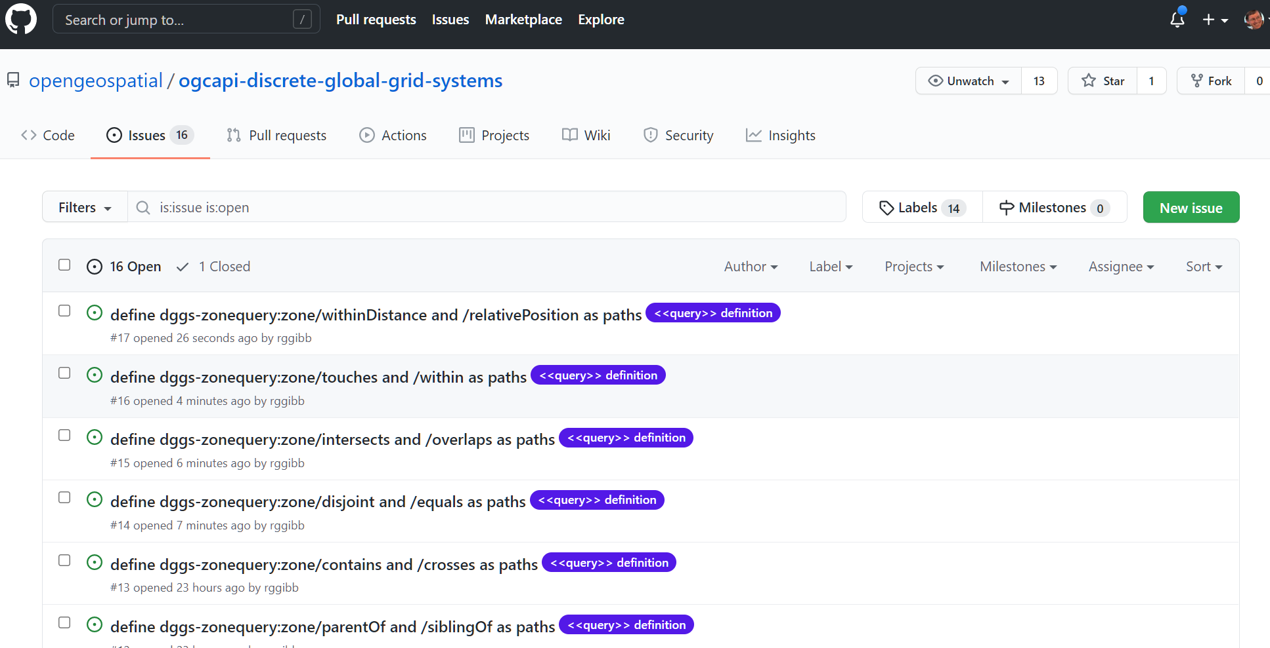
OGC API – DGGS DE9IM <<query>> operations in YAML

Slide 24
OGC API – DGGS DE9IM <<query>> operations in YAML
YAML file structure:
Step 2

Slide 25
OGC API DGGS <<set>>
OGC API DGGS
<<set>>
#OGCAPI

Slide 26
OGC API – DGGS DE9IM <<set>> operations in YAML
Overview
DE9IM <<set>> operations are: buffer, difference, intersection, symDifference, union parent, child, sibling
General pattern: /zone/{ZonalIdentifier}/<<set>>?another=ZonalIdentifier,rangeRefine=refinementLevelRange&projectTo=DirectPosition[4] return zoneIdList where refinementLevelRange is [maxRefinementLevel:minRefinementLevel]
Variations: /zone/{ZonalIdentifier}/parent | child | sibling?levels=Integer&inheritID=Boolean&projectTo=DirectPosition[4] return zoneIdList /zone/{ZonalIdentifier}/buffer?dist=Distance&projectTo=DirectPosition[4]), return zoneIdList

Slide 27
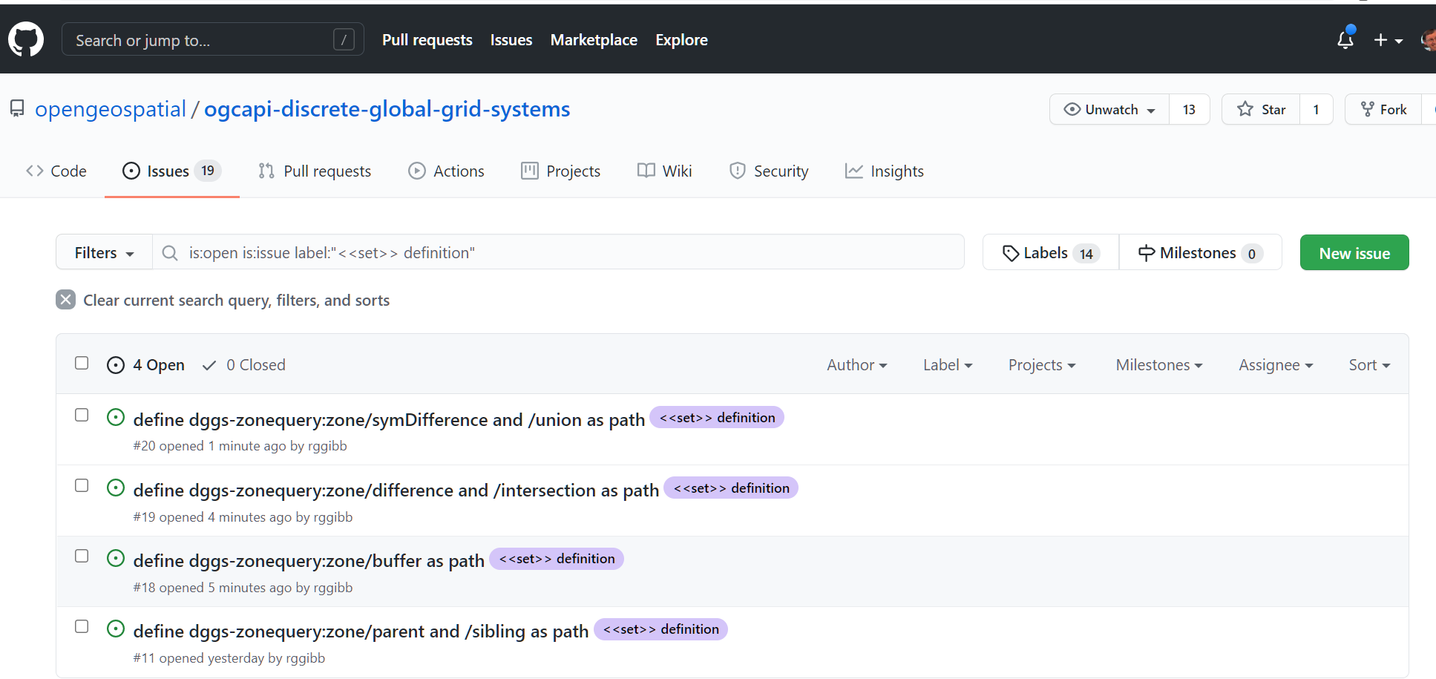
OGC API – DGGS DE9IM <<set>> operations in YAML

Slide 28
OGC API – DGGS DE9IM <<set>> operations in YAML
YAML file structure:
Step 3

Slide 29
OGC API DGGS <<reference>> etc
OGC API DGGS
<<reference>> etc
#OGCAPI

Slide 30
OGC API – DGGS DE9IM <<reference>> and other operations in YAML
Overview
DE9IM <<reference>> operations are: relate, relatePosition
Variations: /zone/{ZonalIdentifier}/relate?another=ZonalIdentifier&matrix=CharacterString&projectTo:DirectPosition[4]) return True|False /zone/{ZonalIdentifier}/relativePosition?another=ZonalIdentifier&relate=RelativePosition&projectTo:DirectPosition[4]) return True|False
other operation: distance
General pattern: /zone/{ZonalIdentifier}/distance?another=ZonalIdentifier&projectTo=DirectPosition[4]) return Distance

Slide 31
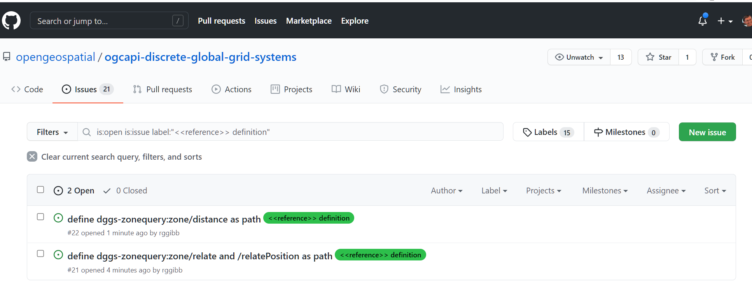
OGC API – DGGS DE9IM <<reference>> operations in YAML

Slide 32
OGC API – DGGS DE9IM <<reference>> operations in YAML
YAML file structure:
Step 4

