Slide 1
EDR API Draft Standard
Chris Little
118th OGC Member Meeting
Virtual | 30 March 2021

Slide 2
EDR API Agenda
Brief Background
Timeline of EDR API
Now
Future Plans
Q&A, Discussion

Slide 3
Background to EDR API

Slide 4
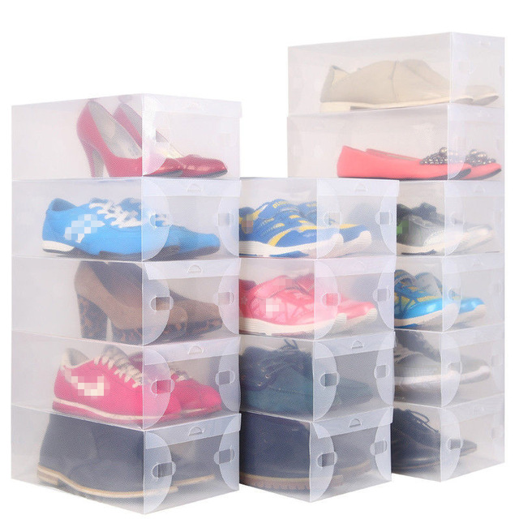
Notes:
Transfer format for data not same as crate – JSON/CSV/XML more transparent, smaller, ligherweight, HTTP resolvable

Slide 5
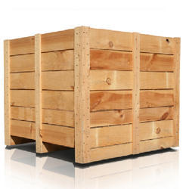
Notes:
NetCDF, GRIB, BUFR, GF3, FITS, BAM, Shapefiles, etc will not go away
Contents currently on INSIDE of lid.
~10km grid= 2560 x 1920 x70 levels x 100 timesteps x ~100 ensembles = 3x10**12 = 3 trillion points
= 15trillion values per forecast
= 60 PB = 5PB/hour = 5000TB = 85TB/min = 85000GB = 1500GB/sec

Slide 6
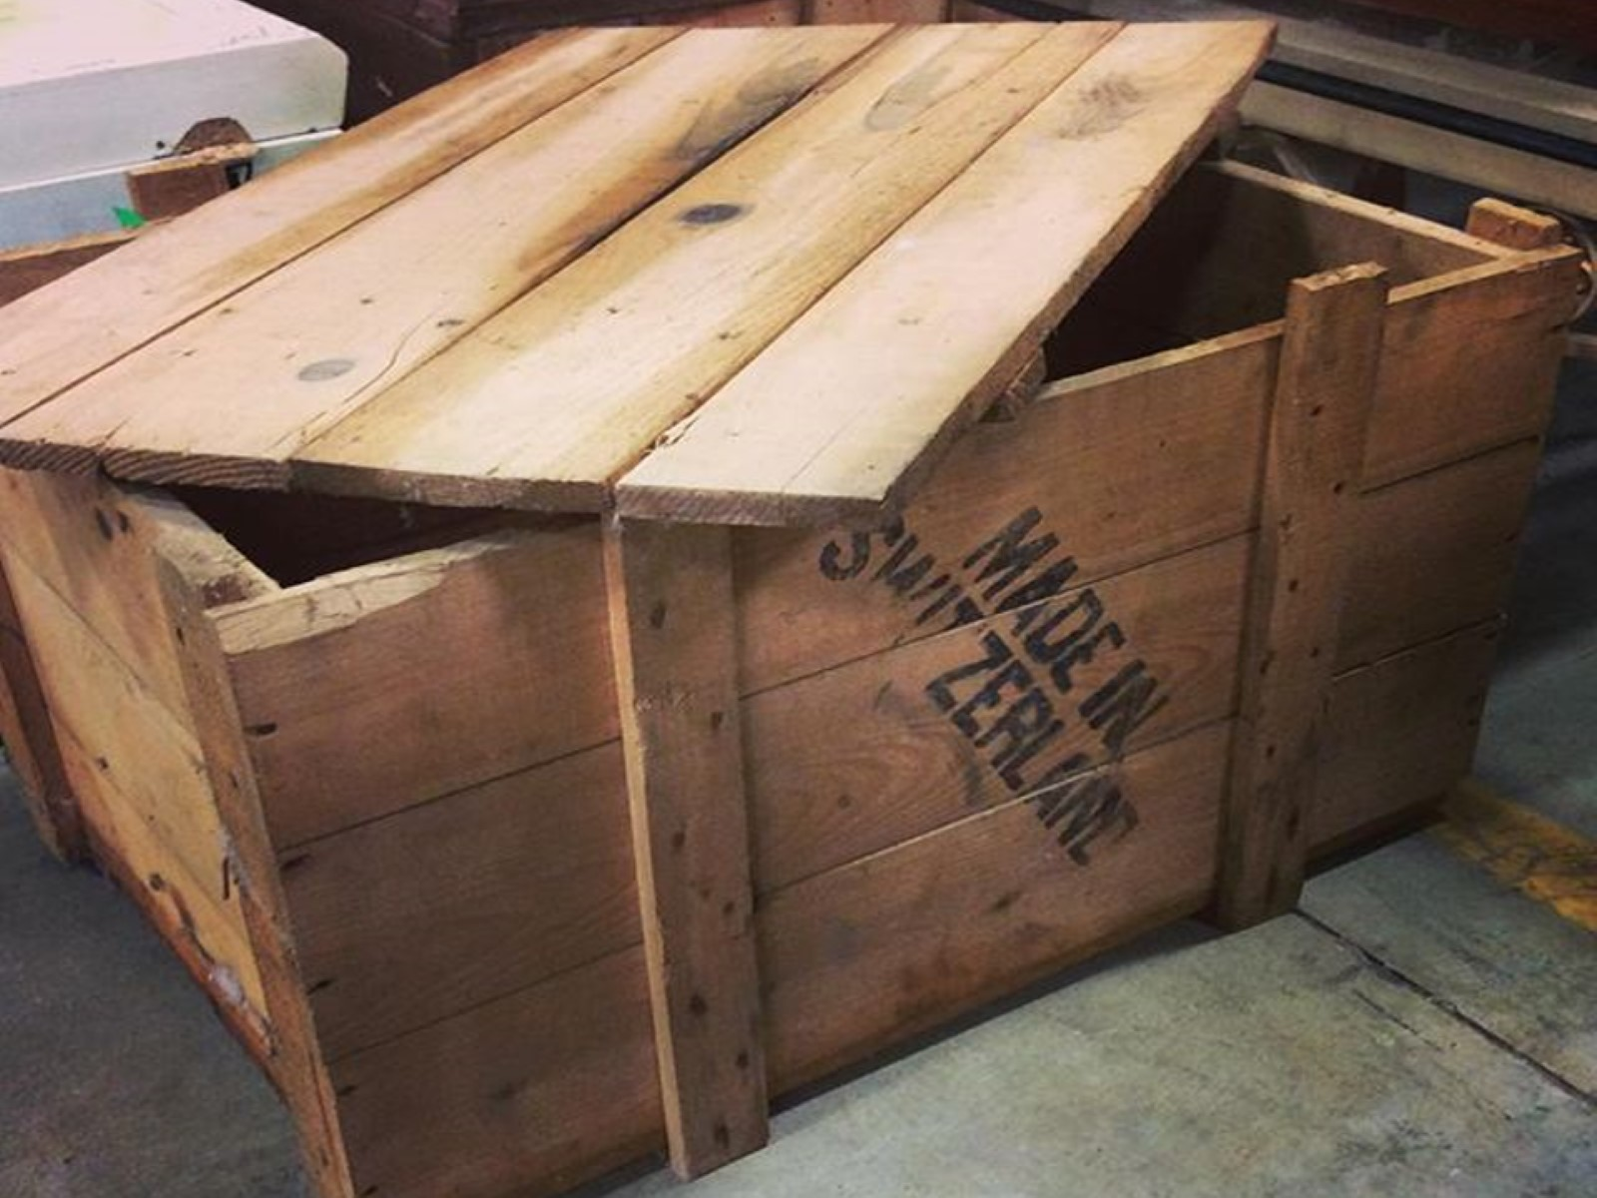

Slide 7
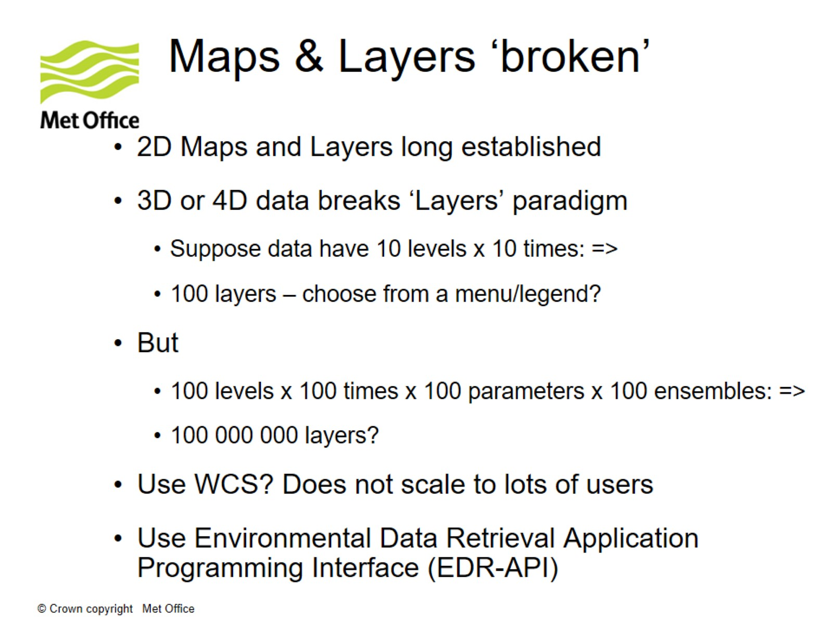
Maps & Layers ‘broken’

Slide 8
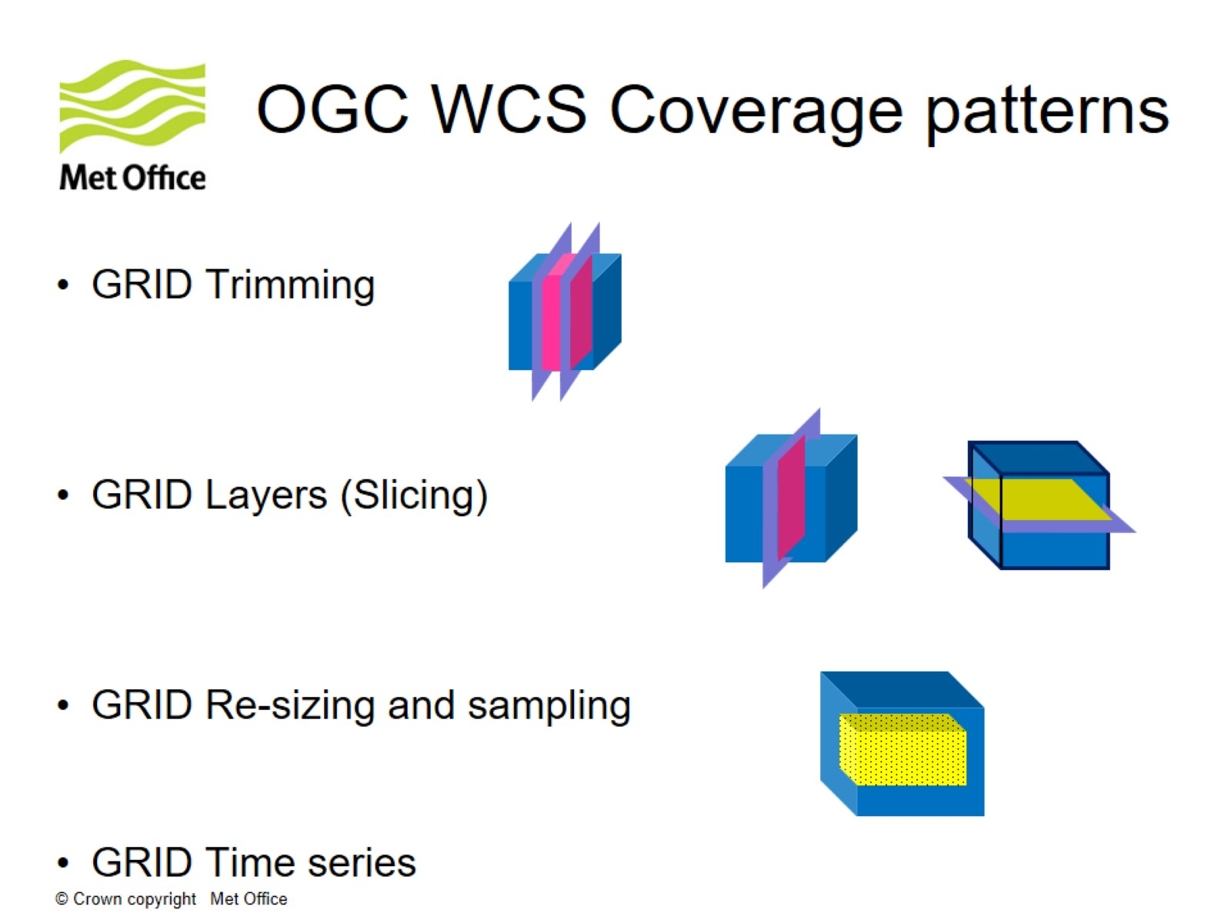
OGC WCS Coverage patterns

Slide 9
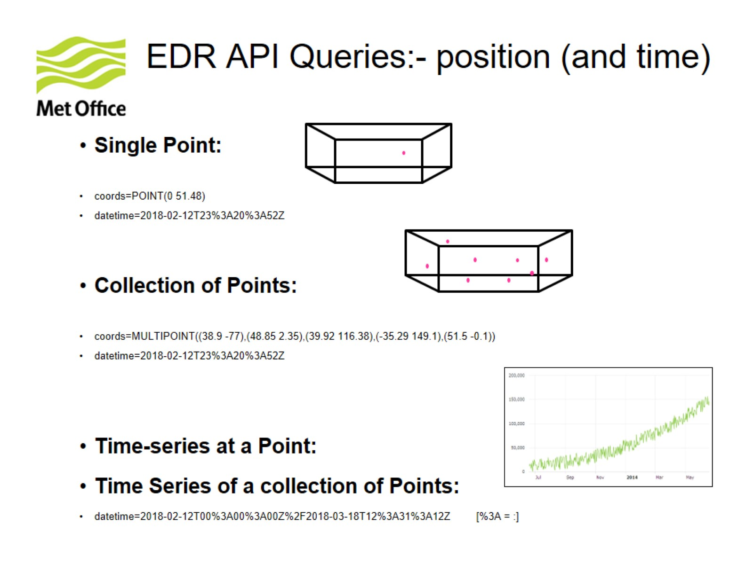
EDR API Queries:- position (and time)

Slide 10
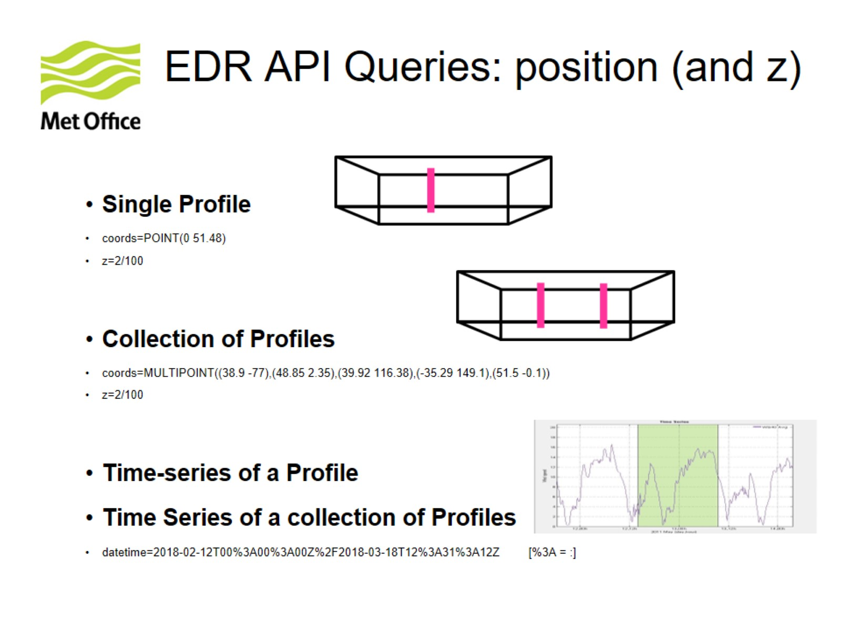
EDR API Queries: position (and z)

Slide 11
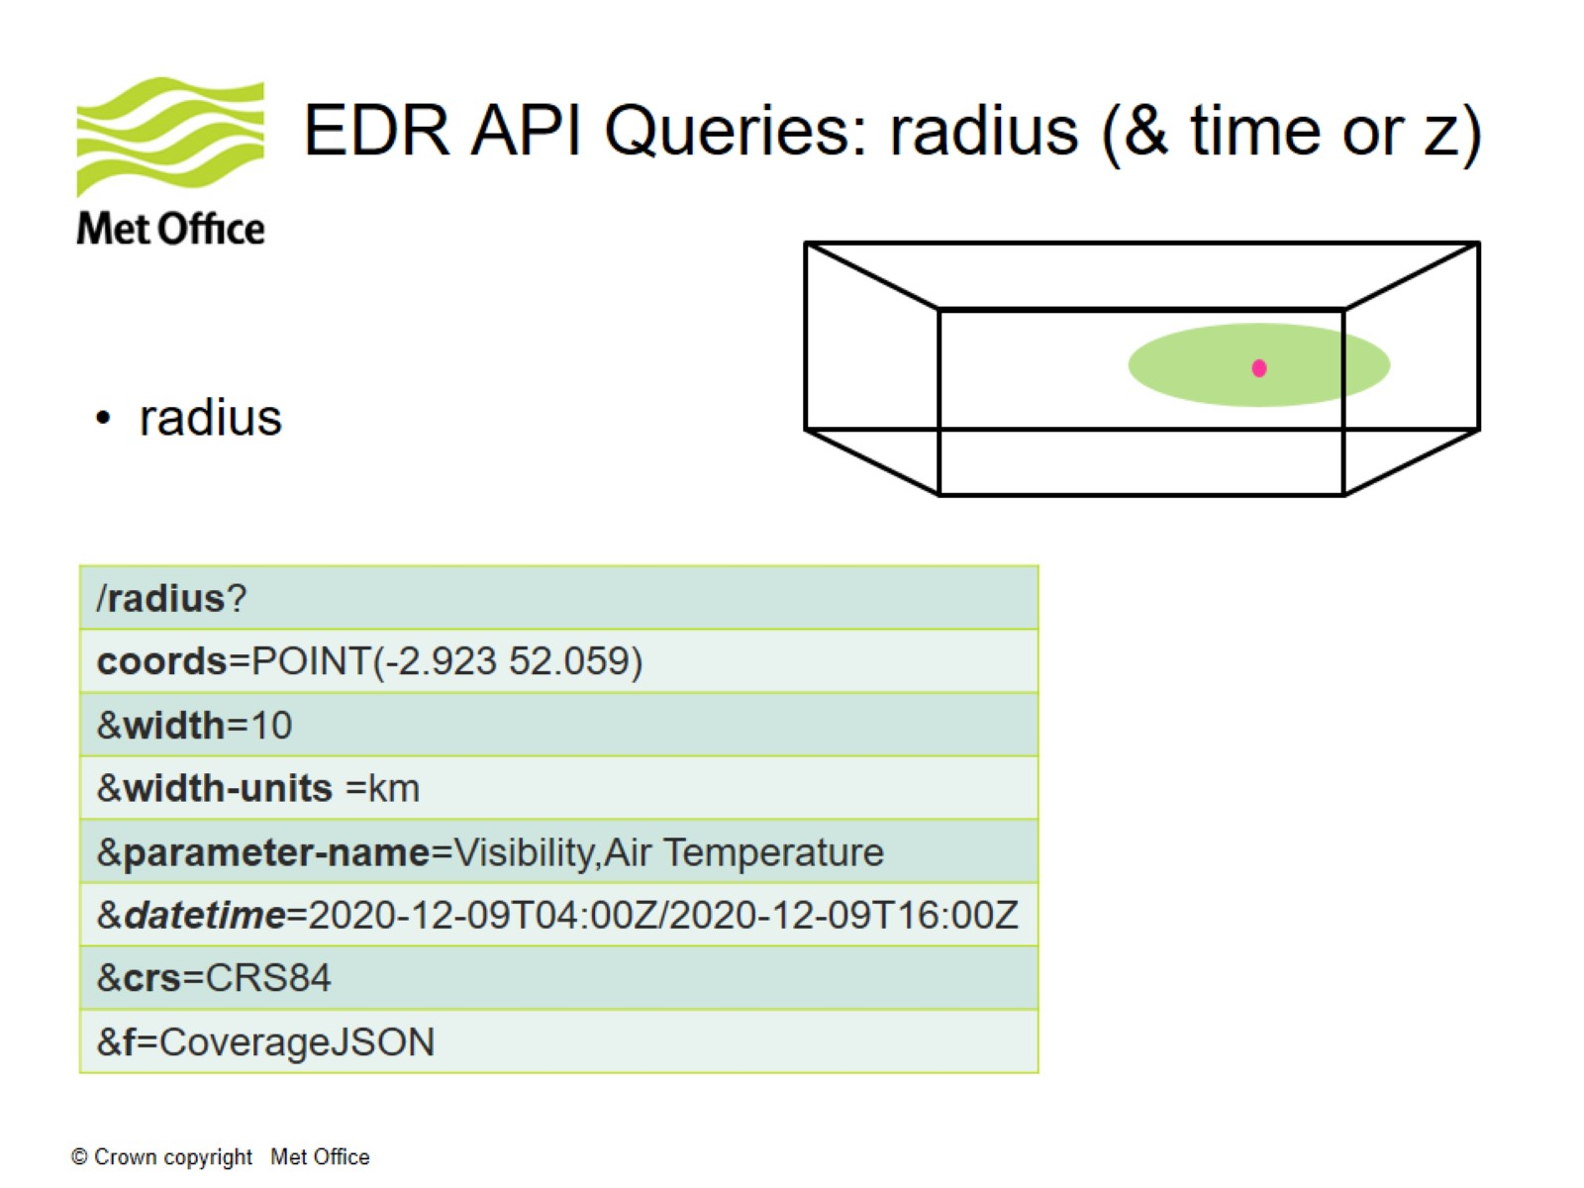
EDR API Queries: radius (& time or z)

Slide 12
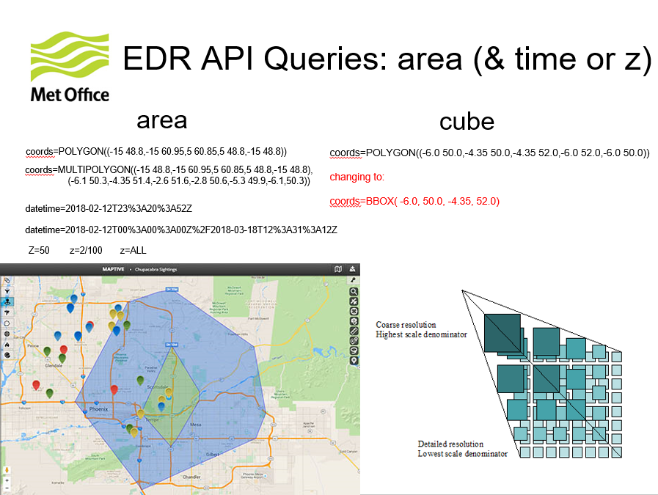

Slide 13
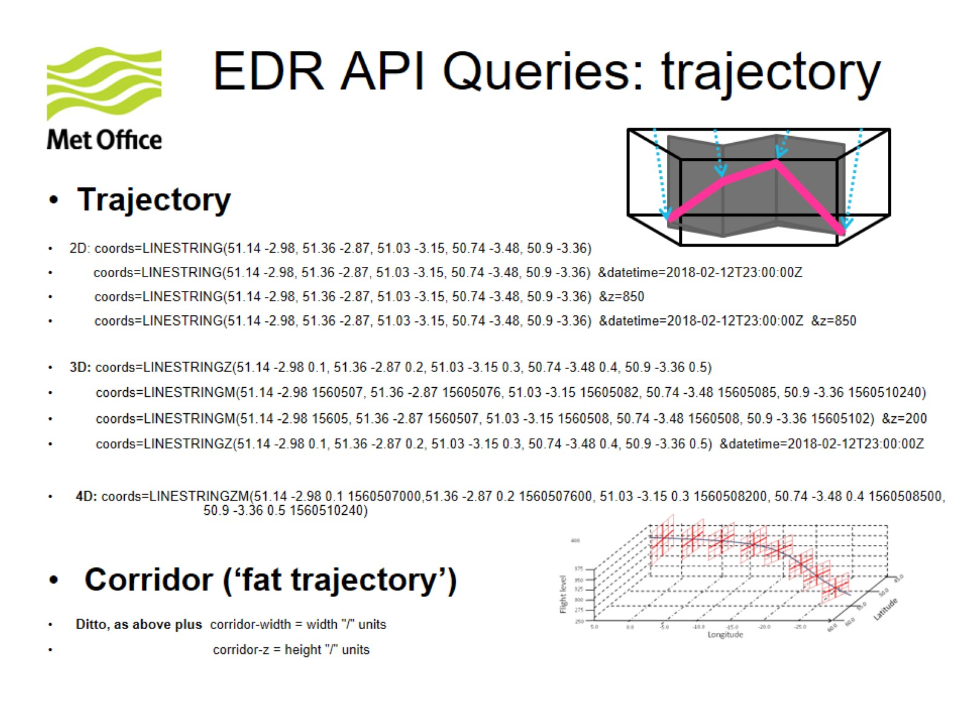
EDR API Queries: trajectory

Slide 14
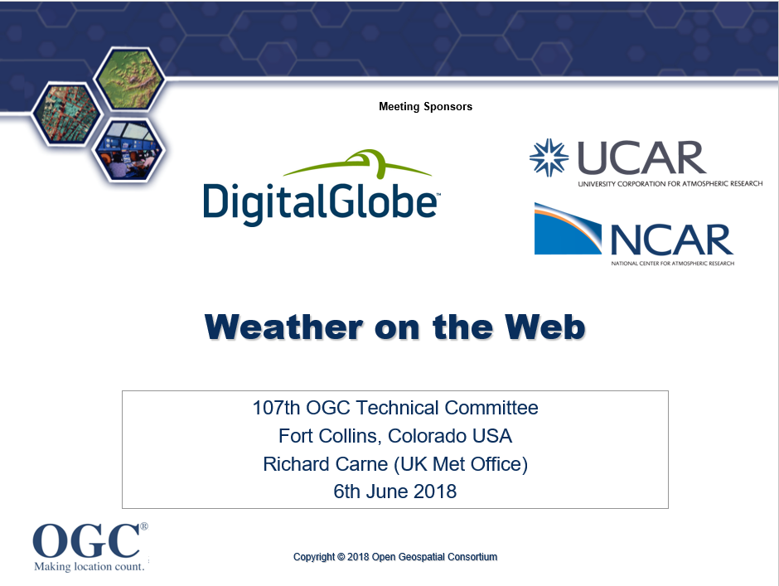
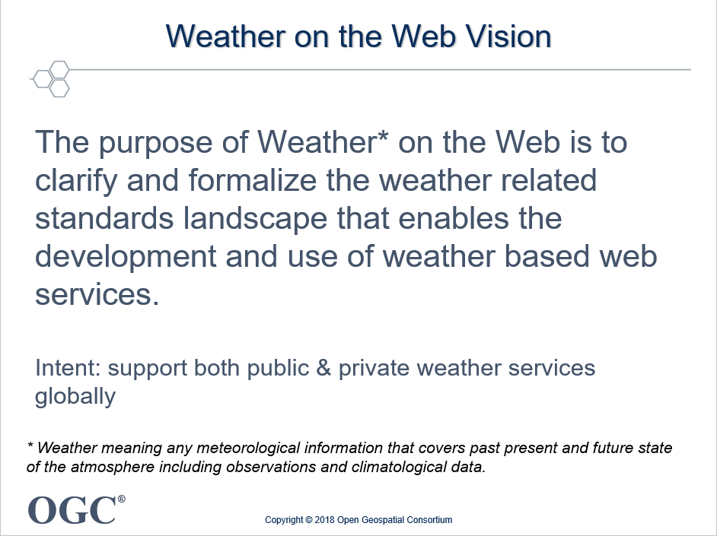
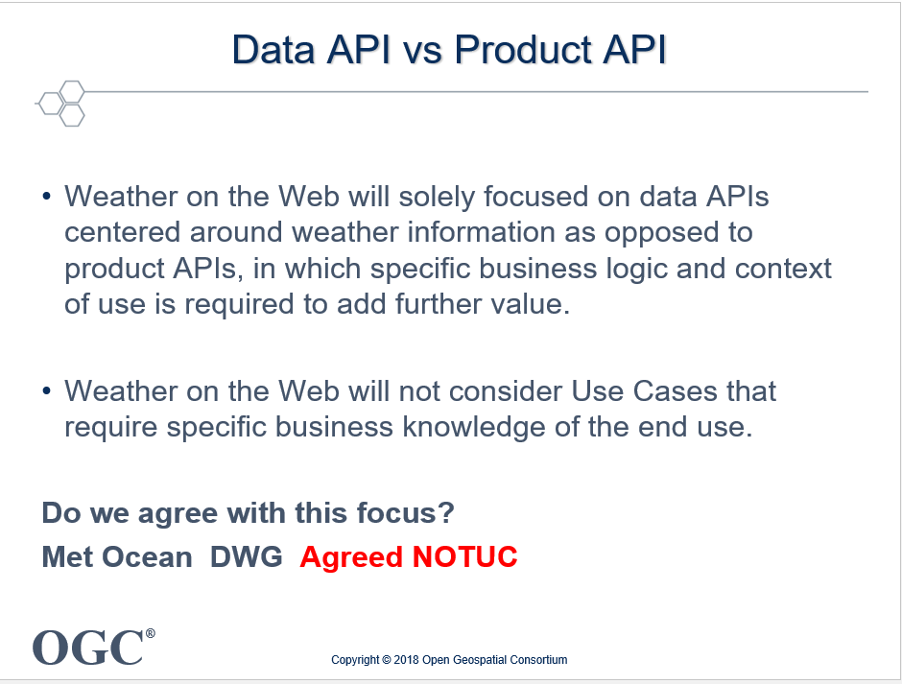
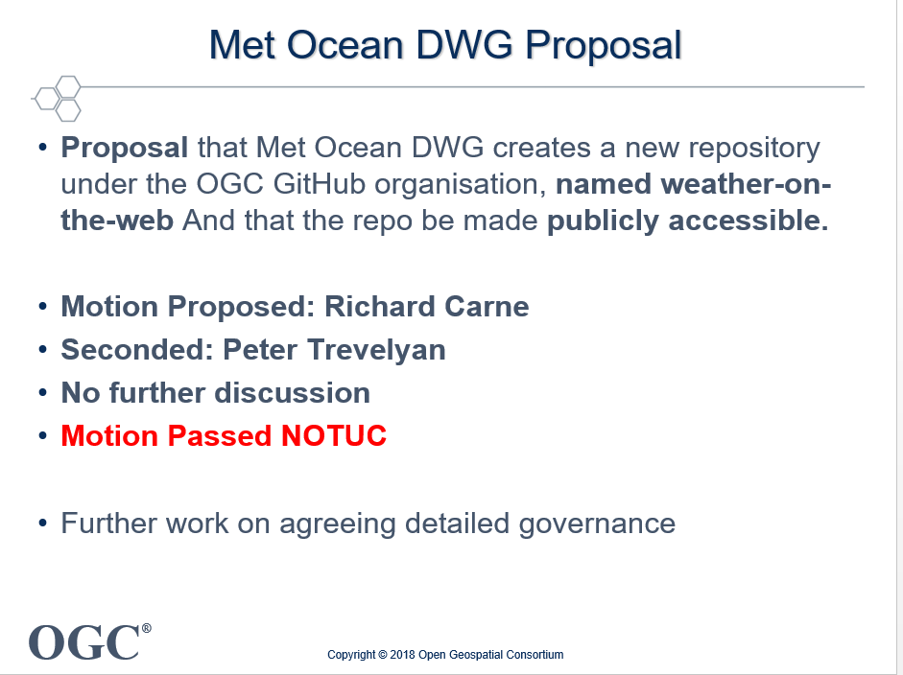
Weather on the Web – 2018: Fort Collins
https://portal.ogc.org/files/?artifact_id=79583
Several long established production weather APIs, so market demand is there
Developed WCS/CIS Met Application Profile
Notes:
In those days, Met Ocean DWG had its own GitHub repo, not an OGC one.

Slide 15
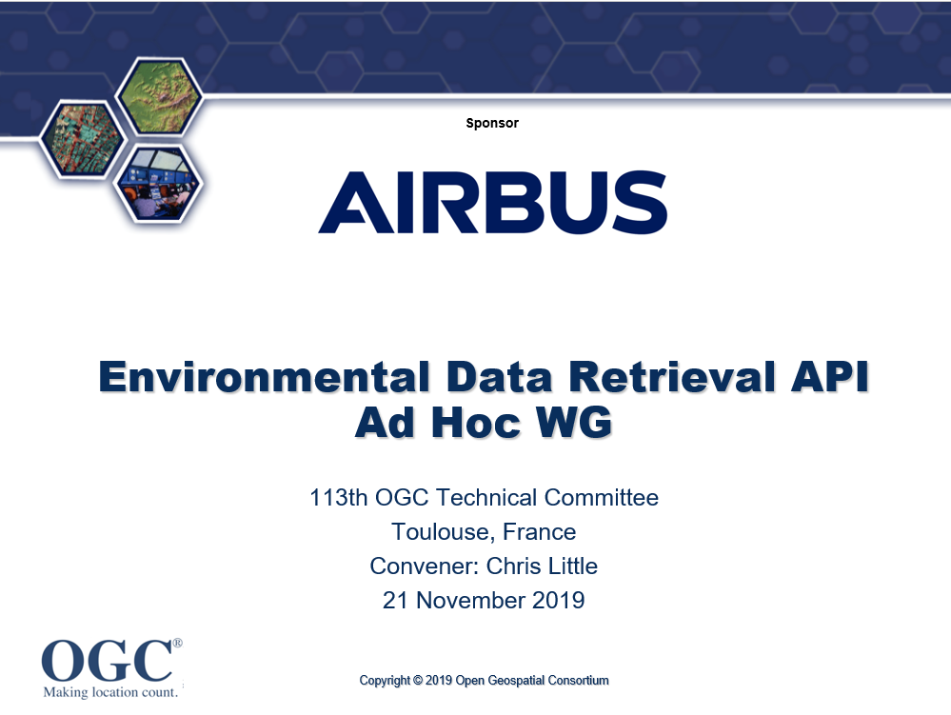
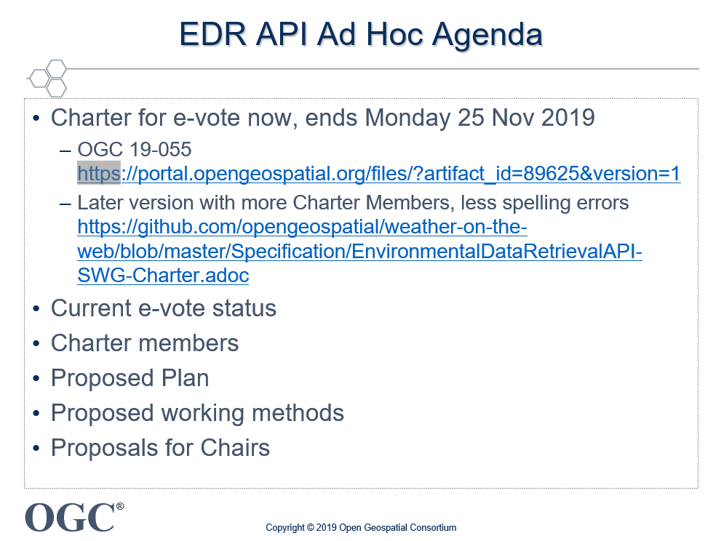
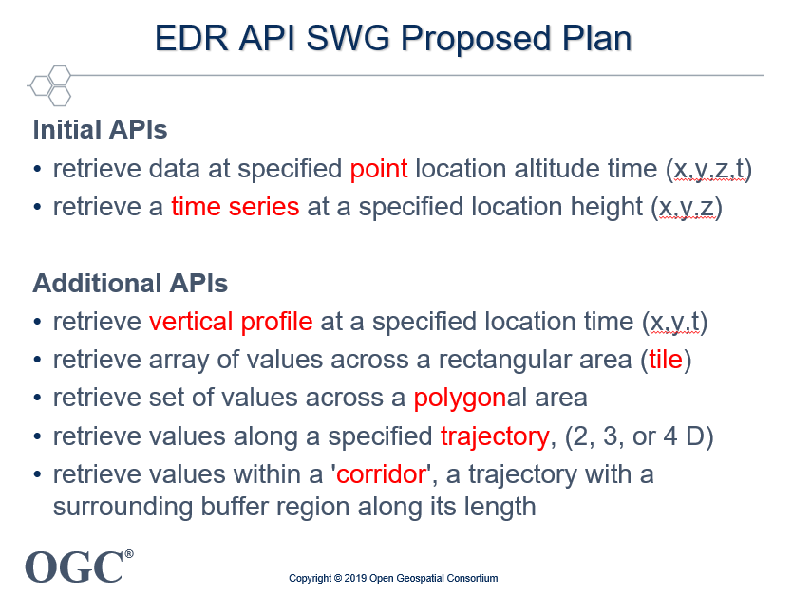
Environmental Data Retrieval API – 2019: Toulouse
Various names discussed, EDR chosen as most appropriate

Slide 16
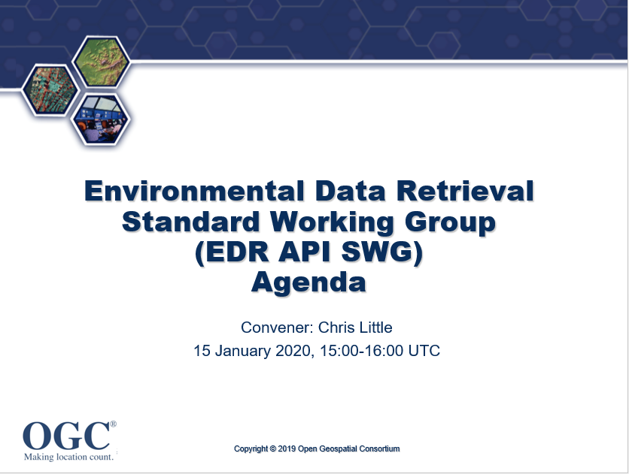
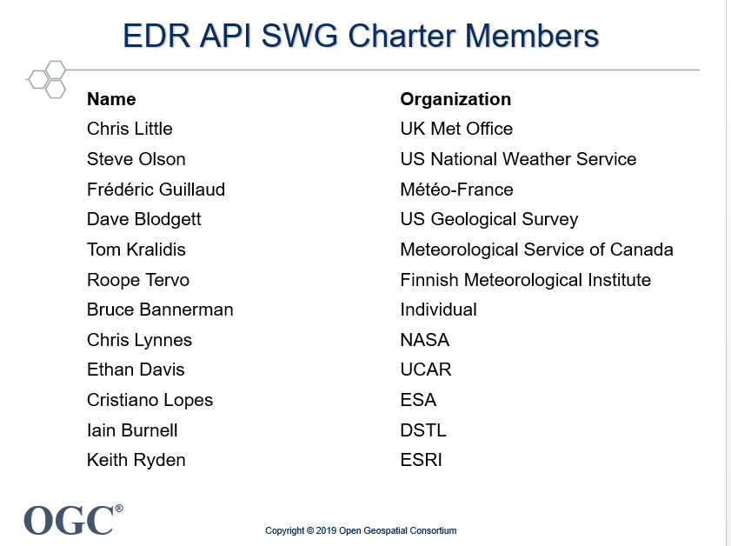
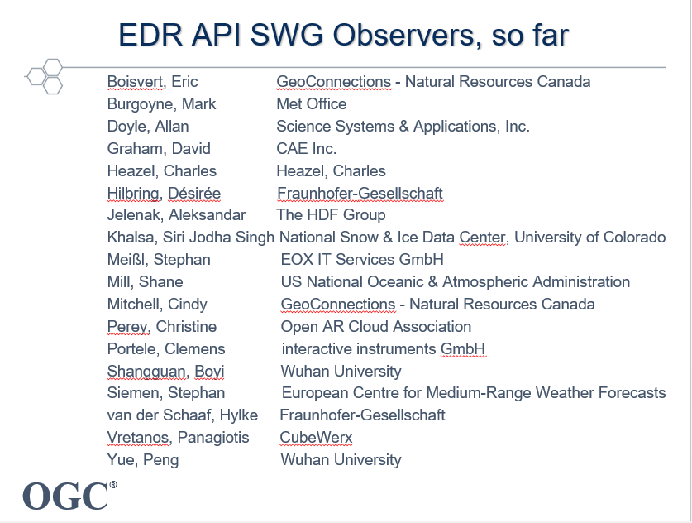
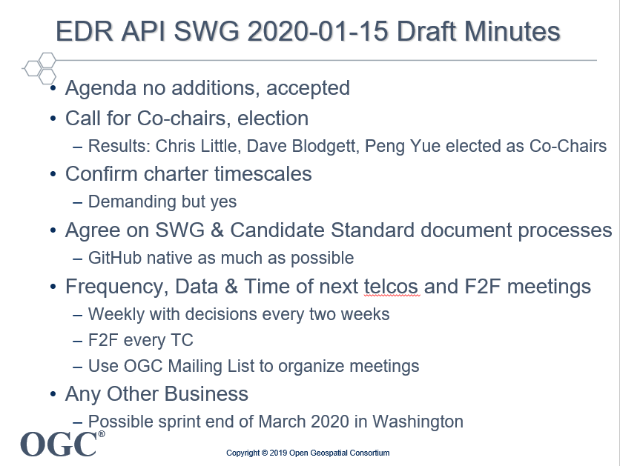
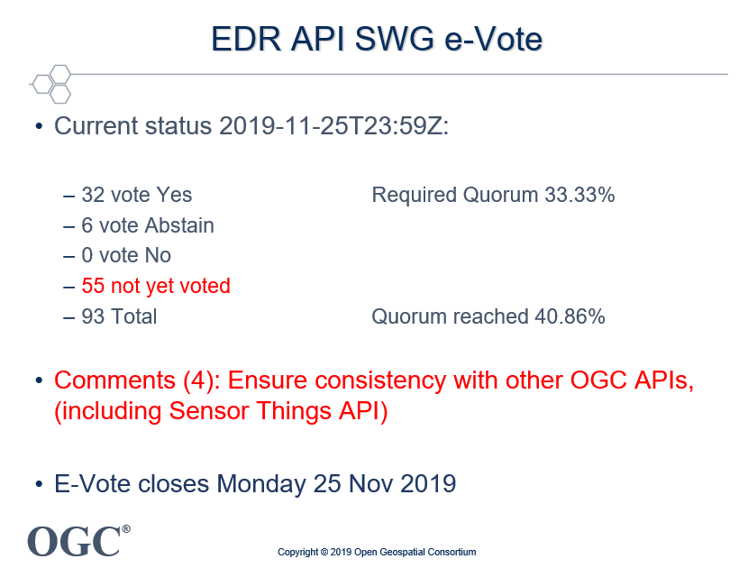
EDR API SWG – 2020: pre-Ottawa

Slide 17
Environmental Data Retrieval API - Timeline
2018-12 Early Proof of Concept Hackathon Washington
based on long standing meteorological production systems
2019-06 WeatherOnTheWeb API renamed EDR API – hydrology, defence, space,…
Github https://github.com/opengeospatial/Environmental-Data-Retrieval-API
Mailing list EDR-API.SWG@lists.opengeospatial.org
2019-06 Other hackathons: London https://www.opengeospatial.org/projects/initiatives/oapihackathon19
2019-09 Ad Hoc EDR API WG (name chosen)
2019-11 Charter established
2019-12 1st EDR API SWG
2020-03 1st EDR API Hackathon
2020-07 OGC Architecture Board Review passed
2020-08 Released for Public Comment
2020-09 Public Comment finish (4, late: Why not CIS JSON? What is “EDR Data Resource”?)
2020-11 2nd EDR API Hackathon (No comments)
2020-12 Request publication from TC (NOTUC)
2021-03 OGC TC E-Vote passed: (23 YES, 8 Abstain, 4 NO, Name change requested)

Slide 18
Environmental Data Retrieval API Now
Awaiting OGC Planning Committee approval next week.

Slide 19
EDR API in one slide
https://a.domain.or.other / collections / {collectionId} / {queryType} ? keyword=value & keyword=value &…
Position​
Area​ & Radius & Cube​
Trajectory​ & Corridor​
Location & Instance & Item​ API-Features compatible
WKT for coordinates / geometry (2D, 3D, or 4D)
ISO 8601/RFC 3339 for other time ranges
Compliant to API - Common Core & Collections (moving goalposts)
Compatible with API - Features Core
Shared parameters: ‘coords’, ‘crs’, ‘datetime’, ‘f’, ‘parameter-name’, ‘z’. Others are query specific
Public Review comments:
Why recommend CoverageJSON, not GeoJSON, CIS JSON, NetCDF, GeoTIFF, etc?
CoverageJSON has significant use in communities, supports obs, features & coverages, libraries, and is performant
NOT mandated - other payload formats can be used
What is an “Environmental Data Resource”? – Now defined as “spatio-temporal data”
with z or t extent

Slide 20
Known Existing and Planned Implementations
Implemented. See Implementations Page on the GitHub repository. All committed to update quickly:
UK Met Office: open source demo, with production infrastructure being developed, Mark Burgoyne
US National Weather Service: open source demo to help explore future infrastructure and API Records link, Shane Mill
IBL: commercial production-quality beta, Igor Andruska and colleagues
Wuhan University: Typhoon warning impact analysis, Peng Yue and colleagues
Meteorological Service of Canada: pygeoapi open source library addition, Tom Kralidis
ESRI Image Server façade: proof of concept, Pete Trevelyan and ESRI consultants
USGS, Monitoring Networks: initially only web pages mock-up, but see below, Dave Blodgett
Further implementations budgeted and planned for 2021:
Unidata OpenDAP/THREDDS enhancement, Ethan Davies
NASA/JPL enhancement to Extensible Data Gateway Environment (EDGE), Thomas Huang
USGS Hydrological Network Monitoring, Jim Kreft
British Oceanographic Data Centre: pilot access to at least two marine archives, Claire Postlethwaite, Alexandra Kokkinaki
Awaiting the full formal standard before committing resources.
British Antarctic Survey (BAS)
European Centre for Medium-range Weather Forecasts (ECWMF)
Notes:
IBL is world leading Met software provider
There may be others in the pipeline – 16 repo forks
Wuhan usually times out in the Great Firewall
Most have demonstrated multiple retrievals against varied collections, whether Obs, Gridded, EO imagery

Slide 21
EDR API Technical Committee E-vote comments
TC E-vote, quorum achieved: 23 YES, 8 Abstain, 4 NO
“Environmental” not entitled to be used, not defined
Did not use O&M terminology
Did not like “parameter-name” for name of a parameter in OpenAPI
Better name is SDR - Spatiotemporal Data Retrieval API (suggested by Yes voters)
Did not explain relationship to SensorThings API
EDR API SWG Responses:
PC to decide on name
Quite a lot of re-naming required by several implementers, editors, OGC staff
(spatiotemporal data definition created, as not actually defined anywhere)
O&M metadata, or Coverage metadata, can be exposed by the service, not mandated
Informative Annex on relationships to some OGC standards added (some APIs, WxSs)
Notes:
3 NO votes quoted same document

Slide 22
EDR API Breaking changes since TC E-Vote approval
Changed OpenAPI parameters from CamelCase to lower-kebab-case
Agreed with APIs - Common, Coverages, Records, Features - DONE
Change definition of ‘Cube’ from Polygon to BBOX
Not well supported in WKT but easier for users and less error prone
Opportunity to get common BBOX syntax (not semantics) across APIs
All implementers willing to change quickly
Change structure of machine-link, query specific, metadata to improve automagic binding to the data without prior knowledge
Reduces dependency on spec, and allows query extensions e.g. plume
All implementers willing to change quickly
All to avoid OGC API-EDR V2.0 in a few months
Notes:
BBOX semantics: approximate area of interest, precise boundary of data, sub-setting of data

Slide 23
EDR API Future Plans
Approval as Full OGC Standard
https://github.com/opengeospatial/ogcapi-environmental-data-retrieval
Outreach
Work on Metadata for Met Ocean uses cases with API-records
Explore combining and aligning with other APIs
Work on:
Ensembles/Stats
Other retrieval patterns (e.g. simple Plume)?
Envisage v1.1, not v2.0
Requested changes from outside OGC

Slide 24
Questions & Answers

