Slide 1
OGC API DGGS
Robert Gibb
Matt Purss
119th OGC Member Meeting
Virtual | 16 June 2021

Slide 2
OGC API DGGS
The DGGS Abstract Specification 21 v2.0 contains definitions for a suite of 4D topological operations that we are going to represent in SwaggerHub as an OpenAPI description.
Practical work: Describing OGC API – DGGS DE9IM <<query>> operations in YAML
Query operations follow the pattern: zone.query-op(another-zone,projectTo) and return True/False (13:15 - 13:45 - 30 minutes)
Practical work: Describing OGC API – DGGS DE9IM <<set>> operations in YAML
Set operations follow the pattern zone.set-op(another-zone,rangeRefine,projectTo) and return a set or list of zones (13:45 – 14:15 - 30 minutes)
Practical work: Describing OGC API – DGGS <<reference>> and DGGS operations in YAML
Reference operations follow the pattern zone.ref-op(another-zone,reference,projectTo) and return True/False also distance, parent, child, sibling, parentOf, childOf, siblingOf (14:15 – 14:45 - 30 minutes)

Slide 3
OGC API DGGS
Abstract Specification: https://github.com/opengeospatial/ogcapi-discrete-global-grid-systems/blob/master/20-040r3-OGC-AS21-DGGSv2.0-draft-19170-1-proof.pdf c.f. section 8.3.3. Core Topological Query Functions module
TB-16 API – DGGS-Process: https://app.swaggerhub.com/apis/aaime-sh/dggs-process/0.0.3 this is going to be our starting point, it implements many contextual functions for DGGS, and binds to H3 & to rHEALPix implementations, but only two of the operations specified in section 8.3.3 are defined, and only in their 2D form. We aren’t going to implement H3 or rHEALPix bindings.
GitHub: https://github.com/opengeospatial/ogcapi-discrete-global-grid-systems

Slide 4
Requirements
Familiarity with git (clone, etc.)
Familiarity with YAML
Familiarity with github &/or swaggerhub

Slide 5
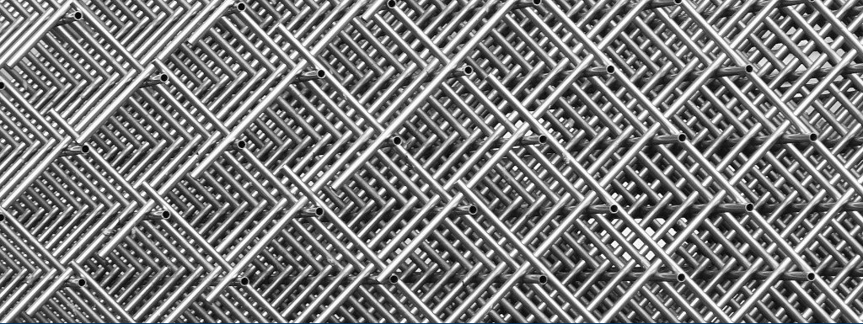
OGC API DGGS <<query>>
OGC API DGGS <<query>>
#OGCAPI

Slide 6
OGC API – DGGS DE9IM <<query>> operations in YAML
Overview
DE9IM <query-op> are: contains, crosses, disjoint, equals, intersects, overlaps, touches, within, withinDistance, relativePosition
General pattern: zone:ZonalIdentifier.<query-op> (another:ZonalIdentifier,projectTo:DirectPosition[4]), return True/False
Variations: zone:ZonalIdentifier.withinDistance (another:ZonalIdentifier,dist:Distance,projectTo:DirectPosition[4]), return True/False zone: ZonalIdentifier.relativePosition (another:ZonalIdentifier,projectTo:DirectPosition[4]), return RelativePosition where RelativePosition:{Before, After, Meets, MetBy, Overlaps, OverlappedBy, Starts, StartedBy, During, Contains, Finishes, FinishedBy, Equals, In, Disjoint}

Slide 7
OGC API DGGS <<set>>
OGC API DGGS <<set>>
#OGCAPI

Slide 8
OGC API – DGGS DE9IM <<set>> operations in YAML
Overview
DE9IM <set-op> are: buffer, difference, intersection, symDifference, union
General pattern: zone:ZonalIdentifier.<set-op> (another:ZonalIdentifier,rangeRefine:refinementLevelRange, projectTo:DirectPosition[4]), return a set or list of zones where refinementLevelRange is [maxRefinementLevel:minRefinementLevel]
Variations: zone:ZonalIdentifier.buffer (dist:Distance,projectTo:DirectPosition[4]), return a set or list of zones

Slide 9
OGC API DGGS <<reference>> etc
OGC API DGGS <<reference>> etc
#OGCAPI

Slide 10
OGC API – DGGS DE9IM <<reference>> and DGGS operations in YAML
Overview
DE9IM <reference-op> are: relate, relatePosition
DGGS-query operations are: parentOf, childOf, siblingOf
DGGS-set operations are: parent, child, sibling
Other operations are: distance

Slide 11
OGC API – DGGS DE9IM <<reference>> and DGGS operations in YAML
Overview
DE9IM <reference-op> are: relate, relatePosition
General pattern: zone:ZonalIdentifier.<reference-op> (another:ZonalIdentifier, reference, projectTo:DirectPosition[4]), and return True/False
Variations: for relate reference is a matrix:CharacterString of size 3x3, where all the members have values of T/F for relatePosition reference is relate:RelativePosition where RelativePosition:{Before, After, Meets, MetBy, Overlaps, OverlappedBy, Starts, StartedBy, During, Contains, Finishes, FinishedBy, Equals, In, Disjoint}

Slide 12
OGC API – DGGS DE9IM <<reference>> and DGGS operations in YAML
Overview
DE9IM DGGS-query operations are: parentOf, childOf, siblingOf
General pattern: zone:ZonalIdentifier.<dggs-query-op> (another:ZonalIdentifier,inheritID:Boolean,projectTo:DirectPosition[4]), return True/False

Slide 13
OGC API – DGGS DE9IM <<reference>> and DGGS operations in YAML
Overview
DGGS-set operations are: parent, child, sibling
General pattern: zone:ZonalIdentifier.<dggs-set-op> (another:ZonalIdentifier, inheritID:Boolean, rangeRefine:refinementLevelRange, projectTo:DirectPosition[4]), return a set or list of zones

Slide 14
OGC API – DGGS DE9IM <<reference>> and DGGS operations in YAML
Overview
other operations are: distance
General pattern: zone:ZonalIdentifier.distance (another:ZonalIdentifier, projectTo:DirectPosition[4]), return a Distance

