Slide 1
OGC API – Records – Part 1: Core
Panagiotis (Peter) A. Vretanos
118th OGC Member Meeting
Virtual | 24 March 2021
Notes:
<number>

Slide 2
Members: please record your attendance
1. Find the appropriate project
2. Go to the Attendance tab
3. Add yourself to the session

Slide 3
Agenda
Specification status
OGC API Records in 1 minute
Conformance classes
Query parameters (Core)
Record properties (Core)
Record access examples (Core)
Sorting (Sorting)
Advanced filtering (Filtering using CQL)
Output formats (JSON record, HTML record, ATOM record)

Slide 4
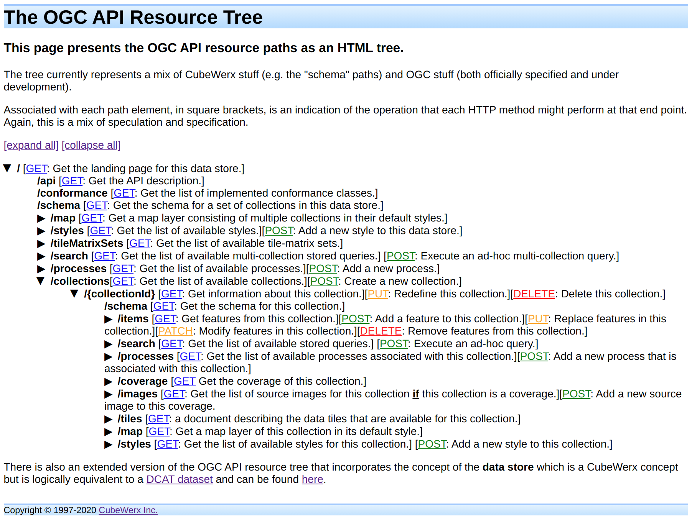
OGC API Tree (https://www.pvretano.com/Projects/tb16/ogcapi/)

Slide 5
Specification status
A specification about managing COLLECTIONS of RECORDs
A record is descriptive information about something that you want to make discoverable.
e.g. datasets/data collections, services, styles, ML models, widget, etc...
DRAFT OGC API - Records - Part 1: Core
Timeline
First labeled draft by end of April
OAB and RFC by the end of year
Adoption vote first quarter of 2022

Slide 6
OCG API Records in 1 minute
Assuming you are familiar with OGC API Features ...
OAPIR is basically OAPIF with ...
Additional query parameters: bbox, limit, datetime + q, type, externalid + extensions
A specified record model that is EXTENSIBLE
Encodings of the record model in: GeoJSON, HTML and ATOM.
There is also a parallel extension in the works …
… to make the /collections endpoint queryable using the records API

Slide 7
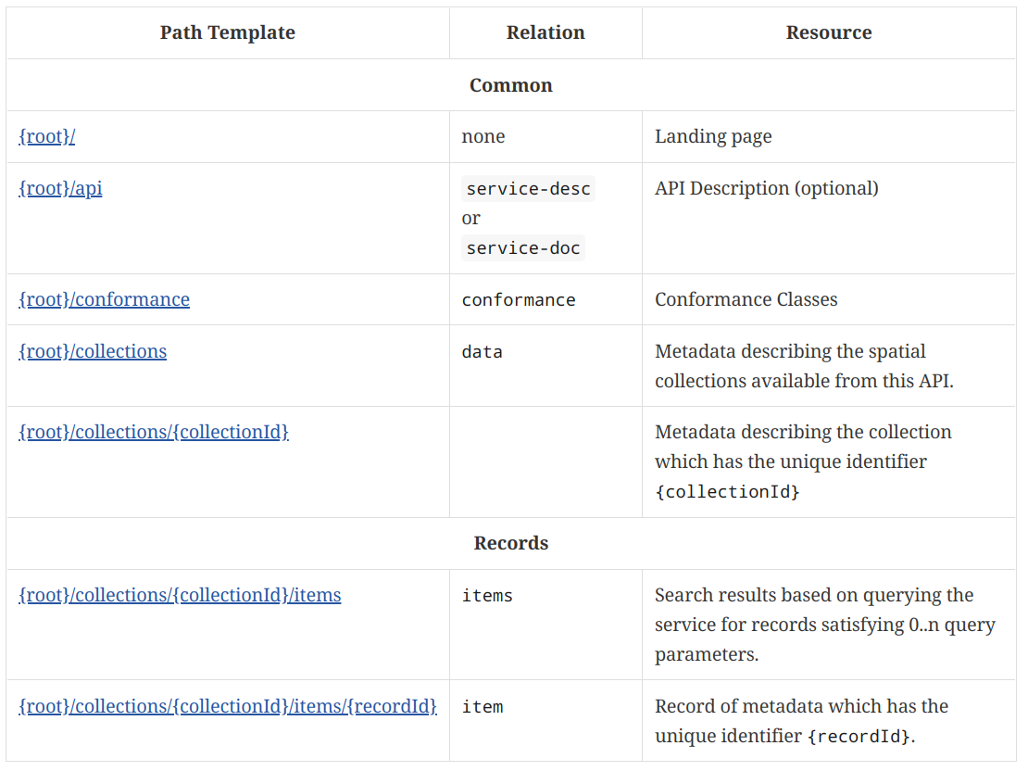
OCG API Records in 1 minute (PATHS)

Slide 8
OCG API Records in 1 minute
Assuming you are familiar with OGC API Features ...
OAPIR is basically OAPIF with ...
Additional query parameters: bbox, limit, datetime + q, type, externalid + extensions
A specified record model that is EXTENSIBLE
Encodings of the record model in: GeoJSON, HTML and ATOM.
There is also a parallel extension in the works …
… to make the /collections endpoint queryable using the records API

Slide 9
OCG API Records in 1 minute
Assuming you are familiar with OGC API Features ...
OAPIR is basically OAPIF with ...
Additional query parameters: bbox, limit, datetime + q, type, externalid + extensions
A specified record model that is EXTENSIBLE
Encodings of the record model in: GeoJSON, HTML and ATOM.
There is also a parallel extension in the works …
… to make the /collections endpoint queryable using the records API

Slide 10
Conformance classes
Core
Core query parameters, core record properties
Sorting
sortby parameter
Filtering with CQL
filter, filter-lang,filter-crs
OpenSearch
Record encodings
GeoJSON record, ATOM record, HTML record

Slide 11
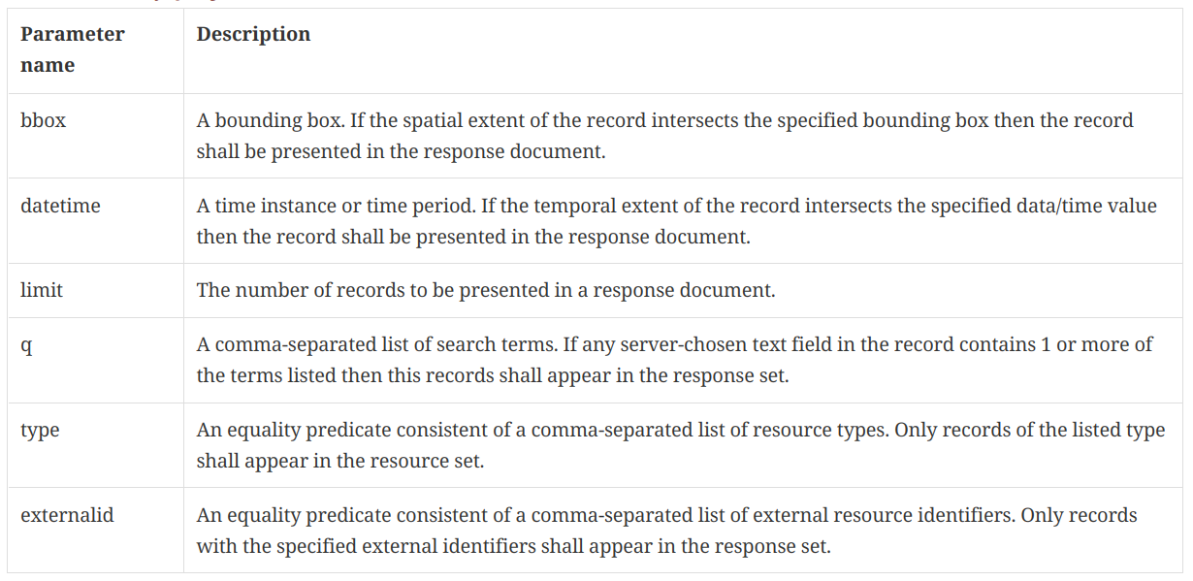
Query parameters (CORE)

Slide 12
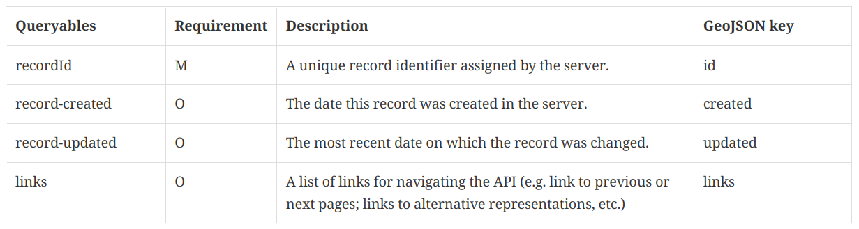
Record properties (CORE – record related)

Slide 13
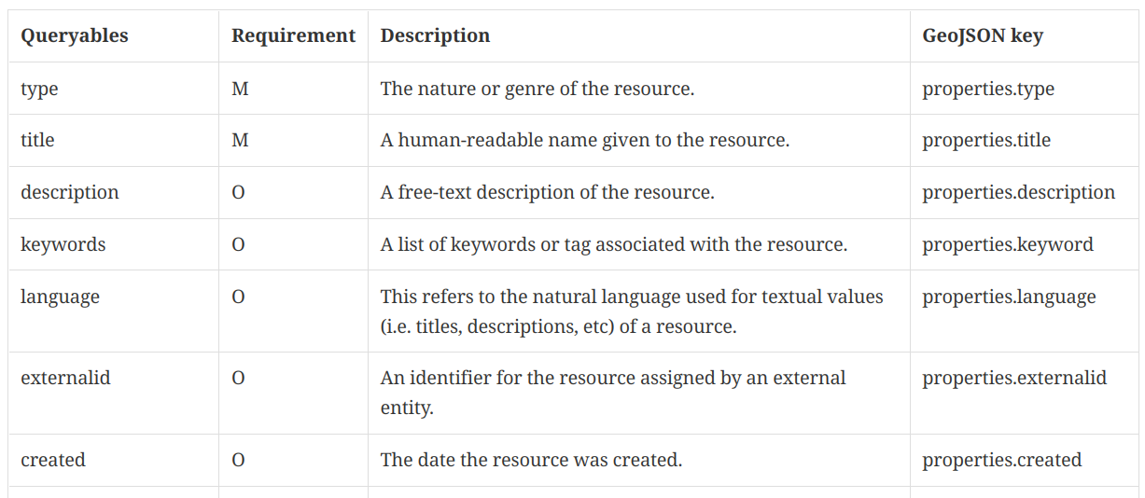
Record properties (CORE – resource related)

Slide 14
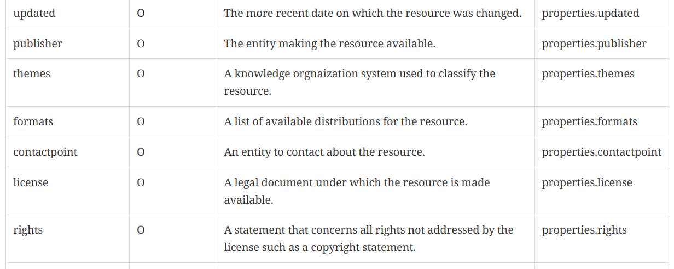
Record properties (CORE – resource related)

Slide 15
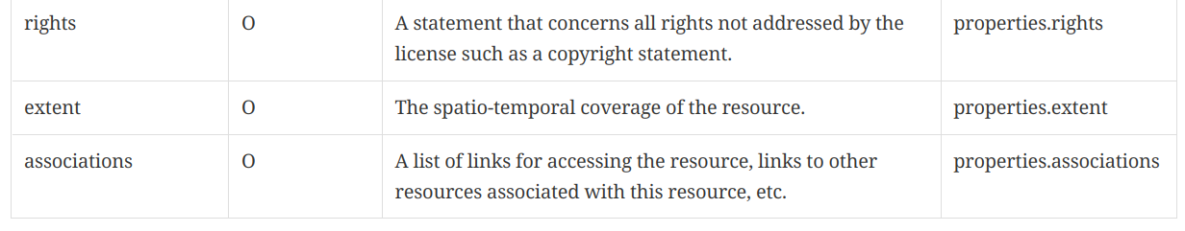
Record properties (CORE – resource related)

Slide 16
Record access
Records access:
/collections/sentinel1cat/items?limit=100&bbox=-69.64,37.76,-56.12,46.63&datetime=2020-01-11T00:00:00/2020-01-12T00:00:00
/collections/dutch-metadata/items?q=waterkwaliteit
Record access:
/collections/tb16cat/items/urn:uuid:452b6afc-c062-11ea-aa84-53b2ade463d0
/collections/dutch-metadata/items/FEB44D94AC0F3D26E0441CC1DE40A734?f=json

Slide 17
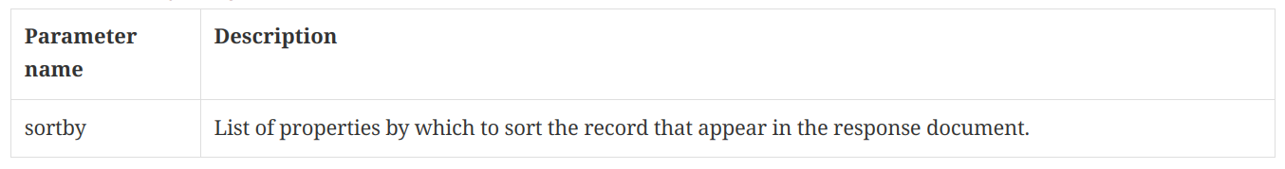
Sortby parameter (SORTING)
Example: /collections/sentinel1cat/items?...&sortby=-updated,recordId&...

Slide 18
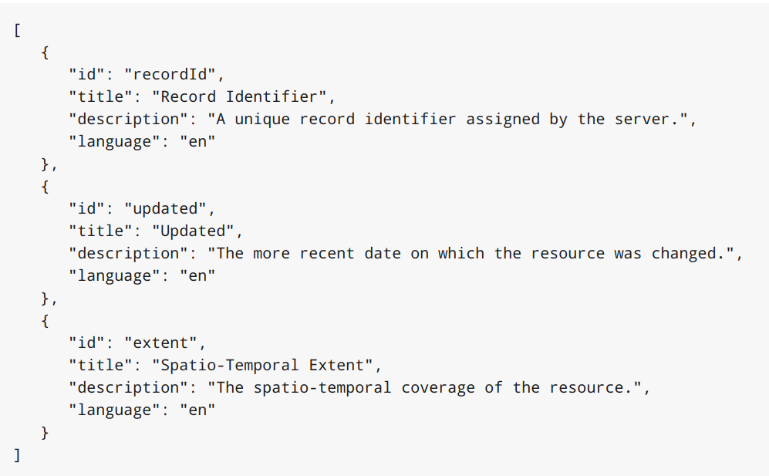
Sortables (SORTING)
List of sortables:
/collections/sentinel1cat/sortables

Slide 19
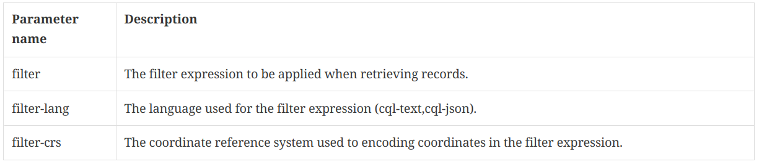
Filter parameters (CQL Filter)
CQL specification is here: https://docs.ogc.org/DRAFTS/19-079r1.html

Slide 20
OpenSearch description document (OpenSearch)
OpenSearch description document access path:
/collections/{collectionId}/api
Media type: application/opensearchdescription+xml
/collections/tb16cat/api

Slide 21
Output formats
GeoJSON
ATOM
HTML

