Slide 1
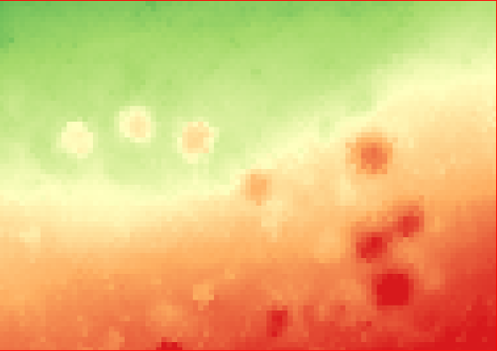
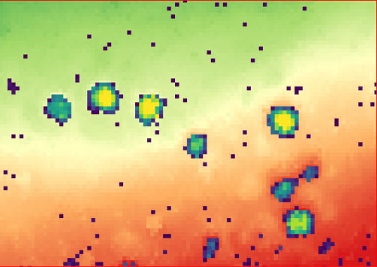
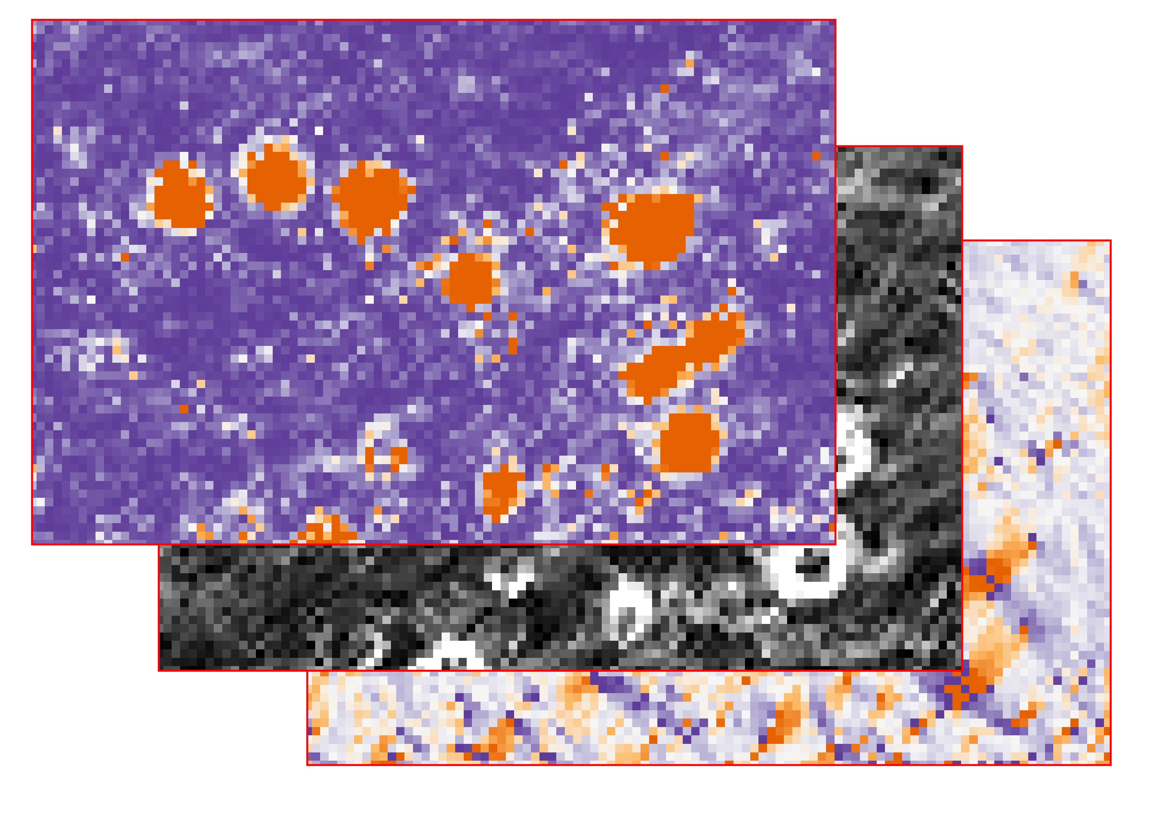
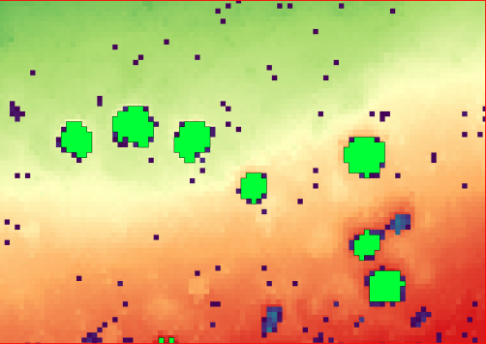
Workflow Data Preprocessing
Input: DEM from LIDAR data
Hollow detection
Value Extraction
CENITH FILL SINKS
Compute Sinks only Model (SOM)
LEGION DEM
Compute several artifically Raster Layers
CENITH HOLLOW SEGMENTATION
Generate polygons for each hollow form
REAVER EXTRACTION
Extract Values from artifically Raster Layers for each hollow form using the polygin Layer

Slide 2
Workflow Ordination and Clusteranalysis
Test Areas Training Areas Study Area
Workflow Data Preprocessing
All Areas will be preprocessed with the workflow Data Preprocessing
Test-Dataset Training-Dataset Study-Dataset
Testing Cluster Quality
REAVER HYPERSPACE
Performs Ordination and Clusteranalysis with 3 Clusters
Validated Training Dataset
Prediction
REAVER HYPERSPACE
Performs Ordination and Clusteranalysis with 3 Clusters
REAVER HYPERSPACE
Performs Ordination and Clusteranalysis with 3 Clusters

