Slide 1
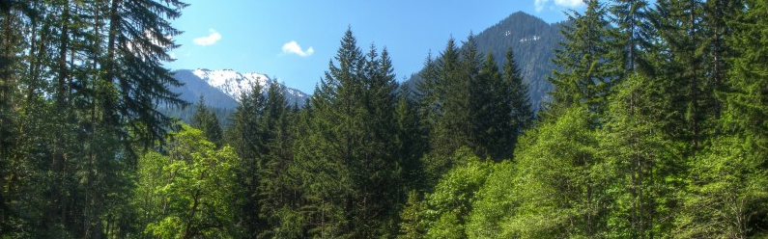
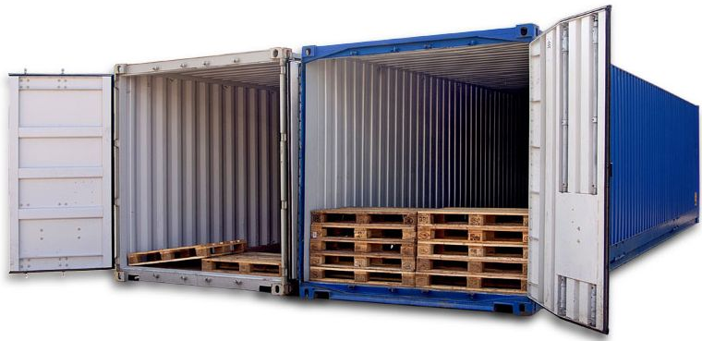
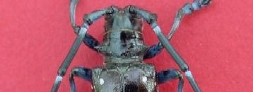
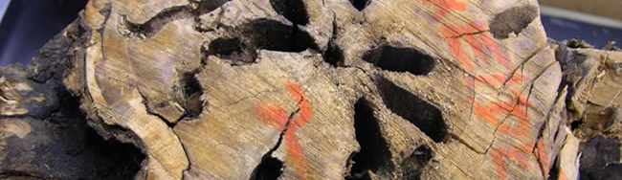


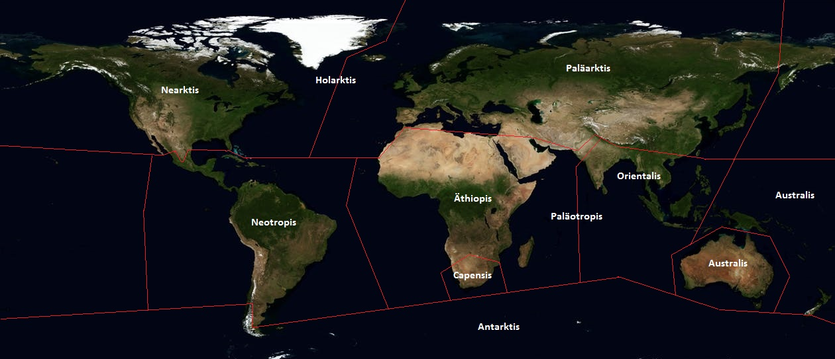
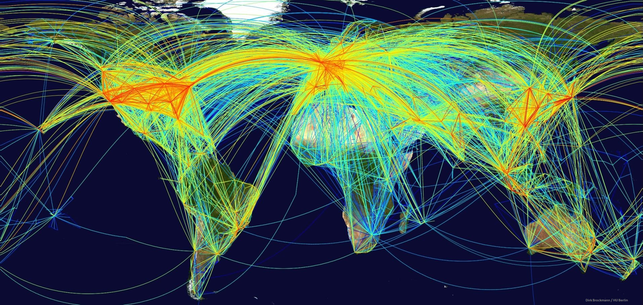
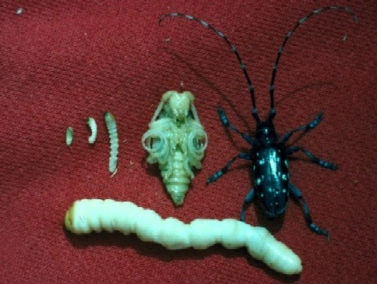
Philipps-Universität Marburg | FB 19 – Geographie | Globaler Wandel
Thorsten Nather | Alexander Schupp | Jan Schwalb | Andreas Schönberg
Bioinvasion – Distribution Patterns for Invasive Species on a Global Scale
Definition | Species are classified as invasive when they appear outside of their natural habitat and harm their newly occupied habitat in manners of ecosystems, biotopes, species or human health.^{9,15} This can happen either intentionally or unintenionally.⁷ A clear distinction between invasive species and non resident species or neobiota isn't always possible due to different focuses in fields of science and different main focuses in guidelines.⁹
Flora and Fauna
Native, naturalized and unsettled animals and plants
Importation of a species to an area outside of it's natural habitat with human influence
Native species
(in regards of nature conservancy and science)
Native/established species and archaeobiota
Accidentally
On purpose
Indigenous animals and plants
(regarding to e.g. BNatSchG)
= Native/established species, archaeobiota and established neobiota
Species remains in habitat or human sway
Introduced into nature trough
Native species
Established naturally before human intervention OR after due to climate changes and evolution
Non resident species
Established due to human intervention either on purpose or accidentally OR evolutionary emerged under participation of non native species
Escape
Liberation
Unsettled indigenous
Only occasionally and uncommon be found
Established indigenous species
Archaeobiota
Species introduced before 1492 and now established
Neobiota
Introduced after 1492
No establishing
No establishing
No establishing
For further information please scan the QR-Code with an appropriate device.
Established neobiota
Established over several generations or long time
Unsettled neobiota
Only occasionally and uncommon to be found
Establishing
After the import, invasive species tend to adapt and increase their numbers. Thus, they also enlarge their territory. As a result, the effects on native species and economy grows. In the final phase, all habitats in the new territory are occupied.¹⁵
Import
Not invasive
No ecological damage
Invasive
Generates ecological damage
Establishing and adaption
Invasion
own depiction based on Nentwig 2010 & Klingenstein et al. 2005
Repletion
Transport | Biological invasions strongly depend on human trade and transport.^{16, 14} First indicators for traiding between humans settlements can be described since the Neolithic.¹⁵ The further development of trading in times of the Roman empire lead to an sufficient transportation system all over Europe.²⁰ Three events linked the worlds floral and faunal realms like nothing before. The first impact took place in the year of 1492, with the end of the middle age in Europe, demographic changes and the discovery and colonization of the new world.³ From the 18th century onwards industrialization, the extension of infrastructure, higher mobility and emigration from europe made the world even smaller.^{2, 13} The third big impact is the modern day globalization and flow of goods in scales humankind have never seen before.^{11, 19}
own depiction based on UNCTAD 2019
own depiction based on Schmitt & Schmitt 2011.
Worldwide transportation | Through out the increasing quantity of transported goods and global distribution the risk of Bioinvasions has dramatically risen in the past decades. The map above demonstrates the main global trading routes. This includes all transportation options (e.g. airborne and seaborne). Local maxima can be oberserved in Europe, North America and Asia.
Flora and Fauna Realms | The figure above demonstrates the borders of the Flora and Fauna Realms on a satelliteborne world map. These borders are natural barriers like high mountains, oceans and deserts. Based on these barriers plants and animals are not able to overcome these obstacles. This results in an insurmountable seperation which can only be undermined by humankind and it's activities.
Example | The Asian Longhorn Beatle
Pathway
The Asian longhorn beetle is transported on infested fire wood, containers, pallets & dunage.
Has reached the United States and other countries in wood packing materials headed from Asia.
It is found frequently at ports and warehouses.
So far the occurance is limited to urban areas. ⁶
North America Impacts
30-35% of trees in urban eastern states are susceptible to its attack.
This could lead to a loss of 1.2 billion trees with an estimated value of $669 billion.
If the beetle reaches natural forests, the potential impact could reach to the elimination of 71 billion trees valued at over $2 trillion dollars.
In case of such an dramatic loss of trees, the whole forest ecosystems could be seriously damaged. ^{17, 21}
Nutrition
Adult Asian longhorn beetles feed on leaves, petiole and twigs preferred on hardwood trees.
They appear to attack healthy trees as well as stressed trees.
Eggs are injected under the bark surface, where they hatch into larvae.
The tunnels oft he larvaes destroy the structural integrety of the trees. ⁶
Management
Eradication programms were implemented by the US Animal and Plant Health Inspection Service (APHIS) by the use of insecticides.
Intensive visual inspections when the beetle is reported.
Trees at high risk are felled and chipped (400m from the edge of the known infestation).¹⁷
own depiction based on UNCTAD 2019 & Worldbank 2019
Development of Global Trading | Compared to 1970 the volume of seaborne transportation is five times higher and airborne passenger transportaion has even increased by the factor of ten.^{22, 23} About 90% of total international transportation of goods is carried out by seaway⁵, while ballast water from cargo ships alone transfers high amounts of species alone.^{18, 4} The key to handle such massive amounts of goods is the invention of the standardized ship container and huge improvements in mechanical engineering.^{1, 10} While cargo transfer via plane takes a minor part for world economy, many invasive species are transfereed with luggage of passengers.^{5, 12} Thus, the chances for bioinvasions had dramatically increased by overcoming natural borders of the floral realms.
¹Cudahy, B. J. (2006): The Containership Revolution. Malcom McLean's 1956 Innovation Goes Global. Transportation Research News 246. 5-9. ²Findlay, R. & O'Rourke, K. H. (2007): Power and Plenty: Trade, War and the World of Economy in the Second Millenium. Princeton University Press, Princeton, NJ. USA. ³Geiter, O., Homma, S., Kinzelbach, R. (2002): Bestandsaufnahme und Bewertung von Neozoen in Deutschland. Berlin. ⁴Hulme, P.E., Bacher, S., Kenis, M., Klotz, S., Kuhn, I., Minchin, D., Nentwig, W., Olenin, S., Panov, V., Pergl, J., Pyßek, P., Roques, A., Sol, D., Solarz, W. & Vila, M. (2008): Grasping at the routes of biological invasions: a framework for integrating pathways into policy. Journal of Applied Ecology, 45, 403–414. ⁵Hulme, P. E. (2009): Trade, transport and trouble: managing invasive species pathways in an era of globalization. Journal of Applied Ecology 46. 10-18. ⁶Invasive Species Specialist Group (ISSG) (2009): Global Invasive Species Database. < http://www.iucngisd.org/gisd/species.php?sc=111 > (Zugriff: 28.01.2019) ⁷IUCN (2000): Guidelines for the Prevention of Biodiversity Loss Caused by Alien Invasive Species. International Union for the Conservation of Nature, Gland, Switzerland. ⁸Klingenstein, F., Kornacker, P. M.m Martens, H., Schippmann U. (2005): Gebietsfremde Arten. Positionspapier des Bundesamtes für Naturschutz. Bonn. ⁹Kowarik, I. (2010)²: Biologische Invasionen. Neophyten und Neozoen in Mitteleuropa. Ulmer, Stuttgart. ¹⁰Levinson, M. (­­­2006): The Box. How the Shipping Container Made the World Smaller and the World Economy Bigger. Princeton/Oxford. ¹¹Lodge, D. M., Williams, S., MacIsaac, H.J., Hayes, K.R., Leung, B., Reichard, S., Mack, R.N., Moyle, P.B., Smith, M., Andow, D.A., Carlton, J.T. & McMichael, A. (2006): Biological invasions: Recommendations for US policy and management. Ecological Applications, 16, 2035–2054. ¹²McCullough, D.G., Work, T.T., Cavey, J.F., Liebhold, A.M. & Marshall, D. (2006): Interceptions of nonindigenous plant pests at US ports of entry and border crossings over a 17-year period. Biological Invasions, 8, 611–630. ¹³McNeeley, J. A. (2006): As the World gets smaller, the chances of invasion grow. Euphytica 148, 5-15. ¹⁴Meyerson, L.A. & Mooney, H.A. (2007): Invasive alien species in an era of globalization. Frontiers in Ecology and the Environment, 5, 199–208. ¹⁵Nentwig, N. (2010): Invasive Arten. Göttingen. ¹⁶Perrings, C., Dehnen-Schmutz, K., Touza, J. & Williamson, M. (2005) How to manage biological invasions under globalization. Trends in Ecology & Evolution, 20, 212–215. ¹⁷Smith, M.T. & Wu, J. (2008): Asian longhorned beetle: renewed threat to northeastern USA and implications worldwide. International Pest Control (November-December): 311-316. ¹⁸Streftaris, N., Zenetos, A. & Papathanassiou, E. (2005) Globalisation inmarine ecosystems: The story of non-indigenous marine species across European seas. Annual Review of Oceanography and Marine Biology, 43, 419–453. ¹⁹Sutherland, W.J., Bailey, M.J., Bainbridge, I.P., Brereton, T., Dick, J.T.A., Drewitt, J., Dulvy, N.K., Dusic, N.R., Freckleton, R.P., Gaston, K.J., Gilder, P.M., Green, R.E., Heathwaite, A.L., Johnson, S.M., Macdonald, D.W., Mitchell, R., Osborn, D., Owen, R.P., Pretty, J., Prior, S.V., Prosser, H., Pullin, A.S., Rose, P., Stott, A., Tew, T., Thomas, C.D., Thompson, D.B.A., Vickery, J.A., Walker, M., Walmsley, C., Warrington, S., Watkinson, A.R., Williams, R.J., Woodroffe, R. & Woodroof, H.J. (2008): Future novel threats and opportunities facing UK biodiversity identiﬁed by horizon scanning. Journal of Applied Ecology, 45, 821–833. ²⁰Teichner, F., Stähler, C. M. (2016): Fischsoßen und die maritime Wirtschaft Roms. In: Archäologie in Deutschland 6/2016. 56-59 ²¹United States Government Accountability Office (GAO) (2006): Report to the Chairman, Committee on Resources, House of Representatives. Lessons Learned from Three Recent Infestations May Aid in Managing Future Effort. ²²UNCTAD (2019): United Nations Conference On Trade And Development – Database.<http://unctadstat.unctad.org/wds/ReportFolders/reportFolders.aspx?sCS_ChosenLang=en> ²³Worldbank (2019): World Bank Open Data. <https://databank.worldbank.org/data/home.aspx> ²⁴Schmitt, E. & Schmitt, T. (2011): Arealkunde. In: Gebhardt, H., Glaser, R., Radtke, U., Reuber, P. (Hrsg.): Geographie. Physische Geographie und Humangeographie. 522-531. Heidelberg.

