Slide 1
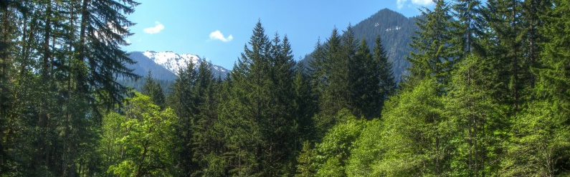
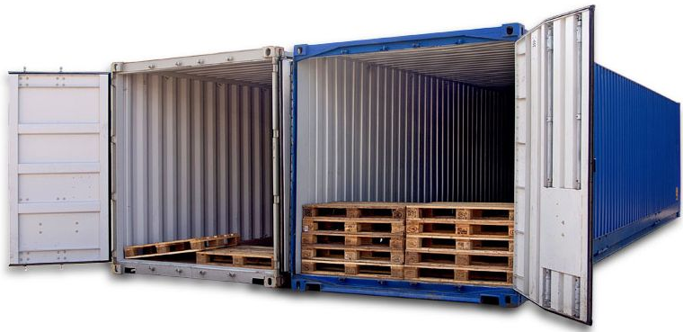
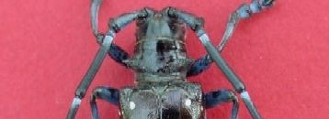
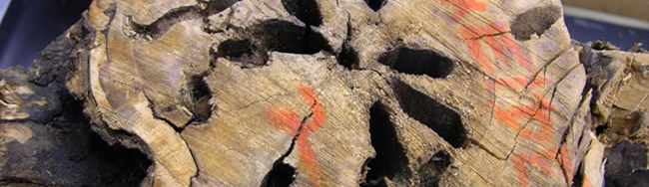
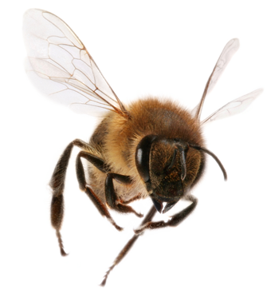
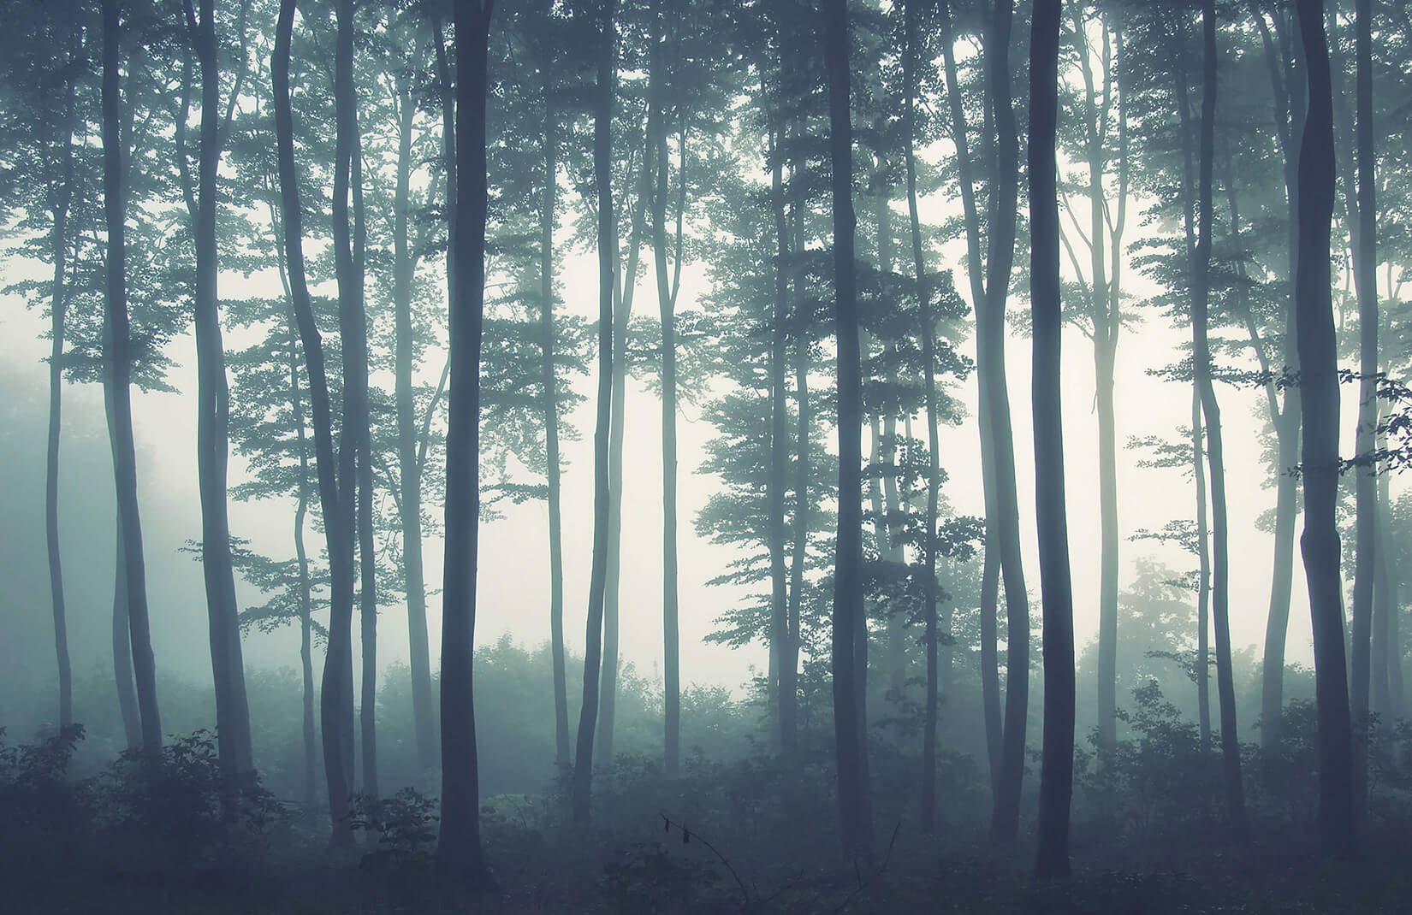
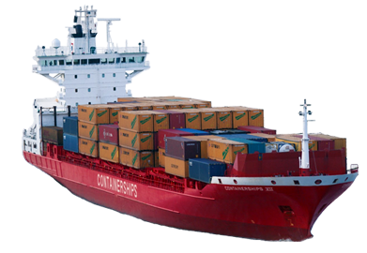
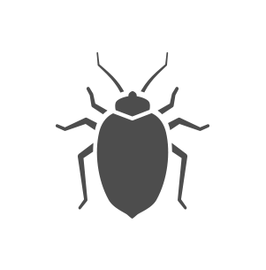
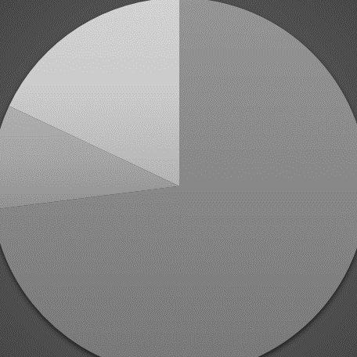
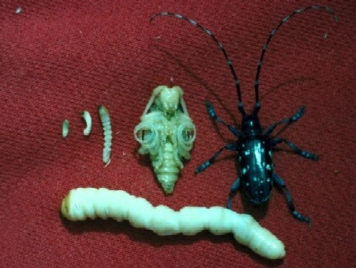
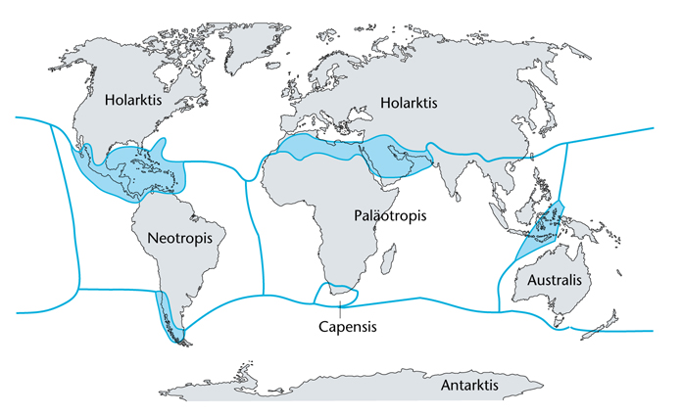
Philipps-Universität Marburg | FB 19 – Geographie | Globaler Wandel
Thorsten Nather | Alexander Schupp Jan Schwalb | Andreas Schönberg
Invasive Species – coherences on a global scale
Definition
Species are classified as invasive when they appear outside of their natural habitat and harm their newly occupied habitat in manners of ecosystems, biotopes or species (KOWARIK 2003 nach BNatschG §7).
Flora and Fauna
Native, naturalized and unsettled animals and plants
Importation of a species to an area outside of it's natural habitat with human influence
Native species
(in regards of nature conservancy and science)
Native/established species and archaeobiota
accidentally
On purpose
Indigenous animals and plants
(in regards of of e.g. BNatSchG)
= native/established species, archaeobiota and established neobiota
Species remains in habitat or human sway
Introduced into nature trough
Native species
Established naturally before human intervention OR after due to climate changes and evolution
Non resident species
Established due to human intervention either on purpose or accidentally OR evolutionary emerged under participation of non native species
escape
liberation
Unsettled indigenous
Only occasionally and uncommon be found
Established indigenous species
Archaeobiota
Species introduced before 1492 and now established
Neobiota
Introduced after 1492
No establishing
No establishing
No establishing
Established neobiota
Established over several generations or long time
Unsettled neobiota
Only occasionally and uncommon to be found
Establishing
After the import, invasive species tend to adapt and increase their numbers. Thus, they also enlarge their territory. As a result, the effects on native species and economy grows. In the final phase, all habitats in the new territory are occupied. (Nentwig 2010)
Import
Not invasive
No ecological damage
Invasive
Generates ecological damage
Establishing and adaption
Invasion
Repletion
Trade
own depiction based on Nentwig 2010 & Klingenstein et al. 2005
Biological invasions strongly depend on human trade and transport. (Hulme 2009) Exchange of goods took place since humans developed settled cultures in the neolithic (Nentwig 2010). Even trade over bigger distances took place, like in the roman empire (Teichner & Stähler 2016). But 3 events linked the worlds floral and faunal realms like nothing before. The first impact took place in the year of 1492, with the end of the middle ages in Europe, demographic changes and the discovery and colonization of the new world (Preston et al. 2004). From the 18th century onwards industrialization, the extension of infrastructure, higher mobility and emigration from europe made the world even smaller (Findlay & O'Rourke 2007; Mc Neeley 2006) . The third big impact is the modern day globalization and flow of goods in scales humankind have never seen before. (Lodge et al 2006; Sutherland et al. 2008)
own depiction based on Cudahy 2006
own depiction based on UNCTAD 2019
own depiction based on Worldbank 2019
The key to handle such huge amounts of goods traded worldwide is the invention of the standardized ship container (TEU) in 1956. This, and great improvements in mechanical engineering has led to enourmous transport capacitys per ship. (Levinson 2006; Cudahy 2006)
Since 1970, there is a huge growth in pace and bulk in seaborne trade. About 90% of total world trade is handled via sea. The international fleet today includes about 50.000 ships. (Hulme 2009) But that aside, ballast water alone transfers up to 10000 species a day. (Streftaris et al 2005); Hulme et al 2008)
Despite a minor part in regard of total trade worldwide, aviation today is the major kind of transportation for passengers worldwide. A high amount of invasive species is transported with lugagge from passengers and cargo. (Hulme 2009)
Containerization
Aviation
Example – The asian longhorn beetle
Between the years 1984 and 2000, 73% of all alien species in the US were introduced via airports. (McCollough et al. 2006). So, the relation in terms of numbers between seaports, airports and other infrastructures is a big factor when it comes to the amount and type of introduced species and also the reach into global regions. (Hulme 2009)
Other
Pathway
The Asian longhorn beetle is transported on infested fire wood, containers, pallets & dunage.
Has reached the USA and other countries is in wood packing materials.
Intercepted frequently at ports and found in warehouses throughout the United States.
General Impacts
It attacks hradwood tree species in the eastern part oft he US (discovered in 1996).
Eggs are injected under the bark surface, where they hatch into larvae.
The tunnels oft he larvaes destroy the structural integrety oft he trees.
Seaports
Airports
Nutrition
Adult Asian longhorn beetle feed on leaves, petiole and twigs
They appear to attack healthy trees (under investigation), as well as stressed trees.
North America Impacts
30-35% of trees in urban eastern states are susceptible to its attack.
Urban areas could lose as much as 35 percent of their tree canopy cover and 30 percent of their trees (1.2 billion trees) (Billion = Milliarde! :D) loss of value of $669 billion.
The potential impact to forests is the loss of 71 billion trees valued at over $2 trillion dollars, if the beetle reaches natural forests (Trillion = Billion!)
Also the production of maple syrup and tourism is at risk.
The loss of trees may also decrease property values, cause aesthetic damage and lessen environmental benefits such as cleaning air and water and providing energy-conserving shade.
Managment
Eradication programme implemented by the US Animal and Plant Health Inspection Service (APHIS)
Intensive visual inspections when the beetle is reported.
Trees at high risk are felled and chipped (400mtrs from the edge of the known infestation)
Using the systemic insecticide, imidacloprid, which has been shown to kill adult beetles.
References:

