Slide 1
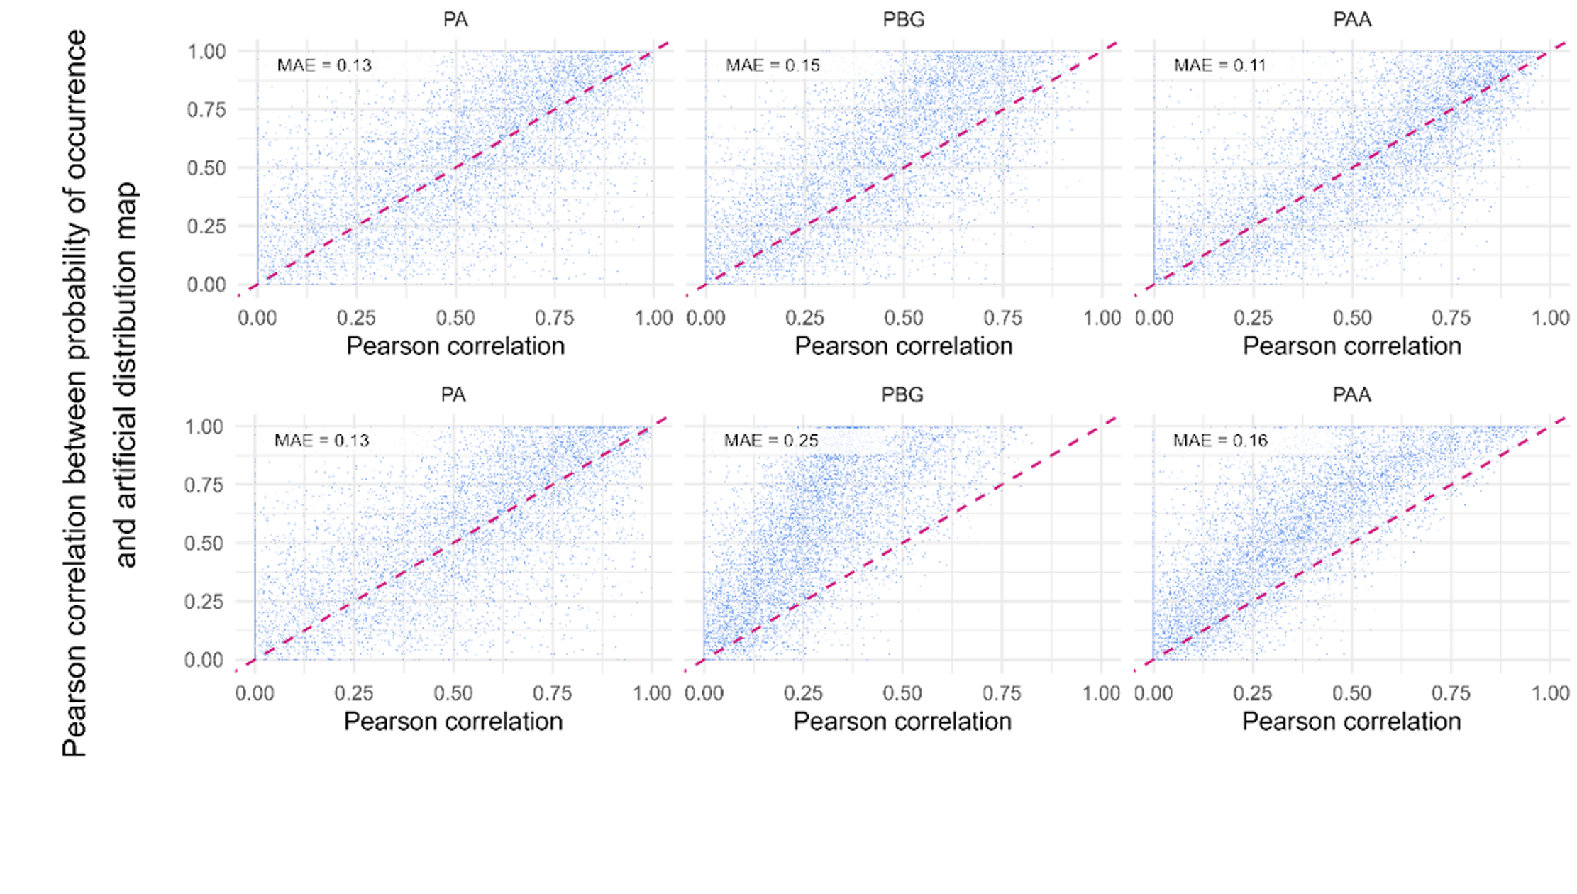
Balanced data 1:1
Imbalanced data 1:10

Slide 2
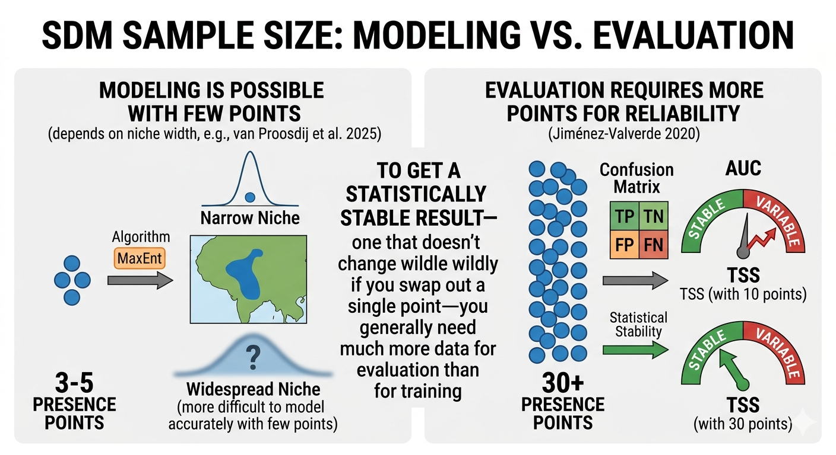
Modelling
Testing
More stable evaluation metrics with more points

Slide 3
