Slide 1
“Dynamics of proteobacterial and recently-discovered taxa in the biogeochemistry of the South Wales coalfield”
Soares, A.1,2,3, Rassner, S.1,3, Edwards, A.2,3, Farr, G.4, Mitchell, A.1
1 – Department of Geography and Earth Sciences (DGES), Aberystwyth University
2 – Institute of Biological, Environmental & Rural Sciences (IBERS), Aberystwyth University
3 – Interdisciplinary Centre for Environmental Microbiology (ICEM), Aberystwyth University
4 – British Geological Survey (BGS), Cardiff
The South Wales coalfield is now a mostly inactive mining region spanning 2200km2 and makes up a large-scale complex hydrogeological network reaching depths of -60m to -1800m from east to west. Characteristically iron-rich, pH neutral groundwater outflows feed the hydrographical basin at rates up to 3000L/s, varying in temperature and geochemistry. Being the largest coalfield in the UK, it’s been shown to be able to hold 150Mt of carbon dioxide.
In this study, triplicate samples of 1L of groundwater were collected across 13 sites in the South Wales coalfield in April, August and December 2016, filtered and had DNA extracted. The v3v4 region of the 16S rRNA gene was then amplified and sequenced using Illumina MiSeq next-generation technology. 70,937 sequence variants (SV’s) corresponding to 9,656,492 reads (68.3% of trimmed, demultiplexed reads) were found following DADA2 processing.
While Proteobacteria were found to generally dominate all sites, recently-discovered phyla Parcubacteria, Omnitrophica and Woesearchaeota followed in abundance. Different β- and ε-proteobacterial taxa defined most of the iron- and sulfur-rich community profiles, respectively. Genera Sideroxydans and Gallionella (β-Proteobacteria, Nitrosomonadales, Gallionellaceae) co-dominated iron-rich sites albeit both being known as aerobic iron-reducing taxa. In sulfur-rich sites however, family Helicobacteraceae composed the vast majority of the community profiles.
In-depth understanding of biogeochemical cycling in the South Wales coalfield relies on defining the temporal and geographical functional dynamics of planktonic microbial communities inhabiting its groundwater. The metabolic response of native microbial communities may significantly impact the success of future long-term carbon dioxide geosequestration experiments in this region.

Slide 2
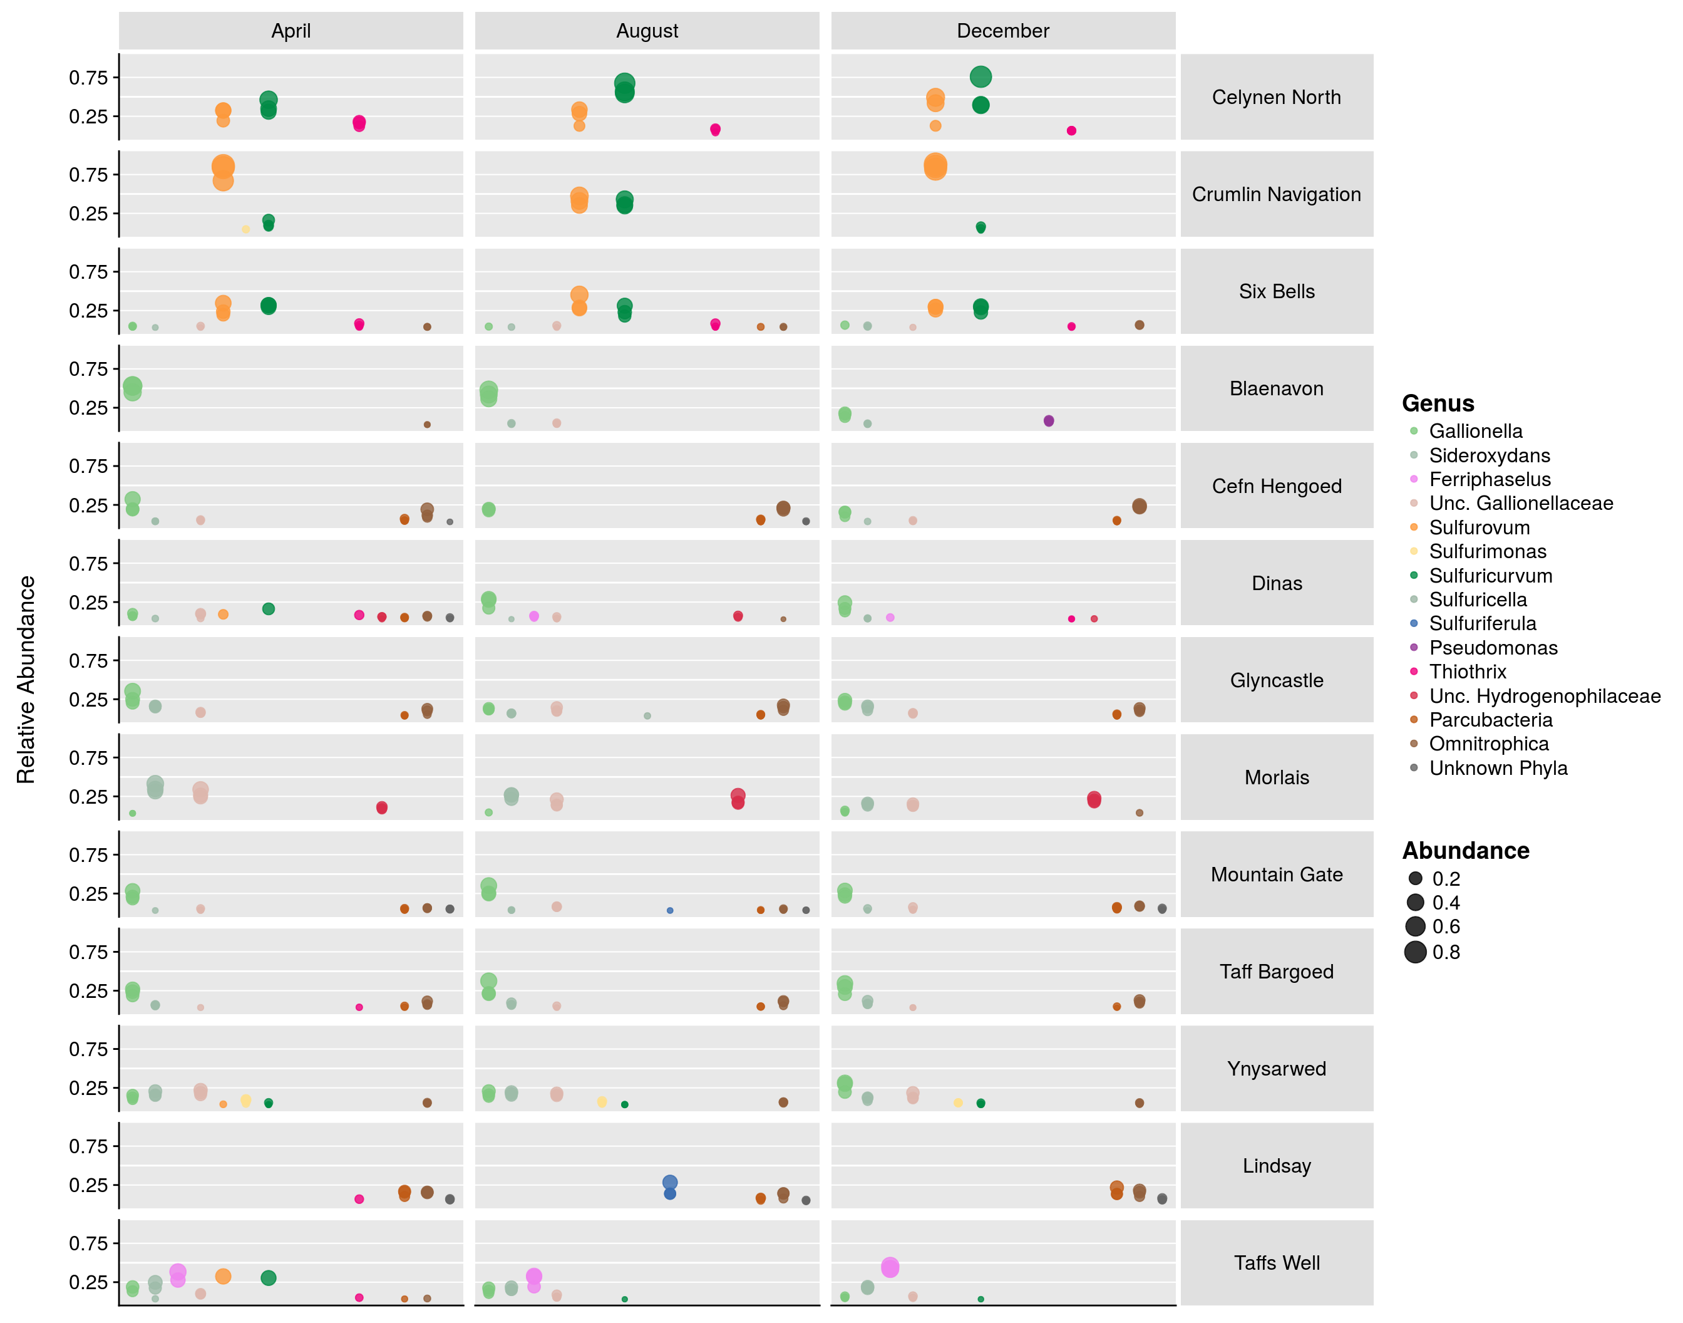
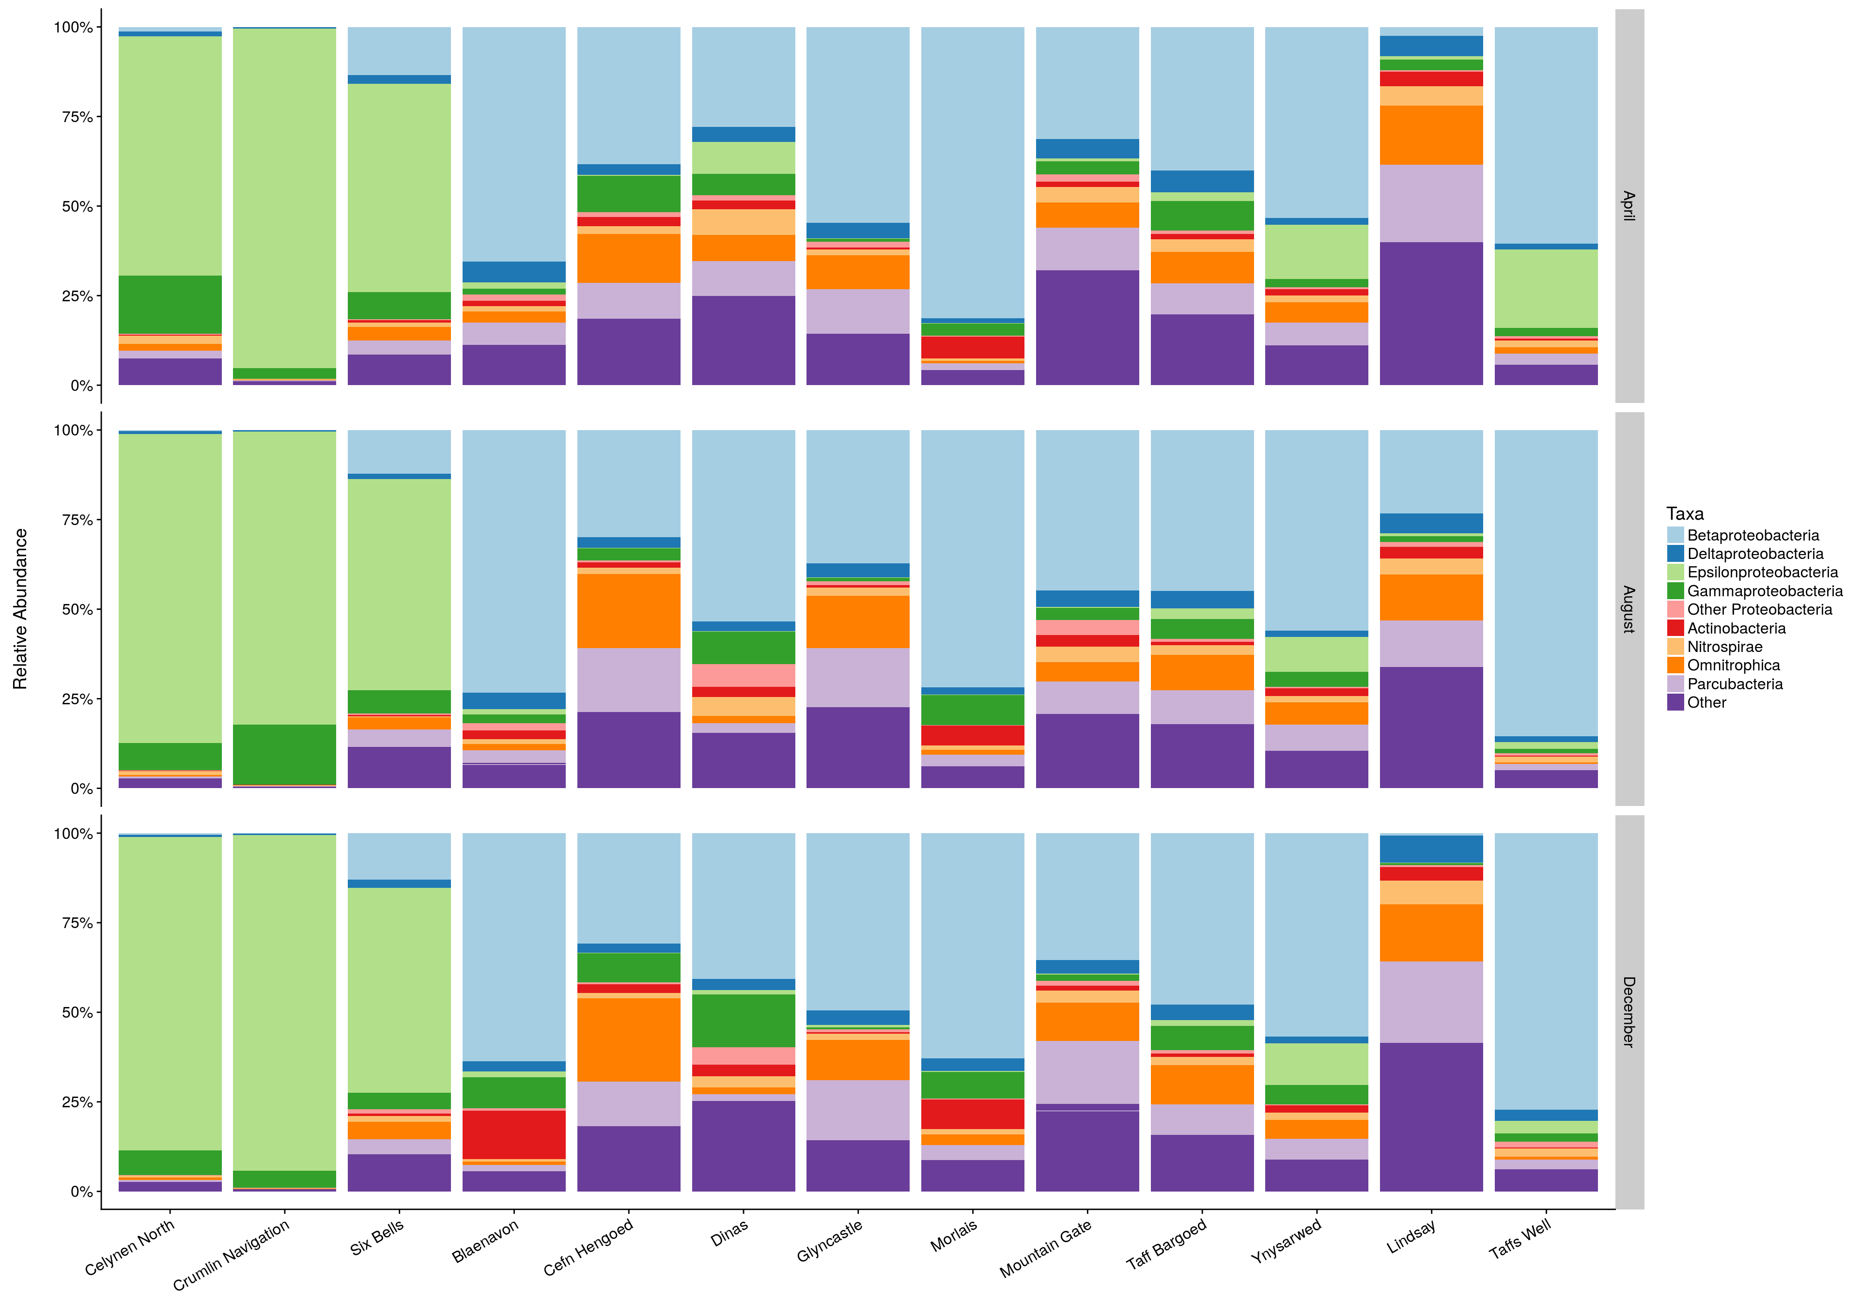
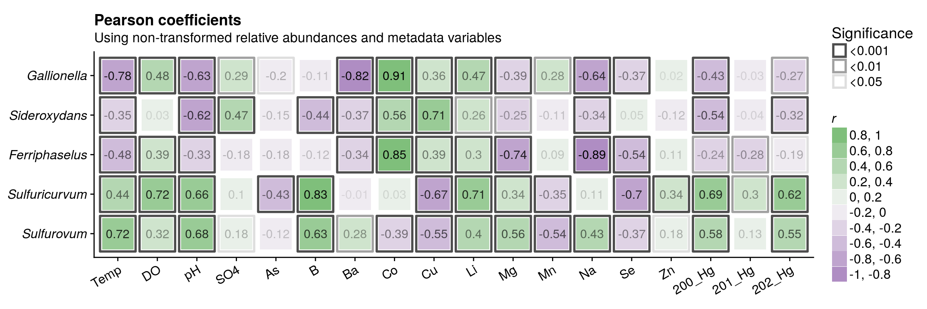
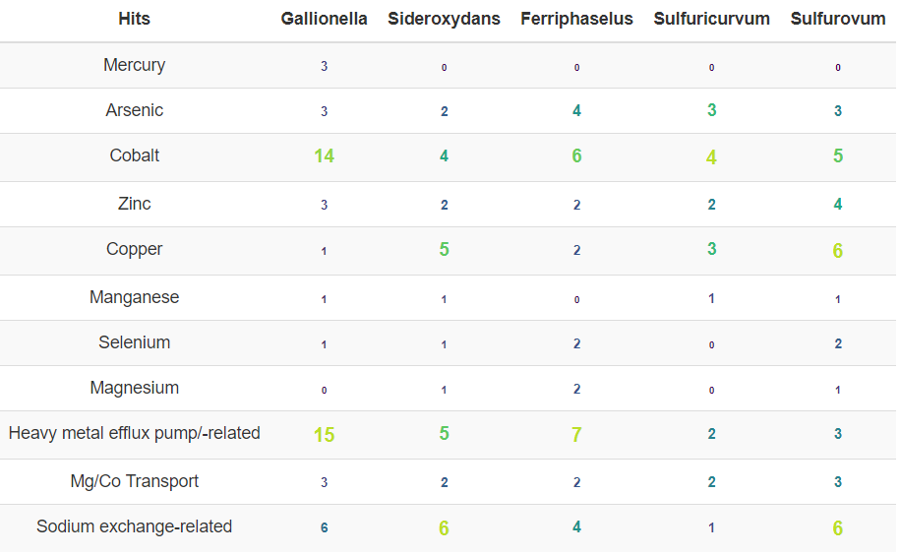
Co-dynamics of Proteobacterial and CPR taxa
in the South Wales coalfield
Soares, A.^{1,2,3}, Rassner, S.^{1,3}, Edwards, A.^{2,3}, Farr, G.⁴, Mitchell, A.¹
The South Wales coalfield is now a mostly inactive mining region spanning 2,200km2 and makes up a large-scale complex hydrogeological network reaching depths of -60m to -1800m from east to west. Characteristically iron-rich, pH neutral groundwater outflows feed the hydrographical basin at rates up to 3000L/s, varying in temperature and geochemistry. Being the largest coalfield in the UK, it’s been shown to be able to hold 150Mt of carbon dioxide.
In this study, triplicate samples of 1L of groundwater were collected across 13 sites in the South Wales coalfield in April, August and December 2016, filtered and had DNA extracted. The v3v4 region of the 16S rRNA gene was then amplified and sequenced using Illumina MiSeq next-generation technology. 70,937 sequence variants (SV’s) corresponding to 9,656,492 reads (68.3% of trimmed, demultiplexed reads) were found following DADA2 processing.
While Proteobacteria were found to generally dominate all sites, recently-discovered phyla Parcubacteria and Omnitrophica followed in abundance. Different β- and ε-proteobacterial taxa defined most of the iron- and sulfur-rich community profiles, respectively. Genera Sideroxydans and Gallionella (β-Proteobacteria, Nitrosomonadales, Gallionellaceae) co-dominated iron-rich sites albeit both being known as microaerophilic iron-reducing taxa. In sulfur-rich sites however, Sulfuricurvum and Sulfurovum genera (ε-Proteobacteria, Campylobacterales, Helicobacteraceae) composed the vast majority of the community profiles.
In-depth understanding of biogeochemical cycling in the South Wales coalfield relies on defining the temporal and geographical functional dynamics of planktonic microbial communities inhabiting its groundwater. The metabolic response of native microbial communities may significantly impact the success of future long-term carbon dioxide geosequestration experiments in this region.
1 - ε-, β-Proteobacterial genera dominate taxonomic profiles.
Proteobacteria composed XX% of the dataset, with XXXX and XXXX SV’s assigned to ε- and β-Proteobacteria, which dominated sulfur- and iron-rich sites, respectively. Genera Gallionella, Sideroxydans, Ferriphaselus, Sulfuricurvum and Sulfurovum composed most of the class-level proteobacterial diversity.
¹ Department of Geography and Earth Sciences (DGES), Aberystwyth University
² Institute of Biological, Environmental & Rural Sciences (IBERS), Aberystwyth University
³ Interdisciplinary Centre for Environmental Microbiology (ICEM), Aberystwyth University
⁴ British Geological Survey (BGS), Cardiff
Figure 1: Relative abundance barchart of phylum- and class-level taxonomy in the South Wales coalfield across the 13 sites sampled. Facets depict months in which sampling took place.
Figure 2: Relative abundance barchart of order- and genus-level taxonomy in the South Wales coalfield across the 13 sites sampled for selected taxa.
While Sulfuricurvum and Sulfurovum co-occurred, Gallionella dominated most iron-sites with Sideroxydans and Ferriphaselus prevailed only in two sites respectively.
2 – Genus-level proteobacterial co-dynamics may be explained by heavy-metal resistance-related genomic adaptations.
Strong positive correlations were found for the presence of Gallionella and Ferriphaselus and cobalto concentrations. In the case of Gallionella, this was corroborated by the presence of cobalt efflux-related genes in a deposited genome.

