Slide 1
The OpenQuake Platform
Armando Scarpati
Global Eathquake Model Foundation (GEM)
Pavia (Italy)
Geonode Summit
11–13 June 2019, Viareggio (Italy)

Slide 2


About Us
Global Earthquake Model Foundation (GEM)
GEM is a not-for-profit foundation that drives a global collaborative effort to assess earthquake risk around the globe.
OpenQuake (OQ)
Comprised of the engine, platform and tools - caters to a variety of users, from modellers and researchers to emergency planners - OpenQuake is used for a wide range of purposes for disaster risk reduction and management.
The OpenQuake Platform
Offers an interactive environment in which users can access, manipulate, and share data, and explore models and tools for integrated assessment of earthquake risk.
Notes:
Includes ...

Slide 3










Stack Software – Platform
GeoNode 2.6.3, GeoServer2.9
Ubuntu 16.04, Python 2.7
Django 1.8.7
Postgresql 9.5, Postgis 2.2
Github, Gitlab
Jenkins, Selenium
Notes:
Ciao

Slide 4
QGIS and Platform Integration
OpenQuake Integrated Risk Modelling Toolkit (IRMT)
The plugin on QGIS where is possible to connect and upload a project including layers, style and socio-economic data. plugins.qgis.org/plugins/svir
Integrated Risk Viewer (IRV)
Application on the OpenQuake Platform for opening projects imported by IRMT. github.com/gem/oq-platform2
Notes:
Includes ...

Slide 5
Testing – Platform
We test everyday the development and production installations with:
Jenkins ci.openquake.org
Continous integration and facilitating technical aspects of continous delivery.
Selenium Python
Open-source web-based automation tool written in Python.
OqMoon github.com/gem/oq-moon
GEM interface between 'selenium' and 'nose' plus commodities and utilities to speed up tests development
Notes:
Engine calc
Console or via qgis
Input by hand or web-application

Slide 6
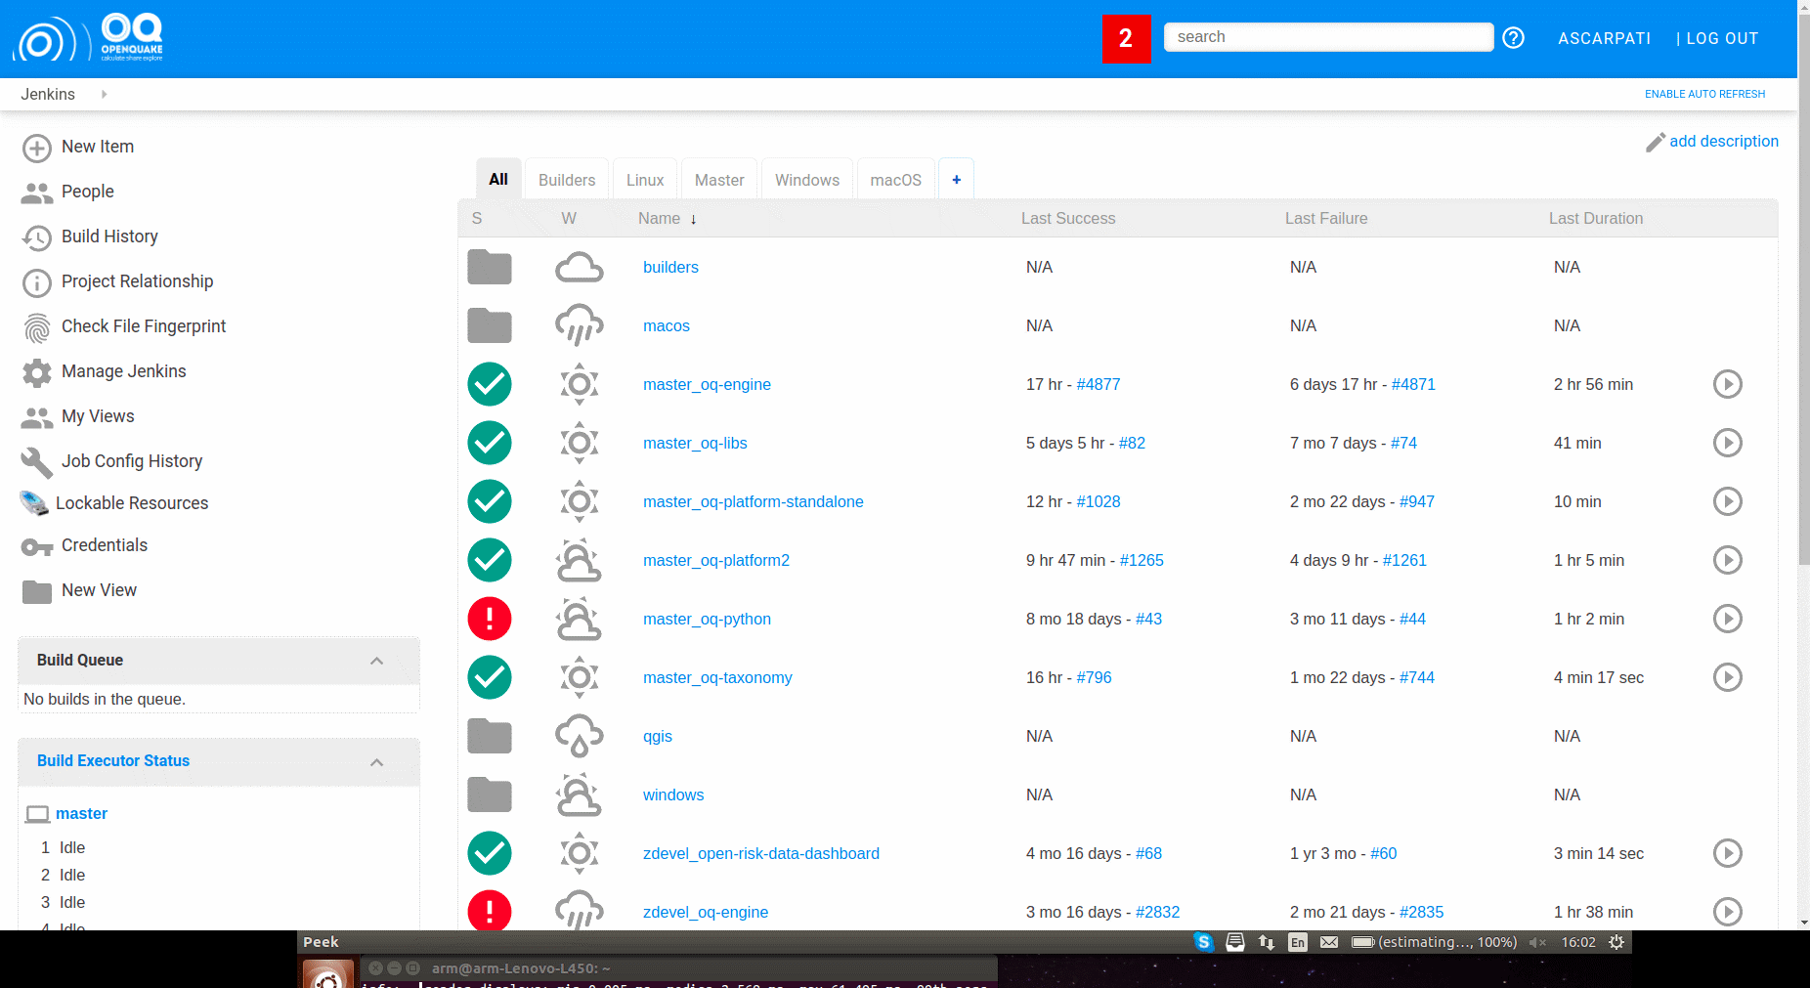
Jenkins – Platform
Notes:
Engine calc
Console or via qgis
Input by hand or web-application

Slide 7
Thank You! For More Information
Web: platform.openquake.org
GitHub: github.com/gem/oq-platform2
Support: groups.google.com/forum/#!forum/openquake-users
IRC: irc.freenode.net, channel #openquake
Twitter: @gem_devs
Email: info@openquake.org
Some questions ?
Notes:
Engine calc
Console or via qgis
Input by hand or web-application

