Slide 1
Daily Permit Tracking
Bakken NDIC
5-30-2023

Slide 2
Daily Permit Tracking
Process Overview

Slide 3
Daily Process Overview
Bring up the Bakken Web map for reference.
Open the NDIC Website and Navigate to Daily Permits Report
Review the Daily Permit report and compare to the Web map
If there is COPC interest in the section described, you will need to report it to the team.
If there is a SWD it will need to be reported to the team.
If you have a “hit” from 4 or 5, turn on the AOR and determine which Negotiator is responsible.
If need be, Open up Outlook and draft an email to the appropriate parties.

Slide 4
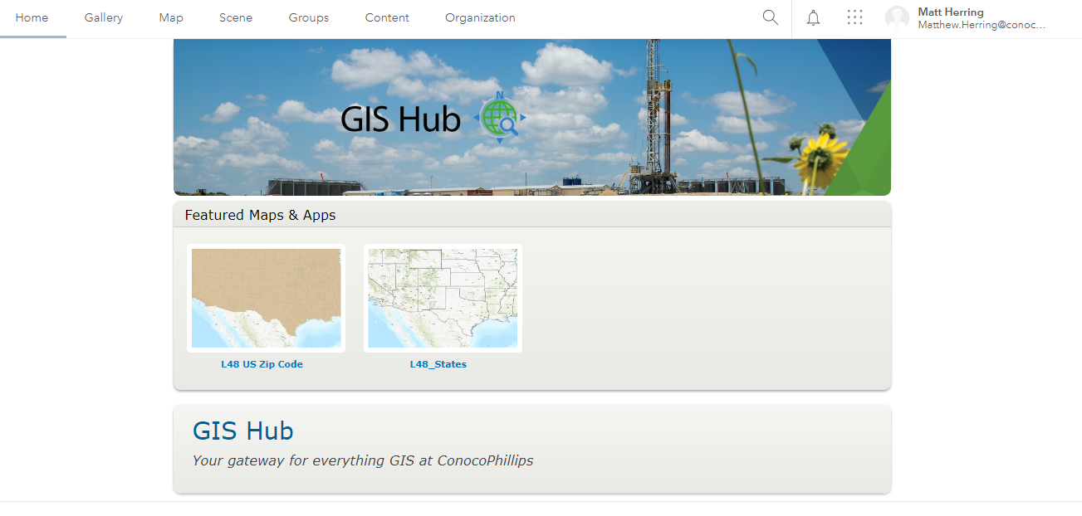
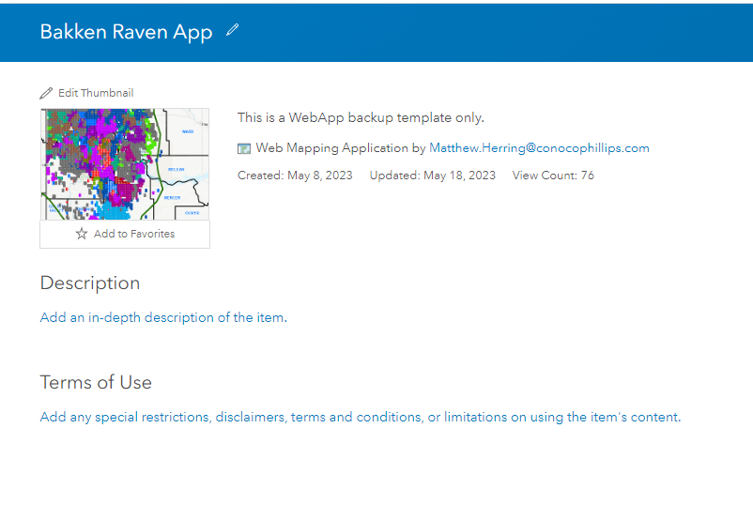
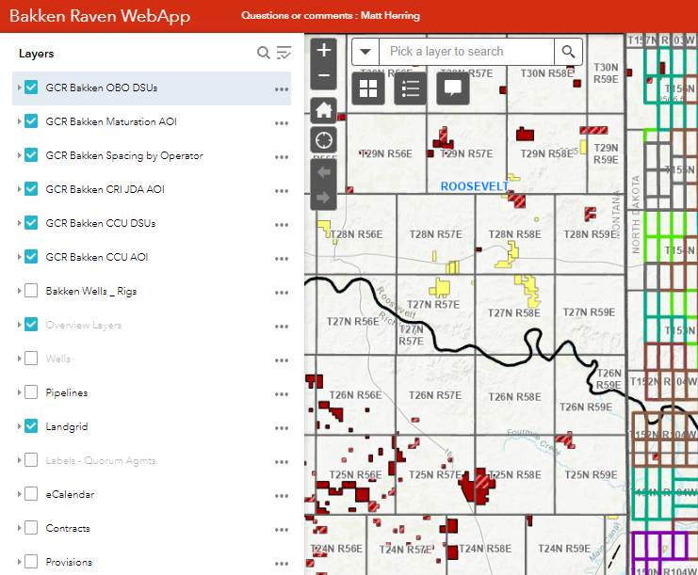
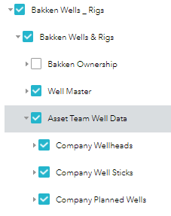
Bakken Web map
Bakken Raven WebApp
Web Address : Bakken Raven WebApp (cop.com)
Can be found by going through the COP GIS Hub.
  GIS Hub (cop.com)
  Your first try , you will create your account.
  Contact Matt Herring to have the new account added to security groups.
The general layout of the web app is similar to the experience you would have using Google Maps.
  Layers on the left
  Map to the right
  Tools across the top of the web app.
You can click and hold then move the map by moving the computer mouse.
You can zoom in and out and interact with content by using the scroll wheel and left clicking.
I try and capture a full township when taking a screen shot.
You will want the following layers turned on for your screen shot.
  Bakken Wells and Rigs ( Asset Team Well Data)
  COPC Leases and Minerals

Slide 5
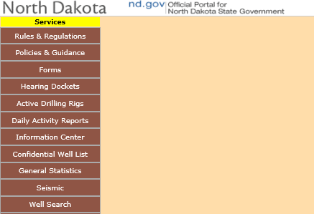
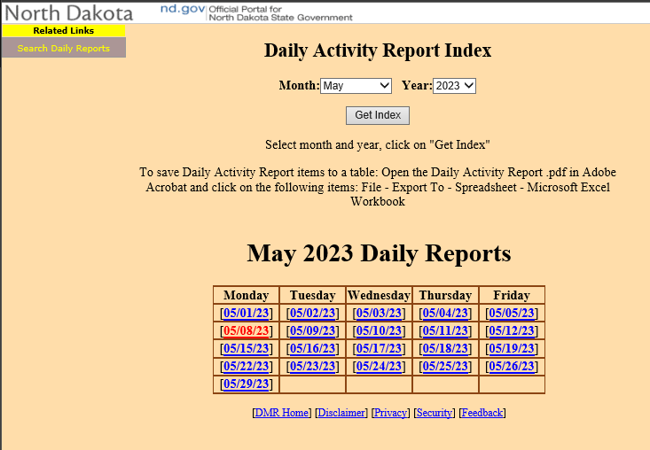
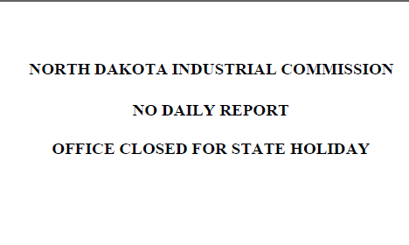
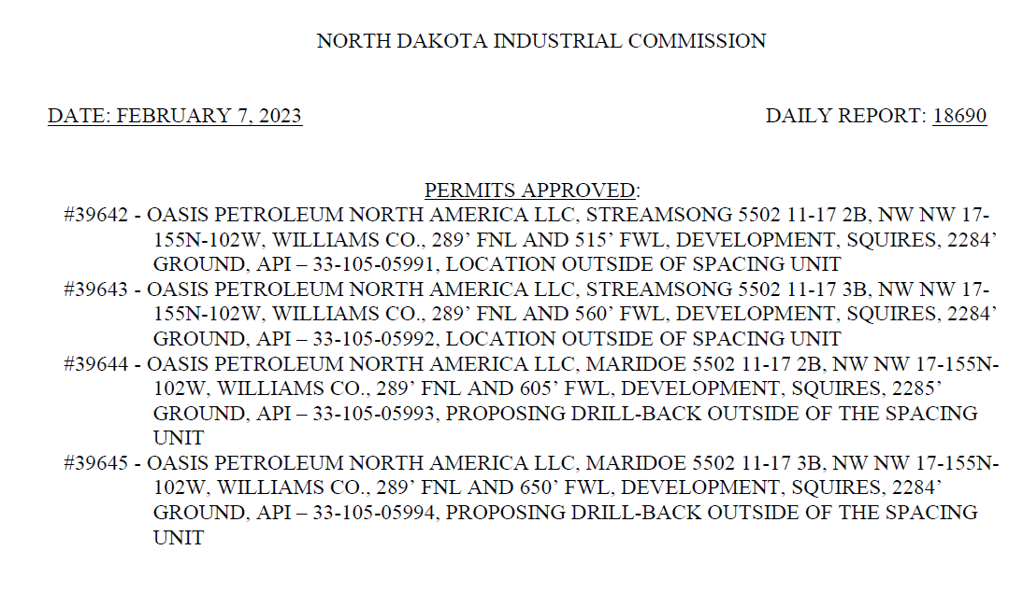
Bakken NDIC Daily Reports
Bakken NDIC Website
Web Address : https://www.dmr.nd.gov/oilgas/
On the Left-Hand side, you will click on “Daily Activity Reports”
On the Daily Activity Report Index Page, you can change the Month and the Year to get an index of reports released during that time frame. For this daily exercise you will want the current month and year. The example here is May, 2023.
You can see a link for each date during the selected Month.
When you click the link for the desired day, a PDF version of the Report will show up in the web browser.
Review the Report and identify the “Permits Approved” Section.
Each Approved permit will be listed.
Each Permit “usually” is reported with the following information:
  Permit Number
  Operator
  Well Name
  Well Number
  Legal Description
  County
  Footage Calls
  Purpose of Permit
  Formation
  Ground Elevation from Formation
  API
  Permit Notes

Slide 6
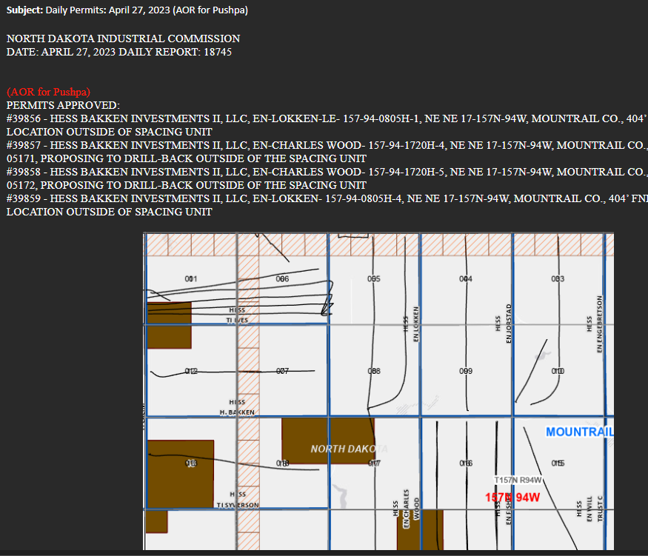
Draft Email
Email Recipients
Email Subject & Body
"Hayes, Tracy M" <Tracy.M.Hayes@conocophillips.com>;
"McDaniel, Maggie" <Maggie.McDaniel@conocophillips.com>;
"Nellikkattil, Pushpa" <Pushpa.Nellikkattil@conocophillips.com>;
"Salvie, Mark W" <Mark.W.Salvie@conocophillips.com>;
"Chentnik, Brenton M" <Brenton.Chentnik@conocophillips.com>;
"Farthing, Alisdair" <Alisdair.Farthing@conocophillips.com>;
"Flack, Dan L" <Dan.Flack@conocophillips.com>;
"Gonzalez, Saul" <Saul.Gonzalez@conocophillips.com>;
"Keyes, Brenden C" <Brenden.C.Keyes@conocophillips.com>;
"Lafferrandre, Sara" <Sara.Lafferrandre@conocophillips.com>;
"Landry, Kirsten A (Gustafson)" <Kirsten.A.Landry@conocophillips.com>;
"Miller, Meredith E" <Meredith.E.Miller@conocophillips.com>;
"Ratliff, Logan" <Logan.Ratliff@conocophillips.com>;
"Sitek, Brian" <Brian.Sitek@conocophillips.com>;
"Staviski, Nick G" <Nick.G.Staviski@conocophillips.com>;
"Zhang, John" <John.Zhang@conocophillips.com>;
"Pratikno, Helmi" <Helmi.Pratikno@conocophillips.com>;
"Kerrigan, Taylor S" Taylor.S.Kerrigan@conocophillips.com
Add staff emails as needed. ( People will get added and dropped here and there)
In the Subject Specify
  Report Date
  AOR for
The body of the email is a copy and paste of the permits that merit attention for the day.
Each Legal Described should be identified in the webmap and a screen shot taken to be inline with the Report Text.

Slide 7
Questions??
If you need any support at all, call Matt Herring
Office : 1-281-647-1843
Cell : 832.407.2799
Email : Matthew.Herring@cop.com
GIS Launchpad : GIS Launchpad - Home (sharepoint.com)

