Slide 1
WP7 Internal reporting
Speakers SIS: Michael Dose, Irena Stevanovic, André Garstka
Speakers THA: Christian Fedorczak
Speakers IRIT: Florence Sedes
28/11/2017

Slide 2
Overview WP7
Status at M36: Main achievements:
WP7 kick-off meeting done (combined with the EB-Meeting)
Work on WP7 started (T7.1 and T7.2)
Future objectives and upcoming events
(M6+):
Impl. of interfaces for analytics / matching provider
Impl. of task scheduler
Work on generic model
Problems encountered:
Integration of IRIT components to be clarified
Added value generated at M6
WP7 recently started at M5

Slide 3
Mapping objectives onto tasks / deliverables
Objective | Task | Deliverable
Development of the backbone platform on which the software modules developed by the other technical partners will be integrated | T7.1 | D7.1
Develop the user interfaces and the semantic queries function | T7.2 | D7.2 / D7.3
V1: Integration with the user interfaces and the components from WP5 and WP6; validation with LEAs | T7.3 | D7.4
V2: Development and integration of version 2 of the VAP including feedback from LEAs | T7.4 | D7.5 / D7.6
Provide support and modifications during field demonstrations at the LEAs | T7.4

Slide 4
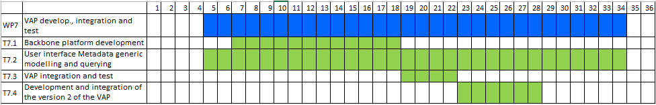
WP7: Video Analysis Platform development, integration and test
Time planning
Relevant active tasks
T7.1 : Backbone platform development
T7.2 : User interface, metadata generic modelling and querying

Slide 5
T7.1: Backbone platform development
T7.1 Backbone platform (SIS) M18
Backbone platform will be developed based on components available from the product MVI (Morpho Video Investigator)
Work for the next 6 months….
Provide open interfaces as specified in WP4.2 + WP4.3
Synchronous and asynchronous interfaces for analytics and matching providers
Focus of analytics provider audio + video
Redesign of internal services such as scheduler to communicate with open analytics provider
Support of GPU within Docker/K8s environment
If possible iteratively integration of analytic providers developed in WP5

Slide 6
T7.2: User interface Metadata generic modelling and querying
T7.2 Graphical User Interface SIS
Simplify and improve user interface based on user requirements specified in D2.1
Tracking of individuals and objects such as cars
Assisted clustering of individuals and objects
State of the art web user interface

Slide 7
T7.2: User interface Metadata generic modelling and querying
Objectives
Develop a generic model of metadata
Make them available to the investigators in a consistent way
Interoperable metadata interfaces for the analytics modules
Expected Results D7.3 (IRIT) + D7.2 (IDEMIA)
A GENERIC MODEL enabling to aggregate all sorts of Metadata
A QUERY PATTERN customisable according to the scenarios

Slide 8
T7.2: User interface Metadata generic modelling and querying
What has been done so far since M5
Proposition of need metadata
CONTENT
Low-level
Quality
Object detection/tracking
Scene description
LAW / ETHICAL
Security Level (Military area)
French Law “Droit à l’image”
Privacy
Etc.
CONTEXT
Meteo
Day / Night
Inside / Outside
Social Network
Social Events
TECHNICAL / MATERIAL
Focal
Sensor
Camera Model
Codec
SPATIAL / TEMPORAL
Geolocalization
Time/Date

Slide 9
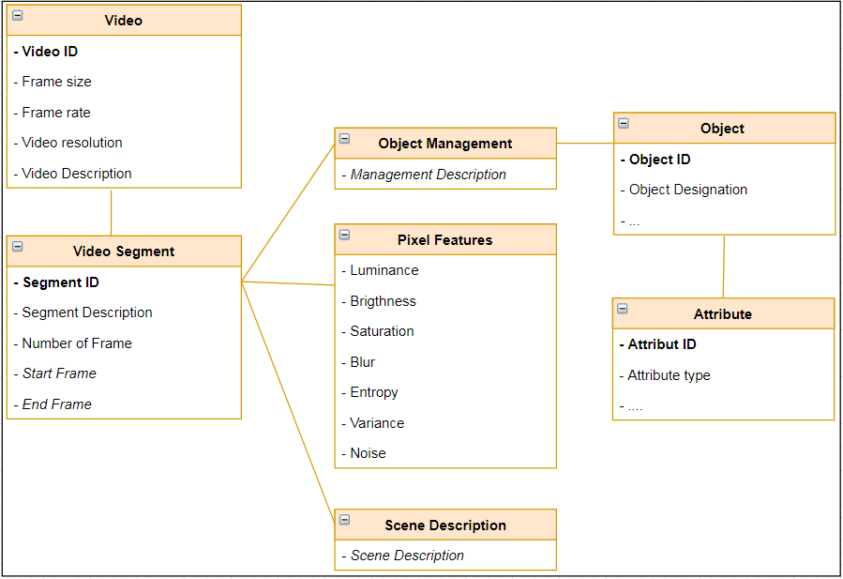
T7.2: User interface Metadata generic modelling and querying
What has been done so far since M5
Proposition of need metadata -> generic model
CONTENT
Low-level
Quality
Object detection/tracking
Scene description
LAW / ETHICAL
Security Level (Military area)
French Law “Droit à l’image”
Privacy
Etc.
CONTEXT
Meteo
Day / Night
Inside / Outside
Social Network
Social Events
TECHNICAL / MATERIAL
Focal
Sensor
Camera Model
Codec
SPATIAL / TEMPORAL
Geolocalization
Time/Date

Slide 10
T7.2: User interface Metadata generic modelling and querying
Planning of the implementation work for the next months
Modeling from D2.1 scenarios & Metadata from other WPs
Model feeding
How to integrate outputs from other WP ?
audio analysis, video analysis, visual analysis
Operational Scenarios
D2.1
Overall Architecture
D4.2
M1
M2
M3
M4
M5
M6
...
...
M18
...
M34
Video analysis
D5.1-4
WP2
WP4
WP5
D7.3 v1
WP6
WP7 T7.2
GENERIC MODEL
QUERYING PATTERN

Slide 11
Deliverables status – M1-M9
DEL n° & title | Leader | Initital due date (DoA) | Date submitted | Quality assurance responsible | Comments
D7.1: Backbone platform | SIS | M18
D7.2: Graphical User Interface | SIS | M18
D7.3: Advanced metadata querying mechanism for VAP prototype V1 | IRIT | M18

Slide 12
Milestone status – M1-M9
MS n° & title | Leader | Initital due date (DoA) | Date submitted | Comments / Means of verification

Slide 13
Risk management
WP | Description | Impact | Mitigation action | Owner
WP7 | Possible delays and changes due to risks identified in WP4 | Required revision of specifications | Fast dummy implementation within WP5, WP7 | SIS

Slide 14


Thank you for your attention! Any questions?
This project has received funding from the European Union’s Horizon 2020 research and innovation programme under grant agreement No740754

