Slide 1
Welcome to
Geoff Spielman’s
CLUSTERFUCK
TM
Learn How to Play
Skip to Lobby

Slide 2
_{TM}
CLUSTERFUCK
Welcome to
Geoff Spielman’s
Learn How to Play
Skip to Lobby

Slide 3





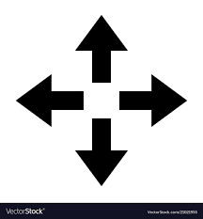
CLUSTERFUCK
TM
This is basically Battleship, except:
There are up to to eight players all on the same map
You design your own ships
There is an anonymous chat window for strategizing, forming alliances, and treachery
There are power-ups
Previous
Next

Slide 4

CLUSTERFUCK
TM
Gameplay:
You will design two ships
Each ship consists of 8 squares
Your ships will be randomly placed on the map
You can see your ships are at all times, the rest of the map starts as fog (unknown)
Each turn you can either fire a shot or use a power-up
A round ends when each player has had a turn
Previous
Next

Slide 5


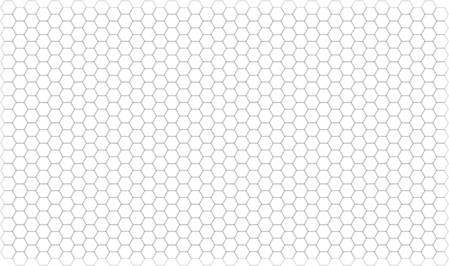
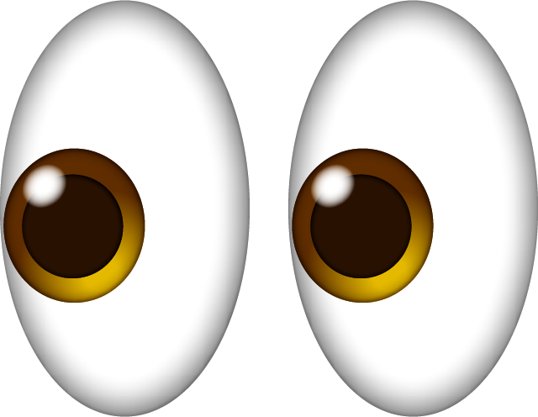
CLUSTERFUCK
TM
Power-ups:
Discovered by missing all ships and hitting a buoy instead
You can only hold 3 at a time. Upon discovering your 4th you must discard one immediately
Big Shot
Bubble Wrap
Sneak-a-Peek
 | ?
 | ?
 | ?
 | ?
 | ?
This military grade bubble wrap protects your entire ship for one rounds. These bubbles do not pop – shots simply bounce off.
Your shot covers 4 squares this turn. Way to go champo!
Reveals what lies beneath five squares of fog. Other players know where you looked but not what you can saw.
Previous
Next

Slide 6


CLUSTERFUCK
TM
Power-ups:
Discovered by missing all ships and hitting a buoy instead
You can only hold 3 at a time. Upon discovering your 4th you must discard one immediately
Move it Minor
Move it Major
God Mode
Allows you to shift one square in any direction.
Allows you to teleport one of your ships to anywhere on the map and reorient it as you please.
The ‘cool down’ limitation on your sound board is removed. Please have mercy.
Moving caveat: if you move under fog (probably a good idea) and an opponent hits one of your already damaged segments, that opponent gets another shot
Previous
Next

Slide 7
CLUSTERFUCK
TM
Game Interface
Previous
Next

Slide 8
CLUSTERFUCK
TM
End Game
The last player with a ship afloat wins
Once your last ship sinks, you’re dead. The entire map will be revealed to you but you lose the ability to send messages in the chat window
A
Previous
Next

Slide 9
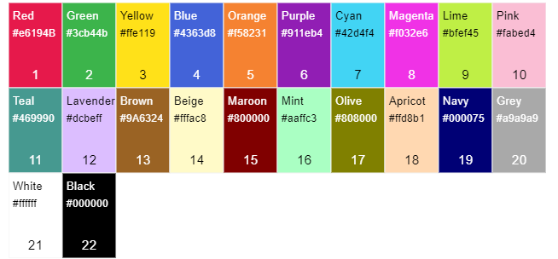

CLUSTERFUCK
TM
Lobby
Taken
Name:
Colour:
Taken
Revealed at the end of the game to determine the bonus prize winner
Please use your real name, it helps troubleshoot connection issues ☺
Alias:
Enter your own or pick from the bank below:
Taken
Lord Farquad
Darth Evader
Dumking aeffeaf
Fleet:
Ready
✓
4/8 squares
Ahoy Lord Farquad! You’re all set.
If you change your mind just click “Ready” again
Back to Start screen
4 players are ready to start

Slide 10
CLUSTERFUCK
TM
FLEET POSSIBLE ERROR MESSAGES:
✓
4/8 squares
Please remove 1 segment
Please remove 2 segments
All segments must be adjacent to at least one other segment

Slide 11
Algorithm: Placing Ships on the Grid
collision detection - Algorithm to fit shapes to 2D grid? - Game Development Stack Exchange
I call this "Place-and-Grow" for lack of having seen a better term elsewhere.
Select a single pixel/cell of your bitmap/source grid to place -- I would start with the centremost pixel. Randomly pick a position in your bacgkround bitmap / destination grid, to place it on. Keep randomising till you find an open space (this process can be optimised in other ways).
If it is now overlapping a solid pixel eg. on the left side, push it out in the opposite direction instead (same applies vice versa and for top/bottom). If you now find it in an empty space once more, you're good to go to the next step. "Grow" the pixel in in all 8 directions around itself, in terms of the source grid / bitmap. Then go back and repeat the shifting step to ensure it's not overlapping anything. Rinse, repeat.
Eventually you will get to a point where either your image is completely drawn in to background space, or you cannot expand it anymore in any direction, and will have to try again.
Basically this approach is described as "physical" because you are pushing away from any boundaries you meet -- until such time as the algorithm is done or it falls out because there is no space on any side to push out toward.

Slide 12
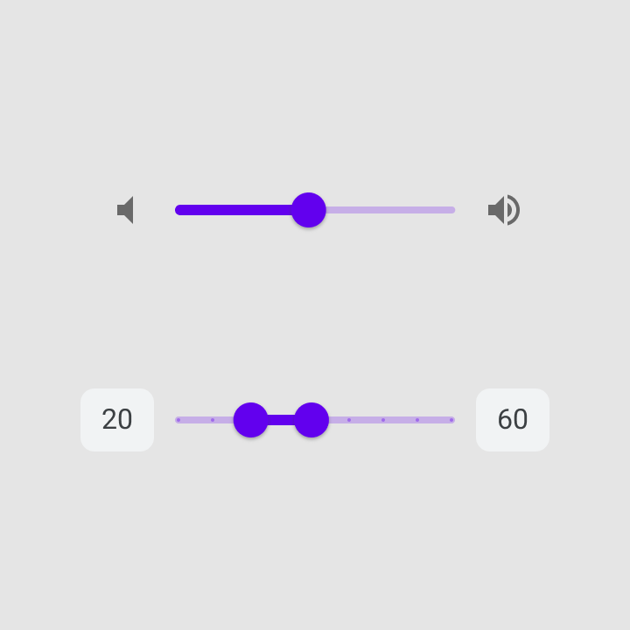

Elastagirl: yeah that would be good
Lord Farquaad: No!
Inigo Montoya: This game is bullshit, I blame Elastagirl
Remaining:
Sneak-A-Peak
2/3
Bubble Wrap
4/5
Big Shot
1/2
Move-it Minor
2/3
Move-it Major
1/4
Send
God Mode
Sound board 0:45
0/1
Ellie Woods
Elastigirl
Darth Evader
Lord Farquaad
Inigo Montoya
Ron Weasely
Poke-ah the Hut
Dorothy Gale

Slide 13
Elastagirl: yeah that would be good
Lord Farquaad: No!
Inigo Montoya: This game is bullshit, I blame Elastagirl
Lord Farquaad deployed Bubble Wrap
Ron Weasely: Oh great, just what we needed
Undiscovered:
HOVER OVER ‘MOVE IT MINOR’:
Sneak-A-Peak
2/3
Bubble Wrap
4/5
Big Shot
Move it Minor
1/2
Move-it Minor
2/3
Move-it Major
Allows you to shift one square in any direction.
1/4
God Mode
Sound board 0:45
0/1
Ellie Woods
Elastigirl
Darth Evader
Lord Farquaad
Inigo Montoya
Ron Weasely
Poke-ah the Hut
Dorothy Gale

Slide 14
Round: 5
Alias > | Name | Socket ID | Overrides
Ellie Woods | Thomas | wer92345few8923
Darth Evader | Garrett | agfewfafefwfefw3
Lord Farquaad | Chris | Wer92345few8923
Ron Weasely | Isaiah | W343445few8923
Skip
Remove
Skip
Remove
Skip
Remove
Skip
Remove
How player data table works:
< | Name | Socket ID | Overrides
-- | Thomas | wer92345few8923
-- | Garrett | agfewfafefwfefw3
-- | Chris | Wer92345few8923
-- | Isaiah | W343445few8923
--

Slide 15
Round: 5
Whose Turn: Ellie Woods
Alias > | Name | Socket ID | Overrides
Ellie Woods | Thomas | wer92345few8923
Darth Evader | Garrett | agfewfafefwfefw3
Lord Farquaad | Chris | Wer92345few8923
Ron Weasely | Isaiah | W343445few8923
Sneak-A-Peak
Skip
Remove
3
^
Skip
Remove
>
Bubble Wrap
Skip
Remove
Skip
Remove
3
^
>
Big Shot
3
^
>
Move-it Minor
Restart Game
3
^
>
Move-it Major
3
^
>
God Mode
3
^
>

Slide 16

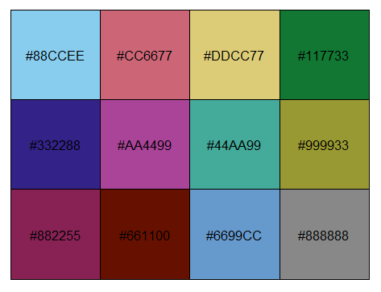

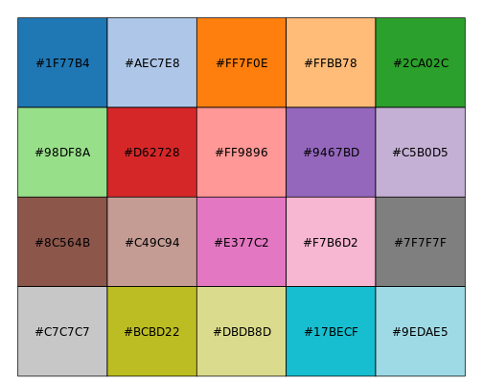

Slide 17
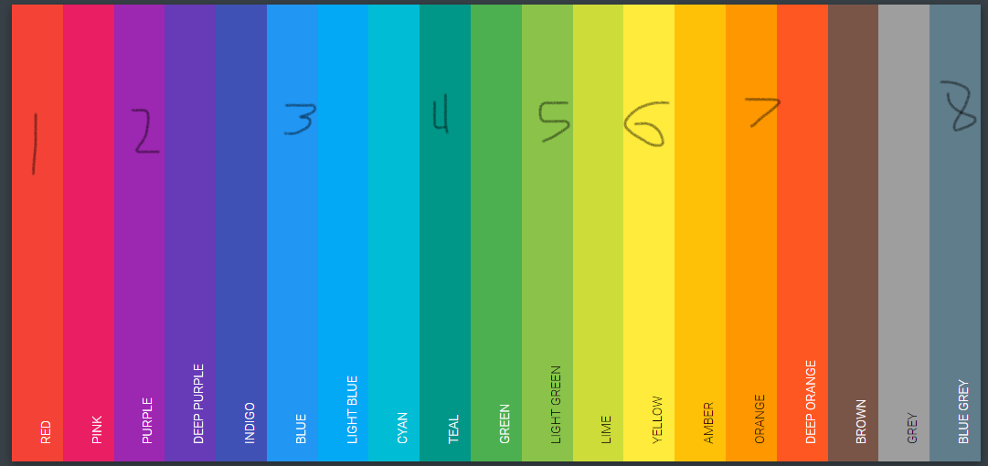

Slide 18
Caveats
Number of players: 2 – 8
Max number of power ups a player can hold: 3

Slide 19
Questions for UI Designers
Good places for open license images

Slide 20
SHIP PLACING ALGORITHM UI
Grid square.val: 0 = water
1 = ship(s)
2 = powerup
Ships to place (blanks are ignored):
ID: 0
`
5/9
rowMin:
rowMax:
colMin:
colMax:
1:
2:
3:
4:
5:
[0,0], [0,1], [1,1], [1,3]…
[0,0], [0,1], [1,1], [1,3]…
[0,0], [0,1], [1,1], [1,3]…
[0,0], [0,1], [1,1], [1,3]…
[0,0], [0,1], [1,1], [1,3]…
[0,0], [0,1], [1,1], [1,3]…
rowMin: colMin:
rowMax: colMax:
rowMin: colMin:
rowMax: colMax:
rowMin: colMin:
rowMax: colMax:
rowMin: colMin:
rowMax: colMax:
rowMin: colMin:
rowMax: colMax:
Status:
Actions:
numRows:
numCols:
maxShipDim:
Next drop point: _____
Reset

Slide 21
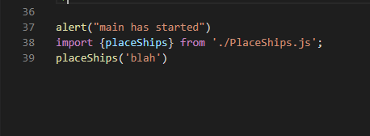
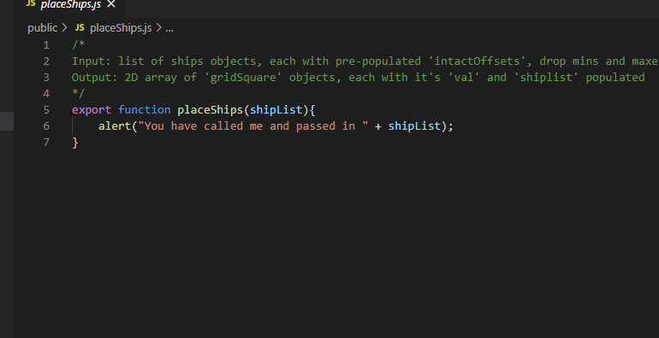
SHIP PLACING ALGORITHM UI
Grid square.val: 0 = water
1 = ship(s)
2 = powerup
Ships to place (blanks are ignored):
ID: 0
`
5/9
rowMin:
rowMax:
colMin:
colMax:
1:
2:
3:
4:
5:
[0,0], [0,1], [1,1], [1,3]…
[0,0], [0,1], [1,1], [1,3]…
[0,0], [0,1], [1,1], [1,3]…
[0,0], [0,1], [1,1], [1,3]…
[0,0], [0,1], [1,1], [1,3]…
[0,0], [0,1], [1,1], [1,3]…
rowMin: colMin:
rowMax: colMax:
rowMin: colMin:
rowMax: colMax:
rowMin: colMin:
rowMax: colMax:
rowMin: colMin:
rowMax: colMax:
rowMin: colMin:
rowMax: colMax:
numRows:
numCols:
Reset

