Slide 1



Geoff and Garrett’s Game Show Extravaganza
Host: Garrett
Technician: Geoff
P1:
Player 1 Name
Player 2 Name
Player 1 Score
Player 2 Score
Socket ID: ###########
IP Address: ###########
P3:
Player 2 Name
Player 4 Name
Player 2 Score
Player 4 Score
Socket ID: ###########
Player Modifiers
IP Address: ###########

Slide 2
Geoff and Garrett’s Game Show Extravaganza
Host: Garrett
Technician: Geoff
P1:
Player 1 Name
Player 2 Name
Player 1 Score
Player 2 Score
Socket ID: ###########
IP Address: ###########
Player Modifiers

Slide 3
Chat Window
Tree structure to select game/questions/content
Start Game
Update Names
Update Scores
Deploy Pic
Summon Leprechaun
Sharks!
P1:
Player 1 Name
Player 2 Name
Player 1 Score
Player 2 Score
Socket ID: ###########
IP Address: ###########
What the players see (For Garret)
Debug/Status info (For Geoff)
P3:
Player 2 Name
Player 4 Name
Player 2 Score
Player 4 Score
Socket ID: ###########
Player Modifiers
IP Address: ###########

Slide 4
Tree structure to select game/questions/content
Start Game
Chat Window
End Game
Update Names
Update Scores
Deploy Pic
Summon Leprechaun
Sharks!
P1:
Player 1 Name
Player 2 Name
Player 1 Score
Player 2 Score
Socket ID: ###########
IP Address: ###########
What the players see (For Garret)
Debug/Status info (For Geoff)
P3:
Player 2 Name
Player 4 Name
Player 2 Score
Player 4 Score
Socket ID: ###########
Player Modifiers
IP Address: ###########

Slide 5
Chat Window
Tree structure to select game/questions/content
PLAY!
Deploy Pic
Summon Leprechaun
Sharks!
Player 1 Name
PlayerID | Name | score | socketID | ipAddress
Player 2 Name
Player 1 Score
Player 2 Score
Update Names
Update Scores
Request Data Update
Mock Console Window
Player 2 Name
Player 4 Name
Player 2 Score
Player 4 Score

Slide 7


Welcome to Geoff and Garry’s Game Show Extravaganza!
Some words of encouragement/ our catch phrase
Please enter your name:
I am Geoff
I am Garrett

Slide 8
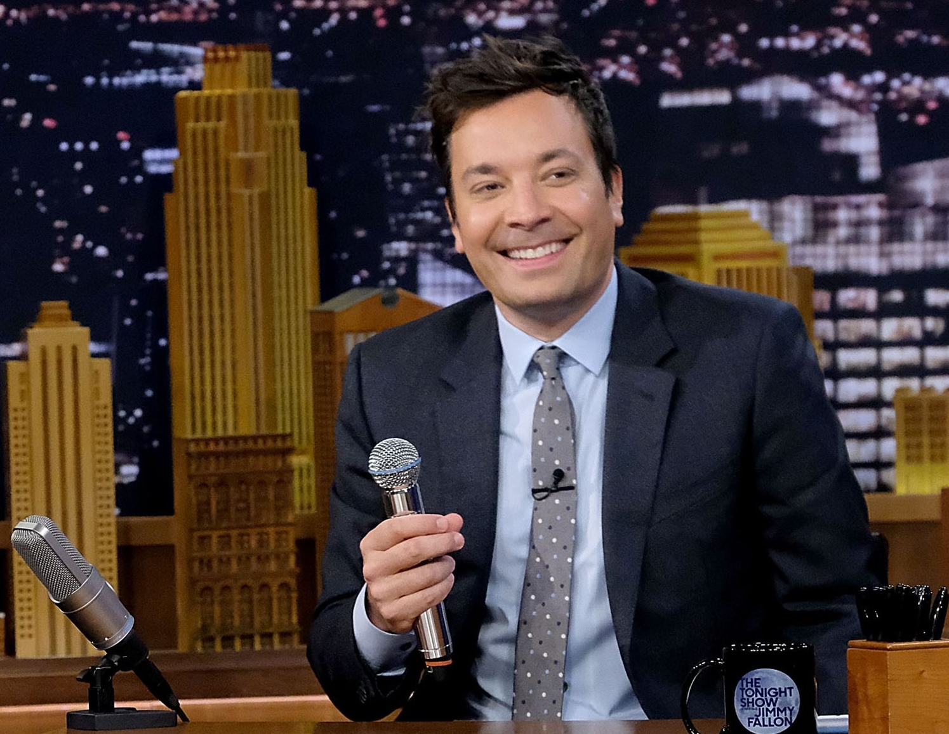




Slide 9


Slide 10


Slide 11


Slide 12


Slide 13


Player Request
Player lands on index, clicks “join game”
playerRequest
newObserver
playerListChanged
Player successfully added to game, broadcast to ALL sockets
playerName = AUDIENCE_MEMBER
Broacast to ONLY the socket trying to join

Slide 14
Audience Request
Player lands on index, clicks “Watch as Audience”
playerName = AUDIENCE_MEMBER
audienceRequest
newObserver
Broacast to ONLY the socket trying to join

Slide 15
Host Request
Host lands on index, clicks “I am Garrett”
playerName = HOST_GARRETT
hostRequest
HostSocketID is recorded
newCastMember
Broadcast to ONLY the socket trying to join

Slide 16
Technician Request
Technician clicks “I am Geoff”,
playerName = “TECHNICIAN_GEOFF”
technicianRequest
technicianSocketID is recorded
newCastMember
Broadcast to ONLY the socket trying to join

Slide 17
Player Leaves Game
Player refreshes/closes the tab
leaveGame
playerListChanged
Name = null, numPlayers -= 1
broadcast to ALL sockets

Slide 18
Cast Sends Message
Host clicks ‘send’
‘sender’ is specified
messageRequest
ONLY BROADCAST TO CAST MEMBERS
messageDelivery
sender: HOST_GARRETT or TECHNICIAN_GEOFF

Slide 19
Technician request fresh data
Technician clicks ‘request current data’
gameDataRequest
Only sent to host:
gameDataDelivery

Slide 20
Technician change names/scores
Technician clicks relevant button
nameChangeRequest
Or scoreChangeRequest
playerListChanged
OR
playerScoresChanged

Slide 21







Socket Connection
Client gets public content (index, images etc) from digital ocean
DNS Server
Worker: no SSL on *gameshow
I give them www.gameshow.geoffspielman.com?ip=24.212.142.167
Parse url for my IP address
Socket connection @ 24.212.142.167:3000

Slide 22
Worker Threw an Exception
Request URL:
https://gameshow.geoffspielman.com/gamesocket/?ip=24.212.142.167&EIO=3&transport=polling&t=N7C6_EQ
Request Method:
GET
path:
/gamesocket/?ip=24.212.142.167&EIO=3&transport=polling&t=N7C6_EQ
Query String Parameters
ip: 24.212.142.167

Slide 23
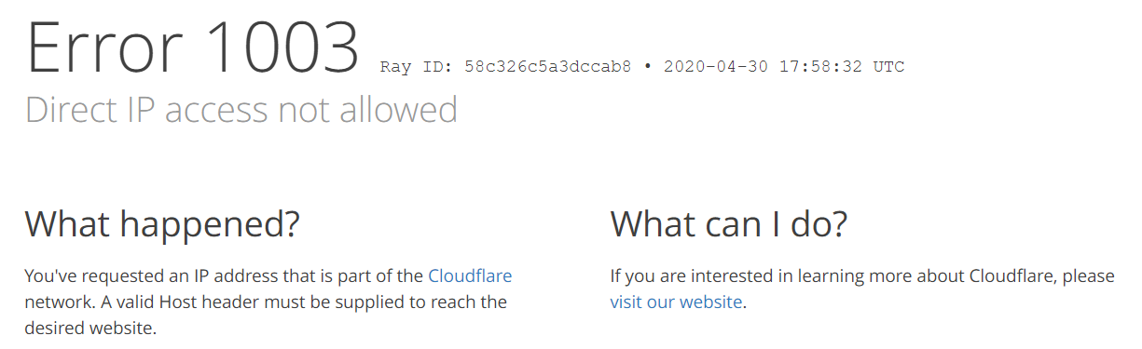
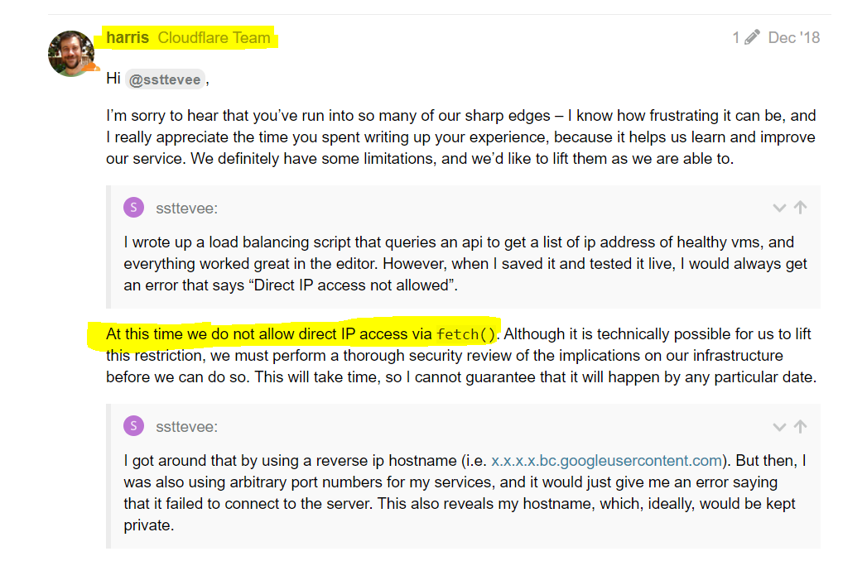
New Error message:

Slide 24
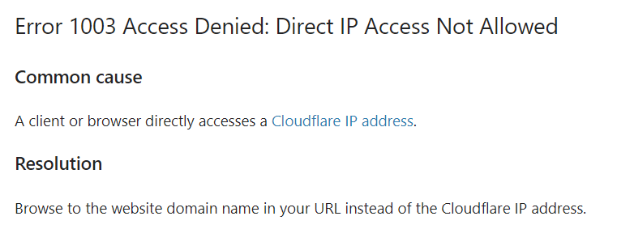
Cloudflare’s help center:

Slide 25
Cookie
Go to google.com
Click on Application tab at the top (network, memory, application)
Cick Cookies on the sidebar on the left and click on a domain
Double click on an empty row under the entires
Name: role
Value: host
Domain: gameshow.geoffspielman.com (tab over this for now)
Path: /
Expires: 2021-01-01T00:00:00

