Slide 1



Geoff and Garrett’s Game Show Extravaganza
Host: Garrett
Technician: Geoff
P1:
Player 1 Name
Player 2 Name
Player 1 Score
Player 2 Score
Socket ID: ###########
IP Address: ###########
P3:
Player 2 Name
Player 4 Name
Player 2 Score
Player 4 Score
Socket ID: ###########
Player Modifiers
IP Address: ###########

Slide 2
Geoff and Garrett’s Game Show Extravaganza
Host: Garrett
Technician: Geoff
P1:
Player 1 Name
Player 2 Name
Player 1 Score
Player 2 Score
Socket ID: ###########
IP Address: ###########
Player Modifiers

Slide 3
Answer/Host Info/Prompts
Tree structure to select game/questions/content
PLAY!
Chat Window
Update Names
Update Scores
Deploy Pic
Summon Leprechaun
Sharks!
P1:
Player 1 Name
Player 2 Name
Player 1 Score
Player 2 Score
Socket ID: ###########
IP Address: ###########
What the players see (For Garret)
Debug/Status info (For Geoff)
P3:
Player 2 Name
Player 4 Name
Player 2 Score
Player 4 Score
Socket ID: ###########
Player Modifiers
IP Address: ###########

Slide 4


Welcome to Geoff and Garry’s Game Show Extravaganza!
Some words of encouragement/ our catch phrase
Please enter your name:
I am Geoff
I am Garrett

Slide 5
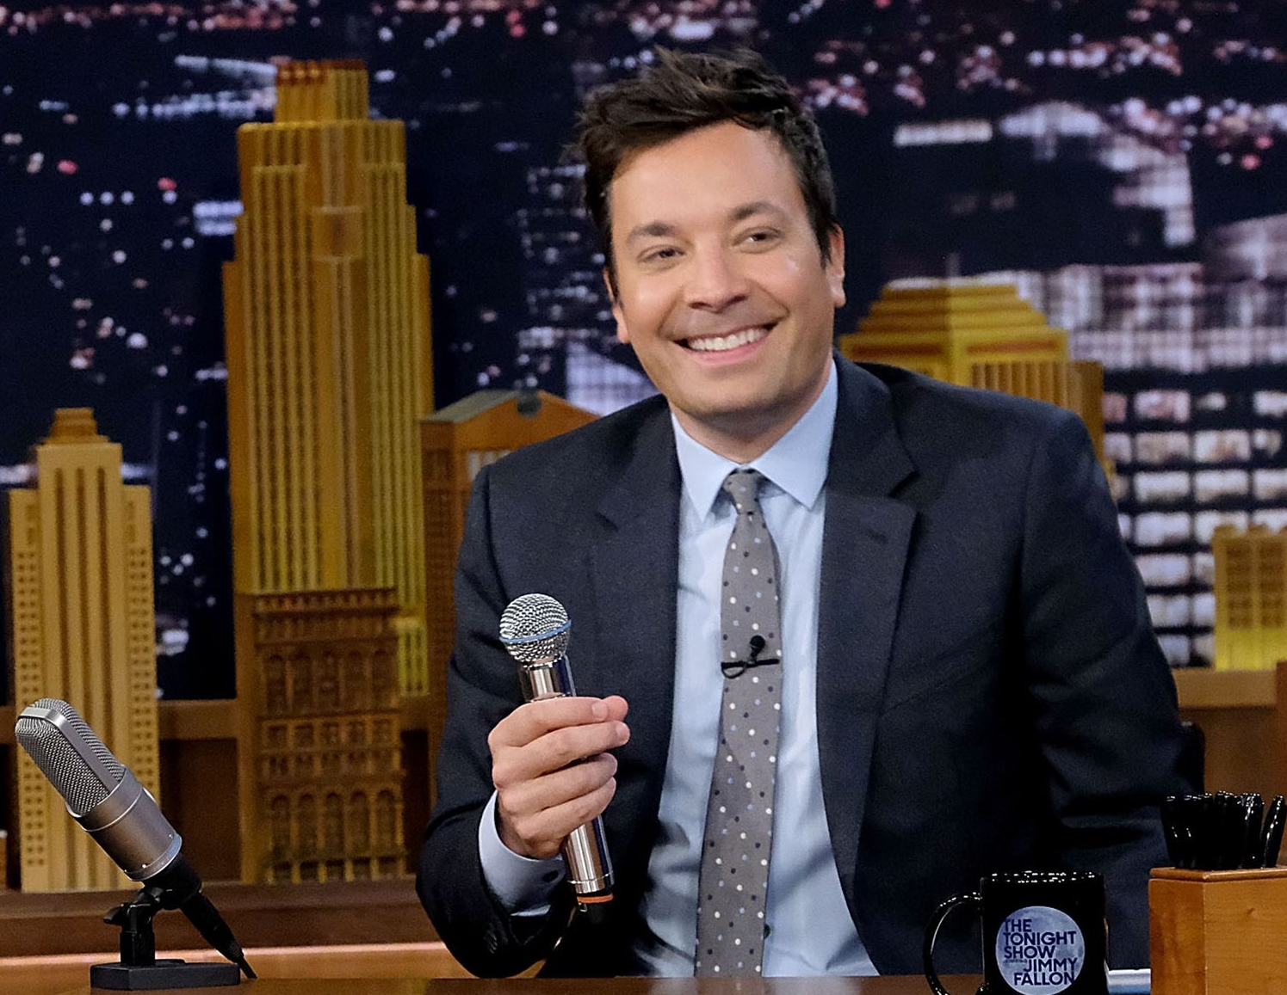




Slide 6


Slide 7


Slide 8


Slide 9


Slide 10


Player Request
Player lands on index, clicks “join game”
playerRequest
newObserver
playerListChanged
Player successfully added to game, broadcast to ALL sockets
playerName = AUDIENCE_MEMBER
Broacast to ONLY the socket trying to join

Slide 11
Audience Request
Player lands on index, clicks “Watch as Audience”
playerName = AUDIENCE_MEMBER
audienceRequest
newObserver
Broacast to ONLY the socket trying to join

Slide 12
Player Leaves Game
Player refreshes/closes the tab
leaveGame
playerListChanged
Name = null, numPlayers -= 1
broadcast to ALL sockets

Slide 13







Socket Connection
Client gets public content (index, images etc) from digital ocean
DNS Server
Worker: no SSL on *gameshow
I give them www.gameshow.geoffspielman.com?ip=24.212.142.167
Parse url for my IP address
Socket connection @ 24.212.142.167:3000

Slide 14
Worker Threw an Exception
Request URL:
https://gameshow.geoffspielman.com/gamesocket/?ip=24.212.142.167&EIO=3&transport=polling&t=N7C6_EQ
Request Method:
GET
path:
/gamesocket/?ip=24.212.142.167&EIO=3&transport=polling&t=N7C6_EQ
Query String Parameters
ip: 24.212.142.167

Slide 15
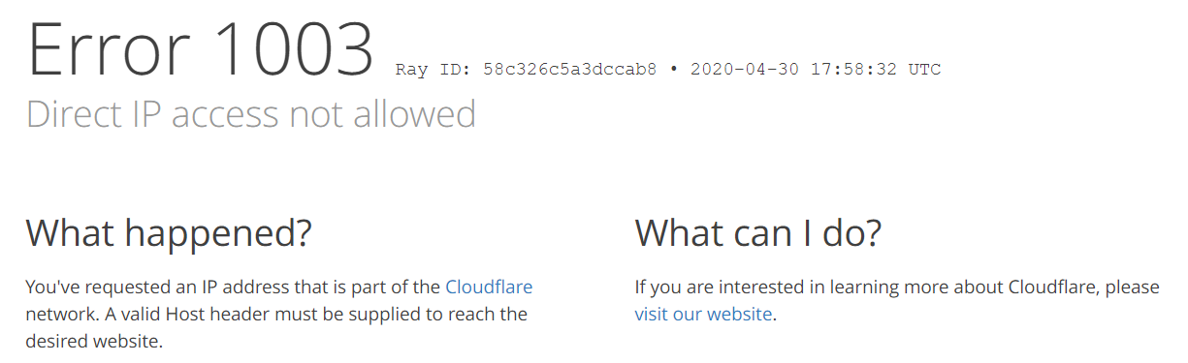
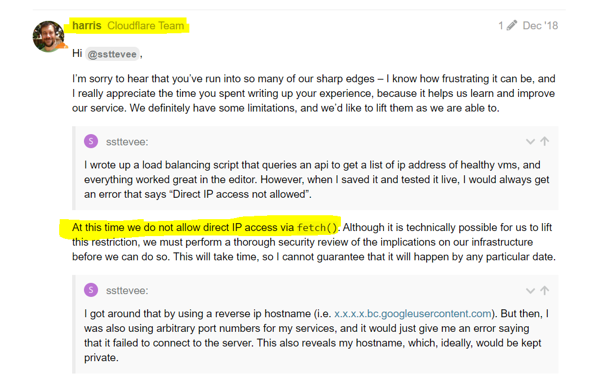
New Error message:

Slide 16
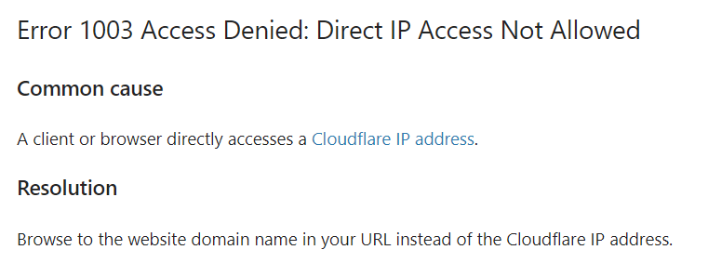
Cloudflare’s help center:

