Slide 1


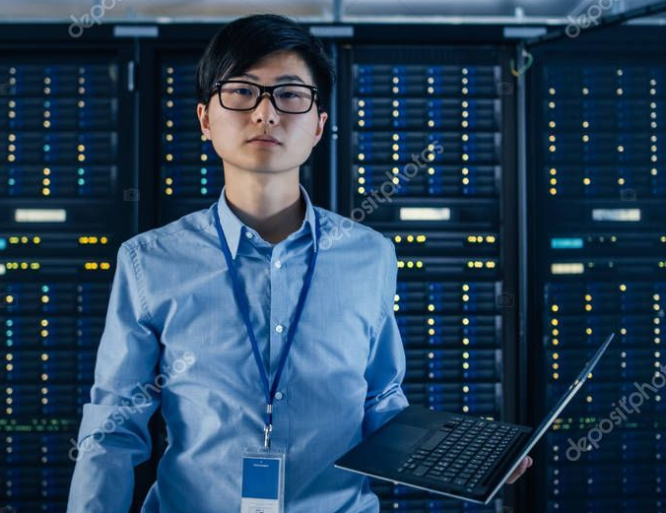
Geoff and Garrett’s Game Show Extravaganza
Host: Garrett
Technician: Geoff
P1:
Player 1 Name
Player 2 Name
Player 1 Score
Player 2 Score
Socket ID: ###########
IP Address: ###########
P3:
Player 2 Name
Player 4 Name
Player 2 Score
Player 4 Score
Socket ID: ###########
Player Modifiers
IP Address: ###########

Slide 2
Geoff and Garrett’s Game Show Extravaganza
Host: Garrett
Technician: Geoff
P1:
Player 1 Name
Player 2 Name
Player 1 Score
Player 2 Score
Socket ID: ###########
IP Address: ###########
Player Modifiers

Slide 3
Answer/Host Info/Prompts
Tree structure to select game/questions/content
PLAY!
Chat Window
Update Names
Update Scores
Deploy Pic
Summon Leprechaun
Sharks!
P1:
Player 1 Name
Player 2 Name
Player 1 Score
Player 2 Score
Socket ID: ###########
IP Address: ###########
What the players see (For Garret)
Debug/Status info (For Geoff)
P3:
Player 2 Name
Player 4 Name
Player 2 Score
Player 4 Score
Socket ID: ###########
Player Modifiers
IP Address: ###########

Slide 4


Welcome to Geoff and Garry’s Game Show Extravaganza!
Some words of encouragement/ our catch phrase
Please enter your name:
I am Geoff
I am Garrett

Slide 5
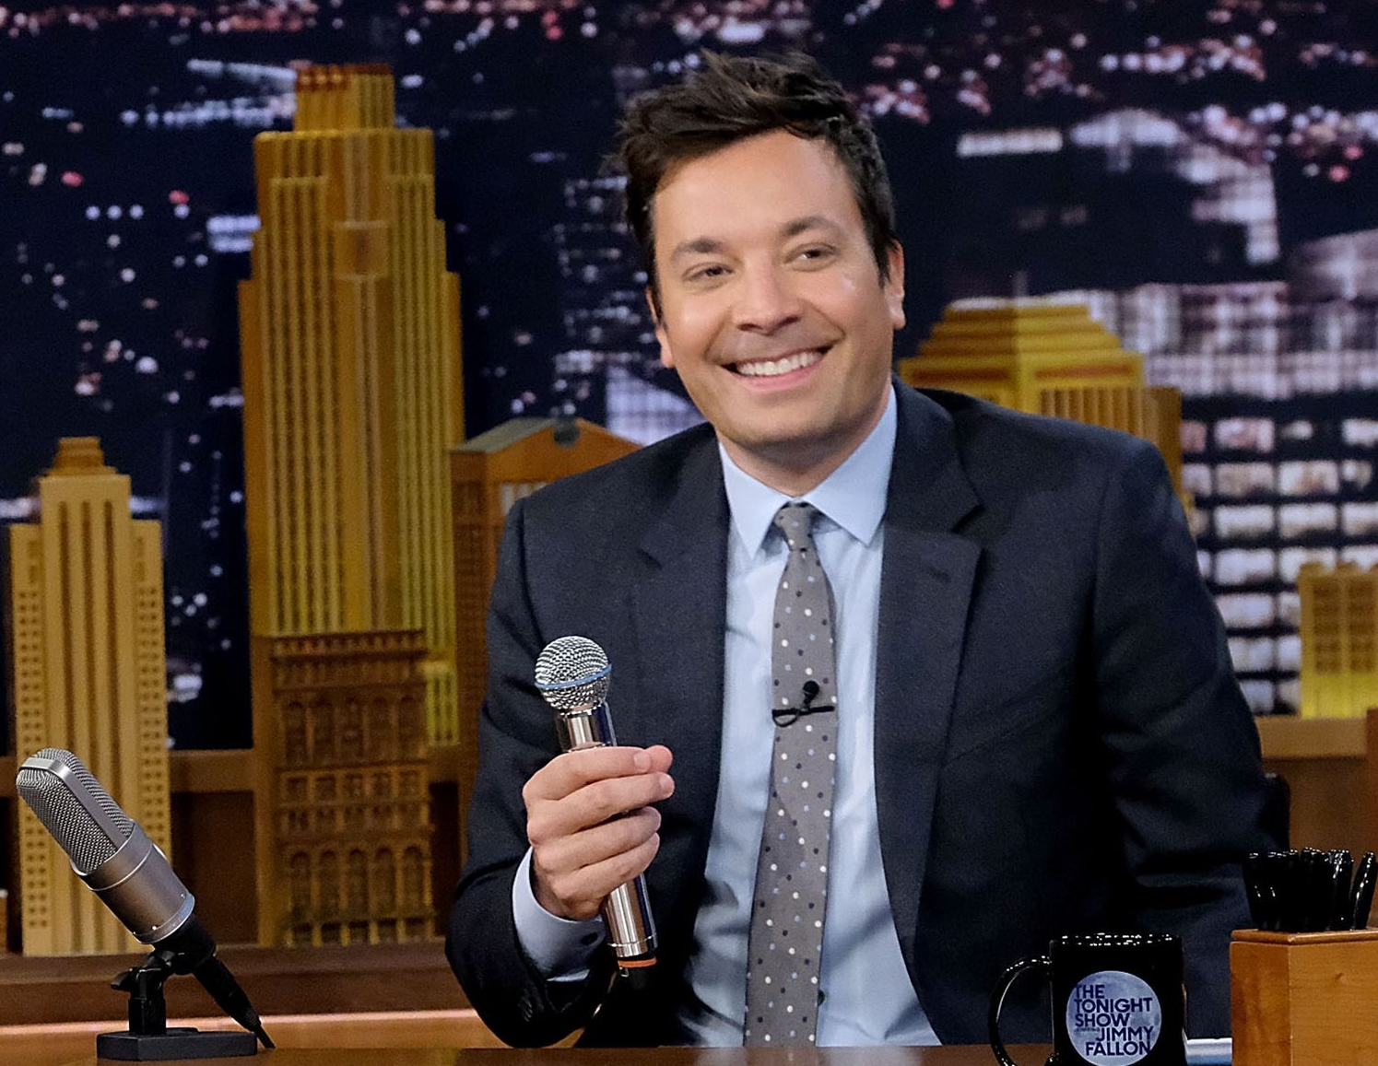




Slide 6


Slide 7


Slide 8


Slide 9


