Slide 1
Hardware Introduction Workshop
Geoff Spielman - 2017

Slide 2
Outline
What is an Arduino?
What is an IDE?
Installing the Arduino IDE
Hardware Basics
Buttons and LEDs
The Serial Monitor
Example
Faking Keyboard/Mouse Input
Example

Slide 3

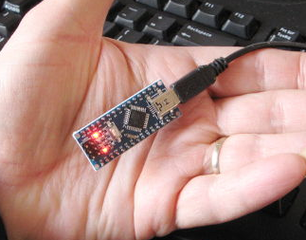
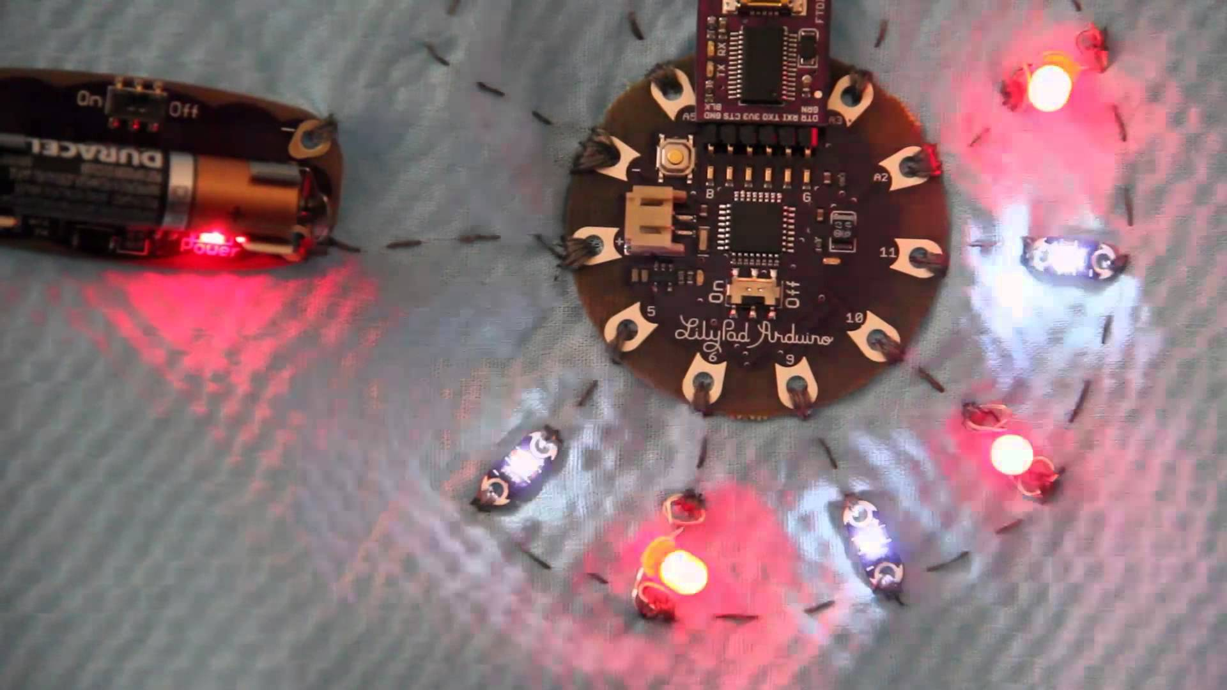
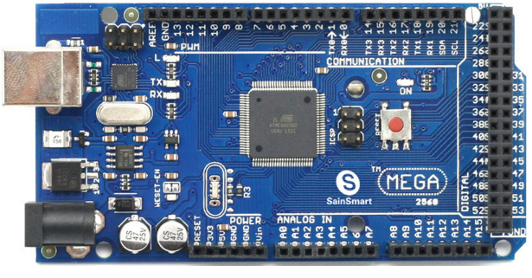
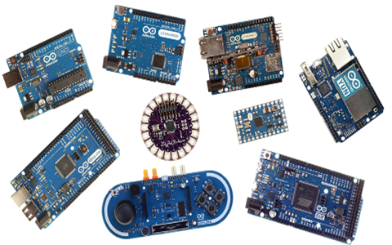
What is an Arduino?
15
Open-source electronics platform and software made by ‘Arduino’
The Arduino Leonardo is a development board that uses an ATmega32U4 microcontroller (big black square) – the brain
Makes the microcontroller easier to use
Board also includes voltage regulator, I/O pins, serial communications interface (USB), hard reset button, and more

Slide 4
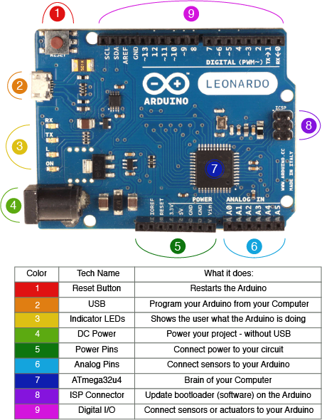
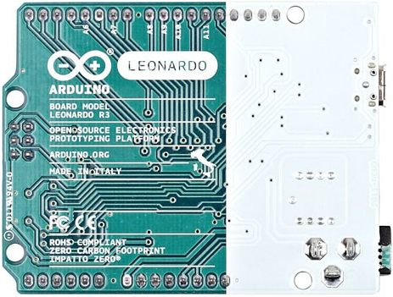
Serial Transmission Indicators
Receive
Transmit
Pin 13 LED
Powered On
Try not to put the bottom (exposed pins) down on conductive surfaces
Image: http://www.keytosmart.com/arduino-leonardo-blinking-led/

Slide 5






What is an IDE?
Integrated Development Environment
Software application providing useful tools/facilities to write code
Include a code editor, sometimes a compiler, debugger, and intelligent code completion
Generally a fully featured text editor that’s very customizable
Arduino is a very simple IDE

Slide 6
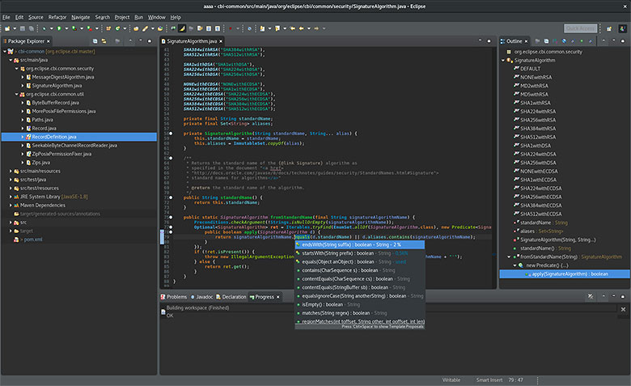

Slide 7
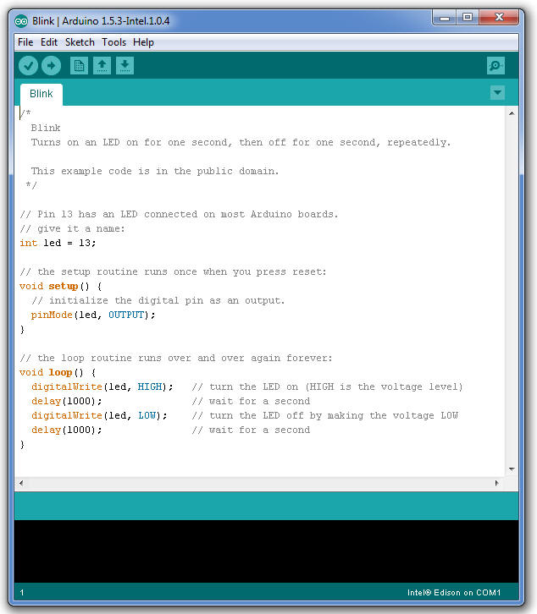

Slide 8
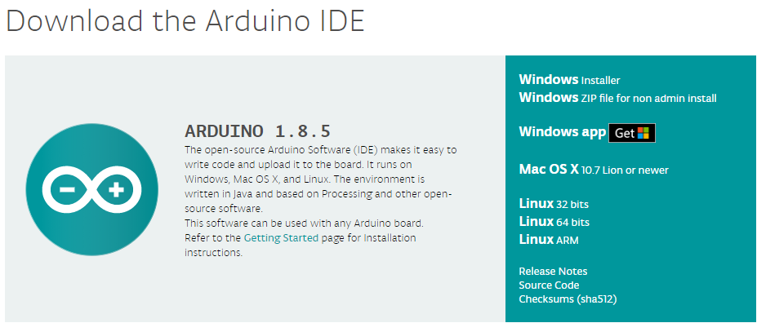
Installing the Arduino IDE
Go to https://www.arduino.cc/en/Main/Software or google “Arduino Software” - first page that shows up

Slide 9
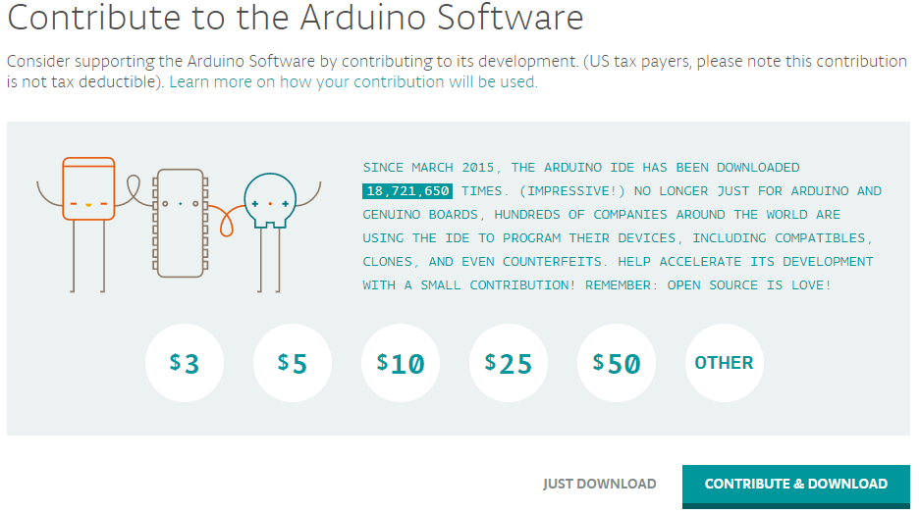

Slide 10
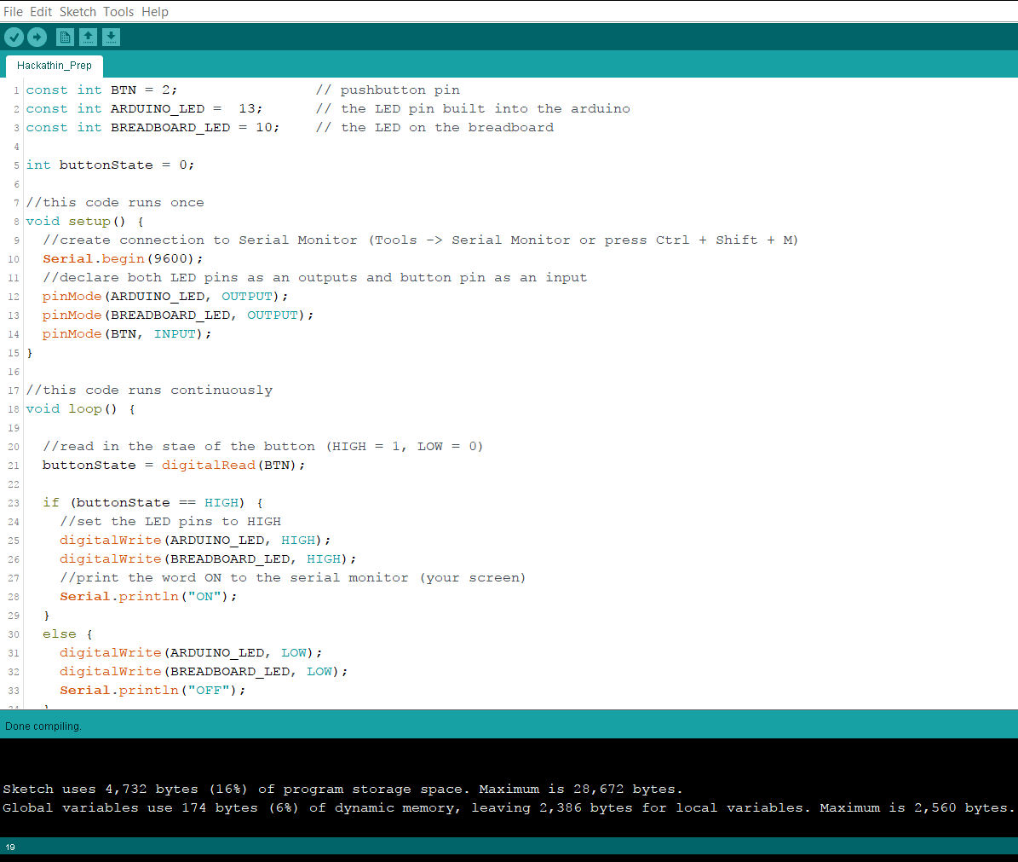





Verify:
- compiles your code
- finds syntax errors
Upload:
- sends compiled code to Arduino
- TX and RX lights will flash
- code starts running immediately
New Sketch
Open
Save

Slide 11
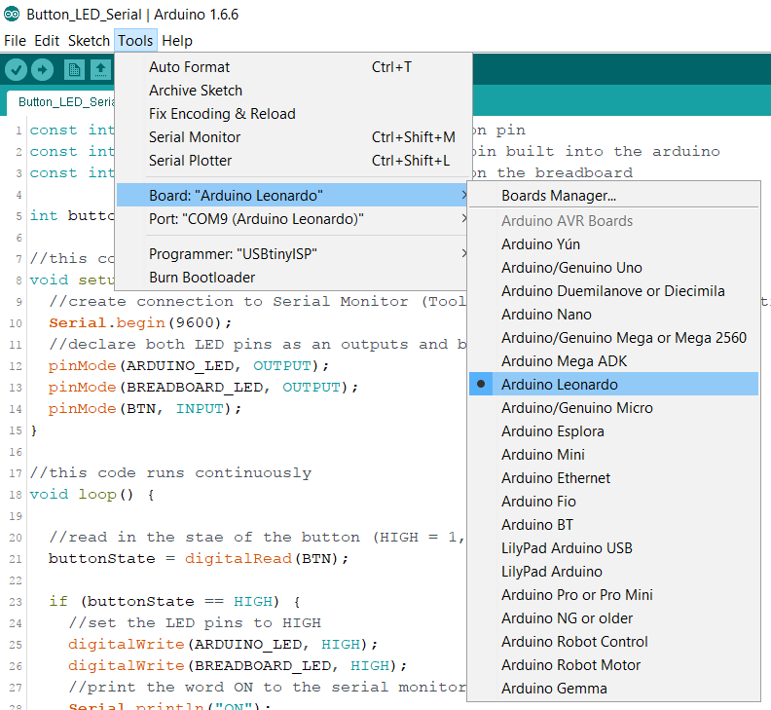

Slide 12
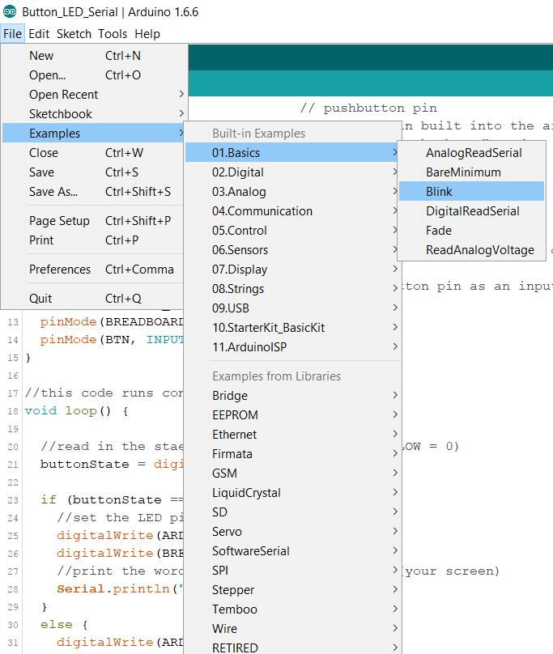
Simplest example – test hardware and uploading process

