Slide 1
Custom Model Architecture
Overview (3361 trainable parameters)

Slide 2
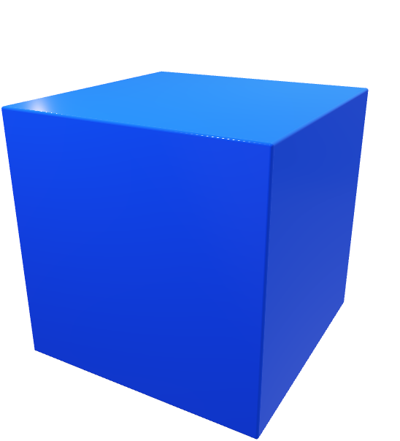
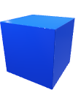


Conv2D
3 x 3
s = 2
MaxPool2D
Bottleneck
Block
224x224x3
112x112x6
56x56x6
56x56x6
MaxPool2D
Bottleneck
Block
MaxPool2D
Flatten
Dense
28x28x6
28x28x6
14x14x6
1176
1

Slide 3
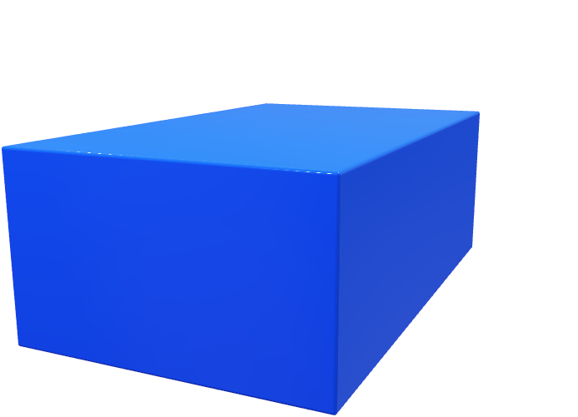
Bottleneck Block
Skip Connection
nxnx6
nxnx24
nxnx24
nxnx6
24x
6x
1x1x6
3x3x24
1x1x24

