Slide 1

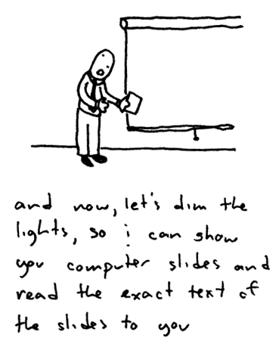
Carpool Application
Eric Borisow
Geoff Scholl
Ty Huynh

Slide 2
Agenda
Our Project Idea
Requirements
Our Development Approach
Live Demo
Testing Results
Metrics

Slide 3
Project Description
Create an application that could be used by an organization (such as a company or institution) that allows people to organize carpools.
Blackberry application for carpooling services.

Slide 4
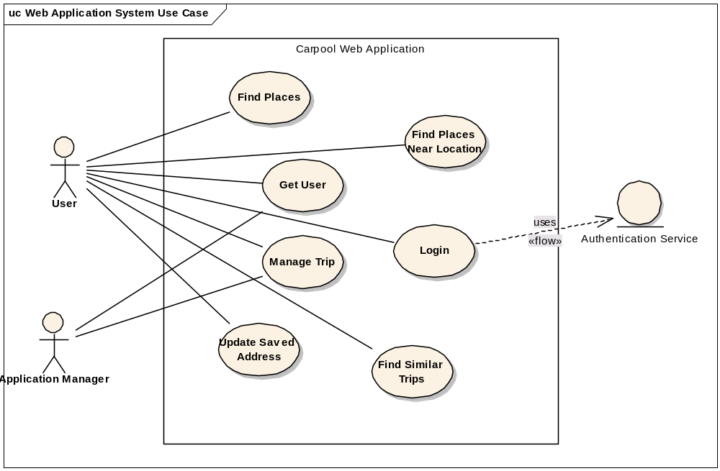
Requirements (main points)
Users can register themselves
Users must login to use the system
Search function to review existing trips
Create a carpool trip
  find existing matching trips
  find similar trips
Select preferred start/end points

Slide 5
Components Used
Blackberry API
Blackberry Java Development Environment (JDE)
Hibernate Persistence
Apache Tomcat
Subversion (SVN)
Another Neat Tool (ANT) – Build script tool
Eclipse
Blackberry Plugin for Eclipse
Structure 101
Spring Framework
Apache Axis 2
MySQL
MGMaps map API
Apache HTTP

Slide 6
Components Used
Blackberry API
Blackberry Java Development Environment (JDE)
Hibernate Persistence
Apache Tomcat
Subversion (SVN)
Another Neat Tool (ANT) – Build script tool
Eclipse
Blackberry Plugin for Eclipse
Structure 101
Spring Framework
Apache Axis 2
MySQL
MGMaps map API
Apache HTTP
Notes:
… and these are the components that we are planning on going into detail on… Eric will start by walking us through the development approach.

Slide 7
Development Approach
“Bottom-up”
  Define the requirement
  Define the data model
  Create Interfaces and Tests
  Create simple implementation
  Define WSDL/Create Web Service
  Create Test for Web Service
  Build user interface for Blackberry
  Fill-in database implementation to get real data

Slide 8
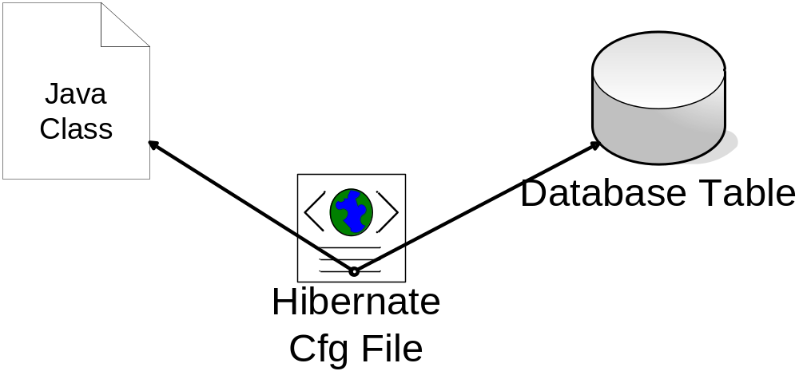
Hibernate
Object to Relational Tool
Notes:
Hibernate is an ORM tool. It spares the developer from having to write SQL and embed it into their classes. It handles relationships on an “as-needed” basis. It automatically populates Java objects for you.

Slide 9
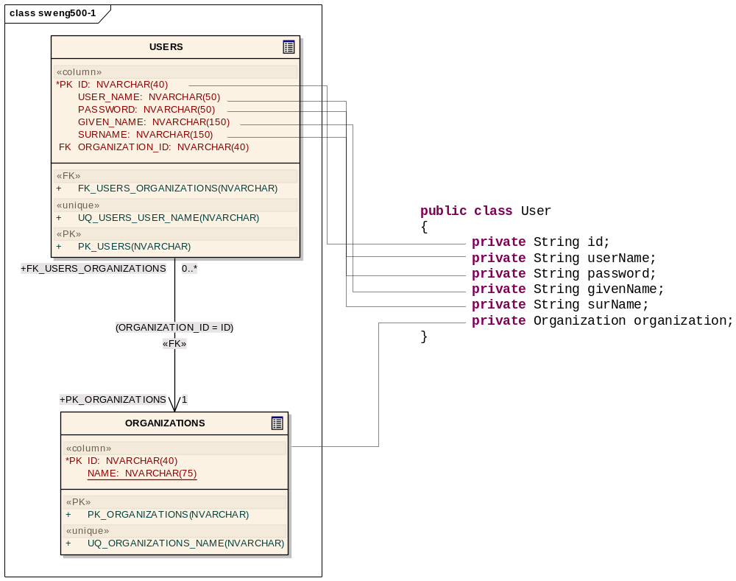
Hibernate Object-to-Table Mapping
Notes:
Here is an example of a mapping that we needed to create for our application. On the left, you can see our Java class that contains a bunch of members. On the left, you can see the table layout from our design tool. So, we want to let Hibernate manage this mapping for us.

Slide 10
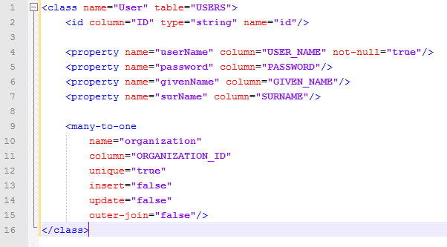
Hibernate Config File
Notes:
This is a snippet of our Hibernate configuration file that defines this mapping. You can see at the top, we defined the name as User which matches the name of our class. Then, the USERS table is referenced as the table that we want to map to. If you recall from the previous slide, you can see some of the members of our class and the columns that we want to match. id is a special designation for the primary key of the table. Finally, you can see that we needed to create a many-to-one relationship between a user and an organization. The organization mapping is defined elsewhere in the file. Here, we are defining the ORGANIZATION_ID as the foreign key.

Slide 11
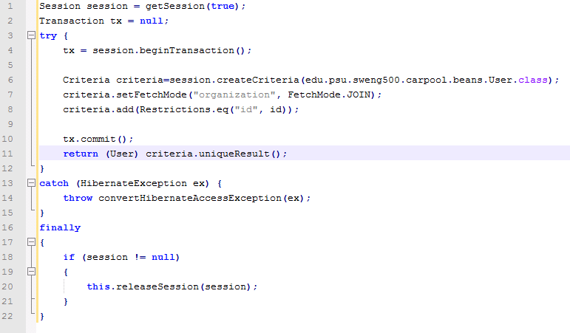
Hibernate Sample Code
Notes:
And, here is a snapshot of the code that we used to retrieve the User object from the database. You can see that we simply pass the id of the User into this method and it will retrieve a User object. If you are familiar with JDBC code, you know that the code can get a lot messier than this.

Slide 12
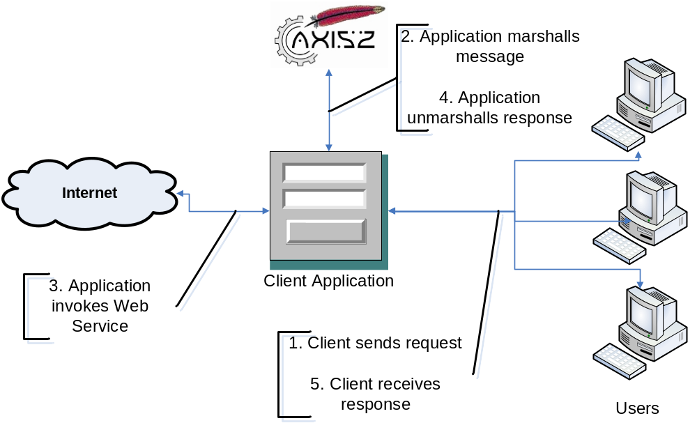
Axis2 for Web Services
Notes:
The next piece that we worked on in our Development process was the Web Services component. We needed to use web services, because Blackberry does not contain an OOTB method for performing direct database calls. (Walk through the steps of the Web service from the client’s perspective)

Slide 13
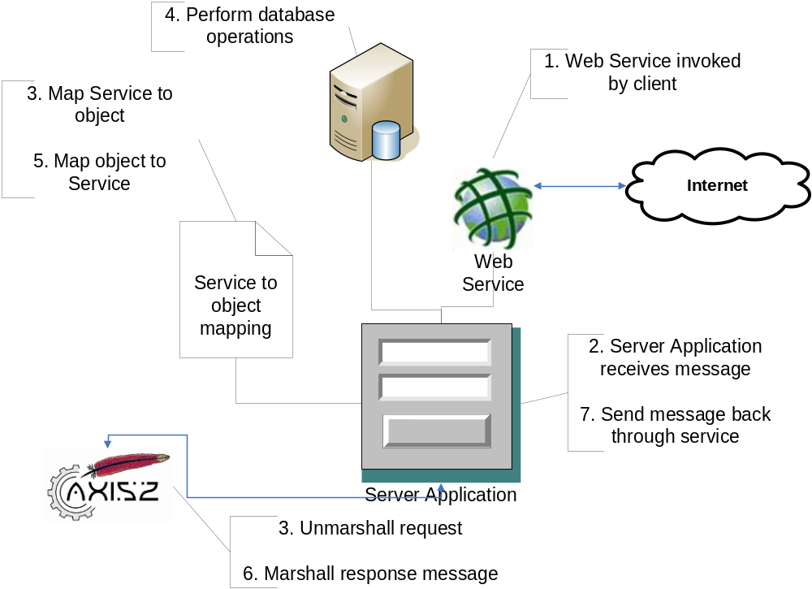
Axis2 Server-side process
Notes:
And, here is what the process looks like from the server’s standpoint. Walk through the steps on this slide.

Slide 14
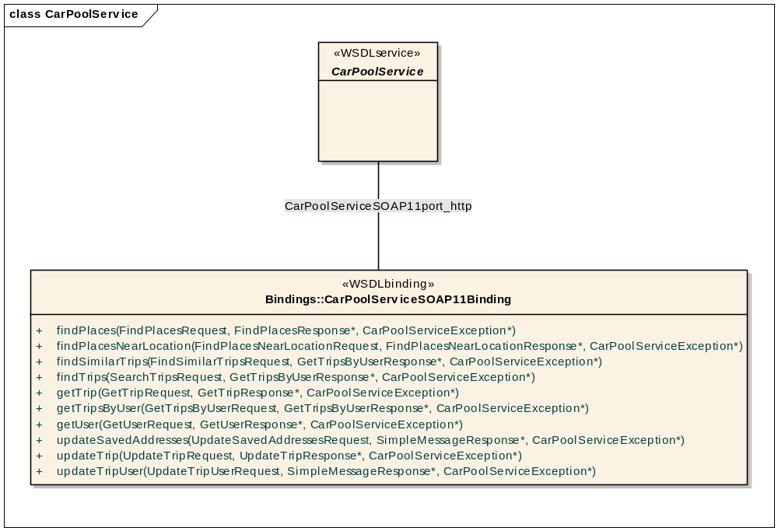
WSDL Bindings
Notes:
Here were all of the bindings that we had to define in our WSDL to support the car pool portion of our application. Each of the parameters is a complex type, but it must be defined in advance. If you need to make a change to the service, all of the clients need to regenerate stubs. We also learned for this project that the Blackberry API has a few bugs in it that require additional functionality. For example, messages cannot contain parameters that are nil. All parameters must have empty values. Also, a type containing other types is not permitted.

Slide 15
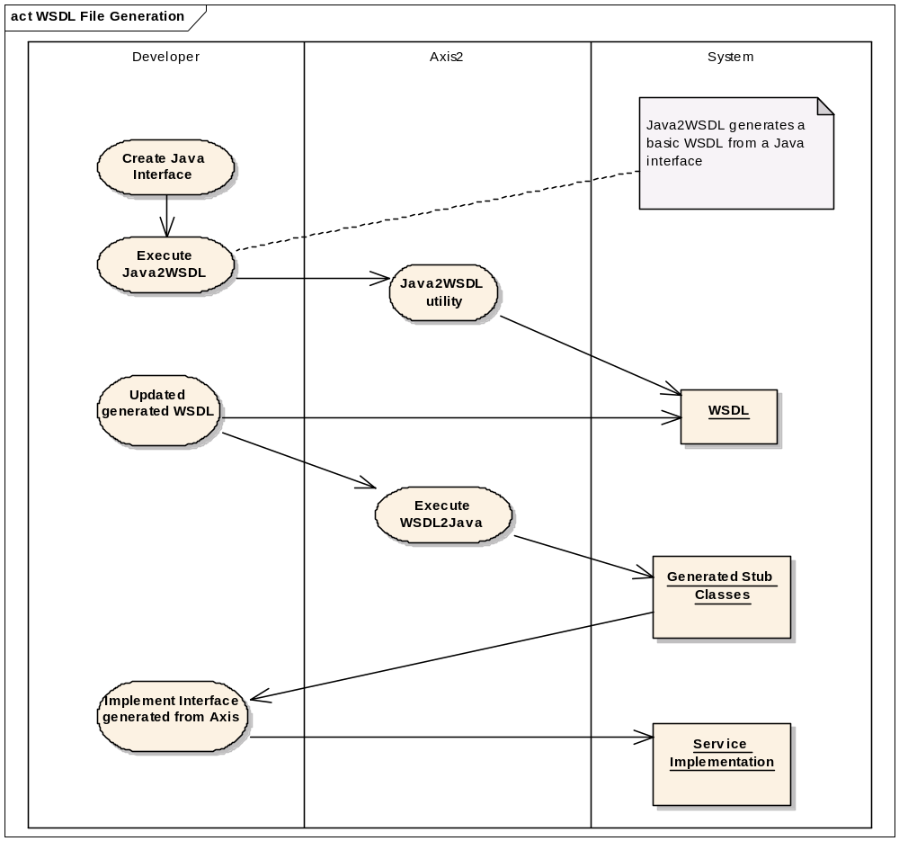
Web Service Update Process
Notes:
This slide illustrates the steps that we followed by using Axis2 to generate our Web Services. Axis2 is a pretty nice tool that creates all of the code for performing the remoting operations and the marshalling/unmarshalling of the XML. Once you generate an interface, your class just needs to implements and the request messages are simple Java Beans.

Slide 16
Web Service Demo
Notes:
Walk through a demo of a web service message getting sent over the wire. Using TCP monitor.

Slide 17
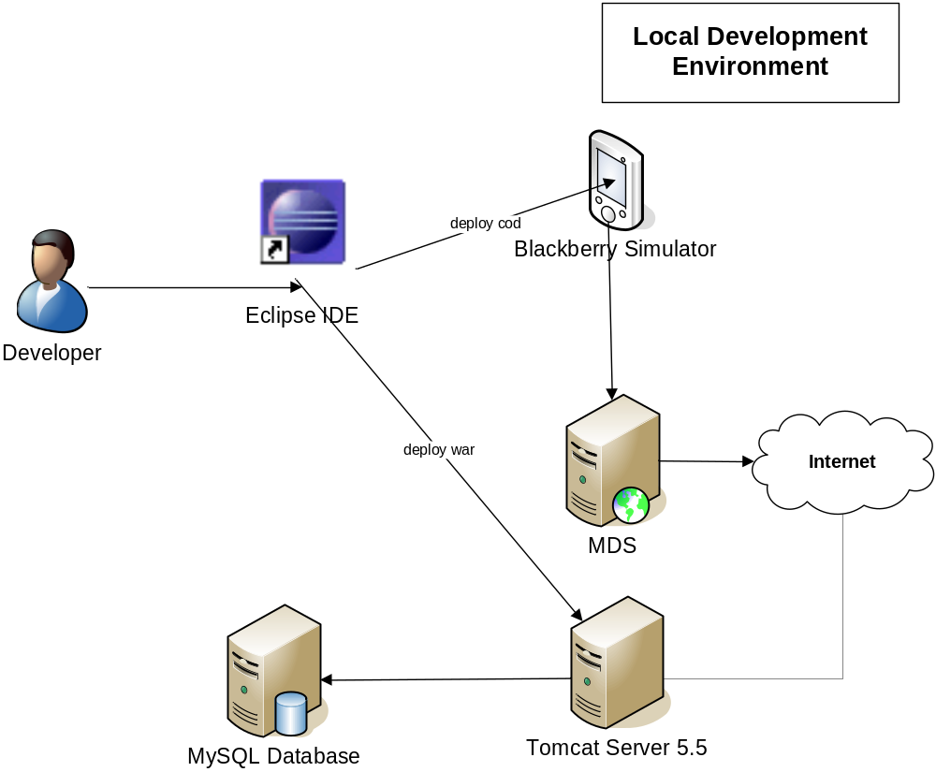
Blackberry Development

Slide 18
Mobile Data Services (MDS)
Required for accessing the web services
Needed when running the simulator
Required for the device to work for normal usage (data provider must enable)
It’s basically just a proxy server for the device

Slide 19
Blackberry API
The Blackberry API is a combination of the J2ME libraries and the Blackberry APIs
We wanted to use this library because there is better support for the features that are only available on Blackberry
The J2ME libraries lack some of the functionality that is available in the basic Java API

Slide 20
Mapping Technologies
The choices that we had to investigate:
  Google Maps
  Yahoo Maps
  Microsoft Maps
  Blackberry Map
These APIs only have basic features available from a custom program
Even the Blackberry API only displays an image rather than something interactive
We found two APIs that seemed to do what we wanted and were FREE
  J2MEMaps and MGMaps

Slide 21

Decision: J2MEMaps vs. MGMaps
J2MEMaps
  Works with J2ME devices
  Provided place mapping and selection
  Supports KML for location images
MGMaps
  Works with J2ME and Blackberry API
  Provided place mapping and selection
  Supports KML for location images
  Plugs into CloudMade for turn-by-turn directions
Winner: After three weeks… MGMaps!

Slide 22
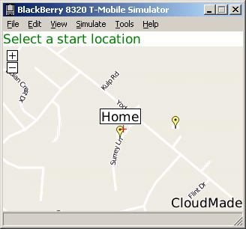
MGMaps
Map can be centered on a latitude/longitude point
Places are added using lat/long
Map can be navigated using keys mapped in program
Places are selected by selecting the trackball
Events are sent back to your code via listeners

Slide 23
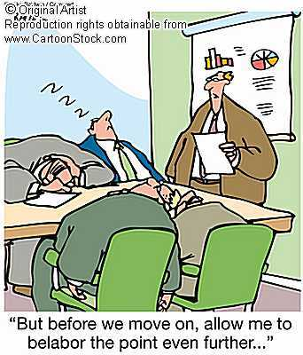
Live Demo

Slide 24
Testing – JUnit
Method name | Assertion | Description | Expected Result
testLoginSuccess | Logon response value is not equal to 6000. | Test to ensure logon and password is correct. | Not 6000
testLoginFailure | Logon response is 6000. | Test to ensure the password is incorrect. The value 6000 represents an error. | 6000
testGetUser | User is not null. | Retrieve user eborisow from the database. | Not Null
testGetBadUser | User is null. | Retrieve user badUser from the database. | Null
testGetNoUser | User is null. | Retrieve user “” (empty string) from the database. | Null
testGetUserById | User ID is not null. | Retrieve user id 11111 which points to user eborisow | Not Null
testGetBadUserById | User ID is null. | Retrieve user id 23432 which points no user | Null
testGetNoUserById | User ID is null. | Retrieve user id “” which points no user. | Null

Slide 25
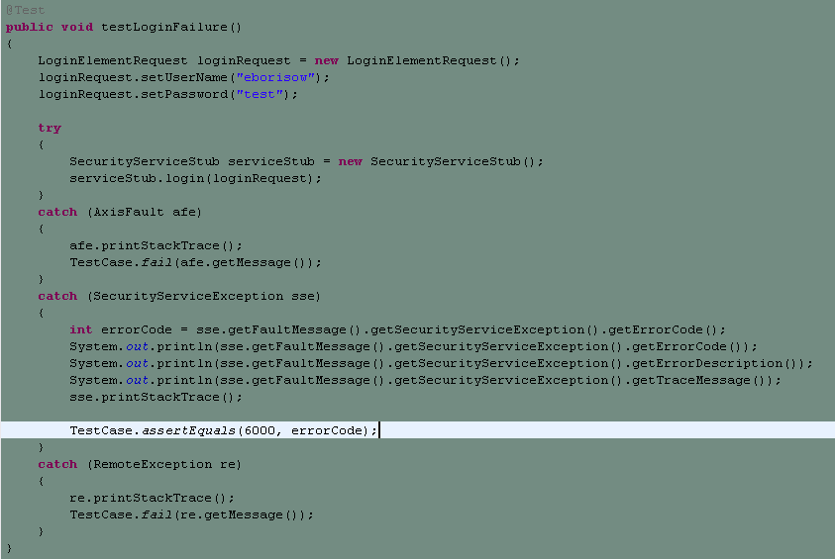
Testing – JUnit

Slide 26
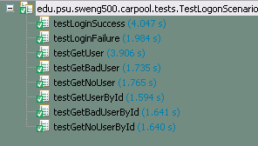
Testing – JUnit

Slide 27
Testing – Results
Testing were based on Scenario testing.
Single scenario verifies multiples requirements.
Fours scenarios to verify all requirements.
Test Case | Name | Result
TC-01 | Logon | PASS
TC-02 | Search trips | PASS
TC-03 | Create default location | PASS
TC-04 | Create trip | PASS

Slide 28
Testing – Traceability matrix
Test Cases/Req ID | TC-01 | TC-02 | TC-03 | TC-04
3.2.2.1 | x
3.2.2.2 | x | x | x | x
3.2.2.3 |  | x
3.2.2.4 |  | x
3.2.2.5 |  | x
3.2.2.6 |  | x
3.2.2.7 |  | x
3.2.2.8 |  | x
3.2.2.9 |  | x
3.2.2.10 |  | x
3.2.2.11 |  |  | x
3.2.2.12 |  |  | x
3.2.2.13 |  |  | x
3.3.2.1 |  |  |  | x
3.3.2.2 |  |  |  | x
3.3.2.3 |  |  | x | x
3.3.2.4 |  |  |  | x
3.3.2.5 |  |  |  | x
3.3.2.6 |  |  |  | x
3.3.2.7 |  |  |  | x
3.3.2.8 |  |  |  | x

Slide 29
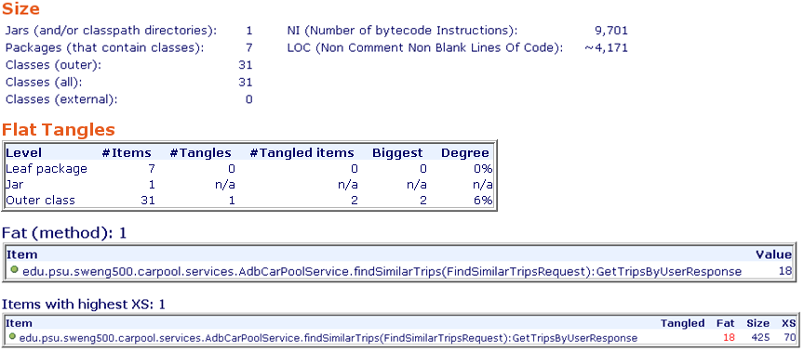
Metrics – Carpool Web Project

Slide 30
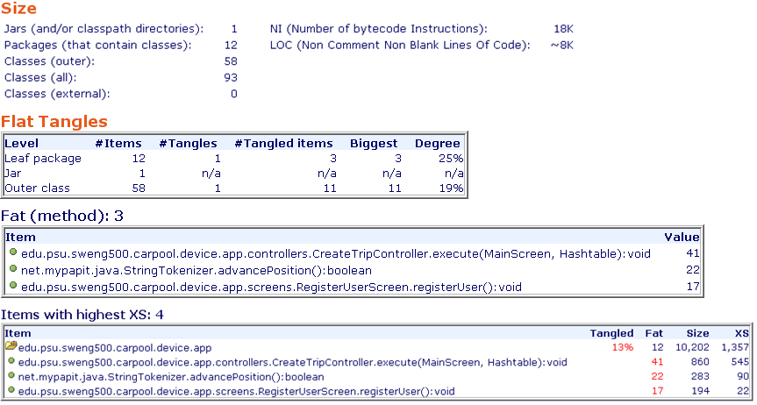
Metrics – Carpool Blackberry Project

Slide 31
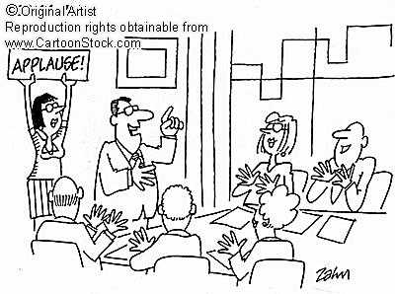
Questions?

