Slide 1
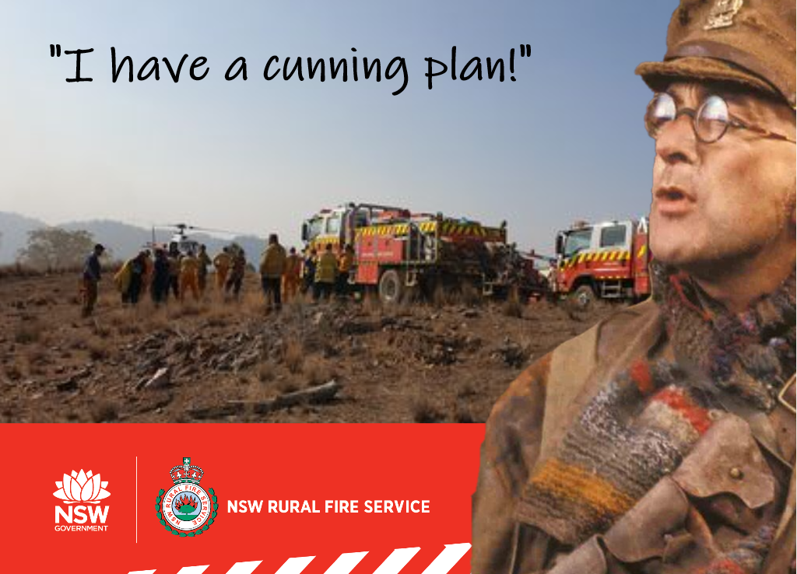
AFO Field Sampling

Slide 2
How to Sample
3 plots per Fuel Type/TSLF combo (suggested sampling point), at least 50 m apart.
Set up 20 m transect at least 50 m from road.
10 measurements (i.e. every 2 m) along transect of height of each strata
Cover will be assessed using the point intercept method.
Litter cover, if the ruler touching: 1 = Litter, 0 = Bare Ground.
NS and Elevated cover, if ruler touching: D = dead, L = live fuel or N = no fuel.
Use the provided fuel hazard guide to assess Bark Hazard, the app should auto populate this.
Measure the height of 3-5 trees using the range finder1. Measure Canopy cover using suggested apps2,3 or visually estimate4.
Take photos of bark, elevated fuel and general site.

Slide 3
What to Sample
Surface
Near Surface
Elevated
Tree Height
Canopy Cover
Bark hazard

Slide 4
What to Sample
Surface
Leaves, twigs, bark and other fine fuel lying on the ground
Predominantly horizontal in orientation
Usually contributes the most to fuel load or quantity
Includes the partly decomposed fuel (duff) on the soil surface.
% cover: 10 reps – hit/miss
depth: 10 reps – hit/miss
Near Surface
Elevated
Tree Height
Canopy Cover
Bark hazard

Slide 5
What to Sample
Surface
Near Surface
Live and dead fuels effectively in touch with the ground but not lying on it
Fuel has a mixture of vertical and horizontal orientation
Either the bulk of the fuels is closer to the ground than the top of this layer, or is distributed fairly evenly from the ground up
Sometimes contains suspended leaves, bark or twigs
% cover: 10 reps – hit/miss
height: 10 reps – hit/miss
Elevated
Tree Height
Canopy Cover
Bark hazard

Slide 6
What to Sample
Surface
Near Surface
Elevated
Fuels are mainly upright in orientation
Generally most of the plant material is closer to the top of this layer
Sometimes contains suspended leaves, bark or twigs
Fuels that have a clear gap between them and the surface fuels
% cover: 10 reps – hit/miss
height: 10 reps – hit/miss
Tree Height
Canopy Cover
Bark hazard

Slide 7
What to Sample
Surface
Near Surface
Elevated
Tree Height
3-5 reps – range finder
Canopy Cover
Bark hazard

Slide 8
What to Sample
Surface
Near Surface
Elevated
Tree Height
3-5 reps – range finder
Forestry Pro Rangefinder
Canopy Cover
Bark hazard

Slide 9
What to Sample
Surface
Near Surface
Elevated
Tree Height
Canopy Cover
5 reps – Habitapp2 or CanopyApp3
Bark hazard

Slide 10
Bark Hazard
See Fuel Hazard Assessment Guide

