Slide 1
AccesSim : Simulation of accessibility in urban settings and experiments in teaching applications
Matthieu Delage, Florent Le Néchet, Thomas Louail, Hélène Mathian, Sébastien Rey Coyrehourcq
Géographie-Cités (Univ.Paris 1, Univ. Paris 7, CNRS)
LVMT (Ecole des Ponts et Chaussées)
IBISC(Univ. Evry Val d’Essonne)

Slide 2
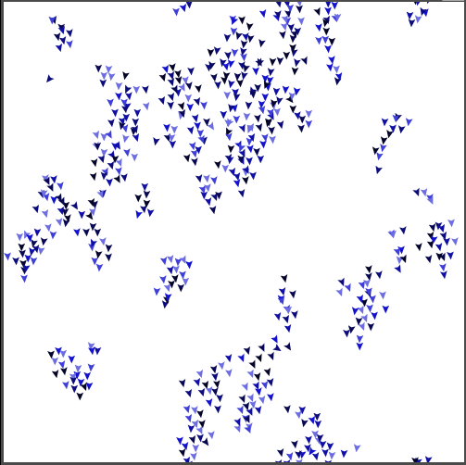
Netlogo
Logiciel gratuit
SMA et automates cellulaires
Programmation « simple »
Bibliothèque de modèles classiques
Modèle « Flocking »
Notes:
Équité / Inégalité

Slide 3
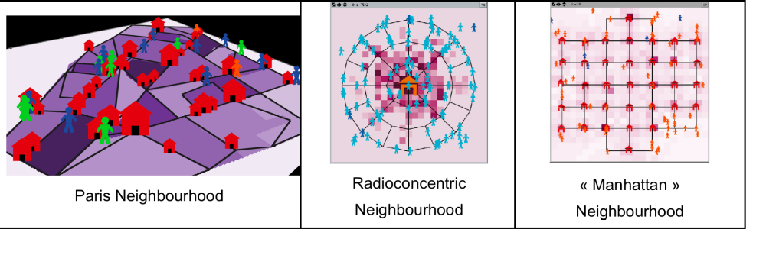
Developing a teaching tool of geographical core notions
Key concepts : Accessibility in an urban setting, relationships between services localisations, network configuration, accessibilities of the services
Why ? To familiarize scholars with the notions of centrality and territorial inequalities
How ? By simulating it and by playing it !

Slide 4
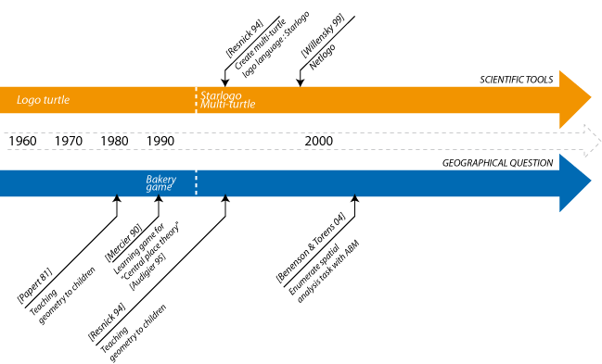
Scientific tools and geographical questions

Slide 5


Pedagogy of agent-based representations ?
PROS
  Focus on entities and their behaviors
  Expressive, heuristic, anthropomorphic
  More structure, less abstraction
CONS
  The more realistic, the harder to analyse and to control
  GUI’s Simplicity hides internal complexity
  Computation reasonement

Slide 6
AccesSim : principles & framework
Accessibility in an urban environment
Focus on regular pedestrian movements
Daily movements by residents to access services
2 points of view on accessibility:
  the city resident : individuals equal needs to services access => territorial planning
  the services : frequentation depends upon the overall accessibility and user potential => geo-marketing
Benefit of the turtle Force : Netlogo modeling

Slide 7
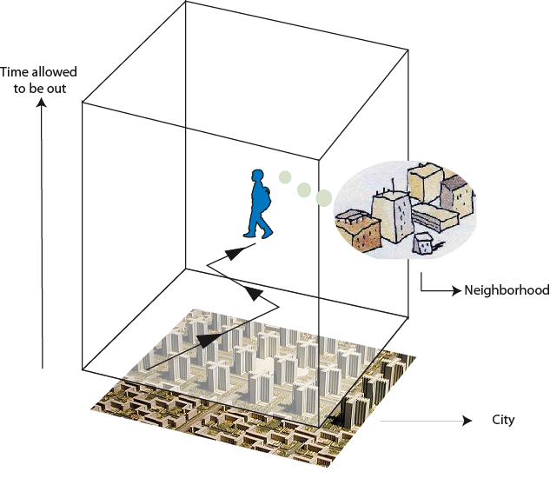




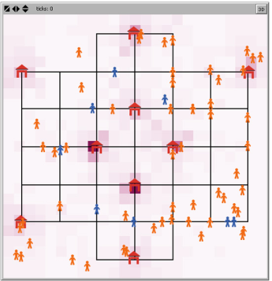
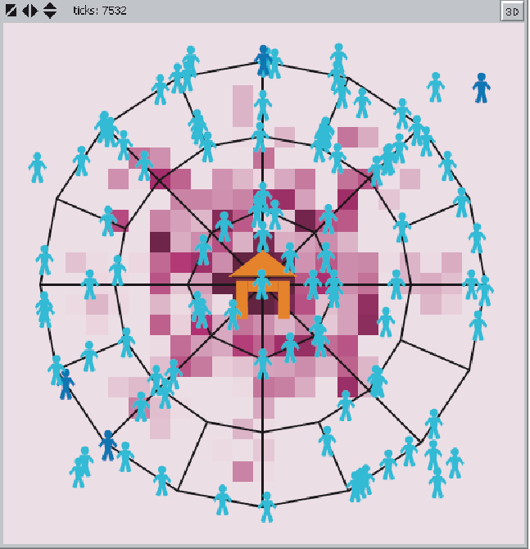
Scales and entities
Geographical reality
Accessim
  Shops and people as individual agents
  Neighborhoods agents
  City transport network
Geographical
scale

Slide 8
Behaviors of the children-agents
Pioneers: Move randomly on the network (try to find new bakeries)
Followers : Choose the most popular OR the quickest path to the services.
Their constraints
They need to go to the bakeries
They have to come back home after a fixed time
They memorize their current path only and its distance cost
They share this perfect information in their neighborhood
Their limits…
They don’t come back home… just disappear !
They have no habits, each time looks like… the first time

Slide 9

Behaviors of the bakery-agents
Simple Algorithm
  Renewal of the stock is deterministic and based upon the children demands (adapted from Comets 2004)
Rent paid to city (uniform)
If unable to pay rent, disappear
Children buy chocolate breads
$
Money lost from non-adapted stocks
~ Unsold stock cannot be sold the next day
~ Clients loss if stock is empty before the end of the day
OR
$
each day
$
Adjustment variable : stock prepared (cost money)
Notes:
Quel part du chiffre est payé à la ville ?

Slide 10


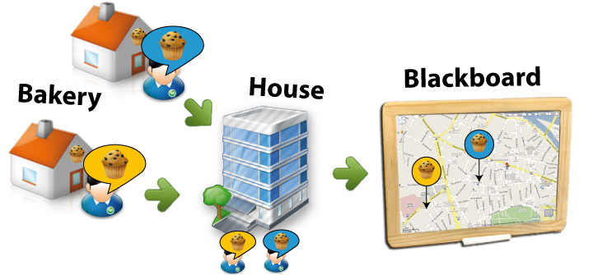
Behaviors of the neighborhoods
Memory place
Knowledge associated
1- Memorize knowledge

Slide 11
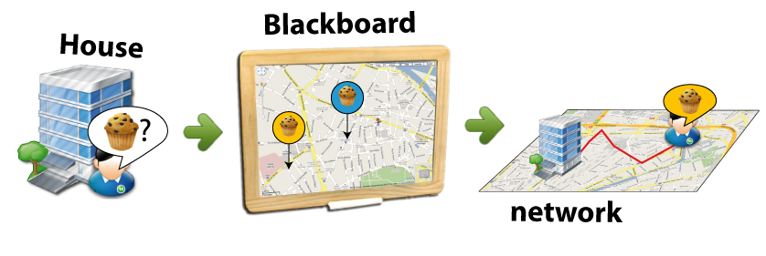
Behaviors of the neighborhoods
2 - Get knowledge

Slide 12
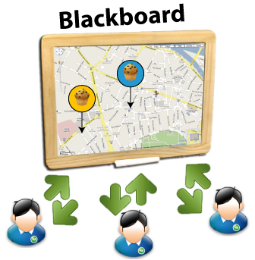
Blackboard communication and reactive optimization
Symbolizes the « collective intelligence »
  Mimics the information exchanged in the school yard
  Blackboard communication (shared read-write memory)
  On the long run results in reactive, non-intentional shortest path “optimization”
  Chocolate taste is let aside… :/

Slide 13
Learning space and spatial inequalities

Slide 14
Emergence of favorite paths

Slide 15


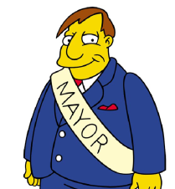
2 Games
2 roles for the child-player
MAYOR
  GOAL : Be re-elected
  Starting point : already-constituted city (densities, networks)
  Has "authority" over the positioning of all the bakeries
  3 real-time indicators to assess his development strategy:
    The rate of satisfied children-agents (to MAX)
    The average distance they walked (to MIN)
    The wealth accumulated by the bakeries (to MAX)
BAKER
  GOAL : Be the most popular baker in town
  Starting point : already-constituted city (densities, networks) AND pre-located bakeries
  What’s the best possible location for a new bakery ?
  Compares its development to that of other bakeries
  Bakeries disapear if not successful => trial and error strategies and on-the-fly visual evaluations

Slide 16
Game 2 : Be the most popular baker in town !

Slide 17
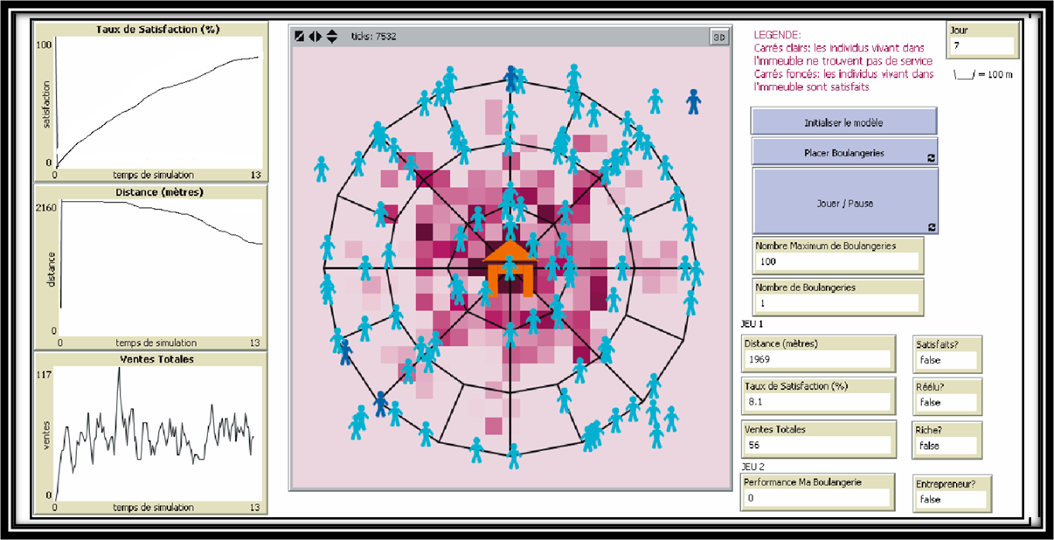
Tools for ABM Learning : GUI
Player ergonomy vs developer ergonomy
=> Key parameters and indicators on the front only

Slide 18
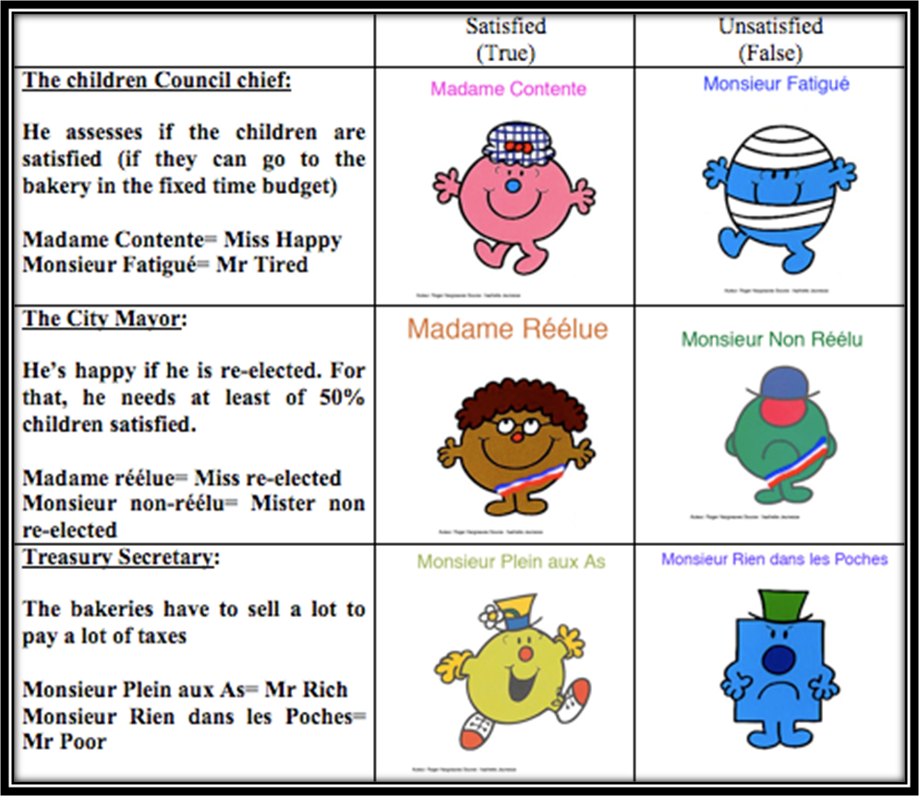
Tools for ABM Learning : restitution paper

Slide 19
Results : Benefits from children and modelers points of view
Several types of player strategies
  The « Blind red fish » strategy
  The « Maths professor’s son » strategy
Transmitted notions
  Spatial inequalities based on accessibility
  Individual vs. Collective interests
  Choices, compromises, multi-criteria decision support
  Good identification of the child-player to the 2 roles
Positive feedback for the team members on their own modeling projects

Slide 20
Perspectives
For us :
  More class experiments with more systematic investigation of learning efficiency
  Another dimension of pedagogy : show the children the code behind the geography…
For you :
  Learn to cook and try to be the best baker in town => download AccesSim on the S4 modelling platform :
  http://www.spatial-modelling.info/ACCESSIM-French-version

Slide 21
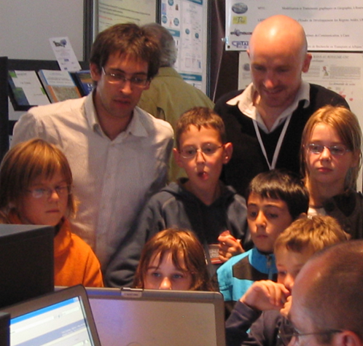
Thank you ! Any questions kids ?

