Slide 1

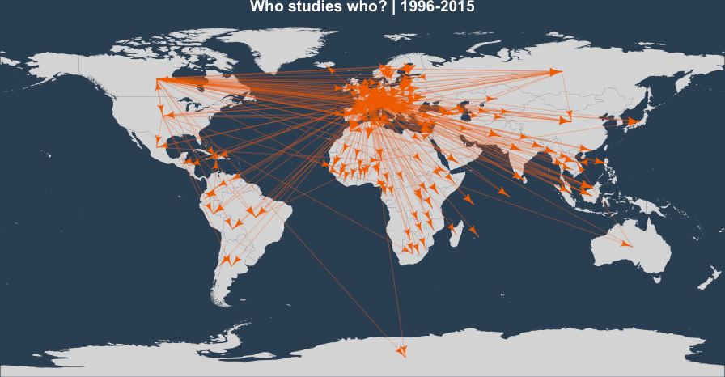

Visualizing Semantic and Geographical Networks
Hadrien Commenges, Univ. Paris 1
Clementine Cottineau, UCL-CASA

Slide 2

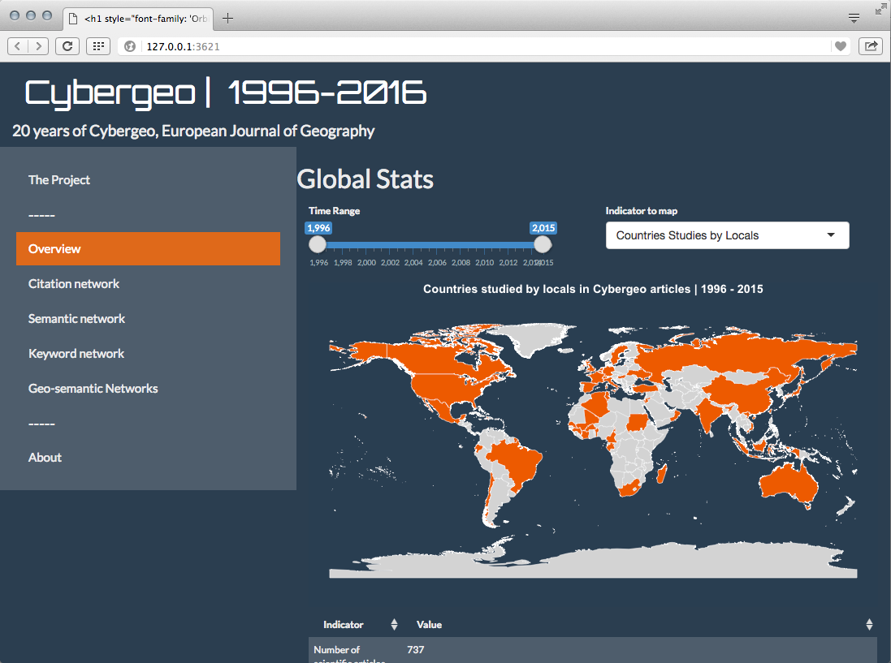
CyberGeoNetworks
shiny.parisgeo.cnrs.fr/CybergeoNetworks/

Slide 3
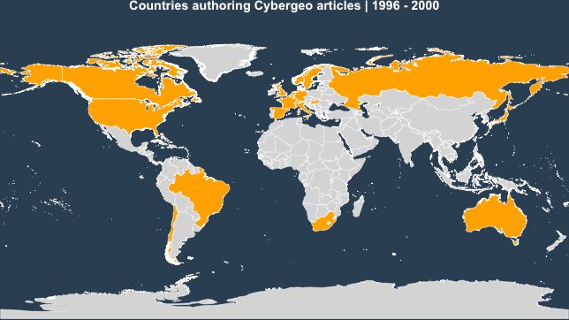
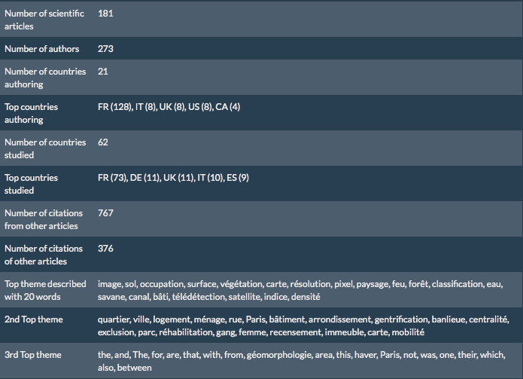
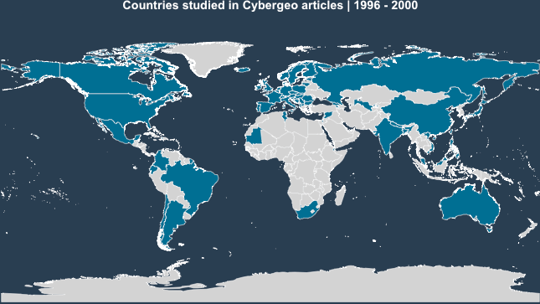
1996-2000
Authoring
Studied

Slide 4
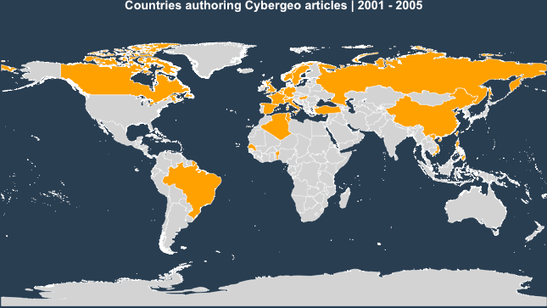
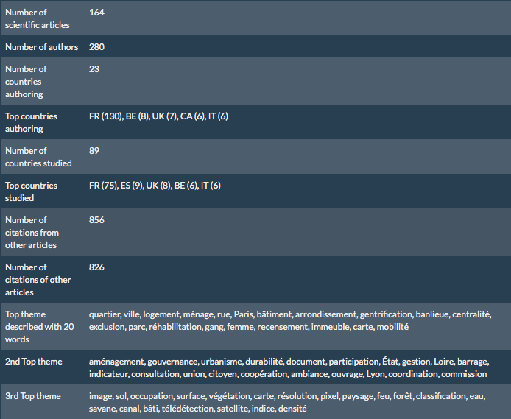
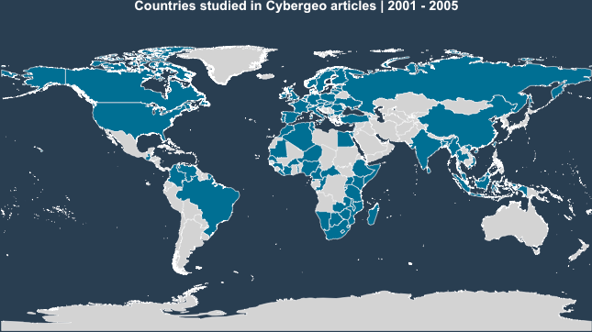
2001-2005
Authoring
Studied

Slide 5
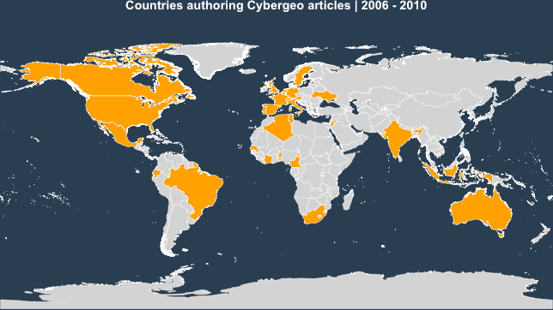
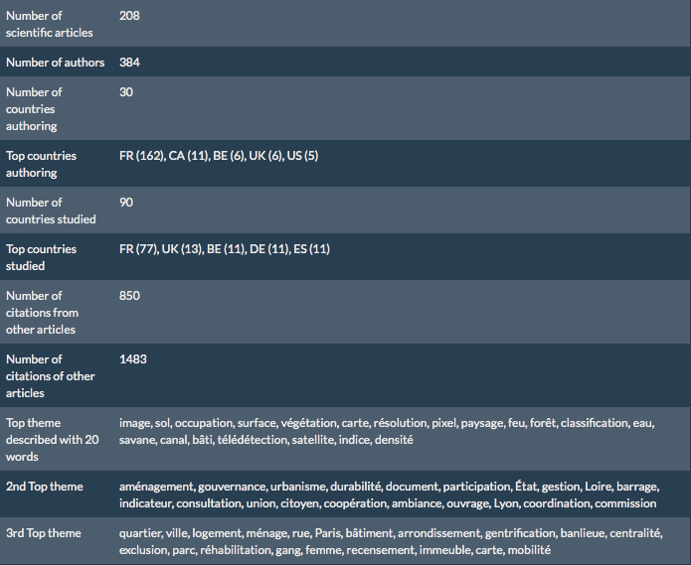
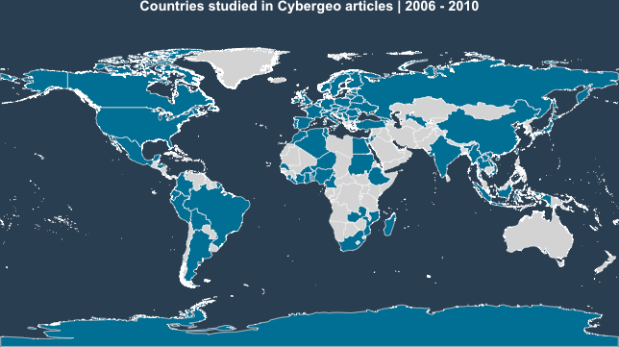
2006-2010
Authoring
Studied

Slide 6
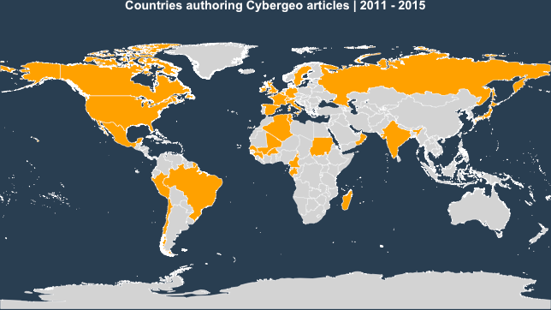
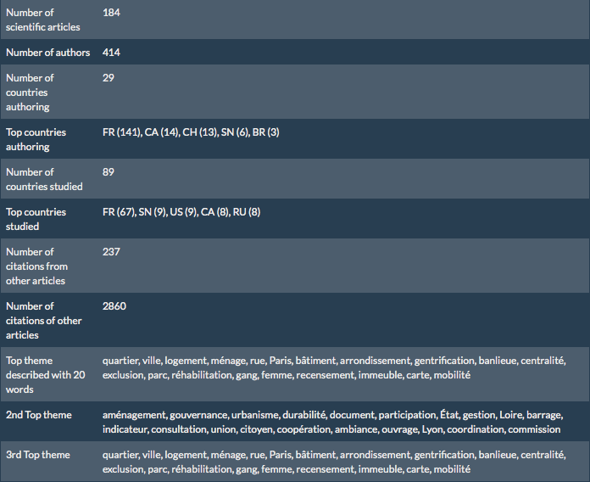
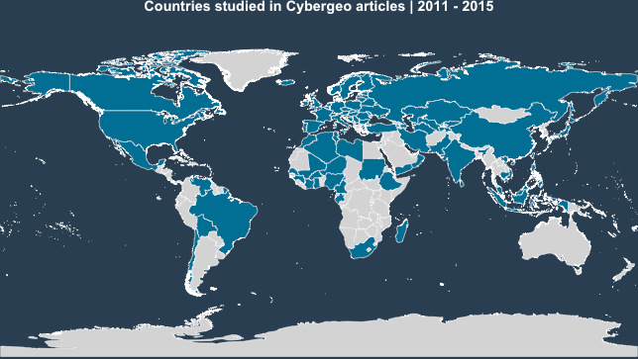
2011-2015
Authoring
Studied

Slide 7
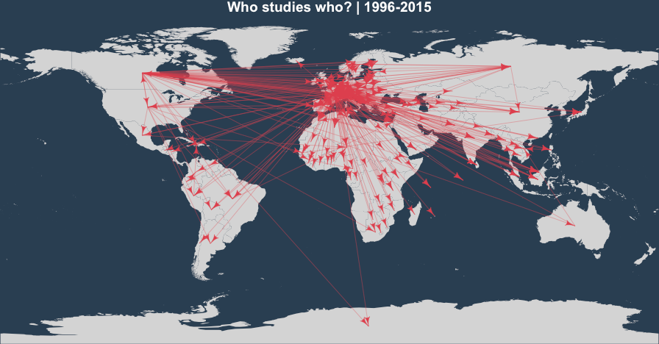
Geo-authoring networks

Slide 8
20 years of Cybergeo
More articles published
Spread of geographical Objects
Diversification + French-speaking predominance for authorship
Growing connexion in citation networks

Slide 9
Declared keywords
Two main approaches in bibliometrics:
Studying actual research: co-publications, colloquium participation, formal research networks
Studying declared research: themes, trends, keywords

Slide 10
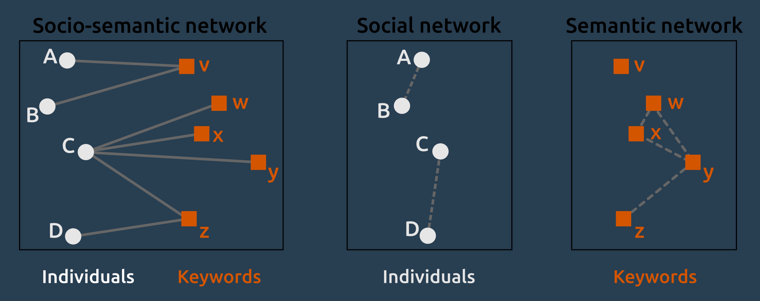
Declared keywords
An undirected valuated semantic network is built:
2 keywords are linked if they are shared in the research interests of one researcher
individual networks are collapsed and summed

Slide 11
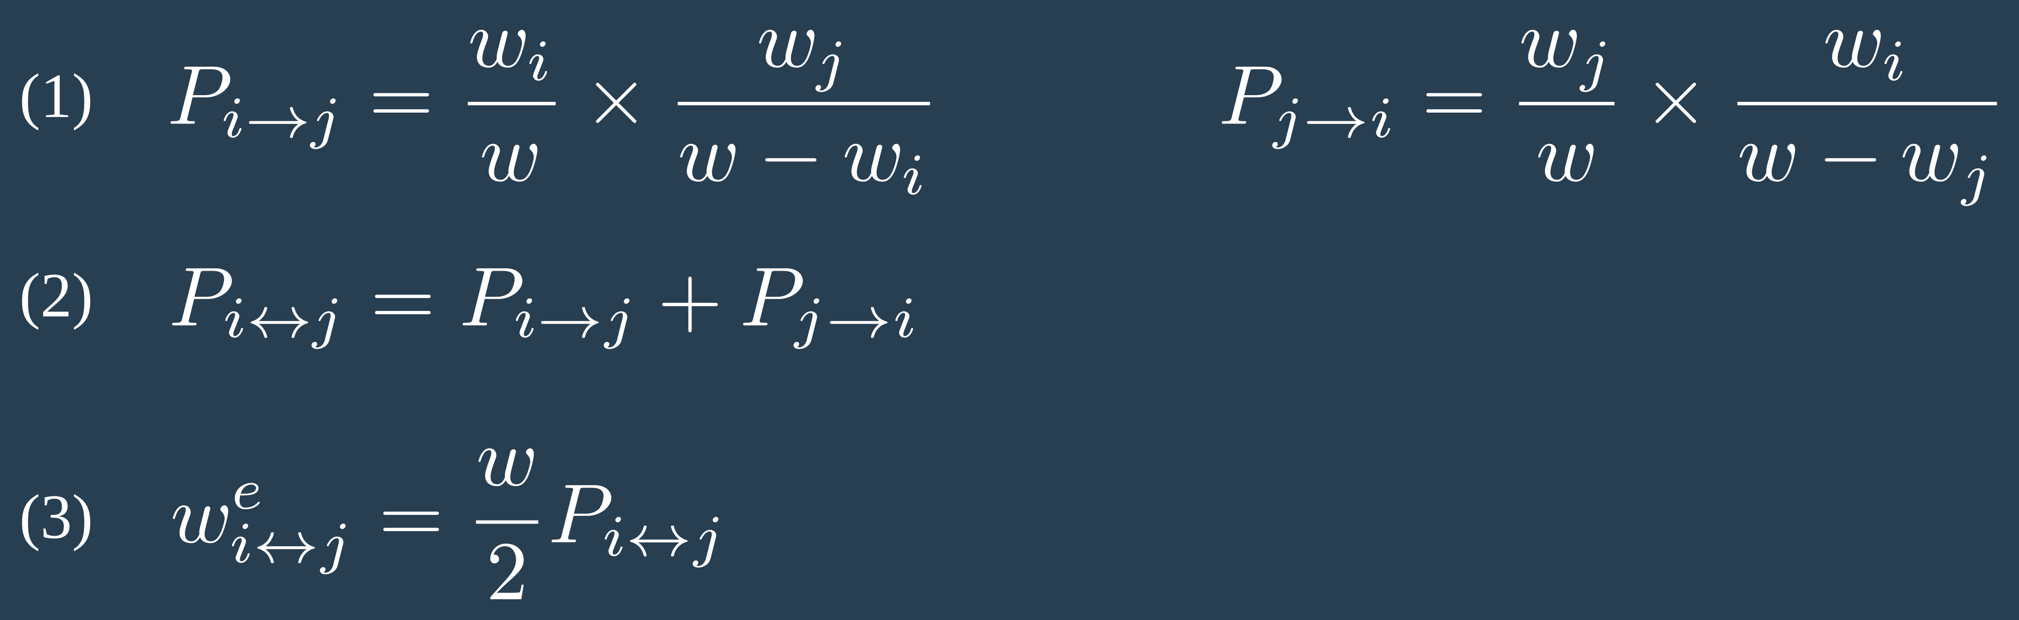
Declared keywords
Correspondence analysis: 250 dimensions poorly correlated
Network metrics: for two keywords i and j, comparison between observed weight (w_{ij}) and expected weight (w_{ij}^{e})

Slide 12
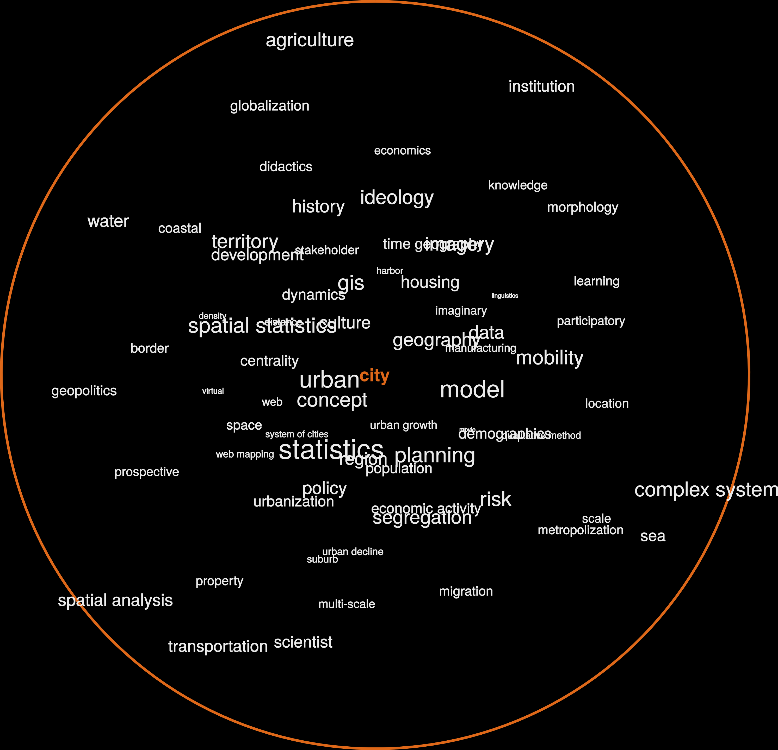

Slide 13
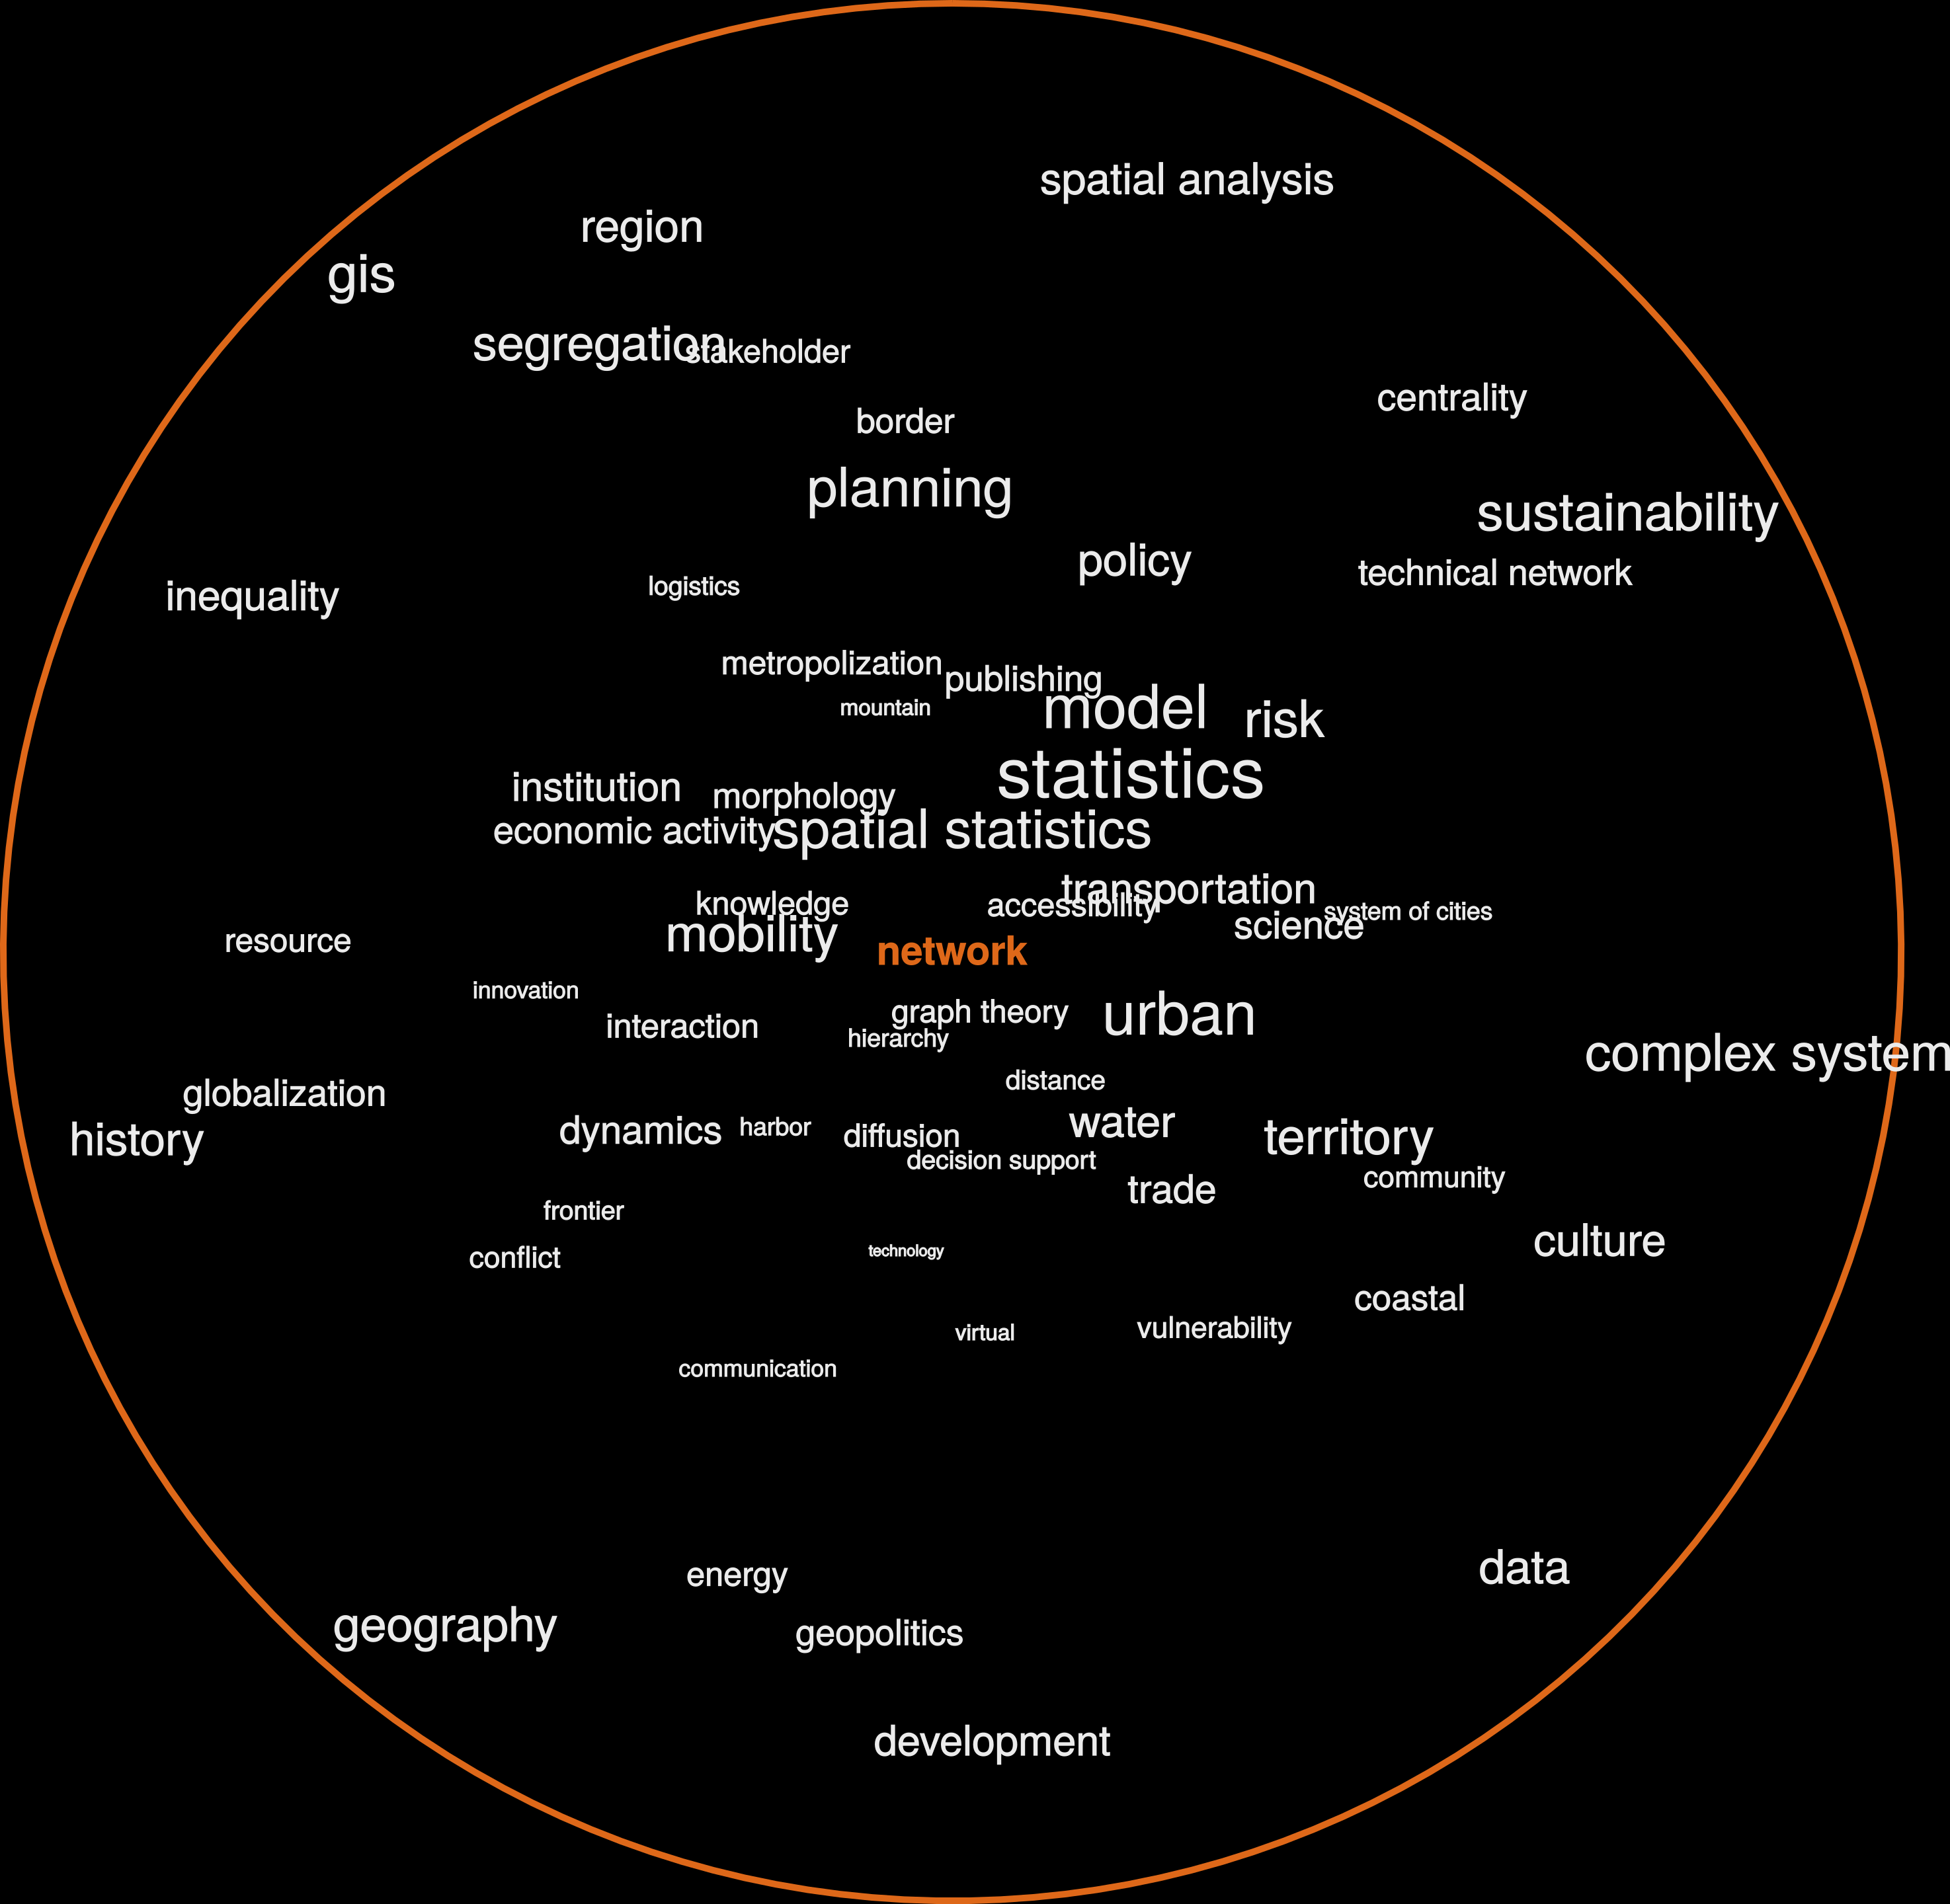

Slide 14
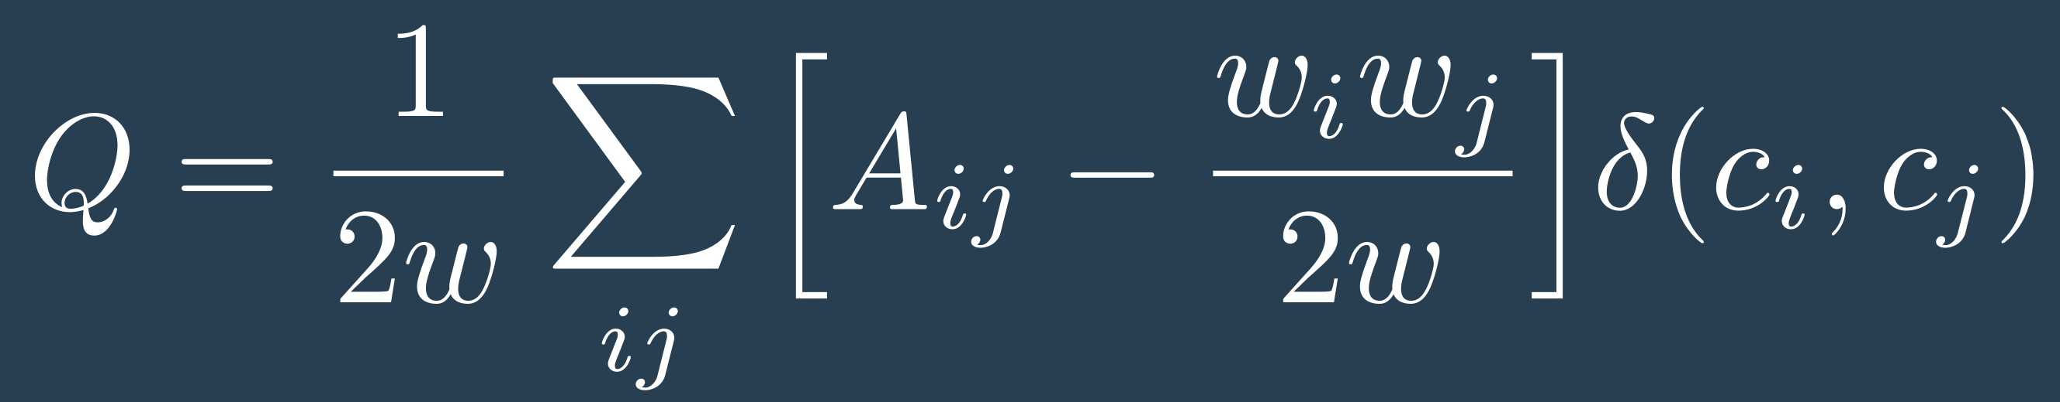
Declared keywords
Community detection:
modularity optimization (Louvain algorithm)

Slide 15
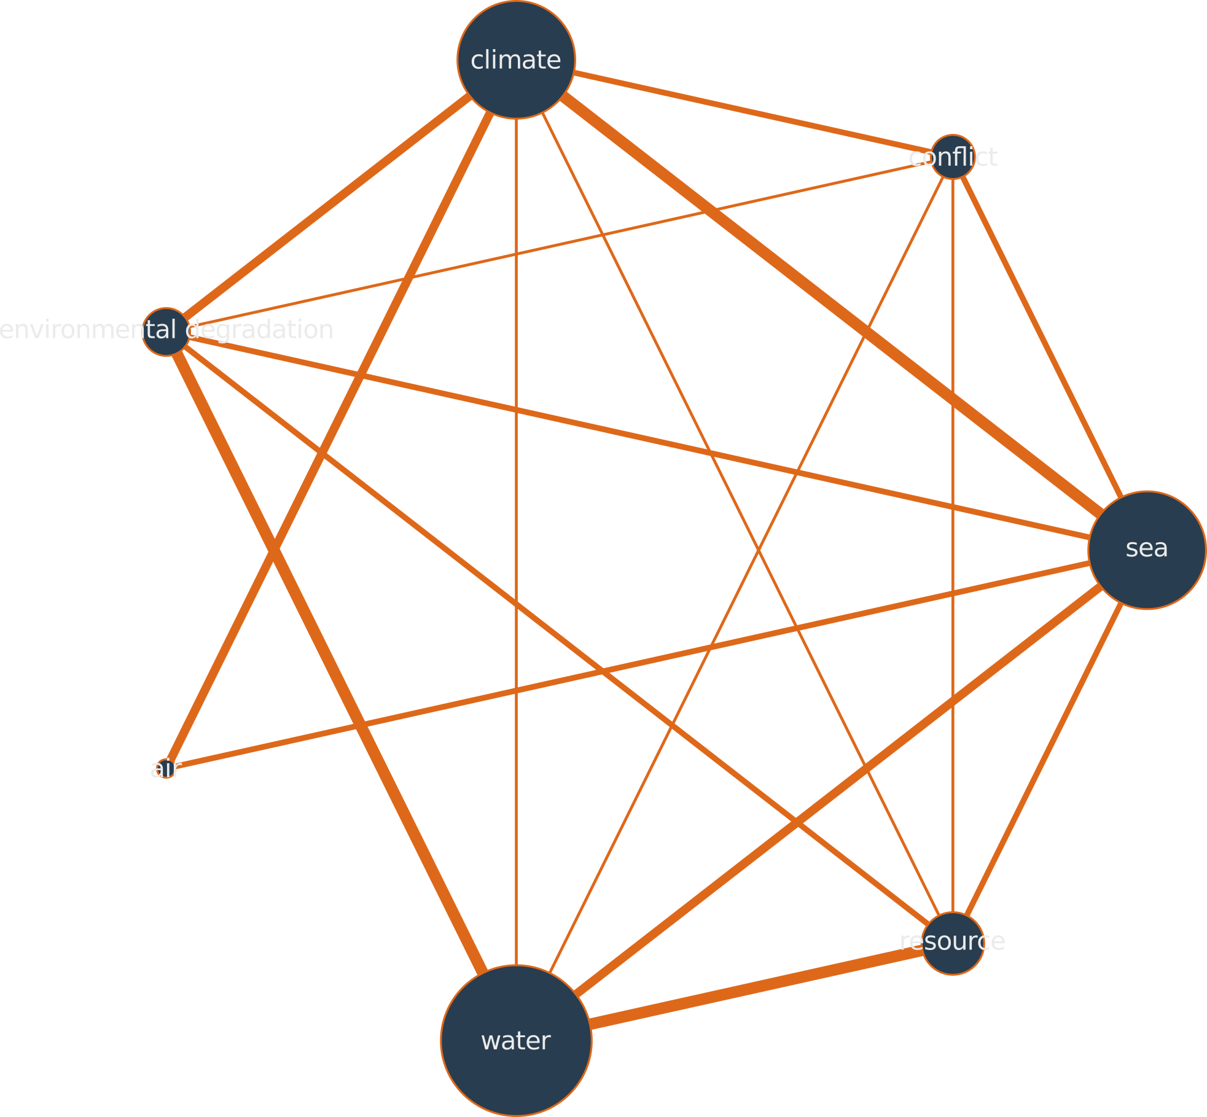
Environment

Slide 16
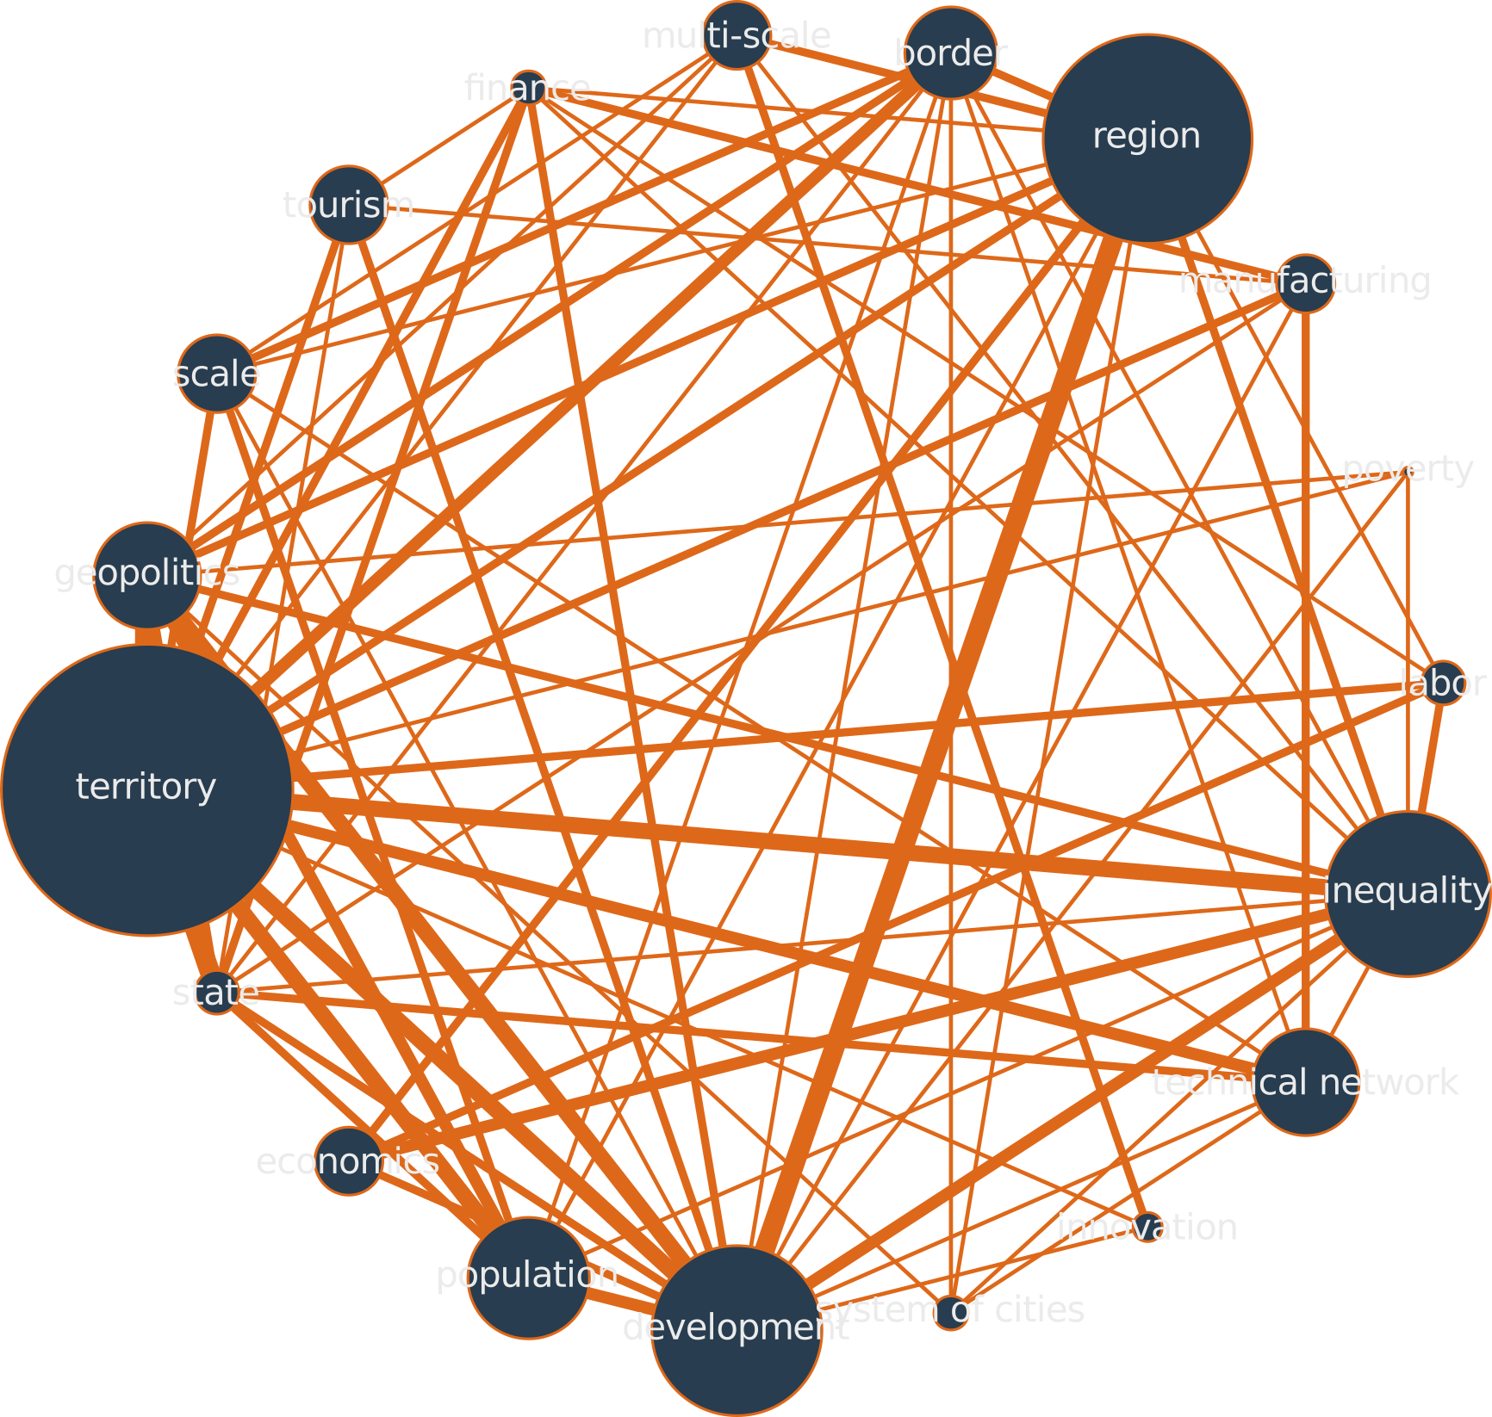
Territory

Slide 17
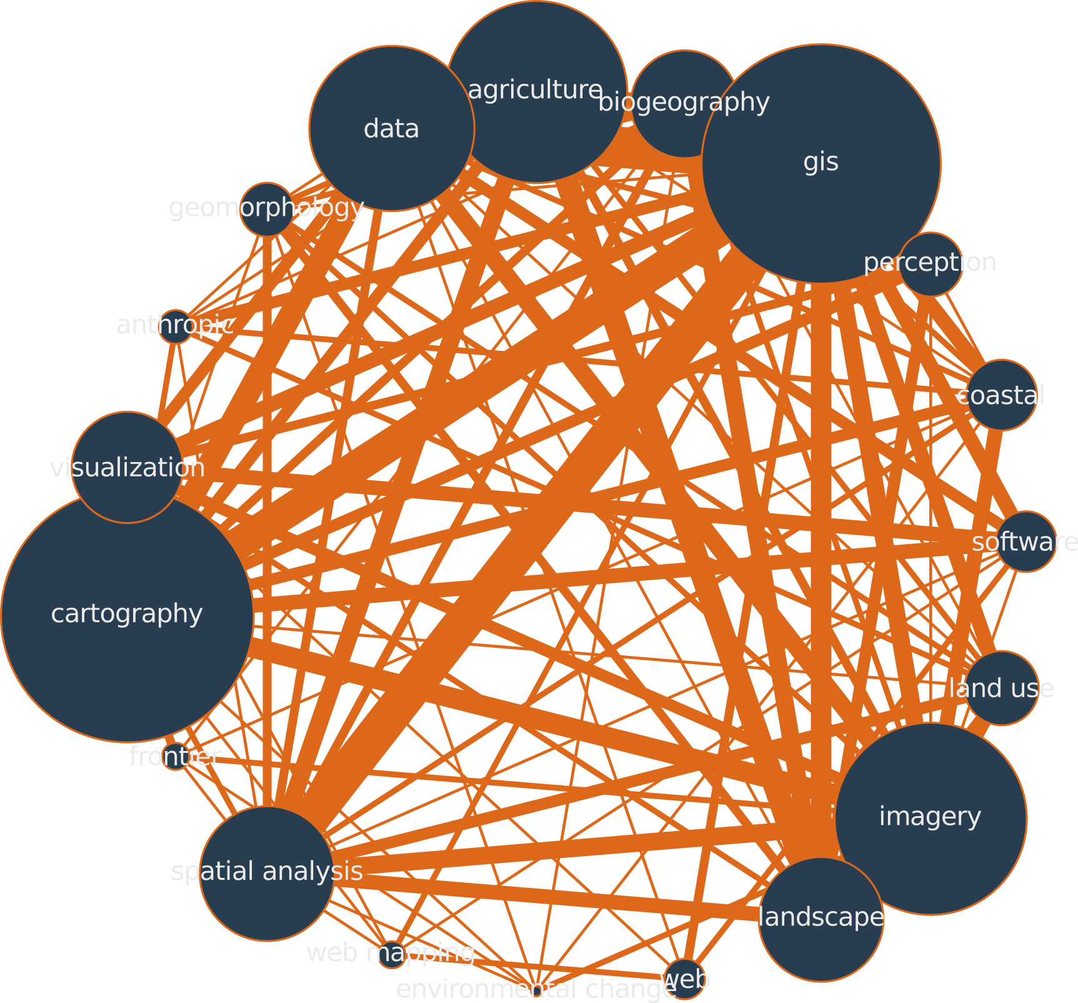
Imagery & GIS

Slide 18
Geo-Semantic Networks
Each article geocoded
Aggregation by country
Hierarchical clustering based on semantics:
- Keywords Communities(HC)
- Citations Communities (JR)
- Terms Communities (POC)

Slide 19
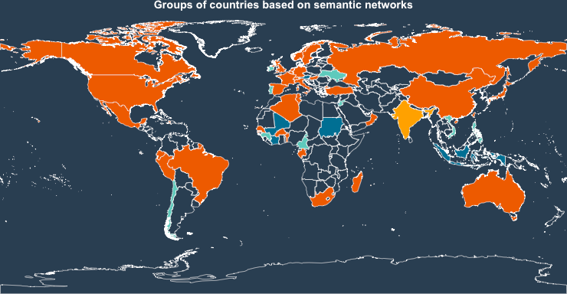
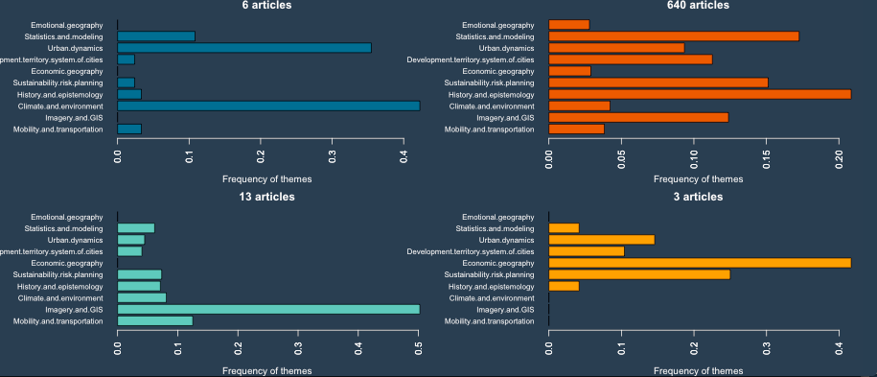
Declared Keywords (HC)
4 groups
Authoring Countries
Declared Keywords

Slide 20
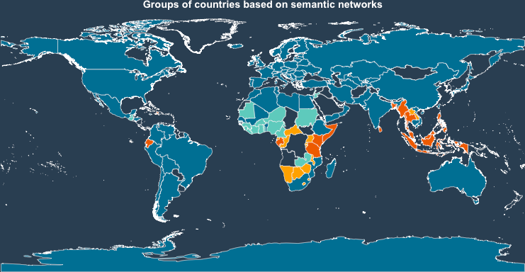
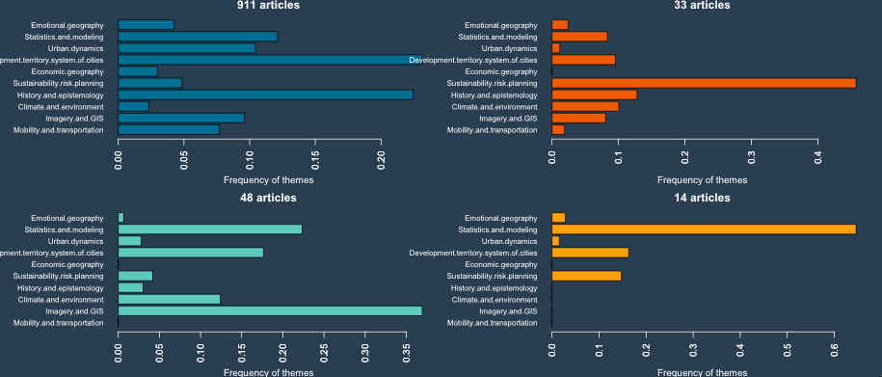
Declared Keywords (HC)
4 groups
Studied Countries
Declared Keywords
Hist. Epistemo.
Hist. Epistemo.
Sustainability
Stats. Model.
Imagery & GIS

Slide 21
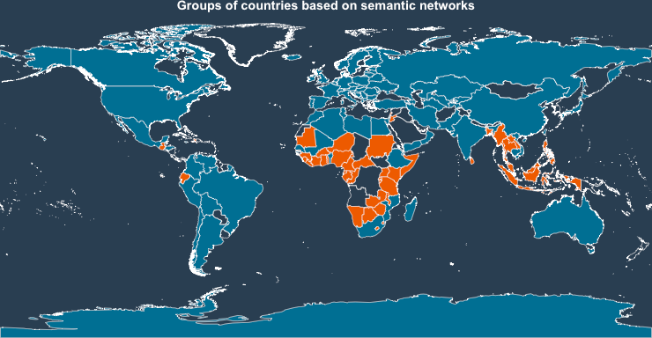
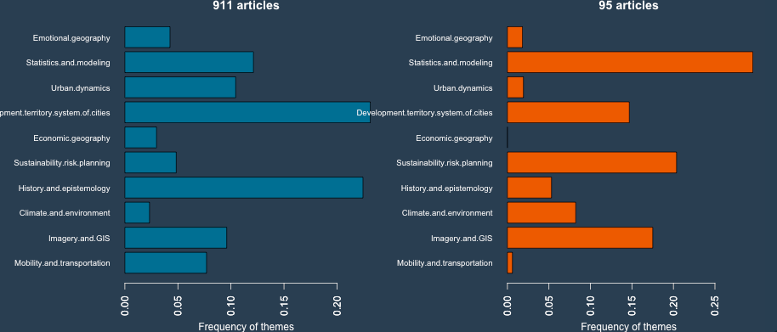
Declared Keywords (HC)
2 groups
Studied Countries
Declared Keywords
Urban Dyn.
Hist. Epistemo.
Health
Mobility
Modelling
Sustainability
Imagery

Slide 22
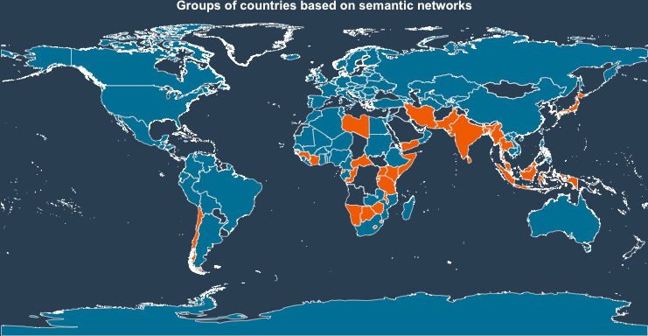
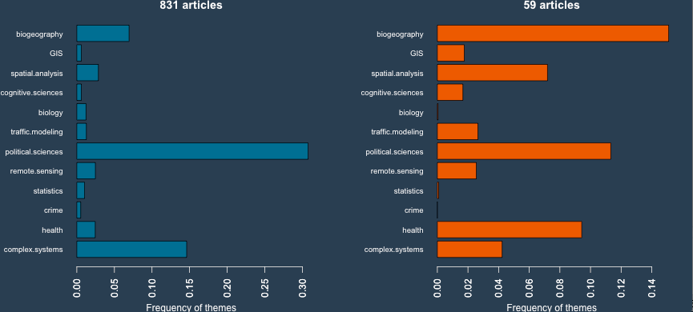
Declared Keywords (HC)
2 groups
Studied Countries
Citations Communities
Pol. Sc.
Complex Sys.
Health
Biogeo.

Slide 23
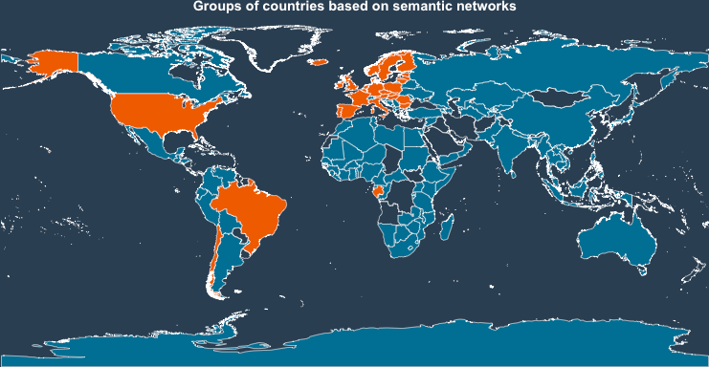
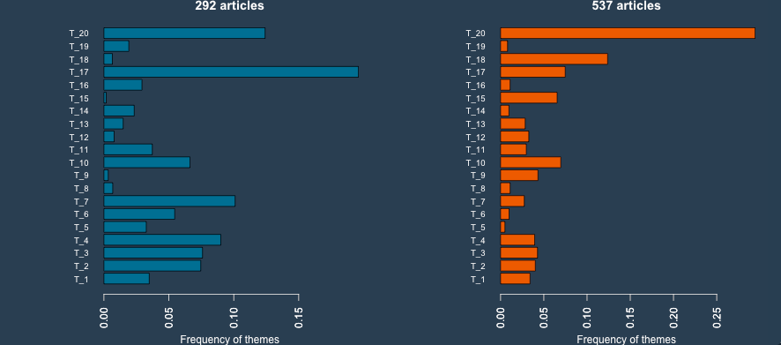
Declared Keywords (HC)
2 groups
Studied Countries
Terms Communities
Census
EN.
Governance
Tradition
State & Id.
Urban & art

Slide 24
Geo-Semantic Networks
Each semantic method...
… gives a different insight!
- Keywords Communities: how the paper is advertised
- Citations Communities: who the paper talks to
- Terms Communities: how the paper is written

Slide 25
Thank you.
CyberGeoNetworks
cybergeo.revues.org
shiny.parisgeo.cnrs.fr/CybergeoNetworks/
@chasset
@ClementineCttn
@hcommenges
@JusteRaimbault
github.com/Geographie-cites/cybergeo20

