Slide 1

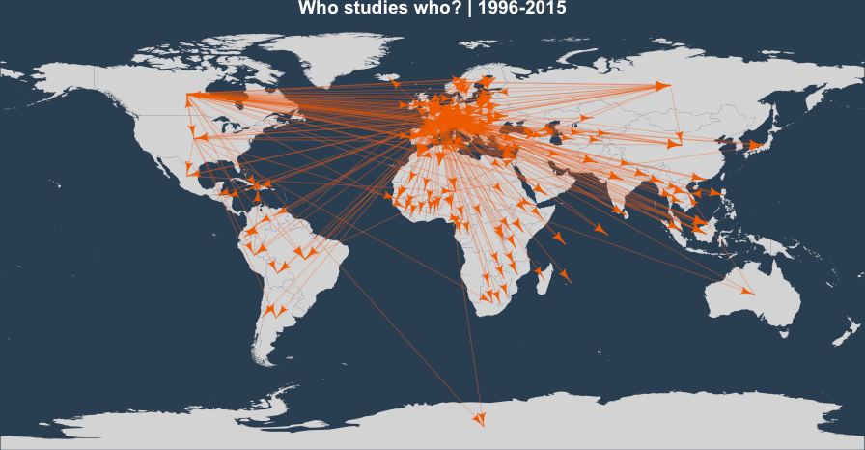

Visualizing Semantic and Geographical Networks
Hadrien Commenges, U. Paris 1
Clementine Cottineau, UCL-CASA

Slide 2
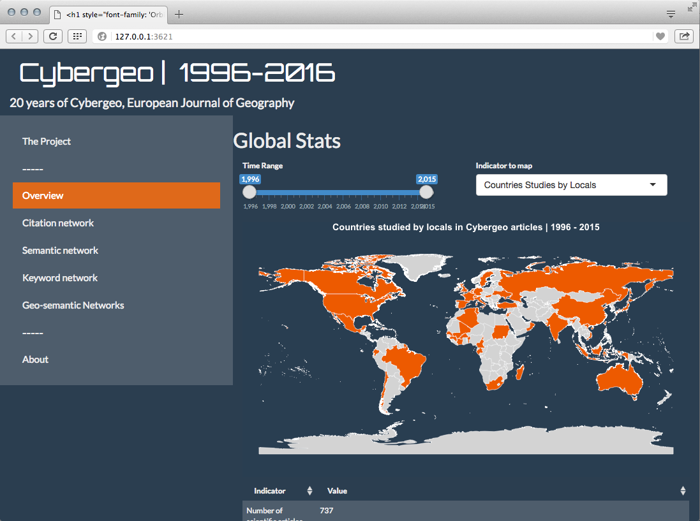

Slide 3
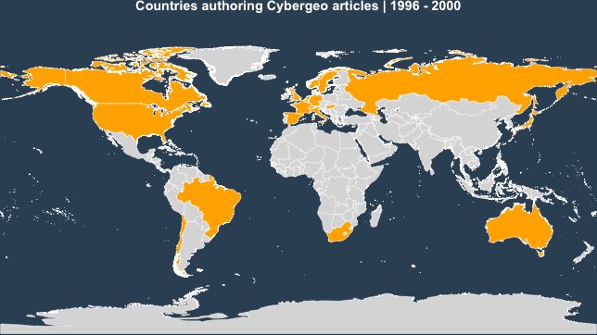
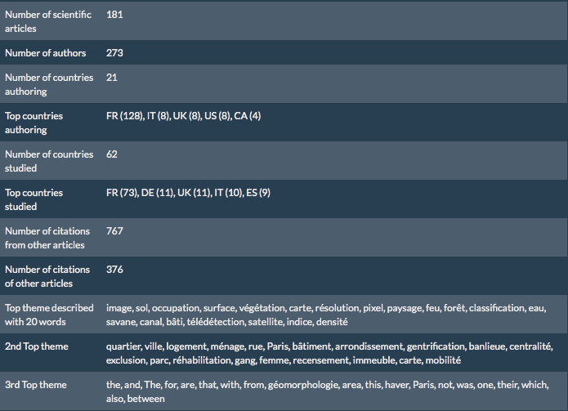
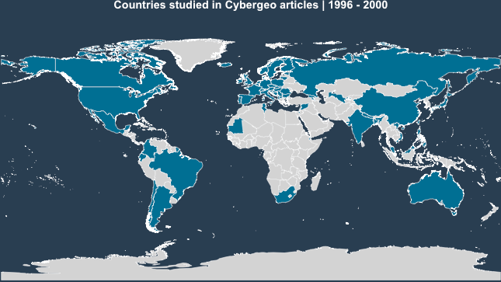
1996-2000
Authoring
Studied

Slide 4
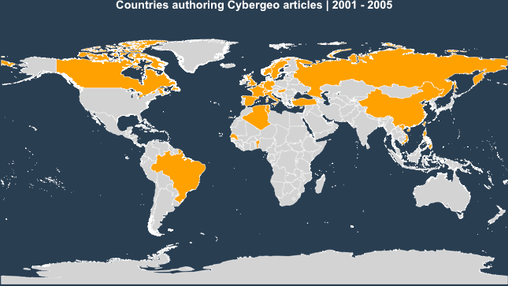
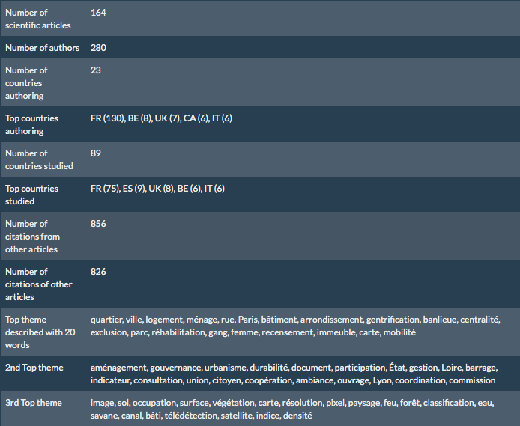
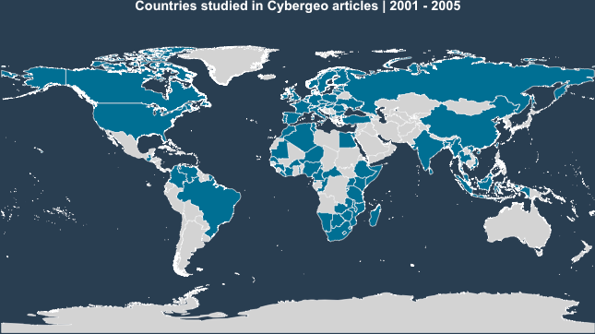
2001-2005
Authoring
Studied

Slide 5
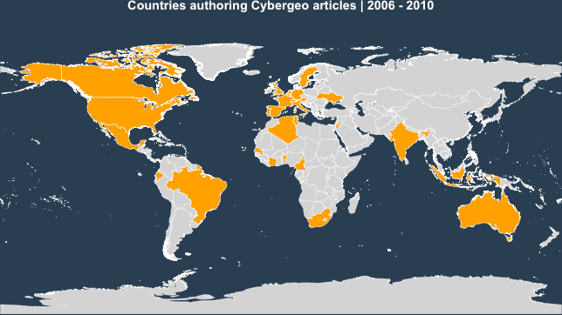
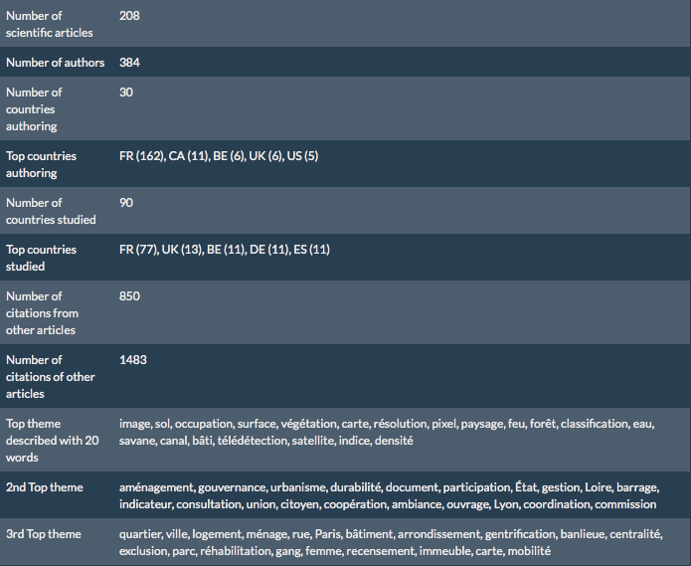
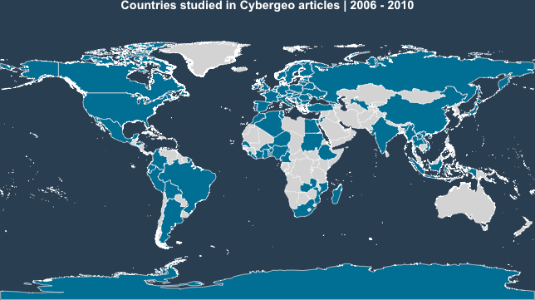
2006-2010
Authoring
Studied

Slide 6
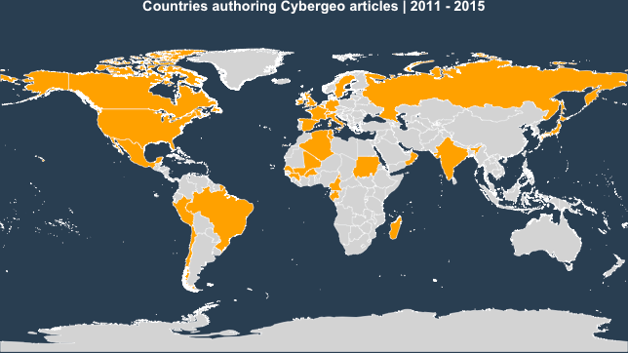
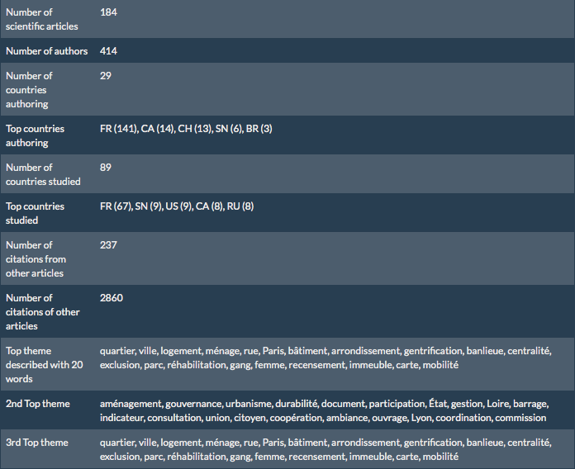
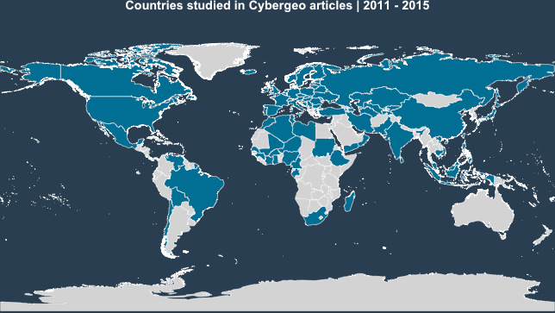
2011-2015
Authoring
Studied

Slide 7
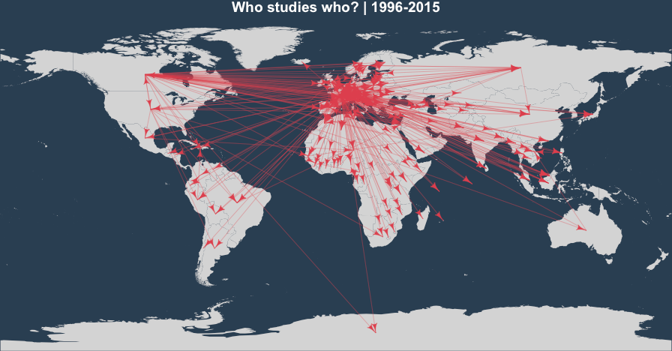
Geo-authoring networks

Slide 8
20 years of Cybergeo
More articles published
Spread of geographical Objects
French-speaking bias for authorship
Growing connexion in citation networks

Slide 9
Hadri

Slide 10
Geo-Semantic Networks
Each article geocoded
Aggregation by country
Hierarchical clustering based on semantics:
- Declared Keywords (HC)
- Citations Communities (JR)
- Terms Communities (POC)

Slide 11
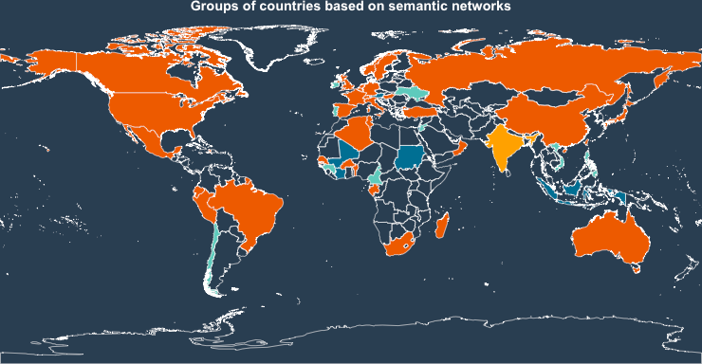
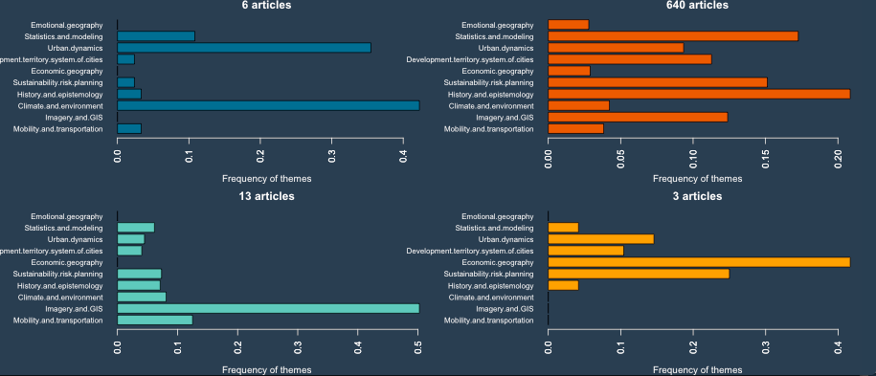
Declared Keywords (HC)
4 groups
Authoring Countries
Declared Keywords

Slide 12
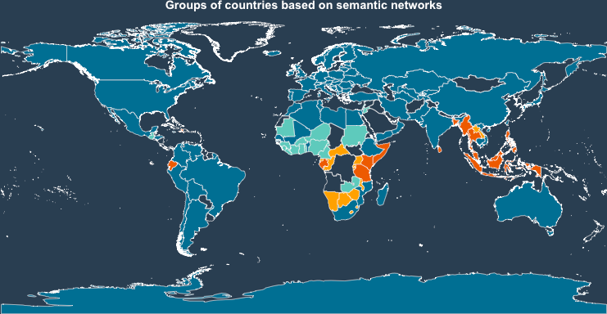
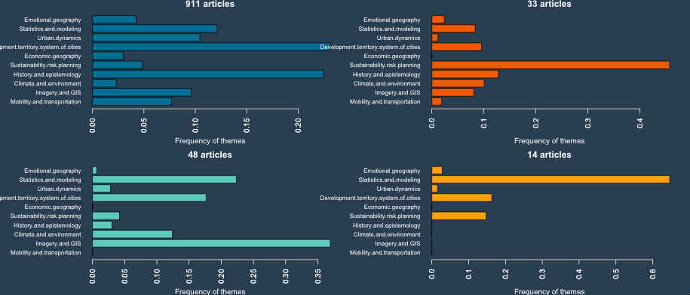
Declared Keywords (HC)
4 groups
Studied Countries
Declared Keywords
Hist. Epistemo.
Hist. Epistemo.
Sustainability
Stats. Model.
imagery & GIS

Slide 13
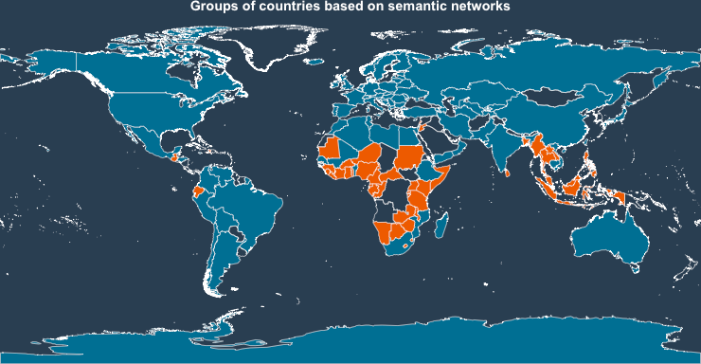
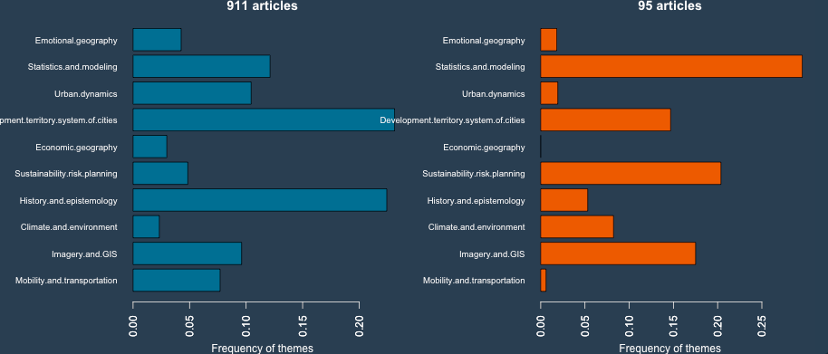
Declared Keywords (HC)
2 groups
Studied Countries
Declared Keywords
Urban Dyn.
Hist. Epistemo.
Health
Mobility
Modelling
Sustainability
Imagery

Slide 14
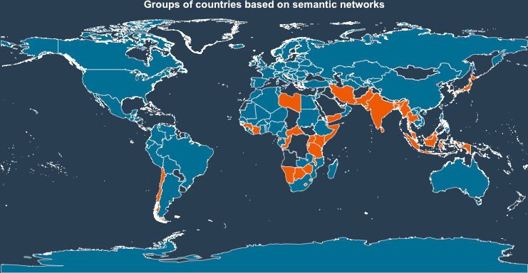
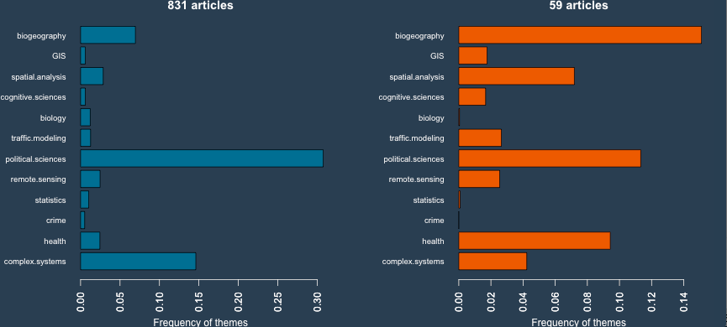
Declared Keywords (HC)
2 groups
Studied Countries
Citations Communities
Pol. Sc.
Complex Sys.
Health
Biogeo.

Slide 15
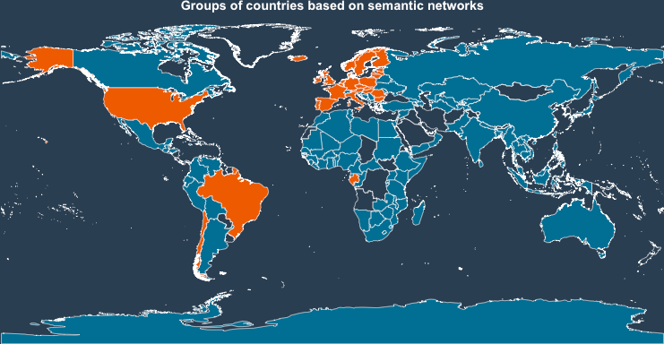
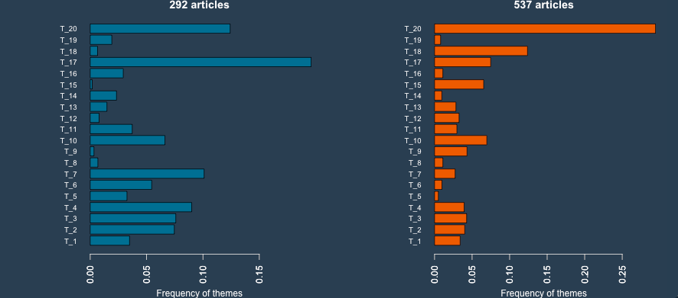
Declared Keywords (HC)
2 groups
Studied Countries
Terms Communities
Census
EN.
Governance
Tradition
State & Id.
Urban & art

Slide 16
Geo-Semantic Networks
Each semantic method...
… gives a different insight!
- Declared Keywords: how the paper is advertised
- Citations Communities: who the paper talks to
- Terms Communities: how the paper is written

