Slide 1






















Gravitationsmodelle und 2SFCA
2SFCA Methode – Schritt 1
Angebots- und Nachfrageverhältnis bilden:
$$R_{j}=\frac{S_{j}}{\sum_{k∈ \left\{d_{kj}≤d_{0}\right\}}{P_{k}}}$$
$$R_{1}=\frac{1}{7}=0,14$$
$R_{2}=\frac{3}{3}$ = 1
$$P_{6}$$
$$s_{4}$$
$$P_{5}$$
$$s_{3}$$
$$P_{1}$$
$$s_{1}$$
$$P_{2}$$
$$P_{3}$$
$$P_{4}$$
$$P_{7}$$
$$P_{8}$$
$$s_{2}$$
$$P_{9}$$
$$d_{0}$$
$$d_{}$$
$$d_{0}$$
$$d_{0}$$
$$d_{}$$
$$d_{0}$$

Slide 2

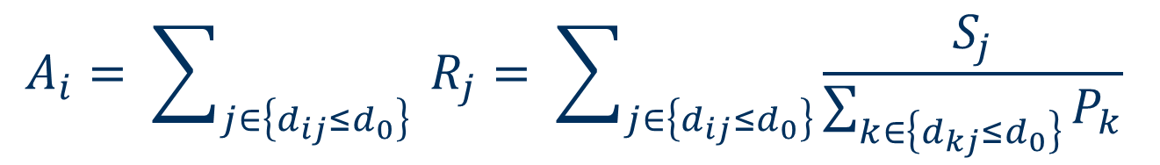






Methodik des räumlichen Zugangs
$$A_{i}= \sum_{j∈\left\{d_{ij}≤d_{0}\right\}}{{ R}_{j}}= \sum_{j∈\left\{d_{ij}≤d_{0}\right\}}{\frac{S_{j}}{\sum_{k∈\left\{d_{kj}≤d_{0}\right\}}{P_{k}}}}$$
$A_{P_{7}}=0,14$= 0,14
$A_{P_{7}}=0,14+1$ = 1,14
$$R_{1}=\frac{1}{7}=0,14$$
$R_{2}=\frac{3}{3}$ = 1
$$P_{6}$$
$$s_{4}$$
$$P_{5}$$
$$s_{3}$$
$$P_{1}$$
$$s_{1}$$
$$P_{2}$$
$$P_{3}$$
$$P_{4}$$
$$P_{7}$$
$$P_{8}$$
$$s_{2}$$
$$P_{9}$$
$$d_{0}$$
$$d_{}$$
$$d_{0}$$
$$d_{0}$$
$$d_{}$$
$$d_{0}$$
$$d_{}$$

Slide 3
Umsetzung des Lösungsvorschlages
Notes:
There has been a great deal of criticism of this approach and an expert report has been commissioned to reform demand planning in Germany.
Points of criticism (we will also experience them in a moment with a case study on a real map in the application in a video):
Klick 1
The planning area is too large to record and compare the situation and quality of patient care in individual villages.
Klick 2
Migration to or from neighboring areas is ignored, as are doctors who provide care near the border. There is no hard border where supply ends.
Klick 3
Centralisation tendencies are not recorded. And so, it is hardly possible to track small-scale supply deficits

Slide 4
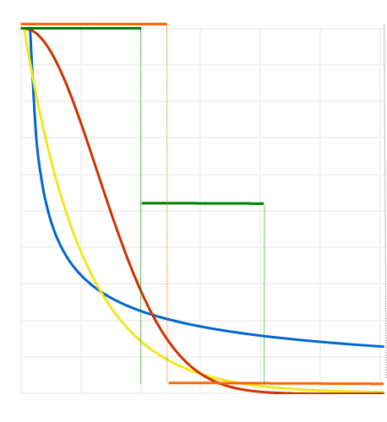



2SFCA Methode – Räumliche Abgewichtungsfunktionen:
$$f(d)$$
binär
hybrid
Gauß
Exponentiell
Inverse Distanz
$$d_{}$$
$$d_{0}$$

Slide 5
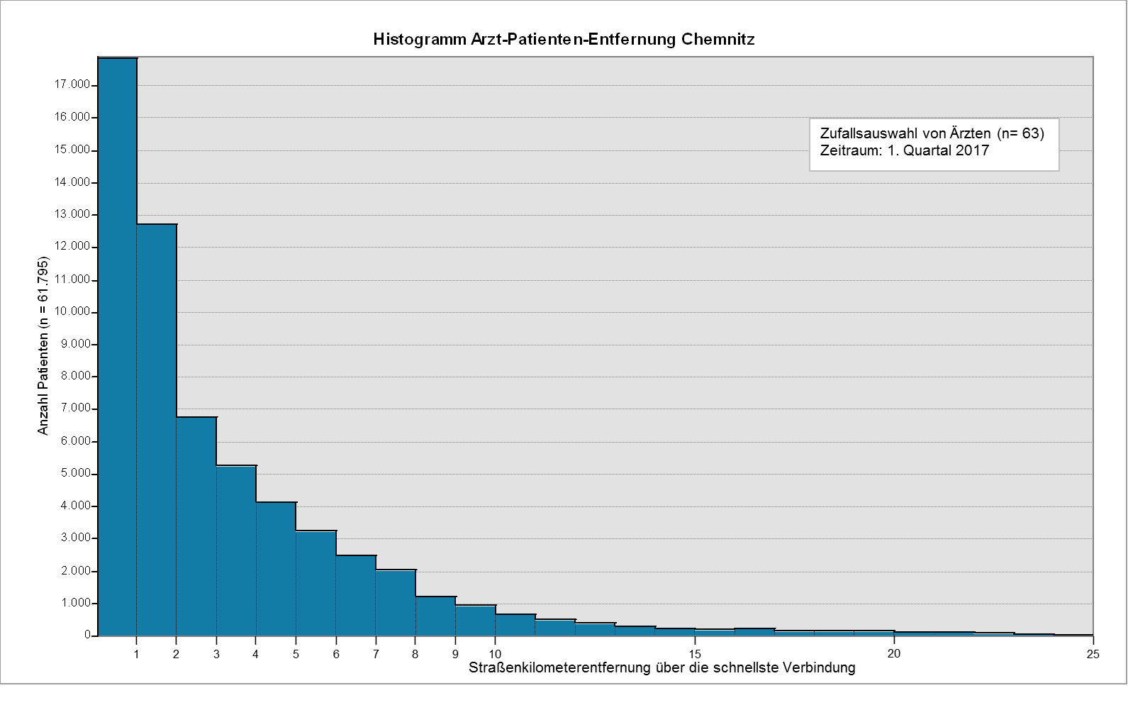
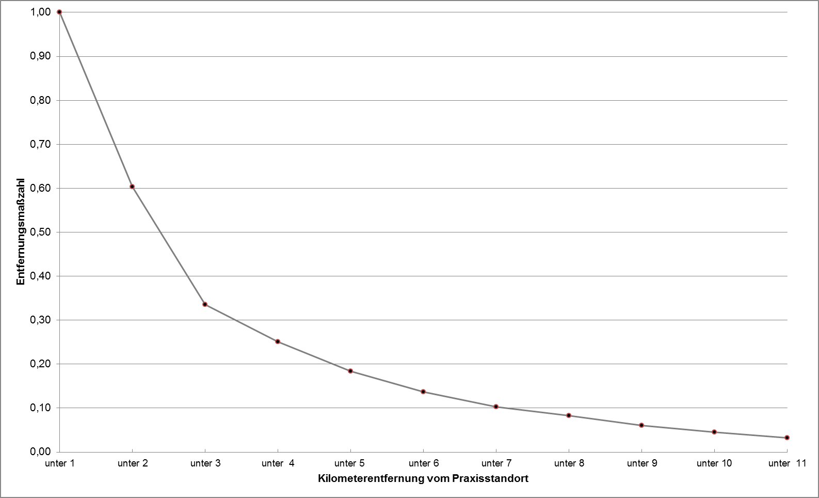
Lösungsvorschläge

Slide 6

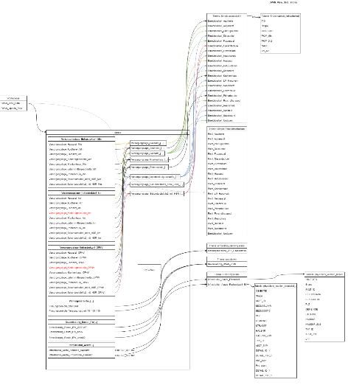










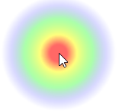





Dokumentationsserver
Rückblick
Entstandene Softwarearchitektur
Datenserver
Frontend-Server
workspaces
WMS extern
stores
styles
wms
Methodenserver
Param json
Fastapi
Numpy
Request
Scipy
Shapely
Uvicorn
asyncio
spatial_access.py
getDistanceDecay
Linear
Patient behavior
Minimum_standards
calcSpatialAccess
BinaryDecay.cs
DistanceDecay.cs
ExponentialDecay.cs
GaussianDecay.cs
HybridDecay.cs
InversePowerDecay.cs
KernelDensityDecay.cs
LinearDecay.cs
PolynomDecay.cs
Dynamic2SFCA.cs
Enhanced2SFCA.cs
GravityAccessibility.cs
Simple2SFCA.cs
SimpleAccessibility.cs

