Slide 1
1.2.1.1 Stadttopographie
VermKatG §§ 1, 9, 23 (Pflichtaufgabe nach Weisung) --- .pdf
* Objektkatalog: Definition des Objektkataloges nach Auswertung der GeoInfoDok bzgl Pflichtinformation und den Anforderungen der Deutschen Grundkarte DGK5 (1:5000). (Amtliche Basiskarte / ABK (ehemals Deutsche Grundkarte DGK 5))
https://www.adv-online.de/GeoInfoDok/
https://gdk.gdi-de.org/geonetwork/srv/search?keyword=Deutsche%20Grundkarte%201:5000
* Genauigkeit: Erfassung der topographischen Objekte für den Zielmaßstab 1:500 in hinreichender Genauigkeit (photogr. Auswertung: Photogrammetrie oder Fotogrammetrie, auch Bildmessung)
Basis für die Eröffnungsbilanz „Straßenvermögen“
Basis für die Erfassung „Grünpflegeflächen“
Basis für Machbarkeitsstudien
Basis für die Vorüberlegungen im Bebauungsplanverfahren

Slide 2
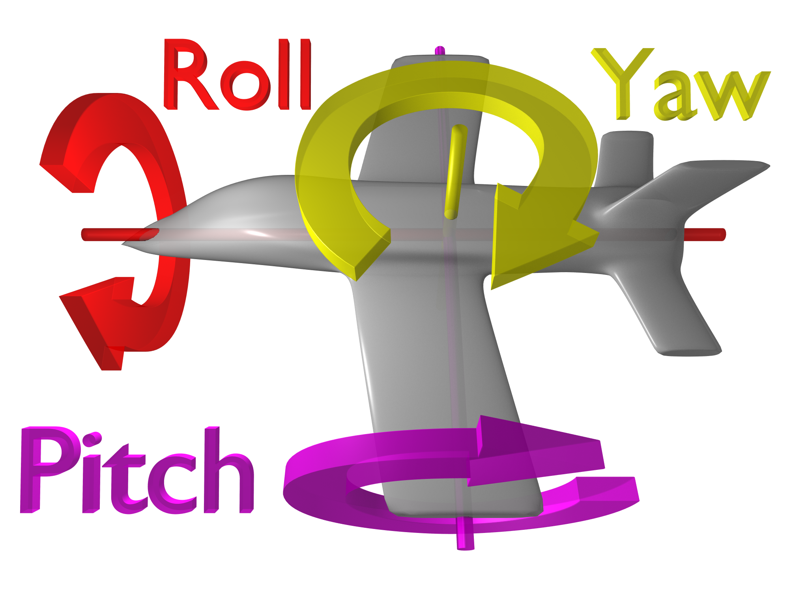

Slide 3
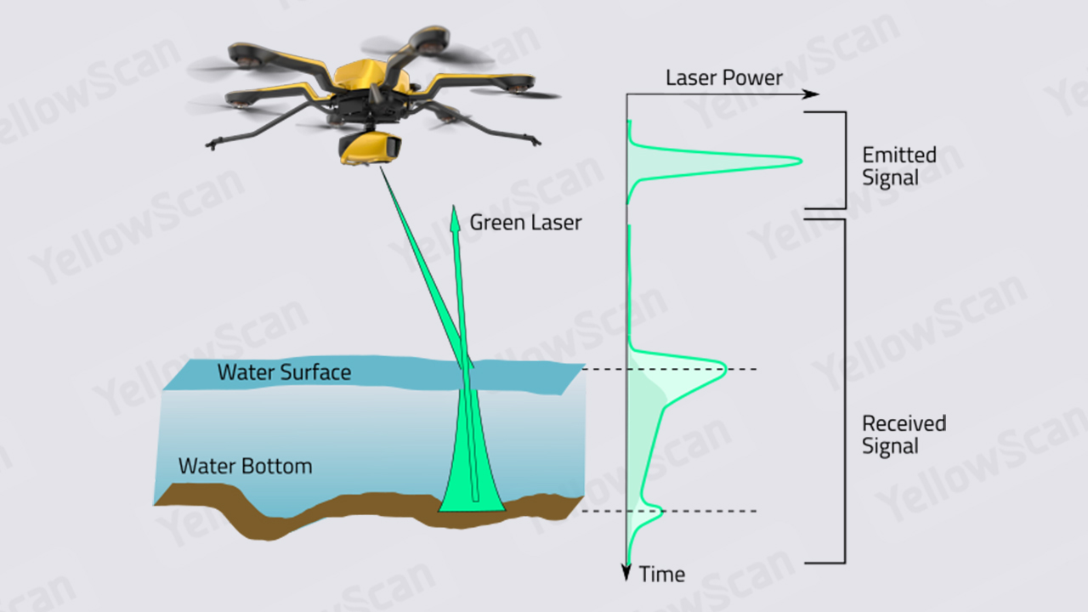
The study of underwater topographies is called bathymetry, whereas studying underwater depths is known under terms such as seafloor mapping or imaging.

Slide 4
LiDAR-based bathymetry is performed using an airborne bathymetric LiDAR system that is mounted on an airplane, helicopter, or unmanned aerial vehicle (UAV) to measure the depths of relatively shallow coastal and inland water bodies.
Bathymetric LiDAR uses green laser pulses. These enable the measurement of the distance from the water’s surface to the seabed. From a flying platform, a laser scanner emits green radiation that passes through the water and is reflected on the bottom of the seabed. The laser scanner collects the reflected radiation of the pulse and calculates the time elapsed between the emission and reception to obtain the distance to both the water surface and seabed.
This is, in a nutshell, how bathymetric LiDAR collects depth information and determines where the water surface is located. Let’s have a closer look at the path of a laser pulse emitted from a laser scanner to understand better what happens after a laser pulse hits the water.
The path of a laser pulse: shoot, hit, and return
https://www.routescene.com/resources/what-is-uav-lidar/
https://www.yellowscan.com/knowledge/does-lidar-work-underwater/

Slide 5
1: https://www.youtube.com/watch?v=pD-hdKizumM
https://github.com/mlss-skoltech/tutorials_week2/blob/master/geometric_techniques_in_ML2/FINAL_Point_Cloud_task.ipynb
2:
https://keras.io/examples/vision/pointnet/
3: c++
https://github.com/nsavinov/semantic3dnet
Hackel, T. et al., 2017. Semantic3d. net: A new large-scale point cloud classification benchmark. arXiv preprint arXiv:1704.03847.
Install, uninstall, and upgrade packages
https://www.jetbrains.com/help/pycharm/installing-uninstalling-and-upgrading-packages.html

Slide 6
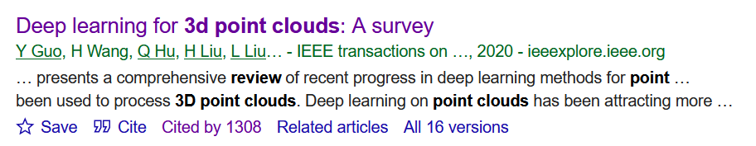

Slide 7
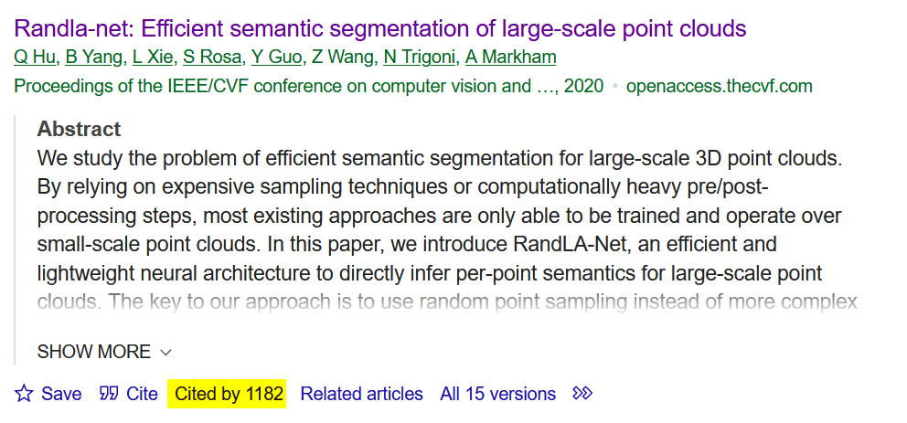
4: Hu, Q. et al., 2020. Randla-net: Efficient semantic segmentation of large-scale point clouds, Proceedings of the IEEE/CVF conference on computer vision and pattern recognition, pp. 11108-11117.
https://github.com/QingyongHu/RandLA-Net

Slide 8
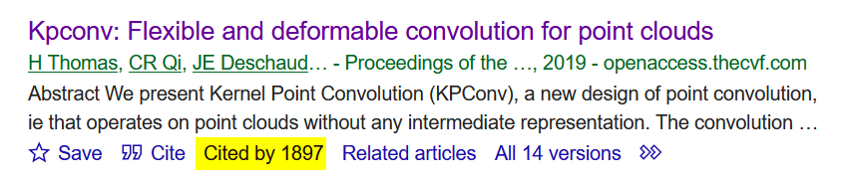
Thomas, H. et al., 2019. Kpconv: Flexible and deformable convolution for point clouds, Proceedings of the IEEE/CVF international conference on computer vision, pp. 6411-6420.
https://github.com/HuguesTHOMAS/KPConv

Slide 9
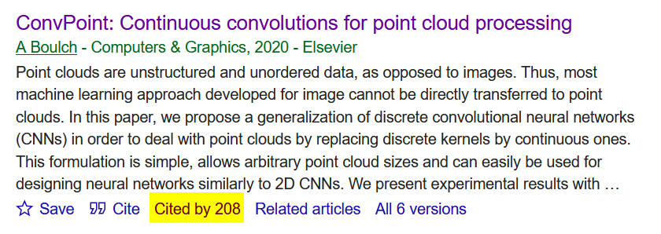
Boulch, A., 2020. ConvPoint: Continuous convolutions for point cloud processing. Computers & Graphics, 88: 24-34.
https://github.com/aboulch/ConvPoint

Slide 10
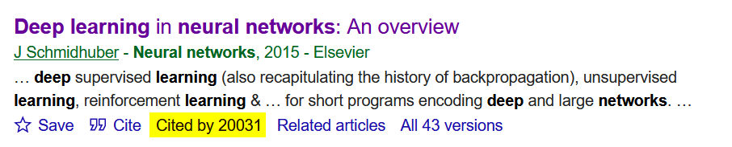

Slide 11
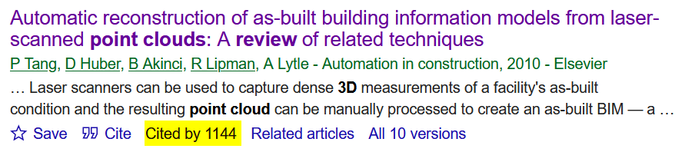
Tang, P., Huber, D., Akinci, B., Lipman, R., Lytle, A., 2010. Automatic reconstruction of as-built building information models from laser-scanned point clouds: A review of related techniques. Automation in Construction, 19(7): 829-843.

